Slide 1


Info-Tech Research Agenda
Quarterly Agenda: March – May 2021
Info-Tech Research Group Inc. is a global leader in providing IT research and advice. Info-Tech’s products and services combine actionable insight and relevant advice with ready-to-use tools and templates that cover the full spectrum of IT concerns.
© 1997-2021 Info-Tech Research Group Inc.

Slide 2

Practical projects you can execute to handle today’s CIOs’ most pressing concerns.
Featured Research Projects
1
American Rescue Plan (ARP) Research Center
2
2021 CIO Priorities Report
3
Recruit & Retain People of Color in IT
4
Get the Most Out of Your ERP
5
Risk-Proof Agile Contracts
“Here are my selections for the top research projects of this past cycle.”
Access some of the $1.9 trillion available to businesses.
Drive enterprise resilience in uncertain times.
Good business, not good philanthropy.
Your digital strategy depends on optimized enterprise applications.
Improve Agile development adoption by reducing the risk in vendor contracts.
6
Manage Your Technical Debt
7
Manage Successful Projects
8
Enterprise Architecture Strategy
9
Build a Security Compliance Program
10
Create an Application Department Strategy
The interest on technical debt must be measured in business impact.
Use our simplified, PMI-aligned approach to improve success.
Help the business make hard decisions in a complex environment.
Cost-effective compliance is not only possible, it’s probable.
Delivering value starts with embracing what your department can – and can’t – do.
11
Take Control of Infrastructure Metrics
12
IT Modernization Research Center
13
Agile/DevOps Research Center
14
IT Vendor Cost & Contract Optimization
Gord Harrison
Senior Vice President
Research & Advisory
Info-Tech Research Group
Improve service delivery and decision making using the right metrics for the job.
Use our research to modernize your department.
Avoid common pitfalls in your Agile transformation.
Save real money on your top IT contracts.

Slide 3
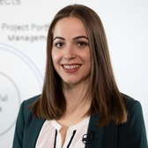
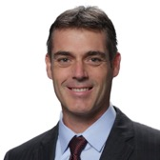

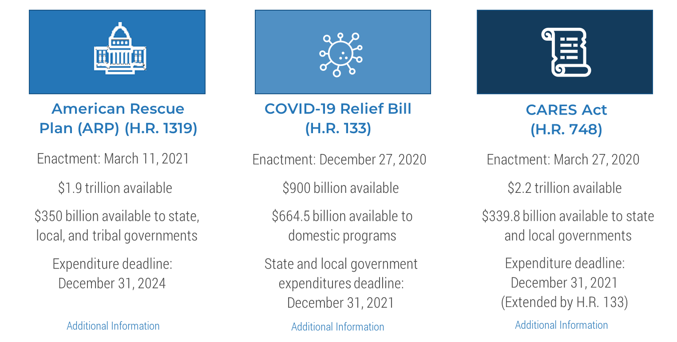
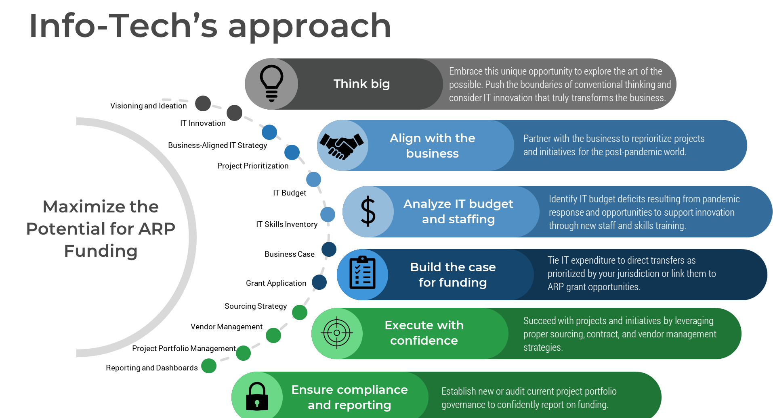

American Rescue Plan (ARP) Research Center
RESEARCH TEAM
Teodora Siman
Senior Research Analyst
Hannes Scheidegger
Senior Market Leader
Leverage the literally trillions of dollars available from the ARP to help your organization thrive post-pandemic.
Download this research or
book an analyst call on this topic
Understand the plan.
Then let us guide you through accessing the funding.

Slide 4
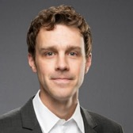
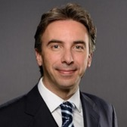
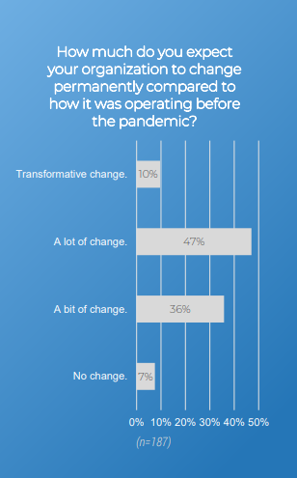
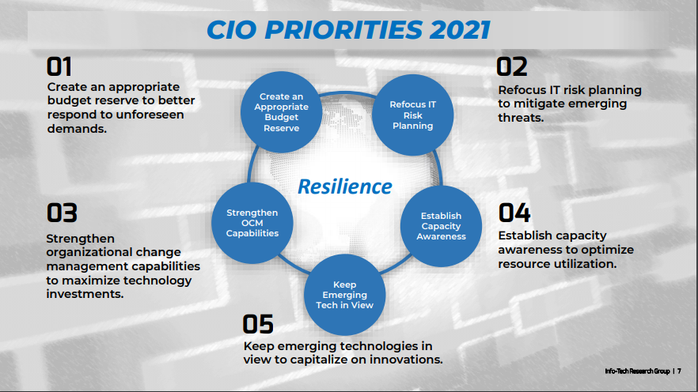
2021 CIO Priorities Report
RESEARCH TEAM
Travis Duncan
Research Director
Jack Hakimian
Senior Vice President, Workshops & Advisory
Drive enterprise resilience in uncertain times.
Download this research or
book an analyst call on this topic
Change is coming.
IT resilience dominates CIO priorities for the next year.
Action backed by research:
Each priority is supported by five foundational research-based findings:
Key insights
Signals of the change
Key drivers of the change
Associated risks
Business benefits
This research guides you to the steps you should take to capitalize on each priority.
Source: Info-Tech CIO Survey, 2021

Slide 5
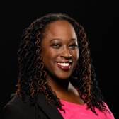
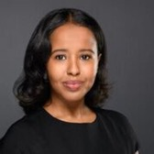
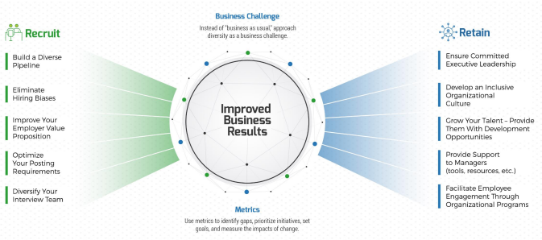
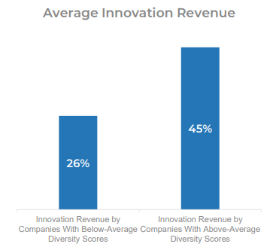
Recruit & Retain People of Color in IT
RESEARCH TEAM
Allison Straker
Research Director
Ugbad Farah
Senior Research Analyst
Good business, not good philanthropy.
Download this research or
book an analyst call on this topic
Info-Tech’s Approach to Recruiting & Retaining People of Color:
Diversity yields 19% higher innovation revenue.
Source: BCG Henderson Institute, 2018

Slide 6
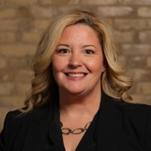
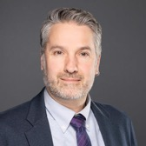
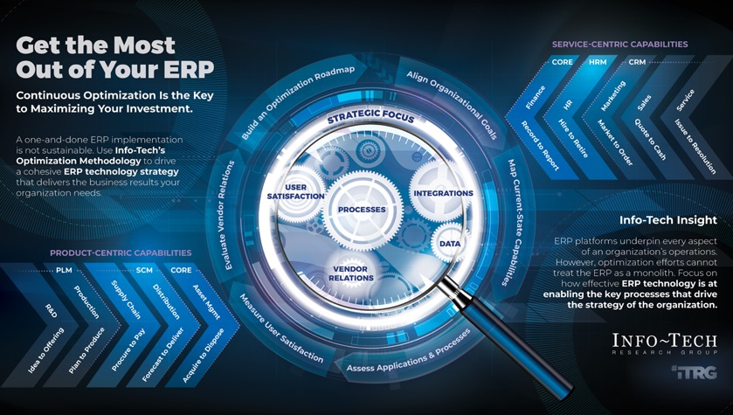
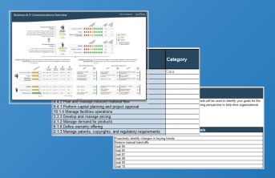
Get the Most Out of Your ERP
RESEARCH TEAM
Lisa Highfield
Research Director
Robert Fayle
Research Director
The key to your digital strategy is to continuously optimize your enterprise applications.
Download this research or
book an analyst call on this topic
Focus on key organizational processes supported by ERP.
Key deliverable: ERP Optimization Roadmap

Slide 7

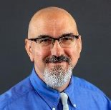
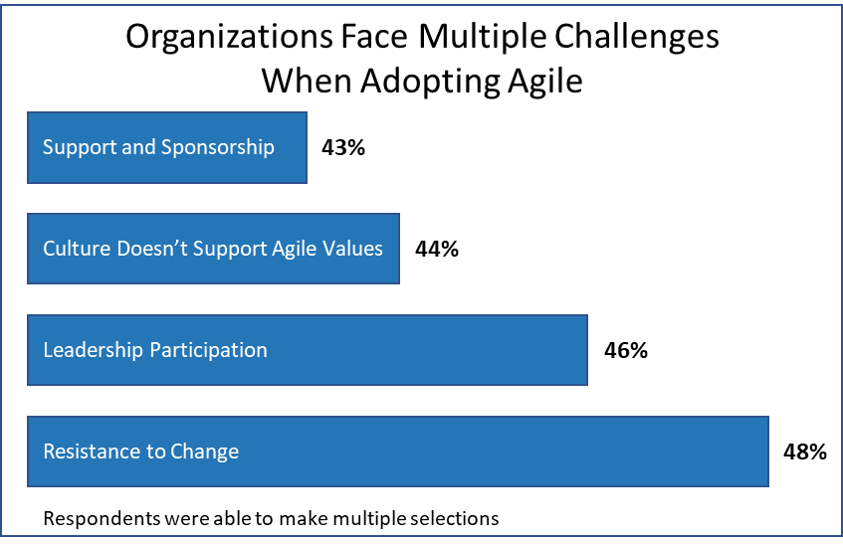
Risk-Proof Agile Contracts
RESEARCH TEAM
Steve Jeffery
Practice Lead
Phil Bode
Research Director
Improve Agile development adoption by focusing on better vendor contracts.
Download this research or
book an analyst call on this topic
Outsourcing Agile development is a barrier to adopting Agile.
Traditional “waterfall” contracting approaches conflict with Agile methodologies.
Legal departments and procurement teams are unfamiliar with Agile.
Customers are forced to take on too much risk.
The “definition of done” is too vague for lawyers.
Agile contracts require Agile-specific clauses to protect you adequately.
Use Info-Tech’s Agile Contracts Checklist to improve your Agile contracts.
Modify your Agile contracts based on true differences between “regular” and Agile contracts.
Develop a legally acceptable definition of “done.”
Avoid disruptions due to vendor personnel changes.
Preserve your contractual flexibility by developing appropriate termination language.
Ensure that you own or have appropriate rights to the work product.
Document key Agile processes in the contract so both parties are clear on roles and responsibilities.
Vendor Management
Source: Digital.ai, 2020

Slide 8
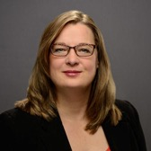
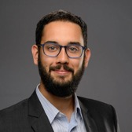
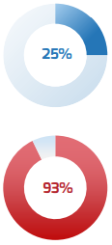
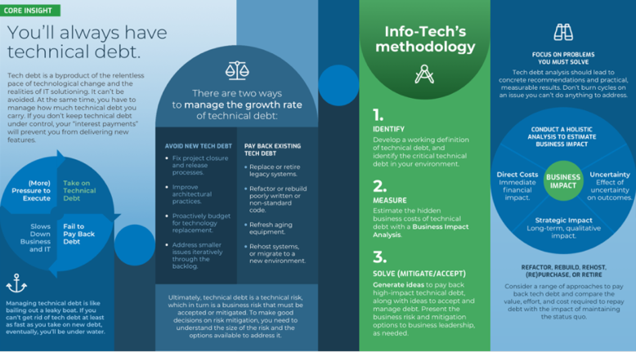
Manage Your Technical Debt
RESEARCH TEAM
Sandi Conrad
Principal Research Director
Andrew Sharp
Senior Research Analyst
Make the case for managing technical debt in terms of business impact.
Download this research or
book an analyst call on this topic
Tech debt costs $$
Technical debt interest accumulates faster than principal repayments.
Three practical steps to managing technical debt:
25% of development time is spent on technical debt.
93% of IT shops have no solution to technical debt.
Identify tech debt
  Define tech debt
  Inventory tech debt
Measure tech debt
  Score and prioritize
  Estimate business impact
Manage tech debt
  Plan tech debt reduction actions
  Track and control
Source: Info-Tech CIO Survey, 2021

Slide 9
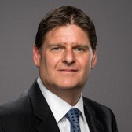
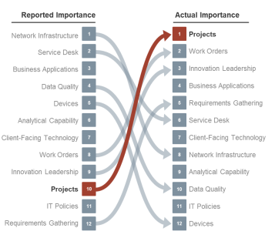
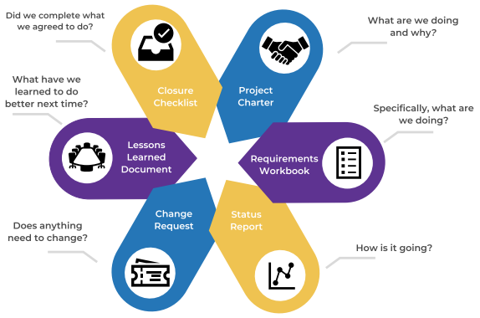
Manage Successful Projects
RESEARCH TEAM
Teodora Siman
Senior Research Analyst
Barry Cousins
Practice Lead
Our simplified, PMI-aligned approach will improve the business’ satisfaction with IT.
Download this research or
book an analyst call on this topic
Successful projects drive business satisfaction with IT.
Info-Tech’s PM Framework improves project success rates.
The Info-Tech difference:
Keep it simple and sustainable. Start with the foundation and build up the process as the team develops project management competencies.
Understand the elements of each project management deliverable and customize the templates to suit your needs.
Review the common mistakes made by project managers and prepare your team to avoid them.
Source: Info-Tech CIO Survey, 2021

Slide 10
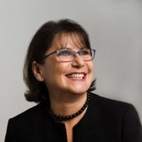
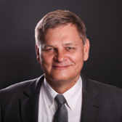
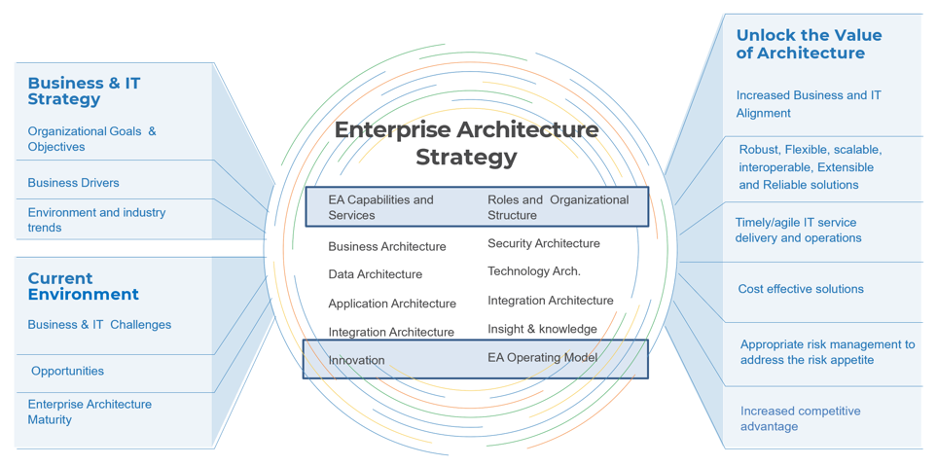
Design an Enterprise Architecture Strategy
RESEARCH TEAM
Milena Litoiu
Principal Research Director
Dirk Coetsee
Research Director
Assist the organization in making decisions that are hard to make in a complex environment.
Download this research or
book an analyst call on this topic
Deliver value with your EA strategy based on the operating environment and the direction of the enterprise.
Ten Info-Tech EA principles:
Use an existing methodology to structure your thinking and establish a common vocabulary to communicate basic concepts, processes, and approaches.
Customize the methodology to your needs, making it as lean as possible.
Execute in an Agile way, but keep in mind the thoughtful checks recommended by your end-to-end methodology.
Clarify your goals.
Have good measures and metrics in place.
Continuously monitor progress, fit for purpose, etc.
Highlight risks, roadblocks, etc.
Get support.
Communicate your vision, goals, key decisions, etc.
Iterate.

Slide 11


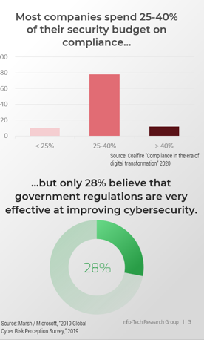
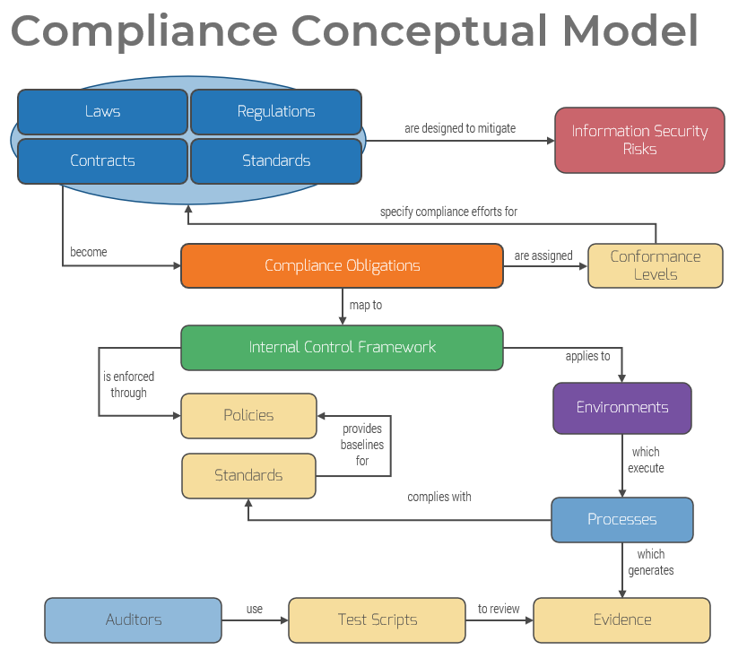
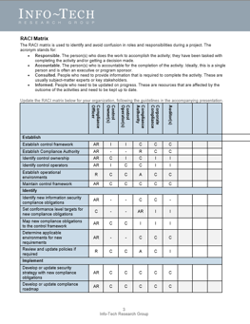
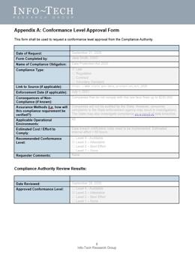
Build a Security Compliance Program
RESEARCH TEAM
Kevin Peuhkurinen
Principal Research Director
Ian Mulholland
Senior Research Analyst
Cost-effective compliance is not only possible, it’s probable.
Download this research or
book an analyst call on this topic
Ineffective compliance costs $$
Info-Tech’s model will guide your implementation.
Our tools help you achieve cost-effective compliance.
Source: Marsh/Microsoft, 2019

Slide 12
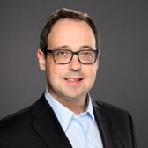
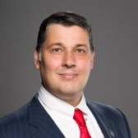
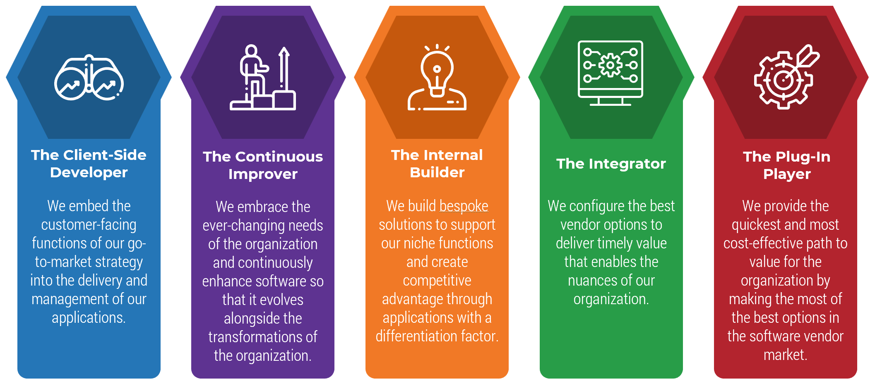
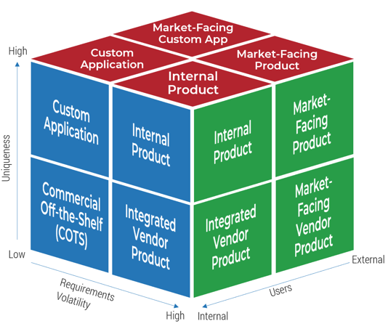
Create an Application Department Strategy
RESEARCH TEAM
Ari Glaizel
Principal Research Director
Cole Cioran
Practice Lead
Delivering value starts with embracing what your department can – and can’t – do.
Download this research or
book an analyst call on this topic
Application departments have five personas:
Leverage these personas and application perceptions to model your application department strategy.

Slide 13
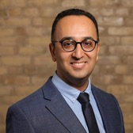
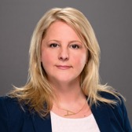
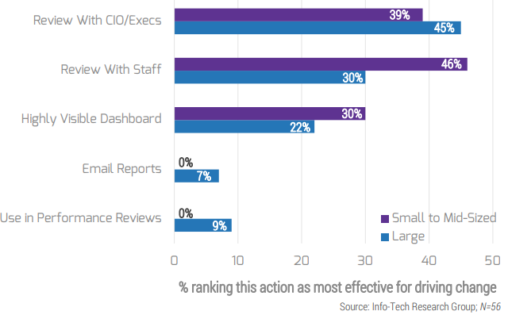
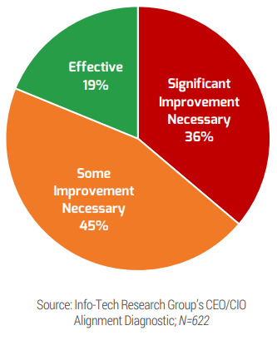
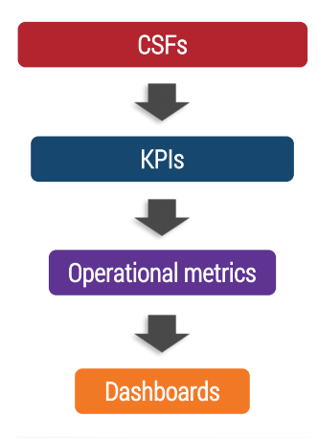
Take Control of Infrastructure Metrics
RESEARCH TEAM
Mahmoud Ramin
Research Specialist
Allison Kinnaird
Research Lead
Make faster decisions and improve service delivery by using the right metrics for the job.
Download this research or
book an analyst call on this topic
Only 19% of CXOs feel their organizations have effective metrics in place to measure success.
Start by defining your critical success factors (CSFs) to determine your business goals.
A face-to-face review of metrics is the most effective means for driving change.

Slide 14
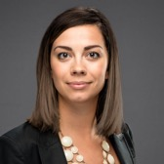
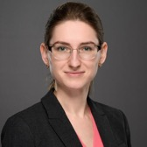
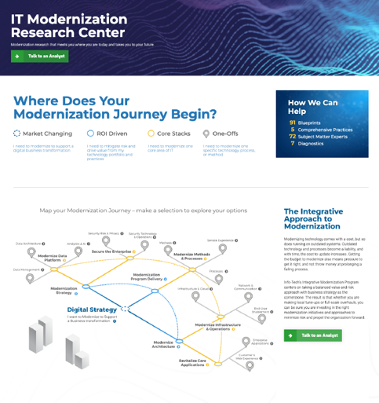
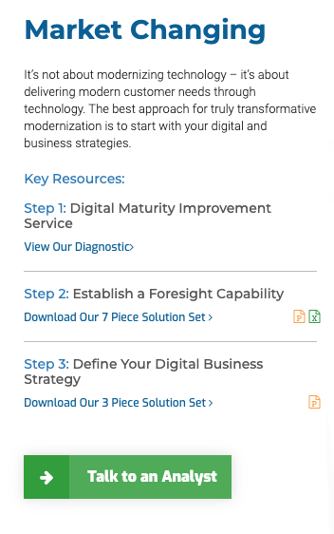
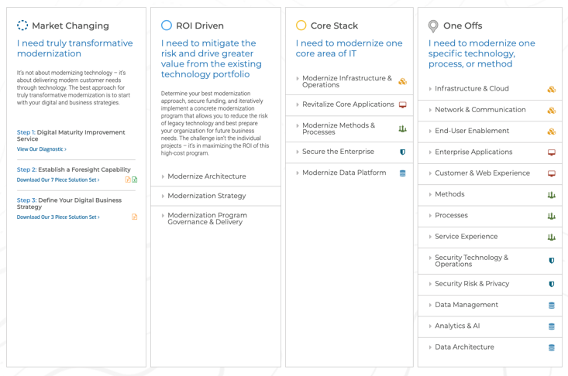
IT Modernization Research Center
RESEARCH TEAM
Carlene McCubbin
Research Lead
Jane Kouptsova
Senior Research Analyst
From digital transformation to “one-off” technology upgrades, use our research to modernize your department.
Download this research or
book an analyst call on this topic
There are drivers behind your decision to modernize.
Let our research guide your modernization journey.

Slide 15
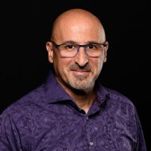
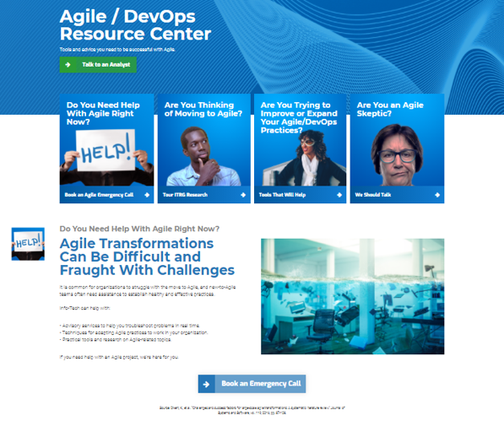
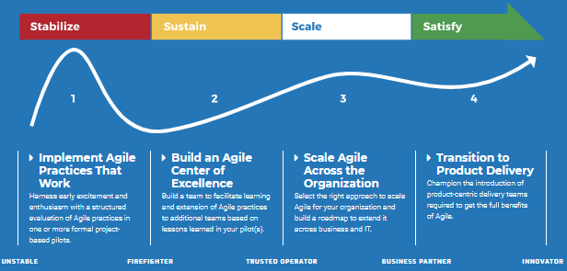
Agile/DevOps Research Center
RESEARCH TEAM
Alex Ciraco
Research Director
Ari Glaizel
Principal Research Director
Agile transformations can be difficult and fraught with challenges. Our Agile/DevOps research collection helps.
Download this research or
book an analyst call on this topic
Choose your Agile persona.
Then let us guide you in your Agile transformation approach.

Slide 16


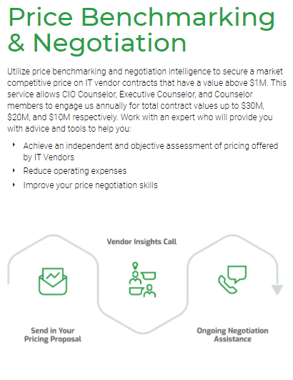


IT Vendor Cost & Contract Optimization
RESEARCH TEAM
Scott Mullan
Vice President, IT Vendor Cost Optimization
Gordana Vuceta
Research Lead
IT vendor contract pricing is complex and wildly inconsistent.
Download this research or
book an analyst call on this topic
Use Info-Tech’s data…
…and our extensive contract negotiation experience.

Slide 17
Other Upcoming Featured Research
We are constantly providing innovative ways to easily consume our practical research. Plan to explore our upcoming Research Centers, which will offer more insight-driven thought models, navigation aids, and frameworks to help guide you to the most compelling and action-oriented resources for your situation.
Mergers, Acquisitions, and Divestitures (MAD) Research Center
Navigating through the MAD journey is traditionally a trial-and-error situation – and failure is not an option! This Research Center will help focus IT leaders on key merger, acquisition, and divestiture activities specific to their scenarios.
IT Trends Research Center
Understand and take action on crucial technology trends using Info-Tech’s approaches and research. From yearly trends reports to priority reports in each key IT role, our trend research will impact your technology roadmap.
Concierge Services
These high-impact, accelerated engagements are designed to be delivered online or onsite!
IT Strategy Review
IT Strategy Visualization Service
Security Policy Assessment & Review
Rapid Application Selection
First 100 Days as a CIO
And many others!

Slide 18
We interview hundreds of experts, members, and practitioners to shape our research each cycle. We welcome feedback and topic ideas.
Some of the other topics now available on our website…
IT ROLE | TOPIC | TOPIC | TOPIC | TOPIC
CIOs/CTOs/CDOs | IT Diversity & Inclusion Tactics | 2021 Tech Trends | Adopt Design Thinking in Your Organization | Understand Common IT Contract Provisions to Negotiate More Effectively
Application Leaders | Automate Testing to Get More Done | Build Your BizDevOps Playbook | Implement & Mature Your User Experience Design Practice | Embrace Business-Managed Applications
Infrastructure & Operations Leaders | Govern Office 365 | Deliver a Customer Service Training Program to Your IT Department | Create a Work-From-Anywhere Strategy | Staff the Service Desk to Meet Demand
CISOs/Security Leaders | Achieve Digital Resilience by Managing Digital Risk | Secure Your High-Risk Data | Implement Risk-Based Vulnerability Management | Identify Components of Your Cloud Security Architecture
Project & Portfolio Leaders | Drive Business Value With a Right-Sized Project Gating Process | Define the Right Kind of PMO for IT and Your Organization | Staff the PMO for Resilience | Audit the Project Portfolio
Data & Analytics Leaders/CDataOs | Establish an Analytics Operating Model | Build a Data Pipeline for Reporting and Analytics | Design Data-as-a-Service | Craft a Customer-Driven Market Strategy With Unbiased Data
Enterprise Architects | Create and Manage Enterprise Data Models | Create a Stakeholder-Centric Architecture Governance | Create an Architecture for AI | Extend the Archi Repository With Best-Practice Patterns
Industry IT Leaders | IT Service Satisfaction Benchmarks for Multiple Industries | InfoSEAT: Sports Entertainment Research Center | Embrace Cashless in Your Casino | Tribal Nation Grant Application Management Framework

Slide 19








Info-Tech Research Leadership
Team
“We have a world-class team of experts focused on providing practical, cutting-edge IT research and advice.”
Jack Hakimian
Senior Vice President
Workshops & Advisory
Nora Fisher
Vice President
Advisory Services
Becca Mackey
Vice President
Research & Advisory Quality
Geoff Neilson
Vice President
Executive Services
Rick Pittman
Vice President
CIO & Applications
Aaron Shum
Vice President
Security & Privacy Research
Mark Tauschek
Vice President
Infrastructure Research
David Wallace
Vice President
Industry Research
Gord Harrison
Senior Vice President
Research & Advisory
Info-Tech Research Group

Slide 20





About Info-Tech Research Group
Info-Tech Research Group produces unbiased and highly relevant research to help leaders make strategic, timely, and well-informed decisions. We partner closely with your teams to provide everything they need, from actionable tools to analyst guidance, ensuring they deliver measurable results for the organization.
Dramatically Outperform Your Peers
Drive Measurable Results
Better Research Than Anyone
Leverage Industry Best Practices
Our world-class leadership team is continually focused on building disruptive research and products that drive measurable results and save money.
Our team of experts is composed of the optimal mix of former CIOs, CISOs, PMOs, and other IT leaders and IT and management consultants as well as academic researchers and statisticians.
We enable over 30,000 members to share their insights and best practices that you can use by having direct access to over 100 analysts as an extension of your team.

Slide 21
Become an Info-Tech influencer:
We interview hundreds of experts and practitioners to help ensure our research is practical and focused on key member challenges.
Help shape our research by talking with our analysts.
Discuss the challenges, insights, and opportunities in your chosen areas.
Suggest new topic ideas for upcoming research cycles.
Why participate in expert interviews?
Discuss market trends and stay up to date.
Influence Info-Tech’s research direction with your practical experience.
Preview our analysts’ perspectives and preliminary research.
Build on your reputation as a thought leader and research contributor.
See your topic idea transformed into practical research.
Contact
Sanchia Benedict
sbenedict@infotech.com
Notes:
Note from Carmi: Suggest this is where I finish housekeeping and hand off to Gord to introduce the research themes and trends.
More general note: Let’s more specifically identify, in the slide notes, who speaks for which sections – and confirm where transitions are expected to occur.
Hand off to Gord

Slide 22




Thank you!
Join us at our webinars to discuss more topics.
For information on Info-Tech’s products and services and to participate in our research process, please contact:
Sanchia Benedict
sbenedict@infotech.com

