Slide 1
Establish Data Governance
Deliver measurable business value.
EXECUTIVE BRIEF

Slide 2
Analyst Perspective
Data governance does not sit as an island on its own in the organization – it must align with and be driven by your enterprise governance.
As you build out data governance in your organization, it’s important to keep in mind that this program is meant to be an enabling framework of oversight and accountabilities for managing, handling, and protecting your company’s data assets. It should never be perceived as bureaucratic or inhibiting to your data users.
It should deliver agreed-upon models that are conducive to your organization’s operating culture, offering clarity on who can do what with the data and via what means.
Data governance is the key enabler for bringing high-quality, trusted, secure, and discoverable data to the right users across your organization. Promote and drive the responsible and ethical use of data while helping to build and foster an organizational culture of data excellence.
Establish a data governance program that brings value to your organization.
Crystal Singh Director, Research & Advisory, Data & Analytics Practice Info-Tech Research Group
Info-Tech Research Group | 2

Slide 3
Executive Summary
Your Challenge
Common Obstacles
Info-Tech’s Approach
The amount of data within organizations is growing at an exponential rate, creating a need for to adopt a formal approach to governing data. However, many organizations remain uninformed on how to effectively govern their data.
Comprehensive data governance should define leadership, accountability, and responsibility related to data use and handling and be supported by a well-oiled operating model and relevant polices and procedures. This will help ensure the right data gets to the right people at the right time, using the right mechanisms.
Organizations are faced with challenges associated with changing data landscapes, evolving business models, industry disruptions, regulatory and compliance obligations, and changing and maturing user landscape and demand for data.
Although the need for a data governance program is often evident, organizations miss the mark when their data governance efforts are not directly aligned to delivering measurable business value. Initiatives should support key strategic initiatives, as well as value streams and their underlying business capabilities.
Info-Tech’s approach to establishing and sustaining effective data governance is anchored in the strong alignment of organizational value streams and their business capabilities with key data governance dimensions and initiatives. Organizations should:
Align their data governance with enterprise governance, business strategy and value streams to ensure the program delivers measurable business value.
Understand their current data governance capabilities so as to build out a future state that is right-sized and relevant.
Define data leadership, accountability, and responsibility. Support these with an operating model that effectively manages change and communication and fosters a culture of data excellence.
Info-Tech Insight
Your organization’s value streams and the associated business capabilities require effectively governed data. Without this, you face elevated operating costs, missed opportunities, eroded stakeholder satisfaction, and increased business risk.
Info-Tech Research Group | 3

Slide 4
Your challenge
This research is designed to help organizations build and sustain an effective data governance program.
“Data processing and cleanup can consume more than half of an analytics team’s time, including that of highly paid data scientists, which limits scalability and frustrates employees.” – Petzold et al., 2020
Your organization has recognized the need to treat data as a corporate asset for generating business value and/or managing and mitigating risk.
This has brought data governance to the forefront and highlighted the need to build a performance-driven enterprise program for delivering quality, trusted, and readily consumable data to users.
An effective data governance program is one that defines leadership, accountability. and responsibility related to data use and handling. It’s supported by a well-oiled operating model and relevant polices and procedures, all of which help build and foster a culture of data excellence where the right users get access to the right data at the right time via the right mechanisms.
“The productivity of employees across the organization can suffer.”
– Petzold et al., 2020
30%
Respondents to McKinsey’s 2019 Global Data Transformation Survey reported that an average of 30% of their total enterprise time was spent on non-value-added tasks because of poor data quality and availability.
– Petzold et al., 2020
As you embark on establishing data governance in your organization, it’s vital to ensure from the get-go that you define the drivers and business context for the program. Data governance should never be attempted without direction on how the program will yield measurable business value.

Slide 5
Common obstacles
Some of the barriers that make data governance difficult to address for many organizations include:
78% of companies (and 92% of top-tier companies) have a corporate initiative to become more data-driven.
– Alation, 2020
Gaps in communicating the strategic value of data and data governance to the organization. This is vital for securing senior leadership buy-in and support, which, in turn, is crucial for sustained success of the data governance program.
Misinterpretation or a lack of understanding about data governance, including what it means for the organization and the individual data user.
A perception that data governance is inhibiting or an added layer of bureaucracy or complication rather than an enabling and empowering framework for stakeholders in their use and handling of data.
Embarking on data governance without firmly substantiating and understanding the organizational drivers for doing so. How is data governance going to support the organization’s value streams and their various business capabilities?
Neglecting to define and measure success and performance. Just as in any other enterprise initiative, you have to be able to demonstrate an ROI for time, resources and funding. These metrics must demonstrate the measurable business value that data governance brings to the organization.
Failure to align data governance with enterprise governance.
78%
But despite these ambitions, there appears to be a “data culture disconnect” – 58% of leaders overestimate the current data culture of their enterprises, giving a grade higher than the one produced by the study.
– Fregoni, 2020
58%
Info-Tech Research Group | 5

Slide 6
The strategic value of data
Power intelligent and transformative organizational performance through leveraging data.
Respond to industry disruptors
Optimize the way you serve your stakeholders and customers
Develop products and services to meet ever-evolving needs
Manage operations and mitigate risk
Harness the value of your data
Info-Tech Research Group | 6

Slide 7
The journey to being data-driven
The Data Economy
Data Enabled
Data
Driven
Data Disengaged
The journey to declaring that you are a data-driven organization requires a pit stop at data enablement.
You are differentiating and competing on data and analytics; described as a “data first” organization. You’re collaborating through data. Data is an asset.
Technology, data architecture, and people and processes are optimized and supported by data governance.
You have a low appetite for data and rarely use data for decision making.
Info-Tech Research Group | 7

Slide 8
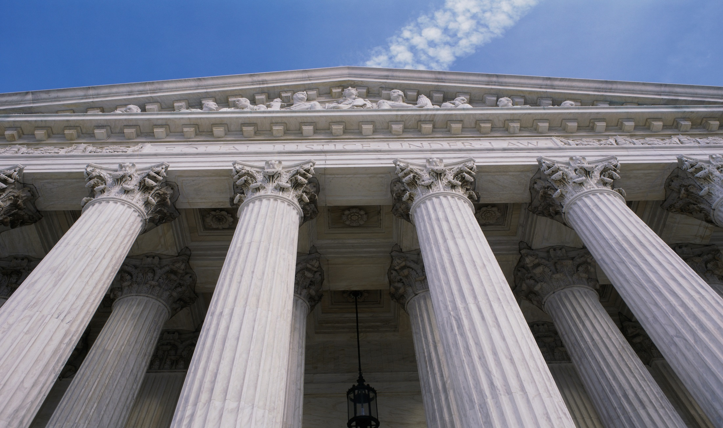
Data governance is an enabling framework of decision rights, responsibilities, and accountabilities for data assets across the enterprise.
Data governance is essential for any organization that makes decisions about how it uses its data.
Data governance is:
Executed according to agreed-upon models that describe who can take what actions with what information, when, and using what methods (Olavsrud, 2021).
True business-IT collaboration that will lead to increased consistency and confidence in data to support decision making. This, in turn, helps fuel innovation and growth.
If done correctly, data governance is not:
An annoying, finger-waving roadblock in the way of getting things done.
Meant to solve all data-related business or IT problems in an organization.
An inhibitor or impediment to using and sharing data.

Slide 9
Info-Tech’s Data Governance Framework
Key to Data Enablement
Defined Data Accountability & Responsibility
Enterprise
Governance
Operating Model
Knowledge & Common Understanding of Data Assets
Oversight & Alignment
Data Ownership & Stewardship
Policies & Procedures
Business Strategy
Trust & Confidence in Traceable Data
Data Strategy
Data Leadership
DATA GOVERNANCE
Strategic Goals & Objectives
Data Literacy & Culture
Improved Data ROI & Reduced Data Debt
Data Privacy & Security
Enterprise Projects & Services
Data Management
Support Ethical Use of Data in a Data-Driven Culture
Info-Tech Research Group | 9

Slide 10
Create impactful data governance by embedding it within enterprise governance
Enterprise Governance
Influence & Oversight
Responsibilities include:
Provide strategic direction for the organization.
Ensure objectives are met.
Set the risk standards or profile.
Delegate resources responsibly.
Data Governance
The governance of data is a component of enterprise governance.
Alignment
Info-Tech Research Group | 10

Slide 11
Organizational drivers for data governance
Data governance personas:
Conformance: Establishing data governance to meet regulations and compliance requirements.
Performance: Establishing data governance to fuel data-driven decision making for driving business value and managing and mitigating business risk.
CONFORMANCE
PERFORMANCE
Regulations and compliance
Privacy and security
Data-driven decision making
Strategic business value
.
Info-Tech Research Group | 11

Slide 12
Data Governance is not a one-person show
Data governance needs a leader and a home. Define who is going to be leading, driving, and steering data governance in your organization.
Senior executive leaders play a crucial role in championing and bringing visibility to the value of data and data governance. This is vital for building and fostering a culture of data excellence.
Effective data governance comes with business and IT alignment, collaboration, and formally defined roles around data leadership, ownership and stewardship.
Data Governance
Leadership
Organizational
Champions
Data Owners, Stewards & Custodians
The Organization
& Data Storytellers
Info-Tech Research Group | 12

Slide 13
Traditional data governance organizational structure
A traditional structure includes committees and roles that span across strategic, tactical, and operational duties. There is no one-size-fits-all data governance structure. However, most organizations follow a similar pattern when establishing committees, councils, and cross-functional groups. Most organizations strive to identify roles and responsibilities at a strategic and operational level. Several factors will influence the structure of the program, such as the focus of the data governance project and the maturity and size of the organization.
Generate awareness and cultural change within the organization.
Hold final decision-making authority for unresolved data conflicts.
Typically includes C-suite executives or senior leadership.
DG Council and/or Executive Sponsor/Champion
Strategic
Decision-making body with cross-organizational representation
Continuously monitors progress of current data initiatives.
Provides oversight on the high-level alignment and integration of data, technology, and the organization.
Forms working groups for specific data initiatives.
Facilitates cross-functional data initiatives.
Steering Committee
Data Owners
Operational
Identify data-related pains affecting the organization.
Recommend solutions.
Participate in defining data rules.
Assist in creating data policies, standards, and procedures.
Deliver on data-related initiatives.
Working Groups
Data Stewards
Data Custodians

Slide 14
A healthy data culture is key to amplifying the power of your data.
What does it look like?
Everybody knows the data.
Everybody trusts the data.
Everybody talks about the data.
“It is not enough for companies to embrace modern data architectures, agile methodologies, and integrated business-data teams, or to establish centers of excellence to accelerate data initiatives, when only about 1 in 4 executives reported that their organization has successfully forged a data culture.” – Randy Bean, 2020
“Albert Einstein is said to have remarked, ‘The world cannot be changed without changing our thinking.’ What is clear is that the greatest barrier to data success today is business culture, not lagging technology. “ – Randy Bean, 2020
Info-Tech Research Group | 14

Slide 15
Data literacy is an essential part of a data-driven culture
Data-driven culture =
“data matters to our company”
In a data-driven culture, decisions are made based on data evidence, not on gut instinct.
Data often has untapped potential. A data-driven culture builds tools and skills, builds users’ trust in the condition and sources of data, and raises the data skills and understanding among their people on the front lines.
Building a data culture takes an ongoing investment of time, effort, and money. This investment will not achieve the transformation you want without data literacy at the grassroots level.

Slide 16
Despite investments in data initiative, organizations are carrying high levels of data debt
Data debt is “the accumulated cost that is associated with the sub-optimal governance of data assets in an enterprise, like technical debt.”
Data debt is a problem for 78% of organizations.
40%
66%
33%
30%
of organizations say individuals within the business do not trust data insights.
of organizations say a backlog of data debt is impacting new data management initiatives.
of organizations are not able to get value from a new system or technology investment.
of organizations are unable to become data-driven.
Source: Experian, 2020
Info-Tech Research Group | 16

Slide 17
Absent or sub-optimal data governance leads to data debt
3%
28%
51%
35%
Only 3% of companies’ data meets basic quality standards.
(Source: Nagle et al, 2017)
Organizations suspect 28% of their customer and prospect data is inaccurate in some way.
(Source: Experian, 2020)
Only 51% of organizations consider the current state of their CRM or ERP data to be clean, allowing them to fully leverage it.
(Source: Experian, 2020)
35% of organizations say they’re not able to see a ROI for data management initiatives.
(Source: Experian, 2020)
Info-Tech Research Group | 17

Slide 18
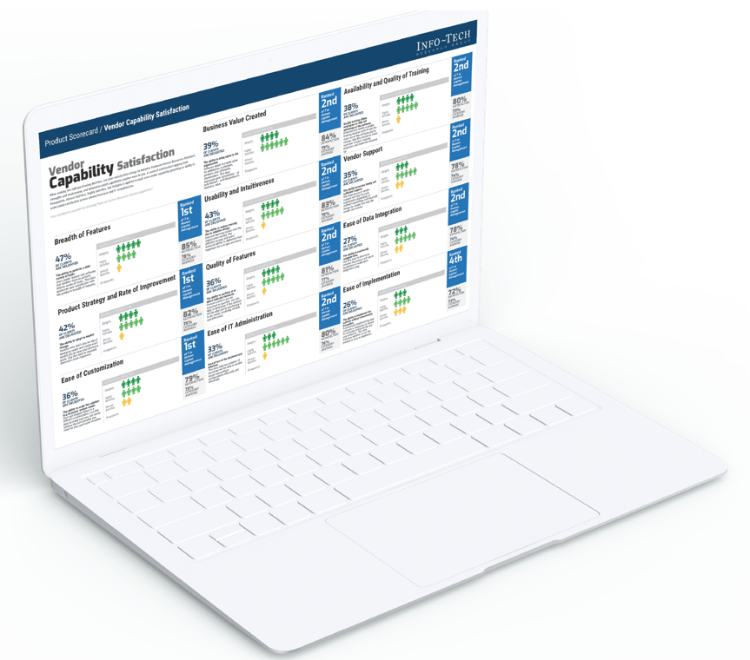
Embrace the technology
Make the available data governance tools and technology work for you:
Data catalog
Business data glossary
Data lineage
Metadata management
While data governance tools and technologies are no panacea, leverage their automated and AI-enabled capabilities to augment your data governance program.
Info-Tech Research Group | 18

Slide 19
Measure success to demonstrate tangible business value
Don’t let measurement be an afterthought:
Start substantiating early on how you are going to measure success as your data governance program evolves.
Put data governance into the context of the business:
Tie the value of data governance and its initiatives back to the business capabilities that are enabled.
Leverage the KPIs of those business capabilities to demonstrate tangible and measurable value. Use terms and language that will resonate with senior leadership.
Info-Tech Research Group | 19

Slide 20
Build a right-sized roadmap
Formulate an actionable roadmap that is right-sized to deliver value in your organization.
Key considerations:
When building your data governance roadmap, ensure you do so through an enterprise lens. Be cognizant of other initiatives that might be coming down the pipeline that may require you to align your data governance milestones accordingly.
Apart from doing your planning with consideration for other big projects or launches that might be in-flight and require the time and attention of your data governance partners, also be mindful of the more routine yet still demanding initiatives.
When doing your roadmapping, consider factors like the organization’s fiscal cycle, typical or potential year-end demands, and monthly/quarterly reporting periods and audits. Initiatives such as these are likely to monopolize the time and focus of personnel key to delivering on your data governance milestones.
Sample milestones:
Data Governance Leadership & Org Structure Definition
Define the home for data governance and other key roles around ownership and stewardship, as approved by senior leadership.
Use Case Build and Prioritization
Build a use case that is tied to business capabilities. Prioritize accordingly.
Data Governance Charter and Policies
Create a charter for your program and build/refresh associated policies.
Business Data Glossary/Catalog
Build and/or refresh the business’ glossary for addressing data definitions and standardization issues.
Data Culture Diagnostic
Understand the organization’s current data culture, perception of data, value of data, and knowledge gaps.
Tools & Technology
Explore the tools and technology offering in the data governance space that would serve as an enabler to the program. (e.g. RFI, RFP).
Info-Tech Research Group | 20

Slide 21
Key takeaways for effective business-driven data governance
Data governance leadership and sponsorship is key.
Build and foster a culture of data excellence.
Make data governance an enabler, not a hindrance.
Ensure strategic business alignment.
Evolve along the data journey.
Info-Tech Research Group | 21

Slide 22
Insight summary
Overarching insight
Your organization’s value streams and the associated business capabilities require effectively governed data. Without this, you face the impact of elevated operational costs, missed opportunities, eroded stakeholder satisfaction, and exposure to increased business risk.
Insight 1
Data governance should not sit as an island in your organization. It must continuously align with the organization’s enterprise governance function. It shouldn’t be perceived as a pet project of IT, but rather as an enterprise-wide, business-driven initiative.
Insight 2
Ensure your data governance program delivers measurable business value by aligning the associated data governance initiatives with the business architecture. Leverage the measures of success or KPIs of the underlying business capabilities to demonstrate the value data governance has yielded for the organization.
Insight 3
Data governance remains the foundation of all forms of reporting and analytics. Advanced capabilities such as AI and machine learning require effectively governed data to fuel their success.
Tactical insight
Tailor your data literacy program to meet your organization’s needs, filling your range of knowledge gaps and catering to your different levels of stakeholders. When it comes to rolling out a data literacy program, there is no one-size-fits-all solution. Your data literacy program is intended to fill the knowledge gaps about data, as they exist in your organization. It should be targeted across the board – from your executive leadership and management through to the subject matter experts across different lines of the business in your organization.
Info-Tech Research Group | 22

Slide 23
Info-Tech’s methodology for establishing data governance
 | 1. Build Business and User Context | 2. Understand Your Current Data Governance Capabilities | 3. Build a Target State Roadmap and Plan
Phase Steps | Substantiate Business Drivers Build High-Value Use Cases for Data Governance | 1. Understand the Key Components of Data Governance 2. Gauge Your Organization’s Current Data Culture | 1. Formulate an Actionable Roadmap and Right-Sized Plan
Phase Outcomes | Your organization’s business capabilities and value streams A business capability map for your organization Categorization of your organization’s key capabilities A strategy map tied to data governance High-value use cases for data governance | An understanding of the core components of an effective data governance program An understanding your organization’s current data culture | A data governance roadmap and target-state plan comprising of prioritized initiatives

Slide 24
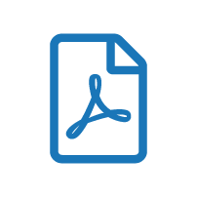
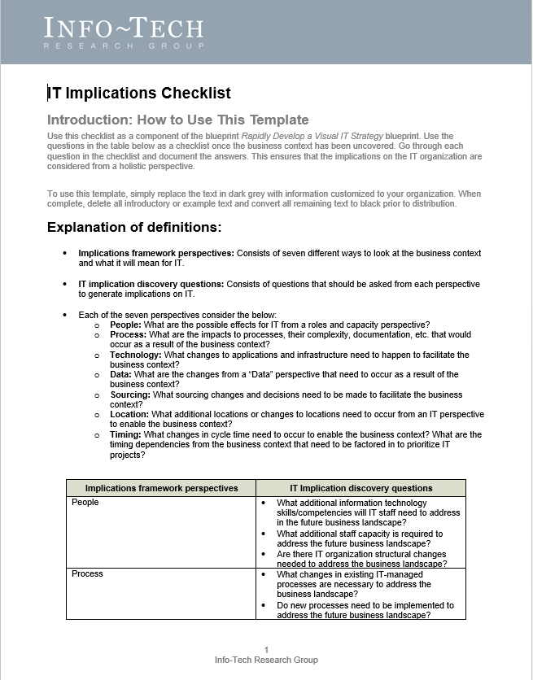
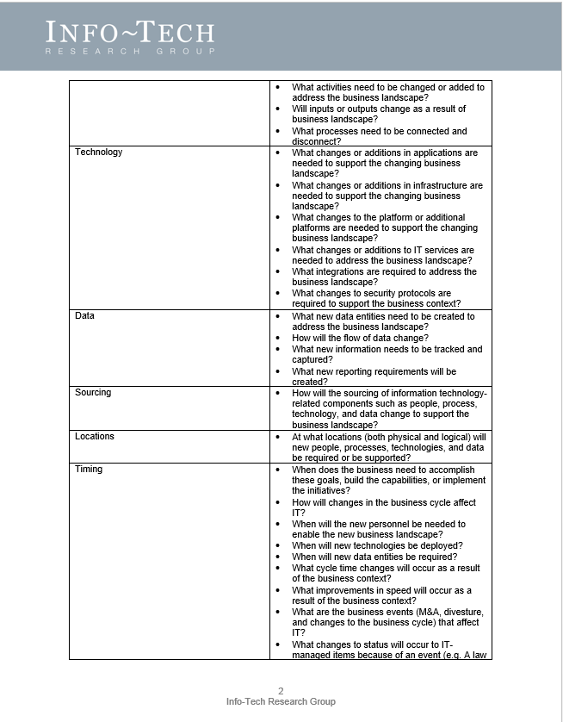
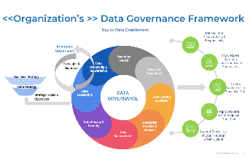
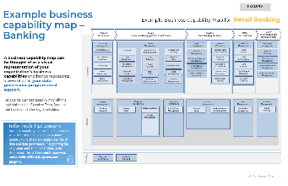
Blueprint deliverables
Key deliverable:
Each step of this blueprint is accompanied by supporting deliverables to help you accomplish your goals:
Data Governance Planning and Roadmapping Workbook
Data Governance Planning and Roadmapping Workbook
Use the Data Governance Planning and Roadmapping Workbook as you plan, build, roll-out, and scale data governance in your organization.
Data Use Case Framework Template
This template takes you through a business needs gathering activity to highlight and create relevant use cases around the organization’s data-related problems and opportunities.
Business Data Catalog
Data Culture Diagnostic and Scorecard
Use this template to document the key data assets that are to be governed and create a data flow diagram for your organization.
Leverage Info-Tech’s Data Culture Diagnostic to understand how your organization scores across 10 areas relating to data culture.

Slide 25
Blueprint benefits
Defined data accountability & responsibility
Shared knowledge & common understanding of data assets
Elevated trust & confidence in traceable data
Improved data ROI & reduced data debt
Support for ethical use and handling of data in a culture of excellence

Slide 26
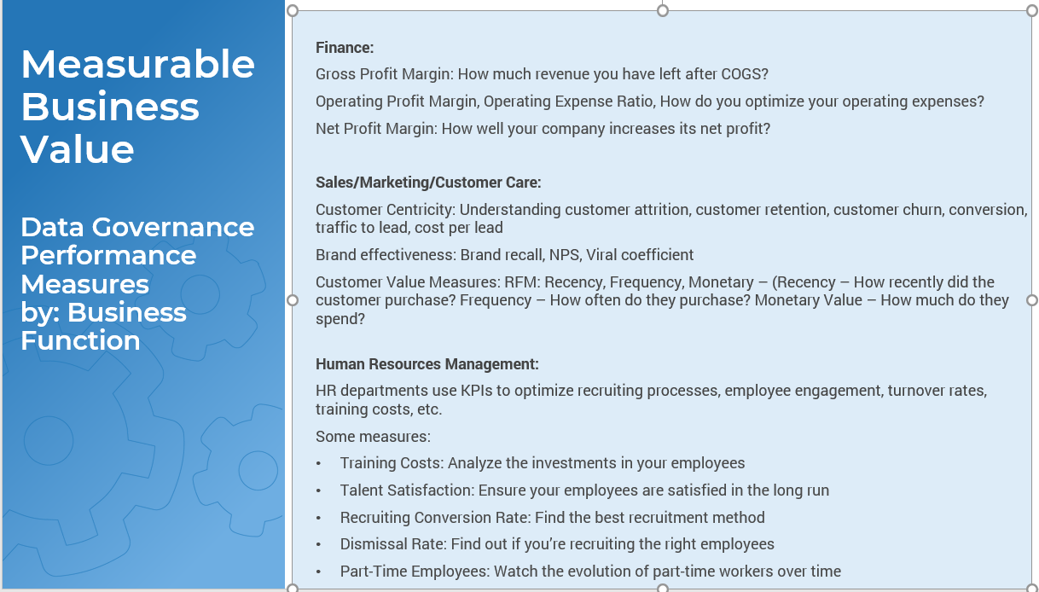
Measure the value of this blueprint
Leverage this blueprint’s approach to ensure your data governance initiatives align and support your key value streams and their business capabilities.
In phases 1 and 2 of this blueprint, we will help you establish the business context, define your business drivers and KPIs, and understand your current data governance capabilities and strengths.
In phase 3, we will help you develop a plan and a roadmap for addressing any gaps and improving the relevant data governance capabilities so that data is well positioned to deliver on those defined business metrics.
Aligning your data governance program and its initiatives to your organization’s business capabilities is vital for tracing and demonstrating measurable business value for the program.
This alignment of data governance with value streams and business capabilities enables you to use business-defined KPIs and demonstrate tangible value.

Slide 28
Establish Data Governance project overview
Contact your account representative for more information. workshops@infotech.com 1-888-670-8889
 | 1. Build Business and User context | 2. Understand Your Current Data Governance Capabilities | 3. Build a Target State Roadmap and Plan
Best-Practice Toolkit | Substantiate Business Drivers Build High-Value Use Cases for Data Governance | Understand the Key Components of Data Governance Gauge Your Organization’s Current Data Culture | Formulate an Actionable Roadmap and Right-Sized Plan
Guided Implementation | Call 1 Call 2 Call 3 | Call 4 Call 5 | Call 6 Call 7 Call 8 Call 9
Phase Outcomes | Your organization’s business capabilities and value streams A business capability map for your organization Categorization of your organization’s key capabilities A strategy map tied to data governance High-value use cases for data governance | An understanding of the core components of an effective data governance program An understanding your organization’s current data culture | A data governance roadmap and target-state plan comprising of prioritized initiatives

Slide 29
Guided Implementation
A Guided Implementation (GI) is a series
of calls with an Info-Tech analyst to help implement our best practices in your organization.
A typical GI is between 8 to 12 calls over the course of 4 to 6 months.
What does a typical GI on this topic look like?
Phase 1
Phase 2
Phase 3
Call #1: Understand drivers, business context, and scope of data governance at your organization.
Introduce Info-Tech’s approach and resources.
Call #2: Provide a detailed overview of Info-Tech’s approach, framework, Data Culture Diagnostic, and blueprint.
Call #4: Further discuss the organization’s alignment of business capabilities to data governance capabilities and use case framework.
Call #6: Plan target state and corresponding initiatives.
Call #8: Identify and prioritize improvements.
Define a RACI chart.
Call #7: Identify program risks and formulate a roadmap.
Call #9: Summarize results and plan next steps.
Call #3: Introduce business capabilities. Align them with your data governance capabilities. Begin to develop a use case framework.
Call #5: Understand and assess your current data governance capabilities and data environment. Review your Data Culture Diagnostic Scorecard, if applicable.
Info-Tech Research Group | 29

Slide 30
Workshop overview
Contact your account representative for more information. workshops@infotech.com 1-888-670-8889
 | Day 1 | Day 2 | Day 3 | Day 4
Activities | Establish Business Context and Value | Understand Current Data Governance Capabilities and Plot Target-State Levels | Build Data Domain to Data Governance Role Mapping | Formulate a Plan to Get to Your Target State
 | Establish business context, value, and scope of data governance at the organization Introduction to Info-Tech’s data governance framework Discuss vision and mission for data governance Understand your business architecture, including your business capability map and value streams Build use cases aligned to core business capabilities | Understand your current data governance capabilities and maturity Set target-state data governance capabilities | Evaluate and prioritize performance gaps Develop and consolidate data governance target-state initiatives Define the role of data governance: data domain to data governance role mapping | Identify and prioritize next steps Define roles and responsibilities and complete a high-level RACI Wrap-up and discuss next steps and post-workshop support
Deliverables | Sample use cases (tied to the business capability map) and a repeatable use case framework Vision and mission for data governance | Current state of data governance maturity Definition of target state | Target-state data governance initiatives Data domain to data governance role mapping | Initialized roadmap Initialized RACI Templated data catalog

