Slide 1
Threat Preparedness Using MITRE ATT&CK®
Keep track of tactics, techniques, and procedures as they evolve.
EXECUTIVE BRIEF

Slide 2

Analyst
Perspective
To effectively remediate, you need to know the attack surface.
Is my enterprise secure? And how would I know if it was not secure? Security professionals are asked this question all the time. They often answer by referring to various threat modeling sessions to demonstrate what is in place to block potential threat vectors. However, even with models and understanding, highly compliant companies continue to be breached on a regular basis. Traditional threat modeling is often too much hoping that you’ve mapped the correct attack vector. Security leaders cannot rely on best guesses to optimize security countermeasures. Truly optimized security requires a thorough understanding of the organization’s threat landscape, the possible attack tactics and techniques, and the security protocols that are currently in place to block them.
Understanding the tactics and methods attackers may use will give you the proper insight to effectively remediate. Know the techniques you are most susceptible to and plan accordingly to protect against them. Assumptions and patchwork security aren’t enough to keep you safe; do the work and know what techniques are coming to breach you.
Isaac Kinsella
Research Specialist, Security, Risk & Compliance
Info-Tech Research Group

Slide 3



Executive Summary
Your Challenge
Common Obstacles
Info-Tech’s Approach
To effectively protect your business interests, you need to be able to address what the most pressing vulnerabilities in your network are. Which attack vectors should you model first? How do you adequately understand your threat vectors when attacks continually change and adapt?
Adequately modeling any and every possible scenario is ineffective and haphazard at best. Hoping that you have chosen the most pressing attack vectors to model will not work in the modern day of threat tactics.
How do you know where to start when looking at threats? The scope and scale are overwhelming, and there is so much to account for.
Security can often be asked the world but given a minimal budget with which to accomplish it.
Security decisions are always under pressure from varying demands that pull even the most well-balanced security team in every direction.
Conducting a typical threat modeling session without accounting for what threats are the most pressing to your organization will leave you open to attack vectors that you may have failed to consider.
Using the MITRE ATT&CK framework, Info-Tech’s approach helps you understand your preparedness and effective detection and mitigation actions.
  Learn about potential attack vectors and the techniques that hostile actors will use to breach and maintain a presence on your network.
  Analyze your current protocols versus the impact of an attack technique on your network.
  Discover detection and mitigation actions.
  Create a prioritized series of security considerations, with basic actionable remediation items. Plan your next threat model by knowing what you’re vulnerable to.
Info-Tech Insight
Traditional threat modeling such as STRIDE or PASTA is based on a spray-and-pray approach to identifying your next potential threat vector. Instead, take a structured risk-based approach to understanding both an attacker’s tactics and how they may be used against your enterprise. Threat preparedness requires precision, not guesswork.

Slide 4
Threat preparedness is increasingly important as the stakes continue to rise
Preparedness makes all the difference in effectively securing your enterprise.
Incident response preparedness was the highest cost saver for businesses.
“The average total cost of a data breach for companies with an IR team that also tested an IR plan using table-top exercises or simulations was $3.29 million, compared to $5.29 million for companies with neither an IR team nor test of the IR plan – a difference of $2 million. The cost difference between these groups was 1.23 million in the 2019 study.”
The average cost of a data breach has increased by 10% since 2014. The weighted average is $3.79 million over seven years.
Source: IBM

Slide 5
Preparing yourself properly can save you costs and headaches
Average Total Cost of a Data Breach by Industry Sector
(Top Five Industries in US Millions)
Every breach is perpetrated by a different vector. The majority of breaches, however, are conducted via malicious attacks against your network. How prepared are you for these attacks? Do you know what to look for or how best to remediate?
Every industry is under constant pressure from malicious attackers, and the cost of a data breach has been rising in key sectors.
Technology
$5.0M
Pharma
$5.1M
Finance
$5.9M
Energy
$6.4M
Healthcare
$7.1M
Source: IBM

Slide 6

Info-Tech’s Threat Preparedness
The Info-Tech difference:
Attack Tactics
Reconnaissance
Resource Development
Initial Access
Execution
Persistence
Privilege Escalation
Defense Evasion
Threat preparedness is based on understanding:
  What the attack vectors are – Using the MITRE ATT&CK® framework, understand how adversaries may attempt to breach your network.
  How prepared you are for an attack tactic – Leverage the synthesized framework by contrasting your current security protocols against the impact of the techniques.
  How to remediate and prioritize – Plan your next threat model with a risk-based approach and actionable detection and mitigation measures.
Credential Access
Discovery
Lateral Movement
Collection
Command & Control
Exfiltration
Impact
Business Impact
Current Mitigations
How prepared are you for threat tactics?
What security protocols are in place?
Detection Actions
Mitigation Actions
Remediation
Prepared
Mostly Prepared
Mostly Unprepared
Unprepared
Exfiltration
Somewhat Prepared
Defense Evasion
Reconnaissance
Lateral Movement
Credential Access
Risk-Based Prioritization for Threat Preparedness

Slide 7
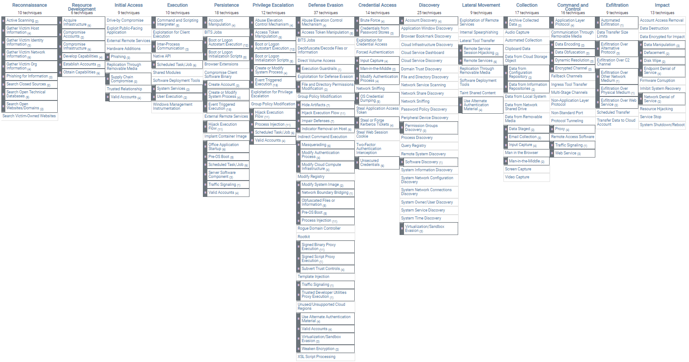
MITRE ATT&CK® Framework
The Info-Tech Understanding:
A structured approach to understanding the tactics, techniques, and sub-techniques facing your enterprise.
A dynamic toolset that responds to your unique environment and is customized to understand your threat preparedness.
Visually appealing templates to communicate and socialize the tactics and techniques.
© 2021 The MITRE Corporation. This work is reproduced and distributed with the permission of The MITRE Corporation.
Info-Tech Research Group | 7

Slide 8
Info-Tech’s Methodology for Threat Preparedness
 | 1. Attack Tactics and Techniques | 2. Threat Preparedness Workbook Mapping | 3. Execute Remediation and Detective Measures
Phase Steps | 1.1 Reconnaissance 1.2 Resource Development 1.3 Initial Access 1.4 Execution 1.5 Persistence 1.6 Privilege Escalation 1.7 Defense Evasion 1.8 Credential Access 1.9 Lateral Movement 1.10 Collection 1.11 Command and Control 1.12 Exfiltration 1.13 Impact | 2.1 Threat Preparedness 2.2 Enterprise Matrix 2.3 Tactic Tabs 2.4 Remediation | 3.1 Prioritized Tactics 3.2 Next Steps 3.2 Summary of Accomplishment
Phase Outcomes | A breakdown of each of the attack vectors and their overarching techniques for additional context and insight into the most prevalent attack tactics. | Map your current security protocols against the impacts of various techniques on your network to determine your risk preparedness. | Use your prioritized attack vectors to plan your next threat modeling session with confidence that the most pressing security concerns are being addressed with substantive remediation actions.

Slide 9
Insight summary
Precision is critical to being able to successfully defend against threats
Traditional threat modeling such as STRIDE or PASTA is based on a spray-and-pray approach to identifying your next potential threat vector. Instead, take a structured risk-based approach to understanding both an attacker’s tactics and how they may be used against your enterprise. Threat preparedness requires precision, not guesswork.
Knowing is half the battle
You may be doing better than you think. Undoubtedly, there is a large surface area to cover with threat modeling. By preparing beforehand, you can separate what’s important from what’s not and identify which attack vectors are the most pressing for your business.
Be realistic and measured
Do not try to remediate everything. Some attack vectors and approaches are nearly impossible to account for. Take control of the areas that have reasonable mitigation methods and act on those.
Identify blind spots
Understand what is out there and how other enterprises are being attacked and breached. See how you stack up to the myriad of attack tactics that have been used in real-life breaches and how prepared you are. Know what you’re ready for and what you’re not ready for.
Analyze the most pressing vectors
Prioritize the attack vectors that are relevant to you. If an attack vector is an area of concern for your business, start there. Do not cover the entire tactics list if certain areas are not relevant.
Detection and mitigation lead to better remediation
For each relevant tactic and techniques, there are actionable detection and mitigation methods to add to your list of remediation efforts.

Slide 10
Understanding the ATT&CK ® Matrix for Enterprise
The ATT&CK ® framework consists of 14 different attack techniques that a malicious actor may use to attempt to gain purchase and achieve some goal in your network.
Reconnaissance
An attacker is trying to gather information they can use to plan future operations.
Privilege Escalation
An attacker is trying to gain higher or additional permissions on your network.
Collection
An attacker is trying to gather data or information that is relevant to their goals.
Resource Development
An attacker is trying to establish resources they can use to support operations.
Defense Evasion
An attacker is trying to avoid being detected on your network.
Command and Control
An attacker is trying to communicate with a compromised system to gain control over it.
Initial Access
An attacker is trying to get into your network.
Credential Access
An attacker is trying to steal account names and passwords to further their goals.
Exfiltration
An attacker is trying to steal data or information off your network.
Execution
An attacker is trying to run malicious code on your network.
Discovery
An attacker is trying to figure out your network’s environment.
Impact
An attacker is trying to manipulate, interrupt, or destroy your system and/or data.
Persistence
An attacker is trying to maintain their foothold on your network.
Lateral Movement
An attacker is trying to move themselves through your environment.

Slide 11
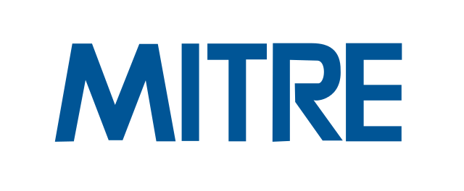
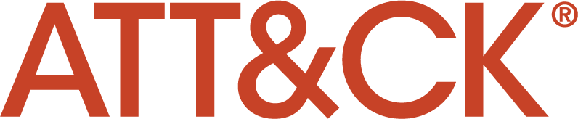
Each technique under the framework has a series of sub-techniques
Each tactic has techniques directly tied to it. Under these techniques are further sub-techniques that represent a more granular approach to how an attack may attempt to breach your network. These areas will be covered more extensively later in the blueprint.
The level of granularity that is applicable to each business will change drastically based on the maturity of your enterprise. However, while not all tactics and their subsequent techniques may be relevant, understanding the possible avenues for entrance into your network has extensive value in and of itself.
The sections of the ATT&CK framework covered in this blueprint will be limited to enterprise sections. However, the ATT&CK framework does make provisions for both mobile and ICS controls, which may be considered later for threat preparedness.

Slide 12


Use Info-Tech’s blueprint to know how prepared you are for every threat vector
IT Benefits | Business Benefits
IT can determine the capabilities of its current security structure to deal with various attack vectors. IT will no longer have to disallow certain applications and services because they are cloud based. Analyzing and threat modeling are no longer a buckshot of guessing what the most pressing concerns are. Know your vulnerabilities and remediate and plan proactively instead of reactively. | Line-of-business managers can understand which areas need improvement and which can be deprioritized. Gain an in-depth understanding of the management aspects of security and threat vectors and techniques. Know which mitigative and detective measures should be implemented to best protect your environment without additional guesswork.
Discovery
&
Assessment

Slide 13




Use Info-Tech’s blueprint to improve enterprise security posture
Threat preparedness can be used to effectively evaluate:
Short-term benefits
Organizational preparedness
Expose operational weak points and transition teams from a reactive approach to a more proactive security program.
Ensure organizational preparedness.
Identify effectiveness of the overall security program.
Streamline the security management program.
Identify people, process, and technology gaps.
Enhanced threat detection, prevention, analysis, and response
Enhance the collaboration and use of your security investments through the simulated evaluation of your threat collaboration environment.
Long-term benefits
Improve return on security investment
Evaluate core staff on their use of process and technology to defend the organization.
Reduce incident costs and remediation time.
Increase operational collaboration between prevention, detection, analysis, and response efforts.
Enhance security pressure posture.
Improve communication with executives about relevant security risks to the business.
Preserve reputation and brand equity.
Identify blind spots and opportunities for continuous improvement
Provide increased visibility into current performance levels, and accurately identify opportunities for continuous improvement with a holistic measurement program.
Iterative benefit
Over time, experience incremental value from knowing the attack vectors through which you can be attacked. Through continual updates your security protocols will evolve with less associated effort, time, and costs.
Discovery
&
Assessment

Slide 14

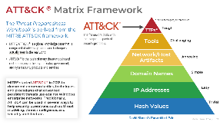
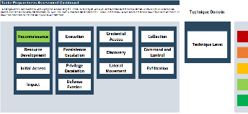
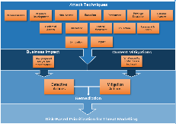
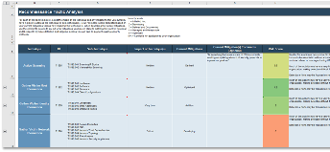
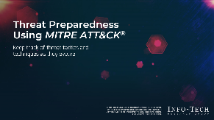
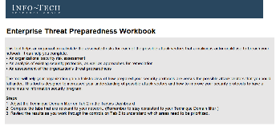
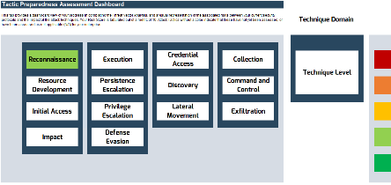


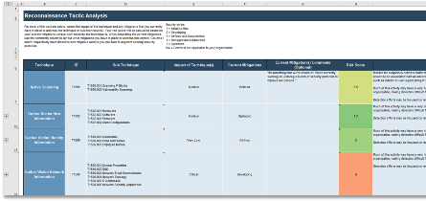
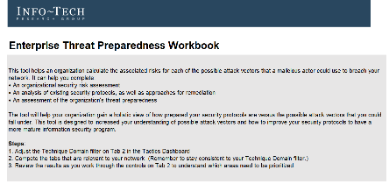
Blueprint materials
Key deliverable:
Each step of this blueprint is accompanied by supporting deliverables to help you accomplish your goals:
  Enterprise Threat Preparedness Workbook
Organize and calculate the associated risks for each of the possible attack vectors that a malicious actor could use to breach your network. Prioritize remediation efforts in accordance to your risks.
Threat Preparedness Using MITRE ATT&CK® Storyboard
  Enterprise Threat Preparedness Workbook
Document your preparedness for each of the attack tactics and sub-techniques that may be used to breach your network.
Understand the various threat methods that can be used against you. Learn how to use the tools to improve your security posture.

Slide 16

Guided Implementation
A Guided Implementation (GI) is series of calls with an Info-Tech analyst to help implement our best practices in your organization.
A typical GI is between 1 to 6 calls over the course of 1 to 2 months.
What does a typical GI on this topic look like?
Phase 1
Phase 2
Phase 3
Call #1: Explain methodology and scoping.
Call #3: Work through associated techniques and sub-techniques.
Call #5: Identify and prioritize detective and mitigative measures.
Call #2: Identify relevant attack tactics and techniques.
Call #4: Analyze preparedness and plan for attack vectors.
Call #6: Summarize results and plan next steps.
Info-Tech Research Group | 16

Slide 17

Executive Brief Case Study
INDUSTRY
SOURCE
Video Communications
Cloud Security Alliance
Zoom
With the prevalence of users moving to remote and work-from-home during the pandemic, Zoom saw a sharp increase in number of users. Subsequently, several issues arose with poor meeting-room security and no preventative, detective, or mitigative controls in place.
Customer credential reuse was a common issue because of the lack of appropriate mitigating security protocols. Attackers also used Zoom Windows client group-chat features to share links that leaked Windows network credentials. Attackers could potentially breach confidentiality of companies’ intellectual property during insecure virtual meetings, or other highly sensitive information. An example of this is UK Prime Minister Boris Johnson using his personal meeting ID instead of a separate code. In posting a tweet, Johnson compromised the forum and potentially discussions of state-held business.
Impact Statement for Zoom
Vulnerabilities:
Insecure interfaces and APIs – Zoom looked for simplified operations and used or performed poor threat modeling to predict which attack vectors were likely to occur.
Misconfiguration and inadequate change control on Zoom accounts – This resulted in easily guessed or non-existent passwords.
Insufficient identity, credential, and access management – Inadequate testing of credentials allowed for credential-stuffing attack.
Business Impacts:
Financial: Business impacts could be significant, from loss of IP to strategic disclosure. Several organizations banned Zoom as a communications platform, resulting in loss of business.
Operational: While Zoom instituted new corrective security controls, the damage was already done – business trust had faded.
Compliance: Liabilities for breaches disclosing PII. Multiple government organizations asked for customized security protocols as a result.
Reputational: Zoom was banned by multiple companies, decreasing trust in the brand, and lost its status as the standard video communication platform. Trust erodes quickly but is hard to build up again.
Key Takeaways
Before the launch of any service, give ample considerations to threat modeling. Threat modeling allows security architects and developers to evaluate control gaps to ensure that security protection is not bolted on but is rather considered from the start. Agile development patterns also aid in ensuring that the security protocols are given multiple reviews, and they allow for quicker responses to feature requirements.

