Slide 1
Increase Grant Application Success
Enhance your organization's grant writing process.

Slide 2
Table of contents
4 Analyst perspective
5 Executive summary
6 Your challenge
24 Phase 1: Identify opportunities
25 Step 1.1: Identify organization priorities
33 Step 1.2: Identify grant opportunities that align with organization priorities
41 Phase 2: Grant prioritization
42 Step 2.1: Prioritize funding opportunities
54 Phase 3: Write the grant application
55 Step 3.1: Write an exemplary grant application
65 Step 3.2: Enhance the grant application
74 Phase 4: Submit the grant application
75 Step 4.1: Submit the grant application
83 Step 4.2: Improve your organization’s grant writing capabilities
87 Summary of accomplishment
88 Additional support
91 Bibliography

Slide 3
Increase Grant Application Success
Enhance your organization's grant writing process.
EXECUTIVE BRIEF

Slide 4

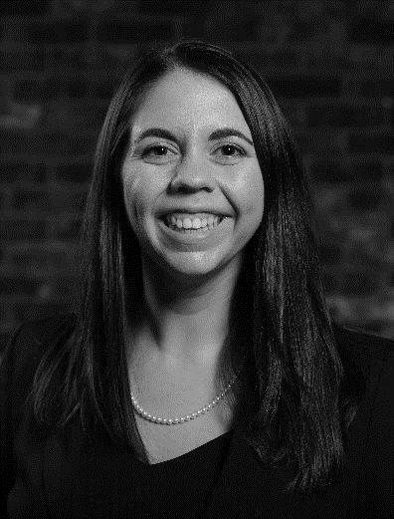
Analyst perspective
Your organization deserves to be awarded more grants. Write better applications and obtain more funding.
Grant writing needs to be an organized and systematic component of your organization’s daily functions to consistently secure funding. When grants are identified and applied for in an ad hoc manner, it reduces your organization’s chances of being awarded these grants. Moreover, there are many common mistakes those writing grant applications make – especially when this is not part of their regular responsibilities.
Bring structure to this process by first identifying funding opportunities that can support the priorities of your organization and its various departments and divisions. Next, prioritize the grant funding opportunities that have the highest chances of success. Apply best practices when writing and submitting the grant applications. Use learnings from unsuccessful applications as an opportunity to develop your organization’s grant writing capabilities and enhance your organization’s chances of being awarded future grants.
Larry Fretz
Practice Lead, Industry
Info-Tech Research Group
Brittany Lutes
Research Analyst, Industry
Info-Tech Research Group

Slide 5



Executive summary
Your challenge
Common obstacles
Info-Tech’s approach
Your organization is unable to pursue projects and initiatives because:
It does not have access to sufficient funding.
Writing grants is not prioritized by the organization.
As a result, the organization (or its divisions and/or departments) is required to seek out and apply for grants to secure the funding that will provide the necessary financial support.
    Grants are found and applied to in an ad hoc manner by employees of the organization because:
Other responsibilities demand the employees’ time and resources.
Selecting and prioritizing grant funding opportunities is not formalized.
Grants require too much time.
As a result, applications are submitted that are incomplete, not in alignment with guidelines, and/or missing critical components.
Our approach is to optimize your organization’s grant application process with key insights and best practice steps for successful grant writing.
It is critical your organization select the right grants to apply for and submit competitive applications to increase your chances of success.
Use Info-Tech’s methodology to enhance your organization’s grant writing capabilities and increase the number of funding opportunities awarded.
Info-Tech Insight
The grant application process involves being strategic in the grant opportunities your organization pursues, dedicating time and resources to writing competitive grant applications, and ensuring your organization will be able to adhere to the grant parameters if awarded the funding.

Slide 6
Your challenge
In 2019, a total of
US$721B
in grants were distributed to states and local governments.
Source: Tax Policy Center, 2019.
In 2021, the National Endowment for the Humanities announced
$32.8M in grants
to support 213 humanities projects across the United States.
Source: National Endowment for the Humanities, 2021
This research is designed to help organizations facing these challenges:
Your organization seeks to secure funds in the form of grants to provide necessary services and resources for your program, recipients, clients, and/or projects.
Your organization is unable to start, finish, and/or continue priority projects, programs, or initiatives because it doesn’t have sufficient funds.
Your organization does not know how to look for and select grant funding opportunities.
Given the amount of time and resources that go into the grants process, if your organization is likely to be denied at any point during application, submission, or selection, it’s probably not worth it for your organization to pursue the opportunity.
Organizations can fund their key priorities through grant awards. Spending sufficient time and resources increases your chances of success.

Slide 7
Common obstacles
120
HOURS
The average number of hours spent on a standard NSF (National Science Foundation) grant or NIH RO1 (National Institute of Health Research Grant Program)
Source: Beth Keithly, The University of Texas at Dallas, Office of Research
These barriers may be difficult to address for many organizations:
Many organizations do not have a dedicated grant writer, let alone an office that oversees all funding opportunities.
The grant application process is not formally embedded in the decision-making or governance structures of the organization.
It is difficult to determine which grant funding opportunities are the most appropriate for your organization. Meeting the grant’s eligibility criteria and the grant’s alignment with the organization's priorities help ensure higher success rates.
Members of your staff might believe that it is unfair that you are required to spend time and resources applying to funding opportunities (especially government funded ones) when you deserve and are owed those funds.
The application success rate across all National Endowment of the Humanities grant programs.
Source: National Endowment for the Humanities, Grants
16%

Slide 8
Grant Management Framework
Grant Governance
Grant Management
O
R
G
A
N
I
Z
A
T
I
O
N
S
T
A
K
E
H
O
L
D
E
R
S
Grant Management Office Creation
Grant Application Management
Grant Performance Management
Grant Management Continual Improvement
Mission, Vision, Values
Strategic Roadmap
Identify Opportunities
Prioritize Opportunities
Success Rate
Time and Resources for Application
Strategic Partners
Sustainment and Continuity
Organization Structure
Grant Operating Model
Write Application
Submit Application
Adherence to Grant Parameters
Ongoing Grant Identification
Grant Categories
Organization Values
GRANTOR APPLICATION & APPROVAL STAKEHOLDERS
IDENTIFICATION TO SUBMISSION CYCLE
Identifying ways to obtain grants that align with the organization's strategic goals.
Ensuring the organization successfully applies for, receives, and uses grant funding.
Writing competitive grant applications that align with the organization’s priorities.
SUBMISSION TO OPTIMIZATION CYCLE
Identifying how to optimize the grant application process.
Selecting grants that will deliver high value to the organization.
Optimizing the grant application process through partnerships
Executive Branch
Finance
Legislative Branch
Judicial Branch
IT
CRITICAL DEPARTMENTS
Education
Social Services
Health Services
Housing Services

Slide 9
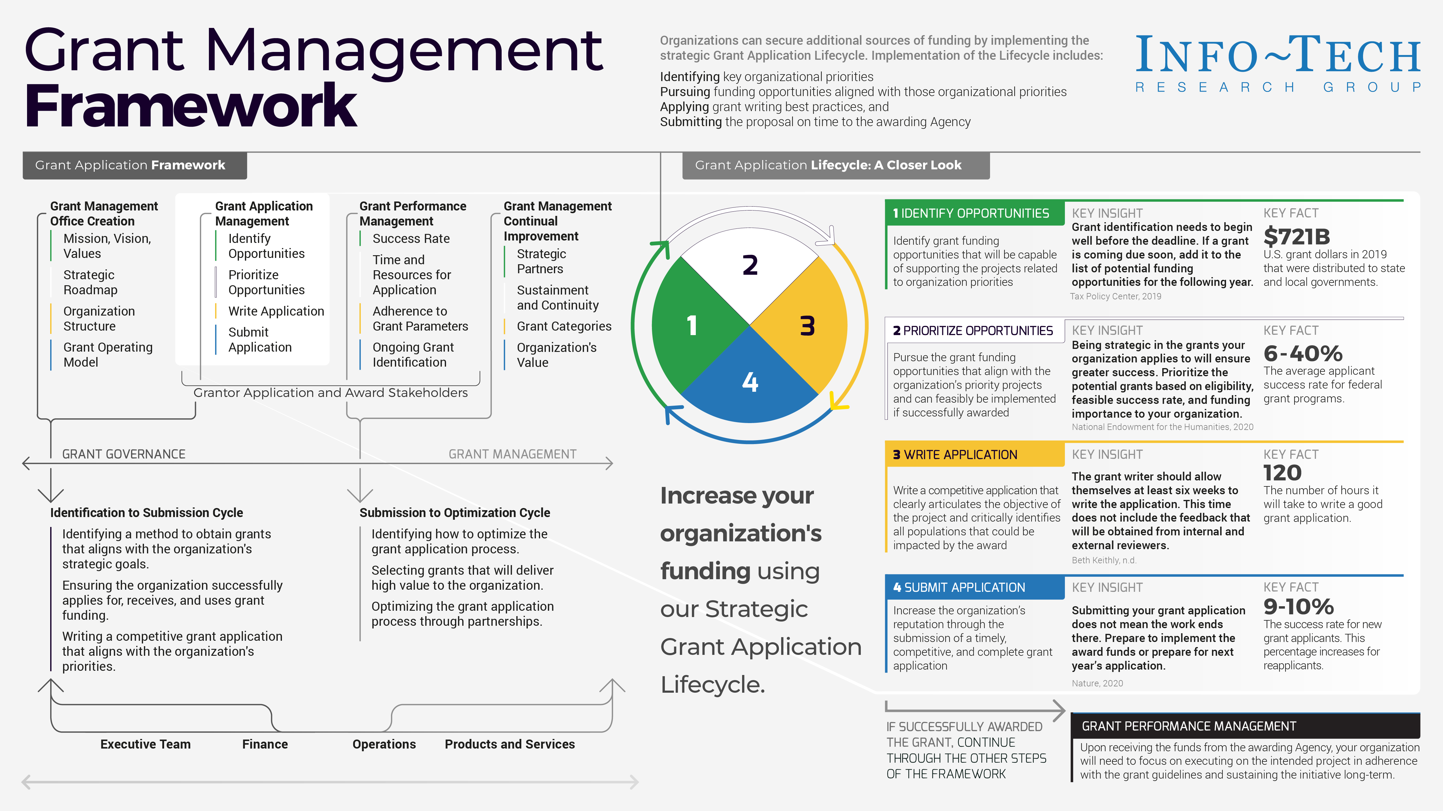

Slide 10




Grant application lifecycle
The grant lifecycle is a part of the greater grant management framework. The entire grant application lifecycle will take approximately 6 to 12 months.
01 Identification
02 Prioritization
The process of identifying potential grant opportunities for your organization. Knowledge of upcoming projects in your organization supports this process.
01
Based on available grants, choose those which your organization has the greatest likelihood of receiving. Additionally, ensure the effort involved in the application process will be worth the grant funding amount.
04
02
03 Application
04 Evaluation
There will be written components associated with an application. This critical piece of the process is where your organization communicates how the intended use of the grant funds aligns with the criteria of the funding opportunity.
Whether successful or not, it is important to follow up with the Agency and inquire about comments and feedback. Document this information to use in next year’s application.
03
Grant Awarded
If you are successfully awarded the grant, move through the phases of Grant Performance Management followed by the phases of Grant Management Continuous Improvement to optimize the Grant Management Process.

Slide 11
What are grants?
And how do they differ from loans?
Loans, on the other hand…
Loans are also considered a form of financial assistance.
Loans will need to be repaid and generally at a higher amount than originally borrowed once interest has been calculated.
The source of loans varies and includes financial institutions and other agencies related to this sector.
Loans require an application and are generally awarded based on eligibility (and not merit).
A grant is a form of financial assistance.
A grant is an award that often comes in a monetary form from a corporation, foundation, or government.
Grants are applied for and often required to be used for a very specific reason, project, or initiative. The award cannot be transferred to a different initiative that is deemed more worthy of the funds by the organization.
A grant involves the organization preparing and submitting an application that will be reviewed by a group who will select the application(s) they consider the most deserving.
Governments and their associated agencies are some of the most common sources of grants.
Sources:
Chinook Indian Nation. “Wanted, An Experienced Contract-Based Grant Writer.” Chinook Indian Nation.
Granted Consulting. “The Difference Between a Grant and a Loan.” Granted Consulting, 16 Mar. 2020.
Market Business News. “What is a grant? Definition and meaning.” Market Business News, 2020.

Slide 12
The importance of grants for organizations
Why are they worth pursuing?
“The funds allowed us to provide all clinicians with new equipment, and more importantly clients were now reconnected with clinicians.”
–Jenni Pollen, Preferred Behavioral Health Group, quoted in Healthcare IT News, 2021
Many organizations want to carry out vital projects and programs, but require funds to operate. Grants can be an advantageous way to secure these funds.
After analyzing your alternatives, your organization believes the use of grant funds may be the best method to implement certain projects.
Your organization may need to supplement the revenue it generates through its various enterprises. Grants can be one of the primary sources of this revenue.
Winning a grant elicits credibility, exposure, and an increased likelihood of being awarded more grants.
Sources:
Glatt, Carter. “GYT Technology Announces Continued Positive Impact for Tribal Nations’ Grant Activities.” Business Wire, 2020.
Walker, Kevin. “Equity for Native American Communities: Using Mission Investments Alongside Grants.” Stanford Social Innovation Review, 1 Apr. 2019.
“The Importance of Grant Writing for Non-Profits.” Lesley University.
Martin, J. Melanie. “Why Are Grants Important?” Bizfluent, 26 Sept. 2017.
Cuellar, Henry. "Why Apply for a Grant?" United States Congressman Henry Cuellar.

Slide 13
Info-Tech’s methodology for organizations applying for grant funding
 | Identify opportunities | Prioritize opportunities | Write the application | Submit the application
Phase Steps | Identify organizational priorities Identify grant opportunities that align with organizational priorities | Prioritize funding opportunities | Write an exemplary grant application Enhance the grant application | Submit the application Improve your organization’s grant writing capabilities
Phase Outcomes | Identify grant funding opportunities that align with your organization’s priorities. | Select grant funding opportunities that have a high rate of success by aligning with your organization’s priorities and capabilities. | Enhance your grant writing capabilities. Apply best practices and avoid the common mistakes that lead to not being awarded funding. | Ensure your grant application is submitted with complete and on time. Identify opportunities for improvement on future applications.

Slide 14
Insight summary
Overarching insight
Organizations need to select grants that align with their organization’s goals, spend sufficient time and resources on the application, and assess the organization’s readiness to implement the funds if awarded the grant.
Phase 1 insight
Your grant identification process needs to start well before the deadline. Most people assume applying half-heartedly is better than not applying at all, but when it comes to grants that is not the case. You need to plan and strategize well in advance.
Phase 2 insight
Set your organization up for success by pursuing a funding opportunity that is related to an initiative or project that you would pursue regardless of whether you received the grant. If it’s that critical of an initiative, you can highlight its value better.
Phase 3 insight
Grant writing is like telling a story. There should be a beginning, middle, and end. The reviewer should be introduced to a problem, understand the solution, and be inclined to support your organization in meeting its goal. Make the reviewer want to see the end come to fruition by funding the initiative.
Phase 4 insight
The post-award process is just as critical to the grant process as the pre-application process. Reach out to the reviewers. Hearing from them what was good about your application and what could be improved will provide valuable lessons and help ensure success in future applications.
Tactical insight
Don’t be afraid to reach out to previous grant recipients. Their experience provides a valuable perspective that your organization will want to consider during the application process.
Tactical insight
Partnerships are key when it comes to grants. Based on the type of grant you are looking to secure, you may wish to partner with local academics, non-profits, and/or experts to increase your organization's chances of success.

Slide 15



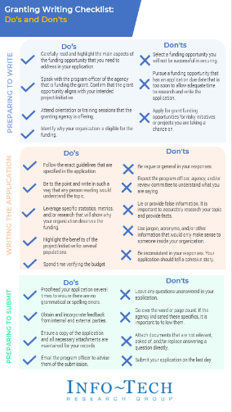
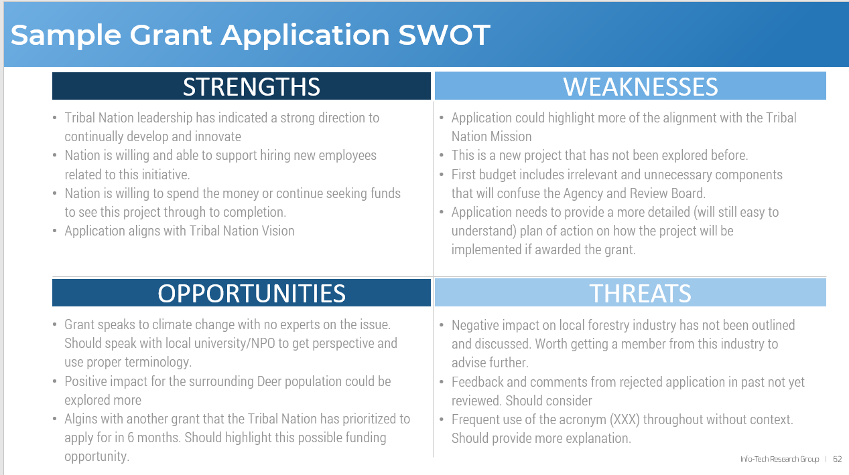
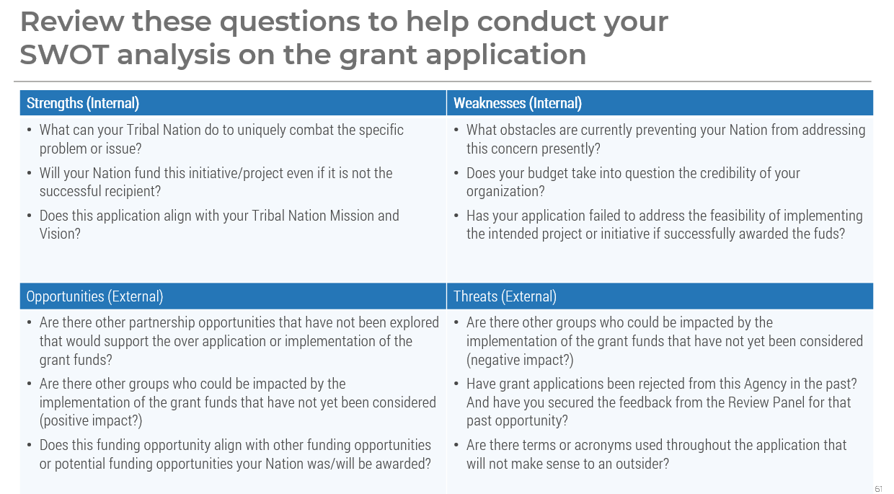
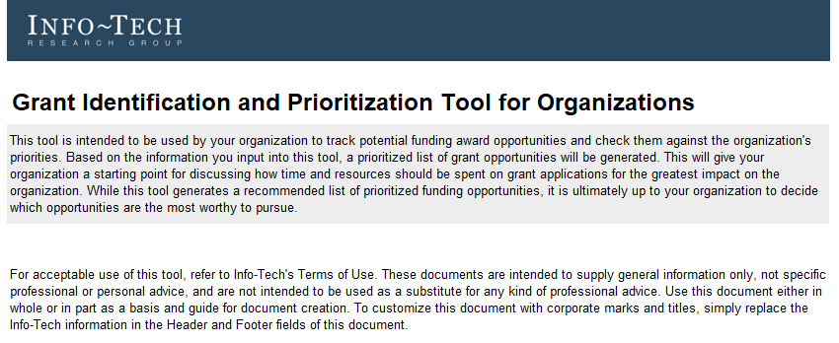

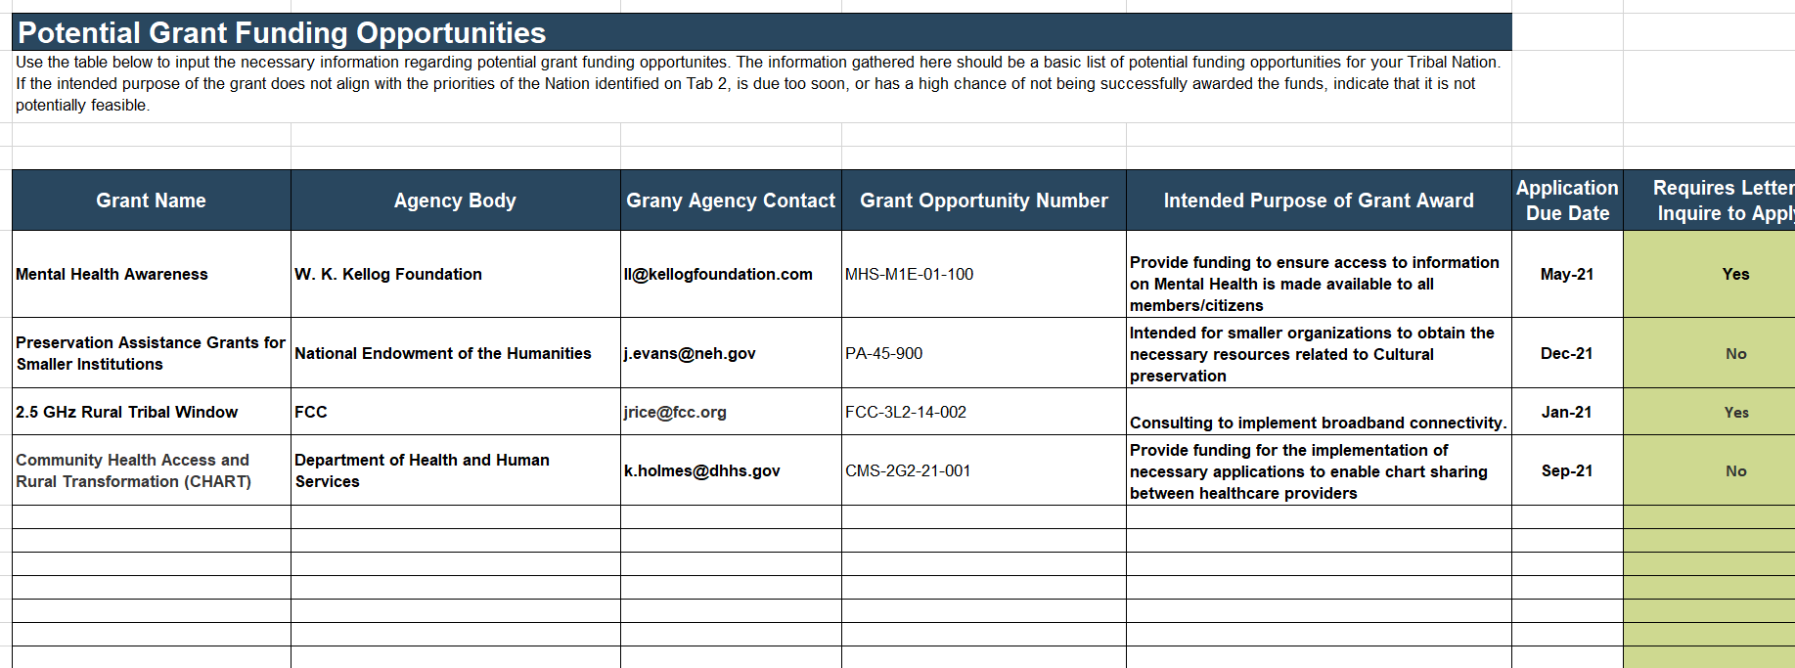
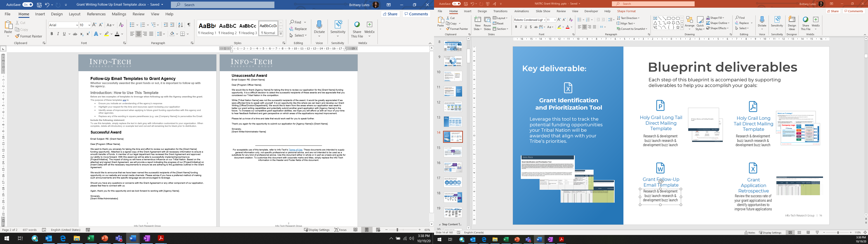
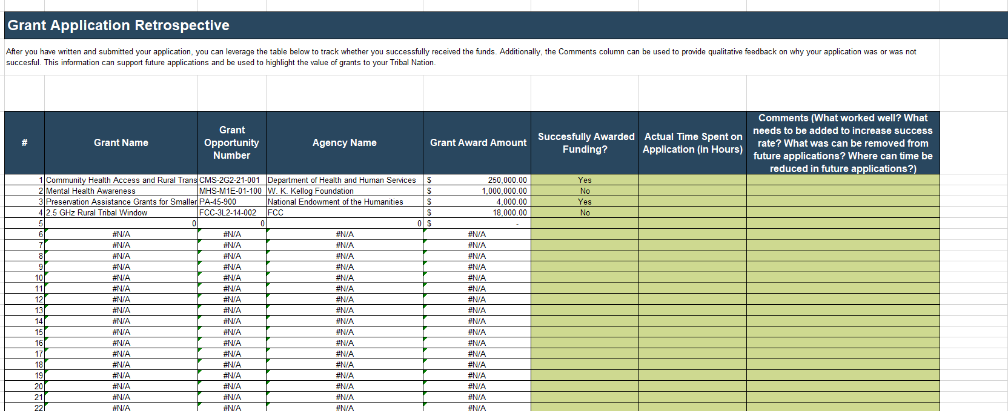
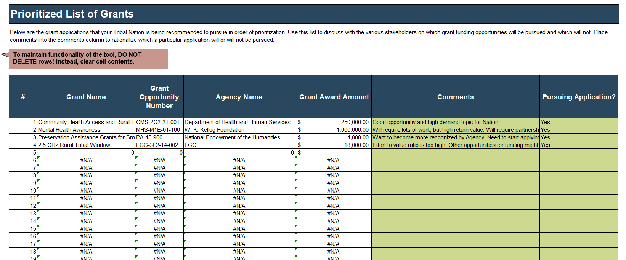
Blueprint deliverables
Key deliverable:
Each step of this blueprint is accompanied by supporting deliverables to help you accomplish your goals:
  Grant Identification and Prioritization Tool for Organizations
  Grant Application SWOT Analysis
  Grant Writing Checklist: Do’s and Don’ts
Leverage this tool to track the potential grant funding opportunities that align with your organization’s priorities.
Critically examine your grant application’s internal capabilities and external opportunities from the perspective of an external party.
Apply best practices when it comes to your grant applications.
  Grant Follow-up Email Template
  Grant Application Retrospective
Follow up with grant program officers and request feedback on unsuccessful applications.
Review the success rate of your grant applications and identify opportunities to improve future applications.

Slide 16
Blueprint benefits
IT benefits | Organization benefits
Enables your IT department/division to apply for more grants and increase the chances of success of those applications. Provides an opportunity for your IT department/division to collaborate with other departments/divisions of your organization and to participate in the grant application process. Standardizes the process for those being asked to perform grant writing as an ad hoc responsibility within your IT department /division. | Ensures that organizations are applying to grant funding opportunities in a strategic manner that takes into consideration the various initiatives that different departments and divisions are pursuing. Secures more funds for the organization to create, continue, or enhance its programs and services Improves the grant writing capabilities of the organization and exercises the best practices that granting agencies and reviewers look for when awarding grants.

Slide 17
Measure the value of this blueprint
    “The average success rate for federal grant programs is between 6% and 40%.”
    Source: National Endowment for the Humanities, “NEH’s Application Review Process.”
    “Spending about 6 weeks minimum on a grant application is recommended.”
    Source: Kiethly, Beth. “Part One: How Long Does it Take to Write a Grant? In Praise of Going Slow.” The University of Texas at Dallas Office of Research.
    “The entire grant application lifecycle is 6 to 12 months.”
    Source: “Tips for the Application Process.” Research Guides: University of Wisconsin-Madison Libraries.
    “34.7% of a non-profit organization's revenue sources come from government grants and private and corporate foundations .”
    Source: National Council of Nonprofits, “Nonprofit Impact Matters,” 2019.
Success in grant writing can look like:
A more effective way to find, prioritize, and apply for grant funding opportunities.
A reduction in the number of grant funding opportunities that are applied to in an ad hoc manner.
A method of successfully aligning your grant funding opportunities with your organization’s priorities.
A reduction in the number of grants that are applied for by multiple divisions within a single organization.
A reduction in the amount of time it takes to write a quality grant application (your organization does not have time to waste on a bad application!). To reduce the time spent on grant applications, aim to develop:
  Relationships with other departments that lead to quick turnarounds.
  The ability to write a good application.
  The expertise needed to generate a budget.
  The capability to track specific metrics regularly for quick access.
An increase in the number of grants that your organization is awarded.
An increase in your organization’s funding that comes from grant sources.

Slide 19

Guided Implementation
A Guided Implementation (GI) is a series
of calls with an Info-Tech analyst to help implement our best practices in your organization.
A typical GI is between 6 to 10 calls over the course of 3 to 6 months.
What does a typical GI on this topic look like?
Phase 1
Phase 4
Phase 2
Phase 3
Call #1: Discuss your organization's
current grant writing capabilities and be introduced to the methodology.
Call #5: Sketch out your grant application.
Call #8: Submit the application. Follow up with the grant agency and/or program officer once you’ve been notified of the grant outcome. Ask for feedback.
Call #3: Input information about grants and identify which grants will be prioritized.
Call #6: Conduct a SWOT analysis to critically assess the draft for improvement.
Call #4: Discuss the prioritized list with leadership and pursue funding opportunities selected.
Call #2: Determine your organization’s priorities. Search for potential funding opportunities.
Call #9: Have a retrospective meeting to discuss the feedback to improve future grant endeavors.
Call #7: Solicit feedback on the draft from internal and external reviewers.
Info-Tech Research Group | 19

Slide 20
Workshop Overview
Contact your account representative for more information.
workshops@infotech.com 1-888-670-8889
 | Day 1 | Day 2 | Day 3 | Day 4 | Day 5
Activities | Determine Organization Priorities | Prioritize Grant Funding Opportunities | Sketch Out a Grant Application | Prepare to Submit the Grant Application | Next Steps and Wrap-Up (Offsite)
 | 1.1 Discuss your grant funding rationale and the importance of grants to the organization. 1.2 Identify your organization’s priorities. | 2.1 Identify a list of potential grant funding opportunities. 2.2 Define the capacity your organization has to support the granting writing process. 2.3 Discuss and prioritize grant funding opportunities. | 3.1 Sketch out a grant application. 3.2 Conduct a SWOT analysis to critically assess your sketch. | 4.1 Identify potential individuals who will review the draft of your application. 4.2 Discuss next steps for the grant submission. 4.3 Review grant writing best practices. | 5.1 Complete in-progress deliverables from the previous four days. 5.2 Set up a time to review workshop deliverables and to discuss next steps.
Deliverables | List of organization priorities. | List of feasible grant funding opportunities to be pursued based on priority. | A sketched version of the grant application that is ready to be drafted. Grant sketch SWOT analysis. | List of potential internal and external reviewers of the grant draft. Grant writing best practices to leverage. | Review of the activities and suggestions on next steps.

Slide 21




Concierge Service: Grant Application Review
Service Benefits
  Increase in grant application quality
  Confident that grant aligns with priorities
  Verify funding objectives are feasible
  Get valuable external feedback
Ensure your application stands out from the competition by enhancing the overall quality of each component of your application.
Have the intended purpose of the grant checked against your organization’s priorities and ensure these are aligned.
Succeed by putting forward realistic and manageable objectives for the grant funds that shows the grant agency you will succeed.
Having someone who is external to your organization review the application and provide critical feedback will improve your application materials.

Slide 22




Concierge Service: Grant Application Review
Our Perspective
  Quality grants are more likely to be successful
  Grants reviewed by external bodies are higher quality
  Grant agencies will look forward to your applications
  Time shouldn’t be wasted on a bad grant application
A high-quality grant will see greater success, and this will be transpired across other grant funding opportunities.
When a grant has been reviewed by an objective external party, it will identify opportunities for clarity that will enable the Review panel to better understand your organization's goals.
The more high-quality grant applications you submit, the more likely grantors will begin to expect and sometimes even seek out your funding applications.
Your organization’s resources are valuable and shouldn’t be wasted on creating and submitting a bad grant application. Put forward your best application every time.

Slide 23
Concierge Service: Grant Application Review
Service Overview
1
2
3
4
Step
Step
Step
Step
  Review funding opportunity announcement
  Score the application
  Discuss with member
  Complete scoring and provide feedback
Examine the funding opportunity announcement (FOA) and any other information provided by the grantor that will be used to inform its decision.
Conduct an initial pass and score the application based solely on the information obtained through the FOA. Identify opportunities for improvement as an impartial third party.
Have a conversation with the member to better understand why this was the grant they selected and how it aligns with the organization’s priorities.
Provide a final score and qualitative feedback on how the grant application can be improved. Aim to better highlight the benefit of the organization being awarded the grant funds.

