Slide 1
Create a Work-From-Anywhere Strategy
Ensure short-term survivability while working toward near-term innovation.

Slide 2
Table of Contents
3 Analyst Perspective
4 Executive Summary
5 Executive Brief
11 Info-Tech’s Approach
22 Phase 1: Define a Target State
23 Step 1.1: Identify Business-Aligned Benefits
31 Step 1.2: Build a Work-From-Anywhere Value Proposition
40 Phase 2: Analyze Current Fitness
41 Step 2.1: Perform a Retrospective of Your Current Work-From-Anywhere Capabilities
44 Step 2.2: Benchmark the Current Organizational Satisfaction with IT
47 Phase 3: Build a Work-From-Anywhere Roadmap
48 Step 3.1: Brainstorm a long list of Initiatives
51 Step 3.2: Review Info-Tech’s other Blueprints
57 Step 3.3: Place the initiatives on a timeline
64 Summary of Accomplishment
66 Additional Support
68 Bibliography

Slide 3


Analyst
Perspective
Do users find their remote work technology valuable, or overwhelming?
COVID-19 caught the world by surprise, and enterprise IT is no different. The pandemic aggressively advanced digital transformations as companies had no choice but to embrace work from home. CEOs that were vehemently against work-from-home realized that people can indeed be productive outside of the office.
Some CEOs didn’t realize this, though. Some of them were overseeing organizations struggling with a sprawling portfolio of apps and devices that were never intended to be used outside of the office. Some of them clung to the outdated idea that work is a place and people are only productive when they can be seen working.
The reality: working from anywhere makes organizations more resilient. It gives additional flexibility to workers that allows them to be more productive. Also, it is better for the environment as it reduces carbon emissions associated with commuting. But it comes at a cost. People aren’t working in predictable locations or at predictable times. IT service management practices – and team management practices – must be revisited and updated.
Stop overwhelming your end users. Build something that they will find not only useful, but valuable. Take the time to proactively improve your portfolio and directly empower your company.
Ken Weston PMP, Cert.APM, SMC
Senior Research Analyst, IT Service Management & Operations
Info-Tech Research Group

Slide 4



Executive Summary
Your Challenge
Common Obstacles
Info-Tech’s Approach
Work-from-anywhere isn’t going anywhere. IT needs to:
Rebuild trust with the CXO.
Identify gaps created from the COVID-19 rush to remote work.
Identify how IT can better support remote workers.
IT went through an initial crunch to enable remote work. It’s time to be proactive and learn from our mistakes.
Work-from-anywhere presents unique obstacles of flex-time, flex-location, and BYOD:
Communication and collaboration are more difficult.
Employee engagement is more crucial than ever.
There are too many initiatives to choose from.
Follow these steps to build a work-from-anywhere strategy that resonates with the business:
Identify a vision that aligns with business goals.
Design the work-from-anywhere value proposition for critical business roles.
Benchmark your current maturity.
Build a roadmap for bridging the gap.
Benefit employees’ remote working experience while ensuring that IT heads in a strategic direction.
It’s not about embracing the new normal; it’s about resiliency and long-term success
Your strategy needs to not only provide short-term operational value but also make the organization more resilient for the unknown risks of tomorrow.

Slide 5
Your Challenge
CXOs’ satisfaction with IT is down 6.25%, and CIOs don’t always know
The way your company does business has fundamentally changed.
Overall, how satisfied are you with IT’s performance as a business partner?
IT hasn’t kept up, and CXOs’ satisfaction has dropped as a result.
COVID-19 presented a business continuity threat. Companies that had never allowed remote work suddenly had to embrace it. Their IT departments suspended endpoint standards to quickly deploy laptops and hastily provide remote access to users.
The move to remote work highlighted tech debt. The gap could be with IT systems, ineffective collaboration tools, low-maturity IT operational practices, or outdated management practices. Demand on remote collaboration services increased to levels not previously seen, and CXOs were not impressed with the technical limitations.
Even trusted operators need to rethink their approach. IT shops that already had remote work tools had an easier time making the shift, but those tools were built for a different time. Take a strategic approach to ensure you are enabling workers tomorrow in the next normal.
Info-Tech Insight
IT departments must ensure service continuity, not for how the company worked in 2019, but how the company is working now and will be working tomorrow.
Info-Tech Research Group, CEO-CIO Alignment Program, 2020; N=339 (218 CXOs and 121 CIOs)

Slide 6
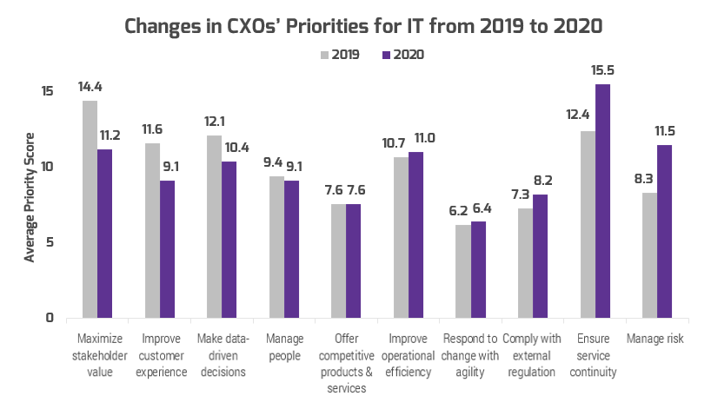
Rebuild trust in IT with a work-from-anywhere strategy
Balance short-term survival with near-term business enablement
Remote work is threatening to undo years of trust. CXOs are focused on service continuity and risk management, and many IT departments are failing to meet expectations.
IT is getting pushed out of important conversations. CXOs want IT to focus on service continuity and risk management, not stakeholder value and customer experiences.
Rebuild trust by helping the business survive. Once you have addressed the basics of collaboration tools and remote access, focus on improving how the business operates.
Work-from-anywhere is an opportunity for IT to show direct value to employee empowerment.
You can architect the new way your company works.
Source: Info-Tech Research Group, CEO-CIO Alignment Program, 2020; N=339 (218 CXOs and 121 CIOs)

Slide 7









Maximize the benefits of remote work
Benefits to the organization
Benefits to employees
Operational continuity in disaster situations that prevent employees from coming into the office.
Cost savings: employees who WFH half the time can save $2,500-$4,000 per year (Global Workplace Analytics, 2020).
Cost savings: organizations save ~$11,000 annually per employee working from home half the time (Global Workplace Analytics, 2020).
Time savings: employees who WFH half the time save on average 11 workdays per year (Global Workplace Analytics, 2020).
Increased attraction: 71% of employees would likely choose one employer over another based on work-from-home (WFH) offerings (Owl Labs, 2019).
Improved wellbeing:
83% employees agree that WFH would make them happier.
80% agree that WFH would decrease their stress.
81% agree that WFH would improve their ability to manage their work-life balance.
Increased retention: 74% of employees would be less likely to leave their employer if they could WFH (Owl Labs, 2019).
(Owl Labs, 2019)
Increased productivity: 50% of employees report they would maintain or increase their productivity while working from home (Glassdoor, 2020).
Increased flexibility: 32% of employees rated the “ability to have a flexible schedule” as the biggest benefit of WFH (Buffer & AngelList, 2020).
Increased engagement: offsite employees tend to have higher overall engagement than onsite employees (McLean & Company Engagement Survey, 2020).

Slide 8



Ensure the strategy also address remote work’s unique challenges
ORGANIZATIONS
LEADERS
EMPLOYEES
Concerns that WFH may stifle innovation (The Economist, 2020) are likely due to the potential lack of collaboration and knowledge sharing.
Fewer organic opportunities for informal interaction between employees working from home means active efforts are required to foster organizational culture.
42% of managers believe that monitoring the productivity of their direct reports is a top challenge of WFH (Ultimate Software, 2019).
The lack of in-person supervision compounded with a lack of trust in employees leads many leaders to believe that WFH will result in a drop in productivity.
20% of employees report collaboration/communication as their top struggle with WFH (Buffer & AngelList, 2020).
Employees often experience burnout from working longer hours due to the lack of commute, blurring of work and home life, and the perceived need to prove their productivity.
Many of these barriers can be addressed by changing traditional mindsets and finding alternative ways of working, but the traditional approach to work is so entrenched that it has been hard to make the shift.

Slide 9

Employee engagement initiatives must be included in your strategy
Employee disengagement is a huge risk
during this pandemic…
…and employee engagement may determine how the organization recovers.
Organizations with high levels of engagement are expected to exceed organizational performance over those with lower levels of engagement.
54%
Only 54% of employees strongly agree that they feel well
prepared to do their job during this pandemic (Gallup, 2020).
Organizations Expecting Increased Engagement
As uncertainty grows and layoffs occur, employees who remain may experience survivor’s guilt. Studies show that this may cause:
Increased absenteeism
Increased fear of being let go
Decreased morale
Reduced job motivation
Reduced organizational commitment
Decreased employee engagement
Reduced speed of decision making
Decreased productivity
Underperforming
Exceeding
Organizational Performance
McLean & Company, HR Trends 2019; N=501
During the 2008 recession, organizations with engaged, enabled, and energized employees experienced increased average annual operating margins of 27.4%.
27%
3x
higher than organizations with low engagement (The Culture Works, 2019).
(Institute for Employment Studies, 2004; SSRN Electronic Journal, 2010)
Organizations who want to maintain their long-term viability must focus on sustaining and boosting employee engagement.

Slide 10




Enable work-from-anywhere
Go beyond remote working
Help the business survive – not just in today’s normal, but in the next normal.
Support users when they need to work. With home and work collapsed together, people need to shift their focus between loved ones and work throughout the day. Ensure they can get IT services after hours.
Support users where they need to work. The COVID-19 crisis has caused people to have to support friends and loved ones. Ensure employees can be productive from anywhere, even outside of their home office.
Support users how they need to work. Most teams were not remote-only before 2020, and people have had to change how they work to adapt. Don’t build a strategy to support a way of working that no longer exists.

Slide 11
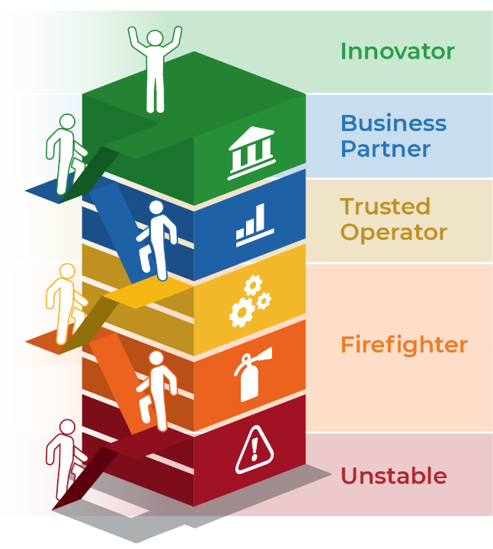

Info-Tech’s approach
The Info-Tech difference:
Before you start climbing, identify what the CEO and end users need out of work-from-anywhere
Get the basics implemented first. Don’t focus on becoming an innovator until you are no longer stuck in firefighting.
Focus on value. Review how major applications and IT capabilities can relieve employees’ pains and provide employees with gains.
Take an Agile approach and provide early value. Address short-term survivability while working toward near-term innovation.
Prepare the enterprise for the next normal
Prepare IT for the next normal
Proactively improve work-from-anywhere
Stop struggling with remote IT operations
Start supporting employees’ new normal
Build the foundations for remote work
Download the Work-From-Anywhere Capability Assessment to identify where you are starting your climb.

Slide 12
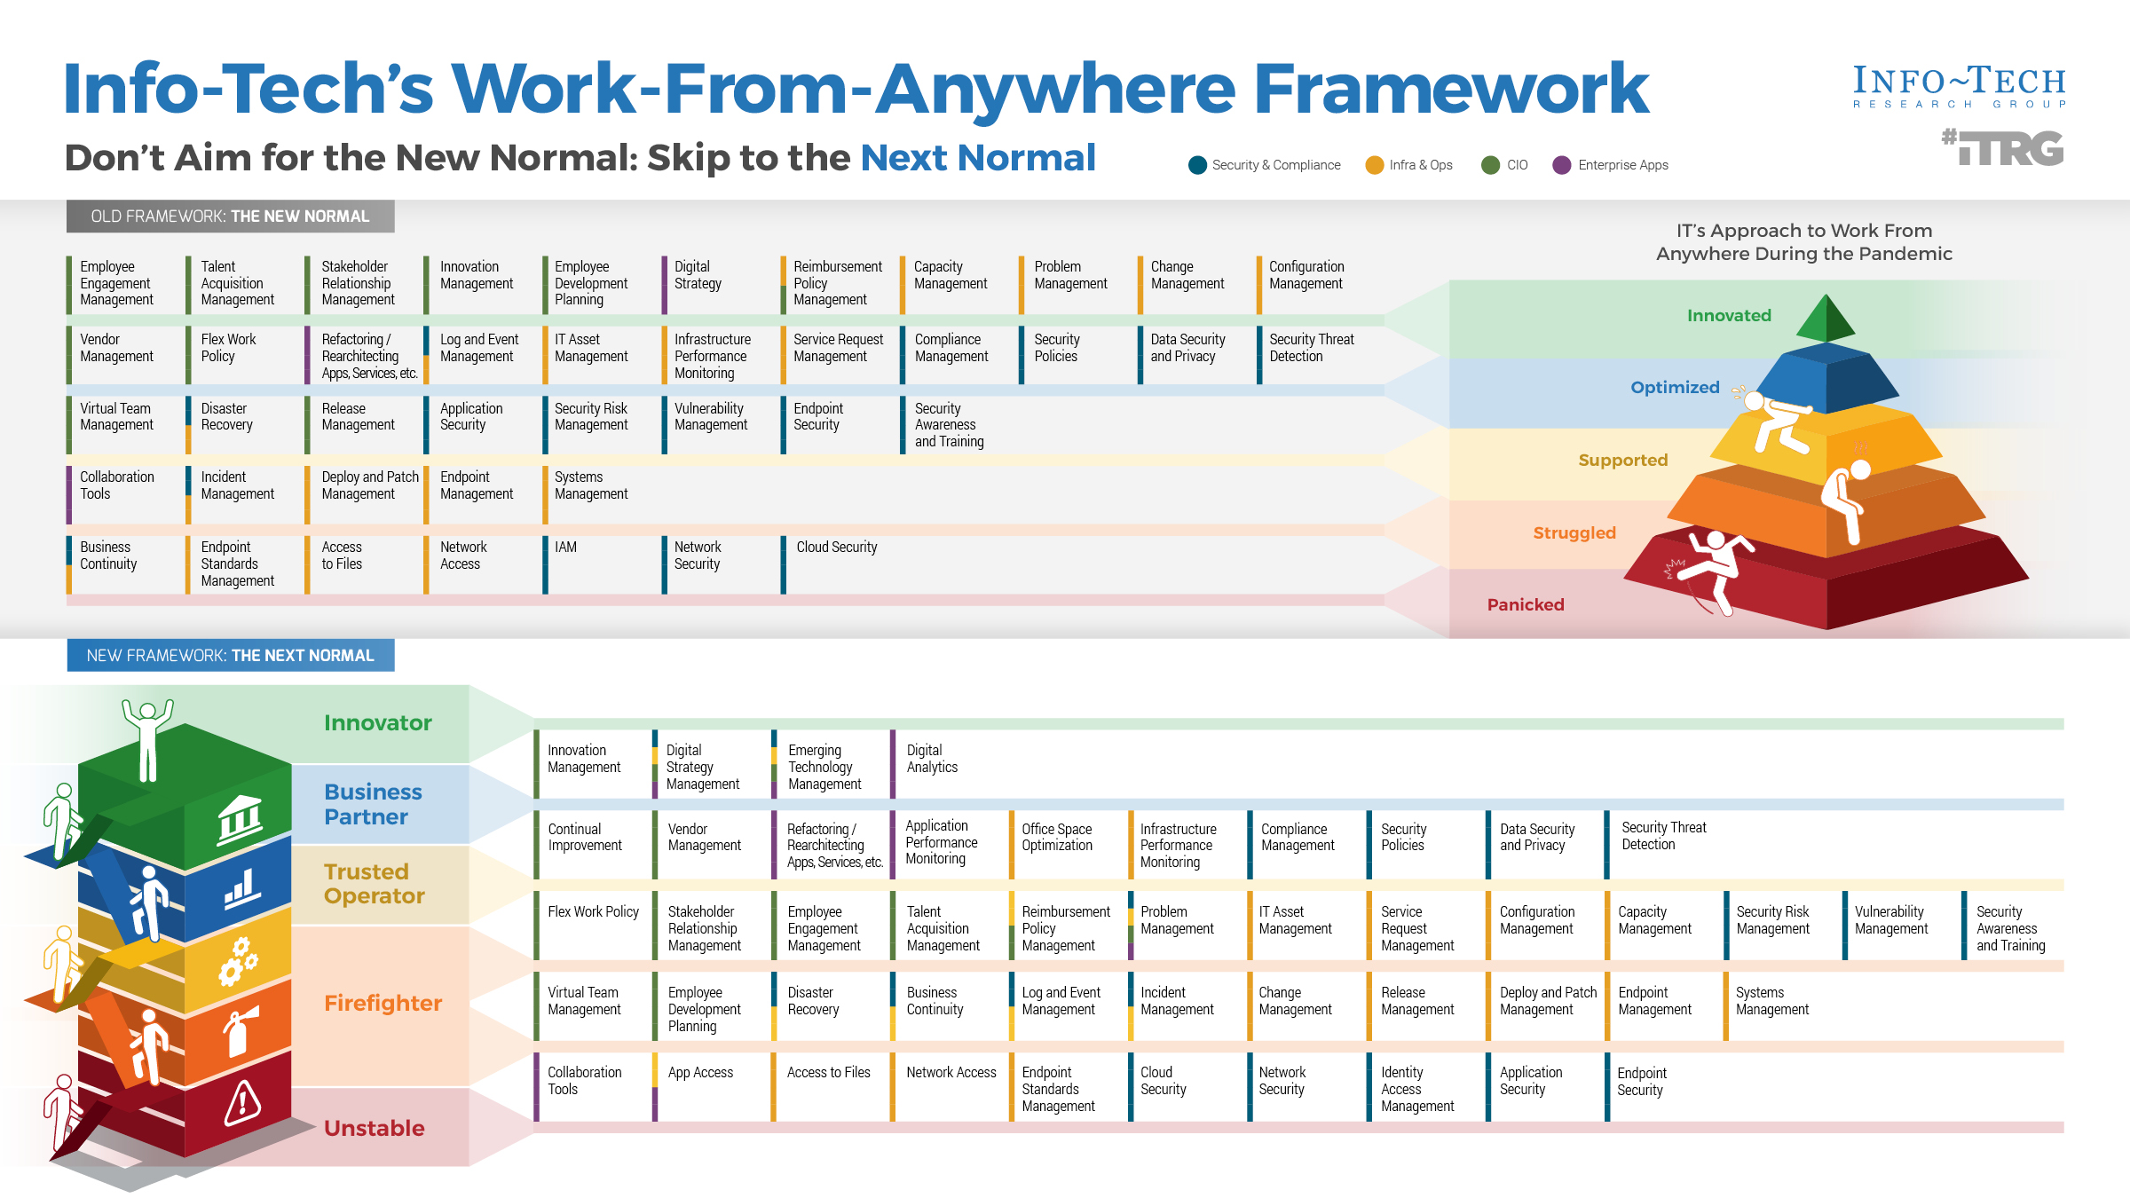

Slide 13
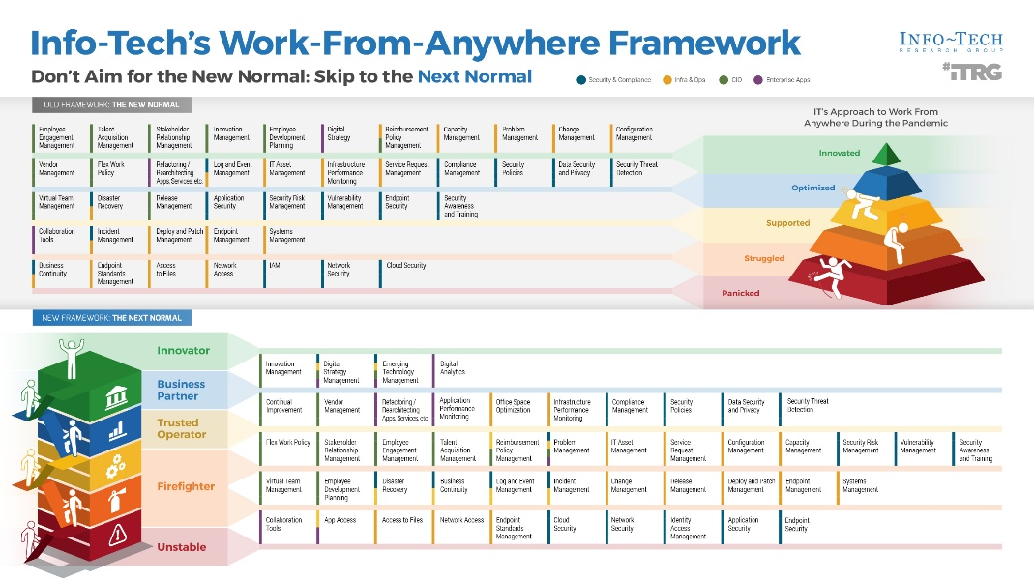
Navigate Info-Tech’s work-from-anywhere research portfolio
Answers to some frequently asked questions
Where do I start?
  Download the Work-From-Anywhere Capability Assessment
What direction should my work-from-anywhere project take?
  Step 1.1: Success metrics
How do I prioritize the work that I have to do?
  Step 1.2: Value proposition design
How do I benchmark my performance?
  Phase 2: Benchmark your performance
Where can I find research on specific work-from-anywhere topics?
  Step 3.1: List of Info-Tech research
Talk to our analysts about any of these questions by booking a call through our website or your account representative.

Slide 14
Info-Tech’s methodology for creating a work-from-anywhere strategy
 | 1. Define a Target State | 2. Analyze Current Fitness | 3. Build the Roadmap
Phase Steps | Identify business-aligned benefits, goals, and vision Build IT’s work-from-anywhere value proposition | Perform a retrospective of your current work-from-anywhere capabilities Benchmark your current fitness | Identify improvement initiatives in each domain Place initiatives on a roadmap
Phase Outcomes | Critical success factors and key performance indicators Vision statement Mission statement Value proposition for work-from-anywhere | Work-From-Anywhere Capability Assessment results Diagnostic results on IT and application satisfaction | Short list of improvement initiatives Dependencies and risks Scope for a proof-of-concept Phased implementation plan

Slide 15
Insight summary
It’s not about embracing the new normal; it’s about resiliency and long-term success
Your strategy needs to not only provide short-term operational value but also make the organization more resilient for the unknown risks of tomorrow.
The nature of work has fundamentally changed
IT departments must ensure service continuity, not for how the company worked in 2019, but for how the company is working now and will be working tomorrow.
Ensure short-term survival
Don’t focus on becoming an innovator until you are no longer stuck in firefighting.
Aim for near-term innovation
Once you’re a trusted operator, become a business partner by helping the business better adapt business processes and operations to work from anywhere.
Base your decisions in senior leadership and user needs
Just as the business rebuilt their processes to survive remote work, so, too, have workers. If they are asking for services after hours or in multiple locations, it’s because that’s what they need to do for familial and other obligations.
Provide early value and plan to iterate
Build a short-term plan that allows you to iterate on your existing strengths and provide early value to your users.

Slide 16



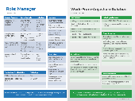
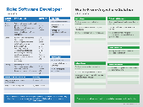
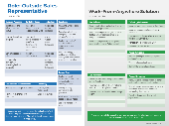
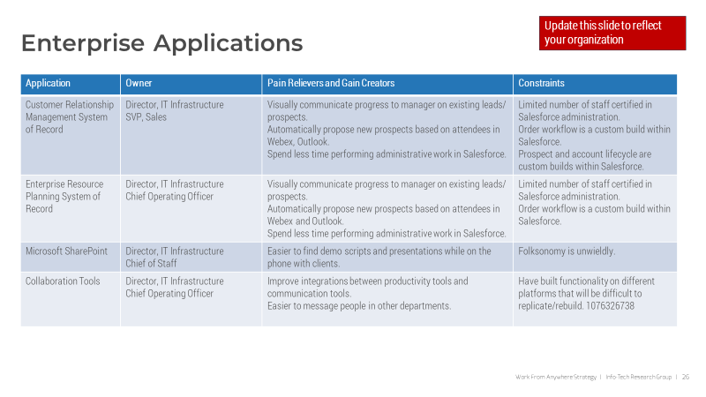
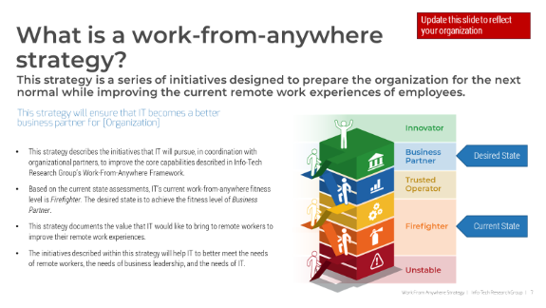

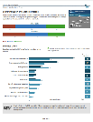
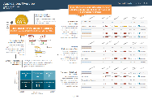
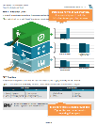
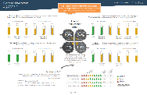
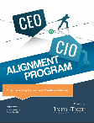
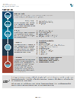

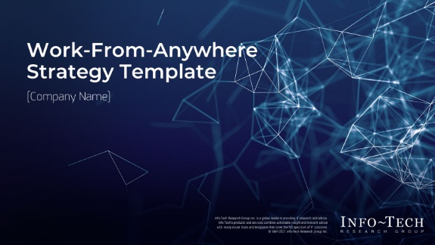
Blueprint deliverables
Key deliverable:
Each step of this blueprint is accompanied by supporting deliverables to help you accomplish your goals:
  Work-From-Anywhere Strategy Template
This strategy template will help you quickly build an effective approach to improve remote work.
  Sample Value Propositions
  Work-From-Anywhere Capability Assessment
Analyze user needs to ensure that your digital workspace provides real user value.
Benchmark your current fitness and identify your starting point.
  CEO-CIO Alignment Report
  End User Satisfaction and Application Portfolio Assessment Report
Ensure you are satisfying your most important stakeholder – the CEO.
Find out what users really think about IT and the apps they use.

Slide 17
Blueprint benefits
IT Benefits | Business Benefits
Adapt IT services to the fundamentally new needs of a remote workforce. Initiatives that are prioritized for short-term gains and long-term business value. Improve the business’s confidence in IT’s capability to support remote workers. Easier communication of the strategy to the business. Improved service continuity and risk management. | A more resilient and engaged workforce. A technology toolset that is more effective for remote workers. Improved strategy and leadership for remote workers.

Slide 18
Measure the value of this blueprint
Track the value as you create a more resilient workforce
In phase 1 of this blueprint, we will help you establish SMART success metrics (such as these) that are relevant to your stakeholders.
Base these metrics on the business goals most important to your stakeholders.
% of deployed devices that are centrally managed
% of bring your own devices (BYODs) that meet security standards
% of deployed devices that have been discovered
# of customer services that are supported by work-from-anywhere strategy
Trends in revenue by division
Output volume, month over month
% of business processes that can be performed remotely
% of tier 1 and tier 2 business processes that can be performed remotely
Average cost of each online self-service transaction
% revenue from online transactions versus in-store transactions

Slide 20

Guided Implementation
A Guided Implementation (GI) is a series
of calls with an Info-Tech analyst to help implement our best practices in your organization.
A typical GI is between eight to twelve calls over the course of four to six months.
What does a typical GI on this topic look like?
Phase 1
Phase 2
Phase 3
Call #1: Assess current work-from-anywhere fitness and objectives.
Call #3: Assess current fitness and satisfaction.
Call #5: Identify the strategy’s scope.
Call #6: Create initiative profiles.
Call #2: Design IT’s value proposition for work-from-anywhere.
Call #4: Review your fitness results.
Call #8: Identify and prioritize improvements.
Call #9: Summarize results and plan next steps.
Info-Tech Research Group | 20

Slide 21
Workshop Overview
Contact your account representative for more information.
workshops@infotech.com 1-888-670-8889
 | Day 1 | Day 2 & 3 | Day 4 | Day 5
Activities | Craft a Vision | Review Work-From-Anywhere Capabilities | Build the Roadmap | Next Steps and Wrap-Up (offsite)
 | 1.1 Identify drivers, benefits, and challenges. 1.2 Perform a goals cascade to align benefits to business needs. 1.3 Define a vision and success metrics for work-from-anywhere. 1.4 Define the value that IT brings to work-from-anywhere. | 2.1 Review work-from-anywhere framework and identify capability gaps. 2.2 Review diagnostic results to identify satisfaction gaps. 2.3 Record improvement opportunities for each capability. 2.4 Identify deliverables and opportunities to provide value for each. 2.5 Identify constraints faced by each capability. | 3.1 Prioritize initiatives and identify dependencies. 3.2 Organize initiatives into phases. 3.3 Estimate effort with Scrum Poker. 3.4 Build a timeline and tie phases to desired business benefits. | 5.1 Complete in-progress deliverables from the previous four days. 5.2 Set up review time for workshop deliverables and to discuss next steps.
Deliverables | Desired benefits Vision statement, mission statement, and guiding principles Success metrics Value propositions for in-scope user groups | SWOT assessment of work-from-anywhere capabilities Projects and initiatives to improve capabilities Deliverables and opportunities to provide value for each capability Constraints with each capability | Prioritized list of initiatives and phases | Completed Work-From-Anywhere Strategy Template Work-From-Anywhere Roadmap

