Slide 1
Implement and Mature Your Experience Design Practice
Better design leads to better organizational performance.
EXECUTIVE BRIEF

Slide 2
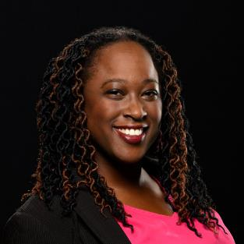
Analyst
Perspective
Know thy user.
To create a better product, solution, or service, you need to understand those who use it, their needs, and their context.
Do your research, design with their needs in mind, and validate. Then wash, rinse, and repeat.
It might feel like your business goals oppose the needs of your users. That shouldn’t be the case. A great experience design practice can help you balance those goals so that they are in harmony with those of your users, which will elevate your organization even higher.
Allison Straker
Research Director, Applications
Info-Tech Research Group

Slide 3
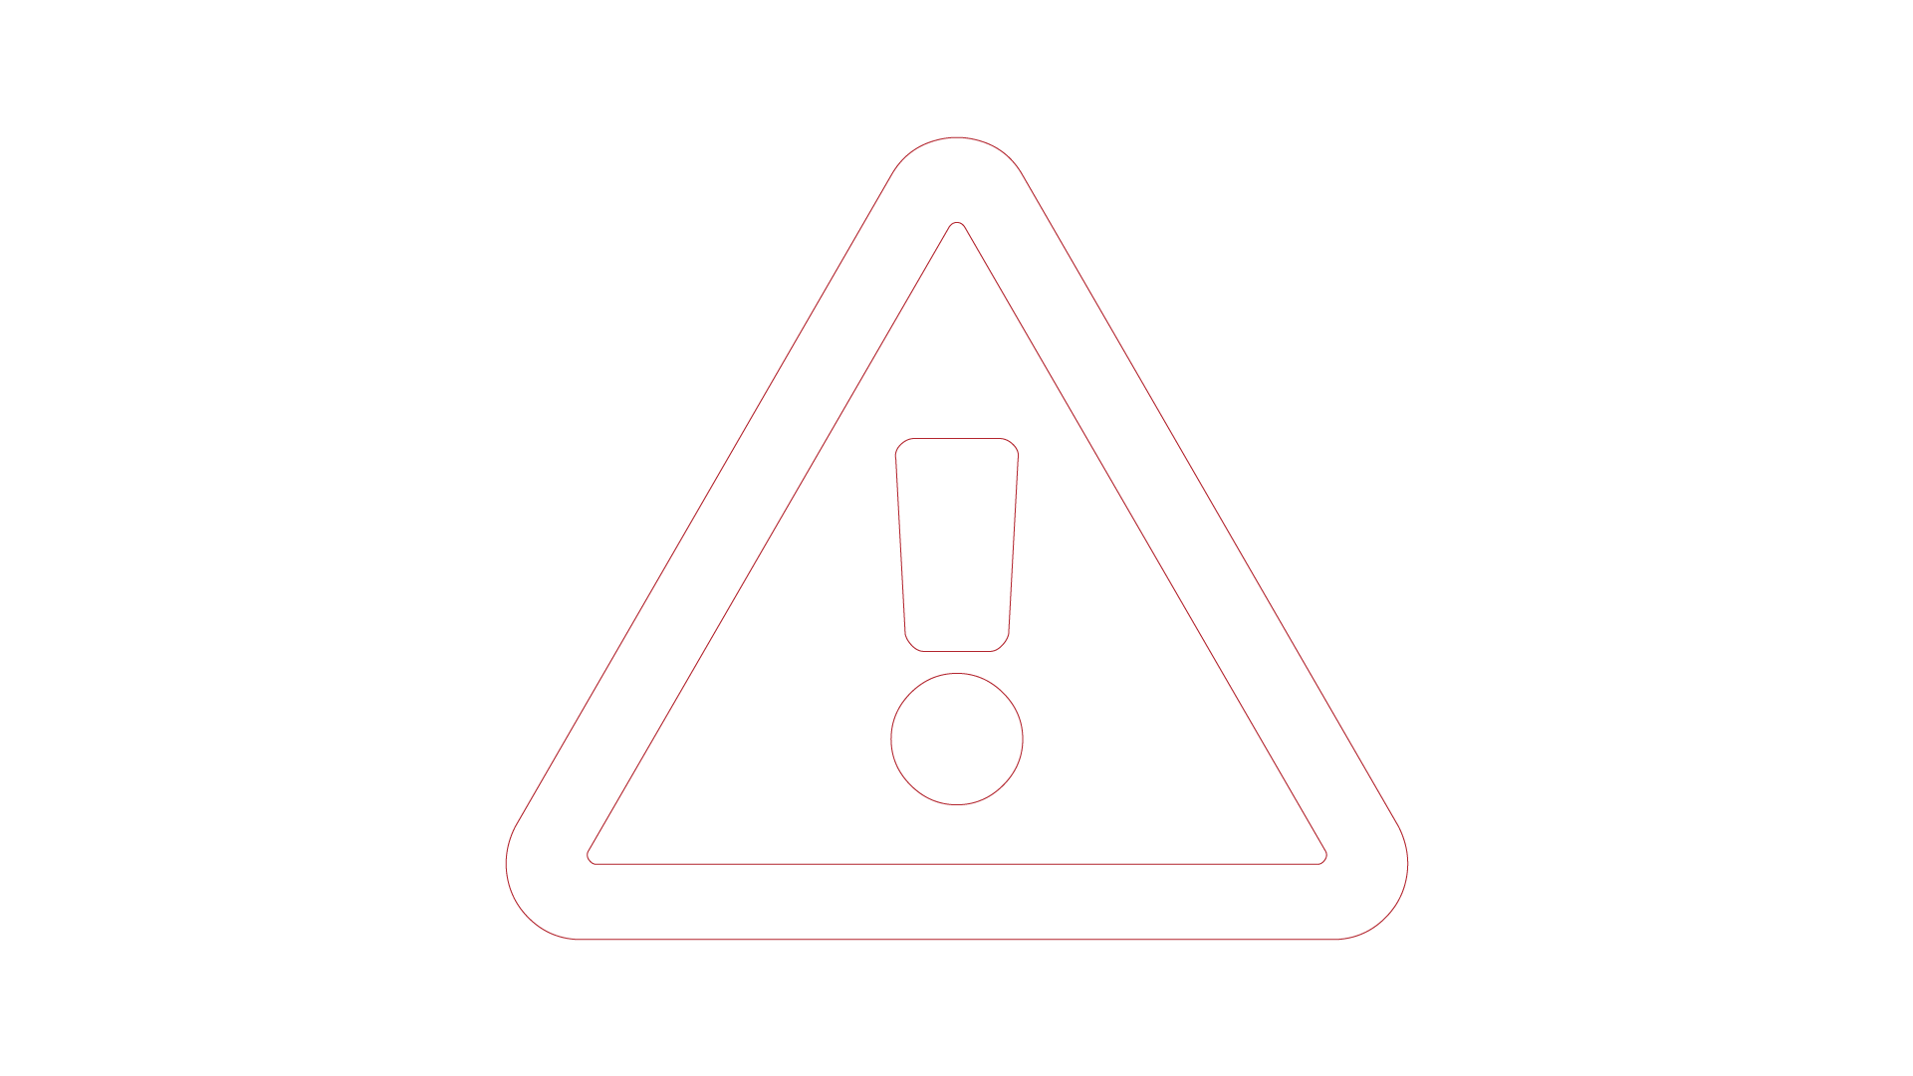

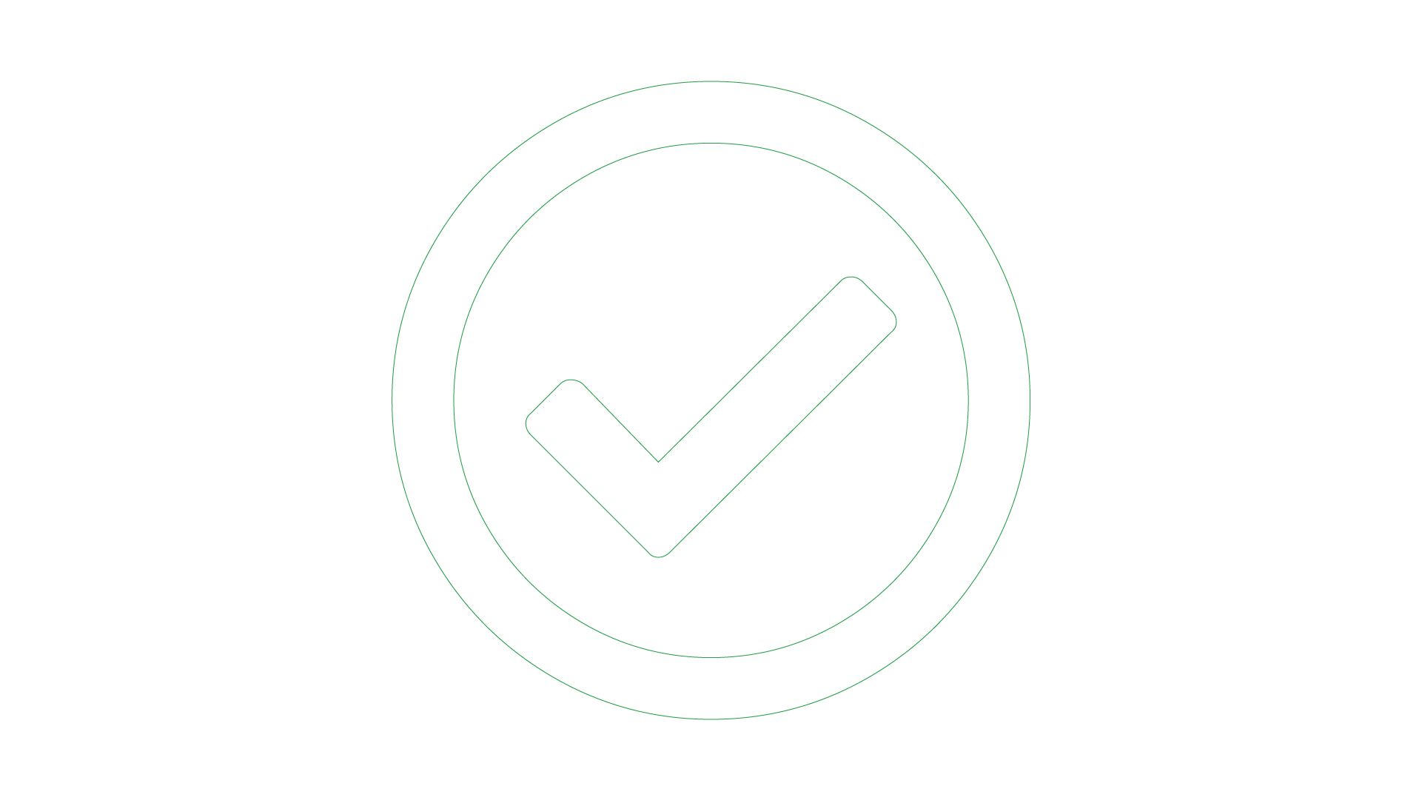
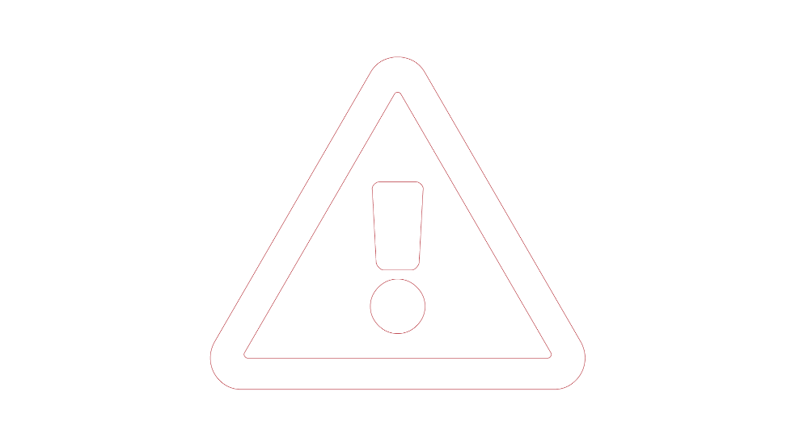

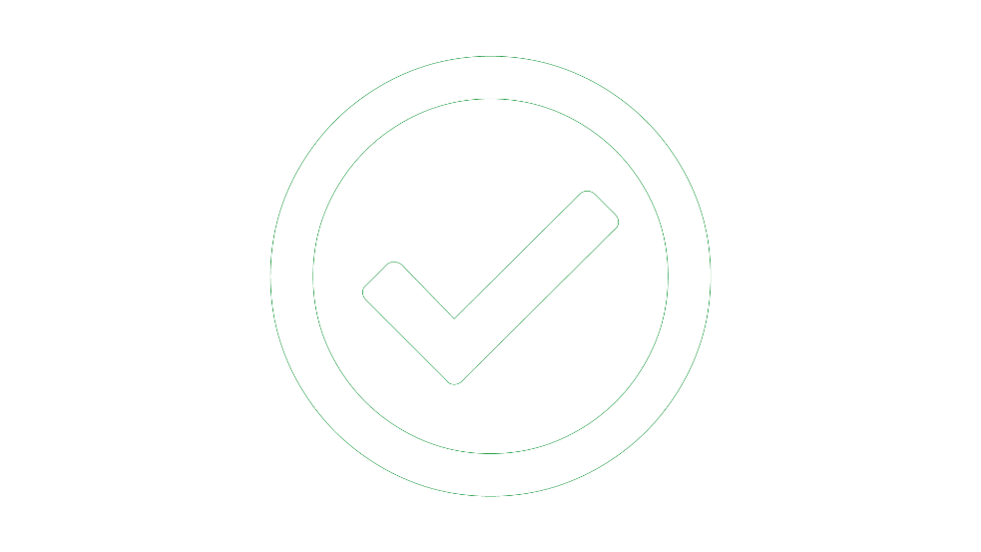
Executive Summary
Your Challenge
Common Obstacles
Info-Tech’s Approach
Many organizations want to get to market quickly and on budget but don’t know the steps to get the right product/service to satisfy users and the business.
This may be made apparent through:
Uninformed decisions leading to lack of adoption of your product or service
Rework due to post-implementation user feedback
The competition releases new products that outshine yours
Too many companies still aren’t talking to their end users during development and aren’t clear on how to improve.
Lack of clarity on the problems to be addressed
Lack of resources who can understand the issues
The organization does not understand how design can help
Unsure how to move beyond solving problems to understanding what people who use the system are trying to achieve
Create a practice that is focused on human outcomes that starts and ends with the people you are designing for:
Establish a practice with a common vision
Enhance the practice through four design dimensions
Communicate a roadmap to improve your business through design
The practice will help create solutions focused on the needs of users, customers, and stakeholders.
Info-Tech Insight
Ensure your practice has a clear understanding of the design problem space – not just the solution. An understanding of the user is critical to this.

Slide 4
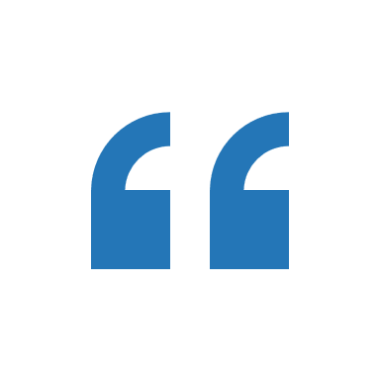
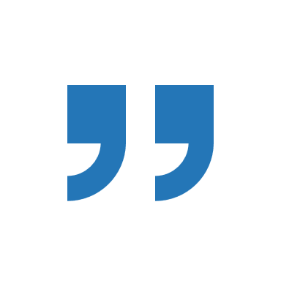
What is the term “UX”?
It’s everything that touches upon your experience with the product. […]
Today that term has been horribly misused. It is used by people to say, ‘I’m a user experience designer, I design websites,’ or ‘I design apps.’ […] and they think the experience is that simple device, the website, or the app, or who knows what.
No! It’s everything – it’s the way you experience the world; it’s the way you experience your life; it’s the way you experience the service. Or, yeah, an app or a computer system. But it’s a system that’s everything.
— Don Norman, pioneer and inventor of the term “user experience,” in an interview with NNGroup

Slide 5

Empathy is at the heart of design
And yet it is hard for many organizations to achieve it:
Despite their best efforts, short courses cannot really teach empathy.
Staff are often not skilled in how to understand their users.
End users are often very different from the team creating the product/service – lack of inclusivity makes it more challenging to create something
that will resonate
with users.

Slide 6
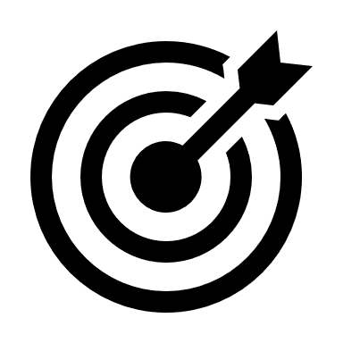
Design Objectives
Can be performed with any SDLC methodology.
Interdisciplinary approach is reflected in the multitude of techniques and outcomes – including persona development, wireframes, information architecture, branding, customer satisfaction, finance (via cost reductions and profitability), and productivity.
Achieve excellence through needs, expertise, empathy, and partnership.
NEEDS
EXPERTISE
Align with business needs
Apply human factors & design principles
EMPATHY
PARTNERSHIP
Understand the end-user
Collaborate with the development team

Slide 7


Info-Tech’s approach
The Info-Tech difference:
Design maturity balances design, business, and delivery.
Focused to help you grow the design practice, not just assess it
Helps you to have design conversations with leadership that might not have experience or an in-depth appreciation of design
BUSINESS
Organizational Alignment
Business Outcomes
DELIVERY
Info-Tech’s approach to maturity leverages learnings from several organizations and maturity models established in the industry.
Design Perspective
Design Integration
DESIGN UNDERSTANDING

Slide 8
Why design adds to the bottom line
Design-Centric Companies including:
71% of organizations that practice design thinking report it has improved their working culture on a team level.
(Parsons School of Design)
Apple
Coca-Cola
Ford
Herman-Miller
IBM
Intuit
Nike
Procter & Gamble
SAP
Starbucks
Design-led organizations vastly outperform others
  The Design Management Institute (DMI) compared S&P 500 companies and found that those that were design centric were over 200% more profitable
  More recent studies by McKinsey (2018) and InVision (2018) supported these findings.
Companies that foster creativity enjoy 1.5 times greater market share.
(Adobe Blog, 2015)
Other S&P 500 Companies
+ 211%
Source: Design Management Institute.

Slide 9
Experience design is effective regardless of your industry
McKinsey Design Index (MDI) scores show the difference between top quartile organizations and their industry peers.
Design-focused organizations continue to outperform others regardless of industry.
McKinsey’s study (2018) looked at three industries: medical technology, consumer goods, and retail banking. Their findings showed design’s effectiveness across these industries.
Whether your organization produces physical or digital products, services, or a combination of these, you can benefit from a mature design practice.
Source: McKinsey.

Slide 10

Your SDLC will benefit from effective UX
If a dollar was spent on an issue discovered during design…
It would cost $10 to resolve it during development…
And over $100 if it had to be resolved after deployment.
(Pressman)

Slide 11
Usability improves organizational performance
Info-Tech’s research shows that high-performing organizations tend to have applications that are more usable and have more user-focused features than more challenged organizations do.
Usability is critical not just for customer-facing products, but for internal applications as well.
1.7% more satisfied
Rapid growth companies
Our research shows that performance and usability of even internal applications are correlated.
Employees can perform better when not bogged down with clunky interfaces; they can focus on being more efficient and productive.
Steady performers
4.6% more satisfied
69.1%
67.4%
Satisfaction with the usability of the application suite
Challenging/ in-decline companies
62.8%
Info-Tech, 2020; N=86 organizations that completed both the APA and M&G diagnostics

Slide 12

What kind of design are we talking about?
Various layers must be considered
User
Interface
User Interface (UI): This could refer to the specifics of one interface – for example, a web page.
System/Product: More holistic than the UI, this could include a website.
Overall Experience: This includes how a person interacts with the various touchpoints related to the organization. This could include the website, in-person channels, and any other interactions with your organization or brand.
System/Product
Overall Experience
Note: All layers are important. Ensure you include these in your practice.

Slide 13

User flows generate results – Executive Brief Case Study
INDUSTRY
SOURCE
Software
Interview
“Get your users' feedback throughout the design process: from the early stages until after launch. It's the best way to make sure that your solution addresses their pain points.”
– Aimilia Tzanavari, UX Manager, proto.io
Proto.io
Proto.io’s design process has a strong emphasis on user research and communication:
Proto.io is a startup company with a strong focus on design and UX. It’s behind the popular web-based prototyping platform, Proto.io, used by thousands of users worldwide.
The User Experience team conducts user research to better understand user needs and to constantly improve the Proto.io platform. One of the techniques used by the team is user flow diagramming. User flows help visualize, communicate, and validate user paths, which would otherwise be a challenge to validate.
Persona Development
User Surveys
User Interviews
User Flow Diagrams
Results
Prototyping
The Proto.io team used this to analyze the Cancel Subscription process. The proposed user flows were communicated with stakeholders through an interactive presentation, and a link was shared for them to record their feedback.
After implementing changes to the cancellation flow based on the feedback, users were better informed about what a cancellation entailed. The changes resulted in a decline in the number of cancellations.
User Testing

Slide 14
Info-Tech’s methodology to Implement and Mature Your User Experience Design Practice
 | 1. Build the Foundation | 2. Review the Design Dimensions | 3. Build Your Roadmap and Communications
Phase Steps | Goals Identification Vision Generation Develop Mission Statement | Organizational Alignment Business Outcomes Design Perspective Design Integration | Structure the Practice Develop the Roadmap Communicate to Stakeholders
Phase Outcomes | Establish the vision and mission statements that will help to communicate the purpose for the practice and motivate the organization. | Examine the aspects of the design practice that will move your organization higher in maturity. | A structured plan that can be discussed with stakeholders communicating the desired changes over time.

Slide 15


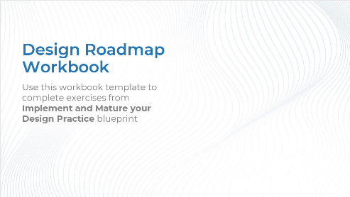
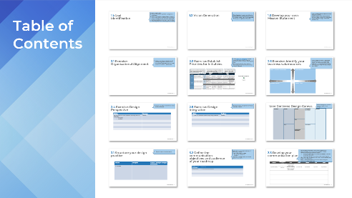
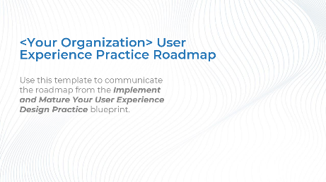
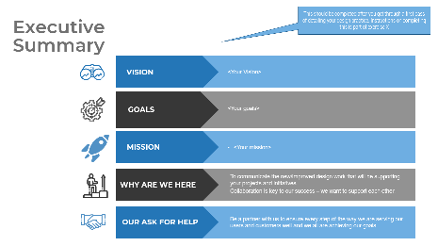
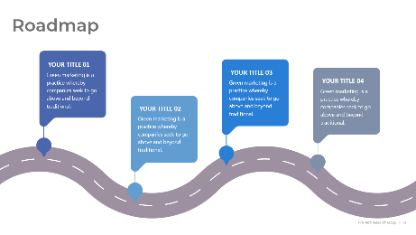
Blueprint deliverables
Key deliverable:
Each step of this blueprint is accompanied by supporting deliverables to help you accomplish your goals:
  User Experience Practice Roadmap
Create your roadmap to communicate the path to your design practice
  Design Roadmap Workbook
Record the results from the exercises to help you define, detail, and make your design practice vision a reality.

Slide 17

Guided Implementation
A Guided Implementation (GI) is series of calls with an Info-Tech analyst to help implement our best practices in your organization.
A typical GI is between eight to twelve calls over the course of four to six months.
What does a typical GI on this topic look like?
Phase 3
Phase 1
Phase 2
Call #1: Scope requirements, objectives, and your specific challenges.
Call #2: Identify goals – what the organization is trying to achieve through the practice.
Call #4: Examine business-oriented design dimensions.
Call #6: Discuss structure of the practice.
Call #3: Create vision and mission statements.
Call #5: Examine scope and integration factors.
Call #7: Identify roadmap initiatives.
Call #8: Summarize results and plan communication.
Info-Tech Research Group | 17

Slide 18
Workshop Overview
Contact your account representative for more information.
workshops@infotech.com 1-888-670-8889
 | Day 1 | Day 2 | Day 3 | Day 4 | Day 5
Activities | Answer “So What?” | Examine Design Dimensions | Create Structure and Initiatives | Roadmap and Communications | Next Steps and Wrap-Up (offsite)
 | 1.1 Define design practice goals. 1.2 Generate the vision statement 1.3 Develop the mission statement | 2.1 Examine organizational alignment 2.2 Establish priorities for initiatives 2.3 Identify business value sources 2.4 Identify design perspective. 2.5 Brainstorm design integration 2.6 UCD-Canvas | 3.1 Structure your Design Practice | 4.1 Define the communications objectives and audience for your roadmap 4.2 Develop your communication plan 4.3 Sponsor check-in | 5.1 Complete in-progress deliverables from previous four days 5.2 Set up review time for workshop deliverables and to discuss next steps
Deliverables | Design vision statement Design mission statement Design goals | Documented initiatives for design maturity Design canvas framework | Design Practice structure with patterns | Communication Plan and Roadmap | Completed Design Practice Roadmap

