Slide 1
Threat Landscape Briefing
Welcome to our team.
March 2021

Slide 2
Agenda
Introduction
Microsoft Exchange Zero-Day Vulnerability Exploited
Patch Exchange Now!
Hackers Exploit the Unpatched Accellion File Transfer Appliance to Breach Multiple Enterprises
Rapid response and transparency may have prevented the worst.
Phishing Scams Leverage COVID-19 Vaccine Rollout
Organizations should inform users about potential vaccine-related phishing scams.

Slide 3
Microsoft Exchange Zero-Day Vulnerability Exploited
Patch Exchange Now!
What
Who
Where
Why
Zero-day vulnerability being exploited for MS Exchange Server 2013, 2016, 2019
Hafnium hacking group suspected initially (believed to be state sponsored)
At least ten additional APTs
State and local governments
Policy think tanks
Academic institutions
Infectious disease researchers
Businesses
Defense contractors
Global, but especially:
USA
Italy
Turkey
Germany
Brazil
Netherlands
Access to email accounts
Ransomware deployment
Logan Rohde
Research Analyst
Source: ZDNet; CNN

Slide 4
Microsoft Exchange Zero-Day Vulnerability Exploited
If you haven’t already, patch your Exchange servers and use Microsoft’s additional tool to help you discover if anything else is amiss on your network.
This attack caught everyone off guard. However, if you found it difficult to address the problem immediately, this could be a sign that your vulnerability management program could use some improvement. We can’t predict when the next zero day will be discovered, but we can take steps to ensure our governance and management allow us to react as fast as possible to minimize risk. The fact that these APT groups are taking advantage of slow responses should not go unnoticed.
Source: ZDNet; CNN
Logan Rohde
Research Analyst

Slide 5
Hackers Exploit the Unpatched Accellion File Transfer Appliance to Breach Multiple Enterprises
In mid-December 2020, Accellion had patched a SQL injection vulnerability in FTA and notified its customers. At the same time, an APT began exploiting the vulnerabilities to install a malicious web shell that extracted lists of files and the metadata of those files from FTA’s MySQL database.
Cybersecurity agencies from five countries issued a warning of hackers using the vulnerability to steal data and execute ransomware. Qualys becomes the latest enterprise to be breached in a long list of affected enterprises including but not limited to:
The Reserve Bank of New Zealand
ASIC, Australia’s Financial Regulator
The Office of the Washington State Auditor
Bombardier
Updating Accellion FTA to version FTA_9_12_432 will mitigate most of the risks associated with using Accellion. If you are unable to update your systems, isolating access to the internet from systems that are hosting the software is a viable alternative. Because Accellion is moving to the end of its lifecycle on April 30, 2021, the long-lasting effects of these breaches will diminish; however, enterprises should seek to migrate to newer products in the meantime.
Related CVE Flaws:
CVE-2021-2701
CVE-2021-27102
CVE-2021-27103
CVE-2021-27104
Isaac Kinsella
Research Specialist
Sources: Cybersecurity Agencies Warn of Accellion Vulnerability Exploits,
Extortion Gang Breaches Cybersecurity Firm Qualys Using Accellion Exploit

Slide 6
Rapid Response and Transparency May Have Prevented the Worst
Honesty may be the best policy.
Although the series of breaches from the Accellion FTA vulnerability has been steady in terms of the number of affected enterprises, the overall efficacy of the attacks has been quite limited. According to Accellion, “fewer than 100 customers have been attacked as a result of four now-patched FTA vulnerabilities and […] fewer than 25 ‘appear to have suffered significant data theft.’” In part, this is due to Accellion’s transparency with the vulnerability and reporting it quickly to affected customers – even urging them to move away from FTA.
Transparency in attacks like these can be critical to effectively mitigating not only the number of affected enterprises but also the degree to which they may have been breached. Presumably, because of Accellion’s disclosure to its affected customers in December, the adverse effects of the breach were limited. Thankfully, in almost all cases, any of the unauthorized access was locked specifically to the FTA services and seems to have left services and access to customer data unaffected. However, even with early warning and disclosure, ultimately, it is still up to the enterprises using Accellion FTA to either partition the affected devices hosting it or migrate away from it altogether. People will always be the “X” factor in breaches and the actions they choose to take will impact the enterprise. Stay aware of what is happening in the news and remediate accordingly to what is feasible to you.
Because Accellion is already close to its end of life, enterprises will undoubtedly be looking to shift away from the service to something more modern. Thankfully, this means that enterprises who may remain unaware of the potential breaches they could incur will have Accellion on their radar as something to update.
Isaac Kinsella
Research Specialist
Sources: Cybersecurity Agencies Warn of Accellion Vulnerability Exploits,
Extortion Gang Breaches Cybersecurity Firm Qualys Using Accellion Exploit

Slide 7
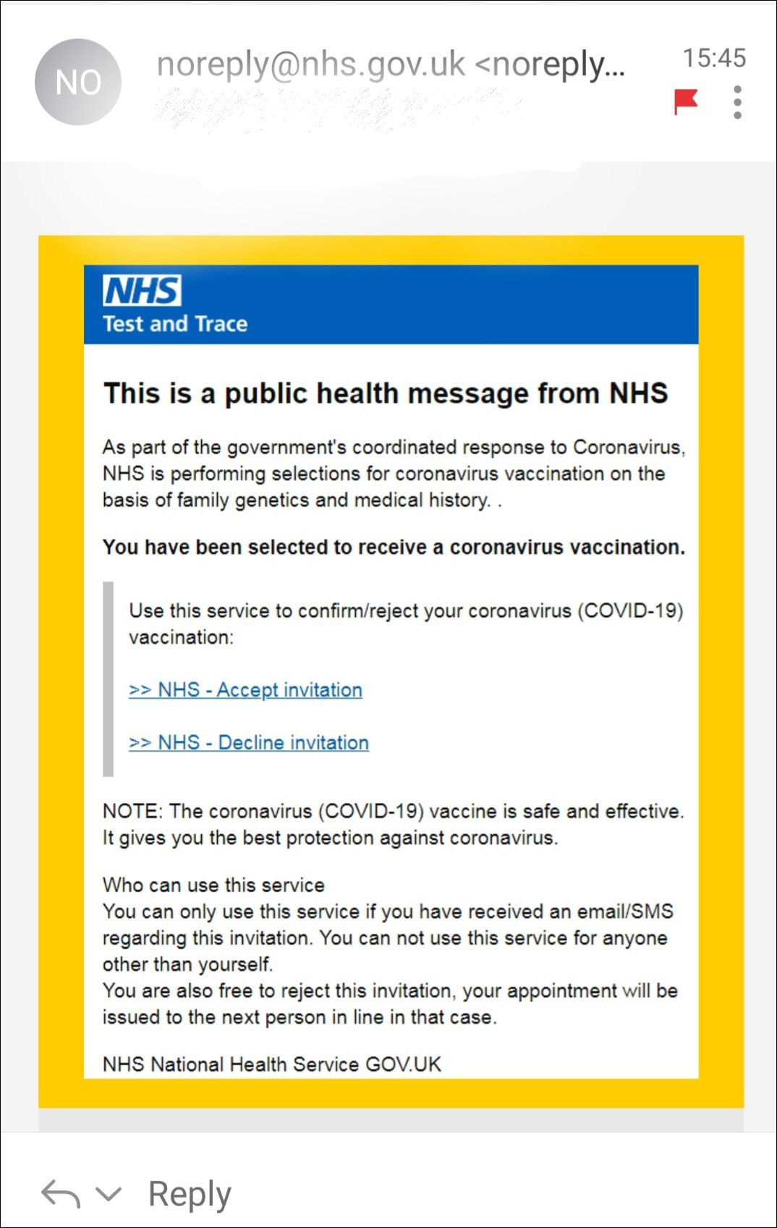
Phishing Scams Leverage COVID-19 Vaccine Rollout
Organizations should inform users about potential vaccine-related phishing scams
The threat:
Phishing attacks tend to take advantage of real-world events.
Today, one of those big events is the rollout of the COVID-19 vaccine around the world.
Organizations have already begun to see social engineering attacks related to this event.
Some of these phishing attacks appear to come from real health organizations, such as the World Health Organization or local organizations responsible for vaccine rollouts.
Image Source: Secure World Expo
A vaccine-related phishing scam sent to Twitter users earlier this year.
Ian Mulholland
Senior Research Analyst
Source: BBC News, National Post, IT World Canada, Secure World Expo

Slide 8
Phishing Scams Leverage COVID-19 Vaccine Rollout
Organizations should inform users about potential vaccine-related phishing scams.
While the organizations being spoofed can make public statements warning people that these scams are occurring, organizations like yourself should add an additional layer of defense, in case one of your users received one of these phishing emails at work or while using a work device. Simulated phishing campaigns are an effective control for helping users identify and report phishing emails. They teach people to be more cautious when sending personal information through emails or clicking on links embedded within the email.
Additionally, further increase the users' awareness of these new vaccine-related series of attacks by incorporating the topic into your security awareness and training program, if it exists.
Ian Mulholland
Senior Research Analyst
Source: BBC News, National Post, IT World Canada, Secure World Expo

Slide 9
Thank You

