Slide 1
Stabilize Infrastructure & Operations During Work-From-Anywhere
Shift from the emergency to the next normal.
EXECUTIVE BRIEF

Slide 2


Analyst
Perspective
This is a huge opportunity for Infrastructure & Operations, but too many are wasting it.
COVID-19 caught the world by surprise, and IT Infrastructure and Operations is no different. Companies had no choice but to embrace work from home. Many CEOs that were vehemently against work from home realized that people can indeed be productive outside of the office.
Many other CEOs have come to the opposite realization. People are less productive from home because they can’t collaborate with coworkers, they struggle with setting up their workstations, and they can’t access the files that they need to work. Therefore, they cling to the outdated idea that work is a place and people are only productive when they can be seen working.
IT Infrastructure & Operations have an opportunity here to take a leadership role. We can fix these issues and pain points. Stabilize IT infrastructure and update IT operations to remove the pain points end users face in work-from-anywhere. Consult with business units and train them on how to be productive with the technology suite they have. Show them how they can be productive.
The reality is that working from anywhere makes organizations more resilient. It gives additional flexibility to workers that can allow them to be more productive. It is better for the environment as it reduces carbon emissions associated with commuting. It’s cheaper as the company needs less office space. Show them this truth, and become a leader in your organization.
Ken Weston PMP, Cert.APM, SMC
Senior Research Analyst, IT Operations
Info-Tech Research Group

Slide 3



Executive Summary
Your Challenge
Common Obstacles
Info-Tech’s Approach
Work from anywhere isn’t going anywhere. IT Infrastructure & Operations needs to:
Rebuild trust in the stability of IT infrastructure and operations
Identify gaps created from the COVID-19 rush to remote work
Identify how IT can better support remote workers
IT went through an initial crunch to enable remote work. It’s time to be proactive and learn from our mistakes.
Work from anywhere presents unique obstacles of flex-time, flex-location, and BYOD:
Users are working at all hours of the day
Communication and collaboration are more difficult
Employee engagement is more crucial than ever
Alternatively or in addition, describe why conventional approaches to this project fail.
Build a work-from-anywhere strategy that resonates with the business.
Strengthen the foundations of collaboration tools, app access, file access, network access, and endpoint standards
Explore opportunities to strengthen IT operations
Proactively help the business through employee experience monitoring and facilities optimization
Use this blueprint in conjunction with Create a Work- From-Anywhere Strategy.
It’s not about embracing the new normal; it’s about resiliency and long-term success
Your strategy needs to not only provide short-term operational value, but also make the organization more resilient for the unknown risks of tomorrow.

Slide 4
Your Challenge
CXOs’ satisfaction with IT is down 6.25%, and CIOs don’t always know
The way your company does business has fundamentally changed.
Overall, how satisfied are you with IT’s performance as a business partner?
IT hasn’t kept up, and CXOs’ satisfaction has dropped as a result.
COVID-19 presented a business continuity threat. Companies that had never allowed remote work suddenly had to embrace it. Their IT departments suspended endpoint standards to quickly deploy laptops and hastily provide remote access to users.
The move to remote work highlighted tech debt. The gap could be with IT systems, ineffective collaboration tools, low maturity IT operational practices, or outdated management practices. Demand on remote collaboration services increased to levels not previously seen, and CXOs were not impressed with the technical limitations.
Even trusted operators need to rethink their approach. IT shops that already had remote work tools had an easier time making the shift, but those tools were built for a different time. Take a strategic approach to ensure you are enabling workers tomorrow in the next normal.
Info-Tech Insight
IT departments must ensure service continuity, not for how the company worked in 2019, but how the company is working now and will be working tomorrow.
Info-Tech Research Group, CEO-CIO Alignment Program, N=339 (218 CXOs and 121 CIOs), 2020.

Slide 5
Rebuild trust in IT with a work-from-anywhere strategy
Balance short-term survival with near-term business enablement.
Remote work is threatening to undo years of trust. CXOs are focused on service continuity and risk management, and many IT departments are failing to meet expectations.
IT is getting pushed out of important conversations. CXOs want IT to focus on service continuity and risk management, not stakeholder value and customer experiences.
Rebuild trust by helping the business survive. Once you have addressed the basics of collaboration tools and remote access, focus on improving how the business operates.
Work-from-anywhere is an opportunity for IT to show direct value to employee empowerment
You can architect the new way that your company works.
Info-Tech Research Group, CEO-CIO Alignment Program, N=339 (218 CXOs and 121 CIOs), 2020.

Slide 6






Traditional IT infrastructure and operations weren’t built for work-from-anywhere
Benefits of Work-From-Anywhere
IT Infrastructure & Operations Constraints
Operational continuity in disaster situations that prevent employees from coming into the office.
Disaster Recovery and Business Continuity Plans were built assuming people are working in the office
Office space, on-prem network infrastructure, and data center investments have already been made.
Cost savings: organizations save ~$11,000 annually per employee working from home half the time (Global Workplace Analytics, 2020).
Emergency cloud migrations mean that workloads running in the cloud are not optimized for the cloud and are wasting money.
Increased productivity: 50% of employees report they would maintain or increase their productivity while working from home (Glassdoor, 2020).
Technology gets in the way: if users can’t get their Bluetooth keyboard to connect, they aren’t being productive.
Increased engagement: offsite employees tend to have higher overall engagement than onsite employees (McLean & Company Engagement Survey, 2020).
Poorly implemented collaboration tools: Concerns that WFH may stifle innovation (The Economist, 2020), likely due to the potential lack of collaboration and knowledge sharing, are multiplied if multiple collaboration tools exist or if those tools aren’t being used properly.
Increased flexibility: 32% of employees rated the “ability to have a flexible schedule” as the biggest benefit of WFH (Buffer & AngelList, 2020).
Service Desks are only set up for standard business hours: end users can’t get the help they need when they need it.

Slide 7

IT Infrastructure & Operations cannot risk negatively impacting employee engagement
Employee disengagement is a huge risk
during this pandemic …
… and employee engagement may determine how the organization recovers.
Organizations with high levels of engagement are expected to exceed organizational performance of those with lower levels of engagement.
54%
Only 54% of employees strongly agree that they feel well
prepared to do their job during this pandemic (Gallup, 2020).
Organizations Expecting Increased Engagement
As uncertainty grows and layoffs occur, employees who remain may experience survivor’s guilt. Studies show that this may cause:
Increased absenteeism
Increased fear of being let go
Decreased morale
Reduced job motivation
Reduced organizational commitment
Decreased employee engagement
Reduced speed of decision making
Decreased productivity
Underperforming
Exceeding
Organizational Performance
McLean & Company, HR Trends 2019; N=501
During the 2008 recession, organizations with engaged, enabled, and energized employees experienced average annual operating margins of 27.4%.
27%
3x
higher than organizations with low engagement (The Culture Works, 2019).
(Institute for Employment Studies, 2004; SSRN Electronic Journal, 2010)
Organizations who want to maintain their long-term viability must focus on sustaining and boosting employee engagement.

Slide 8




Enable work-from-anywhere
Go beyond remote working
Help the business survive, not just in today’s normal, but in the next normal
Support users when they need to work. With home and work collapsed together, people need to shift their focus between loved ones and work throughout the day. Ensure they can get IT services after hours.
Support users where they need to work. The COVID-19 crisis has caused people to have to support friends and loved ones. Ensure employees can be productive from anywhere, even outside of their home office.
Support users how they need to work. Most teams were not remote-only before 2020, and people have had to change how they work in order to adapt. Don’t build a strategy to support a way of working that no longer exists.

Slide 9
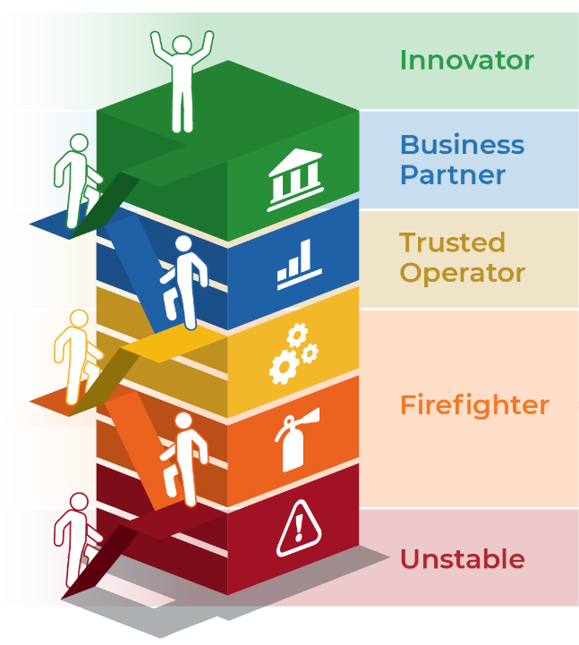

Info-Tech’s approach
The Info-Tech difference:
Before you start climbing, identify what the CEO and end users need out of work-from-anywhere
Get the basics implemented first. Don’t focus on becoming an innovator until you are no longer stuck in firefighting.
Focus on value. Review how major applications and IT capabilities can relieve employees’ pains and provide employees with gains.
Take an Agile approach and provide early value. Address short-term survivability while working towards near-term innovation.
Prepare the enterprise for the next normal
Prepare IT for the next normal
Proactively improve work-from-anywhere
Stop struggling with remote IT operations
Start supporting employees’ new normal
Build the foundations for remote work
Download the Work-From-Anywhere Capability Assessment to Identify where you are starting your climb

Slide 10
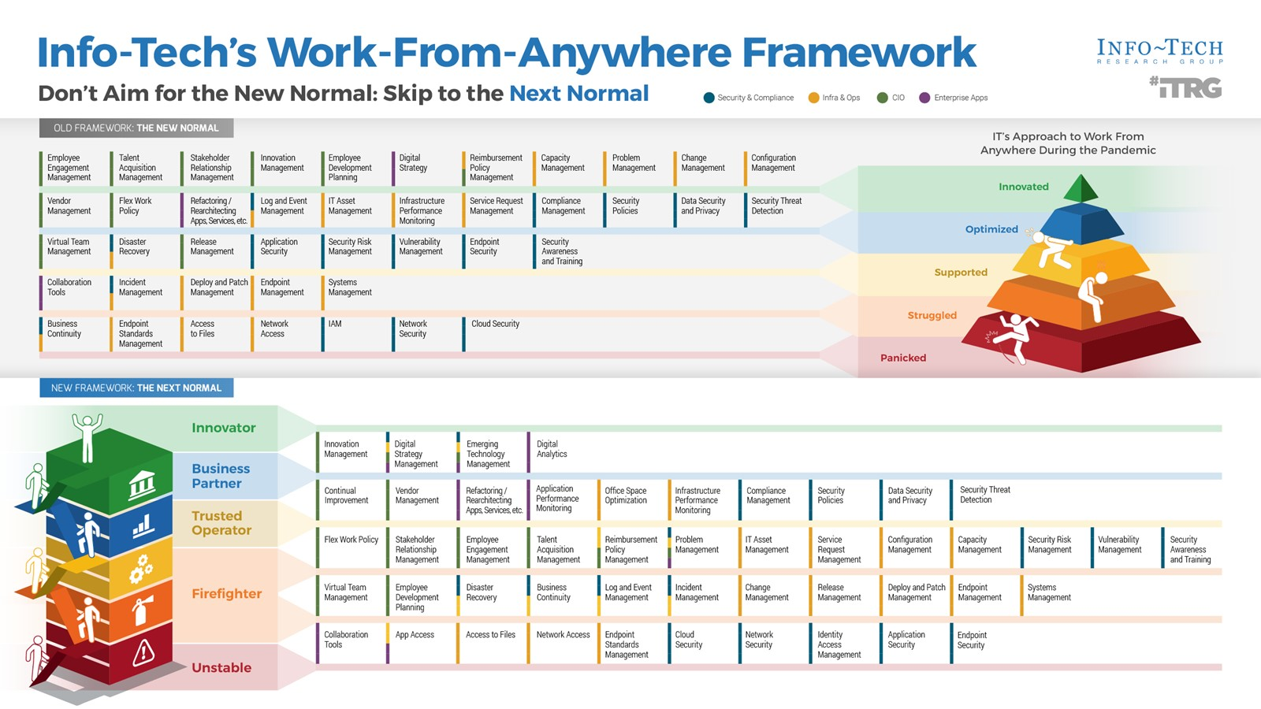

Slide 11
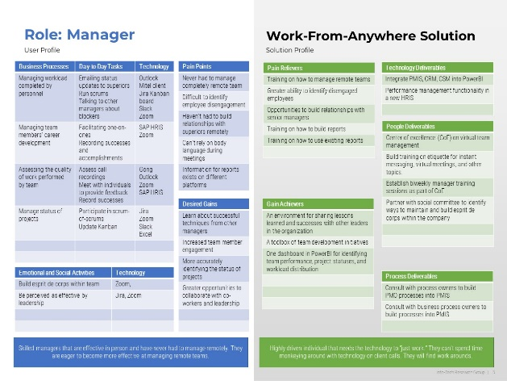
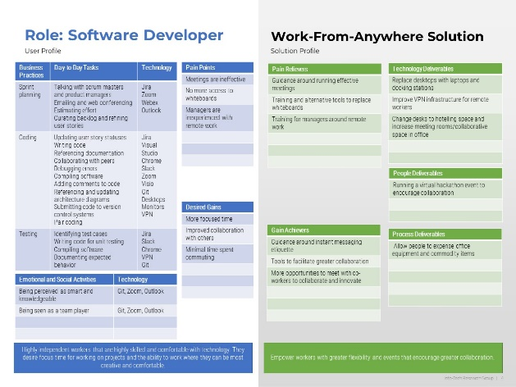
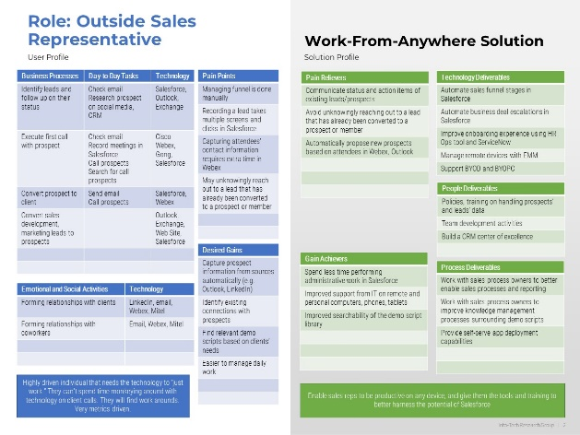
Start by defining a vision and value propositions for work-from-anywhere
Take a user-centric approach to ensure you actually empower people
Start by crafting a vision statement, a mission statement, and guiding principles. This vision statement, mission statement, and guiding principles will be for your work-from-anywhere capabilities and project team.
Next, perform a value proposition design activity. This activity is rooted in the jobs performed by the end user, and the challenges they face. Taking this approach will allow you to:
Better prioritize work. Start with work that will be more valuable to users.
Solicit better requirements. Your focus on how the user works will help you more effectively gather requirements from them.
More effectively communicate successes. When you successfully implement a system, you will already understand how that system directly empowers the business.
Generate insights. Root cause analysis is easier to perform when you understand how the tool is being used.
Download a sample work-from-anywhere value proposition diagram and template
For additional information see Phase 1 of Create a Work-From-Anywhere Strategy

Slide 12
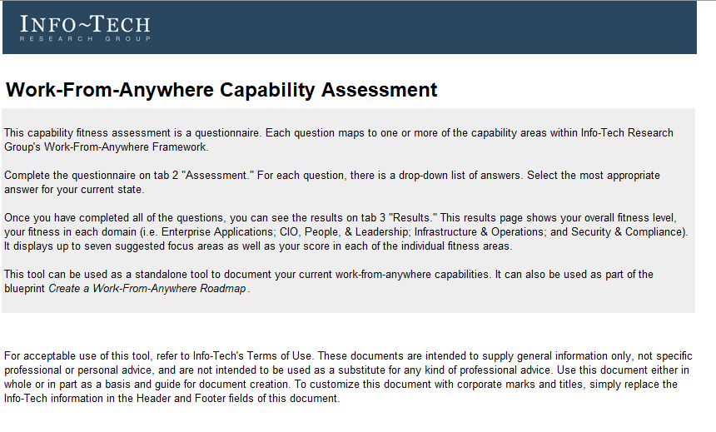
Identify where you’re starting from
Assess your work-from-anywhere capabilities
The assessment goes beyond Infrastructure & Operations to include all aspects of the Work-From-Anywhere framework
Complete the questionnaire on Tab 2.
Schedule an analyst call to discuss the results of the assessment.
Copy the results into your Work-From-Anywhere Strategy in Part 2 “Current State Assessment.”
  Copy the capability rating visual, definition, domain scores, and suggested focus areas onto one page.
  copy the scores by capability area onto a second page.
The most important capabilities for work-from-anywhere for each capability level are on the left-hand side. Prioritize these items for short-term improvement.
Download the Work-From-Anywhere Capability Assessment

Slide 13



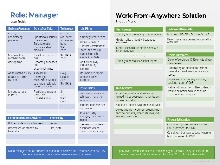
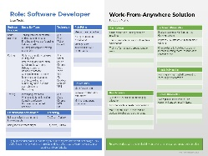
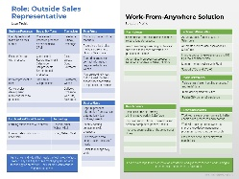
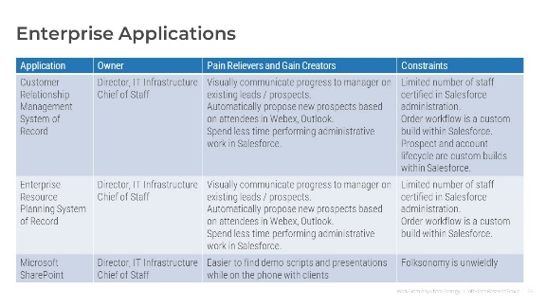
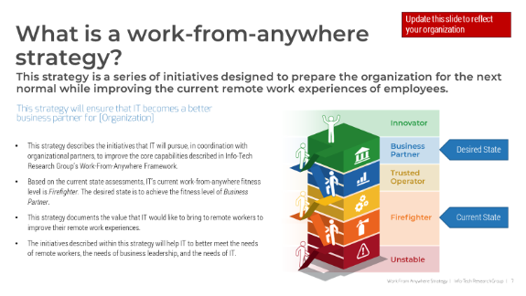
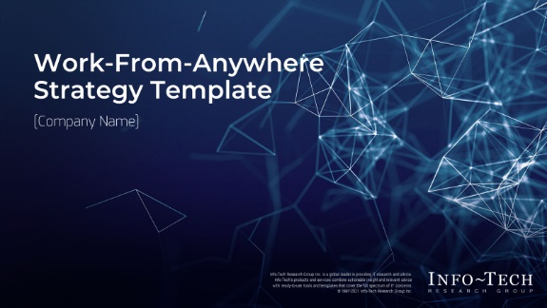
Use this blueprint to go deeper with your work-from-anywhere strategy
Key deliverable:
  Work-From-Anywhere Strategy Template
Use these deliverables as inputs into your work-from-anywhere strategy
This strategy template will help you quickly build an effective approach to improving remote work.
  Work-From-Anywhere Capability Assessment
  Sample Value Propositions
Benchmark your current fitness and identify your starting point
Analyze user needs to ensure that your digital workspace provides real user value
For instructions on this template, see Create a Work-From-Anywhere Strategy
  IT Roadmap Tool
Use this lightweight tool to prioritize and track timelines, owners, progress, and more for action items and projects

Slide 14
Info-Tech’s methodology for improving how IT Infra & Ops supports work-from-anywhere
 | 1. Stabilize Infrastructure | 2. Update IT Operations | 3. Optimize IT Infrastructure & Operations
Phase Steps | Collaboration Network Access App and File Access Endpoint Standards | DR & BCP Management Tools Incident & Service Request Change, Release, & Deploy IT Asset Management | Digital Workspace Office Space Optimization Hoteling Software Infrastructure Performance Monitoring
Phase Outcomes | Action items to improve end-user collaboration Network stability and connectivity action items Defined end user device standards | Roadmap items for refreshing business continuity capabilities Updates to system management and network management tools Updates to ITSM practices to reflect a remote workforce | Project outline for building strategic, new infrastructure capabilities

Slide 15
Insight summary
It’s not about embracing the new normal; it’s about resiliency and long-term success
Your strategy needs to not only provide short-term operational value, but also make the organization more resilient for the unknown risks of tomorrow.
The nature of work has fundamentally changed
IT departments must ensure service continuity, not for how the company worked in 2019, but how the company is working now and will be working tomorrow.
Revisit the basics
Don’t focus on becoming an innovator until you have improved network access, app access, file access, and collaboration tools.
Aim for near-term innovation
Once you’re a trusted operator, become a business partner by directly empowering end users at home and in the office.
Base your decisions in senior leadership & user needs
Just as the business rebuilt their processes to survive remote work, so too have workers. If they are asking for services after hours or in multiple locations, it’s because that’s what they need to do for familial and other obligations.
Provide early value and plan to iterate
Build a short-term plan that allows you to iterate on your existing strengths and provide early value to your users.

Slide 16
Blueprint benefits
IT Benefits | Business Benefits
Adapt IT infrastructure and operations to the fundamentally new needs of a remote workforce. Develop initiatives that are prioritized for short-term gains and long-term business value. Improve the business’s confidence in IT’s capability to support remote workers. Communicate the strategy to the business more easily. Improve service continuity and risk management. | A more resilient and engaged workforce. A technology toolset that is more effective for remote workers. Improved strategy and leadership for remote workers.

Slide 17
Measure the value of this blueprint
Track the impact on these key success indicators
Mean-time-to-resolve incidents
% of deployed devices that are centrally managed
% of BYOD devices that meet security standards
% of deployed devices that have been discovered
# of customer services that are supported by work-from-anywhere strategy
Trends in revenue by division
Output volume month over month
% of business processes that can be performed remotely
% of Tier 1 and Tier 2 business processes that can be performed remotely
Average cost of each online self-service transaction
% of revenue from online transactions versus in-store transactions
Refer to Phase 1 of Create a Work-From-Anywhere Strategy for instructions on selecting your own success metrics

Slide 19

Guided Implementation
A Guided Implementation (GI) is a series
of calls with an Info-Tech analyst to help implement our best practices in your organization.
A typical GI is between three to six calls over the course of two to three months.
What does a typical GI on this topic look like?
Phase 1
Phase 2
Phase 3
Call #1: Assess current work-from-anywhere fitness and objectives.
Call #3: Discuss opportunities to improve IT Operations and Systems Management.
Call #5: Discuss opportunities to optimize office space.
Call #6: Explore Employee Experience Monitoring.
Call #2: Discuss opportunities to strengthen collaboration tools, file access, app access, and network access.
Call #4: Prioritize initiatives and deliverables.
Info-Tech Research Group | 19

Slide 20
Workshop Overview
Contact your account representative for more information.
workshops@infotech.com 1-888-670-8889
 | Day 1 | Day 2 | Day 3 | Day 4 | Day 5
Activities | Craft a Vision | Stabilize IT Infrastructure | Update and Optimize | Build the Roadmap | Next Steps and Wrap-Up (offsite)
 | 1.1 Identify drivers, benefits, and challenges. 1.2 Perform a goals cascade to align benefits to business needs. 1.3 Define a vision and success metrics for work-from-anywhere. 1.4 Define the value that IT brings to work-from-anywhere. | 2.1 Review Work-From-Anywhere Framework and identify capability gaps. 2.2 Review diagnostic results to identify satisfaction gaps. 2.3 Record improvement opportunities for foundational capabilities: collaboration, network, file access, app access. 2.4 Identify deliverables and opportunities to provide value for each. | 3.1 Identify IT infrastructure and operational capability gaps. 3.2 Record improvement opportunities for DRP & BCP. 3.3 Record improvement opportunities for endpoint and systems management practices. 3.4 Record improvement opportunities for IT operational practices. 3.5 Explore office space optimization and employee experience monitoring. | 3.1 Prioritize initiatives and identify dependencies. 3.2 Organize initiatives into phases. 3.3 Estimate effort with scrum poker. 3.4 Build a timeline and tie phases to desired business benefits. | 5.1 Complete in-progress deliverables from previous four days. 5.2 Set up review time for workshop deliverables and to discuss next steps.
Deliverables | Desired benefits Vision statement, mission statement, and guiding principles Success metrics Value propositions for in-scope user groups | Projects and initiatives to stabilize IT infrastructure Deliverables and opportunities to provide value for foundational capabilities | Projects and initiatives to update IT operations to better support work-from-anywhere Longer-term strategic initiatives Deliverables and opportunities to provide value for each capability | Prioritized list of initiatives and phases | Completed work-from-anywhere strategy template Work-from-anywhere roadmap

