Slide 1
Create a Ransomware Incident Response Plan
Don’t be the next headline. Determine your current readiness, response plan, and projects to close gaps.
EXECUTIVE BRIEF

Slide 2
Analyst perspective
Ransomware is arguably the top threat to your organization today.
Ransomware has the attention of every executive team. The challenge is translating that attention into specific actions to improve your ransomware readiness.
For example, as a preventative measure, every security practitioner would like to restrict local admin rights and remote desktop capabilities. But the business will often resist such policies due to likely internal friction that seems more palpable than the potential security threat.
In terms of incident response, your organization might be prepared for traditional security incidents or disasters, but not a ransomware attack that actively seeks to infect backups to give the attacker greater leverage.
IT leaders need a systematic approach to quantify ransomware risk to drive business buy-in. Leaders need to evaluate their existing incident response plans to identify specific gaps that need to be addressed and present prioritized project roadmaps to leadership to improve prevention and recovery capabilities.
Frank Trovato Research Director, Infrastructure and Operations Info-Tech Research Group

Slide 3
Executive summary
Your Challenge
Common Obstacles
Info-Tech’s Approach
Ransomware is a high-profile threat that demands immediate attention:
Organizations large and small hit by ransomware make the news every week. Everyone is a target.
Executives want reassurance but aren’t ready to write a blank check. Improvements must be targeted and justified.
No one is bulletproof, so the ability to recover (not just prevent) a ransomware attack is critical, yet backup and DR capabilities are often lacking.
Ransomware impact and recovery is more complicated than other security breaches:
Ransomware attackers use multiple attack vectors. They can even have ransomware lay dormant, so it infiltrates your backups, disaster recovery (DR) site, and even more endpoints before it’s activated.
Data loss is bad; data loss plus the inability to restore from backups is devastating.
Ransomware is constantly evolving; traditional security and DR practices may not be enough.
No one is bulletproof, but you can reduce your risk and improve your ability to recover if you are hit:
Review the current state of your policies and technology.
Identify your most critical systems and data so you can prioritize security efforts and investment.
Develop a security response plan that accounts for ransomware events.
Prioritize projects to improve prevention and recovery capability.
Info-Tech Insight
Most ransomware victims were aware they were vulnerable but failed to close those gaps until it was too late – despite ransomware being a top concern for executives. This is a failure to translate concern into the necessary steps to identify specific vulnerabilities and drive definitive actions to close those gaps.

Slide 4
News headlines are a reminder of the constant ransomware threat
“Louisiana Suffers Another Major Ransomware Attack”
(Forbes, 20 Nov. 2019)
“British banks hit by hacking of foreign exchange firm Travelex” (CNBC, 9 Jan. 2020)
“Ransomware attack hits school district twice in 4 months”
(Associated Press, 10 Sept. 2019)
“Ryuk Ransomware Uses Wake-on-Lan To Encrypt Offline Devices”
(Bleeping Computer, 14 Jan. 2020)
In 2019, ransomware reached crisis proportions with targeted attacks that “impacted at least 966 government agencies, educational establishments and healthcare providers at a potential cost in excess of $7.5 billion.”
“ ‘Chaos is the Point’: Russian Hackers and Trolls Grow Stealthier in 2020”
(The New York Times, 10 Jan. 2020)
“Sodinokibi Ransomware Publishes Stolen Data for the First Time”
(Bleeping Computer, 11 Jan. 2020)
Source: Emisoft
“Ransomware Gangs Now Outing Victim Businesses That Don’t Pay Up”
(Krebson Security, 16 Dec. 2019)
“Company shuts down because of ransomware, leaves 300 without jobs just before holidays”
(ZDNet, 3 Jan. 2020)
“Baltimore to purchase $20M in cyber insurance as it pays off contractors who helped city recover from ransomware”
(The Baltimore Sun, 16 Oct. 2019)
“Florida city will pay hackers $600,000 to get its computer systems back”
(Washington Post, 20 June 2019)

Slide 5
Some level-setting: Basic ransomware attack
Ransomware is a form of malware, so malware prevention best practices still apply.
What’s different is the extensive business disruption. The ability to recover, not just contain and eradicate, is critical.
Review this high-level illustration of a basic ransomware attack:
Malware delivered (e.g. via a phishing email)
2
Locker ransomware: Locks the victim’s screen or system
Victim notified of compromise through ransom note
1
3
2
Crypto ransomware: Finds data and encrypts it
Malware locks systems and/or encrypts data for financial extortion and/or cyberespionage.
Ransomware spreads like most other malware (not just via phishing emails): drive-by downloads, application vulnerabilities, etc. As a result, prevention can leverage many existing security best practices.
One key differentiator is the extensive business disruption, which is why ransomware must be treated as a security incident and disaster recovery (DR) or business continuity (BC) incident.

Slide 6
Many attacks don’t immediately trigger an alert
Phishing is still the most common method to get in the door, but that’s just the start.
Once in your network, the attacker infects as many critical systems as possible to gain maximum leverage, before taking action that would trigger an alert. For example, the attacker will:
Use legitimate commands to navigate your network, find an admin-level account, and crack that account (e.g. using password spray and/or other common techniques).
Exfiltrate data to gain more leverage.
Encrypt as many critical systems and data sets as possible, including backups, to limit your recovery options.
Threat actors have access to wide range of tools and methods to bypass perimeter security and endpoint protection. Those tools are still important, but don’t count on them preventing all attacks. Hence the need for incident response planning, supported by reliable backups and disaster recovery capability.
Example of a ransomware attack workflow:
Phishing email designed to not trigger spam filter is delivered.
Target admin account is found (e.g. a default admin account for a recently added service).
Data exfiltrated again, using legitimate network commands.
Malware launches legitimate commands (e.g. PowerShell) and is therefore not detected.
Password spray or other techniques are used to crack the account.
Data is then encrypted, which raises a red flag.
It runs a net user command to identify user accounts.
With admin-level rights, critical systems are accessed.
A ransom note is delivered, and incident response is initiated.

Slide 7
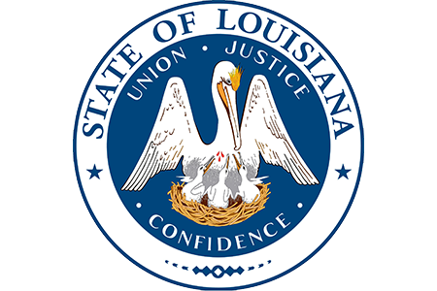
If vulnerabilities aren’t closed, hackers are not shy about hitting you twice
Ransomware attackers depend on catching organizations off-guard and are not afraid to hit the same target twice. Furthermore, without a ransomware incident response plan in place, the costs associated with an unplanned recovery can skyrocket.
Despite its best efforts, including the funding of a Cyber Security Commission in 2017, the State of Louisiana was hit with ransomware twice in 2019. The first attack hit schools and district offices in the summer, while the second attack hit government offices in the fall.
The City of New Orleans was also hit with ransomware in December 2019, showing that attackers will continue to exploit targets until organizations have hardened their security and closed off vulnerable exploits.
Whether you’re hit once or multiple times, the cost impact can be devastating.
The City of Baltimore estimates that the costs associated with its ransomware attack amounted to $10 million in post-breach costs, in addition to $8 million in lost revenue.

Slide 8
Ransomware is not just a problem for industries with tight budgets
All industries are vulnerable, including some you wouldn’t expect
% of publicly reported ransomware attacks hitting each industry in 2020
Governments (particularly municipalities), healthcare, and education are among the hardest hit, at least partly due to tight IT budgets leading to security gaps and their sensitive data making them a target.
However, other industries such as Professional Services and Technology where you would expect a strong security program were also hard hit, and their vulnerability puts their clients at risk also. Look no further than the SolarWinds attack for an example of this risk, even though it wasn’t specifically a ransomware attack.
The key takeaway: No one is bulletproof, so invest in incident response planning, in addition to prevention. Assume you’ll be hit, and know how you will respond to contain and recover from the attack.
BlackFog Inc.: The State of Ransomware 2020

Slide 9
Resilience depends on security response and DR capability
When organizations take weeks to recover – essentially rebuilding their environments – it’s often because their backups or DR solutions were inadequate, in addition to possible gaps in their security responses.
This blueprint will focus on building your Ransomware Incident Response Plan and closing ransomware security vulnerabilities.
For assistance building the disaster response plan (DRP) component, refer to Info-Tech’s Create a Right-Sized Disaster Recovery Plan blueprint. Additionally, also leverage the requirements identified by your ransomware incident response planning.
Analyze
No
DR Required?
Recover
Contain
Execute DRP
Status Update
Yes
Eradicate
Business Impact?
Potential Duration?
Recovery Capability?

Slide 10
Info-Tech’s methodology for Creating a Ransomware Incident Response Plan
 | Assess your ransomware readiness | Conduct a BIA to raise risk awareness and set recovery targets | Create a ransomware response workflow and runbook | Build a project roadmap to close gaps
Phase Steps | Conduct a maturity assessment Review selected systems and dependencies | Record systems and dependencies in Info-Tech’s DRP Business Impact Analysis Tool Complete the impact analysis for selected systems and data sets | Document your threat escalation protocol Use tabletop planning to identify response steps and gaps Update your ransomware response workflow and runbook | Identify initiatives to improve ransomware readiness Prioritize initiatives in a project roadmap Communicate your current status and recommendations
Phase Outcomes | Maturity assessment (includes identifying policy and technology gaps) | Business impact analysis | Tabletop planning results Ransomware Response Workflow Ransomware Response Runbook | Ransomware Project Roadmap Ransomware Readiness Summary
Note: This research can be executed as a do-it-yourself project, a Guided Implementation (series of advisory phone calls), or a facilitated Info-Tech Workshop.

Slide 11
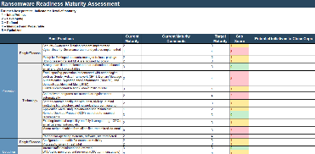
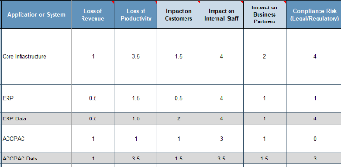
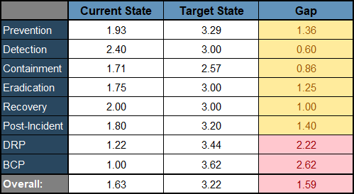
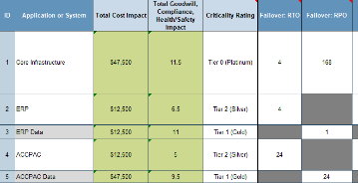
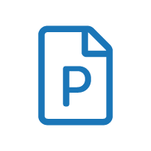
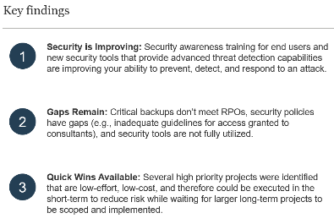
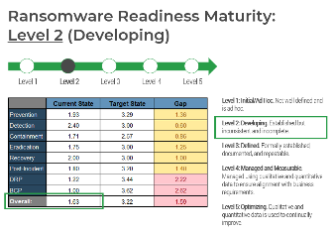
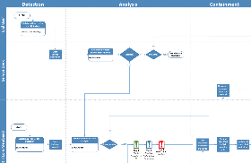
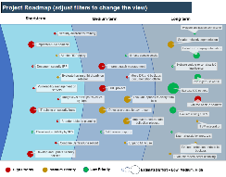
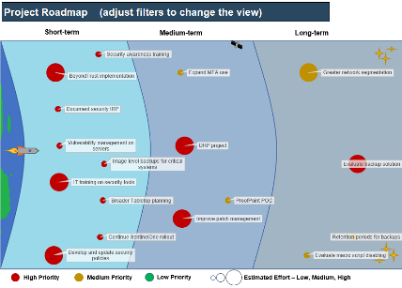
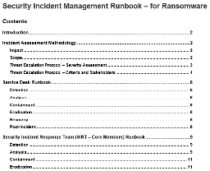
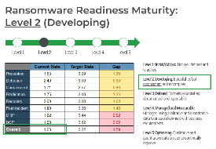
Blueprint deliverables
Key deliverable:
Each step of this blueprint is accompanied by supporting deliverables to help you accomplish your goals:
Ransomware Readiness Summary Presentation Template
Ransomware Readiness Maturity Assessment Tool
Ransomware Business Impact Analysis Tool – Example
Use this executive presentation to communicate the risk of the status quo, present recommended next steps, and drive stakeholder buy-in.
Measure your current readiness and identify policy and technology gaps to address.
Quantify the business impact of a ransomware attack to communicate risk and prioritize investment.
Ransomware Response Workflow & Runbook Templates
Ransomware Project Roadmap Example & Summary Template
The at-a-glance workflow captures key steps for all stakeholders and the runbook offers more details.
The prioritized roadmap and the ransomware readiness summary template helps you outline current status and next steps.

Slide 12
Blueprint benefits
IT benefits | Business benefits
Provide a structured approach for your organization to identify gaps, quantify the risk, and communicate status to drive executive buy-in. Create a practical ransomware incident response plan that combines a high-level, at-a-glance workflow with a detailed runbook to coordinate recovery and ensure key steps are followed. Present an executive-friendly project roadmap that enables you to summarize your plan to address your organization’s gaps. | Enable leadership to make risk-based, informed decisions on resourcing and investments to improve ransomware readiness. Quantify the potential impact of a ransomware attack on your organization to drive risk awareness. Identify existing gaps so they can be addressed, whether by policy, response plans, technology, or any combination of these.

Slide 13
Measured value of this blueprint
Plan now or pay later
Organizations that are unprepared have had to pay anywhere from $200,000 to $10 million based on the size, scope, and impact of ransomware incidents.
Plan ahead now instead of having to pay a lot more later.
$667,627: The amount the City of Woodstock (in Ontario, Canada) had to spend to recover from a ransomware attack – not for the ransom, but the professional service fees and new hardware required to recover.
$84,116: The average ransom payment for Q4 of 2019, an increase of 104% from the previous average of $41,179 in Q3 of 2019.
$47,500 and 10/10: An example of the measured value dollar impact and rating reported by our clients who followed this blueprint.

Slide 14
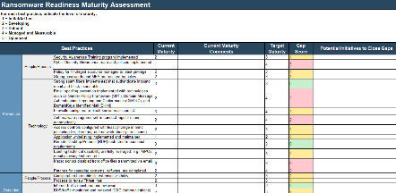
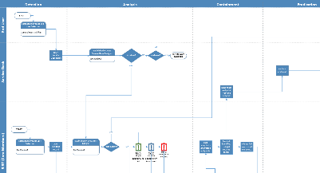
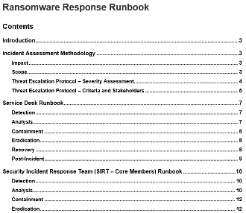
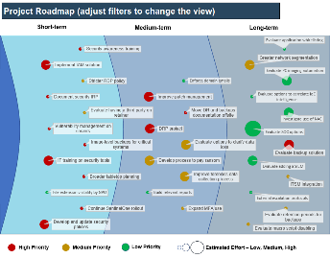
Executive Brief Case Study
INDUSTRY
SOURCE
Government
Info-Tech Workshop Results
Regional government leverages a workshop to fast-track its ransomware incident response planning
A regional government leveraged Info-Tech’s methodology to evaluate and improve its ransomware readiness.
Ransomware Attack and Readiness to Respond
While the organization was developing its security program, including rolling out security awareness training for end users and investing in security solutions beyond the basics, the staff knew they still had holes to fill. For example, security solutions were not yet fully deployed, policies were lacking, and there was no documented ransomware incident response plan.
Workshop Results
A systematic review of existing processes, policies, and technology identified key gaps in the organization’s overall readiness. The impact analysis quantified the potential impact and business risk, which would be important in driving awareness and buy-in to invest in the security program. Info-Tech’s tabletop planning exercise provided a foundation for the organization’s actual response plan: a ransomware response workflow and a framework for a more detailed runbook. The workshop also helped staff further identify gaps in their ability to recover during a ransomware scenario, such as inadequate backups.
The net result was a current-state response plan, appropriate capability targets aligned with business requirements, and a project roadmap to achieve the organization’s desired state of ransomware readiness.

