Slide 1
Identify the Components of Your Cloud Security Architecture
Security in the cloud requires solutions, not speculation.
EXECUTIVE BRIEF

Slide 2

Analyst
Perspective
The move to the cloud is front of mind for many businesses. The cloud offers the benefits of elasticity, potential cost cuts, and more efficient resourcing. However, in all the conversations about the benefits of the cloud, security is rarely brought up. While the migration to a cloud service does change your risk profile, many of the breaches are not the fault of the cloud provider and are instead the result of a failure to consider security at the forefront of any cloud deployment. The rush to the cloud is leaving gaps in security that are much harder to address ad hoc.
Things look different in the cloud. Small omissions that might have gone unnoticed on a private network may now be exposed to the world, increasing security risks dramatically — provided that these risks are not identified at the outset.
This research project is about identifying the risks within your environment and finding concrete solutions to mitigate those risks. You are required to manage identities, secure your data and infrastructure, detect threats, and respond/recover. What are the technologies and services that you can use to enforce controls and position yourself for secure success in the cloud?
The cloud can bring a great deal of benefits, but only if you can use it securely.
Use a risk-based strategy to meet the security needs of your cloud implementation
Isaac Kinsella
Research Specialist, Security, Risk & Compliance
Info-Tech Research Group

Slide 3


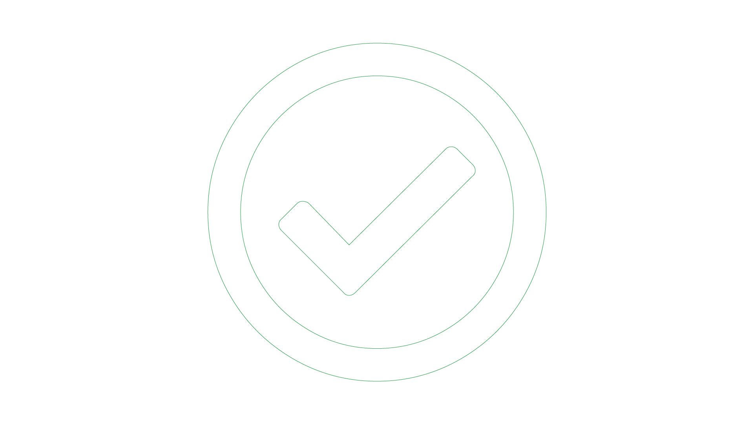
Executive Summary
Your Challenge
Common Obstacles
Info-Tech’s Approach
Ensuring cloud security is a difficult ask. You may be moving or currently have workloads in the cloud. How can you effectively secure them and mitigate your cloud risks?
What are the key assets you want to migrate, and what attributes do they have?
What are the risks associated with moving to the cloud? How do you control your identified risks?
Without having a baseline of knowledge before migrating to the cloud, businesses will experience growing pains as part of securely adjusting their workloads to the cloud.
Creating a successful cloud security architecture requires you to know:
  What are my business-critical programs that I need to move?
  I’m unsure whether cloud is the best solution for my business use case. If the cloud is the correct fit, which service level can help to best address my needs?
  How do I determine what the appropriate security services are that can mitigate risk for my business?
Info-Tech has developed a robust model to not only analyze your workload’s appropriateness to the cloud but also map your risks and mitigating services to secure your cloud deployments.
This approach includes tools for:
  Mapping your workloads and their cloud suitability
  Risk and effort mapping tools
  Prioritized security components & controls
  A preconstructed communication deck to simplify conveying your security components
Your cloud security architecture needs to be strategic, realistic, and based on risk.
The NIST approach to cloud security is to include everything security related into your cloud architecture to be deemed secure. However, you can still have a robust and secure cloud architecture by using a risk-based approach to identify the necessary controls and mitigating services for your environment.

Slide 4
Proper cloud security is a balancing act of responsibility
Cloud security will be a top priority – let your security reflect that importance.
The cloud is becoming more and more accessible and prevalent as a business enabler. The cloud transition can bring tremendous value; however, it can also bring additional unforeseen risks. Access to new services and capabilities can be a game changer for organizations of all kinds. But, as with any change, there is an element of risk, and IT needs to take steps to ensure that any cloud deployments meet security standards.
The challenge for IT security professionals becomes enabling access to the features and capabilities that cloud services can provide without putting the organization at undue risk. Swing too far in either direction, and the cloud deployment will not succeed – either through over-encumbrance or failure to mitigate crucial security risks.
Security professionals need to understand the tools and strategies at their disposal to appropriately secure and govern their environments.
This blueprint proceeds in several parts, each of which may be relevant based on the nature of the deployment you choose to pursue. Software-as-a-Service requires sharing more responsibility for cloud security with the vendor than, say, Infrastructure-as-a-Service or Provider-as-a-Service. Regardless of the service level you choose, each will require knowledge of their suitability and associated risks.
75%
of all enterprise software will be primarily cloud based by 2030.
  75%
Source: BVP, 2020
60%
of cloud security professionals believe their cloud deployments have outpaced security.
  60%
Source: Firemon, 2019

Slide 5
Cloud security is a top priority for IT in 2020
Having the architecture to properly maintain your cloud deployment plan will be a must.
Source: Info-Tech, 2020 Security Priorities Report

Slide 6
What’s holding back cloud adoption?
While cloud adoption may be a top priority, concerns over data security are holding back cloud deployments.
“Security is the top concern restricting faster adoption of the cloud.”
  70%
of businesses say that security worries are hindering their adoption of cloud services.
Source: Barracuda Networks, 2020
  75%
Concerns for cloud security include the security of public cloud infrastructure, and the increase in threats and cyberattacks on cloud-based applications.
of survey respondents reported that they had already experienced a cyberattack on their assets that had been deployed to the cloud.
  29%
of organizations have security staff spending a day or more per week preventing security breaches.
Source: Barracuda Networks, 2020
Source: Barracuda Networks, 2020

Slide 7
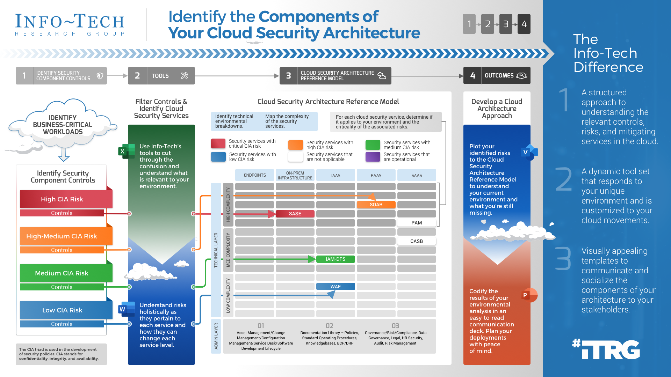

Slide 8
Info-Tech’s Reference Model
High Complexity
Medium Complexity
Endpoints
On-Prem Infrastructure
IaaS
PaaS
SaaS
The Info-Tech difference:
TECHNICAL
LAYER
Threats
Vulnerability Scanning
Vulnerability Management
Vulnerability Management
Vulnerability Scanning
Vulnerability Scanning
Application Code Review
Application Code Review
Application Code Review
Application Code Review – API
A structured approach to understanding the relevant controls, risks, and mitigating services in the cloud.
A dynamic tool set that responds to your unique environment and is customized to your cloud movements.
Visually appealing templates to communicate and socialize the components of your architecture to your stakeholders.
Security Incident Management
Managed Detection Response
Managed Detection Response
SOAR
SOAR
SOAR
Log Collection / SIEM
Low Complexity
Log Collection / SIEM
Log Collection / SIEM – API
Log Collection / SIEM
Firewalls
Secure Application Service Edge
Secure Application Service Edge
Secure Application Service Edge
Endpoints
DLP – Endpoint
Data Loss Prevention
Data Loss Prevention
DLP – API Security
DLP – API Security
Virtualization – VDI
Security Virtualization
Security Virtualization
Identity
Privileged Access Management
Privileged Access Management
Privileged Access Management
Privileged Access Management
Threats
Threat Intel Services
Threat Intel Services
Threat Intel Services
Threat Intel Services
Unified Threat Management
Unified Threat Management
Unified Threat Management
Firewalls
Metrics / Reporting / Visualizations
Cloud Access Security Broker
Cloud Access Security Broker
IPS / IDS / IDPS
IPS / IDS / IDPS
IPS / IDS / IDPS
Access Control List
Access Control List
Application Segmentation
Application Segmentation
Application Segmentation
Endpoints
VPN Client
Endpoint Detection Response
Endpoint Detection Response
Identity
IAM – Directory / Federated Svc
IAM – Directory / Federated Svc
IAM – Role-Based Access
IAM – Role-Based Access
IAM – Role-Based Access
Threat
Patch Management
Patch Management
Patch Management
Patch Management
Firewalls
E-Mail Security Gateway
E-Mail Security Gateway
E-Mail Security Gateway
Network Firewall
Network Firewall
Network Firewall
Network Firewall – API
Web Application Firewall
Web Application Firewall
Web Application Firewall
Web Application Firewall – API
Network Segmentation / NAC
Network Segmentation / NAC
Network Segmentation / NAC
Endpoints
Enterprise Mobile Management
Enterprise Mobile Management
Enterprise Mobile Management
Enterprise Mobile Management
Enterprise Mobile Management – API
Endpoint Protection
Endpoint Protection
Endpoint Protection
Endpoint Protection
Endpoint Protection – API
Identity
IAM – Multi-Factor Authentication
IAM – Multi-Factor Authentication
IAM – Multi-Factor Authentication
IAM – Multi-Factor Authentication
IAM – Multi-Factor Authentication
ADMIN
LAYER
IAM – Single Sign-On
IAM – Single Sign-On
IAM – Single Sign-On
IAM – Single Sign-On
Asset Management / Change Management / Configuration Management/Service Desk/Software Development Life Cycle
Documentation Library – Policies, Standard Operating Procedures, Knowledge Bases, BCP / DRP
Governance / Risk / Compliance, Data Governance, Legal, HR Security, Audit, Risk Management

Slide 9
Info-Tech’s methodology for cloud security architecture
 | 1. Cloud Security Alignment Analysis | 2. Business-Critical Workload Analysis | 3. Cloud Security Architecture Mapping | 4. Cloud Security Strategy Planning
Phase Steps | Cloud Workload Plan Cloud Suitability Questionnaire Cloud Risk Assessment Cloud Risk & Suitability Analysis | “A” Environment Analysis “B” Environment Analysis “C” Environment Analysis Prioritized Security Controls Effort & Risk Dashboard | Cloud Security Architecture Archive Document Cloud Security Architecture Reference Model Mapping | Cloud Security Strategy Considerations Cloud Security Architecture Communication Deck
Phase Outcomes | Workload Deployment List Cloud Suitability & Risk Assessment | Individualize Environment Analysis Prioritized CIA Risk Controls Relevant Mitigating Security Services Effort & Risk Dashboard | Archive Document with security controls and risks Completed Cloud Security Architecture Reference Model | Contextualized understanding of the service level differences between controls Cloud Security Architecture Strategy Document Cloud Security Architecture Communication Deck

Slide 10
Cloud security needs to be taken just as seriously as on-premises security
Your cloud security architecture needs to be strategic, realistic, and based on risk.
The NIST approach to cloud security is to include everything security related into your cloud architecture to be deemed “secure.” However, you can still have a robust and secure cloud architecture by using a risk-based approach to identify the necessary controls, and mitigating services for your environment.
The cloud is not the right choice for everyone
You’re not as unique as you think. Start with a reference model that is based on your risks and business attributes and optimize it from there.
Your responsibility doesn’t end at the vendor
Even if you outsource your security services to your vendors, you will still have security responsibilities to address.
Don’t boil the ocean – do what is realistic for your enterprise
Your cloud security architecture should be based on securing your most critical assets. Use our reference model to determine a launch point.
A successful strategy is holistic
Controlling for cloud risks comes from knowing what the risks are. Consider the full spectrum of security including both processes and technologies.
Your security depends on your deployment model
The cloud isn’t a singular entity. Your cloud security architecture should consider the differences between the services models, and in particular the service levels that are most relevant to you.
Understand the driving force for your move
Ask yourself what the cloud will accomplish that will make this deployment worthwhile? What is the problem you’re trying to address, and has security been a part of that consideration?

Slide 11

Understanding the cloud
The cloud comprises five key elements, all of which need to be present for a service to be counted as a cloud service.
On-Demand Self-Service
The ability to spin services up without contacting the vendor, typically through a console.
Broad Network Access
Resources can be accessed over the open internet.
Resource Pooling
Resources are shared among cloud customers, though tenants are functionally walled off form one another.
Rapid Elasticity
This is the ability to “pay as you go” and spin things up and down as needed.
Measured Service
Cloud providers charge with granularity appropriate to the service model.
Source: NIST, September 2011

Slide 12
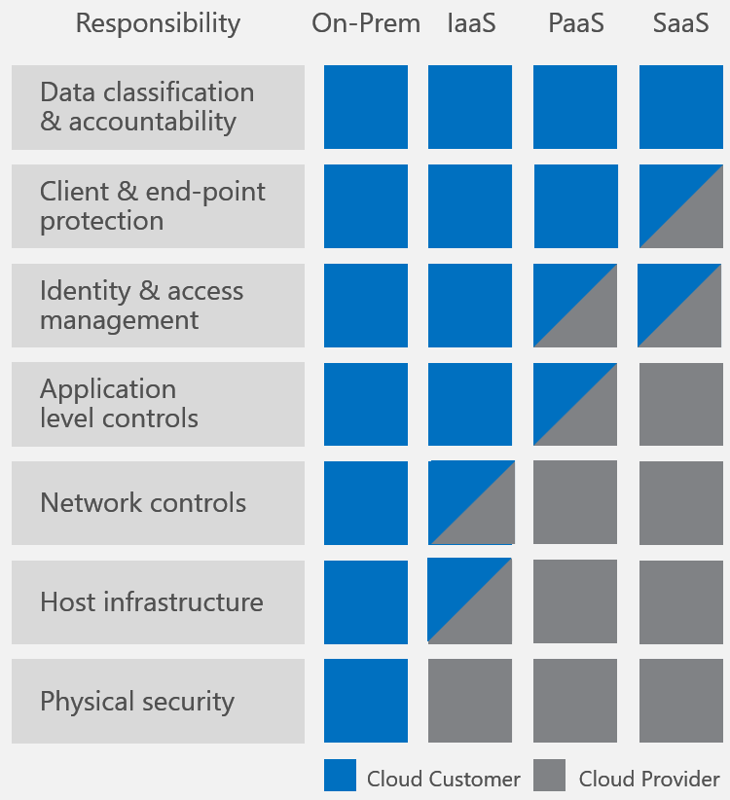
Cloud security is a shared responsibility
IT has always involved an element of shared responsibility. From ISPs to software vendors — from managed service providers and VARs to consultants — IT departments have been sharing responsibility for years. The cloud brings this relationship into sharper focus, and old security techniques may no longer be as effective as they once were.
Cloud providers are responsible for the security of the cloud — that is to say, they manage the hardware, facilities, and other physical components of the cloud, along with some of the software and cloud networking. The consumer maintains responsibility for security in the cloud. Identity and access management, data classification, server-side encryption, networking traffic — all these areas need to be managed by the cloud consumer.
The column on the left shows that most responsibilities that are commonly held between cloud providers and cloud consumers. As you shift from On-Prem to Software-as-a-Service (SaaS), you will invariably give more responsibilities over to the provider. While a general rule, there are inconsistencies with this rule, which means you may be responsible even under a SaaS service level.
Image Courtesy of Microsoft, June 2018

Slide 13
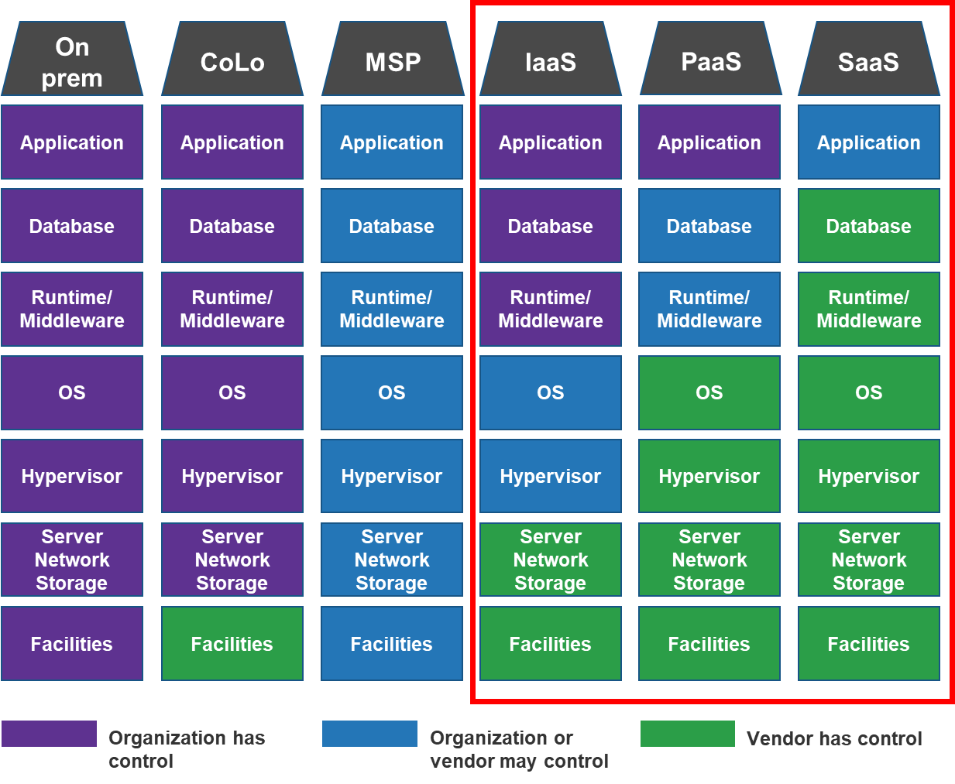
Different cloud service models
Services can be delivered in different ways
Not all clouds are created equal. SaaS is generally managed almost exclusively by the vendor and delivered over the internet, while Infrastructure-as-a-Service (IaaS) comprises virtual machines and other building blocks of IT, giving customers much more granular control. Platform-as-a-Service (PaaS) sits in between these two extremes and offers users a toolset to build out their own services.
Each of these models has its own strengths and risks and in some cases requires different or additional effort to secure their respective services.
Traditional IT offers the benefits of control and relative obscurity, but these may be offset by the advantages of the cloud.

Slide 14


Use Info-Tech’s blueprint to plan your cloud security architecture effectively
IT Benefits | Business Benefits
IT can determine whether moving to the cloud is appropriate for their needs. IT will have control and visibility over the environment and the specific controls and risks that will need to be mitigated. IT will no longer have to disallow certain applications and services because they are cloud based. Access to cloud-based services opens up worlds of productivity not available to those confined on premises. A number of new tools, including productivity suites, ITSM, and ERP, are cloud exclusive. | Line of business managers can be confident of their move to the cloud having considered both the risk and effort involved in the deployment. Determine whether the move to the cloud is even warranted; depending on the workloads you are trying to move, moving to the cloud may be unrealistic. Gain an in-depth understanding of the governance aspects of cloud security and interconnectivity. Know which services are appropriate for you to implement based on your environmental risks.
Iterative benefit
Over time, experience incremental value from knowing the components of your architecture. Through continual updates, your architecture will evolve but with less associated effort and time and fewer costs.
Discovery
&
Assessment

Slide 15
Use Info-Tech’s blueprint to save two to three months
Time, Effort, and Value Using Blueprint
Without Blueprint
Phase 1: Cloud Security Alignment Analysis
Low Value
Fluctuations in the assessment time is based on differences in organizational culture.
Medium Value
1-5 people
Fluctuations in assessment time is based on differences in organizational culture.
1-5 people
0.5-2 days
½ day - 2 days
1-2 weeks
Phase 2: Business-Critical Workload Analysis
1-5 people
1-5 people
Create multiple 3- to 4-hour meetings to work through the environment analysis.
Create multiple 3-4-hour meetings to work through the gap analysis tool.
High Value
2-3 days
High Value
2-3 days
4-8 weeks
Phase 3: Cloud Security Architecture Mapping
1-10 hours of security management’s time to map the security services.
1-2 people
1-8 hours of security management’s time.
1-2 weeks
1-2 people
High Value
1-2 days
High Value
1 day
Phase 4: Cloud Security Strategy Planning
1-2 people
One to two hours to bring together the team from Phases 1 and 2.
1-5 people
Medium Value
1-2 weeks
1-2 days
Medium Value
1-2 days
Time & Effort Saved:
7-14 weeks
Iterative benefit
Over time, experience incremental value from knowing the components of your architecture. Through continual updates, your architecture will evolve but with less associated effort and time and fewer costs.
Discovery
&
Assessment

Slide 16
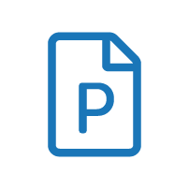

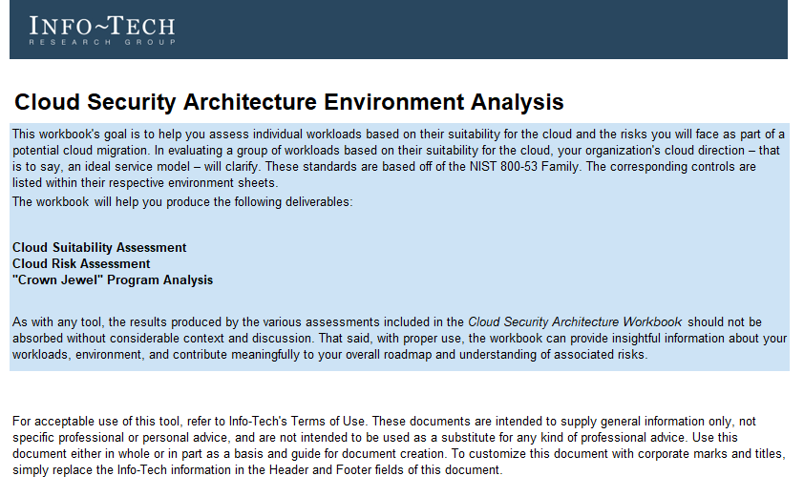
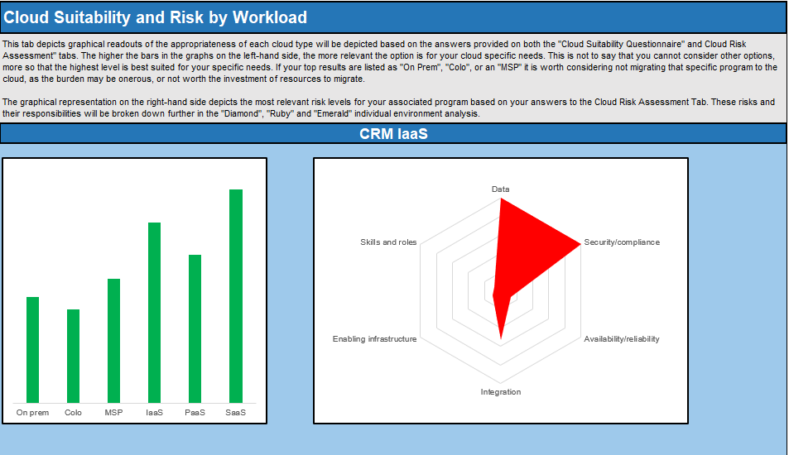
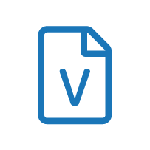
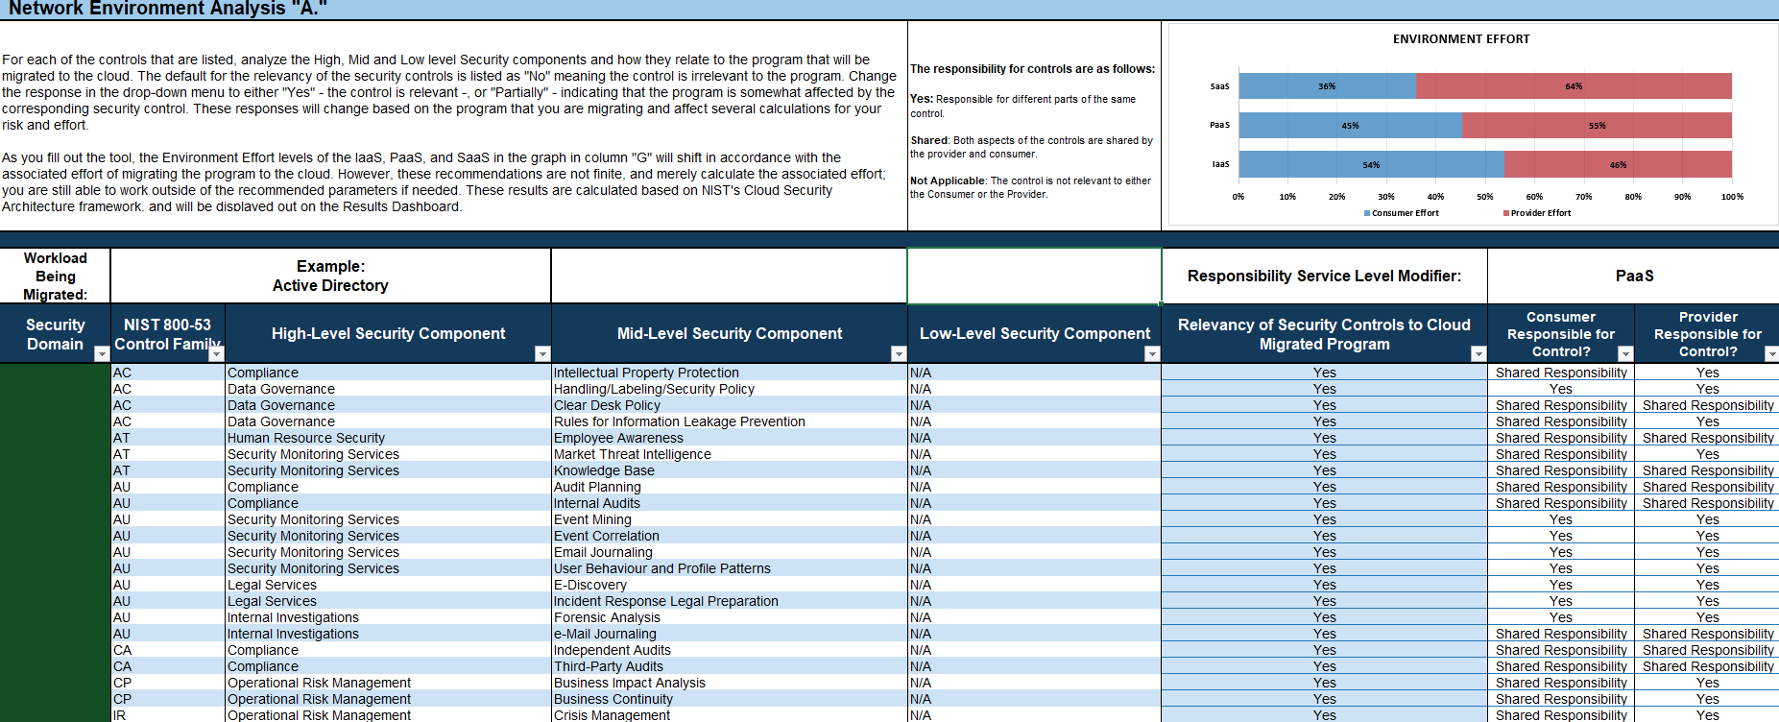
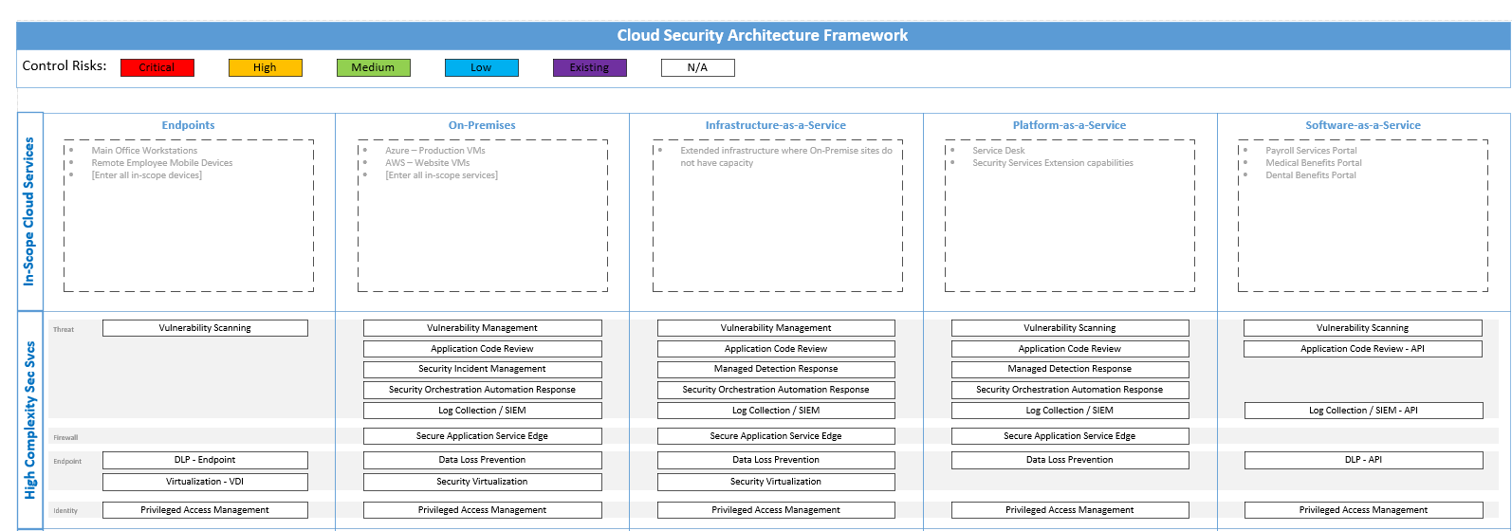
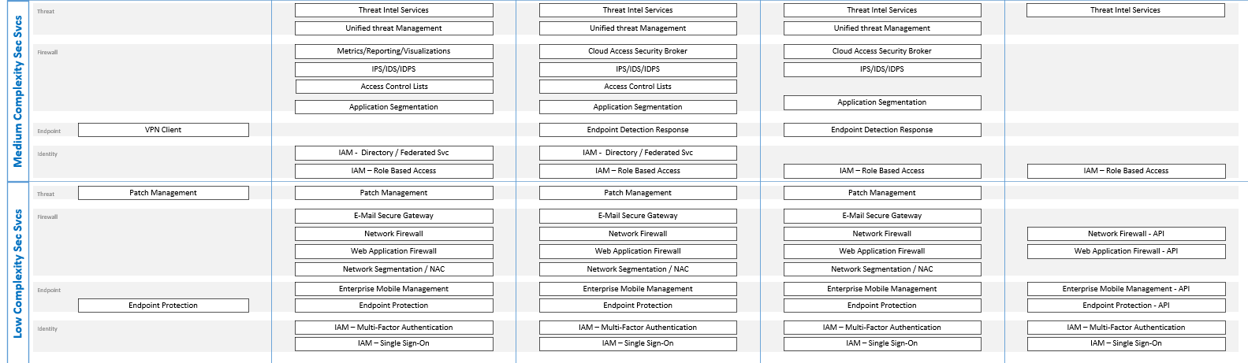

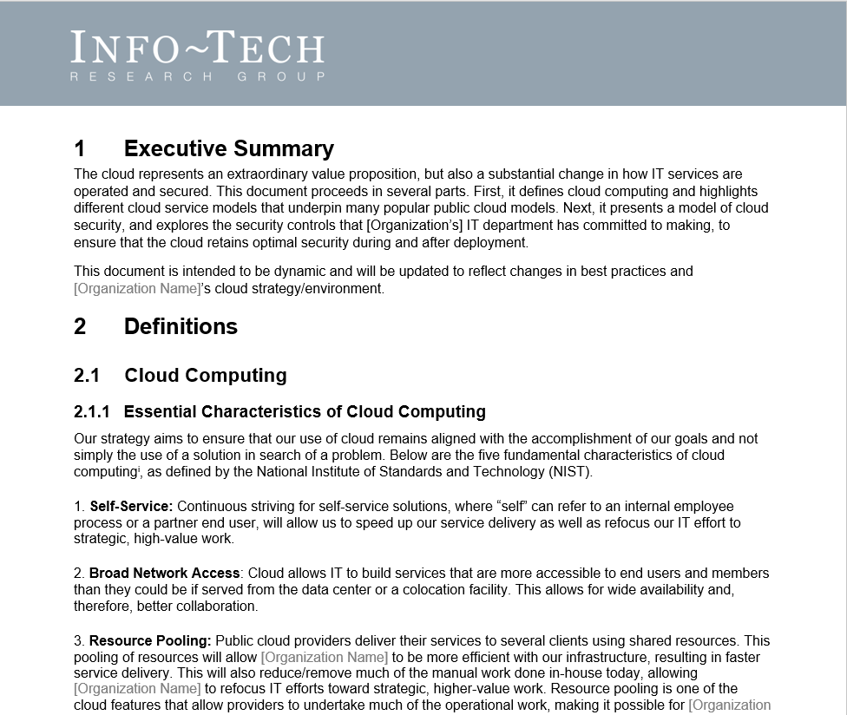
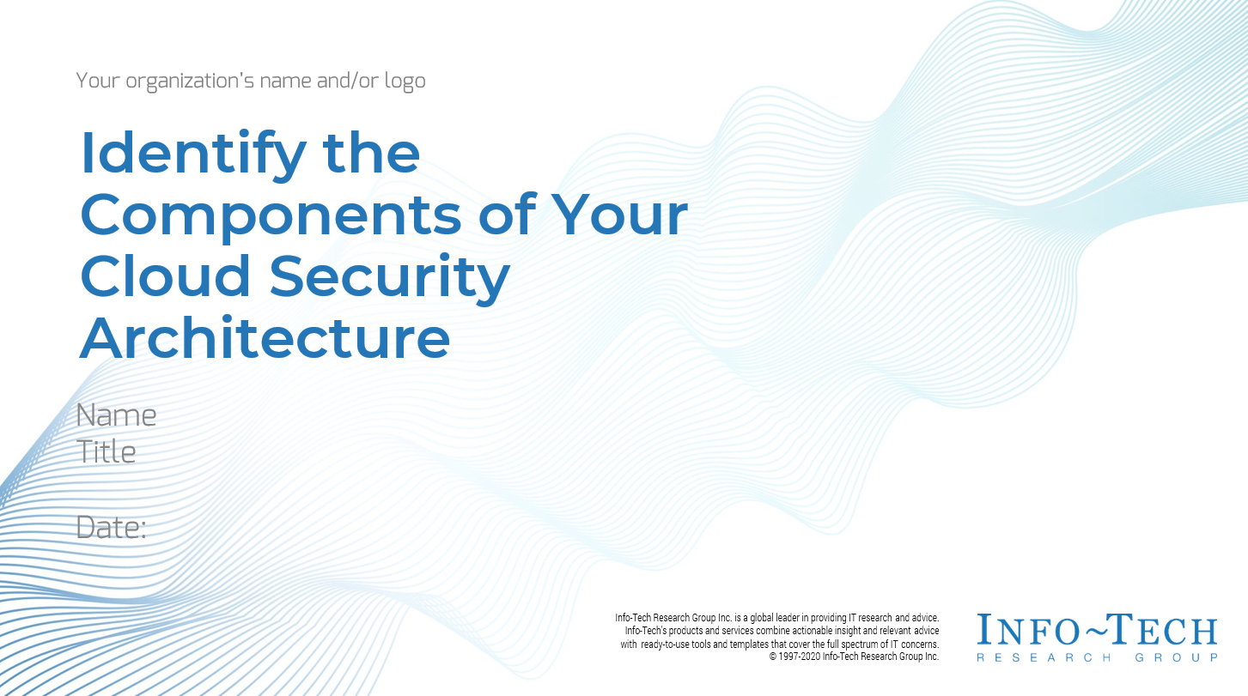
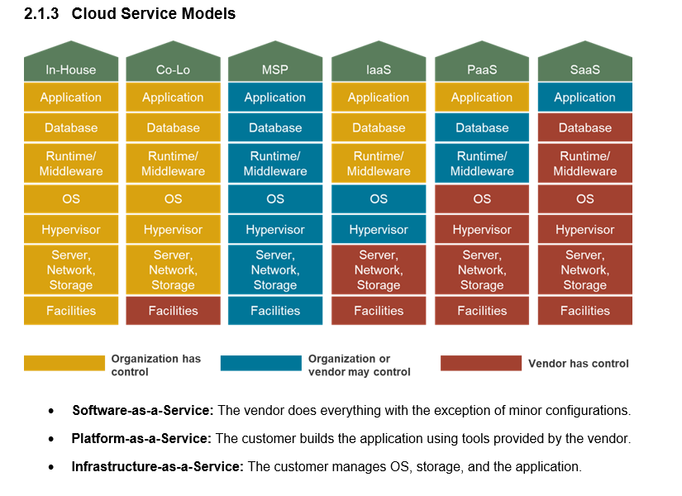
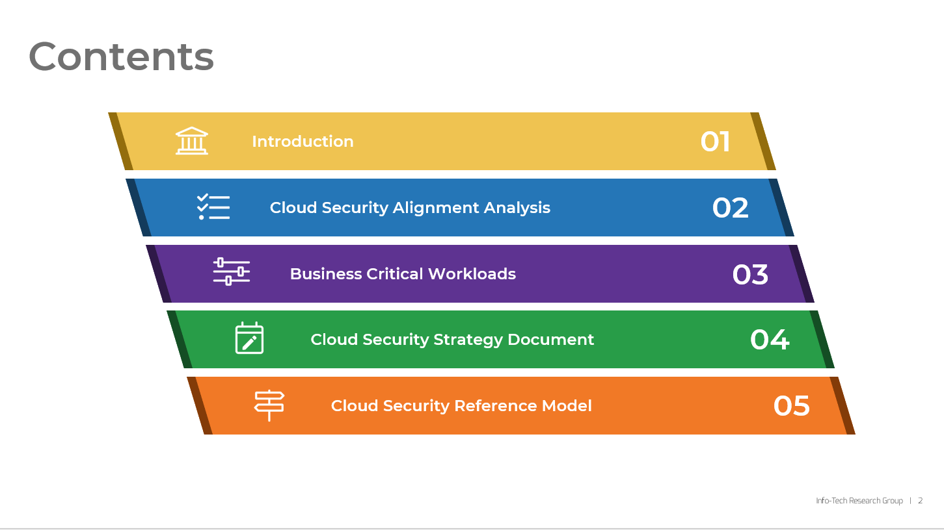
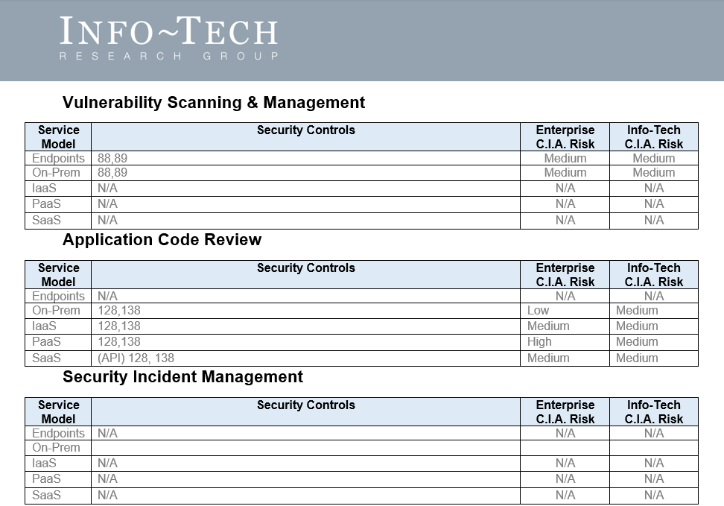
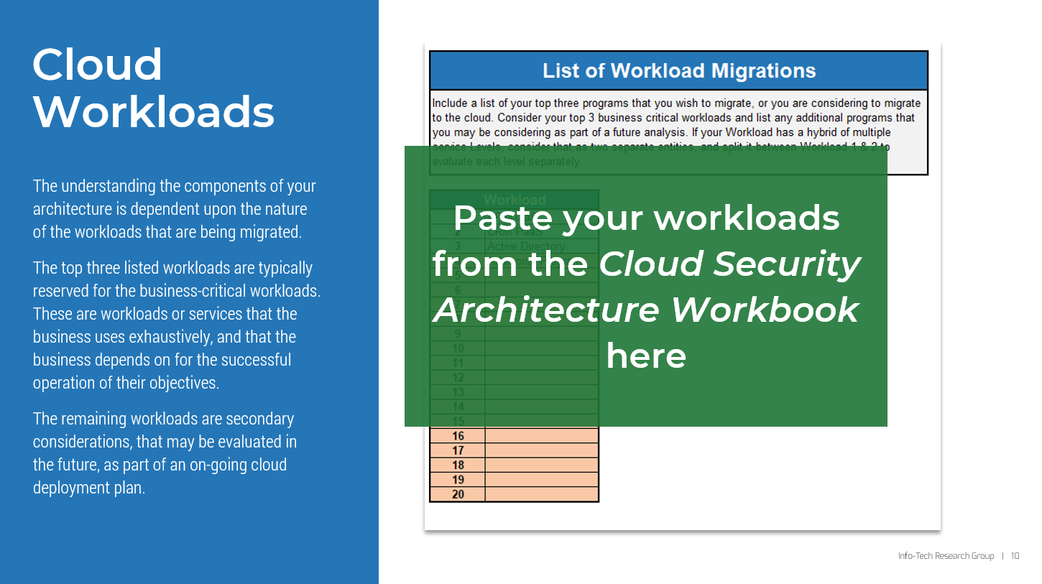
Blueprint deliverables
Key deliverable:
Each step of this blueprint is accompanied by supporting deliverables to help you accomplish your goals:
  Cloud Security Architecture Communication Deck
  Cloud Security Architecture Workbook
Compile your security components to analyze the appropriate services needed to mitigate your cloud risks.
Document the workload deployment to the cloud. Learn the effort and risks associated with each service level.
  Cloud Security Architecture Reference Model
Compile your security components to analyze the appropriate services needed to mitigate your cloud risks. Add or alter the reference model to discover gaps in your security processes.
  Cloud Security Architecture Archive Document
The cloud security architecture archive document provides a home for reference of the controls generated as you address your cloud security challenges.

Slide 18

Guided Implementation
A Guided Implementation (GI) is series of calls with an Info-Tech analyst to help implement our best practices in your organization.
A typical GI is eight to twelve calls over the course of four to six months.
What does a typical GI on this topic look like?
Cloud Security Alignment Analysis
Cloud Security Strategy Planning
Business-Critical Workload Analysis
Cloud Security Architecture Mapping
Call #1: Scope requirements, objectives, and your specific challenges
Call #2: Workload deployment and Cloud Suitability Questionnaire
Call #4: “A” Cloud Environment Analysis
Call #7: Prioritized Security Components & Results Dashboard
Call #10: Cloud Security Strategy Considerations
Call #11: Cloud Security Architecture Communication Deck
Call #5:
“B” Cloud Environment Analysis
Call #8: Cloud Security Architecture Mappings
Call #3:
Cloud Risk Assessment and Cloud Suitability Results
Call #6: “C” Cloud Environment Analysis
Call #12: Summarize results and plan next steps
Call #9: Continue Cloud Security Architecture Mappings
Info-Tech Research Group | 18

Slide 19
Workshop Overview
Contact your account representative for more information.
workshops@infotech.com 1-888-670-8889
 | Day 1 | Day 2 | Day 3 | Day 4 | Day 5
Activities | Cloud Security Alignment Analysis | Business-Critical Workload Analysis | Cloud Security Architecture Mapping | Cloud Security Strategy Planning | Next Steps and Wrap-Up (offsite)
 | 1.1 Workload Deployment Plan 1.2 Cloud Suitability Questionnaire 1.3 Cloud Risk Assessment 1.4 Cloud Suitability Analysis | 2.1 “A” Environment Analysis 2.2 “B” Environment Analysis 2.3 “C” Environment Analysis 2.4 Prioritized Security Controls 2.5 Effort and Risk Dashboard Overview | 3.1 Cloud Security Control Mapping 3.2 Cloud Security Architecture Reference Model Mapping | 4.1 Cloud Security Strategy Considerations 4.2 Cloud Security Architecture Communication Deck | 5.1 Complete in-progress deliverables from the previous four days. 5.2 Set up review time for the workshop deliverables and discuss next steps.
Deliverables | Determining your workload deployment plan Determining the suitability of the cloud for your workloads Risk assessment of workloads Overview of cloud suitability | NIST 800-53 Control Mapping for all three environment levels Prioritized security controls for your environment Paired security services to mitigate cloud risks Effort and Risk Dashboard | Cloud Security Architecture Archive Document with documented security controls and risks Completed Cloud Security Architecture Reference Model | Consider additional security considerations for the Communication Deck Start and or finish Cloud Security Architecture Communication Deck | Complete Cloud Security Architecture Communication Deck

Slide 20

Executive Brief Case Study
INDUSTRY
SOURCE
Streaming Services
Cloud Security Alliance, Sept. 2020
Disney+
Disney+ suffered a breach of its services back in March 2020. External hackers via synchronous credential stuffing hijacked several Disney+ accounts and put them up for sale on the black market. This included not only customers’ login credentials but their network and device types as well. Single accounts and credentials for pre-existing Disney Store and recreation park accounts made a single point of breach exponentially worse than a standard breach.
Subsequently, thousands of users were locked out of their accounts, and their accounts were put up for sale by hackers. Although there was not an imminent Disney+ stock price drop at the launch of the new platform, a breach of credentials this early in the development can be a deterrent for stakeholders and potential customers. Additionally, the data breach exposed PII and other associated personal data with users’ personal accounts.
Impact Statement for Disney+
Vulnerabilities:
A lack of cloud security architecture and strategy: Going live before having an incident response strategy in place is not advisable. Having a single account and credentials for Disney Stores parks and Disney+ accounts also makes breaches exponentially worse.
Insufficient identity and credential management: lack of unique passwords and unmandated MFA.
Business Impacts:
Financial: Deterred potential shareholders and users. Financial costs due to the added operational costs. Increased overhead.
Operational: Incident response. Forensics analysis. Enforced downtime.
Compliance: Possibility of identity theft and breach of personal data, regulatory fines, and inquiry.
Reputational: Brand image and customer trust can be adversely affected.
Key Takeaways
Before the launch of any service, there should be a robust incident management framework and cloud security architecture in place. Mitigate the risks before starting; contextualize your environment and risks and identify the vulnerabilities in your hosted applicated, systems, and interfaces.

