Slide 1
Accelerate Your Automation Processes
Integrate automation solutions and take the first steps to building an automation suite.
EXECUTIVE BRIEF

Slide 2
Analyst perspective
Define an automation suite that works for you.
New trends in IT follow hype cycles, and automation suites are no different. You don’t necessarily need the latest and greatest solution set to create business value as an IT organization, but it’s still worth considering where you’re headed.
If you’ve started your path to process automation with robotic process automation (RPA) and chatbots, consider how your automation suite can continue to improve service. Take the time to learn what is available and see how each piece can be added to and integrated with your current suite. However, do not lose sight of what you have already started.
Benedict Chang Research Analyst, Infrastructure and Operations Info-Tech Research Group

Slide 3
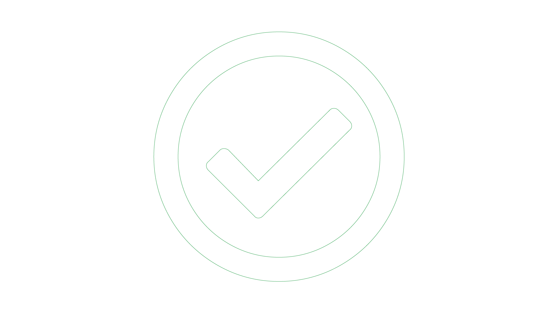
Executive summary
Your Challenge
Common Obstacles
Info-Tech’s Approach
Your organization needs to:
▪Define an automation suite that works.
▪Define the business goals of your automation suite
▪Roadmap your automation modules to continually grow your automation platform.
▪Identify how an automation suite can help your organization improve.
▪Automation platforms and intelligent automation are catchy terms, but it means something different depending on the vendor that you ask. Although every vendor has jumped on the bandwagon to include these terms, there are no standard definitions.
▪Picking tools for the sake of picking tools is not a good strategy and often leads to hardships down the road, since root problems are not solved.
▪Be sure to define your automation suite in terms of your business goals.
▪Take stock of what you have now, for example, RPA, AI Ops, Chatbots. Think about how to integrate and optimize what you have now, as well as roadmap your continual improvement.
Roadmap your decisions to stay on track.
Info-Tech Insight
Start small and do it right. Ensure that any automation solution you implement creates value for your organization according to business vision. You do not necessarily need to implement every possible solution and may end up drowned in governance and maintenance.

Slide 4
Automationresources
1. Plan (You are here)
Use this blueprint, “Accelerate Your Automation Processes,” to chart your path.
2. Learn
Use these blueprints to take your first steps with an automation module:
Optimize the Service Desk With a Shift Left Strategy
Prepare for Cognitive Service Management
Drive Customer Convenience by Enabling Text-Based Customer Support
Automate Work Faster and More Easily With Robotic Process Automation
3. Build
Use these blueprints to create a proof of concept:
Build a Chatbot Proof of Concept
Build Your First RPA Bot
Create an Architecture for AI
Where are you on your automation journey?
02
01
03

Slide 5
Info-Tech’s methodology for accelerating your automation processes
 | Discover automation suite possibilities | Chart your Automation Suite Roadmap
Phase Steps | Assess maturity Identify gaps in your automation ecosystem | Prioritize your possibilities Build your roadmap
Phase Outcomes | Take hold of your current state and identify where you would like to improve. Uncover the right decision for your organization, whether it be adding a new automation module or investing in your current modules. | Build a high-level roadmap of where you want to get your automation suite to in the future.

Slide 6
Insight summary
Overarching insight: Start small and do it right.
Assess whether your current solution works for you. If it does, continue to invest in it before moving onto the next solution. Overwhelming your organization with a plethora of automation solutions can lead to a lack of ability to manage each solution and a decrease in your overall ROI.
Take stock of your use cases and see how automation can help.
The goal of implementing an automation suite is to optimize your business processes from end to end. Choosing a vendor or solution that is best suited for workflows outside your internal use cases will lead to frustration down the line.
Clean data is the backbone of effective automation.
Clean data is integral to any automation solutions you want to implement, whether it is a chatbot, AI operations or analytics, and/or RPA. If the database that feeds an automation solution is not up-to-date or accurate, work on updating it before implementing an automation solution.
Focus on integrations and optimize already available modules.
If you already have an automation solution, optimizing its processes may be more beneficial than acquiring a new solution. Ensure your current suite is optimized before adding new modules.
Look at gaps in your process and prioritize filling them by business goals.
Refrain from acquiring new solutions for the sake of its flashy features. Assess and prioritize your goals first before looking at automation solutions.

Slide 7
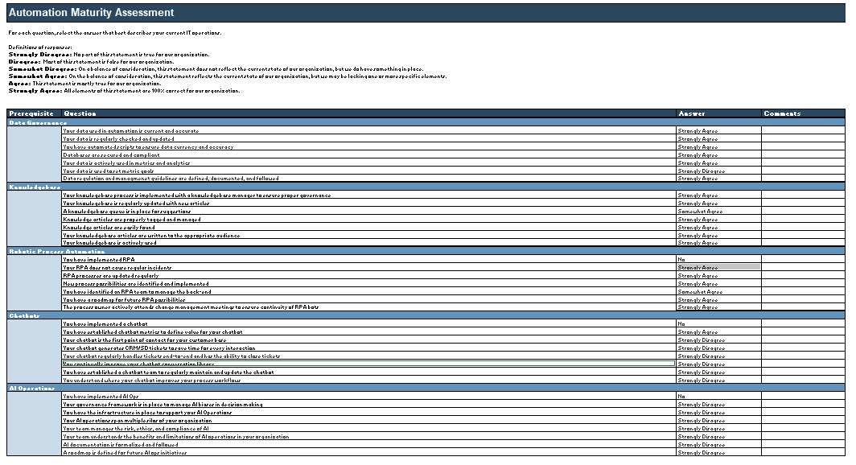
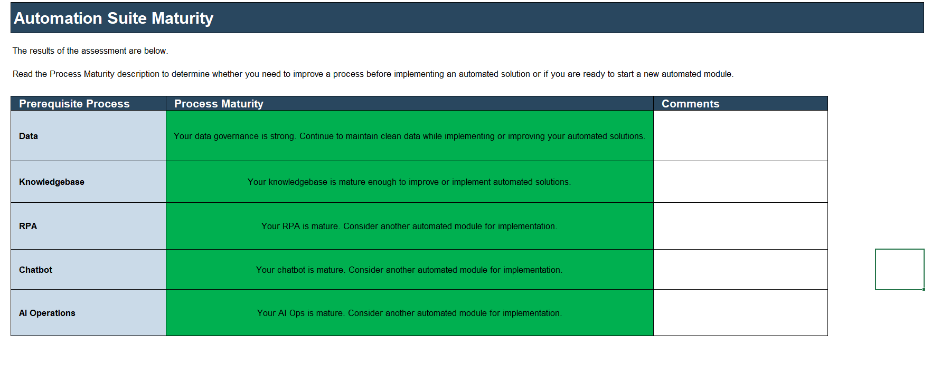
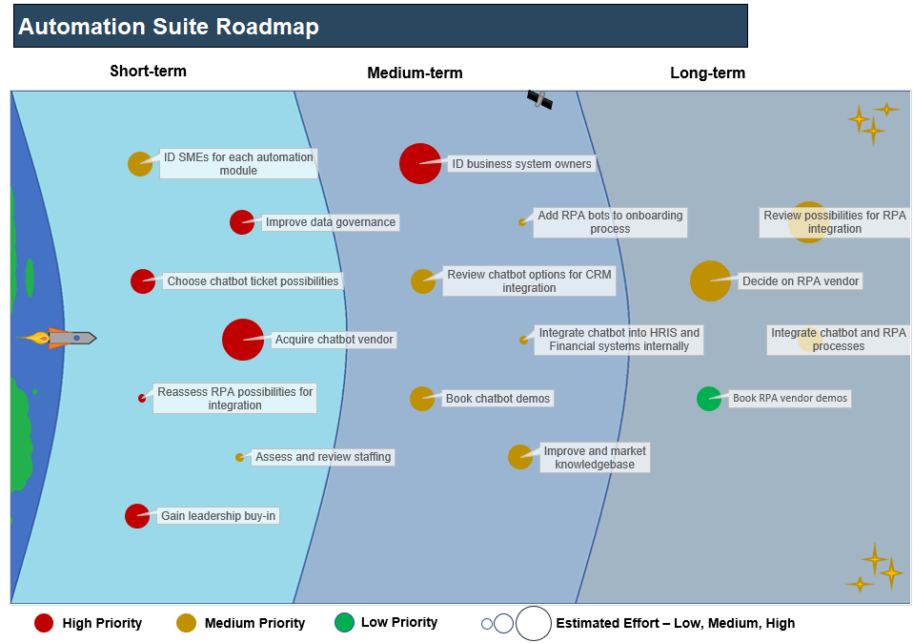
Blueprint deliverables
Automation Suite Maturity Assessment Tool
This blueprint consists of two main deliverables:
Automation Suite Maturity Assessment Tool
Automation Suite Roadmap Tool
Use the Automation Suite Maturity Assessment Tool if you are having trouble deciding what you want to implement next. The maturity assessment will help you discover if your database, knowledgebase, and/or current solutions are mature enough to warrant adopting an additional module.
The Automation Suite Roadmap Tool can help you capture your high-level goals and keep you on track as you integrate your current modules and/or implement additional solutions.
Use the maturity assessment to plan your next steps on your automation journey.
Automation Suite Roadmap Tool
Place your action items in an automation roadmap to realize your short- and long-term goals.

Slide 8
Keep your business goals in mind to plan your automation possibilities
Robotic Process Automation (RPA)
AI
Chatbots
Don’t implement an automation solution just because it’s the popular trend of the year. Consider your business goals when examining possible automation modules. Are you able to put the work in to benefit from its implementation? Will it create business value down the line?
Business Goals
Viable Projects

Slide 9
Blueprint benefits
IT benefits | Business benefits
Develop scalability to absorb spikes in operations and service demands. Free up time to let techs and engineers to solve higher-level problems. Optimize your workflows end to end. Understand how your automation modules work together to provide value. Gain improved insight into metrics. | Save costs by automating repetitive tasks. Leverage integrated metrics to identify new processes to automate. Gain full insight and visibility into optimized workflows. Increase the quality of customer service. Decrease the response time for customer service.

Slide 10
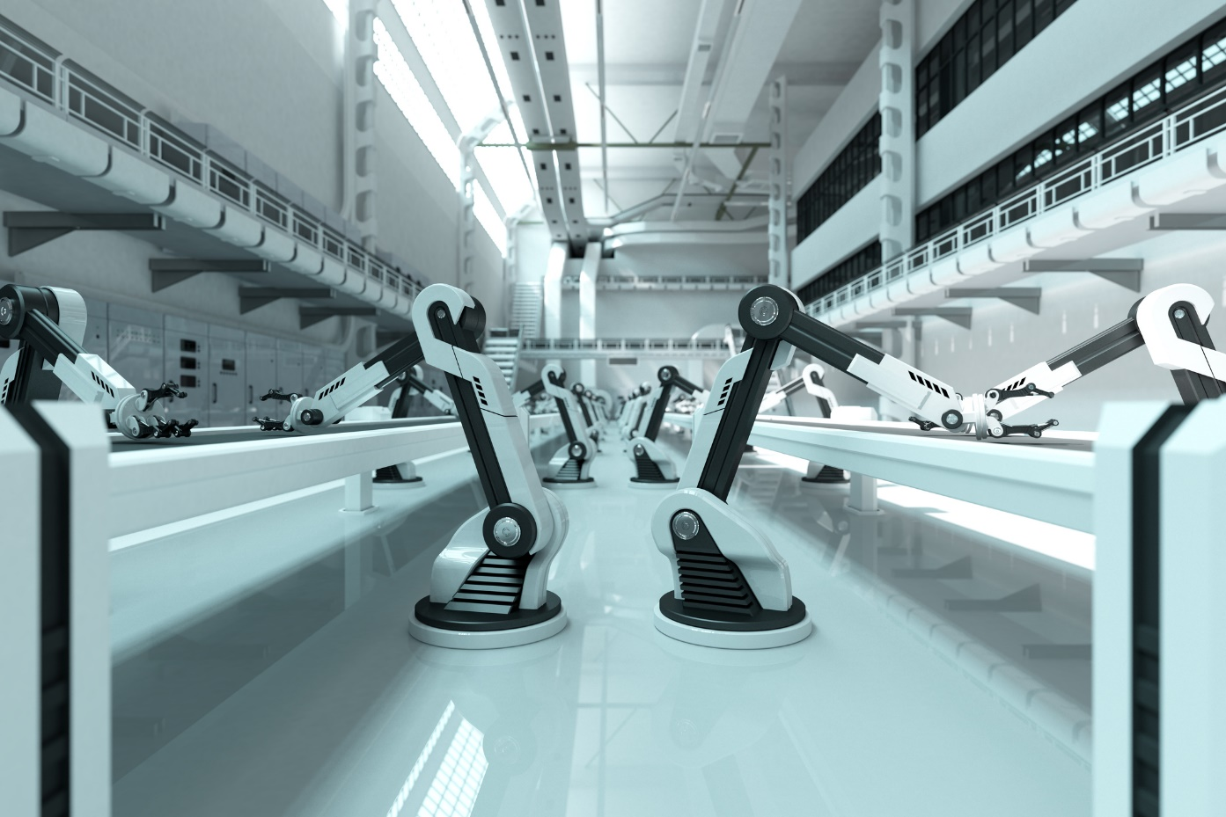
What lies beyond RPA, chatbots, and AIOps?
An automation suite or automation platform means something different to every vendor. In short, it’s combining multiple automated tools so the automation is optimized. Automation suites helps you move beyond automating repetitive tasks. The integration of RPA with analytic metrics, AI ops, and chatbots will help identify new bots to implement to get the most out of your automation suite.
The goal of an automation suite is to achieve end-to-end process automation wherever possible. This may be within manufacturing, from a service perspective, or related to process workflows. Furthermore, the use of AI and analytics to help you improve your own automation possibilities can further efficiency. The difficulties with automation lie in getting the steppingstones in line with proper data and proper governance before taking the plunge.

Slide 11
Understand workflow automation, RPA, and BPM
Business process management (BPM) and robotic process automation (RPA) are not mutually exclusive. You can view RPA as a means to achieve BPM. RPA consists of single bots or a suite of bots making swivel chair screen scraping and form filling tasks that are repetitive and low variability. BPM can utilize multiple RPA bots and/or chatbots and AI Operations to achieve its goal of end-to-end process automation.
Workflow automation | Robotic process automation (RPA) | Business process management (BPM)
Automation of processes within a single tool | Automation of processes within multiple tools | End-to-end business automation from multiple tools and multiple related processes

Slide 12
Take your first steps to building your automation suite
Data/ knowledgebase (KB) | The KB is the backbone of any informational chatbot. Having a solid KB, as well as a sound process for updating and adding new articles/information to your KB, are critical to continuing to grow your chatbot and your automated customer service.
RPA | RPA is the first step towards a fully automation suite. Essentially, an RPA automates high-volume, low-variability tasks that otherwise take up tech/engineer time. Introducing a strong RPA process and continually investing in RPA are critical when considering your automation suite.
Chatbots | Chatbots are the customer service side of automation. Taking repetitive tasks in ticket resolution and letting a scalable solution handle the low-variability jobs frees up time for service desk and/or CRM agents to concentrate on more unique customer problems.
AI Operations | Artificial intelligence (AI) can make insights and help inform your process optimization—but only if the data used is well-organized and structured. AI, however, seldom provides insight into the “why” of these decisions and predictions.
Metrics & Analytics | Metrics and analytics can help you define where you need to get to in terms of automation. Identifying candidates for your next ticket to automate or your next process to enhance is a must when tying together all your automation processes. However, bad data can lead you down a rabbit hole. Making sure your data is up to date and properly organized is the key for a clean automation suite.
Follow these best practices to make sure your requirements are solid.
Automation Suite
RPA
Service Automation (Chatbots)
AIOps
Data & Analytics

Slide 14
Guided Implementation
A Guided Implementation (GI) is series of calls with an Info-Tech analyst to help implement our best practices in your organization.
A typical GI is between 8 to 12 calls over the course of 4 to 6 months.
What does a typical GI on this topic look like?
Phase 1
Phase 4
Phase 2
Phase 3
Phase 5
Call #1: Scope requirements, objectives, and your specific challenges.
Call #2: Assess current maturity level.
Call #4: Identify the relationship between current initiatives and capabilities.
Call #6: Identify strategy risks.
Call #8: Identify and prioritize improvements.
Call #3: Identify target-state capabilities.
Call #5: Create the initiative profiles.
Call #7: Identify the required budget.
Call #9: Summarize results and plan next steps.
Info-Tech Research Group | 14

