Slide 1
Manage the Active Directory in the Service Desk
Build and maintain your Active Directory with good data.
EXECUTIVE BRIEF

Slide 2
Choose the right project for you
You Are Here
Simplify Identity and Access Management
Manage Active Directory in the Service Desk
This research blueprint lays the groundwork for establishing a centralized, effective, and efficient system for managing identity and access. If you are looking to take back control of your IAM environment by implementing a role-based access control model, start with Simplify Identity and Access Management.
This research helps you manage the Active Directory from the service desk perspective. If you are looking to create policies around organizational units (OU), governance around AD monitoring, or AD workflows, this is the research for you.

Slide 3
Info-Tech’s methodology for Managing the Active Directory in the Service Desk
 | 1. Build and Maintain Your Active Directory | 2. Structure Your Service Desk Processes for Your Active Directory
Phase Steps | Structure Your Active Directory Monitor and Audit Your Active Directory Design Active Directory Metrics | Build Active Directory Workflows Optimize the Active Directory by Employing Shift-Left Strategies
Phase Outcomes | Structure your organizational units and policies in your Active Directory and know how to monitor them to detect problems before they happen. | Leverage your service desk for Active Directory changes and updates. Use your resources efficiently.

Slide 4
Insight summary
Do not treat Active Directory like a black box
You cannot manage the Active Directory if you do not have visibility into what is going on. Strive for clean data and be proactive by managing your monitoring and audit schedules.
Catch outage problems before they happen
Splitting monitoring tasks between daily, weekly, and monthly monitoring drives efficiency. Planning the monitoring thresholds for each metric beforehand helps you understand problems before they happen.
Shift left to save resourcing
To balance proper access security and fulfillment of Active Directory tickets, employ shift-left strategies such as workflow automation or scripted authorization for Tier 1 technicians. Shifting Active Directory ticket fulfillment to Tier 1 or self-service drives efficiency and success.
Design actionable metrics
Most of the data you are able to monitor is useless. Determine what metrics you are tracking and only monitor the data that directly connects to those metrics. Also know the meaning of a rising or falling metric before you start tracking it.
Use your metrics to help you make decisions
Don’t spend the time to design and script a new process if it does not benefit you in the end. Use your metrics as an objective measure to decide whether you should tackle a shift-left strategy.

Slide 5
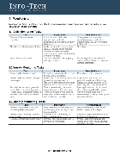
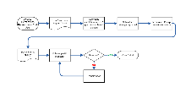
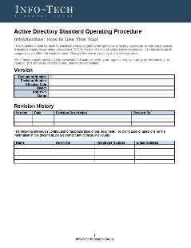
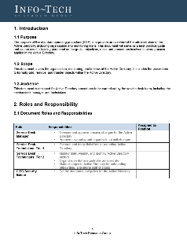
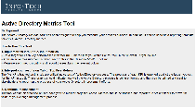
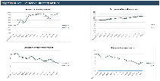
Blueprint deliverables
Key deliverable:
Each step of this blueprint is accompanied by supporting deliverables to help you accomplish your goals:
Active Directory SOP
Use this standard operating procedure (SOP) template to capture how your AD is structured, how to monitor it, and how to efficiently make changes to it.
Monitoring Checklists
Use these daily, weekly, and monthly monitoring checklists to monitor your AD.
(Included in the SOP)
AD Workflows
Workflows for onboarding, offboarding, and role changes in the AD.
Active Directory Metrics Tool
Monitor your AD metrics to continually improve your AD processes.

Slide 6
Design organizational units and policy structure in your AD with security and efficiency in mind.
The Active Directory lifecycle
Planning
Management and Feedback
Deprovisioning
Access Certification
Enforcement
Provisioning
Phase I
Offboard properly to retain compliance.
Onboard with the least-privilege administrative model.
This blueprint covers governance for the different phases of the AD lifecycle, from planning the AD structure to workflows for onboarding, offboarding, and permission changes, as well as metrics and overall process governance.
Monitor metrics to improve your AD processes.
Add ad hoc permissions or change roles with proper governance.
Use shift-left strategies to balance efficiency and security.
Phase II
Use these daily, weekly, and monthly monitoring checklists to monitor your AD.

Slide 7
Benefits of a well-managed Active Directory
IT Benefits | Business Benefits
Centralized resources and security Centralized monitoring Easy logon for access to enterprise resources Better representation of the network Better trust management Easier problem detection and management | Better audit confidence Better business/IT relationship through IT visibility Speed Fewer security breaches Less downtime Facilitated onboarding, offboarding, and staff and resource changes

Slide 8
You can migrate to the cloud, but your governance stays put
Active Directory governance applies equally to on-premises and cloud-based active directories
Whether your organization is a small startup with a cloud-based Active Directory or a larger enterprise with on-premises data centers, Active Directory governance and support cannot be an afterthought.
In both cases, clean data can benefit the Active Directory, and stale, inaccurate data can lead to an organizational mess.
This blueprint addresses how to build effective metrics and Active Directory monitoring as well as how to organize the Active Directory, applicable to both on-premises and cloud directories.

Slide 9
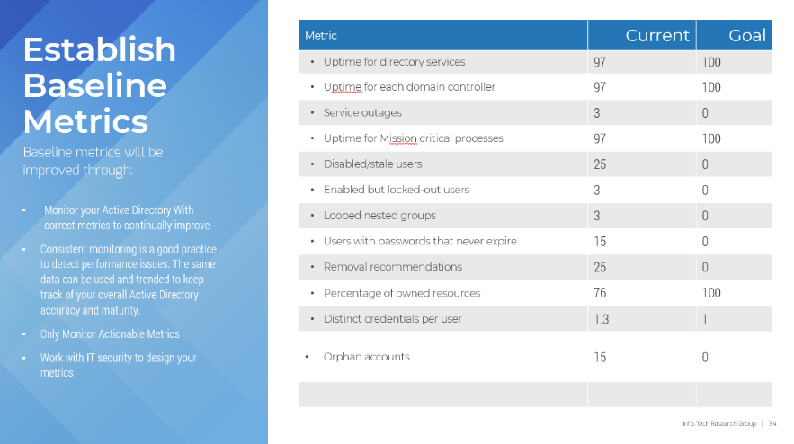
Measure the value of this blueprint
Save project time and ultimately save money
Measure your objective success in managing your Active Directory. Design your project metrics to view your progress throughout the improvement of the Active Directory.
Use the Active Directory Metrics Tool to track your current status and goals for your project metrics.
In phase 1 of this blueprint, we will help you establish current and target state metrics for your organization.
Download the Active Directory Metrics Tool

Slide 11
Guided Implementation
A Guided Implementation (GI) is a series of calls with an Info-Tech analyst to help implement our best practices in your organization.
A typical GI is between 3-6 calls over the course of 2-3 months.
What does a typical GI on this topic look like?
Phase 1
Phase 2
Call #1: Scope requirements, objectives, and your specific challenges.
Call #2: Create organizational unit structure and policy.
Call #4: Design AD workflows.
Call #3: Build monitoring and audit checklists. Design project metrics.
Call #5: Shift-left strategy.
Info-Tech Research Group | 11

