Slide 1
Manage Your Technical Debt
Make the case to manage technical debt in terms of business impact.
EXECUTIVE BRIEF

Slide 2
Analyst Perspective
There’s an iconic scene in I Love Lucy, where Lucy’s wrapping candies on a production line for an overbearing boss. Work that starts out easy becomes difficult, and then impossible, as a torrent of candies come down the line far faster than the workers can wrap them. Even as the workers are hiding (and eating) the candies they can’t wrap, the boss comes back, sees a clear work area, congratulates the team – and orders the line sped up.
If you don’t shed light on the true business impact of technical debt, it can overwhelm your team and your business.
Tech debt tends to drive a lot of IT work the business doesn’t see and that keeps things running smoothly. Efforts to properly pay back technical debt are deprioritized or ignored because they’re infrastructural and don’t clearly offer business benefits. The problem is the bill always comes due.
The goal isn’t to get rid of all your technical debt but to better balance tech debt payback with other business demands. At its core, technical debt is business risk, and it’s up to IT to help the business make an informed decision about which risks to mitigate and which risks to accept.
Use this blueprint to identify your technical debt, measure its business impact, and propose and implement solutions that can help you manage and pay back your technical debt.
But first, go watch that scene from I Love Lucy.
Manage technical debt to better govern risk.
Andrew Sharp Sr. Research Analyst, Operations Practice Info-Tech Research Group

Slide 3
Executive Summary
Your Challenge
Common Obstacles
Info-Tech’s Approach
You know you have technical debt – everyone does. But ask yourself the following:
Do you have a list of your critical technical debt?
Can you confidently speak to the business impact of technical debt?
Do you have a methodology and a business case to address technical debt that has an unacceptable level of impact on the business?
If you answered “no” to any of these questions, read on.
These obstacles get in the way of effective technical debt management:
IT doesn’t have the resources or authority to make needed changes to address the impact of tech debt and can’t make the case for improvement without good data on the problem.
Efforts to track technical debt get stuck in the weeds, don’t connect technical issues to business impact, and run out of steam.
Define and identify your technical debt, focusing on tech debt you think you can actually fix.
Conduct a streamlined and targeted business impact analysis to prioritize tech debt based on its ongoing business impact.
Identify opportunities to better manage technical debt and present those options to business decisionmakers, as needed.
Three key steps enable effective technical debt governance.
Technical debt is a type of technical risk, which in turn is business risk. IT should be a trusted advisor to business leaders making risk management decisions and must communicate the level of risk and options to manage that risk. It’s up to the business to decide whether to accept technical debt or mitigate it.

Slide 4
The technical debt lifecycle
Principal
Direct Costs
+
Strategic Impact
+
Uncertainty
Pay back
A cost is avoided in an IT environment, for the moment.
=
Business impact continues until the initial cost is addressed or the system carrying the debt is abandoned.
Interest
Messy code is deployed to meet a deadline.
Equipment refreshes are deferred.
Security vulnerabilities are left unpatched.
Machine learning algorithms are not analyzed for accuracy or bias.
Data is ungoverned; APIs don’t follow standards.
Broken service management processes are not fixed.
Training budgets are cut.
Old technologies are not replaced.
The initial cost avoidance leads to ongoing business impact (ongoing costs, user impacts, reduced flexibility, and increased risk).
Code is iteratively refactored until it meets acceptable standards.
Patches and updates are scheduled and applied.
New devices are purchased and deployed.
The legacy system is replaced.
A data governance program is developed and enforced.
A training and knowledge management program is developed.
Unused or little-used systems are retired.
New features are slower to code and more likely to break, limiting business agility.
EUDs are slow and hinder productivity.
Data is unusable for analytics or the results are badly flawed.
Integrations are difficult or impossible.
Reliance on expensive outside contractors; slow response, escalation, and resolution times.
A future upgrade becomes gradually more painful.

Slide 5
Tackle a mountain of technical debt
Technical debt describes the result of avoided costs that over time cause ongoing business impact. Tech debt creates friction for your IT and business staff; frustrates your customers; limits your flexibility, competitiveness, and resilience; and erodes business value.
Most organizations have a significant and growing technical debt portfolio.
Left unaddressed, tech debt can become an existential threat that risks your organization’s ability to effectively compete and serve its customers. Businesses that fail to properly manage their technical debt will be at a significant competitive disadvantage.
As an IT leader it’s your role to help the business better understand the risks introduced by technical debt, in terms of its ongoing business impact, and the options available to address it. This allows business leaders to make better decisions to pay back or hold technical debt.
“Poor management of tech debt hamstrings companies’ ability to compete.”
Source: McKinsey Digital

Slide 6
Technical debt is expensive and ineffectively managed
Resolving or minimizing the impact of aging systems is seen as IT’s problem to solve, even when IT has no resources or authority to make needed changes.
Deferred project work is pushed over to operations, sometimes with little visibility or hand-off, where it gets deprioritized and lost.
The effort of keeping legacy systems stable, patched, and updated drains away time from longer-term planning exercises.
Though business leaders are often aware that aging systems are an obstacle to realizing business value, they don’t greenlight fixes because of other, more urgent priorities or because IT isn’t trusted to deliver an effective solution.
Building a case to address technical debt can be difficult because the technical problems are complex and difficult to translate into business impact.
A well-intentioned effort to track every technical debt is doomed to failure. Track just the technical debt you intend to fix. It’s better live with some technical debt than to replace it.
On average, respondents said that 25% of their development time went toward technical debt management activities.
25%
but,
93% of respondents had no way to systematically track and manage the technical debt that was absorbing all that time.
93%
Source: Martini, et al.

Slide 7
Unlock business value by managing your technical debt
IT Benefits | Business Benefits
Manage the chaos and disorder created by technical debt to deliver more reliable, available, and serviceable IT systems and applications. Conduct a holistic analysis of your organization’s technical debt to identify the debt generating unacceptable business impacts. Identify options to reduce technical debt, and use your technical debt business impact analysis to make the case for funding and resources. Build a technical debt register to maintain visibility on tech debt in your environment. | Identify strategic solutions to replace or manage legacy technology that will enable the business flexibility and resilience required to outperform your competitors. Make better resource allocation decisions with better information on the true business cost of deferred IT maintenance.

Slide 9
Insight summary
Three key steps enable effective technical debt governance.
Technical debt can, and should, be actively governed in a way that delivers durable value to the business. Every IT organization must identify, measure, and manage their technical debt to govern technical debt effectively.
Focus on solving the problems you need to address.
Don’t make your tech debt assessment a philosophical exercise, a confessional booth, or an appeal for sympathy. Do this exercise because you have a problem that needs to be better understood to be fixed. Analyzing technical debt only has value in that the analysis can help the business and IT make better risk management and resource allocation decisions. It is a tool to help you get to where you need to be – it is not an end in itself.
Use a comprehensive and more-objective impact analysis.
It’s often challenging to identify a direct financial cost for technical debt. Consider direct costs, but also assess categories of impact that can have a long-term effect on your business: lost customer, staff, or business partner goodwill; limited flexibility and resilience; health, safety, and compliance impacts. Use more-objective measures to track subjective impact. For example, consider the number of customers who could be significantly affected by each tech debt in the next quarter.
Accepted, not ignored.
Not every technical debt in your environment can – or should – be addressed right away. A decision by the business to avoid addressing technical debt now is the business’ acceptance of the risk. This can be an appropriate and acceptable outcome. Of course, the debt doesn’t go away. Track your remaining technical debt and the options available to mitigate or address the risks associated with technical debt.

Slide 10
Manage technical debt
 | Phase 1: Identify Technical Debt | Phase 2: Measure Technical Debt | Phase 3: Manage Technical Debt
Phase Steps | 1.1 Define technical debt 1.2 Identify technical debt items | 2.1 Create impact scoring criteria 2.2 Estimate the business impact of technical debt | 3.1 Identify action items to reduce technical debt 3.2 Track and control technical debt
Phase Outcomes | Identify sources of technical debt in your environment. Consolidate and narrow the initial list and select five to ten tech debt items that are highest impact/risk. | Develop business impact criteria to assess the business impact of identified technical debt. Prioritize technical debt items based on business impact. | Brainstorm projects and action items that can address technical debt. Develop a proposal to manage technical debt. Implement management practices that help you better manage technical debt.

Slide 11
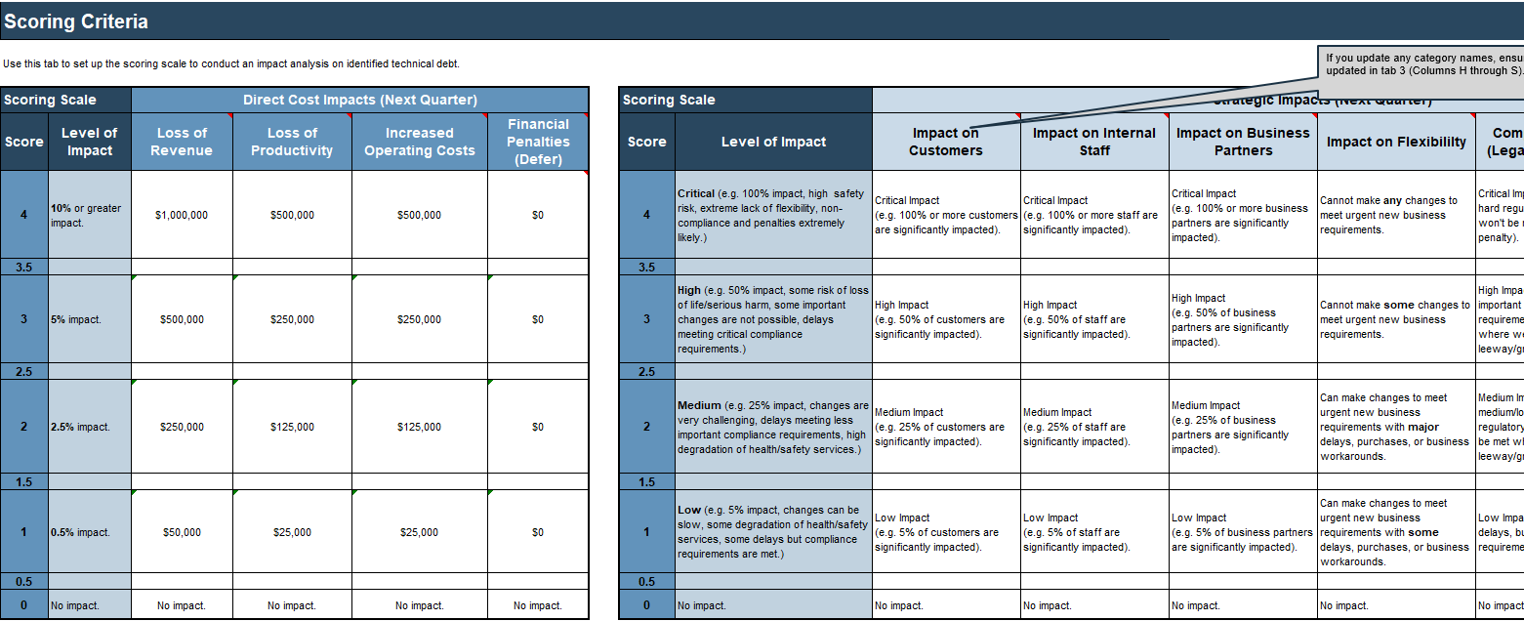
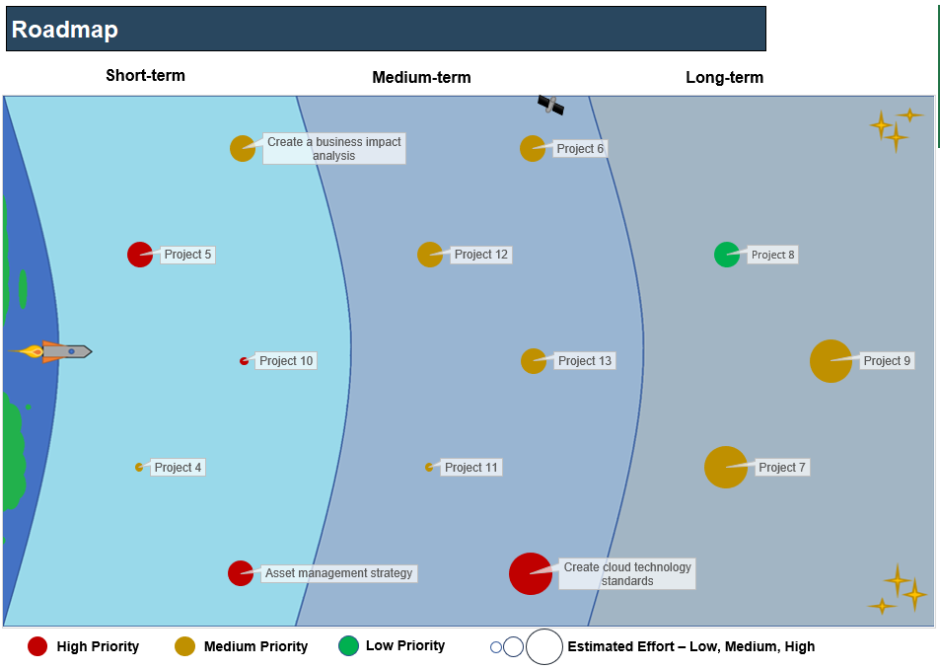
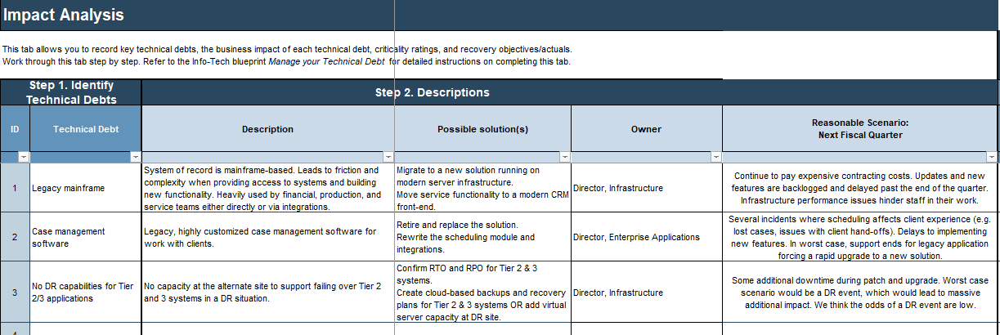
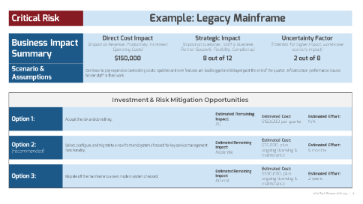
Blueprint deliverables
Key deliverable:
Each step of this blueprint is accompanied by supporting deliverables to help you accomplish your goals:
Technical Debt Executive Summary Presentation
Communicate the risk of technical debt and approaches to address it to an executive audience with this simple and slick overview template.
Technical Debt
Business Impact Analysis
Roadmap Tool
Document technical debts, create a business impact scoring scale, and assess the impact of each technical debt on the business.
Document action items and projects to address technical debt. Estimate risk reduction, effort, and cost. Create a visual roadmap.

Slide 12
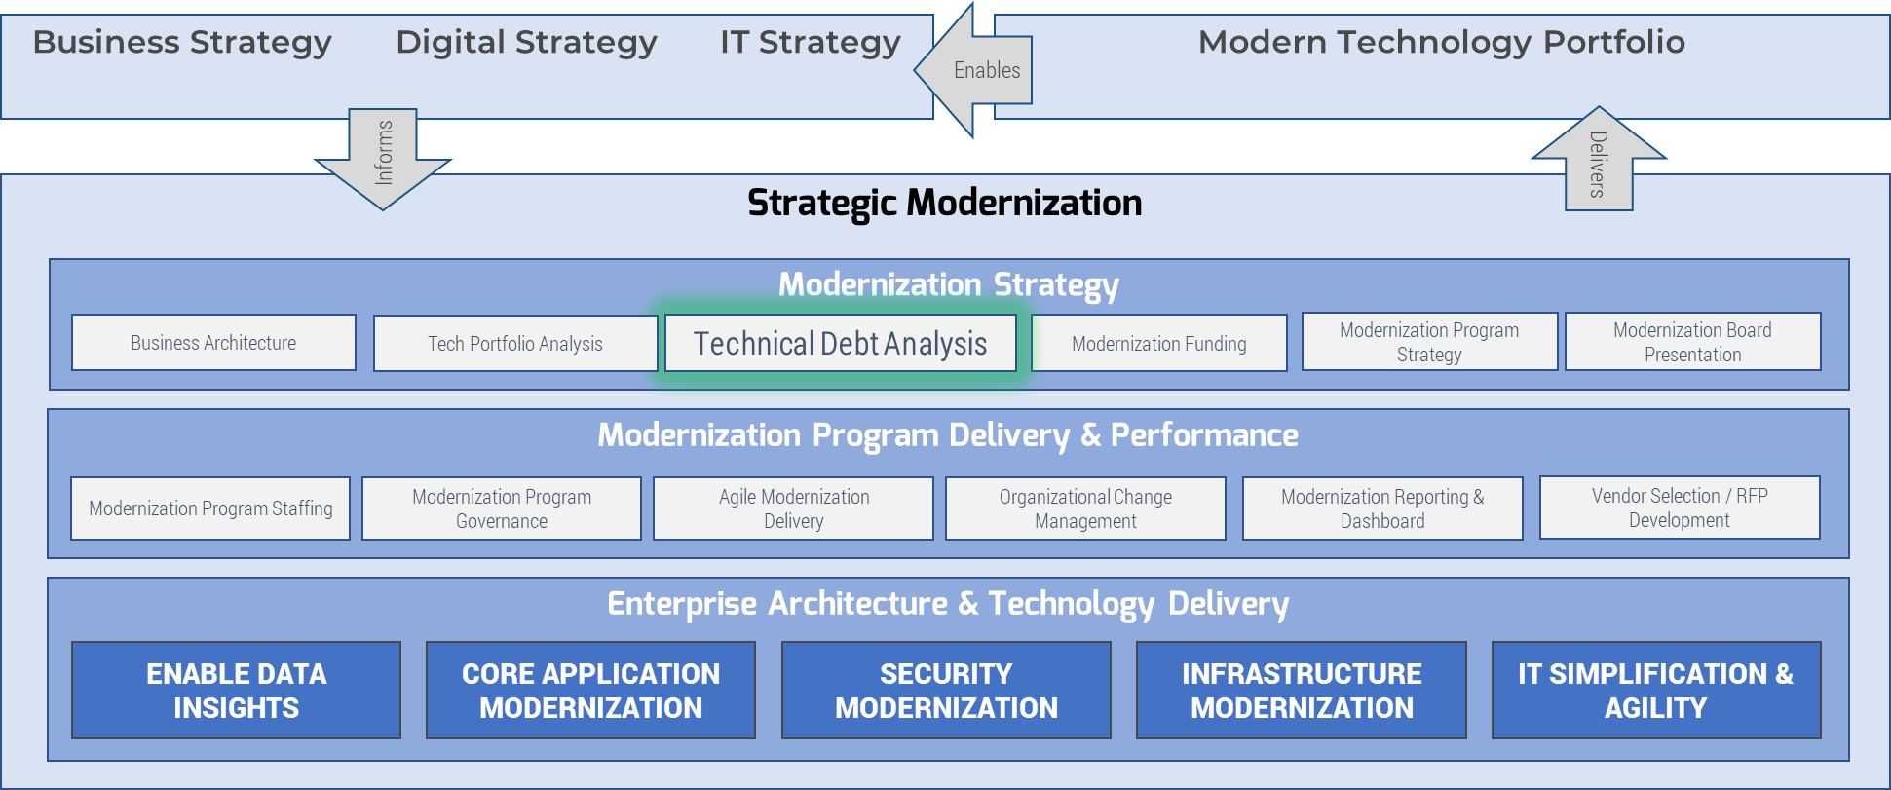
Analyze technical debt to inform your modernization strategy
Chart a path to the future that accounts for the constraints of today.
Major modernization initiatives, including digital transformation, can enable tremendous business value, but technical debt can stand in the way of truly transformative, structural changes.
Old technology may not enable the capabilities and functionality required to digitize business processes.
Use a modernization strategy to make the case for eliminating technical debt.
The constraints introduced by technical debt on modernization are a type of business impact. Use this blueprint to estimate and communicate the impact of technical debt as an obstacle to modernization and inform your modernization strategy with that analysis.
Key Info-Tech Modernization Blueprints: | Modernize Your Applications | Build an Infrastructure Roadmap | Modernize Data Architecture

Slide 14
Guided Implementation
A Guided Implementation (GI) is a series
of calls with an Info-Tech analyst to help implement our best practices in your organization.
A typical GI is between 6 to 10 calls over the course of 3 to 6 months.
What does a typical GI on this topic look like?
Phase 1
Identify Technical Debt
Phase 2
Measure Technical Debt
Phase 3
Manage Technical Debt
Call #1: Scope requirements, objectives, and your specific challenges.
Call #3: Create and document business impact scoring scales that are relevant to your organization.
Call #6: Identify and prioritize actions to address technical debt and review the executive summary template.
Call #2: Review and document sources of technical debt in your environment.
Call #4: Identify reasonable scenarios for impact scoring and begin the scoring exercise.
Call #7: Review the draft executive summary. Identify process improvements to slow down the technical debt “production line.”
Call #5: Review the results of the scoring exercise.
Info-Tech Research Group | 14

Slide 15
Workshop Overview
Contact your account representative for more information. workshops@infotech.com 1-888-670-8889
 | Day 1 | Day 2 | Day 3 | Day 4 | Day 5
Activities | Define Technical Debt | Measure Technical Debt | Build a Roadmap | Manage Technical Debt | Next Steps and Wrap-Up (offsite)
 | 1.1 Develop a working definition for technical debt. 1.2 Discuss your organization’s technical debt risk. 1.3 Identify 5-10 high-impact technical debts to structure the impact analysis. | 2.1 Review and modify business impact scoring scales. 2.2 Identify reasonable scenarios to structure the impact analysis. 2.3 Apply the scoring scale to identify the business impact of each technical debt. | 3.1 Finish the impact analysis. 3.2 Roll up the results of the impact analysis, and identify critical (highest impact) technical debts. 3.3 Brainstorm projects and action items to manage and pay back critical technical debt. 3.4 Prioritize projects and action items to build a roadmap. | 4.1 Use the items on the roadmap to identify different courses of action to address critical technical debt. 4.2 Identify three possible courses of action to pay back each critical technical debt. 4.3 Identify immediate next steps to manage remaining tech debt and limit the introduction of new tech debt. | 5.1 Complete in-progress deliverables from previous four days. 5.2 Set up review time for workshop deliverables and to discuss next steps.
Deliverables | Goals, opportunities, and constraints related to tech debt management A list of technical debt | Business impact scoring scales Scenarios to support the impact analysis Preliminary technical debt impact scores | Technical debt business impact analysis Technical debt management roadmap | Options for technical debt pay back Technical debt executive summary Immediate next steps to manage technical debt | Workshop summary and overview presentation Finalized outputs from all workshop working sessions

