Slide 1
Build a Chatbot Proof of Concept
Create value for your business with your chatbot implementation.
EXECUTIVE BRIEF

Slide 2
Info-Tech’s methodology to Build a Chatbot Proof of Concept
 | 1. Form Your Chatbot Strategy | 2. Architect Your Chatbot | 3. Continually Improve Your Chatbot
Phase Steps | Calculate your chatbot’s ROI to determine its success Organize your metrics to keep the POC on track | Build your chatbot conversation trees Design your chatbot integrations with business value in mind | Build your chatbot support team Identify your future steps for project expansion
Phase Outcomes | Building a strategy is the first step for chatbot success. You will track your project’s ROI, build metrics for your chatbot to measure its success, and use a data-driven approach to choose your chatbot ticket categories. | Design your chatbot integrations before its implementation. You will have a mapped idea of all systems your chatbot will integrate with as well as prototypes for the chatbot decision trees. | Your chatbot does not stop at implementation. You will choose your team to continually support your chatbot and build a business-aligned vision for your chatbot’s next steps.

Slide 3
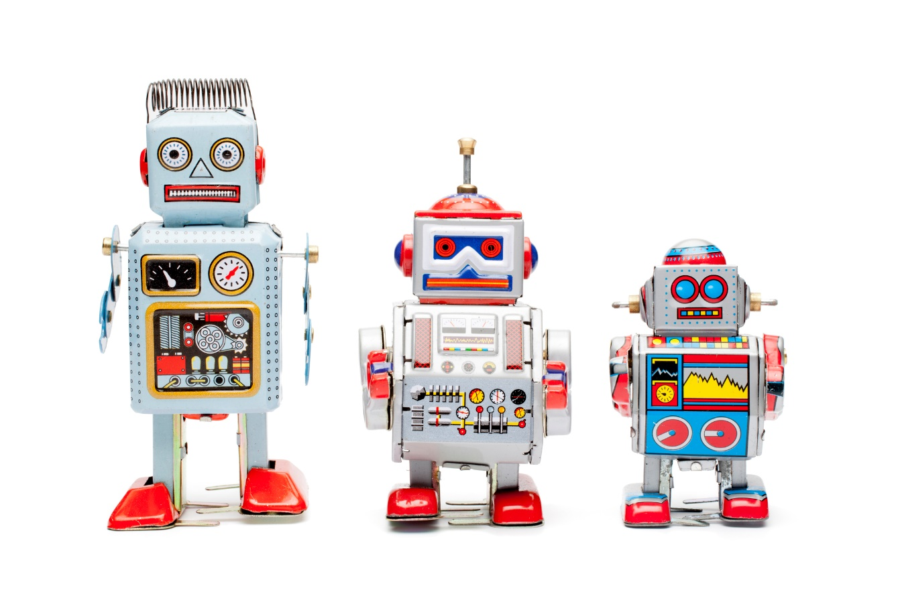
Scope your project carefully
Decide which type of chatbot is right for you
Retrieval chatbots: These chatbots provide an interface to structure content in the knowledgebase. Before implementing a chatbot, your knowledgebase must be mature and up to date.
Generative chatbots: These chatbots submit, categorize, and route requests on the end user’s behalf. These chatbots can be used to verify identity and gather requirements to save time for live agents. This cuts down on time spent by live agents on every ticket.
Intelligent agents or virtual assistants: These are powered by machine learning to automate IT operations like incident, problem, and change management and to identify issues early and resolve them before they have an impact. Intelligent agents can also be used by both the live agent and the customer to perform repetitive tasks needed for tickets.

Slide 4
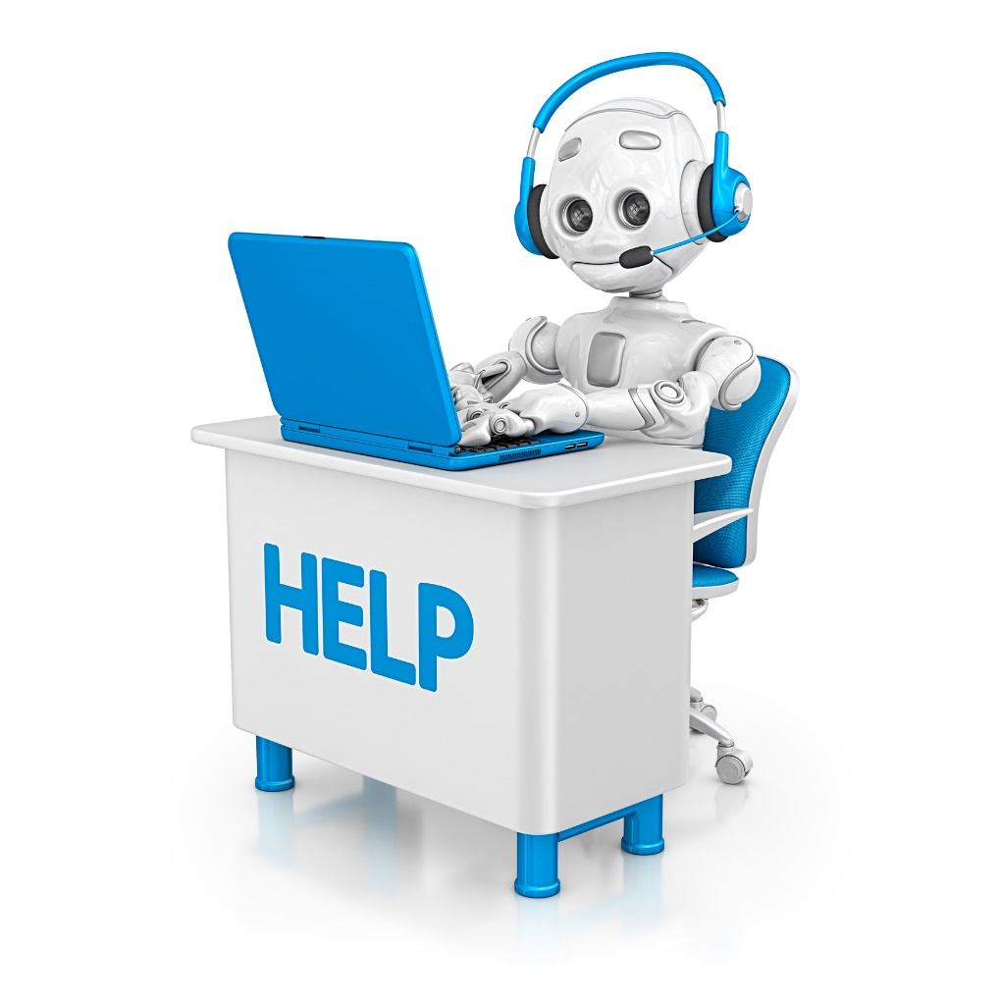
Improve employee self-service
Implementing an IT service management (ITSM) chatbot
Chatbots are a good tool to save resources on every ticket that comes through the service desk. However, how you build the chatbot at the beginning can make or break the entire project. Start with the easy-win tickets that are both common and easy to solve to gain user buy-in and encourage adoption and chatbot use.
Chatbots can be a large component of your shift-left strategy. They help by solving easier tickets or by relaying knowledgebase (KB) articles for solutions. Every ticket successfully solved by a chatbot is time saved by a service desk technician.
When implementing an ITSM chatbot, be careful to define value for the POC. An ITSM chatbot by itself may not generate revenue for the organization directly, but it will increase self-service capacity. It may also open the doors for integrations with other enterprise systems such as finance systems, human resource information systems (HRIS), and enterprise service management tools (ESM).

Slide 5
Improve external customer experience
Leverage chatbot integrations for customer service management (CSM)
Chatbots can function differently with a customer relationship management (CRM) system compared to the service desk. In addition to the easy-to-solve tickets and ticket triage, chatbots in CRM can also be used instead of a live agent at the beginning of the call to take care of verification and identification. With the chatbot handling the repetitive, low-variability tasks used in every call, representatives can focus on the more cognitive part of ticket problem solving.
Deflecting calls from the call center to the chatbot helps with both pre-sale and post-sale support.
Pre-sale: Give customers additional value on a website or mobile app before they make a sale. Chatbots can be used to recommend products based on purchase history or geographical location or to answer product inquiries.
Post-sale: Post-sale support is where chatbots drive value. It takes less effort to retain a customer than it does to obtain a new customer, and keeping customers happy with a good customer experience will drive retention rates. A chatbot solution can be scaled up or down quickly and can be used in a crisis to answer simple inquiries and deflect calls away from the call center.

Slide 6
Improve service
Leverage chatbot integrations for your ITSM and/or CSM
With both internal- and external-facing chatbots, standardization of service is a benefit to strive for. Chatbots can interact with both the customer and the live agent simultaneously. Bringing up suggestions to be vetted by the live agent gives two benefits:
The chatbot is trained under supervision, so responses can continue to be automated with higher confidence.
The chatbot trains the live agent. Recalling knowledgebase articles or tailored responses can help the agent in new situations.

Slide 7
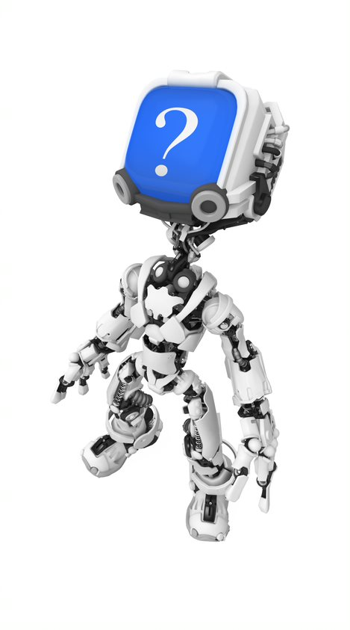
Avoid these pitfalls to implement a thriving chatbot
Chatbots seem like an easy answer, but they’re not always a silver bullet.
If you implement your chatbot using half-filled conversation trees or without addressing the proper tickets, user adoption will plummet.
Organizations can adopt a chatbot and have no idea if it’s successful if they’re missing two pieces of data: metrics and feedback.
Be ready for the task ahead.
Ask yourself what the proper steps are to implement the chatbot, from requisition to build to implementation. Do you have the in-house talent required to carry out the project, depending on the chatbot vendor? If not, you may need to contract out part or all of the project. Additionally, do you have the team to support the project continually once it’s implemented?
Identify places where you can likely improve first:
Chatbots can be implemented as a quick fix to a broken service desk or CRM. However, if the people or process components are lacking or immature, implementing a chatbot is a poor decision and will not help fix the root problem.
Standardize your processes for managing the client experience, including documenting solutions, creating workflows, and creating consistency in your approach.
Going from a standardized service desk or customer experience (Cx) with uniform service to a chatbot is not a high effort task. Look at variability in solutions.

Slide 8
Critical decisions for chatbot implementation
1 | Who is your audience? From an ITSM or CRM perspective, this may seem obvious, but from a chatbot natural language process perspective, this is a heavy consideration. Does your intended chatbot vendor support your audience as a whole? Is the chatbot able to understand their language, dialect, accent, and slang, which will all play into the customer experience?
2 | What is the scope of your chatbot? There are many types of chatbots out there for both ITSM and CRM programs. Virtual assistants and more intelligent chatbots can be used to help customers predict problems before they happen or analyze datasets to find answers that may not be obvious. Chatbots at a base can come in two flavors – retrieval or generative.
3 | What expertise is needed to carry out the project from beginning to end? What expertise is needed to support the chatbot once it launches? Do you have the expertise in house?
Answer these questions before starting your proof of concept
Info-Tech Insight
You don’t have to reinvent the wheel. Chatbots are not new, and vendors have been building and refining them for decades. Their natural language processing (NLP) and AI algorithms are generally more advanced than something that you build in-house and will create a higher return on investment.

Slide 9
Critical decisions for chatbot implementation
4 | In house or outsource? Many vendors have worked over the last several years to optimize NLP even when leveraging third-party text or speech recognition software such as Google or Amazon Alexa. Do not spend unnecessary time building a bot source when that effort could be directed to increase chatbot governance.
5 | Code, low code, or no code? Many chatbot vendors are pushing toward easier implementation by marketing low- or no-code chatbot solutions. Keep in mind that chatbots may have to interface with your ITSM or CRM. While steps like conversation trees may be GUI-based, the API may not.
6 | Current ITSM/CRM or another vendor? Many ITSM or CRM vendors have their own chatbot. Of course, this would make implementation simple, as you may already have the module needed for integration. However, do not rule out aftermarket additions. Ask your organization what you are trying to fulfill with the chatbot. Does the stock chatbot for your current ITSM or CRM fill that space?
Answer these questions before starting your proof of concept

Slide 10
Insight summary
Build your chatbot to create value
Whether it is increasing service or resource efficiency, keep the goal of value in mind when making decisions with your proof of concept (POC).
Clean data leads to proper metrics
The proper metrics with clean data will serve two purposes: Giving you the first round of tickets to implement in the chatbot POC. Giving you the objective answer of whether your POC is successful in its lifecycle.
Value takes different forms
The chatbot should not create value solely for the business. Consider the value for the customer as well. If a ticket cannot be successfully handled by the chatbot alone, know the appropriate escalation point to deflect to a live agent. Be sure the chatbot saves time with each interaction.
Chatbots do not end at implementation
Continue to grow your chatbot beyond the implementation and POC. Have a continual improvement plan ready. Chatbots should not be a one-and-done solution, but a land-and-expand solution. It is a continual investment to create value for the business, IT, and the customer.
Leverage your vendor
Helping other organizations implement their chatbots will give your vendor a good idea of the common tickets, tips, and tricks for your industry.
Do not reinvent the wheel
Vendors have been around a while and know how to code and build the chatbot’s back end. Building an in-house chatbot may end up costing much more than partnering with a vendor.

Slide 11
Blueprint benefits
IT Benefits | Business Benefits
Decreased live-agent handling of tickets and increased self-service Better customer service scalability Higher first contact resolution and fewer escalated support tickets for Tier II and Tier III or fewer live-agent deflections Automated pre-sale support Potential to expand into HRIS, finance, and other enterprise systems outside of IT Standardized service | Better customer experience (Cx) and customer satisfaction (Csat), with faster customer turnaround Increased business continuity preparedness for crises such as COVID-19 More IT project efficiency and better turnaround time for projects Easier customer acquisition Possibility of universal automation Standardized service

Slide 12
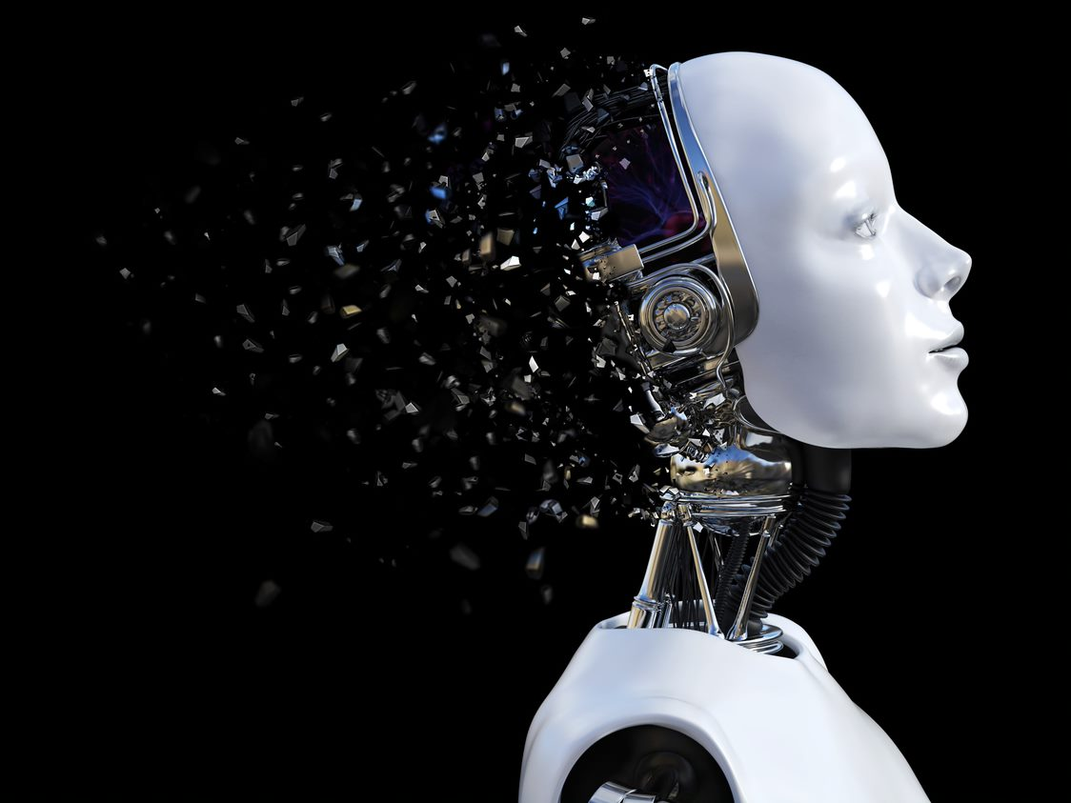
Build your business case for a chatbot POC
When implemented effectively, chatbots can help save costs, generate new revenue, and ultimately increase customer satisfaction for both external and internal facing customers.
Customers are moving toward using chatbots. In 2017, 67% of customers worldwide used a chatbot, and 40% of customers are indifferent to the method of support if their request is satisfied. More and more people are using chatbots every day.
Benefits are internal as well as external. Organizations can save up to 30% in customer support costs and cut down on response times by an average of 80%.
Source: Invespro, 2018

Slide 13
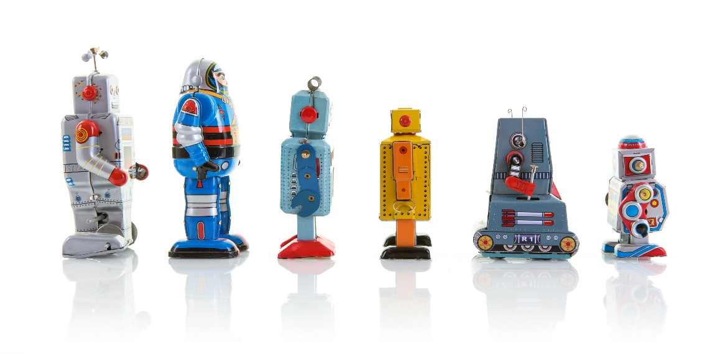
Chatbots and scalability
In early 2020, COVID-19 forced much of the world to work from home. IT departments scrambled to accommodate an enormous workforce paradigm shift. For both internal- and external-facing customer service platforms, organizations needed a quick way to scale up customer service delivery to continue meeting service level agreements (SLAs).
Chatbots were a great solution when implemented properly. They are a quick, scalable solution to handle the increase in volume for customer service while keeping the workforce, as well as costs, stable.
Info-Tech Insight
Chatbot vendors will not automatically solve your problems for you. Even during a crisis, you must plan your implementation and not rely on the chatbot to automatically take up the slack. Take the time to define your goals, choose your tickets, and draw an implementation plan before the chatbot vendor arrives on site.

Slide 14
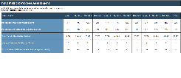
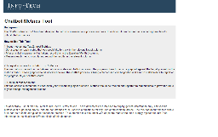
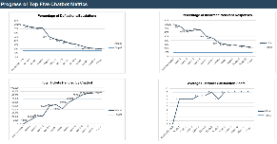
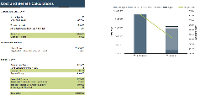
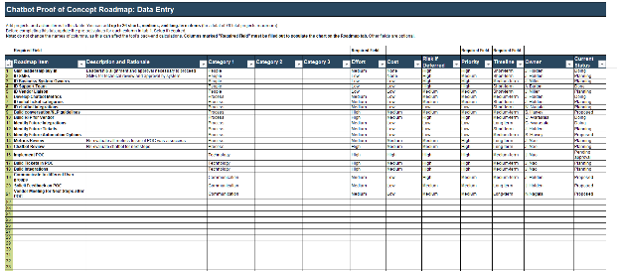
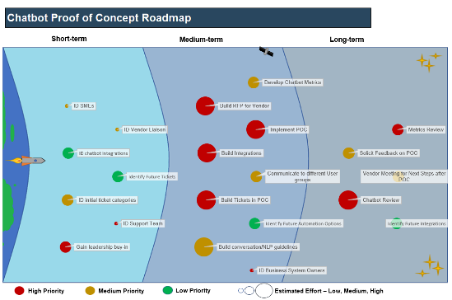
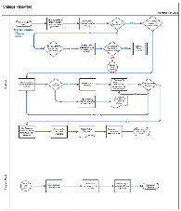
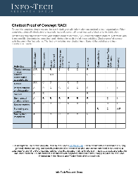
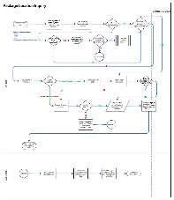
Blueprint deliverables
Key deliverable:
Each step of this blueprint is accompanied by supporting deliverables to help you accomplish your goals:
Implementation Roadmap
Record your implementation activities to get a head start before the vendor arrives on site.
Chatbot POC Metrics Tool
Chatbot ROI Calculator
Build your ITSM or CRM metrics to objectively keep track of your POC success.
Get a data-driven head start with your chatbot. Determine what you need to implement to receive a return on investment.
Chatbot POC RACI
Chatbot Conversation Tree Library
Identify roles and responsibilities for your chatbot support team.
Conceptually build your conversation trees for your chatbot.

Slide 16
Guided Implementation
A Guided Implementation (GI) is a series of calls with an Info-Tech analyst to help implement our best practices in your organization.
A typical GI is between 8 to 12 calls over the course of 4 to 6 months.
What does a typical GI on this topic look like?
Phase 1
Phase 2
Phase 3
Call #1: Scope requirements, objectives, and your specific challenges.
Call #2: Build a measure for the chatbot POC ROI.
Call #4: Architect the chatbot integrations.
Call #6: Identify future steps for the chatbot.
Call #8: Choose implementation steps.
Call #3: Design metrics and choose ticket categories.
Call #5: Build the conversation trees.
Call #7: Build your chatbot support team.
Call #9: Summarize results and plan next steps.
Info-Tech Research Group | 16

Slide 17
Workshop Overview
Contact your account representative for more information. workshops@infotech.com 1-888-670-8889
 | Day 1 | Day 2 | Day 3 | Day 4 | Day 5
Activities | Build Your Strategy | Architect Your Chatbot | Architect Your Chatbot Conversations | Continually Grow Your Chatbot | Next Steps and Wrap-Up (offsite)
 | 1.1 Calculate your chatbot’s ROI to determine its success. 1.2 Organize your chatbot POC metrics to keep the project on track. 1.3 Objectively choose chatbot ticket categories. | 2.1 Design your integrations with business value in mind. 2.2 Begin building chatbot decision trees. | 3.1 Detail your chatbot conversations in the decision trees. | 4.1 Identify talent for chatbot support. 4.2 Create an implementation plan. | 5.1 Complete in-progress deliverables from previous four days. 5.2 Set up review time for workshop deliverables and to discuss next steps.
Deliverables | ROI calculator Ticket category list | Chatbot integration plan | Chatbot conversation and decision trees | Implementation plan Chatbot RACI

