Slide 1
Secure Your High-Risk Data
Develop a comprehensive data security plan.
EXECUTIVE BRIEF

Slide 2

Analyst
Perspective
Gone are the days of simply protecting the network perimeter, or securing your primary assets, and resting comfortably at night knowing that your business’ most important data would not be at risk. An expanded global economy brings with it an expectation of collaboration – not just internally, but between different organizations in different areas of the world. Data has become an asset, and unlike the devices to which it travels, data is not static or stationary, but dynamic and fluid in nature.
Throughout its lifecycle, data will live in a multitude of repositories and move through various sources. The extent of a business’ data sources no longer lie within the confines of the office or primary workspace, a set of easily-controlled devices, or even a physical data center – organizations increasingly keep high volumes of sensitive, valuable data in the cloud. While accessible and convenient, this poses its own set of data security risks and questions.
As a result, business and IT leaders must map the flow of data throughout each stage of its lifecycle. In order to properly account for information that poses a risk to the organization should it be lost, corrupted, or used for malicious intent, the IT leader’s mindset must switch from securing the assets and the network, to securing the data itself.
Secure your data to help secure your business.
Cassandra Cooper
Senior Research Analyst, Security, Risk, and Compliance
Info-Tech Research Group

Slide 3



Executive Summary
Your Challenge
Common Obstacles
Info-Tech’s Approach
Securing data is no longer as simple as implementing a singular set of controls.
Sensitive and high-risk data now lives in various repositories both in and out of the organization, in both on-prem and cloud environments.
Layer in the process of exchanging data and ensuring secure transfer of this information while still making it accessible to the intended group of end-users, and the challenge becomes increasingly complex.
To implement appropriate security controls, InfoSec leaders must first understand:
What data they need to keep safe
Where it exists within the organization
Additionally, organizations must understand the current compliance and regulatory obligations based on location and industry.
Finally, InfoSec leaders must select a combination of technical and process controls that fit the business environment and reduce user friction.
Info-Tech’s Secure your High-Risk Data takes a multi-faceted approach to the problem that incorporates foundational technical elements, compliance considerations, and supporting processes and policies.
Assess what technical controls currently exist within the organization and consider additional controls.
Review compliance obligations and information security frameworks (NIST, CIS) for guidance.
Develop a set of data security initiatives that involve both technical and supporting procedural controls.
Info-Tech Insight
A modern data security strategy must protect data through the entire data lifecycle. Data security efforts must be business-focused, with multi-layered defense, while extending to all data sources.

Slide 4

Your challenge
Data-In-Transit
Applications / Systems
Data Warehouses
Data Lakes
Flat Files
Devices / Endpoints
Data Marts
This research is designed to help organizations who are facing these challenges/looking to/need to:
Identify the set of technical controls involved in adequately securing the organization’s high-risk, or highly sensitive data.
Develop a better understanding of the current sources and repositories for the organization’s data and how they are currently protected and secured.
Implement an approach to effective data security that takes into account the relevant technical and process-based controls.
Ensure that compliance and regulatory obligations are met and protect all retained sources of personal data.
This research is intended for organizations looking to protect highly sensitive or high-risk data, that have previously undergone data classification using either a tool or solution or Info-Tech’s Discover and Classify Your Data research.

Slide 5
Making the Case for End-to-End Data Security
The Modern Data Breach Landscape
The impact and frequency of data breaches is nothing new for CIOs and CISOs. And while even the tightest data security programs can still result in a breach, a comprehensive plan that covers all vectors of potential attack significantly reduces both compliance and business risk.
Of data breaches were perpetrated by external actors, while 45% of breaches featured hacking as the attack tactic.
  70%
Info-Tech Insight
A multi-vector defense involves protection of data-in-use, at-rest, and in-transit, through a combination of both technical and process controls aligned to specific control categories.
Of data-breach victims report having had their personal data compromised.
  58%
Source: Verizon Data Breaches 2020

Slide 6
Common obstacles
The Data Security Dilemma
These barriers make this challenge difficult to address for many organizations:
Of an organization’s IT spend is dedicated to data security.
  34%
A changing technological environment characterized by an increase in cloud computing, rapid proliferation of IoT of connected devices, and a vast number of data sources that become targets for malicious attacks.
The traditional approach of securing the network perimeter no longer ensures security of all data; organizations must take a multi-faceted approach to securing data.
Global privacy regulations are increasing, adding to an already complex environment characterized by multi-jurisdictional differences in controls to implement.
Most organizations will be faced with multiple compliance obligations and must begin to start looking at data security holistically as opposed to piecemeal.
Additionally, industry-specific compliance regulations often present IT leaders with a host of instructions but lack specific examples of technical controls to be put into place in order to ensure data is secured.
Of organizations have experienced a data breach in the past year.
  49%
Of attacks were a result of unauthorized access.
  40%
Source: 2020 Thales Data Threat Report

Slide 7







Info-Tech’s approach: End-to-End Data Security
The Info-Tech difference:
Data Security Control Categories
Effective data security is more than just a single layer or set of controls around your applications – it’s a comprehensive approach to both data-at-rest and data-in-transit. Successful end-to-end data security calls on an exhaustive strategy that includes:
Technical and process controls within the seven core categories of data security;
Secures data through all stages of the data lifecycle, from data creation through until data destruction;
Encompasses both data-at-rest and data-in-transit.
Through both technical and process controls, Info-Tech’s research equips you with the knowledge and tools for an effective approach to data security.
Access Control
Authentication
Data Loss Management
Obfuscation & Data Minimization
Creation
Usage
Archiving
Destruction
Storage
Data Operations
Data Integrity
Encryption
Data Lifecycle Stages
Data-in-Transit
Data-at-Rest
Data-in-Use
Data-at-Rest
Data Classification

Slide 8
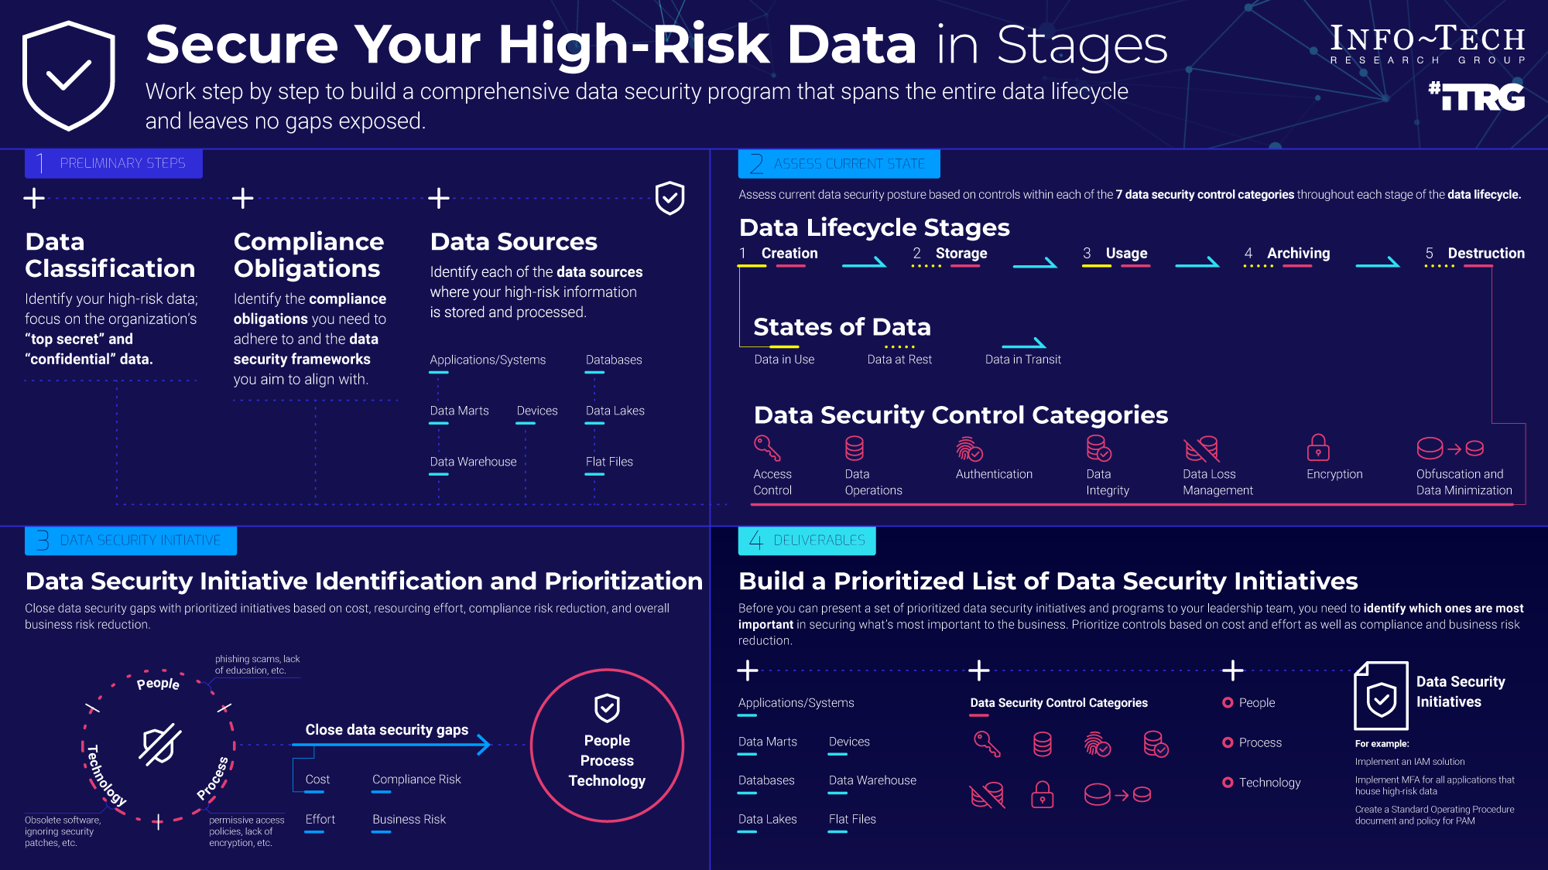

Slide 9
Info-Tech’s methodology for Secure Your High-Risk Data
 | 1. Review Data Security Methodologies | 2. Develop the Data Security Roadmap | 3. Implement Data Security Roadmap
Phase Steps | 1.1 Understand the Role of Data Security 1.2 Review Current Security Controls 1.3 Assess Compliance and Regulatory Frameworks | 2.1 Develop the Data Security Roadmap | 3.1 Prepare Your People 3.2 Establish Metrics
Phase Outcomes | Comprehensive overview of: Access Control Data Operations Authentication Data Integrity Data Loss Management Encryption Obfuscation and Data Minimization Alignment to governing compliance regulations. | Understanding of where the gaps lie in current data security framework and control implementation. Prioritized set of technical and process-based data security initiatives based on specific criteria. | Strategy for implementing both technical and process-based data security controls. Metrics for evaluating the success of data security framework within the organization.

Slide 10
Data Security Has Layers
A modern data security strategy protects data throughout its entire lifecycle.
Data security efforts must be prioritized, business-focused, with multi-layered defense, and extend to all data sources.
Start with the technical, finish with the process.
For every technical control (think encryption, MFA), there are an adjacent set of supporting controls that must be put into action. Think technical, but follow-up by ensuring that the process is developed and documented.
Get your priorities right.
Before you can present a set of controls back to your senior leadership team, you need to identify which ones are most important in securing what’s most important to the business. Prioritize using controls that consider cost, effort, as well as compliance and business risk reduction.
Secure your people.
During the implementation phase, ensure that any employees or end-users that will be impacted by changes in process, or additional controls in place are properly informed, trained, and supported. Secure data fails to remain secure when those managing it are not informed and educated.
Sometimes more is better.
Instead of focusing on one specific data security technique or technology, examine how multiple controls can work cohesively in order to facilitate a multi-faceted approach to securing your data.
Nothing in isolation.
With this exhaustive set of data security controls, you need to evaluate the organization’s full operational landscape. Assess your gap-closing initiatives as part of a comprehensive, defense-in-depth data security roadmap.

Slide 11

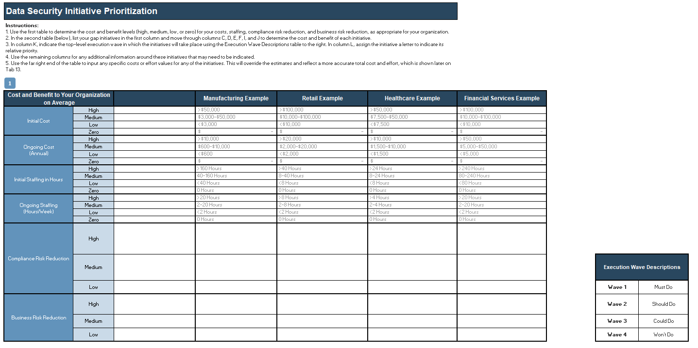
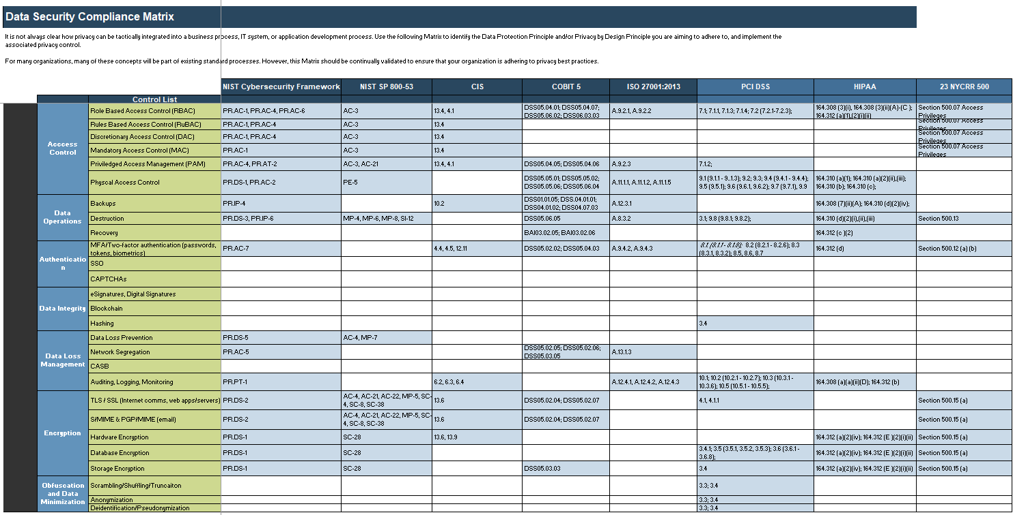



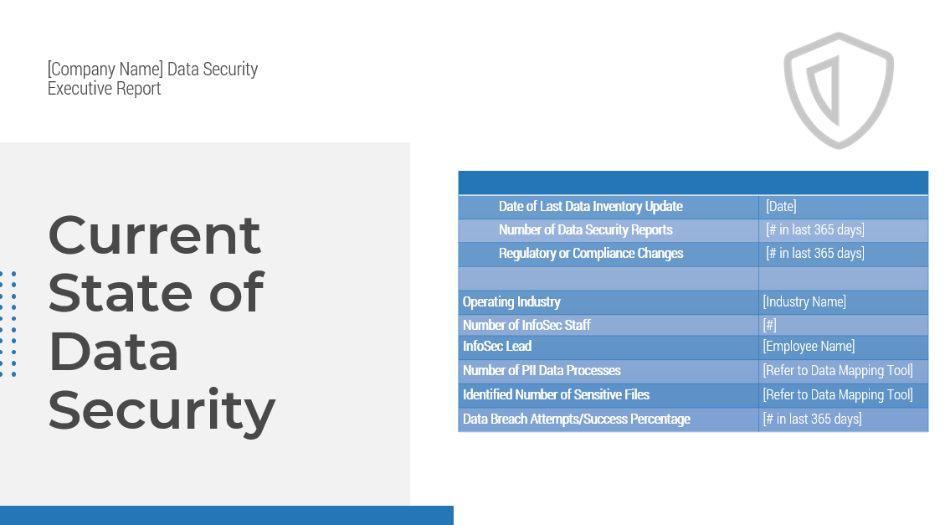
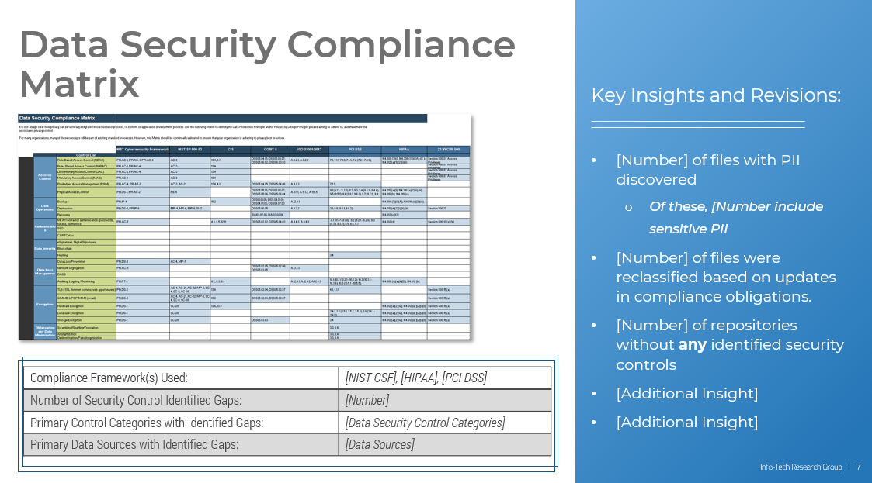
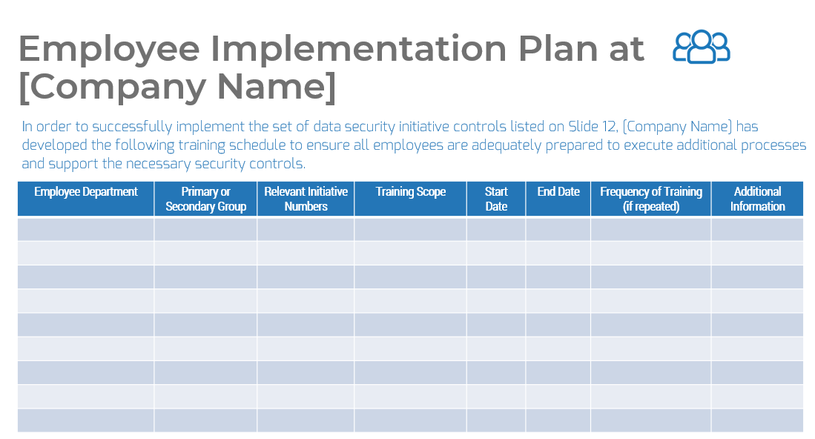
Blueprint deliverables
Key deliverable:
Each step of this blueprint is accompanied by supporting deliverables to help you accomplish your goals:
  Data Security Technical and Report
A comprehensive outlook on the current state of data security. The Data Security Roadmap Report also provides guidance on the implementation of technology, processes, and training to properly secure your high-risk, high-value data.
  Data Security Matrix tool
An assessment tool based on the current state and desired future state, that leverages a set of targeted initiatives to close gaps and provide a data security roadmap.
  Data Security Executive Report template
Review and present your findings to your executive leadership team by highlighting core gaps and identified initiatives to ensure sufficient data security standards are in place.

Slide 12
Blueprint benefits
IT/InfoSec Benefits | Business Benefits
A comprehensive understanding of where sensitive data exists within the organization. A method of mapping the flow of sensitive or high-risk data between sources and while in transit. An overview of technical controls to evaluate and implement in order to enhance data security. An overview of process or administrative controls to evaluate and implement in order to enhance data security. A prioritized set of data security initiatives based on cost, effort, and compliance and business risk values. | Detailed set of initiatives to help effectively secure the organization’s highly sensitive or high-risk data. An understanding of what the compliance obligations for the organization are, and how the security controls in place ensure full adherence. An understanding of the best-practice data security frameworks, and the measures in place to meet framework standards. Increased end-user trust and enhanced organizational reputation through improved data security practices.

Slide 13
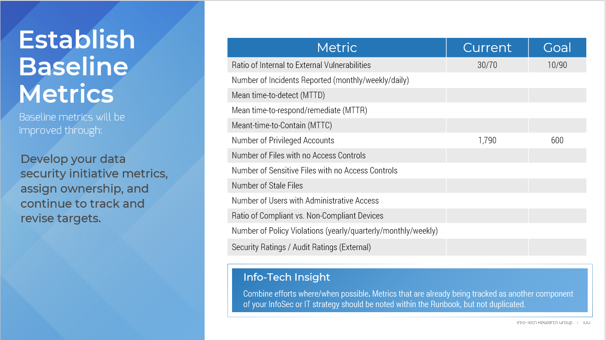
Measure the value of this blueprint
Info-Tech Project Value
Effective data security saves more than just money…
$116,383
Average annual salary of a Senior Cybersecurity Consultant
200 hours (initial)
$ 69,875 (internal project cost)
$3.92 million (data breach cost)
Average total time/cost to completion for the following high-priority data security projects:
Map out full set of data sources for all high-sensitivity data
Complete and revise Data Matrix tool
Map all compliance obligations (regulatory and industry-specific) to current data security controls
Complete gap analysis of data security controls
Develop gap-closing initiatives and create implementation roadmap
Establish metrics and monitoring schedule
Data breaches have become increasingly prevalent, costing organizations an extra 83% between 2018 and 2019 alone.
Legal fines and costs associated with customer damages and compensation are a small portion of the losses incurred as a result of a data breach; reputational damage to the business and brand can have an irreversible long-term impact on the organization.
In Phase 1 of this blueprint, we will help you establish current and target state of data security.
In Phase 3, we will help you develop a set of relevant and achievable metrics to support data security initiatives.
29.6% chance of a data breach occurring
$ 1,230,195
Total Dollars Saved
Source: Indeed, Ponemon Institute

Slide 14

Executive Brief Case Study
INDUSTRY
SOURCE
Education
SCMedia, vpnMentor
OneClass
Remote learning platform OneClass was the recent victim of an extensive data breach, where personal information of over one million North American students was exposed. Information left exposed included records that were linkable to minors (under the age of 13) as well as other OneClass users. The data harvested (account credentials, personal information) provided hackers with the potential to leverage it for social engineering scams to inflict financial damage through obtained payment card information.
The database breach was detected by researchers at vpnMentors, who notified the vendor shortly after the initial date of discovery. Upon notification, OneClass took down the unsecured database under the claim that the data within it was purely test data and was not linkable to individuals associated with OneClass. However, vpnMentor noted that the database contained over 27GB of data, and 8.9 million records, exposing and directly linked to over one million OneClass customers.
Researchers discovered this contradiction between OneClass’ statement and vpnMentors’ discovery, as a sample set of the exposed data was easily matched with public information. A key issue being the fact that many of OneClass’ users are young, and as such would be unaware of the fraudulent activities that could result from their information being stolen by malicious actors.
The Data Security Impact
The AWS-hosted Elasticsearch database used by OneClass was left unsecured.
The issue of incorrectly configured/unsecured databases in the cloud has been a prominent issue, as the transition from a network security approach to a data-specific approach.
Solution
Organizations, like OneClass, need to adopt a more comprehensive approach to data secured off-prem through additional applied controls:
  Higher degree of server security.
  Strengthening of access control measures through additional access rules.
  Ensuring systems that contain large amounts of personal or sensitive data have appropriate authentication measures.

Slide 16

Guided Implementation
A Guided Implementation (GI) is a series
of calls with an Info-Tech analyst to help implement our best practices in your organization.
A typical GI is between six to eight calls over the course of four to six months.
What does a typical GI on this topic look like?
Phase 1
Phase 2
Phase 3
Call #1: Scope requirements, objectives, and your specific challenges.
Call #4: Identify gap closing initiatives.
Call #7: Identify user groups and assess appropriate training plans.
Call #5: Prioritize all gap-closing initiatives based on criteria.
Call #2: Review and complete data security controls matrix.
Call #8: Define metrics and establish monitoring schedule.
Call #3: Review and align compliance framework matrix.
Call #6: Evaluate cost and effort table and implementation timeline.
Info-Tech Research Group | 16

Slide 17
Workshop Overview
Contact your account representative for more information.
workshops@infotech.com 1-888-670-8889
 | Day 1 | Day 2 | Day 3 | Day 4 | Day 5
Activities | Identify Internal and External Drivers | Assess the Current State | Identify Gaps and Define Initiatives | Develop Implementation Plan and Define Metrics | Next Steps and Wrap-Up (offsite)
 | 1.1 Review the business context. 1.2 Review compliance drivers and relevant regulatory frameworks. 1.3 Discuss current drivers from both the InfoSec and business context. 1.4 Define the scope; which data sources will be examined, and what is the tier of data (classification standard) in focus for this project? | 2.1 Map the flow of all high-risk, highly sensitive data in-scope for project workshop (at-rest and in-transit); document and compare with Data Inventory. 2.2 Review current set of data security controls. 2.3 Identify and list future or potential adjustments to the organization’s data security landscape. 2.4 Complete Data Security Matrix and recommended action items. | 3.1 Review data security Gaps. 3.2 Identify gap-closing initiatives in-scope for each of the seven areas of data security. 3.4 Allocate cost and effort values, and prioritize initiatives. 3.5 Compare against compliance obligations and security frameworks. 3.6 Define execution waves and initial timeline for implementation. | 4.1 Finalize implementation roadmap for data security initiatives. 4.2 Identify scope of employees or end-users impacted by changes to data security landscape. 4.3 Develop training plan for any process or administrative-based initiatives. 4.4 Define metrics for measurement of data security program success. 4.5 Outline schedule for monitoring and reporting. | 5.1 Complete in-progress deliverables from previous four days. 5.2 Set up review time for workshop deliverables and to discuss next steps.
Deliverables | Set of data security objectives Mapped compliance matrix Defined project scope | Revised Data Inventory Completed Data Security Matrix (compliance frameworks and security controls) | Finalized Data Security Matrix Completed Data Security Initiatives list | Finalized Data Security Roadmap Data Security Metrics Outline for Data Security Technical report | Completed and delivered Data Security Technical Report and Executive Presentation Additional recommendations based on days one to four of workshop

