Slide 1
Design Data-as-a-Service (DaaS)
Get ready to exchange data products in the data marketplace
EXECUTIVE BRIEF

Slide 2
Data locked in silos
As a result, organizations struggle
to find data
of organizations purchase data directly from the data provider.
Source: IDC Survey, 2020 “The Data-as-a-Service (DaaS) Market at a Glance”
  20%
    Data silos lead to significant roadblocks toward the modernization of data ecosystems. Here are some of the common symptoms of data silos:
    Point to Point B2B and B2C integration
    Low adoption of data marketplaces
    Inadequate technology to break down silos
    Lack of business ownership
    Poorly defined data laws
of organizations purchase data via open or closed data marketplaces.
Source: IDC Survey, 2020 “The Data-as-a-Service (DaaS) Market at a Glance”
  32%
of organizations haven’t had the technology in place to take advantage of their data.
Source: dun & bradstreet, “the Past, Present and Future of data” 2020
of data has been the concern of the IT department rather than the business.
Source: dun & bradstreet, “the Past, Present and Future of data” 2020
  46%
  45%

Slide 3
Data sharing challenge
    Data sharing has enormous economic and societal benefits. Data can stimulate economic growth, promote better decision making, increase transparency and efficiency, as well as improve your quality of life. However, in the current state, it is difficult and risky to share data at the larger scale. Common data sharing issues can be categorized as follows:
Benefits of data sharing
Utility
Uniqueness or exclusivity
Ease of production
Usage and sharing restrictions
Usability and integration
Trustworthiness
Support
Consumer demand
Time to value
- No legal framework
- Does not have established data ecosystems
Privacy
- PII rules and regulations are in its infancy
- No consistent or regulated approach to data merge and matching
- Framework for Consent to ensure data is shared and used as intended by its owners
Access vs. Governance
- Predefine workflows around data ownership
- Complete Access Controls
- Collaboration to contribute to the data value chain
Security
- Ability to work freely with the data within a dedicated workplace
- Unbiased and automated insights
- Clear visibility into data lineage and audit trails
- Flexibility and ability to Plug-and-Play with data tools
Scalability
- Interoperability with predefined API accessibility and standards
- Ability to integrate cloud support suite
- Decentralized and scalable PII protection
“Getting information off the internet is like taking a drink from a firehose.”
– Mitchell Kapor

Slide 4
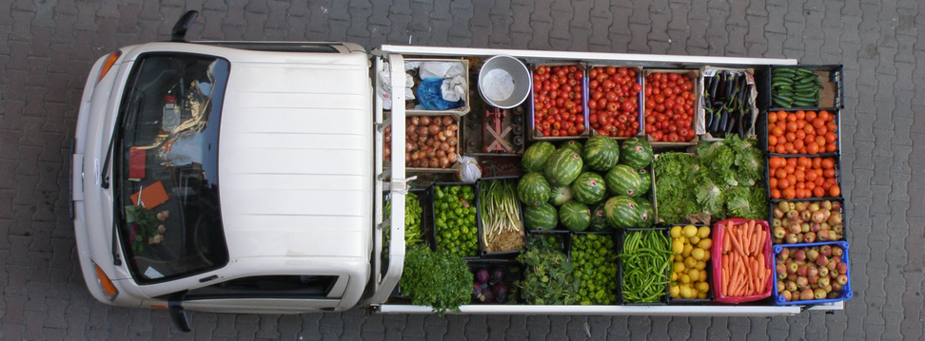

Data Marketplace
Digital platform to exchange or trade data
The data marketplace can be understood as a digital platform on which data products are traded. In today’s digital economy, there is a huge supply of data; however, finding good quality data remains a challenge. Data marketplaces and specialized data vendors may create an ecosystem to alleviate this pain. Data marketplaces provide standardized access to data, and they regulate the usage of data.
Even though consumers have become large data generators, they do no have the luxury to opine on how their data is to be used by organizations. Personal data is often aggregated by value-added service providers in exchange for a free service (for example, Facebook and Google). In such scenarios, the value of data is already recognized in the form of free service; however, the true cost of the data cannot be determined until data is traded openly in the marketplace.

Slide 5
Rise of Data Marketplace
Breaking down barriers between provider and consumer
The data marketplace is based on the concept that the data product can be provided on demand to data consumers regardless of the geographic or organizational separation of the provider. This development has enabled the recent emergence of the relatively new concept of DaaS. In a DaaS ecosystem, every organization must first identify the type of data that they need to consume from the marketplace and/or exchange with the marketplace.
Also, not all data can be shared in the data marketplace. An organization must survey its data sources and identify those that benefit from sharing. Organizations willing to participate in data sharing have a responsibility to be a good data steward to ensure the highest data quality.
“Data driven companies are already providing additional benefits to its customers and are well-positioned to upsell new services to these customers. However, its very important to maintain data quality as they start providing additional data products. This is hard to do, so better to go slow than to dilute your brand. They are better off increasing value of their existing data assets through well organized data management practice”
Source: Hoffmen, 2019

Slide 6
Data marketplace success depends on robust Data- as-a-Service in every organization
    Most organizations are missing the following DaaS features:
    Standards & Interoperability: There is a lack of a consistent approach towards accessing internal and external data within the organization and sharing data with third parties.
    Quality & Certification: Data consumed or shared by organizations lack proper data quality, data certification, tractability, and lineage.
    Discoverability & Sharing: Organizations are often unable to discover external data in a timely manner and at the same time fail to make their own data discoverable and shareable with all stakeholders.
Tools & Technology: Organizations are immature and are constantly involving data platforms, data standards, and technology to truly take advantage of the data.
Culture & Literacy: There is a lack of data literacy and value proposition in data sharing. Everyone strives to become a data centric organization, but very few understand what it really means.
Ownership & Stewardship: Organizations take very little responsibility to ensure data quality is of the highest degree. Data is often considered as a byproduct of existing processes.
Speed & Scalability: Organizations are unable to rapidly expand to incorporate new data sources or participate in large crowdsource data exchanges.
Reason to move towards DaaS foundation
Number of data sources
Complex data
environment
Unreliable external data sources
Slow legacy data platforms
Speed required for new insights

Slide 7
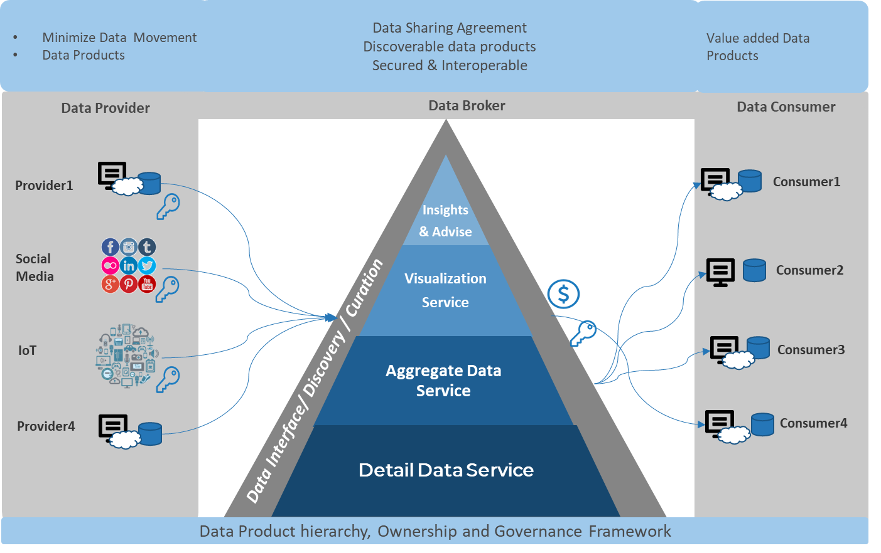
Info-Tech’s DaaS Framework
A better way to securely share or consume data
The Info-Tech Data-as-a-Service framework
Info-Tech’s approach to DaaS improvement
Step1: Understand Data Ecosystems
Step2: Design Data Product
Step3: Establish DaaS framework
“The design of data ecosystems, infrastructures for the secure and reliable data exchange among organizations, is considered one of the key technological enablers for digitalization and the digital economy of the future.”
Source: Cappiello, et al. 2019

Slide 8
Make data easy to Discover, Integrate, Connect, and make it Interoperable
Overarching insight
Despite data being everywhere, most organizations struggle to find accurate, trustworthy, and meaningful data when required. Connecting to data should be as easy as connecting to the internet. This is achievable if all organizations start participating in the data marketplace ecosystem by leveraging a DaaS framework.
Phase 1 insight
All organizations want to turn data into knowledge; however, there is a significant gap in the commercialization and the free exchange of data. The first step towards data-driven knowledge building is to make underlying data available quickly, securely, and consistently to a wider audience.
Phase 2 insight To get data in order, organizations must first understand the value data provides to its most important stakeholder. Organizations must develop data products by leveraging a customer journey map and a design thinking approach.
Phase 3 insight
Most organizations understand core competencies and business strategy; however, very few can connect core data domains to organizational strategy. An organization needs to decouple data from its underlying business processes. This can be achieved by developing a clear data product model that includes core data assets that they own and data that they can easily procure from outside.

Slide 9
Understanding the organization’s role in a Data ecosystem
 | 1. Understand Data Ecosystem | 2. Design Data Product | 3. Establish DaaS Framework
Phase Steps | Data Democratization Internet of Data Data Broker and Data Marketplace Data Value Chain Data Marketplace - Use Cases | Create Stakeholder Map Establish Persona – example: Coffee Consumer Data Consumer Journey Maps Data Product Design | Understand Data Exchange Map Internal and External Data Document and Prioritize Data Product Framework Establish Data Exchange Agreement
Phase Outcomes | This phase will provide clear benefits of adopting the DaaS framework and will provide solid rationale for moving towards a more connected data ecosystem and avoiding data silos. | This phase will leverage design thinking methodology and templates to document the organization’s most important data products. | This phase will provide a step-by-step guide to capture internal and external data sources that are critical to data product success for the organization, and it will document an end-to-end DaaS framework.

Slide 10
Benefits of DaaS
Consistently deliver and manage internal and external data
IT Benefits | Business Benefits
Agility: Firms become more agile, as they can quickly implement changes and roll out new data due to the unified data models, transparency, and simplicity of the process. Flexibility and Cost Efficiency: IT becomes more efficient in managing internal and external data by eliminating redundant copies of data and business processes. This can result in an overall reduction in data management cost and can result in faster access to data. Transparency: Firms utilize unified data models, definitions, metadata, tools, and support. They can leverage specific experience of data owners and providers to access data closer to the source, to increase transparency, and to benefit from enhancements. | The business will have a strong understanding of customer and competitor needs with easy, consistent, cost effective, and secure access to data for market analysis. The business will be able to monetize organization data and explore new business opportunities. Data is an asset, and accessibility to data incurs costs. The business must effectively leverage its assets and look for opportunities to increase its value. The business will have a mature data practice by adopting a comprehensive legal, financial, and monetary framework for data and its ownership.

Slide 11

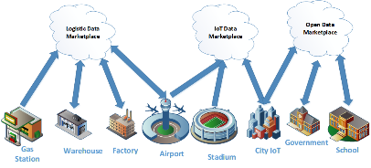
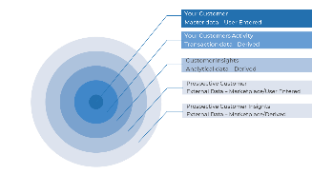
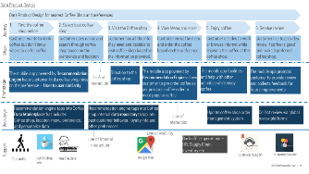
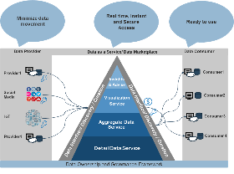
Blueprint deliverables
Key deliverable:
This blueprint will generate following outputs
Data product ideas
Data marketplace alignment
Data product design
Internal and external data source mapping
DaaS framework
Each step of this blueprint is accompanied by supporting deliverables to help accomplish the most important goals:
  Data product ideas & data marketplace alignment
  Internal and external data source mapping
  Data product design
  DaaS framework

Slide 12
Measure the value of data products
Measure the value of data products as a data provider and data consumer
Data providers have the potential to create new revenue streams by effectively leveraging their existing data assets and business models. The most obvious benefit is the opportunity to effectively transact data with other organizations and create a new digital data economy with new recurring revenue models.
Data consumers get on-demand access to data with fewer barriers. Also, many data consumers realize that internal data is not sufficient and would find greater value by augmenting data with other related external data assets. Additionally, data consumers can become data providers by providing value-added data services with combined data assets.
Understand customer journey
Reduce uncertainty.
Provide information to get from worst to best case.
Data product ideas
Test different value proposition.
Rational for investment.
Uniqueness of data and external benefits.
Value proposition
Optimize data products.
Include feedback loop.
Optimize algorithm.

Slide 13
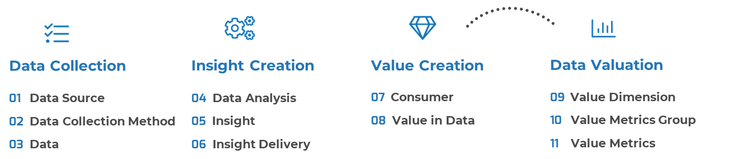
Metric | Current | Goal
Usage Metrics
Quality Metrics
Value Metrics
For example, the following metrics will help measure the data product for recommending nearby coffee shops
Usage Metrics: No. of coffee shops suggested
No. of preferred coffee shops suggested
Quality: Accuracy of suggested coffee shops
Value Metrics: Market value, Data API cost structure
Data product ideas evolution
Data product development
Establishing data value metrics
Establish quantitative & qualitative metrics based on product ideas or development.
Leverage Info-Tech’s Data Valuation blueprint to take a more comprehensive
approach to data valuation.

Slide 14
Smart Cities – Use Case
What does it really mean to be smart
INDUSTRY
SOURCE
City & Municipal Government
Data Ecosystem: Sovereign Data Exchange among organizations
Smart Cities concept is driven by embedding sensors across every aspect of the city and forming an “Internet of Things (IoT).” Data is collected through these IoT devices and leveraged strategically for performance analysis and for detecting patterns and inefficiencies with the ultimate goal to improve the quality of the life of the citizens.
However, the much less discussed topic is how cities could leverage data ecosystems that connect multiple smart cities. The learnings from the aggregate data of all cities can be leveraged and applied towards a rapid transformation into a smart city network.
$3.6
Trillion
IoT data potentially unlocking more than $3.6 trillion in value by 2030
  $4.38
  Zettabytes
Results
IoT data traded yearly by 2030
US Ignite, the non-profit organization, and ATIS technology is such an initiative whereby accelerating the smart cities movement. The foundation component of this initiative includes a data-sharing framework, data formats, protocols, security, privacy requirement, and common APIs. All cities and municipalities are invited to participate in this program, which can potentially enable many next-generation smart cities applications.
Source: The Dawn of the Data Marketplace

Slide 16

Guided Implementation
A Guided Implementation (GI) is a series
of calls with an Info-Tech analyst to help implement our best practices into your organization.
A typical GI is between 8 to 12 calls over the course of 1 to 3 months.
What does a typical GI on this topic look like?
Phase 0
Phase 3
Phase 1
Phase 2
Call #1: Scope requirements, objectives, and your specific challenges.
Call #2: Assess current maturity
Call #4: Evaluate data product idea
Call #6: Map internal and external data
Call #5: Create data product design
Call #7: Document data service framework
Call #3: Discuss DaaS benefits and concepts
Call #8: Formalize data sharing agreements
Info-Tech Research Group | 16

Slide 17
Workshop Overview
Contact your account representative for more information.
workshops@infotech.com 1-888-670-8889
 | Day 1 | Day 2 | Day 3 | Day 4 | Day 5
Activities | Data Marketplace and DaaS explained | Design Data Product | Assess Data Sources | Establish a DaaS Framework | Next Steps and Wrap-Up (offsite)
 | 1.1 Review the business context 1.2 Understand data ecosystems 1.3 Draft product ideas and use cases 1.4 Capture data product metrics | 2.1 Create a Stakeholder Map 2.2 Establish a Persona 2.3 Data Consumer Journey Map 2.4 Document data product design | 3.1 Review the conceptual data model 3.2 Map internal and external data sources 3.2 Document data sources | 4.1 Design target state DaaS framework 4.2 Document DaaS framework 4.3 Assess the gaps between the current environment and the target environment 4.4 Brainstorm initiatives to develop DaaS capabilities | 5.1 Complete in-progress deliverables from previous four days 5.2 Set up review time for workshop deliverables and to discuss next steps
Deliverables | Data product ideas Data sharing use cases Data product metrics | Data product design | Internal and external data sources relationship map | Target DaaS framework DaaS initiative | DaaS framework strategy and report

