Slide 1
Implement Infrastructure Shared Services
Assess internal capabilities, pick a model, and make a comprehensive plan
EXECUTIVE BRIEF

Slide 2

Analyst perspective
It’s tempting to make a strategic plan for sharing the services that are common across all units of an organization. However, business units leverage these services in different ways.
The most common barrier to implementing shared services is the resistance of the workforce to change. Cultural differences, perceived risks, a lack of communication, and inefficient data collection impede the sharing of services.
This research is designed to assist you in identifying core services, assessing risks, and communicating with the business units that will be most affected.
Assess internal capabilities, pick a model, and make a comprehensive plan before implementing
Mahmoud Ramin
Research Specialist, Infrastructure and Operations
Info-Tech Research Group

Slide 3



Executive summary
Your challenge
Common obstacles
Info-Tech’s approach
Many organizations have service duplications, and these duplications increase business expenditure.
A lack of collaboration between business units (BUs) to share services increases costs and reduces the organization’s faith in implementing shared services.
Transitioning to shared services is challenging for many organizations. It requires accurate planning and efficient communication between participating BUs.
Improper planning for shared services increases workload and causes businesses to hesitate implementing shared services.
Some BUs fear that sharing IT services will mean they are competing with other departments to access services they need. They believe that some BUs’ requirements may take priority over their own.
Some BUs are afraid sharing services will result in the loss of in-house functionality.
Info-Tech can help an organization to:
Understand the value of shared services and determine whether transitioning to shared services would benefit their organization.
Identify the best implementation plan based on their goals, needs, and services.
Build a process for managing and ensuring the success of their implementation plan.
Info-Tech Insight
It’s important to identify your current processes, tools, staff resources, and capabilities before implementing shared services. Understanding the financial considerations prior to implementation will help you assess if your organization is ready to transition to a shared services model.

Slide 4
Shared services is a growing trend that needs better governance to realize the benefits
$110B
91% of C-level executives believe that implementing shared services is critical for reducing complexity in their organizations. 89% believe that shared services can be leveraged to redesign the fundamental structure of their companies (Accenture, 2015).
“Over 80% of Fortune 500 companies have implemented some form of shared services in their US operations” (Deloitte Shared Services Handbook, 2011).
The global shared services practice was about $56 billion in 2018 and is estimated to reach over $110 billion by 2025. As government organizations have been moving towards deploying shared services, vendors have been competing to secure contracts with them (MarketWatch, 2019).
Shared services allow multiple BUs to use a single IT capability. The main purposes of using shared services are to maximize use of resources, increase efficiency, reduce costs, and create opportunities to improve quality.
2025
2018
$56B

Slide 5

An effective shared-services model reduces costs and improves service quality
The potential to control costs while improving quality makes businesses interested in implementing shared services.
However, ineffective governance incurs further costs and undermines the benefits of shared services. In fact, Info-Tech research shows that while 33% of shared services implementations were found to increase service quality, 11% worsened IT service. This is mainly due to ineffective governance.
A good shared services model should:
Improve quality
Comply with best practices
Manage external relationships
Analyze end-user satisfaction
Define technological requirements
Source: Implement a Shared Services Model. Info-Tech Research Group.

Slide 6
Shared services can improve service quality
Implementing shared services helps organizations improve service quality and control costs.
Shared services reduce duplication
Example: A state government has two IT departments performing similar functions using similar human resources and technology. They reduce costs by combining the IT departments in a separate entity and sharing the services.
Shared services help multiple BUs share a single, high-quality service provider
Example: BU1 has more advanced data center operations than BU2. Leveraging the more advanced services of BU1 would benefit BU2.

Slide 7
Info-Tech’s approach
The Info-Tech difference:
Discover the benefits of shared services for your organization.
Define your goals and challenges on the way to reaching them.
As an IT service provider, view the services you offer as a product.
Build a clear process and timeline.
Communicate effectively for continuous improvement.
02
Design the product
Develop your product vision and roadmap
01
03
04
Define the opportunity
Support and continuously improve the product

Slide 8

Case Study
INDUSTRY
The Government of Canada created Shared Services Canada (SSC) to consolidate the IT infrastructure services of federal departments.
Government
Situation
Creation of Shared Services Canada
Results
The GC developed a transformation plan through the creation of SSC to consolidate, standardize, and modernize the GC’s IT infrastructure.
SSC is now committed to reducing costs and improving IT services and security.
Until 2011, each of the 43 departments of the Government of Canada (GC) used their own IT services based on their own requirements.
IT services varied widely across the government.
Each IT department funded its own IT investments from their allocated budgets.
The government’s IT infrastructure was at the risk of breaking down, which would have a devastating impact on the government’s functionality.
In August 2011, the GC announced the creation of SSC to centralize infrastructure services from 43 individual departments, including servers, human resources, data centers, and IT budgets. These departments are now known as partners.
Although IT infrastructure is managed by SSC, each department is responsible and accountable for their own data.

Slide 9
Gauge if shared services is worth pursuing
Ask these three questions to find out if it’s worth providing shared services in your organization:
1. Are you solving unmet needs?
Is there a specific need in your industry that existing service providers don’t accommodate?
2. Will shared services improve the way users access the service?
For example, if users are currently accessing the help desk service through a phone number, will your product offer a more effective channel or process (such as a self-service ticketing system)?
3. Will you be providing service capabilities that your customers can’t currently deliver on their own?
If you could not answer “yes” to any of the above questions, you should reconsider pursuing shared services.

Slide 10

Ineffective governance undermines the benefits of shared services
Poorly planned shared services lead to:
Participant resistance
  Without proper incentives, BUs will resist sharing their capabilities.
  Failure to align the interest of BUs with the organization’s strategy results in limited participation.
  Not specifying the benefits of shared services causes BUs to lose faith in their implementation.
Underperformance of services
  A lack of well-planned shared services may worsen service quality and/or increase IT expenditures.
“I would absolutely agree that [stakeholder resistance] at the senior level is the number one issue.” –Al Povoledo, Partner, Canadian Project Partners
Ineffective governance has a major role in the failure of shared services implementation
Common problems in governing shared services:
  Failure to encourage participation in the implementation.
  A lack of accountability for the success of the implementation.
  The business practices of the participants fail to change.
  No attempt at reconciling the various interests of participations to the implementation.
Source: Implement a Shared Services Model. Info-Tech Research Group.

Slide 11
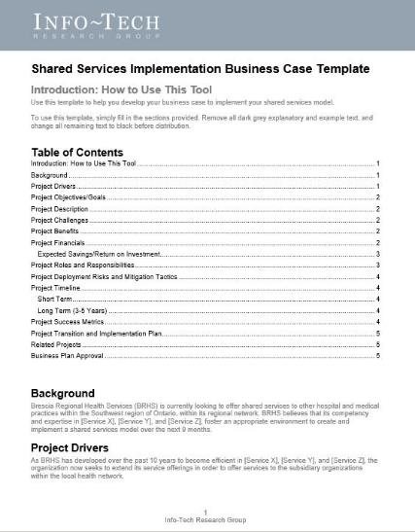
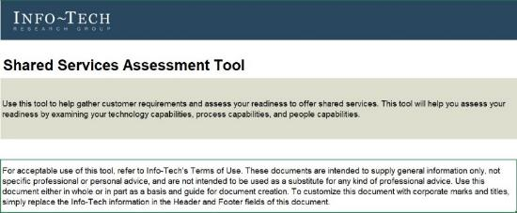
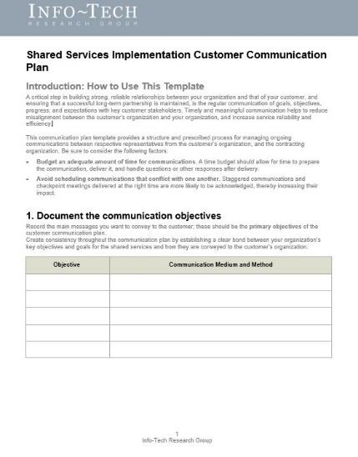
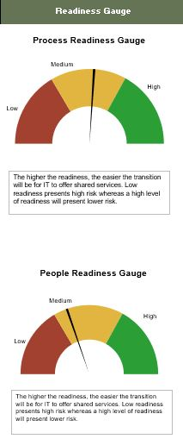

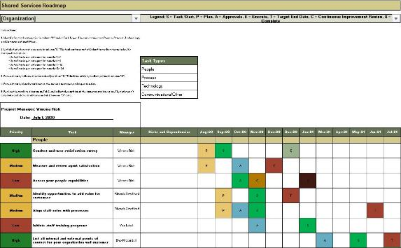


Follow Info-Tech’s three levels of implementing shared services
Follow the steps for your appropriate model to ensure the smooth implementation of shared services and to reduce internal resistance to new service delivery methods.
Follow these steps to:
Improve participation
Create accountability
Reconcile varying interests

Slide 12
Insight summary
Overarching insight
Identify your current processes, tools, staff resources, and capabilities before implementing shared services. Understanding the financial considerations prior to implementation will help you assess if your organization is ready to transition to a shared services model.
Phase 1 insight
Shared services require fundamental changes in IT delivery. Evaluate these changes and assess the advantages of transitioning to shared services prior to their implementation. Otherwise, it may incur more costs and deteriorate service quality.
Phase 2 insight
Choose a model based on your capabilities and requirements, not just the overall maturity of your organization.
Phase 3 insight
Establish clear information, prioritize your key processes, and build concrete expectations in your plans to make develop a consistent and efficient practice.
Tactical insight 1
This is a good opportunity to see how you can improve services while saving money. Maintain a balance between these two factors to ensure the success of shared services plan.
Tactical insight 2
Create an actionable timeline for your initiatives and communicate it to the participating BUs.

Slide 13
Blueprint benefits
IT benefits | Business benefits
As IT becomes a service provider, allocating a small team within IT for shared services gives you the control you need to ensure that your plan will reach its long-term goals. Selecting the right technology and model that suits organizations’ requirements enhances the value of your plan. Successful shared services planning will improve the end-user experience and augment their overall satisfaction with IT. | Implementing shared services provides cost-effective, high-quality, and efficient service management that will benefit the whole organization. Service consolidation results in better governance through concrete service management. Transitioning to shared services helps ensure that services are provided at a competitive rate when compared to the cost of the same services when provided externally.

Slide 15

Guided implementation
A guided implementation (GI) is series of calls with an Info-Tech analyst to help implement our best practices in your organization.
A typical GI is five to six calls over the course of three to four months.
What does a typical GI on this topic look like?
Phase 1
Phase 2
Phase 3
Call #1: Scope requirements, objectives, and your specific challenges.
Call #3: Assess key players.
Call #5: Create an implementation roadmap.
Call #4: Identify the best shared-services model for your organization.
Call #6: Establish a communication plan.
Call #2: Assess end-user satisfaction and align it with technical and process capabilities.
Info-Tech Research Group | 15

Slide 16
Workshop overview
Contact your account representative for more information.
workshops@infotech.com 1-888-670-8889
 | Day 1 | Day 2 | Day 3 | Day 4
Activities | Identify your challenges | Assess your capabilities | Define the model | Implement and communicate
 | 1.1 Identify your organization’s main drivers for using a shared services model. 1.2 Define whether it’s beneficial to implement shared services. | 2.1 Identify your organization’s resistance to implement shared services. 2.2. Assess process and people capabilities. | 3.1 Define core services that will be moved to shared services. 3.2 Assess different models of shared services and pick the one that satisfies your goals and needs. | 4.1 Create an implementation roadmap for shared services. 4.2 Make a plan to communicate about the changes.
Deliverables | Executive presentation Shared services mission Shared services goals | Shared services business case Shared services assessment | List of services to be transitioned into shared services Shared services model | List of initiatives to reach the end target Shared services strategy risks Timeline Communication plan

