Slide 1
Optimize the Service Desk With a Shift-Left Strategy
The best type of service desk ticket is the one that doesn’t exist.
EXECUTIVE BRIEF

Slide 2

Analyst
Perspective
A shift-left strategy involves shifting resolution of service desk tickets down from more costly resources to the first line of support and to end users themselves through self-service options. This not only reduces operating costs and frees up time at the service desk to focus on strategic improvements, but also improves service delivery and end-user satisfaction, making it a win-win for everyone.
Shifting left should be a priority for IT departments that have already standardized their service desk processes and are looking to optimize service delivery. Practically, shift left tasks can include building a comprehensive knowledge management program, a user-friendly self-service portal, and automating manual, repetitive tasks.
However, shifting left isn’t as simple as deploying a knowledgebase, self-service portal, or chatbot, then sitting back to reap the benefits. In order to be successful, there needs to be assigned accountability for the project, a defined, holistic strategy in place for how and what work will be shifted left, a sustained effort to continually improve and expand the effort, and a solid communication and adoption plan in place.
Shifting left is a win-win for IT and end users.
Natalie Sansone
Senior Research Analyst, Infrastructure & Operations
Info-Tech Research Group

Slide 3



Executive Summary
Your Challenge
Common Obstacles
Info-Tech’s Approach
Tier 2 and 3 specialists lose time working on tickets instead of more complex projects.
The service desk finds themselves resolving the same incidents over and over, wasting manual work on tasks that could be automated.
Employees expect modern, consumer-like experiences when they need help; they want to access information and resources from wherever they are and have the tools to solve their problems themselves without waiting for help.
Specialists would often rather work on projects, but it can be difficult to overcome the mindset that difficult functions need to be escalated.
Most IT departments aren’t successful at capturing, storing, using, and maintaining shared knowledge.
The self-service portal is often deployed out of the box with little input from end users and fails to deliver its intended benefits.
Management wants to enable more automation of tasks but doesn’t know where to start with identifying the best opportunities for automation.
Embrace a shift-left strategy by moving service desk tasks and requests into lower-cost delivery channels such as self-help tools and automation.
Shift work from Tier 2 and 3 to Tier 1 through good knowledge management practices, scripts, and templates. Shift work to the end user by empowering them to find their own solutions on a self-service portal. Shift away manual repetitive work through the use of AI and automation.
Successfully shifting this work left can reduce time to resolve, decrease support costs, and increase end-user satisfaction.
Info-Tech Insight
Shift left; shift all the way left. Don’t just stop at shifting tasks to Level 1 support; the greatest return on investment from a shift-left strategy is empowering users with the resources to solve their own issues, and the ultimate goal should be the prevention of a ticket reaching the service desk at all.

Slide 4
Your challenge
With digital transformation efforts, the service desk must support a growing complexity of devices and technologies, but doesn’t have the time, resources, or training to do so.
The majority of organizations are seeing increasing ticket volumes each year, with 61% of organizations reporting an increase in ticket volume in 2018 (HDI, 2018).
  61%
Traditional support models can lead to high costs, long times to resolve tickets, and frustrated end users.
This project will help you
Build a strategy to shift service support left to free up time and resources, reduce costs, and increase end-user satisfaction.
Source: MetricNet 2016.
The further right a ticket is escalated, the more costly it becomes to resolve.

Slide 5
Your challenge
SDI’s 2019 survey of service desk professionals asked:
In your daily service desk life, what causes you the most pain?
This research is designed to help organizations facing these challenges:
The service desk finds themselves resolving the same incidents over and over, wasting manual work on tasks that could be automated or tickets that could be prevented.
Tier 2 and 3 support staff lose time and resources working on service desk tickets that are repeatedly escalated instead of more complex projects.
Employees want a modern, streamlined self-service experience. They want access to information and resources from wherever they are and tools to solve their problems themselves without waiting for help.
  51%
Increasing business demand for services
Low self-service adoption
  50%
  44%
Lack of integrated knowledge tools

Slide 6
Common obstacles
HDI’s 2019 state of user-facing knowledge and knowledge management (KM) report asked:
These barriers make shifting left difficult to implement for many organizations:
What’s the primary reason your KM program hasn’t met your organization’s expectations?
We can’t get users to adopt it
IT leaders don’t know where to start to implement shift-left strategies. They feel they lack time or resources for seemingly large projects such as knowledge management, self-service, and automation.
It’s difficult to overcome the mindset that complicated tasks need to be escalated to more experienced resources. There may also be internal resistance to the idea of “taking work away” through automation.
Knowledge management programs are critical to the success of shift left but often lack the dedicated resources to keep them relevant.
The self-service portal is often deployed out of the box with little input from end users or the business and without a communication strategy, so it fails to be adopted.
It’s a lot more work than we anticipated
We can’t get analysts to adopt it
What are the barriers preventing your organization from investing in KM?
No budget available
No time for the project
Lack of ROI

Slide 7






Info-Tech’s approach
Info-Tech’s Approach to Shift Left
Vendor
Move repeatable service desk tasks and requests into lower-cost delivery channels such as self-help tools and automation.
Successfully shifting this work left can reduce time to resolve, decrease support costs, and increase end-user satisfaction.
Apply a shift-left strategy through:
A comprehensive knowledge management program
A user-friendly self-service portal
A holistic view into automation opportunities
Level 3
Specialists
Level 2
Desktop Support
Level 1
Service Desk
Cost
Level 0
Self-Help
SHIFT TICKET VOLUME AND RESOLUTION LEFT
Ticket Prevention
Time to Resolve

Slide 8
Info-Tech’s methodology for building a strategy to shift service support left
 | 1. Prepare to shift left | 2. Design shift-left model | 3. Implement & communicate
Phase Steps | 1.1 Determine readiness to shift left 1.2 Make the case 1.3 Define metrics to measure success | 2.1 Shift resolution to Level 1 2.2 Shift resolution to end user 2.3 Shift resolution to automation | 3.1 Implement changes 3.2 Communicate to increase adoption
Phase Outcomes | Understanding of shift left and how it applies to your service desk Prerequisites assessment to determine whether you are ready to shift left RACI outlining high-level accountability and responsibilities for the project Documented objectives for the shift-left program Stakeholder presentation to get buy-in for the project Documented critical success factors based on goals Defined KPIs and metrics to measure the success of shift left | Documented process workflows to embed knowledge creation, usage, and review in service desk processes Documented KCS strategy, responsibilities, and metrics Strategy and identified opportunities to improve self-service portal and increase its adoption Plan to continually improve, update, maintain, and measure the success of the self-service portal Self-service workflow and checklist Strategy to leverage AI and automation to support the shift-left strategy Identified candidates for automation | Incident management workflow with shift-left opportunities embedded Documented responsibilities specific to shift left for each role Completed shift-left action plan to track and manage opportunities Documented communications plan and objection responses

Slide 9
Insight summary
Shift left; shift all the way left
Don’t just stop at shifting tasks to Level 1 support; the greatest return on investment from a shift-left strategy is empowering users with the resources to solve their own issues, and the ultimate goal should be the prevention of a ticket reaching the service desk at all.
To shift left, you need support from the right
Shift left involves a change to the traditional support model, which can cause some internal resistance. Manage the change carefully and get buy-in from all levels of support before implementing any changes.
If you build it, they won’t come
Many organizations build a knowledgebase and self-service portal, sit back to await the benefits, then wonder why nothing changes. Both projects require continual investment, maintenance, communication, and integration into processes in order to succeed.
Look at the big picture
While specific tasks may shift only one level left, a successful shift-left model impacts processes that flow across all levels of the service desk and beyond. Look holistically across tiers, across types of process workflows, and across IT departments when building your strategy.
shift-left metrics can appear counterintuitive
A successful shift-left program should result in the service desk handling fewer and more complex tickets, which could increase mean time to resolve. Carefully define goals and metrics up front to interpret them correctly.
Shift left is a way of working, not a one-time project
This optimization project will never really have a completion date. Embed the changes in your way of working and have everyone on the team contribute to continual opportunity identification and improvement.

Slide 10



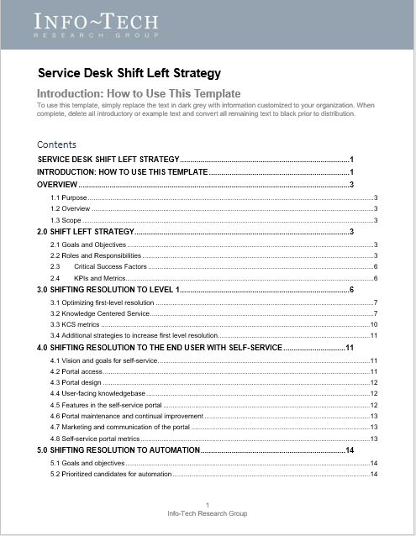
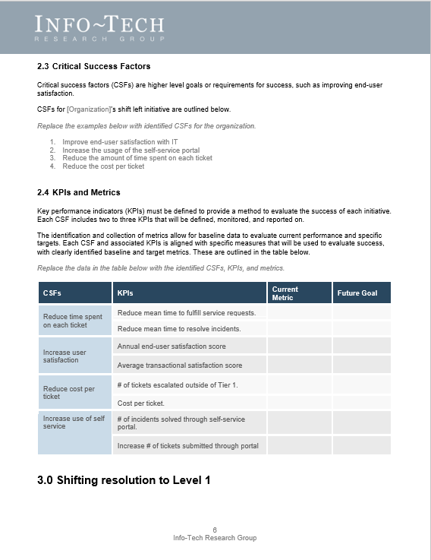
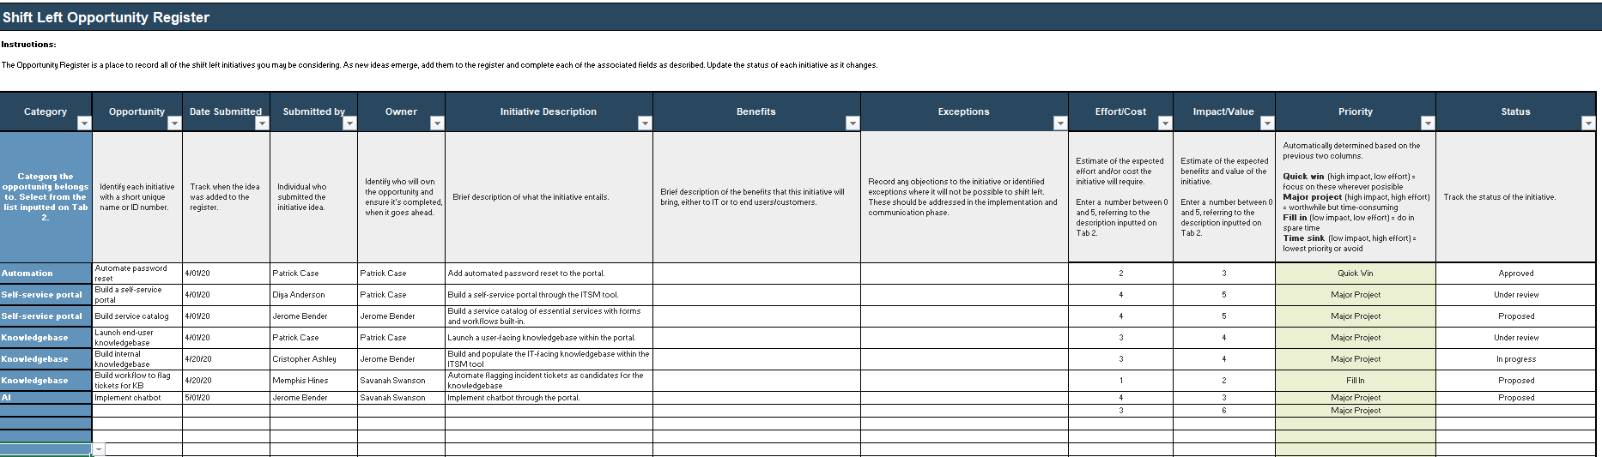
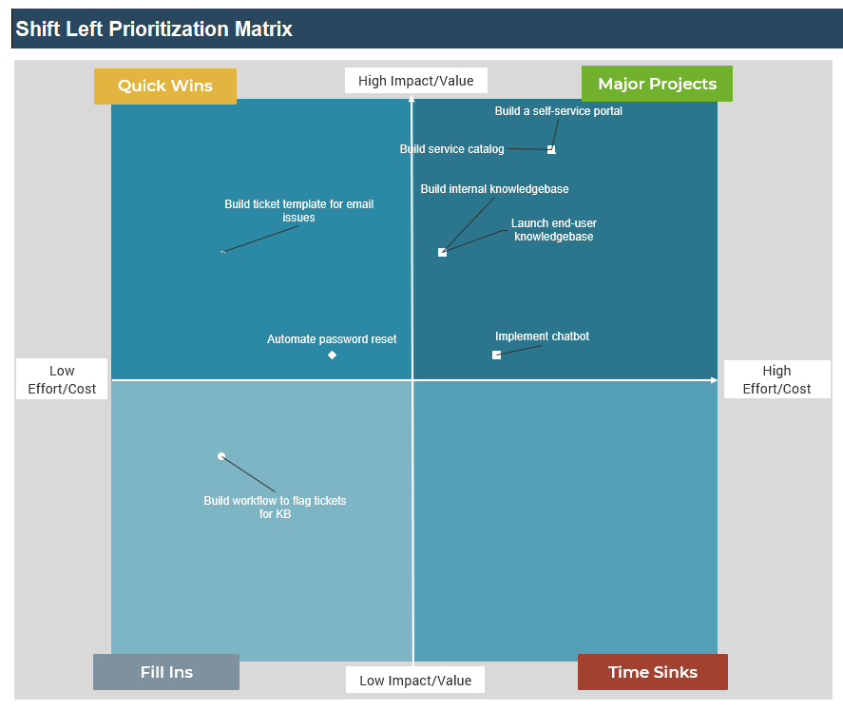
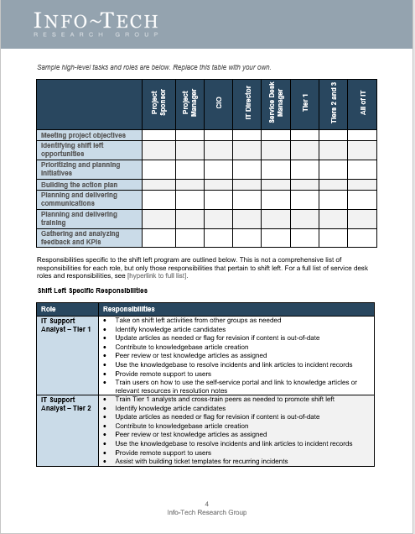

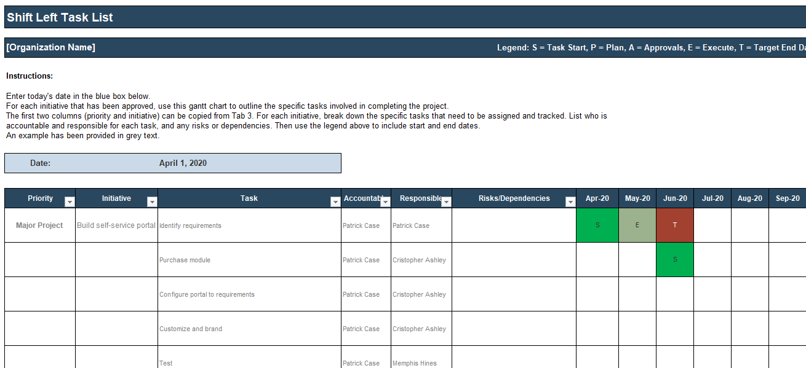
Blueprint deliverables
The two key deliverables where you will document most of the outcomes from the activities in this blueprint are:
As you work through the activities in this blueprint, watch for these two icons which will instruct you on how to complete these two deliverables by pointing you to specific sections of each.
  Shift-Left Action Plan
  Shift-Left Strategy
Use this tool to track and prioritize opportunities and tasks to be completed as part of the shift-left initiative.
Use this template to document the strategy to shift service support left.
Document in the Shift-Left Action Plan
Document in the Shift-Left Strategy

Slide 11

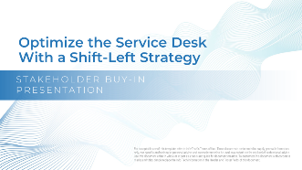
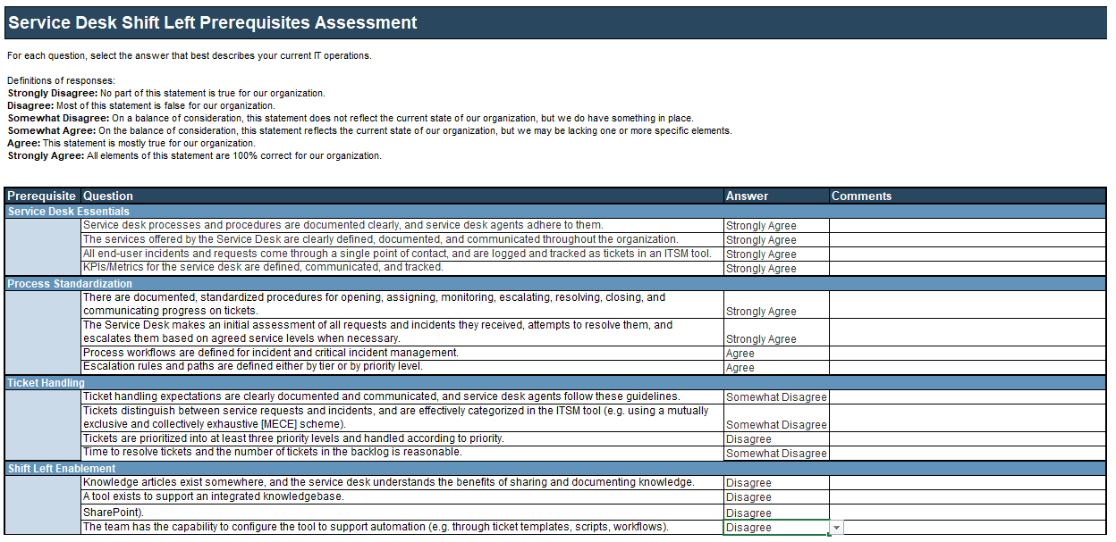
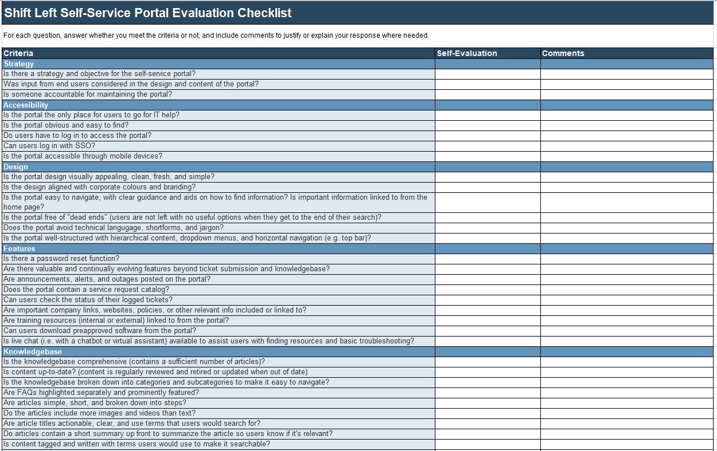
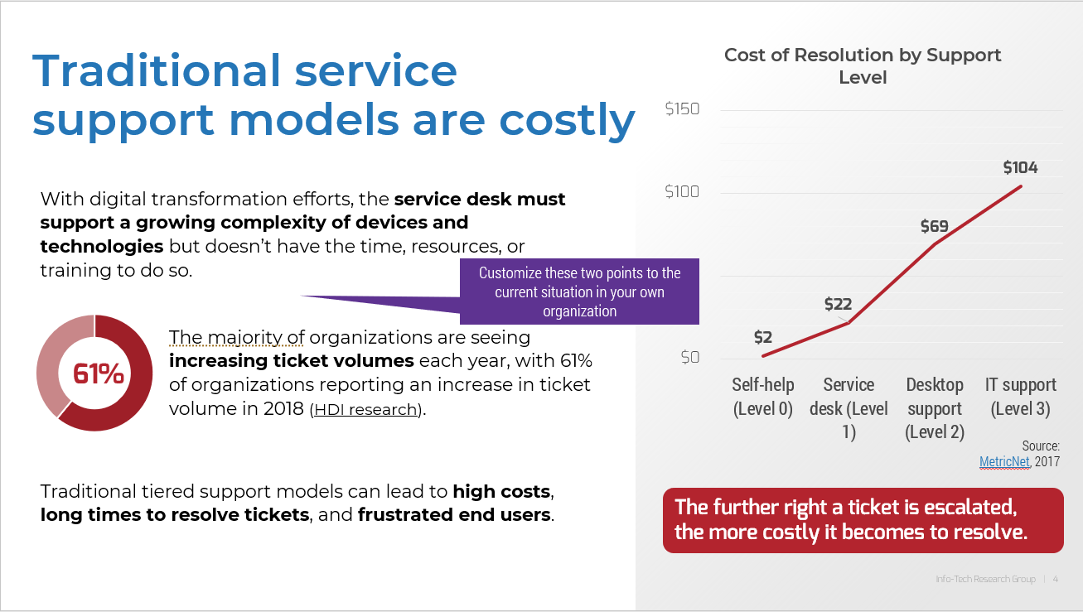

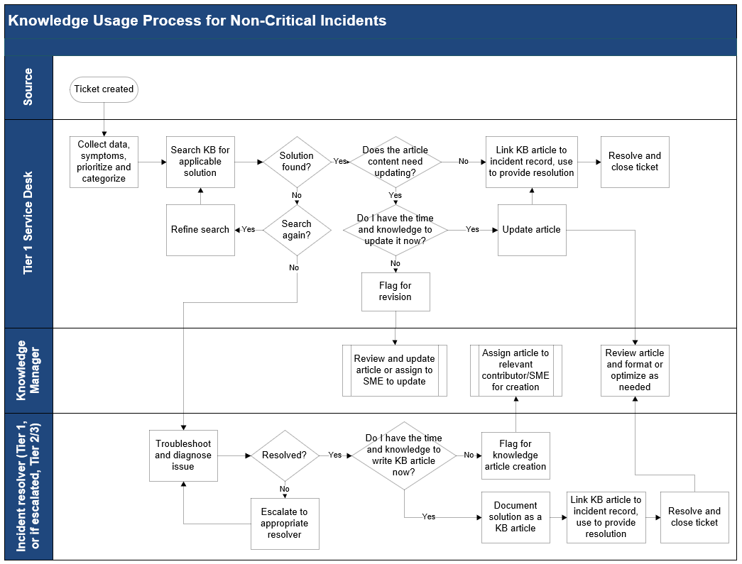
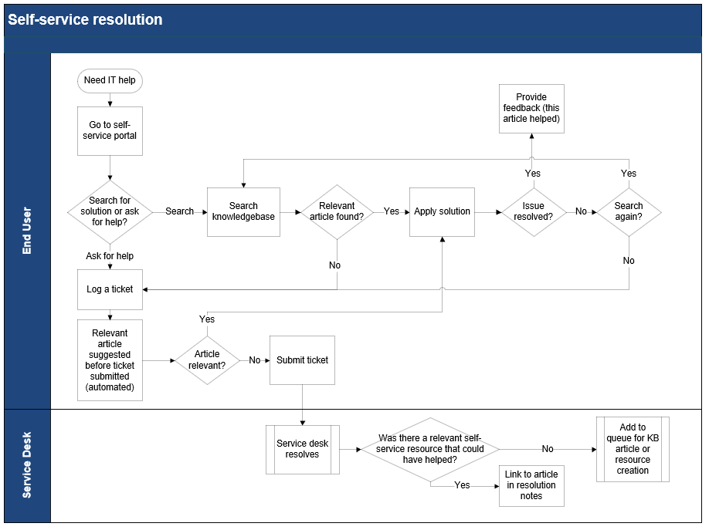
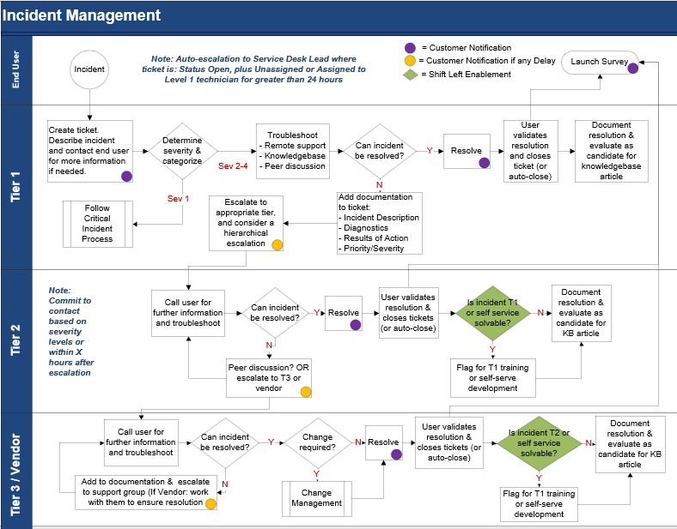
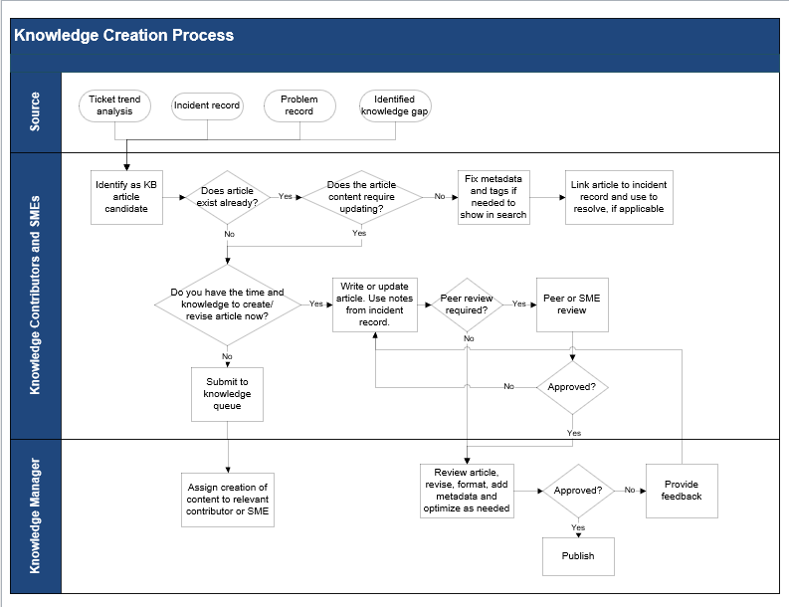
Additional blueprint deliverables
In addition to the two key deliverables described on the previous slide, each step of this blueprint is accompanied by supporting tools and templates to help you accomplish your goals.
  Shift-Left Stakeholder Buy-In Presentation
  Shift-Left Prerequisites Assessment
  Self-Service Portal Checklist
Use this template to build the business case and get everyone on board with the shift left optimization initiative.
Use this lightweight tool to assess your current service desk maturity to decide whether to proceed with the shift-left project.
Use this checklist as a self-evaluation of features and criteria to optimize the self-service portal to enable a shift-left strategy.
  Knowledge Management Workflows
  Self-Service Resolution Workflow
  Incident Management Workflow
Use this template to document service desk process workflows for knowledge creation, usage, and review.
Use this template to document the process through which users will interact with the self-service portal to resolve their issue.
Use this template to document the incident management process workflow and identify where opportunities for shift left exist.

Slide 12

Project benefits
Benefits for IT
Benefits for the business
Reduce repetitive tasks: Automation and self-service reduce the amount of time IT has to spend on repeated low-value tasks.
Decrease ticket volume: The ultimate goal of shift left is preventing a ticket from coming to the service desk.
Reduce time to resolve: Providing tools and knowledge to frontline staff and users reduces the amount of troubleshooting time and escalations, which should lead to a reduction in overall resolution time.
Free up time for project work: Specialists will have more time for project work when they shift tickets left.
More efficient processes: Documentation and automation will streamline manual processes.
Increase end-user satisfaction and empower employees: Self-service and more efficient ticket resolution will improve customer service and the overall customer experience.
Improve business productivity: When users aren’t left waiting for solutions so that they can do their work, they have more time to be productive.
Reduce costs: While this shouldn’t be the only goal of shift left, it can be a result of shifting support into lower-cost delivery channels.
Better allocation of resources and alignment to the business: The IT team will have more time to focus on complex tasks, innovation, and strategic projects.

Slide 13

Measure the value of shift left
There are many measurable and immeasurable benefits to a shift-left project, from increased end-user satisfaction to more efficient customer service delivery.
In order to estimate the ROI from a shift-left project to gain buy-in, you can estimate the time and cost savings of shifting resolution of tickets to Level 1 of the service desk, and to end users through the portal.
In Phase 1 of this blueprint, we will help you establish metrics to track and evaluate the success of the shift-left project.
Examples of possible savings per month:
# of internal knowledgebase articles created
Average reduction in Level 1 troubleshooting time
Level 1 hours saved to solve other tickets, per analyst
10
1 hour
10 hours
# of prevented escalations to Level 2
Average handle time of a Level 2 ticket
Level 2 hours saved to be redirected to projects
50
1 hour
50 hours
# of tickets prevented through self-help
Average cost per ticket – Average cost per self-help
Amount of money saved
200
$16-$2 = $14
$2800

Slide 14






Executive Brief Case Study
INDUSTRY
SOURCE
Support Center
Richard Sykora, Senior Manager, Support Operations at Blackbaud (via HDI 2017)
Objective
Results
A two-year support center transformation to improve tools and processes, improve efficiency, provide a consistent customer experience, make major changes to knowledge management, establish a single online community, and ultimately give users the tools to help themselves and deflect calls.
The transformation was complete in just over a year.
Unique knowledgebase users increased from 20,000 to 80,000 users.
Keys to Success
Community page views increased by over 300,000 quarterly.
Vision: The first step was to create a clear vision and get buy-in from leadership.
Accountability: Assigned a change manager to communicate and gather feedback throughout the change. A project manager helped to keep things on track. Knowledgebase coaches and champions were identified to develop and maintain content.
Divided the work: The tasks were compartmentalized and assigned to different support leaders, allowing everyone the time to continue to deliver daily operations
Metrics were defined to establish clear goals and a means to measure success.
Communication: Regular communication throughout the project and webinars for content delivery were conducted continuously.
Calls have been deflected with incoming volume remaining flat or lower YOY.
Operational costs decreased more than $1 million.
Client base increased 8% YOY.
Customer satisfaction is 93%+ each month.

Slide 16
Guided Implementation
A Guided Implementation (GI) is a series of calls with an Info-Tech analyst to help implement our best practices in your organization.
A typical GI is between six to nine calls over the course of three to four months.
What does a typical GI on this topic look like?
Prepare
Shift to automation
Shift to Level 1
Shift to end user
Implement
Call #1: Discuss shift left and determine readiness
Call #3: Identify opportunities to shift resolution to Level 1 and optimize knowledge sharing
Call #4: Identify opportunities to shift resolution to the end user and optimize self-service portal
Call #5: Identify opportunities to shift resolution to automation and AI
Call #6: Build implementation and communication plan
Call #2: Complete buy-in presentation and define metrics
Info-Tech Research Group | 16

Slide 17
Workshop Overview
Contact your account representative for more information.
workshops@infotech.com 1-888-670-8889
 | Day 1 | Day 2 | Day 3 | Day 4 | Day 5
Activities | Prepare to Shift Left | Plan to Shift to Level 1 | Plan to Shift to End User and Automation | Build Implementation & Communication Plan | Next Steps and Wrap-Up (offsite)
 | 1.1 Review current service desk structure 1.2 Discuss challenges 1.3 Review shift-left model and discuss how it would apply in your organization 1.4 Complete the Shift-Left Prerequisites Assessment 1.5 Complete an RACI chart for the project 1.6 Define and document objectives 1.7 Review the stakeholder buy-in presentation 1.8 Document critical success factors 1.9 Define KPIs and metrics | 2.1 Identify barriers to Level 1 resolution 2.2 Discuss knowledgebase challenges and areas for improvement 2.3 Optimize KB input process 2.4 Optimize KB usage process 2.5 Optimize KB review process 2.6 Discuss and document KCS strategy and roles 2.7 Document knowledge success metrics 2.8 Brainstorm additional methods of increasing FLR | 3.1 Review existing self-service portal and discuss vision 3.2 Identify opportunities to improve portal accessibility, UI, and features 3.3 Evaluate the user-facing knowledgebase 3.4 Optimize the ticket intake form 3.5 Document plan to improve, communicate, and evaluate portal 3.6 Map the user experience with a workflow 3.7 Document your AI strategy 3.8 Identify candidates for automation | 4.1 Examine process workflows for shift-left opportunities 4.2 Document shift-left-specific responsibilities for each role 4.3 Identify and track shift-left opportunities in the action plan 4.4 Brainstorm objections and responses 4.5 Document communications plan | 5.1 Complete in-progress deliverables from previous four days 5.2 Set up review time for workshop deliverables and to discuss next steps
Deliverables | Completed shift-left prerequisites assessment RACI chart Defined objectives Stakeholder buy-in presentation Documented KPIs and metrics | KCS strategy and roles Knowledge success metrics KB input process KB usage process KB review process Identified opportunities to increase FLR | Identified opportunities to improve self-service portal Self-service resolution workflow Identified candidates for automation and AI | Incident management process with shift-left opportunities Shift-left responsibilities Action plan with populated list of opportunities to shift left Objection handling plan Communication plan | Completed shift-left strategy document Shift-left action plan

