Slide 1
The First 100 Days as CISO
CISO success in five steps.
EXECUTIVE BRIEF

Slide 2

Analyst
Perspective
1. Prepare
2. Build Relationships
3. Inventory components of the business
4. Assess Security Posture
5. Deliver Plan
Every CISO needs to follow
Info-Tech’s five-step approach to truly succeed in their new position.
Throughout the first 100 days, expect to engage in several meet and greets, be in a constant state of discovery and analysis, and most importantly, build and educate a high-level security strategy that reflects the needs of the business to your stakeholders. While these steps are probably not surprising, it is easy to get overwhelmed and sidetracked. For this reason, Info-Tech developed a five-step approach based on the experiences of seasoned CISO professionals to provide a roadmap to structuring your first 100 days in the new position. Of course, the circumstances of the role will impact the priorities of each CISO. As a result, there may be changes to the order or amount of time allocated to the steps; however, the overall approach will remain the same.
Michelle Tran
Security, Risk & Compliance
Info-Tech Research Group

Slide 3



Executive Summary
Your Challenge
Common Obstacles
Info-Tech’s Approach
You have been promoted from within the organization to the role of CISO.
You have been hired externally to take on the role of CISO.
Making a strong first impression; establishing trust and credibility.
Developing a high-level security strategy in a short time.
Clarifying the scope of your role and setting expectations with stakeholders.
Use Info-Tech’s 100-day plan to get you on the right track.
Use Info-Tech’s diagnostic tools to inform you and the organization of gaps in the security program.
Info-Tech Insight
80% of your time will be spent listening. The first 100 days of the CISO role is an information gathering exercise which will involve several conversations with different stakeholders and business divisions. Leverage this collaborative time to understand the business, its internal and external operations, and people. Unequivocally, active listening will build company trust and help you to build an information security vision that reflects that of the business strategy.

Slide 4
Your challenge
Average Tenure of a CISO is
26 months.
This research is designed for newly positioned CISOs who are looking to
Make a good first impression at their new job.
Obtain guidance on how they should approach the first 100 days.
Assess the current state of the security program and recommend areas of improvement and possible solutions.
Develop a high-level security strategy in three months.
  88%
  of CISOs report being moderately or tremendously stressed.
Starting a new position is daunting.
Being CISO is stressful.
Let Info-Tech help make the transition easier.
Source: CISO Stress report, Nominet Cyber Security, 2020

Slide 5

Common obstacles
These barriers make this challenge difficult to address for many CISOs:
The expectations, responsibilities, and scope of the role are unclear.
The organization has a non-existent or immature security program or has not previously evaluated their security program.
The security strategy must be drafted to reflect business requirements.

Slide 6
Info-Tech’s approach
The Info-Tech difference:
THE 100-DAY PLAN
C
PREPARE
1
Work with Info-Tech to prepare a 100-day plan that will position you for success.
Leverage Info-Tech Diagnostic Surveys and Tools to collect the details needed to build out a high-level information security strategy quickly.
BUILD RELATIONSHIPS
2
INVENTORY COMPONENTS OF THE BUSINESS
Governance & Management Scorecard
ASSESS SECURITY POSTURE
IT Security Business Satisfaction & Alignment
DELIVER PLAN
-10
0
30
60
90

Slide 7
Info-Tech’s methodology for
The First 100 Days as CISO
 | 1. Prepare | 2. Build Relationships | 3. Inventory Components of the Business | 4. Assess Security Posture | 5. Deliver Plan
Phase Steps | 1.1 Interview your predecessor 1.2 Learn the corporate structure 1.3 Review communications 1.4 Use the intro sheet | 2.1 Introduce yourself to your team 2.2 Get to know your sphere of influence 2.3 Schedule and Conduct Interviews | 3.1 Inventory company assets to know what to protect | 4.1 Leverage the Security Diagnostic Program 4.2 Benchmark your results 4.3 Build an Information Security Strategy | 5.1 Build the executive deck 5.2 Communication considerations
Phase Outcomes | Interview your predecessor Create a one-page introduction sheet | Brainstorm a list of business stakeholders to meet Conduct interviews with key stakeholders | Inventory and review company assets | Complete the Security Governance & Management Scorecard Complete the IT Security Business Satisfaction Alignment Report Complete Diagnostic Benchmarking | Build and communicate the executive deck

Slide 8
Insight Summary
Insight 1
Every CISO needs to follow Info-Tech’s 5-step approach to truly succeed in their new position. The meaning and expectations of a CISO role will differ from organization to organization and person to person; however, the approach to the new position will be relatively the same.
Insight 2
80% of your time will be spent listening. The first 100 days of the CISO role is an information gathering exercise which will involve several conversations with different stakeholders and business divisions. Leverage this collaborative time to understand the business, its internal and external operations, and people. Unequivocally, active listening will build company trust and help you to build an information security vision that reflects that of the business strategy.
Insight 3
Start “working” before you actually start the job. This involves finding out as much information about the company before officially being an employee. Investigate the company website and leverage available organizational documents and initial discussions to better understand your employer’s leadership, company culture, and business model.

Slide 9


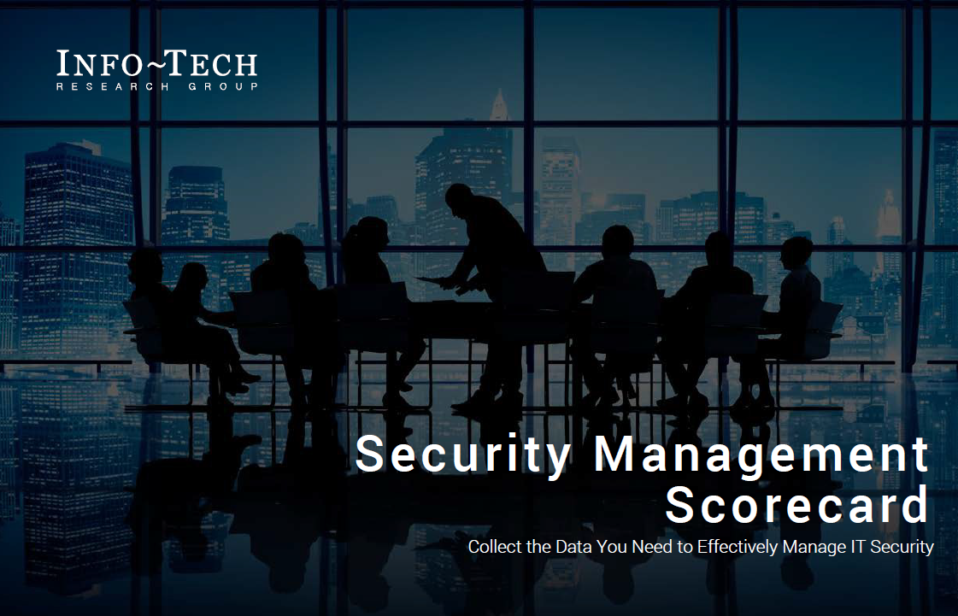
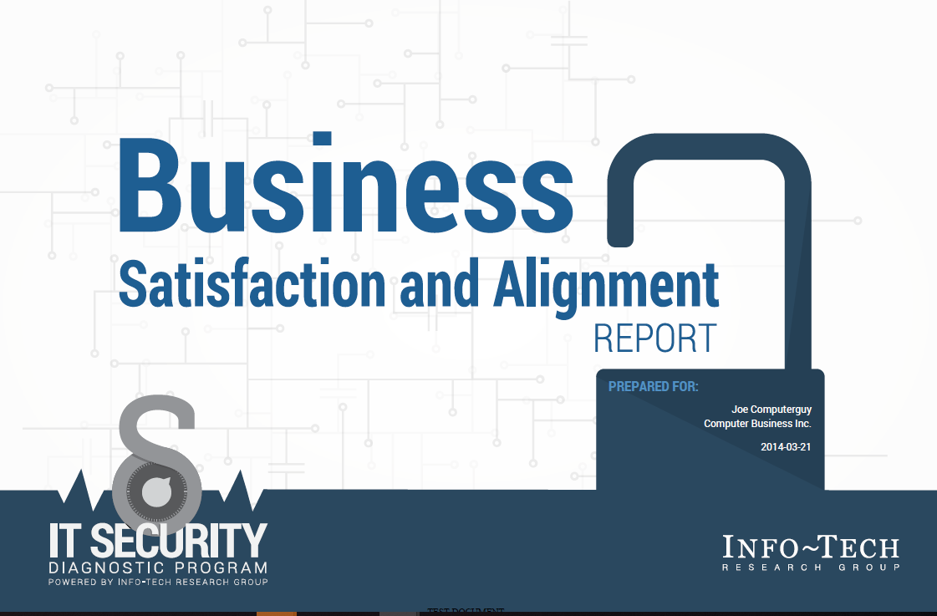
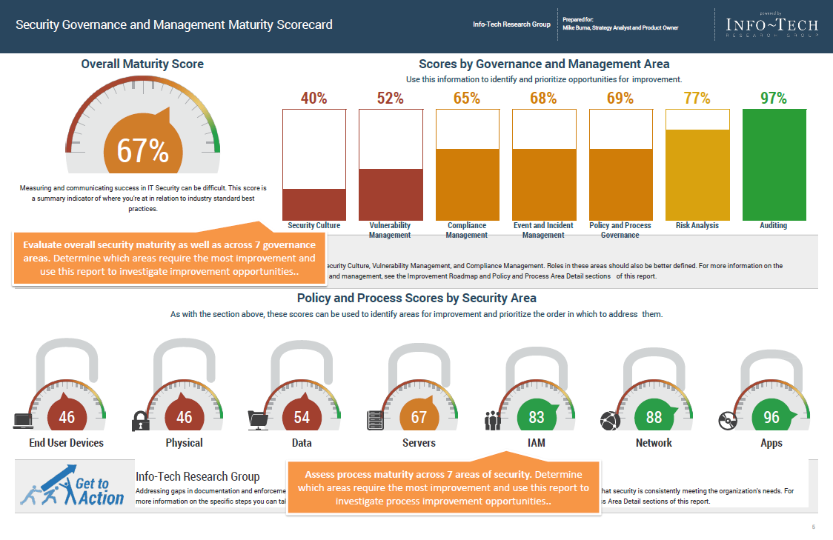
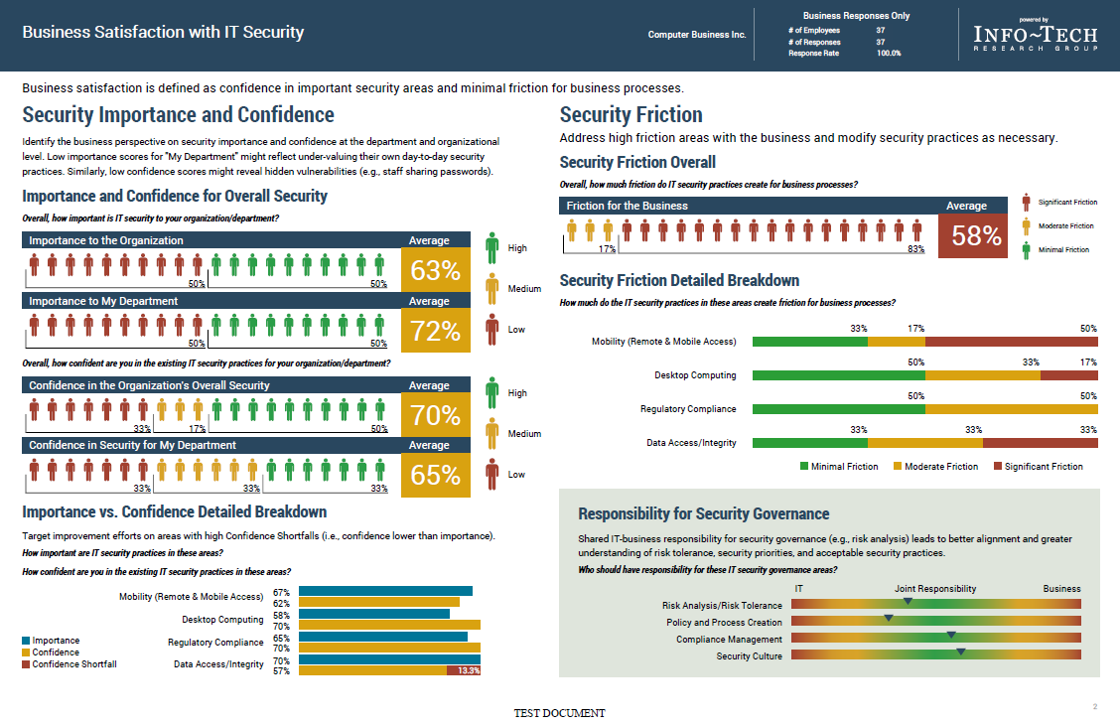
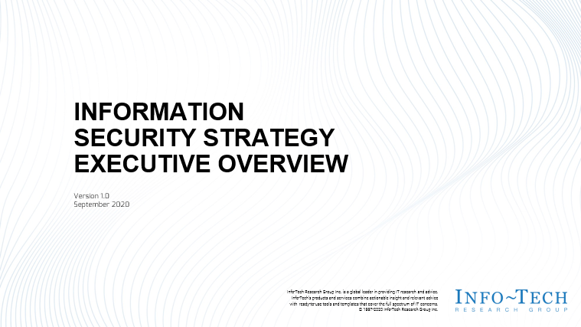
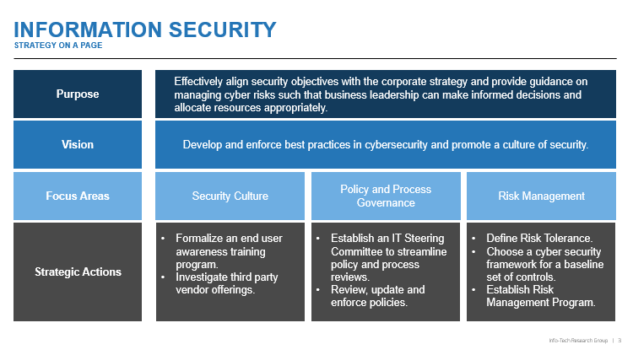

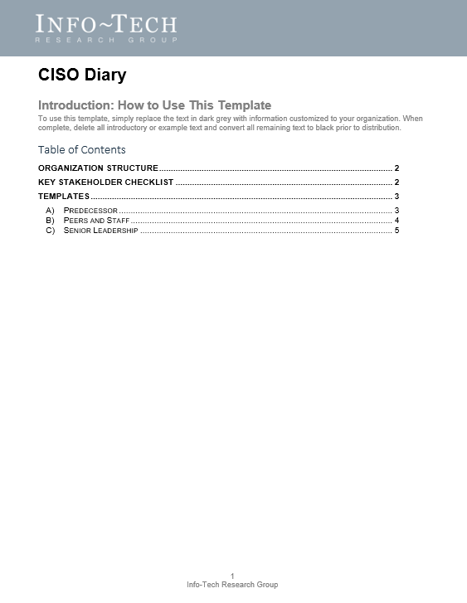

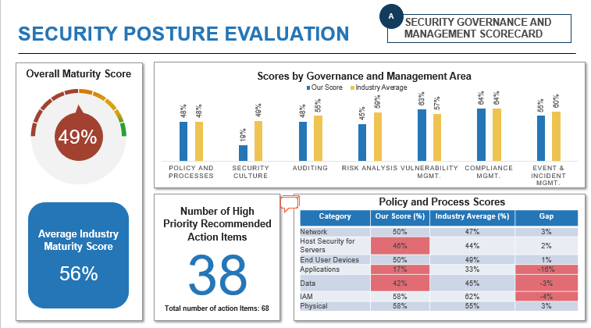
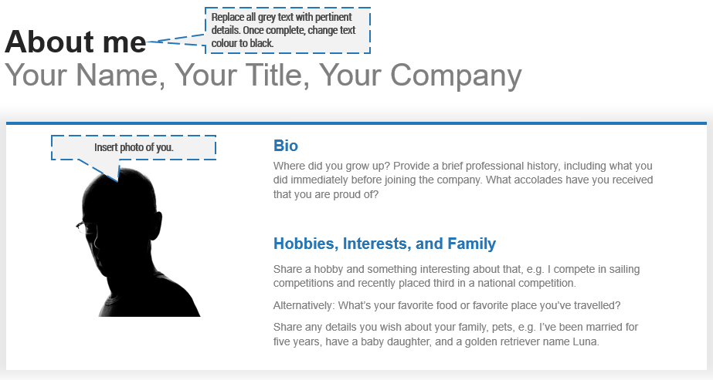
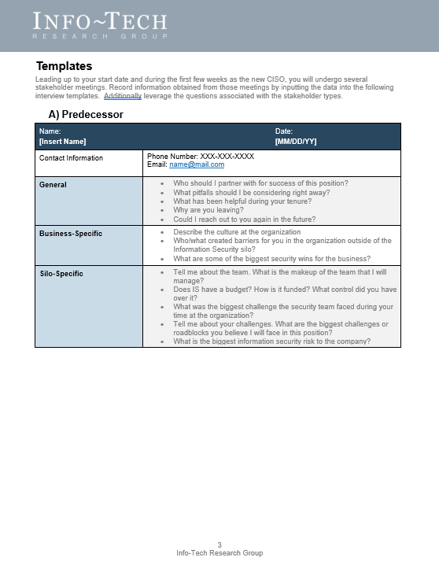
Blueprint deliverables
Key deliverable:
Each step of this blueprint is accompanied by supporting deliverables to help you accomplish your goals:
  Executive Presentation Template
Deliver your high-level security strategy to the business using Info-Tech’s easy-to-use presentation template.
  Security Management Scorecard
  Business Satisfaction and Alignment Report
Assess security practices and identify areas for improvement and optimization.
Measure business satisfaction and gaps between IT and business perceptions of security practices.
  CISO Diary
  Introduction Sheet
A single resource to record meeting notes. Includes example stakeholder interview questions.
A template used to communicate to the business who you are on your very first day.

Slide 10
Blueprint benefits
CISO Benefits | Business Benefits
Hit the ground running with Info-Tech’s ready-made agenda vetted by CISO professionals to impress your colleagues and superiors. Gather details needed to understand the organization (people, process, technology) and to determine the current state of the security program. Track and assess high-level security gaps using Info-Tech’s Diagnostic Tools and cross compare yourself to industry benchmarking data. | Increase visibility into the organization’s security program strengths and weaknesses. Learn of information security gaps and possible solutions to minimize risk to the organization.

Slide 11
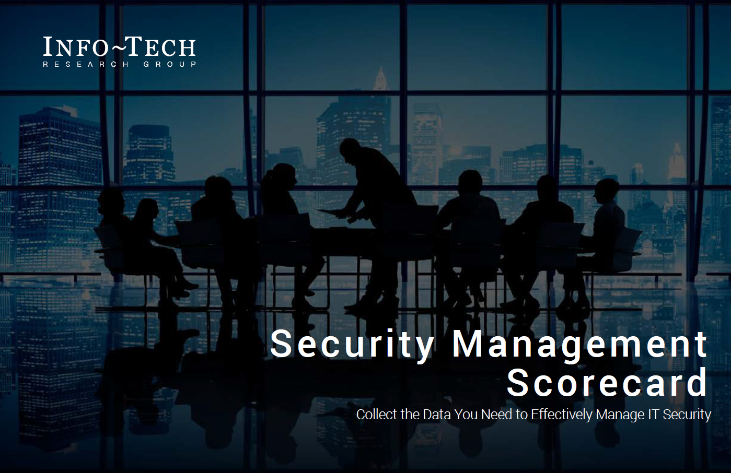
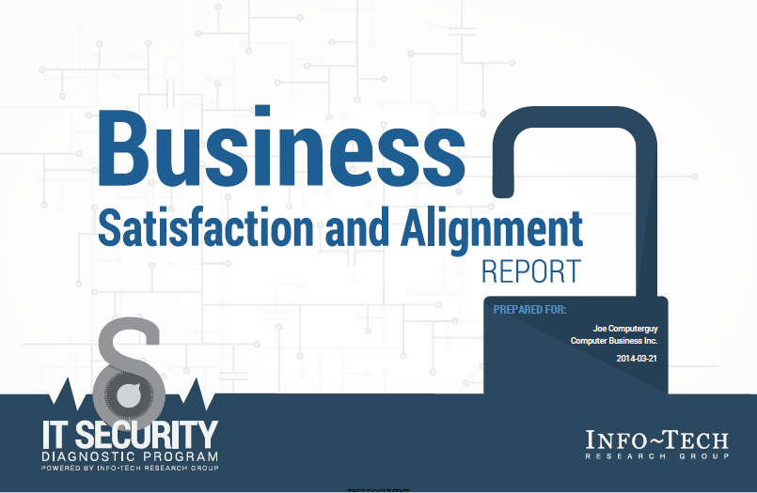
Measure the value of this blueprint
In Phase Four of this blueprint, you will complete two IT Security Diagnostic Tools to evaluate the strengths and weaknesses of your organization’s security program.
Within the first 100 days you will have
Achieved a general understanding of the business operations and strategy.
Inventoried and acquainted yourself with elements of the business (people, process, and technology).
Assessed the security posture of the business.
Prepared and communicated a high-level security strategy to stakeholders.
Our IT Security Diagnostic Program offers a self-evaluation of your overall security posture.
Average Days saved: 28 Days | Average Dollars Saved: $11,000 USD
“The diagnostic report is easy to read, follow, and understand and, importantly, it includes recommendations for action with the description of the issues. Going through the report with the security expert from Info-Tech helped us to understand more thoroughly, and through discussion, helped to identify which areas should be our priorities. This will help us move forward quickly and get the most benefits faster.”
– Nuna Logistics Limited

Slide 12


Executive Brief Case Study
Industry
Source
Healthcare
Christine Coz
Background
When Christine Coz started as the Director of IT at the Hospital Diagnostic Imaging Repository Services (HDIRS), a role that included PMO, IT Operations, IT Architecture, and the Clinical Program, the security function had been handled at a middle management operational level. Security as a function was handled within the IT Operations group, with the support of an external advisor. Upon reviewing existing managed service contracts and the progress on the program to date, it was clear to HDIRS that a formalized security program was needed. To get the program started, a strategy was put forward to the Board of Directors to create the CISO role. In obtaining approval, Christine was internally promoted to Sr. Director Operations (CIO), CISO, and CPO. Her previous experience leading security in several organizations along with her professional development degrees and certificates helped.
Approach
To jumpstart the security program, Christine followed the 100-day approach outlined in this blueprint. As a first step, Christine familiarized herself with existing contracts and obligations to members, clients, and other stakeholders including eHealth Ontario. She then liaised with senior stakeholders to review corporate strategy materials, external member security requirements, vendor managed services contracts, and member and client agreements, amongst other resources. A review of existing skillsets within the operational and vendor teams was also performed along with a current security posture assessment. Evaluating the information collected, Christine consolidated her resources and developed a strategy to present to the board.

Slide 14

Guided Implementation
A Guided Implementation (GI) is a series of calls with an Info-Tech analyst to help implement our best practices in your organization.
A typical GI is between five to eight calls over the course of two to three months.
What does a typical GI on this topic look like?
Phase 1
Phase 5
Phase 2 & Phase 3
Phase 4
Call #1: Prepare before you start.
Call #2: Understand the business.
Call #3: Evaluate the business’ security posture using the Info-Tech Diagnostic Program.
Call #6: Build Executive Deck
Call #4: Review Security Governance and Management Scorecard.
Call #5: Review IT Business Satisfaction and Alignment Report
Info-Tech Research Group | 14

