Slide 1
Durable Goods Manufacturing Business-Aligned IT Strategy

Slide 2
Executive Summary: Durable Goods Manufacturing Business-Aligned IT Strategy
Situation: Competitive Landscape Transformation
Complication: Lack of Skills and Collaboration
Solution: A Business-Aligned Approach
The Durable Goods Manufacturing environment is changing significantly. With new Industry 4.0 technology, a rapidly growing consumer class, changes in demographics, a push for operational efficiency, and a more highly regulated space, the competitive landscape has become complex. The need to innovate and digitally transform operations is increasing.
IT organizations must play a critical role in the business transformation by harmonizing the interconnectivity and communications necessary for rapid and effective change.
There are many issues that are complicating the industry:
Industry 4.0 is a technology platform that requires planning and investment in new technology and new skills.
Attracting and retaining talent is more difficult due to the specialized skills necessary for new technology and holding back skilled staff for support of existing technology.
Harmonization of IT and OT departments is critical for smooth adoption and maximized ROI of Industry 4.0.
By engaging in the insights and activities presented in this research, you will:
Learn about the fundamentals of your industry, including its ecosystem, influences, opportunities, and constraints.
Conduct PESTLE and SWOT analyses within the context of your industry, with guiding insights from Info-Tech, to understand unique implications for IT.
Devise a list of initiatives you can integrate into your IT strategic plan to transform the role IT plays in your organization.
Info-Tech Research Group | 2

Slide 3
The Durable Goods Manufacturing Industry
Making things that last
Design and fabrication of durable items typically takes longer than for non-durable items.
Goods are expected to last more than three years.
Involves both a complex production process and a complex supply chain process.
Higher exposure to obsolescence.
Typically more expensive to produce.
Requires heavy up front capital investment.
Higher-end product purchase value.
Customer purchase is based on rational decision rather than on emotional factors.
Selling the product might involve financial tools (leasing, loans, etc.).
Longer lead time.
Strong planning capabilities requirements.
Info-Tech Research Group | 3

Slide 4
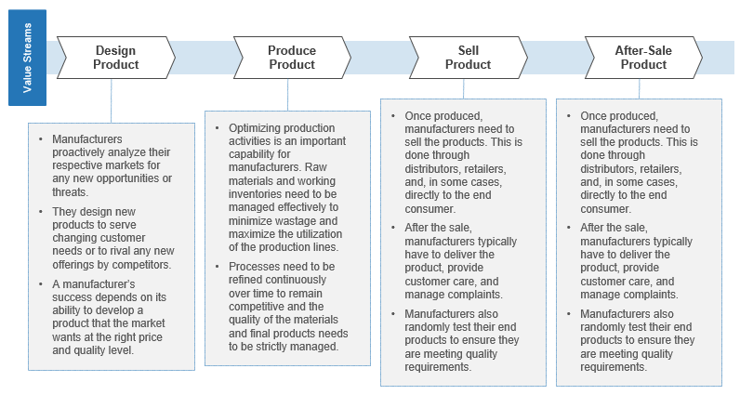
Durable Goods value stream
Value Stream Defined…
Value streams connect business goals to the organization’s value realization activities in the marketplace. Those activities are dependent on the specific industry segment in which an organization operates.
There are two types of value streams: core value streams and support value streams.
Core value streams are mostly externally facing. They deliver value to either an external or internal customer and they tie to the customer perspective of the strategy map.
Support value streams are internally facing and provide the foundational support for an organization to operate.
An effective method for ensuring all value streams have been considered is to understand that there can be different end-value receivers.
Info-Tech Research Group | 4

Slide 5
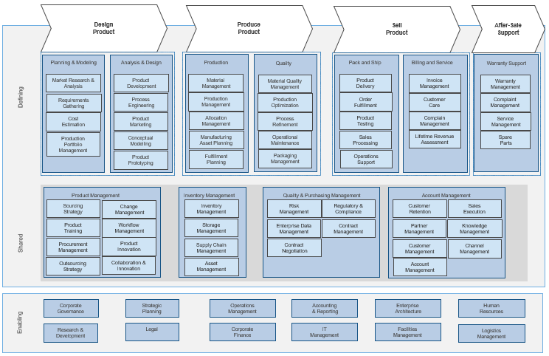
Durable Goods business capability map
Business Capability Map Defined…
In business architecture, the primary view of an organization is known as a business capability map.
A business capability defines what a business does to enable value creation. Business capabilities:
Represent stable business functions.
Are unique and independent of each other.
Typically will have a defined business outcome.
A business capability map provides details that help the business architecture practitioner direct attention to a specific area of the business for further assessment.
Info-Tech Research Group | 5

Slide 6
The Durable Goods IT environment
Influencing factors
Technological innovation: Technology and innovation are creating opportunities for the Durable Goods Manufacturing space. They have the potential to transform and disrupt the market. Industry 4.0 technologies such as additive manufacturing and AR/VR is creating new markets and lowering the entry barriers for some smaller manufacturers.
Environmental stewardship: Beyond sustainable manufacturing, which pursues economically and environmentally friendly processes, environmental stewardship is a holistic approach that leads and promotes the use of cost-efficient, safe, and ecologically friendly processes.
Disposable income: An increase in disposable income for the middle-class demographic directly impacts this sector as post Covid-19 business ramps up.
Economic outlook: Economic outcomes influence this industry at a higher degree given the higher price and lifespan expectations of the products made.
Trade agreements: Global protectionism and trade disputes have reshaped the landscape; offshoring has been reduced and onshoring has grown.
Capital investment: Businesses need to be more creative in order to deal with the large capital investments needed for sustainable manufacturing processes. Affordable and sustainable credit in developed countries offers them a distinct competitive advantage.
Technological innovation
Environmental stewardship
Disposable income
Economic outlook
Trade agreements
Capital investment
Info-Tech Research Group | 6

Slide 7
Durable Goods industry facts
The hard numbers…
Contribution to GDP: Manufacturing is one of the biggest contributors to the US GDP. In fact, for every $1 spent in manufacturing, another $2.79 is added to the economy.¹
Small manufacturers: Most manufacturers in the US are small. A survey in 2017 identified 248,030 manufacturers, and all but 3,914 were small (having fewer than 500 employees).¹
Strong worldwide growth: Over the past 19 years, worldwide manufacturing has multiplied 2.67 times from US$4.8 trillion to US$12.75 trillion.¹
Unfilled positions: Projected to need 4 million jobs by 2030 with 2.1 expected to go unfilled as workers attempt to pursue other, more modern career paths.¹
Tops in innovation funding: Although it is difficult to retain people, the manufacturing sector performs nearly 62% of all private sector R&D at approximately US$293.6 billion in 2019 and should be leveraged to compel workers to stay within the sector as it continues to grow.¹
Contribution to GDP
Small manufacturers
Strong worldwide growth
Unfilled positions
Tops in innovation funding
Sources:
1. National Association of Manufacturers
Info-Tech Research Group | 7

Slide 8
Durable Goods competitive landscape
Transformation of Durable Goods
Digital transformation: Increased dependency on digital infrastructure will create a migration and sustainability challenge for the IT organization.
Legacy migration needs to be addressed as part of the digital transformation strategy, which must be timely due to the inherent cybersecurity risks associated with legacy equipment and software.
Digital workforce: New conditions generated by Industry 4.0 and an expanded remote workforce, as well as accelerated use of IoT, AI, blockchain, and cobotics that are driving the need for rapid change. New training programs must be put in place to upskill and reskill staff with a focus on technology, process, and effective communications.
Contactless interaction: Covid-19 created many instant changes for business, and some changes like contactless processes will be retained as workers wish to remain safe from new variants.
New competitors: Some technologies will bring new competitors as the entry barriers are lowered or removed altogether for certain sectors within the industry.
Digital transformation
Digital workforce
Contactless interaction
New competitors
Info-Tech Research Group | 8

Slide 9
Critical challenges
in Durable Goods IT
Catching up with rapid transformation
Legacy: Legacy systems are an essential part of the current operations for many manufacturing businesses and cannot easily be replaced by some of the newer technologies. They become more costly to service as providers, skills, and parts are in short supply.
New tech in a traditional culture: The introduction of new technology will generate the need for:
Overcoming a weak digital culture, which will create an obstacle for new technology adoption and proliferation in the organization.
A skills-level review of the organization’s workforce and development of retraining programs.
The need to leverage new technology in an agile way as big bang replacement isn’t practical from a skills and cost perspective.
Avoiding disruption of the 100% uptime business model.
Balancing innovation and operational lights-on support with standardization.
New competition: Globalization means new competitors.
Adjusting the business model: Products will need to be converted to a subscription-based operating model in order to keep pace with industry-wide business model changes.
Legacy
New tech in a traditional culture
New competition
Adjusting the business model
Info-Tech Research Group | 9

Slide 10
Critical opportunities in Durable Goods IT
New tech and new markets
Expanded horizons: New markets, new partnerships with customers, and converting products to services will expand business opportunities as well as more predictable revenue streams.
Faster design-to-market cycle: Accelerated design and testing processes will bring products and services to market faster with improved quality.
New industry 4.0 technologies: Augmented reality, AI, blockchain and digital twin technologies are examples that can be leveraged for increased ROI in the business.
More customization: Higher degrees of customization and flexibility will be enabled by new visual codeless technologies. Traditionally expensive customization can now take place at a much lower cost and at an extremely rapid pace.
Takeover business opportunities: Legislative changes create complications for the business while also creating opportunities for takeover business as some businesses exit legacy markets for emerging markets. The automotive sector is a good example of where emissions standards cause some businesses to exit or pivot away from gasoline engine market.
Expanded horizons
Faster design-to-market cycle
New Industry 4.0 technologies
More customization
Takeover business opportunities
Info-Tech Research Group | 10

Slide 11
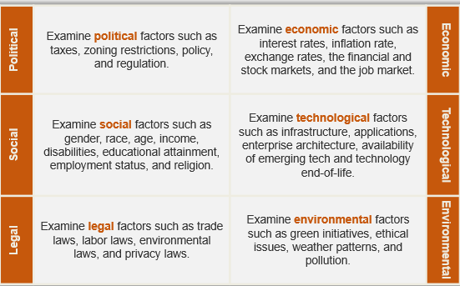
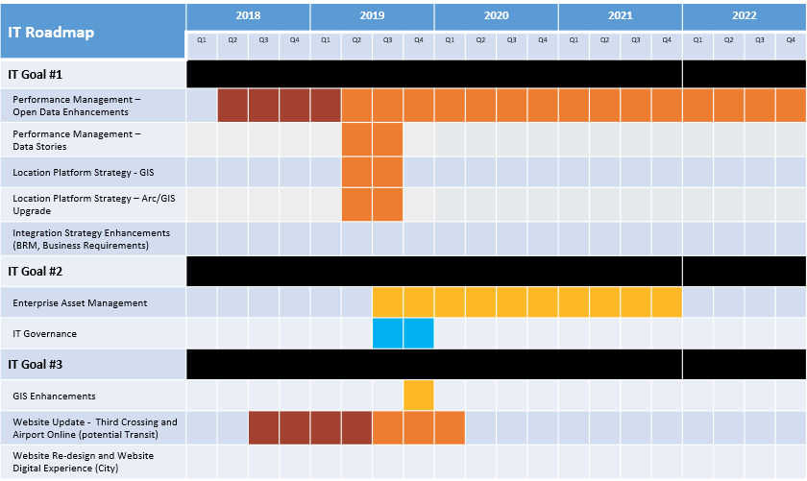
Assess your ecosystem and influencers to refine your IT strategic priority initiatives
PESTLE Results
PESTLE/Value Stream
SWOT
High-Level Impacts
IT Strategic Plan Initiatives
Info-Tech Research Group | 11

Slide 12
Durable Goods PESTLE analysis
Know the factors and influencers at work in your industry’s value stream
A PESTLE analysis is a useful tool for understanding the broader ecosystem within which Durable Goods Manufacturing IT is operating to gauge external impacts and influencers on your institution.
Political | Examine political factors such as taxes, zoning restrictions, policy, and regulation. | Examine economic factors such as interest rates, inflation rate, exchange rates, the financial and stock markets, and the job market. | Economic
Social | Examine social factors such as gender, race, age, income, disabilities, educational attainment, employment status, and religion. | Examine technological factors such as infrastructure, applications, enterprise architecture, availability of emerging tech, and technology end-of-life. | Technological
Legal | Examine legal factors such as trade laws, labor laws, environmental laws, and privacy laws. | Examine environmental factors such as green initiatives, ethical issues, weather patterns, and pollution. | Environmental
Info-Tech Research Group | 12

Slide 13
Activity: PESTLE analysis of the Durable Goods Manufacturing value stream
Part 1 Duration: 1 Hour
Objective:
To identify and analyze the key drivers of change in the Durable Goods value stream. Use each of the six PESTLE lenses (letters) to brainstorm implications for each component in the value stream.
Steps:
Describe the PESTLE framework for the group.
Divide the participants into seven groups, one for each PESTLE lens plus one for COVID-19 (if relevant). If you don’t have enough people, balance the lenses accordingly or work as a single group. Give each group the PESTLE template and appropriate PESTLE lens worksheet.
Have each group brainstorm Durable Goods Manufacturing factors arising from their assigned lens. For example, the “P” group should discuss political factors influencing Durable Goods Manufacturing as a whole. Use the questions provided in the PESTLE template to prompt discussion. List factors identified on the PESTLE worksheet (under “Other”) on the left-hand side, as needed.
For each factor, determine the degree of impact (High, Medium, Low) that factor has on each component of the value stream. Record these in the heatmap chart in the appropriate PESTLE worksheet starting with a review of the ones listed.
For each “High” impact factor, brainstorm possible implications for IT. Record these implications on the worksheet on the right-hand side.
When complete, you should have six completed PESTLE worksheets (or seven if including COVID-19) with factors, degrees of impact, and IT implications.
Update these results into your Durable Goods Manufacturing IT Strategy Initiatives Workbook by copying and pasting the appropriate slides.
Download the Durable Goods Manufacturing IT Strategy Initiatives Workbook
Info-Tech Research Group | 13

Slide 14
Activity: PESTLE analysis of the Durable Goods Manufacturing value stream
Business strategy Existing IT strategy | IT implications for the major factors affecting the Durable Goods Manufacturing industry
Whiteboard/flip charts Durable Goods PESTLE Template Durable Goods PESTLE Lens Worksheets | CIO IT team management Project managers
Input
Output
Materials
Participants
Info-Tech Research Group | 14

Slide 15
PESTLE analysis questions for Durable Goods
Political | Are tariffs or other trade legislation affecting your business? Is privacy legislation accounted for (e.g. GDPR, CCPA)? Have there been geographical changes to the organization? Would immigration legislation impact your business? Is the business impacted by environmental changes? | How are your costs changing (e.g. global logistics and market fluctuations)? Can you attract and pay for top-quality talent (e.g. desirable location, challenge, compensation, lifestyle, comfort, safety)? Is the organization impacted by local buying or incentives given to companies by local governments in other countries? | Economic
Social | Are there any trends that could impact company product(s)? Have there been any changes to your core customer base? Is there an impact due to employee turnover rate? Can enough skilled staff be sourced in the market? Is your business impacted by seasonality? Are the buying habits of your customers changing? | Is there any physical infrastructure that needs to be modernized within your geographical location? How are new technology and remote work impacting productivity? Are IT and OT harmonized within the business? Are new materials/process changes causing obsolescence in the product portfolio or production processes? | Technological
Legal | Have there been government changes to reporting, standards, licenses, permits, labeling, or health and safety that could impact the business? Are there union factors that must be considered? Are new trade agreements impacting the business? Is sustainability/environment legislation impacting the business? | Are government environmental standards for sustainable manufacturing impacting the business (e.g. reduce, reuse, repair, and low carbon emissions)? How are you impacted by material and waste disposal standards? Do you have environmentally friendly initiatives underway? Do renewable technologies play a role in your business? | Environmental
Info-Tech Research Group | 15

Slide 16
PESTLE for Durable Goods: Political
 | Value Stream Impact
Political Factors Influencing Durable Goods | Design Product | Produce Product | Sell Product | After-Sale Support
Working conditions: Remote connectivity will create new working conditions for staff and management.
Trade: The Global Trade agreements and growing protectionism movements have and will continue to shape the supply chain.
Privacy: Increased role of government in data protection and privacy.
Other: List here.
IT implications of political factors
Companies are dependent on connectivity and infrastructure to deal with new emerging markets.
Governments are having more impact on companies to build and buy local.
Industry 4.0 is changing the job market due to automation and proliferation of robotics.
New technology is providing solutions for organizations too lower production costs, accelerate product development, improve quality and capture new market opportunities.
Others? List them here.
High | Med | Low
Info-Tech Research Group | 16

Slide 17
PESTLE for Durable Goods: Economic
 | Value Stream Impact
Economic Factors Influencing Durable Goods | Design Product | Produce Product | Sell Product | After-Sale Support
Market landscape: New competitors entering the market. New and parallel business opportunities due to market shifts.
Innovation: Faster design-to-market cycles with focused innovation models that forget, extend or bust-out from current processes.
Industry 4.0: Losing competitive edge or not being able to compete altogether. Need to upgrade technology infrastructure.
Other: List here.
IT implications of economic factors
The increased cost for reskilling workers may be a barrier for some companies.
Industry 4.0 will change many jobs due to automation and expanded use of robotics processes.
Factory automation, AI, AR/VR and robotics will play a significant role in the industry’s modernization.
IT organizations will be required to be agile, harmonize with OT, and efficiently implement complex technology.
Others? List them here.
High | Med | Low
Info-Tech Research Group | 17

Slide 18
PESTLE for Durable Goods: Social
 | Value Stream Impact
Social Factors Influencing Durable Goods | Design Product | Produce Product | Sell Product | After-Sale Support
Skills: Skills shortage. Training requirements. Need to upgrade technology skills
Working conditions: Need to relocate jobs/factories. Need to retain workers beyond the traditional retirement age.
Industry 4.0: Some jobs could become obsolete. Technology could serve as an incentive to attract young professionals.
Other: List here.
IT implications of social factors
These new challenges will require new skills for IT staff to be prepared to deal with this reality.
Factory automation and robotics will play a significant role in the industry’s modernization efforts.
Millennials will be attracted to jobs that offer more technology interactions.
May need to incentivize some workers to support legacy technology through transition periods.
Others? List them here.
High | Med | Low
Info-Tech Research Group | 18

Slide 19
PESTLE for Durable Goods: Technological
 | Value Stream Impact
Technological Factors Influencing Durable Goods | Design Product | Produce Product | Sell Product | After-Sale Support
Collaborative design: New materials, fabrication methods, and design techniques.
Cybersecurity: The need to allow vendors/customers to provide remote support could create security vulnerabilities.
IT/OT convergence: Enables predictive maintenance. Enables automation and cost reductions.
Adaptability: The Goliaths are rapidly changing the landscape.
Other: List here.
IT implications of technological factors
IT organizations are becoming more critically involved in the running of the production shop floor. IT and OT need to create synergistic models that streamline communication methods.
Factory automation and cobotics will play a significant role in the industry’s modernization and demand for timely service.
These new challenges will require new skills for IT and OT staff to be prepared to deal with a new set of challenges.
The Amazon factor as game creator and changer.
Others? List them here.
High | Med | Low
Info-Tech Research Group | 19

Slide 20
PESTLE for Durable Goods: Legal
 | Value Stream Impact
Legal Factors Influencing Durable Goods | Design Product | Produce Product | Sell Product | After-Sale Support
Labor laws: Laws may change to reflect new realities on the shop floor where humans will interact with robots. Cobotics.
Working conditions: Contract negotiations and working conditions will reflect the impact that Industry 4.0 technology brings into businesses.
Unions: Potential issues for unionized employees as many traditional manufacturing jobs disappear/change due to automation.
Other: List here.
IT implications of legal factors
IT will need to review contracts with service providers as some of those services become critical to the operations of the business.
In some cases, IT may need to have creative recruiting methods in order to get workers in some areas where there is scarce technical talent.
Job changes may lead to potential restructuring within the business to accommodate new demands.
Others? List them here.
High | Med | Low
Info-Tech Research Group | 20

Slide 21
PESTLE for Durable Goods: Environmental
 | Value Stream Impact
Environmental Factors Influencing Durable Goods | Design Product | Produce Product | Sell Product | After-Sale Support
Optimization: More energy efficient equipment. Reduction of waste and optimization of raw materials use.
Energy: Less machine downtime and breakdowns. Reduction of energy consumption.
COVID-19: Manufacturing businesses have had to adjust their entire supply chain and their operations, temporarily shutting down in some cases.
Pollution control: Sustainable Manufacturing is forcing all businesses to adjust to new realities.
Other: List here.
IT implications of environmental factors
IIoT technology could improve overall equipment utilization reducing water and energy consumption.
In some cases, IT may need to recruit foreign workers in some areas where there is a shortage of technical talent.
IT organizations will incorporate Industry 4.0 technology like AI, analytics, and IIoT in order to deal with the need for data to predict patterns of consumption and visibility to their production process.
Being environmentally friendly is now becoming more cost efficient.
Others? List them here.
High | Med | Low
Info-Tech Research Group | 21

Slide 22
COVID-19: Pandemic Impact on Durable Goods Manufacturing
Initial Crisis (Past)
Continuing in Crisis (Mid-Term)
Crisis Resolved (Long-Term)
IT needs to reassess temporary technology that was deployed in the early stages of the crisis, making sure that it is fully documented and sustainable.
Make the change management process flexible to create agility due to the large number of changes being considered.
Develop a supply chain sustainability plan.
Reprioritize the entire project portfolio.
Develop strategic vendor-management capabilities.
Implement screening and contactless tools for the business.
Formalize WFH processes and policies.
Revise security strategy and incorporate WFH processes.
Plan for bringing employees back on site and update the BCP and DRP plans to ensure readiness for a new wave.
Update strategic plans and backlog to generate new priorities.
Review innovation resulting from the pandemic crisis and conduct an updated SWOT analysis.
Conduct a technology and risk management review to determine whether to keep or suspend practices specific to Covid-19.
Immediate disruption of the entire supply chain causing stoppages, order cancelations, and delays.
Increased demand for necessities such as food, toiletry products, and cleaning supplies.
Added production shifts to cope with increased demand for some industries.
Adapted operations with reduced staff on site and pivoting operations to work from home for employees who don’t need access to the shop floor.
IT set up alternatives for remote access and leveraged online collaboration tools.
Info-Tech Research Group | 22

Slide 23
PESTLE for Durable Goods: COVID-19 Easing
 | Value Stream Impact
COVID-19 Factors Influencing Durable Goods | Design Product | Produce Product | Sell Product | After-Sale Support
Physical distancing (PD): Unique PD requirements will emerge as measures are lifted.
Supply chain ramp-up: Goods, equipment, and services will be ramping up quickly as companies attempt to regain position.
Work-from-home (WFH): New models of WFH or remote working will impact the workforce composition and interaction.
Other: List here.
IT implications of COVID-19 factors
Contact tracing initiatives.
Asset management tracking initiatives.
Employee scanning/counting tools.
Temperature monitoring.
Capacity analysis initiatives.
Labor scheduling software.
Physical/digital separation of multi-facility workers.
New tools to deal with remote workers/suppliers/customers.
Others? List them here.
High | Med | Low
Info-Tech Research Group | 23

Slide 24
Activity: Summarize and rank the IT implications
Part 2 Duration: 1 Hour
Objective:
To rationalize the implications of the PESTLE analysis and shorten the list of implications to those that matter the most to the IT department and the business.
Steps:
As an entire group, collate all the PESTLE IT implications into a single list as on the Ranked List of IT Implications Template that follows.
Decide as a group the criteria you will use to rank IT implications. Info-Tech recommends using cost and customer impact, but other valid criteria could include risk, reduced IT workload, reduced worker workload, safety, and so on.
Using customer impact and cost as the axes, plot each IT implication on the MoSCoW* matrix as shown in the slide that immediately follows the activity description slides.
Based on this quick analysis, create a ranked list of IT implications to carry forward into the SWOT analysis.
Update these results into your Durable Goods Manufacturing IT Strategy Initiatives Workbook by copying and pasting the appropriate slides.
* MoSCoW = M (Must Address), S (Should Address), C (Could Address), W (Won’t Address)
Download the Durable Goods Manufacturing IT Strategy Initiatives Workbook
Info-Tech Research Group | 24

Slide 25
Activity: Summarize and rank the IT implications
Business strategy Existing IT strategy IT implications | Ranked list of IT implications of external factors on Durable Goods Manufacturing IT departments
MoSCoW Framework (next slide) and IT Implication Ranking Template (following slide) | CIO IT team management Project managers
Input
Output
Materials
Participants
Info-Tech Research Group | 25

Slide 26
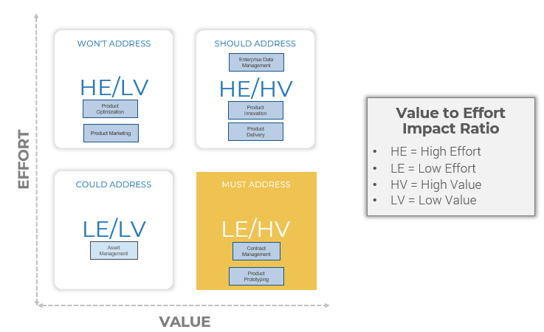
MoSCoW IT implications analysis
Act on these first.
Info-Tech Research Group | 26

Slide 27
Ranked list of IT implications
MoSCoW Rank | IT Implication | Value Stream Impacted | Comments/Actions
M | [Implication] | [Value Stream]
M | [Implication] | [Value Stream]
M | [Implication] | [Value Stream]
S | [Implication] | [Value Stream]
S | [Implication] | [Value Stream]
S | [Implication] | [Value Stream]
C | [Implication] | [Value Stream]
C | [Implication] | [Value Stream]
C | [Implication] | [Value Stream]
W | [Implication] | [Value Stream]
W | [Implication] | [Value Stream]
W | [Implication] | [Value Stream]
Info-Tech Research Group | 27

Slide 28
Activity: SWOT analysis
Duration: 1 Hour
Objective:
To assess IT’s ability to manage the implications of PESTLE factors influencing Durable Goods Manufacturing and to identify initiatives necessary to mitigate a risk or threat or to take advantage of an opportunity.
Steps:
Review how to conduct a SWOT analysis with the group using the SWOT analysis framework, if necessary.
Break the participants into two groups. Group 1 will work with the “Must Address” and Group 2 with the “Should Address” IT implications from the previous exercise. Skip the “Could Address” and “Won’t Address” implications – IT capacity will be insufficient.
Discuss each implication under consideration, one at a time. If IT is in a position of strength to handle the implication, add it to the strengths quadrant. Add weaknesses to the weakness quadrant, opportunities to be exploited to the opportunities quadrant, and those with inherent threats to the threats quadrant.
For each of the weakness, opportunity, and threat quadrants, create a corresponding IT initiative necessary to mitigate the risk/threats or capitalize on the opportunity presented. Record these Initiatives in the Potential New IT Initiatives Template. Prioritize these initiatives according to impact on the business.
As a final step, note conditions/dependencies or immediate actions (e.g. approvals needed) in the Comments/Actions column.
Update these results into your Durable Goods Manufacturing IT Strategy Initiatives Workbook by copying and pasting the appropriate slides.
Download the Durable Goods Manufacturing IT Strategy Initiatives Workbook
Info-Tech Research Group | 28

Slide 29
Activity: SWOT analysis
Business strategy Existing IT strategy IT implications from previous exercise | SWOT results Potential new IT initiatives
Whiteboard/flip chart SWOT Template | CIO IT team management Project managers
Input
Output
Materials
Participants
Info-Tech Research Group | 29

Slide 30
SWOT analysis framework
STRENGTHS
WEAKNESSES
For each implication, discuss how Durable Goods Manufacturing IT departments are uniquely positioned to handle the implication in a positive fashion.
For each implication, discuss why Durable Goods Manufacturing IT departments are unable to handle the implication in a positive fashion.
INTERNAL
FACTORS
OPPORTUNITIES
THREATS
For each implication, discuss how Durable Goods Manufacturing IT departments are uniquely positioned to take advantage of the implication and achieve a breakthrough.
For each implication, discuss how Durable Goods Manufacturing IT departments are exposed by the implication in a way that could cause failures.
EXTERNAL FACTORS
POSITIVE
NEGATIVE
Info-Tech Research Group | 30

Slide 31
SWOT template: IT implications
Strengths (Internal) | Weaknesses (Internal)
[Initiative] [Initiative] [Initiative] | [Initiative] [Initiative] [Initiative]
Opportunities (External) | Threats (External)
[Initiative] [Initiative] [Initiative] | [Initiative] [Initiative] [Initiative]
Info-Tech Research Group | 31

Slide 32
Potential list of IT initiatives
Priority Rank | IT Initiative* | Value Stream Impacted | Funding Implications | Comments/Actions
1 | [Initiative] | [Value Stream]
2 | [Initiative] | [Value Stream]
3 | [Initiative] | [Value Stream]
4 | [Initiative] | [Value Stream]
5 | [Initiative] | [Value Stream]
6 | [Initiative] | [Value Stream]
7 | [Initiative] | [Value Stream]
8 | [Initiative] | [Value Stream]
9 | [Initiative] | [Value Stream]
10 | [Initiative] | [Value Stream]
* Consider adding these to your long list of initiatives or refining initiatives, if applicable, in your existing IT strategy.
Info-Tech Research Group | 32

Slide 33
Tools & templates to finalize your list of strategic initiatives
The Durable Goods Manufacturing IT Strategy Initiatives Workbook is a place for you to collect all of the strategic initiative identification activity outcomes you’ve completed.
It also includes next-steps exercises to help you create a prioritized final list of initiatives and descriptions to consider for inclusion in your IT strategic plan.
Download the Durable Goods Manufacturing IT Strategy Initiatives Workbook
Once you’ve completed the IT Strategy Initiatives Workbook, it’s time to pull it all together and share with your organization’s leadership team.
Use the Durable Goods Manufacturing Industry Impacts on IT Strategy: Senior Management Presentation Template to highlight the key findings from the business-aligned analysis you’ve done. .
Download the Durable Goods Manufacturing Industry Impacts on IT Strategy: Senior Management Presentation Template
Info-Tech Research Group | 33

Slide 34
Take best advantage of your industry benchmarking & roundtable experiences
THE FULL EXPERIENCE
DO-IT-YOURSELF
ANALYST GUIDANCE
With 36 planned experiences in each industry sector every year, how you participate is up to you.
PEER PARTICIPATION
INDUSTRY BENCHMARKING
INDUSTRY ESSENTIALS
Read all the research, talk to the analysts, do all the benchmarks, and attend all the roundtables.
Choose to read the published research and take action on your own using our step-by-step written guidance.
Work virtually with one of our industry analysts to understand the key insights in the published research and customize your experience.
Attend our monthly Executive Industry Roundtables to share insights and learn best practices from your peers on the hottest topics relevant to your industry.
Take the Industry Benchmarking Track for data-based insights on how you differ from others in your industry. Every three months, the Executive Industry Roundtables will focus on insights gleaned from the thousands of diagnostics we execute each year, from Stakeholder Satisfaction and Process Improvement to IT Staffing and Spending. Then we’ll create a custom benchmark report just for you.
Don’t have time to attend all 36 experiences? Let your executive advisor build a custom Key Initiative Plan that will guide you through the essential experiences customized to your environment.
Info-Tech Research Group | 34

Slide 35
Bibliography
“2018 Manufacturing Skills Gap Study.” Deloitte United States, 2018. Web.
“3D Printer Comparison Chart.” Product Chart, n.d. Accessed 13 Feb. 2020.
“Additive Manufacturing & Material Market by Technology, by Material (Plastics, Metals, and Ceramics), by Application, and by Geography – Analysis and Forecast to 2014 – 2020.” MarketsandMarkets, Oct. 2014. Accessed 13 Feb. 2020.
“Autonomous Mobile Robots Market Size Is Expected to Exhibit 600 Million USD by 2025.” MarketWatch, 8 April 2020. Accessed 13 Feb. 2020.
Badrick, Craig. “What CTOs Can Do to Get IT and OT on the Same Page.” Turn-Key Technologies, 6 Feb. 2019. Accessed 12 Feb. 2020.
Bosche, Ann, et al. “Unlocking Opportunities in the Internet of Things.” Bain & Company, 7 Aug. 2018. Web.
Columbus, Louis. “The State Of Digital Business Transformation, 2018.” Forbes, 22 April 2018. Accessed 13 Feb. 2020.
“Facts About Manufacturing.” National Association of Manufacturers, n.d. Accessed 12 Feb. 2020.
“Global 3D Printing Industry Market Size 2018.” Statista, n.d. Accessed 13 Feb. 2020.
“IoT Market Size Worldwide 2017-2025.” Statista, n.d. Accessed 16 June 2020.
“IT/OT Convergence: Moving Digital Manufacturing Forward.” Cisco, 2018. Web.
“The Internet of Things in Manufacturing: Benefits, Use Cases and Trends.” i-SCOOP, n.d. Accessed 12 Feb. 2020.
Lueth, Knud Lasse. “IoT Platform Companies Landscape 2020.” IoT Analytics, 23 Dec. 2019. Accessed 13 Feb. 2020.
Nadel, Brian. “The Best Industrial 3D Printer Reviews of 2020.” business.com, n.d. Accessed 13 Feb. 2020.
Purvis, James. “8 Digital Transformation Statistics Every CIO Should Know in 2017.” LinkedIn, 17 Jan. 2017. Accessed 13 Feb. 2020.
Santagate, John. “Cloud Robotics: Enabling On-Demand Automation.” IDC, n.d. Web.
Shaffer, Jonathan. “How to Safely Implement Collaborative Robots.” AutomationWorld, 16 Dec. 2019. Web.
Shaw, Keith and John Santagate. “2019 RBR50: Top Robotics Companies Continue to Innovate, Grow Market.” Robotics Business Review, 2019. Accessed 13 Feb. 2020.
Info-Tech Research Group | 35

Slide 36
Bibliography
“Smart Manufacturing.” Fujitsu Ireland, n.d. Accessed 13 Feb. 2020.
“State of the 3D Printing Industry Survey 2019.” AMFG, 2019. Accessed 13 Feb. 2020.
“Talent Management in Manufacturing: The Need for a Fresh Approach.” PWC, n.d. Accessed 9 Mar. 2020.
“Top 4 Manufacturing Challenges of Implementing IoT” Wipfli, 12 June 2018. Accessed 13 Feb. 2020.
“Webinar Recap: Large-Scale 3D Printing – Realizing Value from Design to Production.” BigRep GmbH, 14 Sept. 2018. Web.
“What is 3D printing? The definitive guide.” 3D Hubs, n.d. Accessed 13 Feb. 2020.
Info-Tech Research Group | 36

