Slide 1
Build Your First RPA Bot
Support RPA delivery with strong collaboration and management foundations.

Slide 2
Analyst Perspective
Set the right foundations
The biggest challenge with RPA is not the technology. Rather, it is the organizational changes required to bring business and IT together to jointly own and deliver successful RPA bots.
Andrew Kum-Seun Senior Research Analyst, Application Delivery and Application Management Info-Tech Research Group

Slide 3
Executive Summary
Your Challenge
Common Obstacles
Info-Tech’s Approach
Your organization has many business processes that rely on manual, routine, and repetitive data collection and processing work. These processes need to be automated to meet strategic priorities.
Your stakeholders decided to invest in robotic process automation (RPA). They are ready to begin the planning and delivery of their first RPA bot.
However, your organization lacks the critical foundations involved in successful RPA delivery, such as analyzing the suitability of candidate processes, business and IT collaboration, and product ownership.
Not every business capability is suitable for RPA. Regulations, corporate policies, process complexities, and ethics may impede the end-to-end automation that stakeholders are expecting.
Many operating models do not enable or encourage the collaboration needed to evaluate business processes and underlying operational systems.
RPA brings significant organizational, process, and technical changes that IT and lines-of-business (LOBs) may not be prepared or willing to accept and adopt.
Establish the right expectations. Gain a grounded understanding of RPA value and limitations in your context. Discuss current IT and business operations challenges to determine if they will impact RPA success.
Build your RPA governance. Clarify the roles, processes, and tools needed to support RPA delivery and management through IT and business collaboration.
Evaluate the fit of RPA. Obtain a thorough view of the business and technical complexities of your candidate processes. Indicate where and how RPA is expected to generate the most return.

Slide 4
Executive Summary
Manage your business and IT debt before you adopt RPA. RPA doubles down on your process inefficiencies, lack of operations and architectural standardization, and unenforced quality standards. RPA solutions will be fragile and prone to failure if debt is not managed.
Info-Tech Insights
Adopt BizDevOps. RPA will not be successful if your lines-of-business (LOBs) and IT are not working together. IT must empathize with how LOBs operate and proactively support the underlying operational systems. LOBs must be accountable of all products leveraging RPA and be able to rationalize RPA’s technical feasibility.
Start with RPA 1.0. Don’t get caught up in the AI and machine learning (RPA 2.0) hype. Evaluate the acceptance and value of RPA 1.0 in order to establish a sustainable and collaborative foundation for its delivery and management. Then use the lessons learned to prepare for future RPA 2.0 adoption. In many cases, RPA 1.0 is good enough.

Slide 5
Your RPA journey has begun
Scaling RPA is a challenge
Your stakeholders decided to invest in robotic process automation (RPA).
What is RPA?
RPA is a technology to automate rules-based, repetitive tasks performed by human workers to collect and process data.
The “robots” in RPA are software bots that follow prescribed rules to carry out business processes. Bots distinguish RPA from other automation technologies by using applications’ user interface (UI) to interact with data sources and output targets as a human user would, rather than relying on programmatic access.
Build the Case for RPA with Candidate Processes
RPA brings significant opportunities to improve business productivity in a continuously changing environment. However, organizations are struggling to understand what it is and how it can specifically fit in their context.
Get stakeholders on the same page with RPA candidates using Info-Tech’s Automate Work Faster and More Easily With Robotic Process Automation blueprint.
14%
Of respondents have implemented more than 10 bots.
Source: Deloitte, 2018.

Slide 6
Think big and build RPA in many steps
Continuous improvement (learn-build-measure)
Scope of this blueprint
Gain Buy-In & Motivate Change
Enhance Productivity With MVP
Pilot
Build Your RPA Backlog
Reimagine IT’s Role
Scale by Adding More Automation Capabilities
Build Digital Products With Seamless Automation & Intelligence
Introduce Adaptive Process Governance
Implement a RPA CoE
Enterprise-Grade
Govern & Manage an RPA Platform

Slide 7
Stakeholders expect RPA to support top priorities
“In Japan, the workforce is naturally shrinking because of the demographic changes we are experiencing. Robotics is not about cost reduction. It’s about maintaining the business. Automation is no longer an alternative but necessity.”
– Senior Executive, Japanese telecommunications company.
Source: Deloitte, 2018.
Many organizations see RPA as a component of their digital transformation strategy. Of those surveyed, 69% of IT practitioners said digital transformation has been a high priority for their organization during the pandemic (Info-Tech Tech Trends 2022 Survey).
Digital Transformation Priorities
Business Automation Priorities (including RPA)
Improve agility and accelerate innovation
Reduce costs and improve efficiency
Achieve growth in new markets
Address evolving customer behaviors and preferences
Increase business productivity
Improve customer experience
Scale automation
22%
38%
17%
15%
18%
14%
16%
Source: Outsystem, 2019
Source: Deloitte, 2018.

Slide 8
However, RPA is not suitable for everyone
What do you want to do?
Organizations struggle to scale RPA beyond the initial proof-of-concept. Many of the scaling impediments are not specific to RPA but are foundational to business operations.
Processes are not well understood and documented, do not reflect reality, and are inefficient. Local automation adds to the process debt created by poorly designed and implemented processes.
Lack of sufficient IT support for automation and lack of business involvement during the delivery process.
Little desire to change how the business operates.
No buy-in to manage technical debt, which results in fragile and error-prone RPA solutions.
To RPA
Not To RPA
Invest in RPA technologies to quickly roll out business automation capabilities at the interface level and bring business and IT closer together to support RPA delivery. The operational platform is mostly left intact.
Invest in business process management, data integration, or other technologies to build automation into operational systems. Automation is slowly delivered but is developed to maximize value potential.

Slide 9
Oversold RPA sets unrealistic goals
RPA benefits are not equally felt across the industry.
Of organizations did not see their timeliness/ability to work 24/7 met.
RPA is more than a tool. It brings a cultural and operational shift that many organizations struggle to adopt.
22%
Stakeholders recognize the importance and want to innovate, be differentiators, and find new ways to deliver more value. The slow IT response and low barrier to entry for many traditional technologies motivated stakeholders to invest in RPA to achieve advertised benefits without the traditional IT headaches. But, they may be oversold.
Ninety percent of organizations believe that RPA has met or exceeded their expectations¹ on improved productivity, improved compliance, and cost to implement. However, these organizations likely have built a practice around their automation tools that goes beyond the technology, which heavily contributed to their success.
In fact, only 25% of the mistakes or problems experienced have to do with the RPA technology. Of those, 75% are more to do with management of the technology.²
Bottom Line: The entire organization must change how it works and operates to see the full benefits of RPA.
Of organizations did not see their cost reduction expectations met.
20%
Of organizations did not see their flexibility to scale capacity expectation met.
19%
¹ Deloitte, 2018.
² Robotic & Cognitive Automation, July 2019.
Source: Deloitte, 2018.

Slide 10
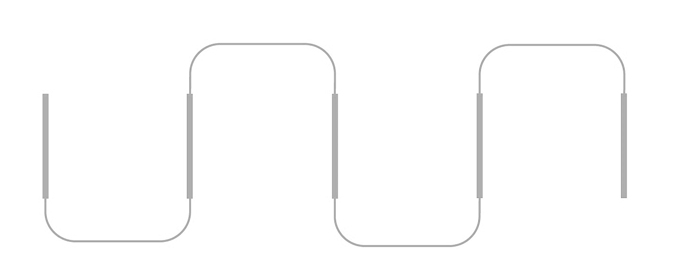
The need for RPA can be a symptom of fundamental challenges
Unmanaged Shadow IT
Process Inefficiencies
Unreliable Data
Poor System Qualities
Bots developed without IT consultation risk compromise to underlying data and operational systems.
More steps are performed than what is needed. RPA worsens the waste immature and poor processes create.
RPA consumes and manipulates incomplete and inaccurate data. Generated insights are not trustworthy.
Bot performance and scalability are hampered due to the operational system not meeting technical standards.

Slide 11
Start with RPA 1.0
“RPA can represent a profound change, with the potential to empower non-IT professionals and process owners with the tools to automate a significant share of their workload.”
Source: Federal RPA Community of Practice, 2020
Build the right foundations to see the fit and benefits with RPA 1.0 to prepare for RPA 2.0
RPA 1.0 only carries out business processes and tasks that can be expressed as a series of steps (e.g. process flow) with clearly defined rules and boundaries. It does not learn from mistakes or adapt to changes, nor does it handle unstructured and non-electronic data well.
Despite its drawbacks, the various use cases for RPA 1.0 are good enough to begin with its experimentation. This opportunity also allows your LOBs and IT teams to develop and continuously improve their new operating environment.
Use your lessons learned to prepare for RPA 2.0
RPA 2.0 augments its bots with artificial intelligence (AI) and machine learning (ML) to overcome the RPA 1.0 challenges with handling unstructured data, process mining, and automatic managing of exceptions. Leverage your foundation to overcome the specific complexities of RPA 2.0:
Need large, clean data for the training of the bot
Bots cannot be held accountable for the decisions made or supported by the bot
AI actions cannot be understood

Slide 12
Choose the right business processes
Evaluate RPA risks and impacts by breaking down your business process into the various components that span across all technical layers.
RPA
Human Users
Not all business capabilities will benefit from RPA. Ensure your candidate processes are high quality.
Automated Processes
Manual Processes
End-User Device
Low and No Code RPA Solution
User Interface
Key Quality Attributes
Business Value
Business & Technical Debt
Data Quality
Platform Support
The process is manual, repeatable, and high volume. The outcome of the process directly supports or drives key business value sources.
Self-Serve Operational System
Front End Application
AI / ML
Front End
Services
The process is efficient and lean. The underlying platform is scalable, maintainable, and modifiable. The process and platform are continuously reviewed and improved.
Application Integration
Backend Databases, Applications, and Infrastructure
Back End Application
AI / ML
Back End Service
The process leverages and generates data that is reliable and trustworthy. Data structure and integration is defined, governed, and monitored.
Data Integration / Platform
Enterprise Infrastructure
Third-Party Infrastructure
The underlying platform (application, integration, and infrastructure) supports the operational requirements of the RPA solution.

Slide 13
Adopt BizDevOps
Plan-build-run operating models don’t support the business integration, cross-functional collaboration, and delivery empowerment that are required for successful RPA adoption. The business, development, and operations departments (BizDevOps) must work closely together to build a trusting partnership.
What is BizDevOps?
BizDevOps is an operational philosophy that seeks to promote an improved relationship among development, operations, and LOBs by breaking down barriers, aligning all groups to a common vision, and becoming jointly accountable for customer value delivery.
BizDevOps extends the principles and lessons learned from Agile and DevOps. See our Build Your BizDevOps Playbook blueprint for more information.
Business
Operations
Development
Value Delivery (SDLC)
Why is BizDevOps critical in RPA?
Business-IT trust ensures bots reflect how processes are actually performed without risking business continuity and system integrity.
RPA stretches holistically across the entire organization. BizDevOps ensures bots do not benefit one team while another suffers.
Quick delivery of solutions through a lean process and team empowerment.
Operational systems are reliable and self-healing and can scale when RPA bots require additional capacity.

Slide 14
RPA presents an opportunity for the business to manage their own bots
Vendors provide low and no code capabilities to enable this empowerment.
Not everyone is happy with their throughput and quality
What are business-managed applications?
A business-managed application (BMA) is broadly defined as application software that is implemented, developed, configured, automated, and supported by the business. It is often expected that the business will manage the application’s funding, vendor relationships, and continuous modernization and optimization.
BMAs include software the business can implement on their own (e.g. commercial off-the-shelf cloud solutions) or tools that allow them to build their own applications (e.g. low-code development).
What are the impacts of poorly implemented and supported BMA?
The business may not have the technical knowledge and skillset to make sound application selection and implementation decisions. This can result in:
High operational and maintenance costs of the platform or its outputs
Inability to scale or integrate with other enterprise systems
Not able to meet security, industry, and regulatory policies and standards
IT’s inability to support BMAs due to competency or resource gaps
26% of organizations stated that their application development throughput is somewhat ineffective or not effective.
26%
21% of organizations stated that their application development quality is somewhat ineffective or not effective.
21%
Source: Info-Tech’s Management & Governance Diagnostic, 2021; N=256
The business would rather develop apps themselves
58% of business respondents stated that “business stakeholders would rather build applications themselves than to explain their ideas to IT”.
Source: Dimensional Research, 2019
58%
See our Embrace Business-Managed Applications blueprint for more information on the organizational changes needed to support BMA.

Slide 15
Instill delivery confidence and trust with good practices
BizDevOps do not address core delivery practices. Understand and introduce the right tools and techniques to effectively support RPA.
 |  |  | Good Practice Examples |  | Info-Tech Research
 | Manage all delivery commitments with artifact traceability, productivity monitoring, and stakeholder communication. |  | Application lifecycle management tools |  | Application Lifecycle Management
 | Increase cross-team collaboration through the delivery pipeline. |  | Agile, DevOps |  | Agile Development, DevOps Practices
 | Enforce security, scalability, and other quality standards consistently across the delivery process. |  | Defined delivery process, demonstrations, peer reviews, change advisory board, static code analysis |  | Software Quality Assurance
 | Review and refactor the application architecture and the bot’s code to improve its maintainability and its scalability into other LOBs or products. |  | Addition of refactoring tasks in project and sprint planning, application architecture review |  | Solution Architecture and Source Code Good Practices
 | Continuously reprioritize and refine your product backlog to reflect current priorities and maintain healthy products, including RPA. |  | Product management practices, application portfolio management |  | Backlog Management and Product Delivery Practice

Slide 16
Build a scalable and manageable platform
RPA is dependent on the efficiency and reliability of the underlying operational platform. This platform must support RPA’s computational and performance demands in a changing business environment, whether it is composed of off-the-shelf or custom-developed solutions.
Applications
The UI design and content language is standardized and consistently applied
Applications are automatically versioned
Controlled application access and decision-making capabilities of the bot
Holistic bot portfolio management
Data
Automated data management to preserve data quality (e.g. removal of duplications)
Defined single source of truth
Adherence to data governance and privacy and security policies
Development of good training data
Integration
Backend database updates are efficient
Loosely coupled architecture to minimize system regressions and delivery effort
System and data monitoring
Infrastructure
Containers and sandboxes are available for testing and learning
Self-healing and self-service environments
Automatic system scaling
Comply to budgetary and licensing constraints

Slide 17
Pay attention to organizational changes
! | Plan what will end users do with key processes automated and capacity freed up.
! | Address the transformational needs to optimize or redesign processes for the digital world involving RPA.
! | Ensure continuous management and leadership support for refining business operations and shifts in role definitions.
! | Build business and IT trust and empowerment by transitioning to BizDevOps practices.
! | Shift product ownership and management away from development and operations.
! | Establish an organizational body (e.g. center of excellence) to manage the growth, adoption, and delivery of RPA.
Be prepared to answer:
How will bots change the way I do my job?

Slide 18
Prototype your first bot
“The beauty of a POC is that it proves whether a solution will or won’t work in the confines of business’ customized environment. It also provides an opportunity to validate the software or platform selected and the commitment of the resources involved to ensure success of a larger program.”
– Tracy Lipasek
The initial RPA deployment should be viewed as an IT productivity tool. RPA should be in the hands of IT until a more cross-functional governance model can be implemented.
What are your goals?
RPA requires an intimate understanding of business and IT operations at its lowest level along with all the cultural, processes and technology nuances. This reality comes with a number of risks and impacts that can only be validated through an RPA rollout. Strategically pick the right processes to gauge RPA fit and build a foundational practice.
Level set stakeholder expectations of what RPA can and cannot achieve.
Fill the knowledge and skills gaps required for RPA.
Develop a vendor engagement and financing plan.
Form a sustainable RPA delivery practice, including defined roles, processes, and tools.
Fine tune operational systems to better support RPA.
Build a team of RPA champions with the backing of senior management to fund future efforts and communicate RPA success.

Slide 19
Gauge RPA value with the right metrics
Focus your effort on measuring key metrics.
Business Value – The amount of value and benefits delivered. | Justify the investment and impact of RPA. | ROI, user productivity, IT satisfaction, operational costs, error rate
Product Quality – Satisfaction of a product’s quality standards. | Predict maintenance and enhancement efforts given quality concerns. | Cost of quality, defects, system dashboards, time to restore
Delivery Effectiveness – The efficiency of RPA delivery. | Identify constraints and opportunities to streamline delivery. | Lead time, hours spent, burndown, cost of RPA delivery
Category
Purpose
Examples
Metrics are a powerful way to drive behavior change in your organization. But metrics are highly prone to creating unexpected outcomes and so they must be used with great care. Use metrics judiciously to avoid gaming or ambivalent behavior, productivity loss, and unintended consequences.
See Info-Tech’s Select and Use SDLC Metrics Effectively blueprint for more information on metrics good practices.

Slide 20
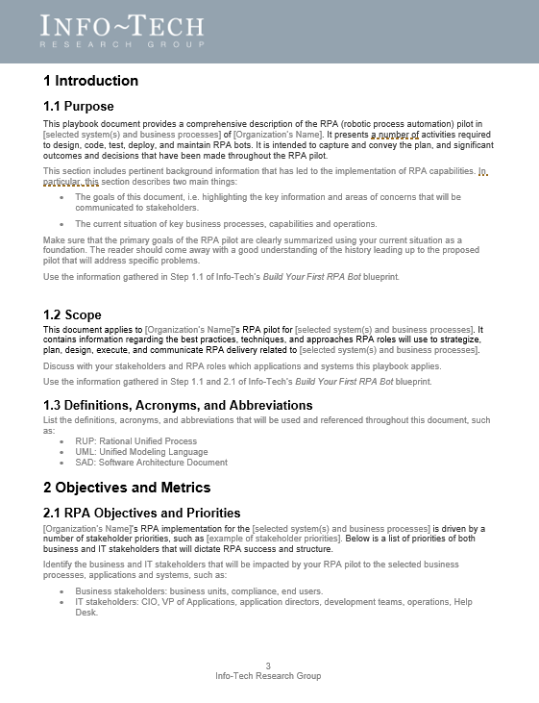
Document your RPA pilot with Info-Tech’s template
Based on the step-by-step exercises performed in this blueprint, transcribe the key outputs into the RPA Pilot Playbook Template.
INFO-TECH DELIVERABLE
Quick Reference | Matching Steps in Blueprint
Introduction | Edit where appropriate
Objectives and Metrics | 1.1
Product Governance | 1.2, 1.3
RPA Delivery Governance | 1.2, 1.3, 2.3
Pilot Project Overview | 2.1, 2.2, 3.1
Conclusion | Edit where appropriate

Slide 21
Build Your First RPA Bot: Project Overview
Contact your account representative for more information. workshops@infotech.com 1-888-670-8889
 | 1. Define Your RPA Governance | 2. Deliver and Manage Your Bots | 3. Roadmap Your RPA Adoption
Best Practice Toolkit | 1.1 State Your RPA Objectives 1.2 Define Your RPA Principles 1.3 Develop Your RPA Capabilities | 2.1 Prepare Your RPA Platform 2.2 Select Your RPA Vendor 2.3 Deliver and Manage Your Bots | 3.1 Roadmap Your RPA Adoption
Guided Implementations | Call 1: Discuss Info-Tech’s perspective and kick-off this initiative Call 2: Review your RPA expectations, principles, and desired roles and capabilities | Call 1: Review your candidate processes and the operational platform required to support them Call 2: Review your desired vendor features Call 3: Review your optimized delivery process | Call 1: Discuss your RPA roadmap
Phase Outcomes | RPA objectives, value, and vision Metrics to gauge success Guiding principles and ethics RPA capabilities RPA roles | Candidate processes for RPA and their assessments for RPA fit Scope of operational platform to support RPA Shortlist of features of desired RPA solution Delivery process (i.e. SDLC) supporting RPA delivery | RPA adoption roadmap

Slide 23
Workshop Overview
 | Day 1 Morning | Day 1 Afternoon | Day 2 Morning | Day 2 Afternoon | Day 3
Activities | Set the Context | Build Your RPA Capabilities | Plan Your First Bot | Roadmap RPA Adoption | Next Steps and Wrap-Up (offsite)
 | 1.1 State Your RPA Objectives | 2.1 Define Your RPA Principles 2.2 Develop Your RPA Capabilities | 3.1 Prepare Your RPA Platform 3.2 Select Your RPA Vendor 3.3 Deliver and Manage Your Bots | 4.1 Roadmap Your RPA Adoption | 5.1 Complete in-progress deliverables from previous four days. 5.2 Set up review time for workshop deliverables and to discuss next steps.
Deliverables | RPA objectives, value, and vision Metrics to gauge success | Guiding principles and ethics RPA capabilities RPA roles | Candidate processes for RPA and their assessments for RPA fit Scope of operational platform to support RPA Shortlist of features of desired RPA solution Delivery process (i.e. SDLC) supporting RPA delivery | RPA adoption roadmap | Your RPA Pilot Playbook

