Slide 1
Bring Visibility to Your Day-to-Day Projects
Sweat the small stuff
EXECUTIVE BRIEF

Slide 2
Analyst Perspective
It’s becoming increasingly common for IT organizations to have clearly defined rubrics for distinguishing project work and non-project workloads for the purposes of properly triaging work efforts that should be subject to PMO governance and formal project management rigor.
The challenge is that thresholds requiring PMO governance are usually quite high, and not everything that falls outside of a PMO’s purview is necessarily “non-project.”
Functional units are routinely charged with managing and delivering work that is of much greater size, risk, and complexity than a typical operational task, but it does not necessarily require the full rigor of a governance process.
These initiatives that fall in-between the cracks of full project governance and operational tasks get called many things across organizations (e.g. operational initiatives, non-PMO projects, enhancements, and BAU projects), but they’re something I’ve taken to call “day-to-day” projects.
For me, the term “day-to-day” captures some of the inherent characteristics found in these types of projects: they are typically small, emergent, team-specific, and operationally vital yet generally perceived as being strategically unimportant. As such, top level leadership has limited understanding of them when they are approving and prioritizing major projects.
Without this understanding, leadership approves projects with no insight into how IT’s capacity is already stretched thin by existing demands, and much of the time they think that what IT teams will deliver to major projects is fractured by the day-to-day project demands within those units.
It’s the equivalent to what happens with household consumer debt: if you’re not tracking the small stuff, you’re bound to overspend and compromise your ability to get the big stuff done.
Bring color to the no man’s land of IT resource capacity.
Travis Duncan Research Director, PPM Practice Info-Tech Research Group

Slide 3
Executive Summary
Situation
Complication
Solution
As an IT leader, you are responsible for getting new things done while keeping the old things running.
These “new things” can come in many forms (e.g. service requests, incidents, officially sanctioned PMO projects as well as a category of “unofficial” projects that have been initiated through other channels).
These unofficial projects get called many things (e.g. level 0 projects, non-PMO projects, day-to-day projects), but they all have similar characteristics:
They are smaller and less complex than officially sanctioned projects.
They are larger and more risky than operational tasks.
They are focused on the needs of specific functional units and tend to stay within these units to get done.
Because these day-to-day projects are small, emergent, team-specific, and operationally vital yet generally perceived as being strategically unimportant, top level leadership has limited understanding of them when approving and prioritizing major projects.
As a result, they approve projects with no insight into how a team’s capacity is already stretched thin by existing demands. The consequences are twofold:
The priorities communicated by senior leadership are only half the story as the day-to-day projects within your unit often have an element of urgency and necessity that can’t be put off.
much of the time senior leadership thinks your team will deliver to major projects is fractured by the day-to-day projects that fly under their radars. Project throughput suffers in turn.
Senior leadership cannot contrast the priority of things that are undocumented. As an IT leader, you need to ensure day-to-day projects receive the appropriate amount of documentation to support visibility without drowning your team in process. This can be done by,
Creating a repeatable process to document and report where the time goes across all given pockets of demand your team faces.
Establishing a method to consistently identify day-to-day projects across different functional teams.
Establishing a way to balance and prioritize the operational necessity of day-to-day projects against the strategic value of major projects.
This research will help you accomplish all three.

Slide 4
Executive Summary
Info-Tech Insight
Insight 1
Don’t go broke “$5” at a time. Put proper spending controls on the small stuff to ensure better throughput of small and large projects alike.
Project Portfolio Success is on you. Senior leadership cannot contrast the priority of things that are undocumented. As an IT leader you need to ensure day-to-day projects receive the appropriate amount of documentation without drowning your team in a process that these types of projects don’t warrant.
Insight 2
Project Portfolio Success is on senior leadership as well. When executive oversight took over the strategic portfolio, we assumed they’d resource those projects as a priority. Instead, they focused on “alignment,” “strategic vision,” and “go to market” while failing to secure and defend the resource capacity needed. To focus on the big stuff, you need to sweat the small stuff – don’t bleed your capacity dry by leaving the back door open.
Insight 3

Slide 5
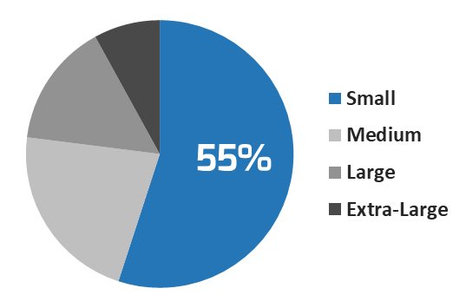
Sweat the small stuff
Number of projects by size:
Statistics show that the majority of IT projects can be classified as “small to moderate.”
Despite this fact, very few project management or portfolio management best practices are built for small projects.
The project and portfolio management best practices industry has tended to tailor its advice to the largest, most complex projects.
While it’s true that these types of projects require the most project management rigor, the fact remains that most IT projects do not require this much process.
Because the amount of rigor proposed has seemed disproportionate to the risk and complexity, many IT departments have recoiled, allowing these smaller projects to get delivered with little to no management formality around them. The results of this are almost always detrimental to portfolio management.
Source: Standish Group, CHAOS Report
Statistics from the Standish group reveal that most projects are small to moderate in size.
With over half of the projects being identified as “small” or “moderate” in size, even incremental improvements in project visibility will eventually translate into a major improvement in the organization’s portfolio management practices.
Executive Brief

Slide 6
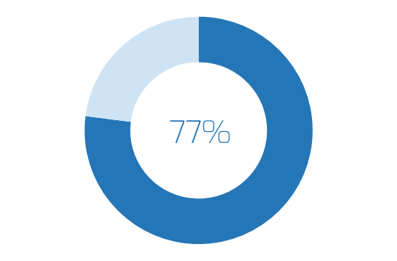
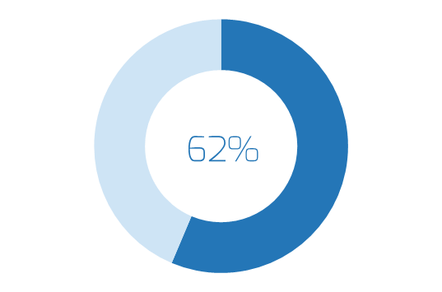
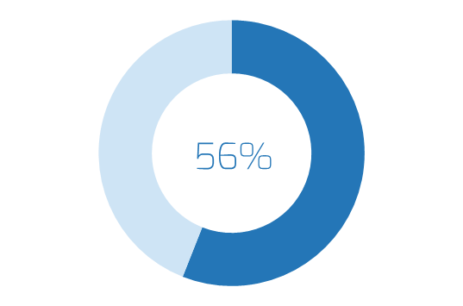
A lack of visibility hurts projects
Organizations that lack effective capacity planning have:*
Without proper spending controls on the “small stuff,” IT resource capacity constraints can be exacerbated.
Overcommitted resources
Many of the small projects that occupy IT’s time are not initiated through official channels (e.g. the PMO), nor do they bubble up to the level of portfolio governance and visibility.
As a result, the resource consumption of these projects largely escapes the oversight of senior leadership.
When major projects are being approved and prioritized, they are done so without any insight into the capacity footprint of these smaller, emergent, team-specific projects.
An inability to prioritize resources
Inaccurate resource estimates
*Karen Anderson, 2016
Executive Brief

Slide 7
Better visibility starts with better project categorizations
While it’s true that the scope, risk, and complexity of these projects is generally less than major projects, this category of work still requires some structure and process to facilitate portfolio-level visibility.
Non-Project Work
Day-to-Day Projects
Major Projects
Because they typically fall outside of PMO governance standards, small projects are often improperly categorized as non-project work.
Common Characteristics:
Tasks are ongoing and repetitive.
Work is related to maintaining an existing thing, product, or service.
The scope of tasks is small with minimal risk and complexity.
Work is operational or administrative in nature.
Outcomes support the status quo.
Limited stakeholders are involved; work is executed within a specific team/area.
Common Characteristics:
Timebound, temporary, and a one-off.
Uncertainty around outcomes.
Non-repetitive work and sizeable enough to introduce a heightened risk.
Strategic focus, business case informed capital funding, and execution activities driven by a charter.
Introduces change to the organization.
Multiple stakeholders involved and cross-functional resourcing.
Common Characteristics: This category of work is much harder to characterize than the simple project/non-project dichotomies found in the boxes on the left and the right.
What we’re calling day-to-day projects in this research tend to have an in-between quality, having elements of both project and non-project work.
This makes defining this category of work in a standard and repeatable way much more difficult.
Executive Brief

Slide 8
Use this research to establish day-to-day visibility
This blueprint is broken up into two concise phases to help you build organizational understanding of your current state and build a customized process to establish ongoing day-to-day project visibility.
Phase One: Uncover your organization’s hidden pockets of day-to-day projects
Phase Two: Establish ongoing day-to-day project visibility
Step 1.1: Define what constitutes a day-to-day project
Outcome: a method for identifying day-to-day projects consistently across functional teams.
Step 1.2: Perform a supply/demand analysis
Outcome: a resource capacity analysis that assesses day-to-day project demand and resource supply.
Recommended Participants for Phase One: Portfolio Manager (or equivalent), Functional Directors and Managers, Project Managers.
2.1 Define process baselines for day-to-day projects
Outcome: a high-level process wireframe for prioritizing and tracking the ongoing capacity footprint of day-to-day projects.
2.2 Implement a tool to maintain visibility
Outcome: a portfolio management spreadsheet to assist in the maintenance of portfolio visibility of day-to-day projects.
Recommended Participants for Phase Two: CIO, Portfolio Manager (or equivalent), Functional Directors and Managers, Project Managers.
Executive Brief

Slide 9
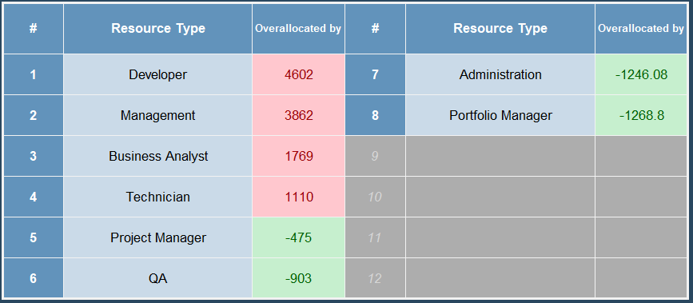
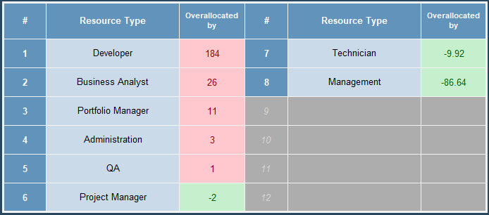
Measure the value of portfolio visibility
The sample data in these screenshots show one of the data points covered in the Calculator and a typical progression of how portfolio managers can monitor their improvement over time.
Use the tools associated with this research to measure the progress and value of your portfolio management optimization.
Current State
Project portfolio management discipline adds value to the organization, but it’s often difficult to track and report on the value it brings.
After you’ve completed the current state analysis in this research – using Info-Tech’s Day-to-Day Project Supply-Demand Calculator – and then completed the portfolio management optimizations in this blueprint, you can use the Calculator at regular intervals to measure your progress against three key metrics:
Reduction in supply/demand imbalances across major projects and day-to-day projects.
Reduction in wasted resource utilization on major projects.
Reduction in the overallocation of key resources on day-to-day projects and non-project work.
12 Months Time
89% of executives say they lack an integrated view of their portfolios across the enterprise, making portfolio decisions difficult and poorly informed.
89%
– PMI, 2015
Executive Brief

Slide 10
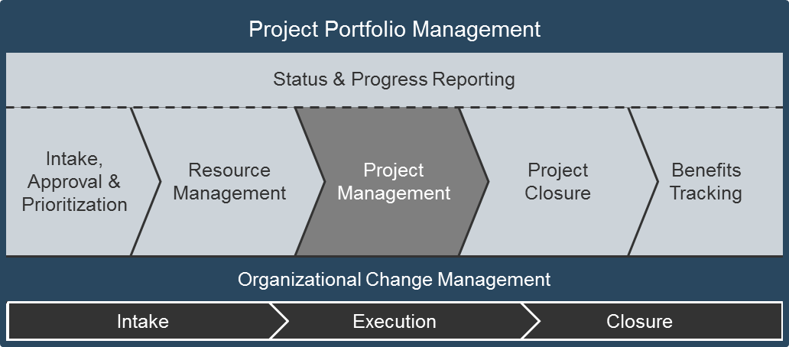
Case Study
INDUSTRY
SOURCE
Higher Education
Info-Tech Client
A mature PMO for major projects is not enough; you need to track the small stuff too.
Challenge
A large university with a mature PMO was having trouble with resource planning on major projects. Despite having mature project management practices and evolving resource management discipline on projects, they consistently struggled with project estimation and bringing projects in on-time.
Info-Tech’ s PPM framework is based on extensive research and practical application, and it complements industry standards such as those offered by PMI and ISACA.
Solution
Minor projects that skirted governance processes and stayed within functional units were identified as major sources of undocumented demands that were eating into the hours budget for major projects. These projects were more sizable and complex than a typical operational task, but they were smaller in scope and risk than projects requiring formal PMO governance or project manager staffing.
Working with functional teams, the PMO developed right-sized intake and resource management practices to ensure these smaller departmental projects received some visibility at the governance layer and to ensure that their capacity footprint was factored into PMO prioritization and resourcing decisions. As a result, better intake decisions were made by the university’s steering committees, and there was better throughput of both day-to-day and major projects.
Executive Brief

Slide 11
Executive Brief

Slide 12
Bring Visibility to Your Day-to-Day Projects Project Overview
Contact your account representative for more information. workshops@infotech.com 1-888-670-8889
 | 1. Uncover your organization’s hidden pockets of day-to-day projects | 2. Establish ongoing day-to-day project visibility
Best Practice Toolkit | Define what constitutes a day-to-day project Perform a supply/demand analysis | Define process baselines for your day-to-day project Implement a tool to maintain visibility
Guided Implementations | Call 1: Scoping Call Call 2: Define day-to-day projects and determine project levelling criteria Call 3: Analyze day-to-day project capacity and demand | Call 4: Determine portfolio management process baselines for day-to-day projects Call 5: Develop a project value scorecard Call 6: Configure Info-Tech’s Day-to-Day Project Intake and Prioritization Tool
Phase Deliverables | Day-to-Day Project Definition Tool (.xlsx) Day-to-Day Project Supply/Demand Calculator (.xlsx) | Day-to-Day Project Intake and Prioritization Tool (.xlsx) Day-to-Day Project Process Document (.pptx)
Executive Brief

Slide 13
Workshop Overview
 | Day 1 | Day 2 | Day 3 | Day 4 | Day 5
Activities | Assess the Current State of Portfolio Management | Establish Day-to-Day Intake Practices | Develop Day-to-Day Capacity Awareness | Prepare to Implement a Day-to-Day Process | Next Steps and Wrap-Up (offsite)
 | 1.1 Establish Workshop Expectations 1.2 Perform PPM Current State Scorecard diagnostic 1.3 Perform a resource supply/project demand analysis | 2.1 Formalize the definition of a day-to-day project 2.2 Establish project levels 2.3 Develop a project value scorecard for day-to-day projects (and for major projects if desired) 2.4 Develop an intake workflow | 3.1 Map the current resource management process flow and accountabilities 3.2 Perform a right-wrong-missing-confusing 3.3 Establish target state resource management dimensions and develop a workflow 3.4 Configure a resource management tool and/or report | 4.1 Assess the time-costs of new portfolio management processes to gauge sustainability 4.2 Perform a change impact and stakeholder management analysis 4.3 Perform a start-stop-continue activity 4.4 Define an implementation roadmap | 5.1 Complete in-progress deliverables from previous four days 5.2 Set up review time for workshop deliverables and to discuss next steps
Deliverables | Workshop expectations canvass PPM Current State Scorecard Report Day-to-Day Project Supply/Demand Calculator | Day-to-Day Project Definition Tool Project value scorecard Intake workflow (with supporting deliverables) | Right-wrong-missing-confusing analysis Target state resource management workflow (with support deliverables) Day-to-Day Project Intake and Prioritization Tool | Process overhead analysis Change impact analysis Start-stop-continue analysis Implementation roadmap | Completed Day-to-Day Project Process Template. Supporting tools and templates configured to support the process
Executive Brief

