Slide 1
Create a Business-Aligned Information Security Strategy
Create value by aligning your strategy to business goals and business risks.

Slide 2
Create a Business-Aligned Security Strategy
Webinar Objectives
01
Understand the Info-Tech methodology for developing a successful security strategy
02
Learn how to gather business requirements and translate them into security goals
03
Discover how to assess your security program against targets and build an actionable roadmap
04
Q&A

Slide 3

Create a Business-Aligned Security Strategy
Housekeeping
Use the Q&A function to post questions.
We will select a few common questions to be answered by our panelists at the end of the session.
We will send out the slides and link to a recording of the presentation.

Slide 4
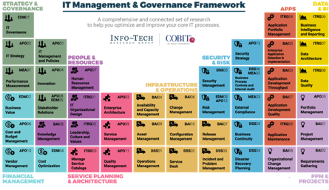




About Info-Tech Research Group
Info-Tech Research Group produces unbiased and highly relevant research to help leaders make strategic, timely, and well-informed decisions. We partner closely with your teams to provide everything they need, from actionable tools to analyst guidance, ensuring they deliver measurable results for the organization.
Dramatically Outperform Your Peers
Drive Measurable Results
Better Research Than Anyone
Leverage Industry Best Practices
Our world-class leadership team is continually focused on building disruptive research and products that drive measurable results and save money.
Our team of experts is composed of the optimal mix of former CIOs, CISOs, PMOs, and other IT leaders and IT and management consultants, as well as academic researchers and statisticians.
We enable over 30,000 members to share their insights and best practices that you can use by having direct access to over 100 analysts as an extension of your team.

Slide 5



Your Webinar Presenters
Aaron Shum
Practice Lead
Security, Privacy, Risk & Compliance
Info-Tech Research Group
Michelle Tran
Research Analyst
Security, Privacy, Risk & Compliance
Info-Tech Research Group
Kevin Peuhkurinen
Research Director
Security, Privacy, Risk & Compliance
Info-Tech Research Group

Slide 6
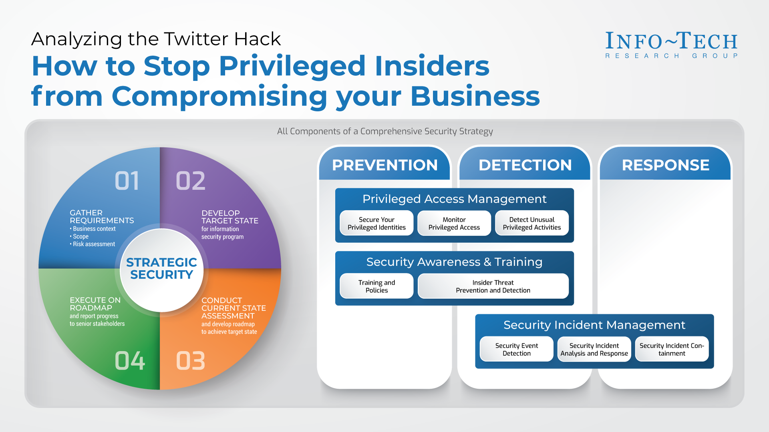

Slide 7



Executive summary
Your Challenge
Common Obstacles
Info-Tech’s Approach
Many security leaders struggle to decide how best to prioritize their scarce information security resources.
The need to move from a reactive approach to security towards a strategic planning approach is clear. The path to getting there is less clear.
Developing a security strategy can be challenging. Complications include:
Performing an accurate assessment of your current security program can be extremely difficult when you don’t know what to assess or how.
Determining the appropriate target state for security can be even more challenging. A strategy built around following “best practices” is unlikely to garner significant support from business stakeholders.
Info-Tech has developed a highly effective approach to building an information security strategy, an approach that has been successfully tested and refined for 7+ years with hundreds of organizations.
This unique approach includes tools for:
Ensuring alignment with business objectives
Assessing organizational risk and stakeholder expectations
Enabling a comprehensive current state assessment
Prioritizing initiatives and building out a security roadmap
Info-Tech Insight
The most successful information security strategies are:
Holistic – they consider the full spectrum of information security,
including people, processes, and technologies.
Risk-Aware – they understand that security decisions should be made based on the security risks facing their organization, not just on best practice.
Business-Aligned – they demonstrate an understanding of the goals and strategies of the organization and how the security program can support the business.

Slide 8

Info-Tech’s approach
The Info-Tech difference:
“Business as usual”
A proven, structured approach to mature your information security program from reactive to strategic.
A comprehensive set of tools to take the pain out of each phase in the strategy building exercise.
Visually appealing templates to communicate and socialize your security strategy and roadmap to your stakeholders.
Gather requirements:
Business context
Scope
Risk assessment
Mitigate the threat
Reactive
Security
Identify new security threat
Execute on roadmap and report progress to senior stakeholders
Purchase new security tool
Strategic
Security
Indicates Info-Tech tools included in the blueprint
Develop target state for information security program
Maturing from reactive to strategic information security
Conduct current state assessment and develop roadmap to achieve target state

Slide 9
Info-Tech’s Security Strategy Model
The Info-Tech difference:
Requirements
`
Business Context
Pressures
An information security strategy model that is:
  Business-Aligned – Determines business context and cascades enterprise goals into security alignment goals.
  Risk-Aware – Understands the security risks of the business and how they intersect with the overall organizational risk tolerance.
  Holistic – Leverages a best-of-breed information security framework to provide comprehensive awareness of organizational security capabilities.
Enterprise Goals
Compliance Obligations
Scope & Boundaries
Security Risks
Risk Tolerance
Stakeholder Expectations
Security Target State
Maturity Model
Security Framework
Security Alignment Goals
Target Maturity
Time Frame
Current State Assessment
Gap Analysis
Security Current State
Initiative List
Task List
Prioritization Methodology
Gantt Chart
Information Security Roadmap

Slide 10
Analyze your business goals
Identifying business goals is the first step in aligning your strategy with your business vision.
  Security leaders need to understand the direction the business is headed in.
  Wise security investments depend on aligning your security initiatives to the business objectives.
  Information security should contribute to your organization’s business objectives by supporting operational performance and ensuring brand protection and shareholder value.
    For example, if the organization is working on a new business initiative that requires handling credit card payments, the security organization needs to know as soon as possible to ensure the security strategy will enable the organization to be PCI compliant.
If a well-defined business strategy exists, use this to describe existing goals.
If corporate goals cannot be identified, use business goals instead.
If a well-defined corporate strategy does not exist, these questions can help pinpoint objectives:
    What is the message being delivered by the CEO?
    What are the main themes of investments and projects?
    What are the senior leaders measured on?
Info-Tech Insight
Developing a security strategy is a proactive activity that enables you to get in front of any upcoming business projects or industry trends, rather than having to respond reactively later. Make sure to consider as many foreseeable variables as possible.

Slide 11
Goals cascade based on COBIT
Goal | Goal Name | Examples of Key Goal Indicators | Recommended Security Alignment Goals
EG01 | Portfolio of competitive products and services | - Products and services that meet or exceed targets in revenues and/or market share - Products and services that provide competitive advantage - Improved time-to-market for new products and services | Secure applications | Secure the cloud
EG02 | Managed business risk | - Critical business objectives and services covered by risk assessment - Appropriate management of risk profile | Assess and manage security risks | Manage vendor risk
EG03 | Compliance with external laws and regulations | - Minimization in cost of regulatory noncompliance, including settlements and fines - Minimization of noncompliance matters noted by regulators or supervisory authorities | Manage compliance obligations | Create culture of security
EG04 | Quality of financial information | - Satisfaction of key stakeholders regarding the transparency, understanding and accuracy of enterprise financial information - Minimized regulatory noncompliance with finance-related regulations | Secure applications | Protect data
EG05 | Customer-oriented service culture | - Reduced number of customer service disruptions - Business stakeholders satisfied that customer service delivery meets agreed levels - Minimized number of customer complaints - Improvement in customer satisfaction survey results | Protect data | Ensure availability
EG06 | Business service continuity and availability | - Minimization of service or business process interruptions causing significant incidents - Reduced business cost of incidents | Ensure availability | Secure the infrastructure
EG07 | Quality of management information | - Board and executive management satisfaction with decision-making information - Reduced incidents of incorrect business decisions based on inaccurate information - Timeliness of management information | Secure applications | Security process improvement
EG08 | Optimization of internal business process functionality | - Satisfaction levels of board and executive management with business process capabilities - Satisfaction levels of customers with service delivery capabilities | Security process improvement | Improve security governance
EG09 | Optimization of business process costs | - Optimized ratio of cost vs. achieved service levels - Satisfaction levels of board and executive management with business processing costs | Improve security governance | Detect and respond to threats
EG10 | Staff skills, motivation, and productivity | - Improved staff productivity compared to benchmarks - Level of stakeholder satisfaction with staff expertise and skills - Percent of satisfied or engaged staff | Security staff learning & growth | Create culture of security
EG11 | Compliance with internal policies | - Reduced number of incidents related to noncompliance with policy - Percent of stakeholders who understand policies - Percent of policies implemented via effective standards and working practices | Improve security governance | Create culture of security
EG12 | Managed digital transformation programs | - Digital transformation programs on time and within budget - Stakeholders satisfied with program delivery | Secure the cloud | Protect data
EG13 | Product and business innovation | - Stakeholder satisfaction with levels of product and innovation expertise and ideas - Number of approved product and service initiatives resulting from innovative ideas | Secure the cloud | Enable secure mobility

Slide 12
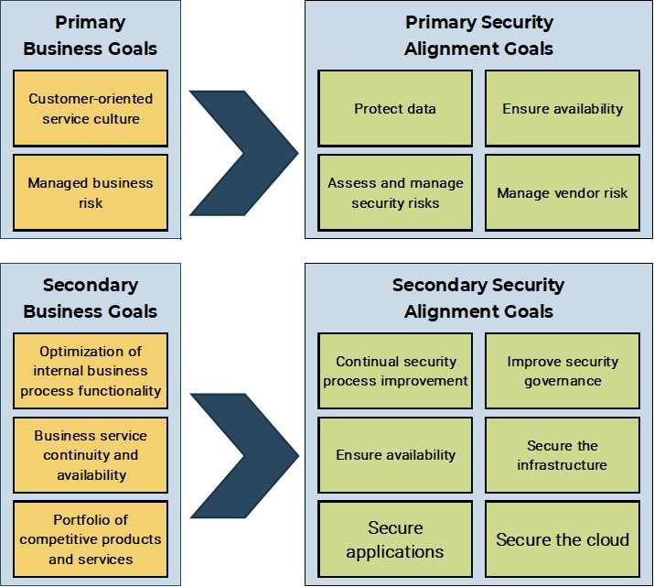
Completed business goals cascade
The information security strategy must align with, and support, organizational objectives.

Slide 13
Identify your compliance obligations
Most conventional regulatory obligations are legally mandated legislation or compliance obligations, such as:
Compliance obligations also extend to voluntary security frameworks:
Sarbanes-Oxley Act (SOX)
NIST
Sarbanes-Oxley Act (SOX)
  Applies to public companies that have registered equity or debt securities within the SEC to guarantee data integrity against financial fraud.
National Institute of Standards and Technology; a non-regulatory agency that develops and publicizes measurement standards.
Payment Card Industry Data Security Standard (PCI DSS)
Payment Card Industry Data Security Standard (PCI DSS)
CIS – 20 CSC
  Applies to any organization that processes, transmits, or stores credit card information to ensure cardholder data is protected.
Center for Internet Security – 20 Critical Security Controls. Foundational set of effective cybersecurity practices.
Health Insurance Portability and Accountability Act (HIPAA)
ISO 27001
Health Insurance Portability and Accountability Act (HIPAA)
Applies to the healthcare sector and protects the privacy of individually identifiable healthcare information.
An information security management system framework outlining policies and procedures.
Health Information Technology for Economic and Clinical Health (HITECH)
Health Information Technology for Economic and Clinical Health (HITECH)
COBIT 5
Applies to the healthcare sector and widens the scope of privacy and security protections available under HIPAA.
An information technology and management and governance framework.
Personal Information Protection and Electronic Documents Act (PIPEDA)
HITRUST
Applies to private sector organizations that collect personal information in Canada to ensure the protection of personal information in the course of commercial business.
A common security framework for organizations that use or hold regulated personal health information.

Slide 14
Establish your scope and boundaries
It is important to know at the outset of the strategy: what are we trying to secure?
This includes physical areas we are responsible for, types of data we care about, and departments or IT systems we are responsible for.
This also includes what is not in scope. For some outsourced services or locations, you may not be responsible for their security. In some business departments, you may not have control of security processes. Ensure that it is made explicit at the outset what will be included and what will be excluded from security considerations.
Physical Scope and Boundaries
IT Systems Scope and Boundaries
How many offices and locations does your organization have?
Which locations/offices will be covered by your information security management system (ISMS)?
How sensitive is the data residing at each location?
You may have many physical locations, and it is not necessary to list every one. Rather, list exceptional cases that are specifically in or out of scope.
There may be hundreds of applications that are run and maintained in your organization. Some of these may be legacy applications. Does your ISMS need to secure all your programs or a select few?
Is the system owned or outsourced?
Where are we accountable for security?
How sensitive is the data that each system handles?
Organizational Scope and Boundaries
Will your ISMS cover all departments within your organization? For example, do certain departments (e.g. Operations) not need any security coverage?
Do you have the ability to make security decisions for each department?
Who are the key stakeholders/data owners for each department?

Slide 15
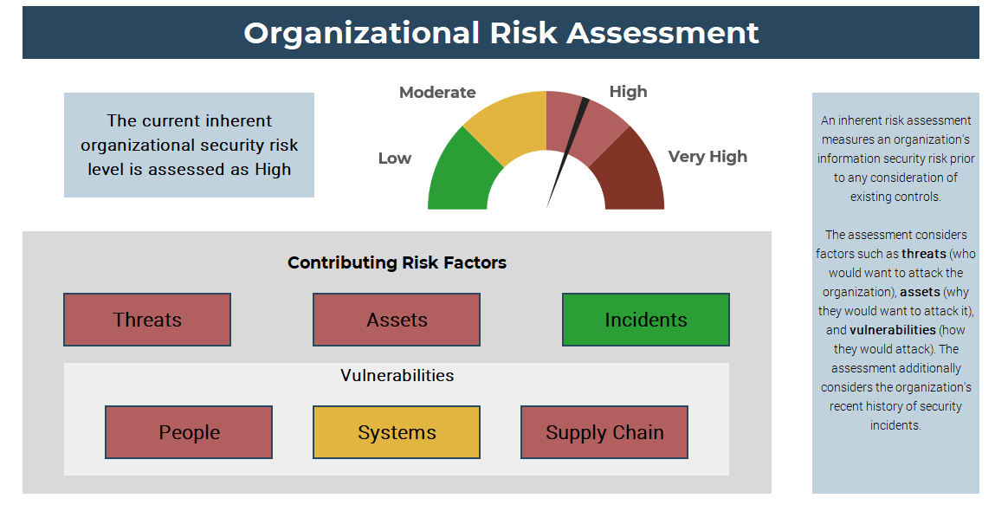
Conduct a risk assessment
Consider your inherent organization security risks, including:
  Threats
  Assets
  Vulnerabilities
  Historical incidents and trends
Info-Tech Insight
Understanding your organization’s security risks is critical to identifying the most appropriate level of investment for your security program. Organizations with more security risks will need more a mature security program to mitigate those risks.
  It is important to remember that the assessment measures inherent risk, meaning the risk that exists prior to the implementation of security controls. Your security controls will be assessed later as part of the gap analysis.

Slide 16
Understand risk tolerance
Upper management often asks security leaders the question: Are we secure enough?
As a security leader, there is one prerequisite question that must be answered before you can address this: To what degree does my organization want me to secure things?
Security professionals don’t know – and shouldn’t decide alone – what is enough when it comes to security. The business needs to tell security professionals when to stop securing things because it is an impediment to functionality, security is becoming too costly, or there are other competing priorities.
A formalized risk tolerance level will:
Support risk-based security decisions that align with business goals.
Provide a rationale for security initiatives that will be meaningful to executives and stakeholders.
Generate transparency in decision making as it pertains to operational and investment strategies.
Support risk monitoring through the measurement of inherent risk and residual risk exposure to support determination of appropriate monitoring.
Risk Tolerance Curve
Do not accept the risk
Probability
Risk Tolerance
Accept the risk
Impact
  Information security risk tolerance is the degree of potential negative impact an organization is willing to accept to its systems and data from a security incident to achieve its strategic goals.

Slide 17
Risk tolerance descriptions
High
Moderate
Low
High
Organizations with high risk tolerances are often found in industries with limited security risk, such as Construction, Agriculture and fishing, or Mining.
A high risk tolerance may be appropriate for organizations that do not rely on highly sensitive data, have limited compliance obligations, and where their customers do not demand strong security controls. Organizations that are highly focused on innovation and rapid growth may also tend towards a higher risk tolerance.
However, many organizations adopt a high risk tolerance by default simply because they have not adequately assessed their risks.
Organizations with medium risk tolerances are often found in industries with moderate levels of security risk, such as Local Government, Education, or Retail and wholesale
A medium risk tolerance may be appropriate for organizations that store and process some sensitive data, have a modest number of compliance obligations, and where customer expectations for security tend to be implicit rather than explicit.
Organizations with low risk tolerances are often found in industries with elevated security risk, such as Financial Services, Federal Governments, or Defense Contractors.
A low risk tolerance may be appropriate for organizations that store very sensitive data, process high-value financial transactions, are highly regulated, and where customers demand strong security controls.
Some organizations claim to have a low risk tolerance, but in practice will often allow business units or IT to accept more security risk than would otherwise be permissible. A strong information security program will be required to manage risks to an acceptable level.

Slide 18
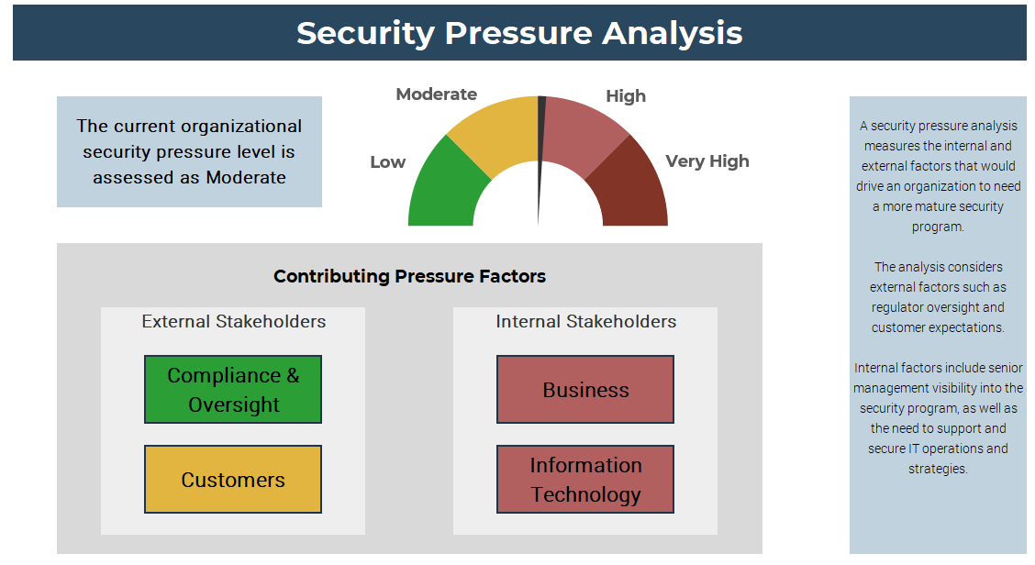
Conduct a stakeholder pressure analysis
Identify your external stakeholders (regulators, shareholders, customers) and internal stakeholders (business units, IT).
Determine their overall expectations related to information security within your organization.
Info-Tech Insight
A low security pressure means that your stakeholders do not see information security as being very important. In this case, you will likely struggle to gain support for a security strategy that aims too high. You may need to try to change the organizational culture before introducing significant new security controls.

Slide 19
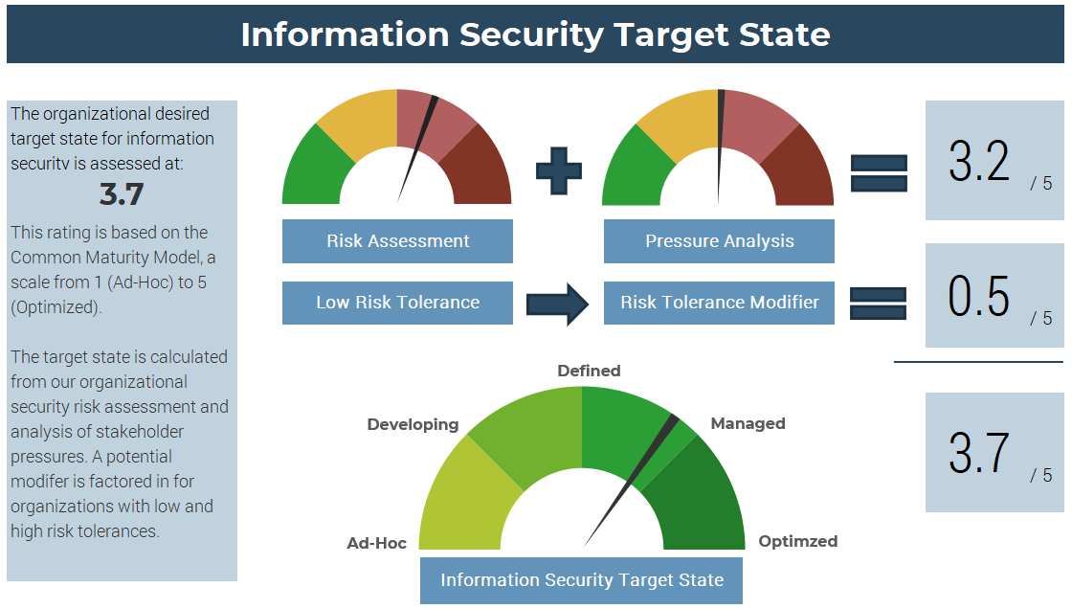
Develop a target state that is supported by all stakeholders
Info-Tech Insight
Higher target states require more investment to attain. It is critical to ensure that all key stakeholders agree on the security target state. If you set a target state that aims too high, you may struggle to gain support and funding for the strategy. Taking this opportunity to ensure alignment from the start will pay off dividends in future.

Slide 20
Understanding security target states
  Maturity models are very effective for determining information security target states. This table provides general descriptions for each maturity level. As a group, consider which description most accurately reflects the ideal target state for information security in your organization.
OPTIMIZED 05
MANAGED 04
An Optimized security program is based on strong risk management practices, including the production of key risk indicators (KRIs). Individual security services are optimized using key performance indicators (KPIs) that continually measure service effectiveness and efficiency.
Managed security programs have robust governance and metrics processes. Management and board-level metrics for the overall program are produced. These are reviewed by business leaders and drive security decisions. More mature risk management practices take the place of best practices.
DEFINED 03
DEVELOPING 02
A Defined security program is holistic, documented, and proactive. At least some governance is in place, however, metrics are often rudimentary and operational in nature. These programs still often rely on best practices rather than strong risk management.
AD HOC 01
Developing security programs can be effective at what they do but are not holistic. Governance is largely absent. These programs tend to rely on the talents of individuals rather than a cohesive plan.
Initial / Ad hoc security programs are reactive. Lacking strategic vision, these programs are less effective and less responsive to the needs of the business.

Slide 21
Info-Tech’s best-of-breed security framework
ISO 27000 series
CIS Top 20
COBIT 2019
NIST 800-53
NIST CSF

Slide 22
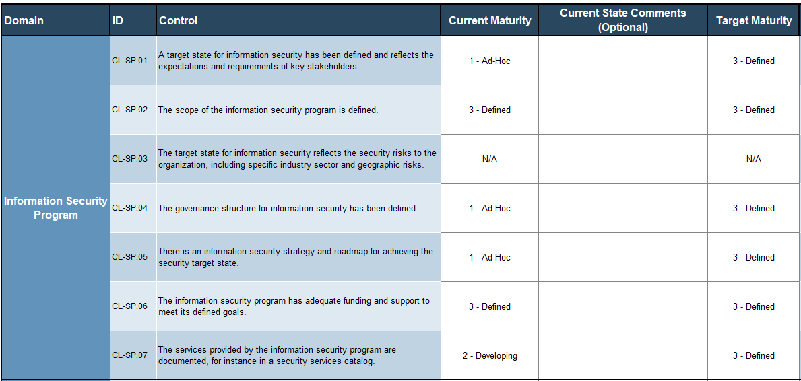
Conduct current state assessment
Carefully review each of the controls. For each control, indicate the current maturity level.
  You should only use “N/A” if you are confident that the control is not required in your organization. For example, if your organization does not perform any software development then you can use “N/A” for any controls related to secure coding practices.
Provide comments to describe your current state. This step is recommended as it may be important to record this information for future reference.
Select the target maturity for the control, based on your security target state.
1
2
3

Slide 23
Example maturity levels
  To help determine appropriate current and target maturity levels, refer to the example below for the control “Email communication is filtered for spam and potential malicious communications.”
OPTIMIZED 05
MANAGED 04
There is a dedicated email security administrator with advanced technical training. Custom filters are developed to further enhance security, based on relevant cyberthreat intelligence. Email security metrics feed key risk indicators that are reported to senior management.
Metrics are produced to measure the effectiveness of the email security service. Advanced technical features of the solution have been implemented and are regularly fine-tuned based on the metrics.
DEFINED 03
DEVELOPING 02
There is a policy and documented process for email security. Roles are assigned and administrators have adequate technical training. Most of the features of the solution are being used. Rudimentary reports are generated, and some fine-tuning is performed.
AD HOC 01
There is a secure email gateway. However, the processes for managing it are not documented. Administrator roles are not well defined. Minimal fine-tuning is performed, and only basic features are in use.
There is no centrally managed spam filter. Spam may be filtered by endpoint email clients.

Slide 24
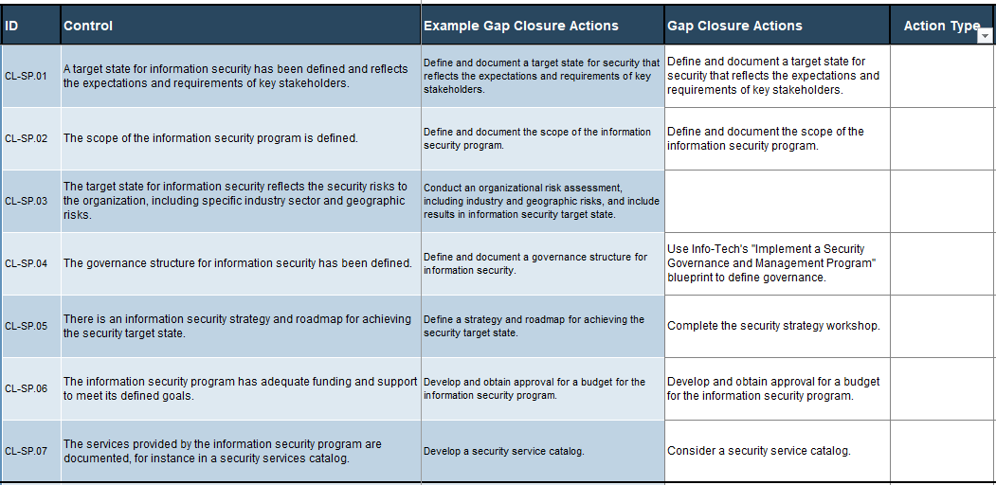
Identify gap closure actions
For each of the controls where there is a gap between the current and target state, a gap closure action should be identified.
Identify whether the action should be managed as a task or as an initiative. Most actions should be categorized as an initiative. However, it may be more appropriate to categorize them as a task when:
  They have no costs associated with them.
  They require a low amount of initial effort to implement and no ongoing effort to maintain.
  They can be accomplished independently of other tasks.
1
2

Slide 25
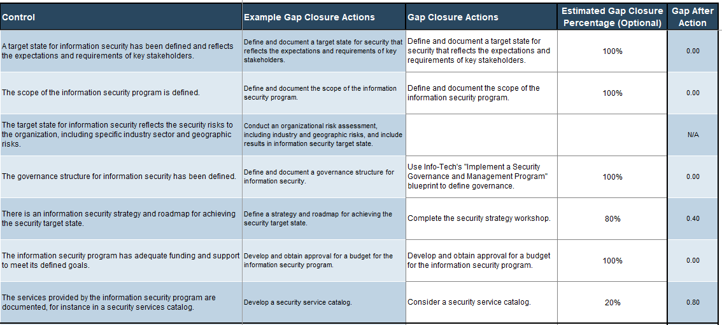
Define gap closure action effectiveness
For each of the gap closure actions, enter an estimated gap closure percentage to indicate how effective the action will be in fully closing the gap.
  For instance, an action to “investigate solutions and make recommendations” will not fully close the gap.
  This is helpful to understand how much progress towards your security target state you will make based on your roadmap.
1

Slide 26
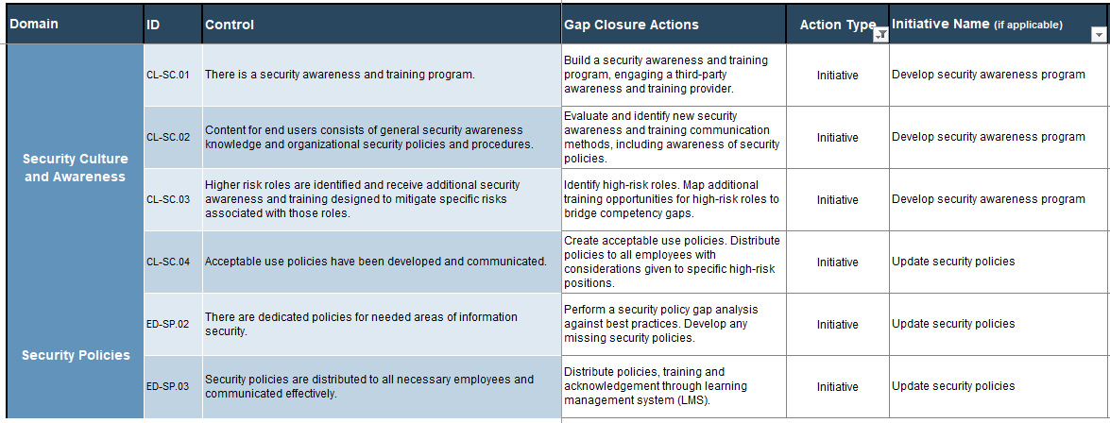
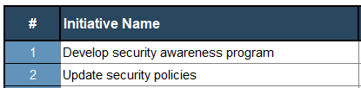
Initiative consolidation example
In the example below, we see three gap closure actions within the Security Culture and Awareness domain being consolidated into a single initiative “Develop security awareness program.”
We can also see one gap closure action within the same domain being grouped with two actions from the Security Policies domain into another initiative “Update security policies.”
Info-Tech Insight
As you go through this exercise, you may find that some actions that you previously categorized as tasks could be consolidated into an initiative.

Slide 27
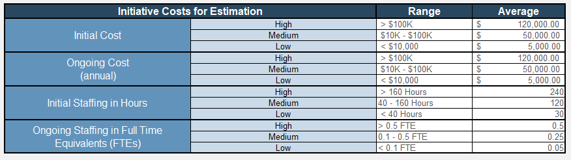
Define costing criteria
Determine high, medium, and low ranges for initial and ongoing costs and efforts.
  Initial costs are one-time, upfront capital investments (e.g. hardware and software costs, project-based consulting fees, training).
  Ongoing cost includes any annually recurring operating expenses that are new budgetary costs (e.g. licensing, maintenance, subscription fees).
  Initial staffing in hours is total time in person hours required to complete a project. It is not total elapsed time, but dedicated time. Consider time required to gather requirements and to design, test, and implement the solution.
  Ongoing staffing in FTEs is the ongoing average effort required to support that initiative after implementation.
1
2
  Make sure that your ranges allow for differentiation between initiatives to enable prioritization. For instance, if you set your ranges too low, all your initiatives will be assessed as high cost, providing no help when you must prioritize them.

Slide 28
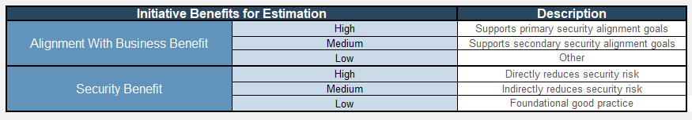
Define benefits criteria
1
Determine high, medium, and low values for the “Alignment with Business Benefit.”
  This variable is meant to capture how well each initiative aligns with organizational goals and objectives.
  This benefit should be linked directly to business goals through the primary and secondary security alignment goals.
Enter a high, medium, and low value for the “Security Benefit.”
  This variable is meant to capture the relative security benefit or risk reduction being provided by the gap initiative.
  By default, this benefit is linked to security risk reduction.
2
  Some organizations prefer to use the “Security Benefit” criteria to demonstrate how well each initiative supports specific compliance goals.

Slide 29
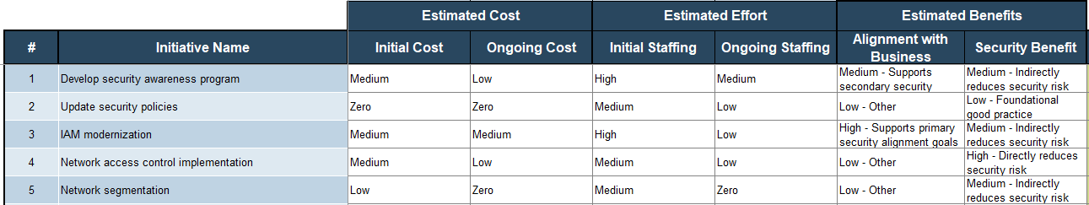
Complete the cost/benefit analysis
Determine the estimated costs and efforts for each initiative, using the criteria defined earlier.
Determine the estimated benefits, also using the criteria defined earlier.
1
2

Slide 30


Create effort map
Low Cost
On a whiteboard, draw the quadrant diagram shown.
Create sticky notes for each initiative on your initiative list.
For each initiative, use the “Cost/Effort Rating” and the “Benefit Rating” calculated on the Prioritization tab to place the corresponding sticky note onto the diagram.
Low Benefit
High Benefit
  An effort map is a tool used for the visualization of a cost and benefit analysis. It is a quadrant output that visually shows how your gap initiatives were prioritized. In this example, the initiative “Update Security Policies” was assessed as low cost/effort (3) and high benefit (10).
Update Security Policies
Cost
3
Benefit
10
High Cost

Slide 31
Assign initiatives to execution waves
01 MUST DO
02 SHOULD DO
Using sticky flip chart sheets, create four sheets and label them according to the four execution waves:
  MUST DO – These are initiatives that need to get moving right away. They may be quick wins, items with critical importance, or foundational projects upon which many other initiatives depend.
  SHOULD DO – These are important initiatives that need to get done but cannot launch immediately due to budget constraints, dependencies, or business impacts that require preparation.
  COULD DO – Initiatives that have merit but are not a priority.
  WON’T DO – Initiatives where the costs outweigh the benefits.
Using the instructions on the following slides, move the initiative sticky notes from your effort map into the waves.
03 COULD DO
04 WON’T DO

Slide 32








Considerations for prioritization
Starting from the top right of the effort map, begin pulling stickies off and putting them in the appropriate roadmap category.
Keep dependencies in mind. If an important initiative depends on a low-priority one being completed first, then pull dependent initiatives up the list.
It may be helpful to think of each wave as representing a specific time frame (e.g. wave 1 = first year of your roadmap, wave 2 = year two, wave 3 = year three).
01 MUST DO
02 SHOULD DO
Low Cost
03 COULD DO
04 WON’T DO
Info-Tech Insight
Use an iterative approach. Most organizations tend to put too many initiatives into wave 1. Be realistic about what you can accomplish and take several passes at the exercise to achieve a balance.
Low Benefit
High Benefit
High Cost

Slide 33
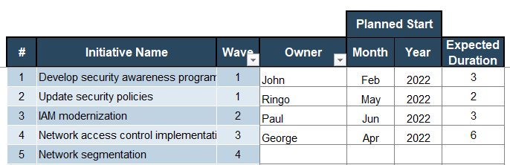
Schedule initiatives using a Gantt chart
Using a Gantt chart, for each initiative enter an owner (the individual who will be primarily responsible for execution).
Additionally, enter a start month and year for the initiative and the expected duration in months.
1
2
Info-Tech Insight
Use the Owner column to help identify resourcing constraints. If a single individual is responsible for many different initiatives that are planned to start at the same time, consider staggering those initiatives.

Slide 34
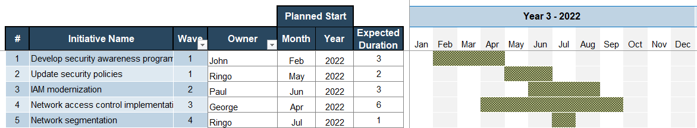
Review your roadmap
When you have completed the Gantt chart, as a group review the overall roadmap to ensure that it is reasonable for your organization. Consider the following:
  Do you have other IT or business projects planned during this time frame that may impact your resourcing or scheduling?
  Does your organization have regular change freezes throughout the year that will impact the schedule?
  Do you have over-subscribed resources? You can filter the list on the Owner column to identify potential over-subscription of resources.
  Have you considered any long vacations, sabbaticals, parental leaves, or other planned longer-term absences?
  Are your initiatives adequately aligned to your budget cycle? For instance, if you have an initiative that is expected to make recommendations for capital expenditure, it must be completed prior to budget planning.

Slide 35
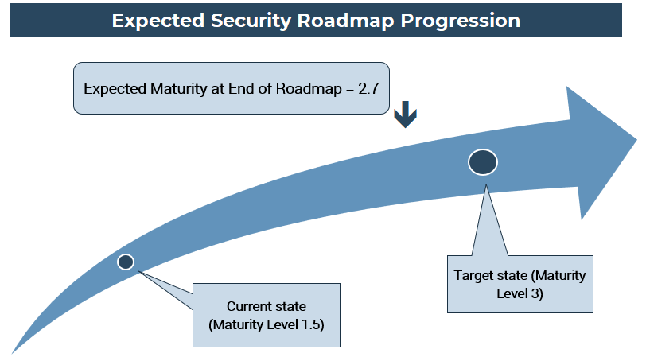
Review your expected roadmap progression
Info-Tech Insight
Often, internal stakeholders will ask the question “If we do everything on this roadmap, will we be at our target state?” This diagram will help answer that question.

Slide 36
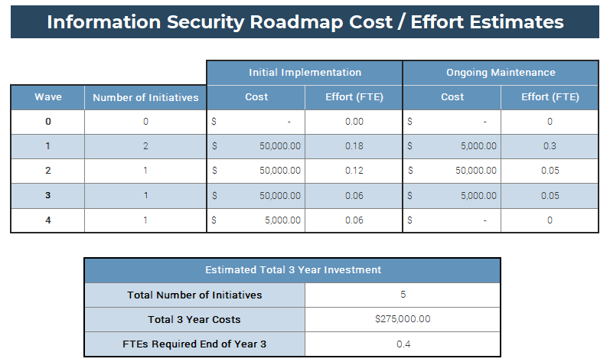
Review your cost/effort estimates
Once you have completed your roadmap, review the total cost/effort estimates. In your review consider:
  Is this investment realistic? Will completion of your roadmap require adding more staff or funding than you otherwise expected?
  If the investment seems unrealistic, you may need to revisit some of your assumptions, potentially reducing target levels or increasing the amount of time to complete the strategy.
  This table provides you with the information to have important conversations with management and stakeholders

Slide 37
Communication considerations
Developing an Information Security Strategy is only half the job. For the strategy to be successful, you will need to garner support from key internal stakeholders. These may include the CIO, senior executives, and business leaders. Without their support, your strategy may never get the traction it needs. When building your communication deck and planning to present to these stakeholders, consider the following:
  Gaining support from stakeholders requires understanding their needs. Before presenting to a new audience, carefully consider their priorities and tailor your presentation to address them.
  Use the communication deck to clarify the business context and how your initiatives that will support business goals.
  When presenting to senior stakeholders, anticipate what questions they might ask and be sure to prepare answers in advance. Always be prepared to speak to any data point within the deck.
  If you are going to present your strategy to a group and you anticipate that one or more members of that group may be antagonistic, seek out an opportunity to speak to them before the meeting and address their concerns one-on-one.
Info-Tech Insight
Reinforce the concept that a security strategy is an effort to enable the organization to achieve its core mission and goals and to protect the business only to the degree that the business demands. It is important that stakeholders understand this point.
  If you have already fully engaged your key stakeholders through the requirements gathering exercises, presenting the strategy will be significantly easier. The stakeholders will have already bought in to the business goals, allowing you to show how the security strategy supports those goals.

Slide 38
Execute on your roadmap
Executing on your information security roadmap will require coordinated effort by multiple teams within your organization. To ensure success, consider the following recommendations:
  If you have a project management office, leverage them to help apply formal project management methodologies to your initiatives.
  Develop a process to track the tasks on your strategy task list. Because these will not be managed as formal initiatives, it will be easy to lose track of them.
  Develop a schedule for regular reporting of progress on the roadmap to senior management. This will help hold yourself and others accountable for moving the project forward.
Plan to review and update the strategy and roadmap on a regular basis. You may need to add, change, or remove initiatives as priorities shift.
Info-Tech Insight
Info-Tech has many resources that can help you quickly and effectively implement most of your initiatives. Talk to your account manager to learn more about how we can help your strategy succeed.

Slide 39
Conclusion
Summary of key insights
HOLISTIC
Use a security framework as a starting point to ensure a holistic assessment.
However, don’t rely on the idea that a security framework equals best practices.
RISK-AWARE
Conduct an inherent risk assessment that includes industry and geographical risks.
Keep it high level.
Risk tolerance is a critical component.
BUSINESS-ALIGNED
Use a goals cascade approach to drive out security-to-business alignment.
Conduct a pressure analysis to help arrive at a consensus security target state.

Slide 40






Info-Tech offers various levels of support to best suit your needs
  DIY
  Guided Implementation
  Workshop
  Consulting
“Our team has already made this critical project a priority, and we have the time and capability, but some guidance along the way would be helpful.”
“Our team knows that we need to fix a process, but we need assistance to determine where to focus. Some check-ins along the way would help keep us on track.”
“We need to hit the ground running and get this project kicked off immediately. Our team has the ability to take this over once we get a framework and strategy in place.”
“Our team does not have the time or the knowledge to take this project on. We need assistance through the entirety of this project.”

Slide 41
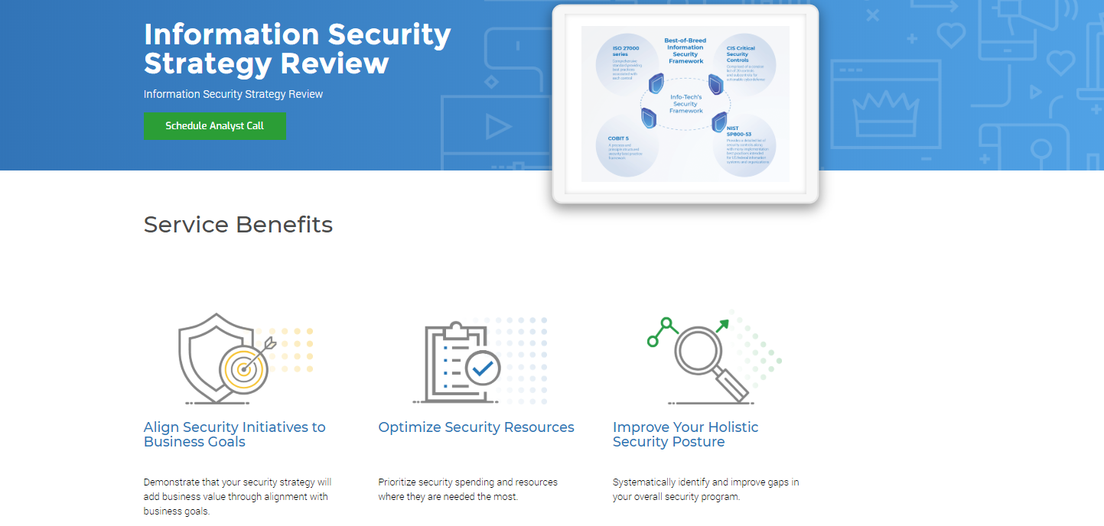

Slide 42
Create a Business-Aligned Security Strategy
Time for a few questions…
Q&A

Slide 43


Thank you!
If you have additional questions on this topic, please contact:
Kevin Peuhkurinen
kpeuhkurinen@infotech.com
For information on Info-Tech’s products and services, please contact:
Dave Bell
dbell@infotech.com

