Slide 1
Welcome to our team.

Slide 2
Threat Landscape Briefing June 2020
Notes:
Hello and welcome to this month’s Info-Tech Threat Landscape Briefing.
My name is Ian Mulholland, and I am a research analyst in our Security and Threat Intelligence practice. I will be facilitating today’s briefing.
During today’s discussion we will cover topics related to cybersecurity; threat actor campaigns; regulatory, compliance, and legal issues; and threat actor exploits and tactics.
Our Cybersecurity section covers high-level topics, such as threat trends, data breaches, control strategies, and exposure to vulnerabilities, that act to broaden your understanding of cybersecurity’s impact on your business.
Our Threat Actor Campaign section covers topics related to nation-states, cybercriminals, and hacktivists orchestrating campaigns designed to compromise networks and exfiltrate sensitive data.
Our Regulatory, Compliance, and Legal section covers trends in the global regulatory and legal landscape with the potential to impact compliance adherences or disrupt business operations.
And lastly, our Exploitation and Tactics section provides information related to the tools, tactics, and exploits threat actors are leveraging in their attack campaigns.
<<<Advance to the next slide.>>>

Slide 3
Agenda
Topics
Introduction
Cybersecurity
How COVID-19 has impacted cybersecurity teams
Regulatory, Compliance, and Legal
Privacy in the realm of IoT: A new layer probed by the pandemic
Exploitation and Tactics
Humans continue to be the weak link in data breaches
Defeating fingerprint scanners with
3D printing
Notes:
For this month’s briefing, we start with Research Director Christine Coz with a discussion about how COVID-19 has impacted cybersecurity teams. Then we’ll hear from Senior Research Analyst Cassandra Cooper, who will talk about privacy in the realm of IoT. Then Research Analyst Logan Rodhe will talk about how humans remain the weak link in data breaches. And finally we will hear from Research Director William Wong, who’s going to discuss how fingerprint scanners can be defeated with 3D printing.

Slide 4
High-level topics such as threat trends, data breaches, control strategies, and exposure to vulnerabilities that act to broaden your understanding of the cybersecurity impact to business.
Cybersecurity
Target Audience:
Chief Information Officers
Chief Information Security Officers
IT Risk Professionals
Business/Data Owners
Legal, Human Resources, and Public Relations
Vulnerability Management
Incident Responders, Security Operations
IT Professionals

Slide 5
Christine Coz Principal Research Advisor
How COVID-19 has impacted cybersecurity teams
In an ISC2 Survey:
Observations Reported:
75% of 342 cybersecurity team respondents indicated that their jobs have changed, and 35% report significant changes.
One significant change reported was that security staff were often asked to help with configuring mobile workstations.
With the exception of security teams working in critical services such as healthcare, most security teams report they are working from home.
Companies reported that they did not always have the right tools to support cybersecurity activities, though it was seen as an essential service
Some security respondents felt that they were being seen as enablers by facilitating the quick realignment of remote connectivity and in some cases introducing significant changes to remote connectivity capacity and methods to respond to the crisis.
Others reported that quick activities led to lessons learned, for example when the original deployment of laptops had to be changed to remote desktop access to support specialized cases.
Log, review, and assess lessons learned and expect this to be the new normal in part or as a whole.

Slide 6
Trends in the global regulatory and legal landscape with the potential to impact compliance adherences or disrupt business operations.
Regulatory, Legal, and Compliance
Target Audience:
Chief Information Officers
Chief Information Security Officers
IT Risk Professionals
Chief Privacy Officers
Privacy Professionals
Business/Data Owners
Legal, Human Resources, Public Relations
IT Professionals

Slide 7
Cassandra Cooper Senior Research Analyst
Privacy in the realm of IoT: A new layer probed by the pandemic
IoT Ecosystem: The rapid proliferation of IoT devices within homes of the general public proves both a pro (high degree of interconnectedness) and a con (increased opportunity for cyberthreats/risks) for users.
Pandemic Problem: With many individuals now working from home, IoT devices are faced with prime opportunities to collect increasing volumes of sensitive data (e.g. information discussed during work calls, data shared email).
Too Much Data: An FTC report shows that 150 million discrete data points are collected daily from a subset of under 10,000 households.
Tech First, Privacy Second: The concepts of “Privacy by Design” and “Security by Design” are not at the forefront of IoT device development, making data privacy a potential threat to the proper deployment of these devices.
Legal Lag: Global privacy regulations have not caught up to the speed at which IoT devices continue to be developed, and as such significant discrepancies exist with respect to how data collected by these devices is handled and used.
Public Safety
Precautionary Prep: Individuals should assess their home IoT environment and make necessary changes to their working setup. This may include using a headset, ensuring that computer screens are not visible, and taking any additional security measures when working with sensitive data elements.
Know Your Terms: Take time to review the terms and conditions. As you create a connected ecosystem of IoT devices, ensure that you are fully aware of the ways in which your data is being kept, used, and safeguarded.
Sources: CPO Magazine, Business Insider, Privacy by Design

Slide 8
Information related to the tools, tactics, and exploits threat actors are leveraging in their attack campaigns.
Exploitation and Tactics
Target Audience:
Chief Technology Officers
Chief Information Security Officers
Information Security Officers
Threat Intelligence Analysts
Vulnerability Management
Incident Responders
Security Operations
IT Professionals

Slide 9
Logan Rohde
Research Specialist
Humans continue to be the weak link in data breaches
For more help, refer to these Info-Tech research sets:
Top 3 Factors in Two-Thirds of Data Breaches
1
Credential Theft
2
Social Engineering
3
Human Error
Develop a Security Awareness and Training Program That Empowers End Users
Notice the role that human error plays in the other two
Develop and Implement a Security Incident Management Program
Source: IT World Canada, Verizon
Notes:
This year’s Verizon DBIR has been released, and one of the key findings was that just over two-thirds of data breaches involved credential theft, social engineering (including phishing), or human error. Such results are perhaps not particularly surprising, but it is worth pausing for a moment to notice the connection between human error and the other two categories.
While there is more than one way to steal credentials, exploiting poor password hygiene and using social engineering tactics are both common methods, and human error underlies both of them. Social engineering, really, is just a specialized form of human error and having credentials stolen because of poor password practices is often the result of a human’s decision to not comply with a secure password policy.
What we see, then, is something of a feedback loop between these various categories.
The takeaway? It seems that humans continue to be a cybersecurity weak link, suggesting that one of the best investments you can make to improve your overall security posture is to better train the people using the systems and data you’re trying to protect.
Check out the Info-Tech resources provided to help develop your training and awareness program as well as your incident management program for when things go wrong.

Slide 10
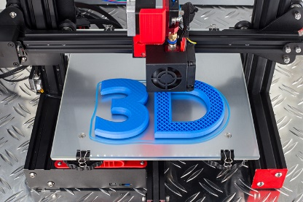
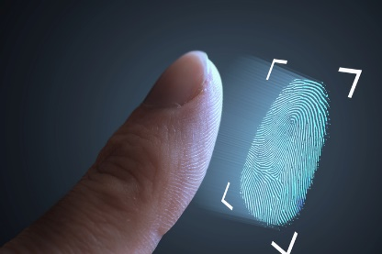
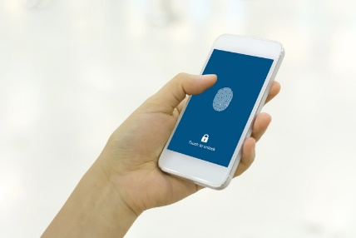
William Wong Principal Research Advisor
Defeating fingerprint scanners with 3D printing
Research by Cisco Talos shows fingerprint technology can be defeated by lifting actual fingerprints and reproducing them through 3D printers.
Researchers collected actual fingerprints of real people and then created molds of the prints with 3D printers. They had about an 80% success rate while using the fake fingerprints where fingerprint sensors were bypassed at least once.
In the future, smartphones, laptops, and other biometric devices with fingerprint technologies may become a much larger mainstream threat. Glass on smartphones provides a perfect medium to capture fingerprints.
It may be time to review your incident management response program.
Compromised
Access
Source: TechTarget
Notes:
Research by Cisco Talos shows that popular fingerprint scanning technology can be defeated by lifting actual fingerprints and reproducing them through 3D printers. Trying to compromise biometric fingerprint authentication is not new. Since fingerprint authentication started becoming mainstream, many researchers, curious individuals, hackers, and companies have tried and succeeded in compromising fingerprint authentication.
In reference to the article, this isn't the first time researchers have questioned the effectiveness of biometric authentication. In 2018 researchers at New York and Michigan State Universities developed something called “DeepMasterPrints,” which was AI-created images of fake fingerprints that could fool biometric sensors. But this latest developments speaks to a much broader future threat. It provides a relatively low cost set of tools that anyone can technically develop and produce in their basement. Imagine you’re a little gang of knowledgeable technology thieves, prowling food courts or restaurants or unsecured office buildings, just looking for smartphones to steal.
In yesteryear, smartphone and laptop thieves would steal your device, reinitialize it, and then sell it. In the future they could steal it, get access to the contents, sell the data contents on the dark web, then sell your phone online, thereby maximizing their ROI. I can just see future business model of “hire-a-hacker” wanted ads on the dark web: something along the lines of “Seeking Smartphone content. For JPMorgan Chase Investment Research employees at New York City HQ – Top Anonymous Bitcoins paid.”
Depending on how this exploitation and tactic evolves, here are some personal and business tips from Info-Tech.
Device owners have the option to disable fingerprint readers on their devices, but most people will always select convenience over security. So a few things people can do to address the risks are:
Always know where your device is, especially your smartphone.
Be wary of distraction thefts in busy places like restaurants and shopping malls.
Check if the manufacturer or mobile vendor offers a phone location or remote wipe service.
For companies that have a corporate mobile device environment, you will likely have some type of mobile device management solution in place. Low-cost “easy to do” recommendations for companies are:
Review your security awareness program and ensure you have mobility and device usage content.
Review your incident management processes and documentation.

Slide 11
Welcome to our team.
Notes:
This concludes our monthly threat briefing. If you have any questions or need any support, please do not hesitate to contact us to set up an analyst call.
Thank you.

