Slide 1
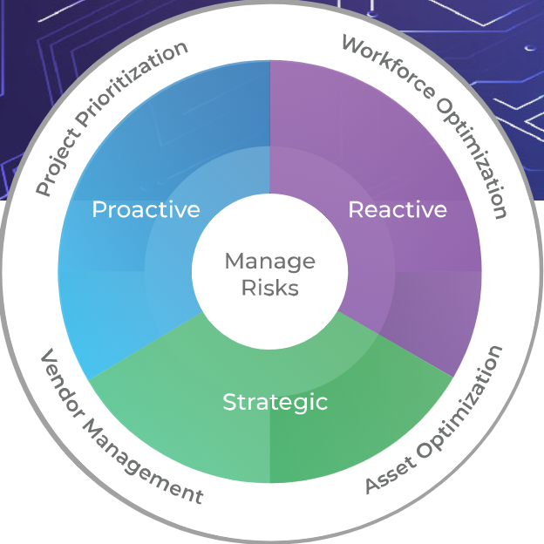
Cost-Reduction Planning for IT Vendors
A tactical and strategic approach to IT expense reductions.
Sample
Get the complete storyboard with free trial membership now!

Slide 2
Introduction
Current Challenge
Info-Tech’s Approach
Unprecedented health and economic conditions are putting extreme pressure and controls on expense management.
IT needs to implement pre-emptive measures to reduce costs and show immediate results.
IT must sustain these reductions beyond the near term and evaluate options on an ongoing basis since no one knows how long current conditions will last.
The speed at which IT leaders need to reduce costs is unprecedented. IT faces a momentous challenge to identify and prioritize cost-reduction measures that don’t significantly affect operational capabilities.
Pinpoint and implement tactical countermeasures and savings opportunities to reduce costs immediately (Reactive: <3 months).
Identify and deploy proven practices to capture and sustain expense reduction throughout the mid-term (Proactive: 3-12months).
Create a long-term strategy to improve flexibility, make changes more swiftly, and quickly generate cost-cutting opportunities (Strategic: >12 months).
Generate and prioritize a list of potential expense reductions to achieve quick wins with minimal effort and high contributions to expense reductions.
Info-Tech Insight
Proactively initiating a “War on Waste” (WoW) to reduce the expenses and costs in areas that do not impact operational capabilities of IT is an easy way to reduce IT expenditures. This is accomplished by following the principle “Stop Doing Stupid Stuff” (SDSS), which many organizations deemphasize or overlook during times of growth and prosperity. Initiating a WoW and SDSS program with passion, creativity, and urgency will deliver short-term cost reductions.

Slide 3
IT-Contract Cost-Cutting Framework
1
Assess your current situation using the “Bickley Box”
2
Gather historical, budgeted, and projected spend data
Contain and Reduce
3
Use the Info-Tech 4 R’s to classify and prioritize cost-cutting opportunities
4
Develop a plan for each opportunity based on priority and timeline
5
Identify the appropriate negotiation style and prepare (as applicable)

Slide 4
Guiding Principles
“We cannot solve our problems with the same thinking we used when we created them.”
Albert Einstein
Follow these guiding principles to maximize your cost reduction results.
1 | Be creative: new perspectives must be considered, and new ideas must be generated.
2 | Prioritize your WoW and SDSS initiatives based on effort and value.
3 | Don’t allow sunk costs to influence your decision to continue a project.
4 | Your contracts reflect the current situation – renegotiate to change the paradigm.
5 | Track, report, and share your results internally.

