Slide 1
Pandemic Preparation:
The People Playbook
Info-Tech Research Group Inc. is a global leader in providing IT research and advice. Info-Tech’s products and services combine actionable insight and relevant advice with ready-to-use tools and templates that cover the full spectrum of IT concerns.
© 1997-2020 Info-Tech Research Group Inc.

Slide 2
First: Don’t Panic
“We should not be too eager to declare a pandemic without a careful and clear-minded analysis of the facts.”
Dr. Tedros Adhanom Ghebreyesus, Director General, World Health Organization

Slide 3
Second: Have a Crisis Response Plan
Unlike traditional disaster recovery planning, business continuity planning and work from home initiatives, this time we know what the threat is and when it is likely to hit.
This is our advantage: We have time to prepare!

Slide 4
1
Employee Absenteeism
Key employee absenteeism
Mass employee absenteeism
Employee panic
Prepare for Three Key Issues
2
Travel Restrictions
Restricted travel from quarantined areas
Impeded travel elsewhere
Supply chain interruption
3
Downstream Impacts
Site closure
Post-pandemic issues

Slide 5
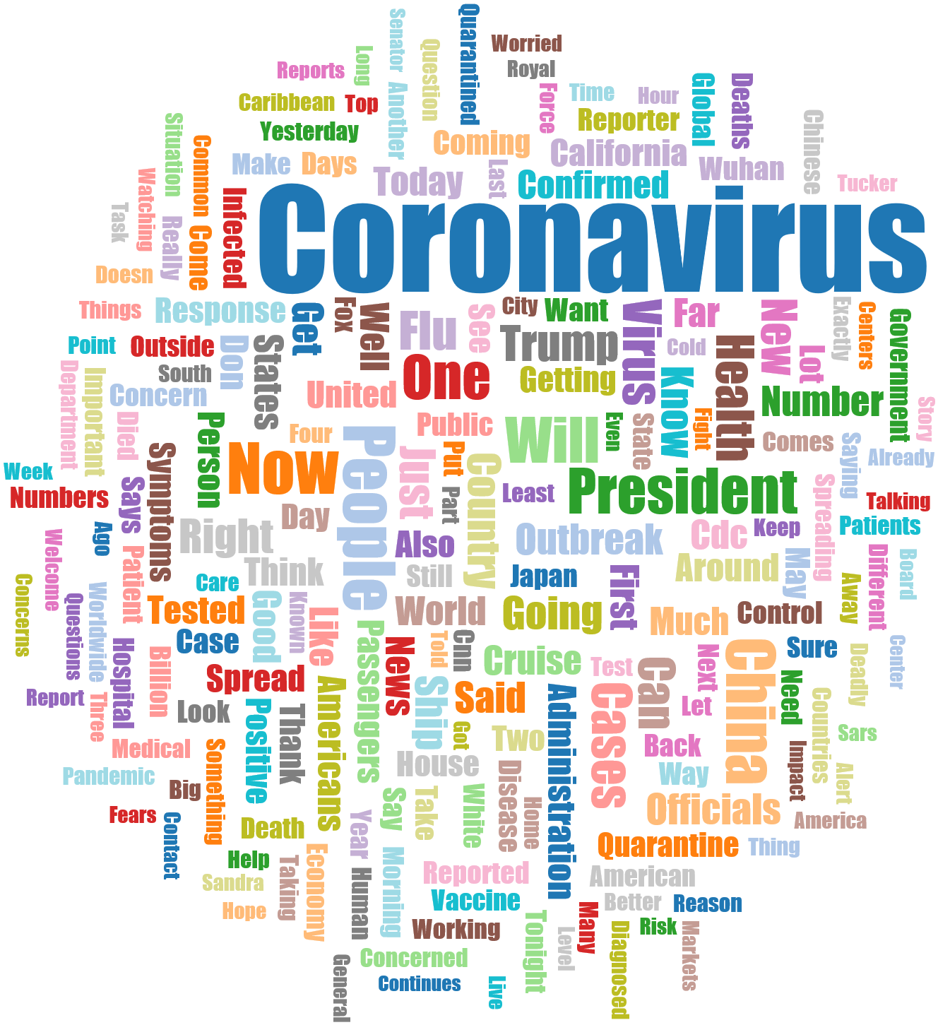
Recommended Actions
Immediate pandemic preparation for your people can be carried out through actions 1-4 below.
Form a pandemic response team
Prepare key messages now
Cascade communications to ensure clarity
Establish pandemic travel protocols
Identify your critical roles now
Enable work from home now via tools like MS Teams, WebEx, Slack
Constantly re-prioritize your backlog
Use the opportunity to jumpstart BCP
Increase internet bandwidth and VPN connectivity to peak capacity
Begin network and storage modernization
Enable two-factor authentication
Prepare to do a post-pandemic retrospective
People Preparation
Process
& Technology

Slide 6
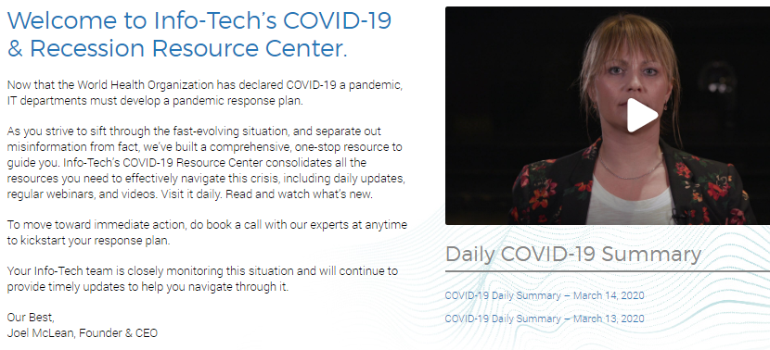
Suggested Research
Develop a Balanced Flexible Work Program
Develop a Business Continuity Plan
Implement Crisis Management Best Practices
Stay connected to our COVID-19 & Recession Resource Center for frequent additions to resources

Slide 7
Bibliography
“Coronavirus (COVID-19).” Centers for Disease Control & Prevention. Web. https://www.cdc.gov/coronavirus/2019-ncov/.
“Coronavirus Disease (COVID-19) Advice for the Public: Myth Busters.” World Health Organization. Web. https://www.who.int/emergencies/diseases/novel-coronavirus-2019/advice-for-public/myth-busters.
“Coronavirus disease (COVID-19) outbreak.” World Health Organization. Web. https://www.who.int/emergencies/diseases/novel-coronavirus-2019.
“Coronavirus disease (COVID-19): Prevention and risks.” Canada Public Health, 14 Mar. 2020. Web. https://www.canada.ca/en/public-health/services/diseases/2019-novel-coronavirus-infection/prevention-risks.html#p.
“Coronavirus Disease 2019 (COVID-19) | How to Protect Yourself.” Centers for Disease Control & Prevention, 14 Mar. 2020. Web. https://www.cdc.gov/coronavirus/2019-ncov/prepare/prevention.html.
“Coronavirus Disease 2019 (COVID-19) | Reducing Stigma.” Centers for Disease Control & Prevention, 3 Mar. 2020. Web. https://www.cdc.gov/coronavirus/2019-ncov/symptoms-testing/reducing-stigma.html.
Craven, Matt, et al. “COVID-19 Implications for Business.” McKinsey & Company, 9 Mar. 2020. Web. https://www.mckinsey.com/business-functions/risk/our-insights/covid-19-implications-for-business.
Edelman, Richard. “Trust at Work.” Edelman, 21 Jan. 2020. Web. https://www.edelman.com/insights/trust-at-work.
Getting Your Workplace Ready for COVID-19. World Health Organization, 3 Mar. 2020. Web. https://www.who.int/docs/default-source/coronaviruse/getting-workplace-ready-for-covid-19.pdf.
“Health Promotion Materials.” Centers for Disease Control & Prevention, 5 Mar. 2020. Web. https://www.cdc.gov/handwashing/materials.html.
Reeves, Martin, et al. “Lead Your Business Through the Coronavirus Crisis.” Harvard Business Review, 27 Feb. 2020. Web. https://hbr.org/2020/02/lead-your-business-through-the-coronavirus-crisis.
Social Stigma Associated with COVID-19. World Health Organization, 24 Feb. 2020. Web. https://www.epi-win.com/sites/epiwin/files/content/attachments/2020-02-24/COVID19%20Stigma%20Guide%2024022020_1.pdf.
“Travel: Frequently Asked Questions & Answers.” Centers for Disease Control & Prevention, 14 Mar. 2020. Web. https://www.cdc.gov/coronavirus/2019-ncov/travelers/faqs.html#returning-from-travel.
Wilkie, Dana. “Stop These Coronavirus Myths from Spreading in Your Workplace.” Society for Human Resources Management, 9 Mar. 2020. Web. https://www.shrm.org/resourcesandtools/hr-topics/people-managers/pages/coronavirus-myths-.aspx.

