Slide 1
Create a Disaster-Ready Ransomware Recovery Plan
Don’t let ransomware catch you off guard.
Info-Tech's products and services combine actionable insight and relevant advice with ready-to-use tools and templates that cover the full spectrum of IT concerns.© 1997-2020 Info-Tech Research Group Inc.

Slide 2
ANALYST PERSPECTIVE
Ransomware may be the most effective attack type ever!
Ransomware is one of the most impactful cyberattacks ever. A barrage of headlines every day seems to report that yet another organization has been hit with a new and more insidious form of ransomware.
Never has an attack type such as this been as disruptive to its victims nor garner as much profit for its attackers. This combination of effectiveness and profitability can lead to staggering attack rates.
What is most frustrating about ransomware is that organizations can prepare for a ransomware attack. Knowing the business impact of ransomware will mean you can make informed decisions in how you will respond. Until organizations put the time and funds into security and resiliency best practices, ransomware proliferation will continue.
Marc Mazur
Research Specialist – Security, Risk & Compliance Info-Tech Research Group
Info-Tech Research Group
SAMPLE

Slide 3
Our understanding of the problem
CISOs, CSOs, or other heads of security departments
IT security professionals
Understand what ransomware is and its characteristics and what tactics are employed by ransomware users.
Understand how to prepare for and prevent a ransomware attack.
Understand how to detect, respond to, and recover from a ransomware attack.
CIOs, IT directors, or other IT professionals with security responsibilities
CEOs, Chief Legal Counsel, risk managers, and other roles with risk management functions
Understand what ransomware is and its characteristics and what tactics are employed by ransomware users.
Understand how to prepare for and prevent a ransomware attack.
Understand how to detect, respond to, and recover from a ransomware attack.
Info-Tech Research Group
SAMPLE

Slide 4
Executive summary
Municipalities, hospitals, and small businesses hit by ransomware make the news every week. Everyone is a target and it’s a crisis.
Some organizations have closed their doors completely or have spent millions of dollars to recover from an attack.
Organizations don’t always integrate their incident response and disaster recovery plans, creating gaps in their response strategy to ransomware – this can contribute to why we often see organizations paying the ransom.
It’s just malware. Ransomware, although unique in its end goal, is still malware and can be prepared for accordingly.
You will have to pay, but you should choose who you pay. Whether you pay to modernize your security controls, for cyberinsurance, or for an MSSP, you want to avoid paying the attacker.
You can't prevent ransomware, but you can respond better. Mitigate the impact of ransomware with a security incident response plan that includes disaster recovery.
Many organizations pay the ransom because they aren’t confident they can recover sufficiently because of gaps in their incident response and disaster recovery processes.
Ransomware attackers use multiple attack vectors and can even allow ransomware to lay dormant so they infiltrate your backups, DR site, and even more endpoints before the ransomware is activated.
Ransomware is constantly evolving and organizations can’t keep up.
Effective and efficient management of ransomware involves a formal process of preparation, detection, analysis, containment, eradication, recovery, and post-incident activities.
Many conventional information security best practices can defend against a ransomware attack. Ensure you have security awareness and training, disaster recovery, and business continuity in place for your response strategy.
Stop worrying about becoming the next ransomware headline. Make the necessary preparations to defend your organization against the effects of ransomware.
Info-Tech Research Group
SAMPLE

Slide 5
What is ransomware?
Ransomware, in one simple sentence, is a type of malware that infects a system and restricts the user’s access to that infected system.
The main points to highlight:
Ransomware is a generic term used for a family of malware that attempts to extort money from a user, locking either their system or some of their data and alerting them that if they pay a ransom, they will get access back.
Ransomware is an access-denial attack or extortion type of malware.
Ransomware uses fear and panic as its primary tactic to coerce its victims to pay, often known as “scareware.”
Ransomware is a type of malware with many variants in the wild that can be used for a wide spectrum of purposes, ranging from financial extortion to cyberespionage.
Ransomware is spread like most other malware: drive-by downloads, RDP exploits, phishing emails, fileless attacks, etc.
Ransoms on average have increased 13% to $41,198 in Q3 2019 compared to $36,295 in Q2 of 2019 and usually require payment through a cryptocurrency such as Bitcoin or DASH.
To security professionals today, ransomware can be two things:
In either case, this research will help arm you with the information and actionable steps to secure your organization from ransomware.
A terrible headache where access to critical data or systems is lost, resulting in potential organizational process disruptions, direct financial costs, public reputation damages, and/or regulatory fines.
Something your CIO or CEO read about and is now demanding information on how the organization is protected.
Source: Coveware, “Ransomware Payments Rise…”
Info-Tech Research Group
SAMPLE

Slide 6
Have you heard the news? Ransomware is here to stay
Louisiana Suffers Another Major Ransomware Attack
Forbes
British banks hit by hacking of foreign exchange firm Travelex
CNBC
Ransomware attack hits school district twice in 4 months
Associated Press
Ryuk Ransomware Uses Wake-on-Lan To Encrypt Offline Devices
Bleeping Computer
In 2019, ransomware reached crisis proportions with targeted attacks that “impacted at least 966 government agencies, educational establishments and healthcare providers at a potential cost in excess of $7.5 billion.”
‘Chaos is the Point’: Russian Hackers and Trolls Grow Stealthier in 2020
The New York Times
Sodinokibi Ransomware Publishes Stolen Data for the First Time
Bleeping Computer
Ransomware Gangs Now Outing Victim
Businesses That Don’t Pay Up
KrebsonSecurity
Company shuts down because of ransomware, leaves 300 without jobs just before holidays
ZDNet
Baltimore to purchase $20M in cyber insurance as it pays off contractors who helped city recover from ransomware
The Baltimore Sun
Florida city will pay hackers $600,000 to get its computer systems back
Washington Post
Source: Emisoft
Info-Tech Research Group
SAMPLE

Slide 7
Ransomware does not discriminate by industry
Ransomware attacks are more targeted than ever before.
If we look at the attack trends, we can see that industries with lower maturity security programs are hit until attackers can no longer leverage the same exploits. Some common characteristics include:
Large attack surfaces covering many devices in heterogeneous environments.
The possession of some sort of critical data that if compromised could be devastating.
Average number of employees changes based on the ransomware family, ranging from 600 to thousands of employees.
The public sector accounted for 11% of all incidents in the fourth quarter of 2019, an increase of 2% from the second quarter of 2019.
Healthcare was especially affected because of service disruptions, with ransomware accounting for 70% of total incidents reported in 2019.
MSP-based attacks were wide-ranging in the scope but also in terms of the impact these attacks can have on hundreds of separate small businesses with 12% of software services affected.
Source: Hiscox, Coveware: “Ransomware Payments Rise…”, CrowdStrike
Info-Tech Research Group
SAMPLE

Slide 8
Organizations are unprepared and are increasingly paying up
Ransomware is constantly evolving and using advanced persistent threats to hit more targets and gain more payments.
In US dollars was the average ransom payment for Q4 2019, an increase of 104% from the previous average of $41,179 in Q3 2019.
$84,116
77%
Increased detection of ransomware-related threats over the first six months of 2019 compared to the second half of 2018.
Nearly One in Five
Organizations have reported a ransomware incident in 2019.
22%
Increase in organizations paying ransoms to recover data in software supply chain attacks. Studies show between 40% and 45% of organizations now pay ransoms.
Three Out of Four
Organizations are unprepared to deal with an incident in 2019.
Sources: Coveware – “Ransomware Costs Double…”, Hiscox, CrowdStrike
Info-Tech Research Group
SAMPLE

Slide 9
Three public organizations highlight the need for preparation
Ransomware attackers depend on catching organizations off-guard and are not afraid to hit the same target twice. Furthermore, without a ransomware response plan in place, the costs associated with an unplanned recovery can skyrocket.
Despite best efforts, including the funding of a Cyber Security Commission in 2017, the state of Louisiana was hit with ransomware twice in 2019. The first attack hit schools and district offices in the summer, while the second attack hit government offices in the fall.
The city of New Orleans was also hit in December 2019, showing that attackers will continue to exploit targets until organizations have hardened their security and closed off vulnerable exploits.
Multiple Attacks
Post-Incident
Costs
The city of Baltimore estimates that the costs associated with the ransomware attack amounted to $10 million in post-breach costs in addition to the $8 million in lost revenue.
The city of Woodstock had to pay $667,627 after it was hit with a ransomware attack for professional service fees and for new hardware.
Source: Forbes, Global News, The Baltimore Sun
Info-Tech Research Group
SAMPLE

Slide 10
Ransomware raises the age-old game-theory question to the top of social minds: to pay or not to pay?
The dilemma: should an organization or an individual pay an extortion fee to regain access to their data or systems? Or should the organization or individual refuse to pay, notify legal authorities, and stand up to the cybercriminals? This is an extension of the prisoner’s dilemma and is known specifically as the extortion dilemma (below).
Possible Outcomes:
AC: Best scenario for cybercriminals and the third worst for organizations/individuals. Assuming decryption does occur, profit is surrendered and a threat-crime environment is fostered.
BC: Second-best scenario for cybercriminals and the worst for organizations/individuals. Data or systems could be lost and the criminal just moves on to the next victim.
AD: Third-best scenario for cybercriminals and second best for organizations/individuals. The cybercriminal is free to focus on other activities and there is no victim from extortion.
BD: Worst case for cybercriminals and best case for organizations/individuals. Cybercriminal does not make any money and they operate in a victim-resistant environment.
Assumptions:
Data or systems are decrypted when the extortion fee is paid. This is generally the case because cybercriminals want to increase the willingness of victims to pay, but this may not always be true.
Freely available decryption tools do not exist. Although there has been a number of these tools created recently, they are always lagging behind the most recent ransomware variant.
Legal authorities, even if notified, are unable to intervene in any direct way for the organization or individual.
Extortion Dilemma
 |  | Cybercriminals
 |  | C) Extortion | D) Do not extort
Organizations or individuals | A) Accept crime and pay the fee | AC | AD
 | B) Do not pay and notify authorities | BC | BD
4
2
2
3
3
1
1
4
Info-Tech Research Group
SAMPLE

Slide 11
Use Info-Tech’s methodology so that ransomware won’t catch you off-guard
Ransomware is now more likely to hit your organization than a natural disaster and may well be more disastrous because of a breach of security. Make sure to use Info-Tech’s methodology that combines our research on incident management and disaster recovery to provide a best-practice approach to plan for, respond to, and recover from a ransomware attack.
Incident Management
Ransomware Response Plan
Disaster
Recovery
Info-Tech Research Group
SAMPLE

Slide 12
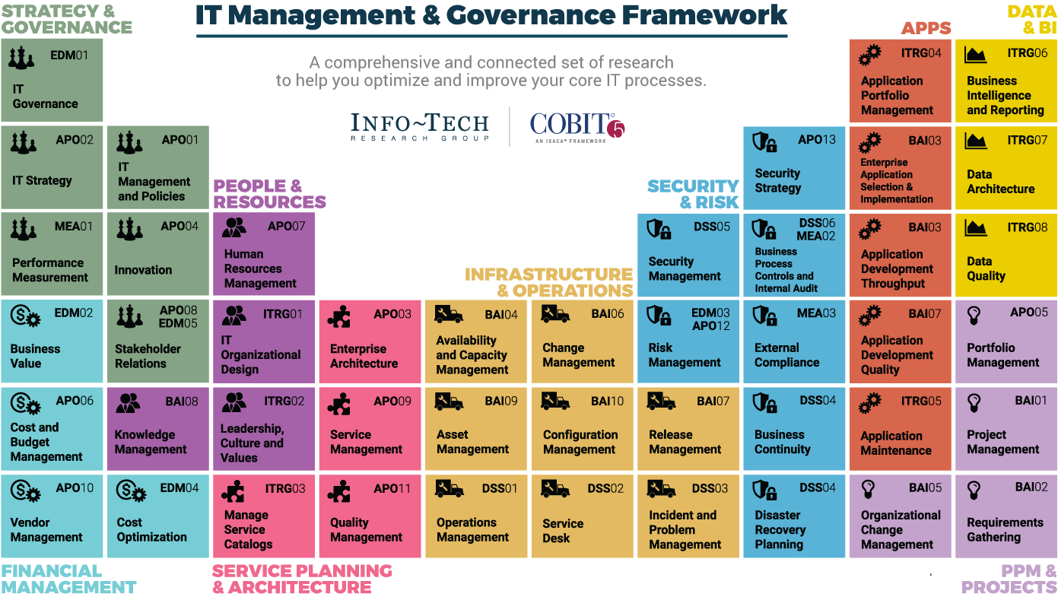
Dive Deeper Into Our Research
by Clicking One of the Elements Below
Find out how Info-Tech makes your job easier. Contact Us Today: Toll-Free (US & Canada): 1-888-670-8889
Info-Tech Research Group
SAMPLE

