Slide 1
Improve Your Statements of Work to Hold Your Vendors Accountable
Identify and reduce performance risk before you execute your next SOW.
Info-Tech's products and services combine actionable insight and relevant advice with ready-to-use tools and templates that cover the full spectrum of IT concerns.© 1997-2019 Info-Tech Research Group

Slide 2
ANALYST PERSPECTIVE
Your biggest SOW obstacles may be lurking under your own bed.
There are many internal forces that must be addressed (and overcome) when reviewing, drafting, and negotiating statements of work (SOWs).
Internal personnel may not see the value of investing the time necessary to yield a good SOW. However, the IT axiom ‘garbage in, garbage out’ is applicable to SOWs as well.
In some cases, SOWs may be treated informally, with the belief that SOWs are not important, merely a formality, or (gasp) not even legal documents.
Unfortunately, this can ultimately result in SOWs being used to document services rendered after the fact, once the work has been completed – when we have lost our negotiation leverage and potentially our protections.
Phil Bode,
Research Director, Vendor Management Info-Tech Research Group
SAMPLE

Slide 3
Our understanding of the problem
The CIO of an organization who depends on numerous key vendors for services
The CIO of an organization who wishes to maximize the value delivered by IT vendors
A director or manager of an IT procurement or vendor management team
A director or manager whose IT department holds responsibility for SOW negotiation and SOW management
Review and negotiate new SOWs
Renegotiate existing SOWs
Baseline and benchmark existing SOWs
Protect your organization from SOWs that favor the vendor’s interests
Discuss SOW terminology with Legal and vendors
IT managers who oversee purchasing decisions
IT Procurement
Contract teams
Senior leadership
Navigate through SOWs
Understand the relationships between various SOW provisions
Identify potential SOW risk
SAMPLE

Slide 4
Executive summary
IT organizations are becoming more reliant on vendor-provided services and products to meet customer and stakeholder needs.
SOWs are used to provide flexibility in the contracting process, allowing multiple projects to be done using a single contract.
SOWs may be generated by the vendor or created internally without a unified process to review/create a document that protects the customer.
There is often a disconnect between what is sold and what is purchased. To gain the customer’s approval, vendors will present a solution- or outcome-based proposal. However, the SOW is task- or activity-based, shifting the risk for success to the customer.
A good SOW takes time and should not be rushed. The quality of the requirements and of the SOW wording drive success. Not allocating enough time to address both increases the risk of the project’s failure.
SOW reviews are tedious, and reviewers may lack the skills and experience to effectively complete the process.
Vendors draft provisions that shift the performance risk to the customer in subtle ways that are often overlooked or not identified by customers.
Customers don’t understand the power and implications of SOWs, treating them as an afterthought or formality.
Info-Tech’s guidance and insights will help you navigate the complex process of SOW review and identify the key details necessary to maximize the protections for your organization and hold vendors accountable.
This blueprint provides direction on spotting vendor-biased terms and conditions and offers tips for mitigating the risk associated with words and phrases that shift responsibilities and obligations from the vendor to the customer.
SAMPLE

Slide 5
Current state of affairs
In your estimation, what percentage of the projects completed within your organization in the past 12 months…?
Successfully met the original goals and business intent of the project
69%
Finished within their initial budgets
57%
Finished within their initially scheduled times
52%
Experienced scope creep or uncontrolled changes to the project’s scope
52%
Were deemed failures
15%
Source: PMI, 2018
SAMPLE

Slide 6
Maturity helps
Maturity Leads to Greater Project Performance
Average % of projects completed on time
64%
36%
Average % of projects completed within budget
67%
43%
Average % of projects that met original goals/business intent
78%
56%
Average % of projects experiencing scope creep
45%
63%
Average % of projects deemed failures
12%
21%
High Maturity
Low Maturity
Source: PMI, 2018
SAMPLE

Slide 7
Bad beginnings and bad endings
$
60%
55%
10%
60% of IT projects are NOT finished “mostly or always” on time (Wellingtone, 2018)
Only 55% of IT personnel feel that the business objectives of their software development projects are clear to them (Geneca, 2017)
10% of project spend is wasted due to poor project performance – that’s $10 million for every $100 million invested (PMI, 2018)
Get the PMO or project manager to help with creating the SOW to minimize these pitfalls.
SAMPLE

Slide 8
The basics never go out of style
… having a clear statement of work up front is essential in getting agreement … on what will actually be accomplished. A poorly constructed statement of work (or absence of one) will lead to ambiguities that are hard to resolve …
– Bryan Fangman, senior project manager, Borland, quoted in CIO.com, 2013
SAMPLE

Slide 9
Don’t let a lack of forethought ruin your project
CASE STUDY
Industry
Source
Financial
Anonymous
The Situation
The Outcome
Lessons Learned
The SOW listed tasks and activities that the vendor was to perform.
The customer was unhappy with the result of the services provided by the vendor.
The customer met with the vendor to discuss the perceived lack of performance.
The customer complained that the “deliverables didn’t work.”
The vendor stuck to its position that the tasks and activities had been performed in accordance with the SOW – that nowhere in the SOW did it state the deliverables had to “work.”
The customer went to its Legal department to obtain assistance.
Legal reviewed the SOW and told the customer, ”You didn’t tell the vendor the deliverables had to ‘work.’”
SOWs must be clear with respect to outcomes, responsibilities, and obligations of the parties.
Outcome-based statements are better than tasks and activities if you want the vendor to be accountable for the results provided.
Vendors are only responsible for what is actually in the SOW, nothing more and nothing less.
SAMPLE

Slide 10
Spotlight on the past – has anything really changed?
Bankruptcy
Black Swans
Big Bucks
A sobering 17% of IT projects go so badly that they can threaten the very existence of the company (McKinsey, 2012).
On average one in six IT projects turns into a “black swan,” with an average cost overrun of 200% and a schedule overrun of 70% (Harvard Business Review, 2012).
Cost and time overruns cost US companies up to $150 billion per year and European Union companies up to €142 billion (Gallup Business Journal, 2012).
SAMPLE

Slide 11
According to the statistics, the same problems still exist (1 of 5)
Source: PMI, 2018
SAMPLE

Slide 12
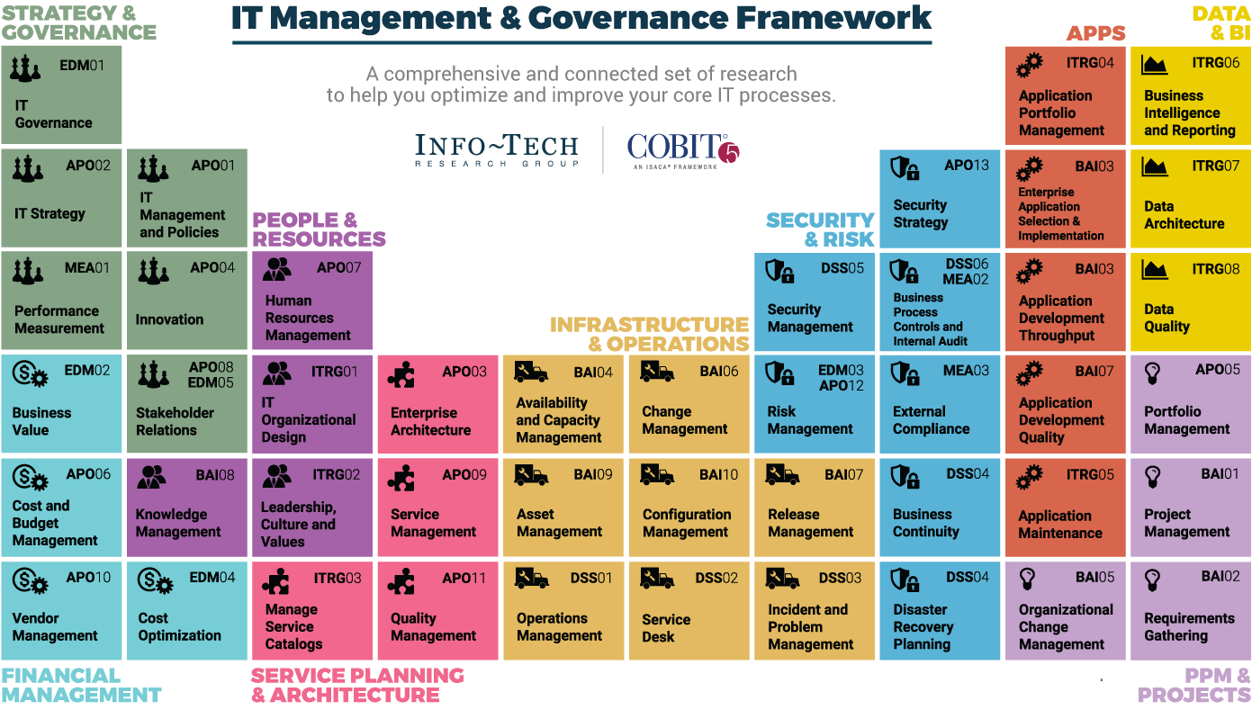
Dive Deeper Into Our Research
by Clicking One of the Elements Below
Find out how Info-Tech makes your job easier. Contact Us Today: Toll-Free (US & Canada): 1-888-670-8889
SAMPLE

