Slide 1
Define the Right Kind of PMO for IT and Your Organization
Focus on your organization’s needs to get value from your PMO.

Slide 2
ANALYST PERSPECTIVE
If your PMO isn’t doing it, then who is?
For some, it seems obvious that the project management office (PMO) is simply an office filled with project managers. Often, the PMO is administrative. Others would ask, “Who’s managing the portfolio?”
At the end of the day, whether or not your PMO manages projects is secondary. What does your company need? If you can’t answer that question, project management may not be enough. Who’s selecting the right projects? Who’s holding the sponsors accountable?
It’s not about frameworks and best practices. It’s time to get situational awareness of the company’s needs. Perhaps your PMO should manage some projects. This blueprint will help you figure out the rest.
Ugbad Farah, PMP,
Research Analyst, PMO Practice Info-Tech Research Group

Slide 3
Our understanding of the problem
PMO directors
CIOs
Project managers tasked with running, implementing, or restructuring a project management office
Understand the types of PMOs that are out there, along with Info-Tech’s recommended types.
Determine what functions your PMO needs to have based on organizational need.
Executives
Functional managers
Get clarity into who is doing what in the organization.

Slide 4
Executive summary
As PMO director, you serve many different stakeholders, each with a different perception of what the PMO should do and provide.
PMOs are often set up with weak mandates, enabling the differing opinions on what your PMO's role is to proliferate and cause confusion.
Organizations tend to spend as little as possible on services as a natural process. You need to, at the very least, fulfil the minimum requirements.
A successful PMO not only understands who its customers are, but also knows how to meet their needs.
Failing to fulfil the minimum requirements of your organization but prescribing maximum processes will result in a PMO that doesn’t meet your needs.
People start building a PMO without knowing what it is; they assume it’s an office of project managers but they’re not able to explain what that means to their organizations and what services they should provide.
People often take for granted that their PMO should be a project management office, when in fact project management discipline isn't what's causing their projects to suffer.
Get some situational awareness. Figure out what your current state is, including the functions that are being provided. Use this as a reference to understand and what your organization needs from a PMO.
Once you have established need, properly set up your PMO with:
A clear vision
An articulated reasoning for establishing it
An understanding of its goals and which challenges it sets to address
Define a PMO with functions that work for you based on the needs of your organization and the gaps in services. A “fit-for-purpose” PMO is the right kind of PMO for your organization.

Slide 5
A PMO may not simply be an office with project managers
There are many options for form and function when setting up or reconfiguring a PMO.
Project management offices are evolving and taking on activities that differ from company to company.
1930s: The US Air Corps creates a Project Office function to monitor aircraft development (probably the first record of the term being used).
1980s: The Project Office concept exported to construction and IT.
1990s: The PMO gains a lot of momentum with professional associations and project management certifications becoming recognized industry standards.
1915: Frederick Taylor introduces the PMO with the implementation of the scientific management method and the increase in the number and complexity of projects.
1950s: The US military starts developing complex missile systems. Each weapon system was composed of several sub-projects grouped together in system program offices (SPOs). This built the structures underlying the traditional PMO.

Slide 6
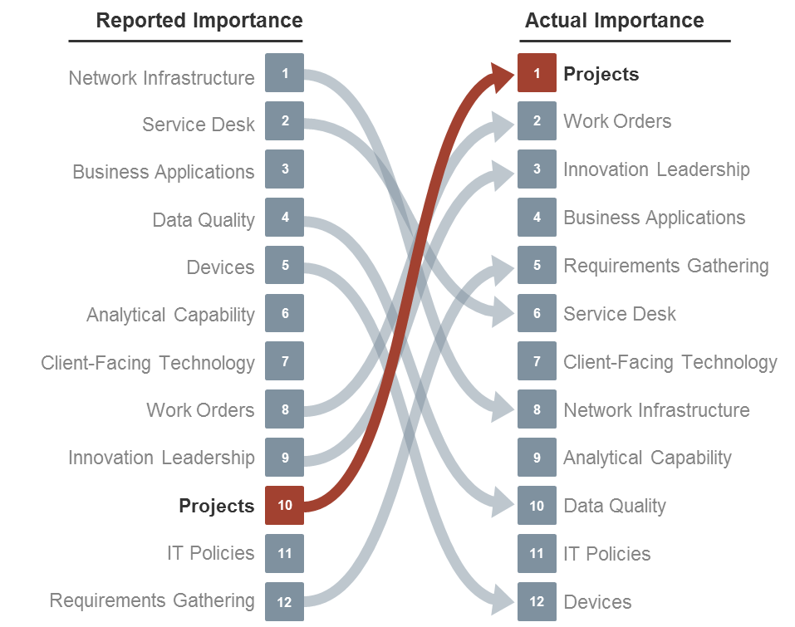
CIOs have underestimated the importance of their projects
Info-Tech’s CIO Business Vision Survey (N=21,367) identified IT project success and overall business as the number one driver of business satisfaction with IT.
CIOs rate projects lower in importance…
…but their customers say that IT projects are the biggest drivers of their satisfaction.

Slide 7
In an effort to set a standard, the governance frameworks have over complicated it for most of us
Organizations are confused about what a PMO is, whether they should have one, and
what it should do.
PMBOK | COBIT | OPM
The responsibilities of a PMO can range from providing project management support functions to the direct management of one or more projects. | The PMO can be responsible for portfolio maintenance, setting a standard approach for project, and program and portfolio management. | The PMO is an organizational body assigned with various responsibilities related to the centralized and coordinated management of those projects under its domain.
A PMO may make recommendations, lead knowledge transfer, and terminate projects.
The PMO may play a role in supporting strategic alignment and delivering organizational value Integrate data and information for organizational strategic projects and evaluate how higher-level strategic objectives are being fulfilled

Slide 8
PMOs can inadvertently get wrong, confusing, or inconsistent mandates
Often a lack of congruity is the reason PMOs fail to deliver results: they don’t “fit” in the organization. When there’s congruity, things fit together in a way that makes sense.
Do you know how much you’re spending on your PMO?
Does it have a job description?
Does it have a mandate?
Would senior leadership have a common understanding of what it does?
PMOs are often poorly structured with weak mandates and opaque views of resourcing. If you don’t build the right kind of PMO for your organization, you will get:
An office of project managers trying to address project pain points with project management methodologies.
An office that supplies templates and pushes paper work (overhead without any value).
This blueprint will provide a guide to building the right PMO for your organization. This research is organized into two phases. At the core of the research is the theme that time is better spent building an effective PMO than quickly setting up a “standard” one and wondering later why it was created in the first place.

Slide 9
Use Info-Tech’s framework to create the PMO that works for your organization
Use this blueprint to help develop your PMO’s mandate to address the organization’s unsatisfied needs.
Hierarchy of PMO Needs
PMO Services
PMO Mandate
Organizational Needs
Determine the Services Your PMO Will Provide
Manage your PMO services in alignment with your mandate and your organization’s needs.
Establish Your PMOs Mandate
Figure out the purpose of your PMO and write it down so it’s clear to your leadership. Align your mandate to the organization’s needs.
Ensure Organizational Needs Are Being Met
Before you can decide on what your PMO will do, find out who’s doing what in your organization so you can fill gaps instead of duplicating efforts.
Consider the principles of Maslow’s Hierarchy of Needs that view the lower tiers of the hierarchy as fundamentally required to validate the pursuit of the higher tiers.

Slide 10
Use these icons to help direct you as you navigate this research
Use these icons to help guide you through each step of the blueprint and direct you to content related to the recommended activities.
This icon denotes a slide where a supporting Info-Tech tool or template will help you perform the activity or step associated with the slide. Refer to the supporting tool or template to get the best results and proceed to the next step of the project.
This icon denotes a slide with an associated activity. The activity can be performed either as part of your project or with the support of Info-Tech team members, who will come onsite to facilitate a workshop for your organization.

Slide 11
Info-Tech offers various levels of support to best suit your needs
Guided Implementation
DIY Toolkit
Workshop
Consulting
“Our team has already made this critical project a priority, and we have the time and capability, but some guidance along the way would be helpful.”
“Our team knows that we need to fix a process, but we need assistance to determine where to focus. Some check-ins along the way would help keep us on track.”
“We need to hit the ground running and get this project kicked off immediately. Our team has the ability to take this over once we get a framework and strategy in place.”
“Our team does not have the time or the knowledge to take this project on. We need assistance through the entirety of this project.”
Diagnostics and consistent frameworks used throughout all four options

