Slide 1
Drive Digital Transformation With Platform Strategies
Innovate and transform your business models with a digital platform.

Slide 2
ANALYST PERSPECTIVE
Digital native enterprises have realized that building platforms is the key to beating the competition.
To remain relevant in times when disruption is around the corner, enterprises will need to think like digital native enterprises and embrace platform thinking. Moreover, they need to build platforms that enable speed, agility, and easy access to real-time data for analysis and decision making.
Arif Mustafa,
Director Research, CIO Advisory Info-Tech Research Group

Slide 3
Our understanding of the problem
Chief Digital Officer (CDO)
Chief Information Officer (CIO)
Head of Enterprise Architecture
Chief Architect
Business Architects
Understand platform thinking, business model, and strategies.
Understand the role of customers, suppliers, and platform providers.
Understand digital native enterprise design, structure, and platform building.
Understand underpinnings of modern platforms: business and technology perspectives.
Product Owners
Software Development Managers
Software Development Leads
Understand execution of digital transformation (DX) from a solution design and delivery perspective.
Understand microservices and streaming platforms.
Understand team organization, structure, and culture required for agility.

Slide 4
Executive summary
Organizations are struggling with the execution of digital strategy and are trying to understand how successful digital enterprises have the ability to be disruptive and scale agility.
Platform enterprises outperform other enterprises.
Successful digital enterprises build digital platforms and not a system of digitized processes.
Digital native enterprises are data-driven and leverage modern architectures (e.g. cloud native, microservices).
Legacy business models and systems do not scale, and instead hinder agility.
Enterprises are stuck with existing business models that don’t allow them to innovate or to re-invent the enterprise.
Lack of (near) real-time data slows down decision makers.
Organizations must think and act like digital native enterprises and make the strategic shift to platform thinking. Platform thinking entails enterprises refresh/renew their business models to platform business models and build digital platforms.
This blueprint helps with:
Understanding platform business models and strategies.
Aligning your DX themes with digital platform capabilities.
Designing foundations of digital platforms.

Slide 5
The platform business model outperforms other business models*
Sales growth (year over year)
25%
Business Models
20%
Asset Builders
Deliver value through the use of physical goods.
Examples: Ford, Marriot, Exxon
15%
10%
5%
Service Providers
Deliver value through skilled people.
Examples: Info-Tech, Accenture
Asset Builder
Service
Provider
Technology
Creator
Platform Provider
Gross profit margin
Technology Creators
Deliver value through technology and/or intellectual property they create (software, hardware, pharma, etc.).
Examples: Pfizer, IBM, Oracle
75%
50%
Platform Providers
Deliver value through interactions, content curation, value orchestration, networks, etc.
Examples: Amazon, Airbnb, Uber
25%
Asset Builder
Service
Provider
Technology
Creator
Platform Provider
*Adapted from “The Network Imperative,” 2016

Slide 6
Platform thinking leads to successful DX
Less Than One in Five
Companies are “very effective” with DX
A platform approach enables your enterprise to leverage a flexible, structured, and scalable foundation, while speeding development time, leveraging investments, and incorporating ‘long tail’ processes. A platform approach provides flexibility to embrace process changes and emerging capabilities along your transformation journey. And it makes your enterprise development process more predictable and repeatable, enabling faster time-to-market with lower risks.
– Dan Glessner, Vice President, Digital
18%
19%
63%
Source: Harvey Nash & KPMG, 2017

Slide 7
Platform dominance (1/2)
Platforms Dominate the Top Firms of the Digital Age
Ten Most Valuable Public Companies Founded Since 1994
Company | Platform Enterprise (Y/N) | Market Value, 9/5/15 (in billions) | Year Founded | Country
Google | Y | $425.40 | 1998 | United States
Facebook | Y | $248.30 | 2004 | United States
Amazon.com | Y | $235.70 | 1994 | United States
China Mobile | N | $232.63 | 1997 | China
Alibaba Group | Y | $167.00 | 1999 | China
Tencent Holdings | Y | $150.87 | 1998 | China
Sinopec | N | $73.62 | 1998 | China
Priceline Group | Y | $62.86 | 1994 | Unites States
Baidu | Y | $52.40 | 2000 | China
Salesforce.com | Y | $45.45 | 1999 | United States
* Adapted from “Build Platforms, Not Just Product,” 2016

Slide 8
Platform dominance (2/2)
Performance of Top 10 Weighted Stocks in the S&P 500
Company Name | Ticker | Percent Gain/Loss | Platform (Y/N): Example
Apple Inc. | AAPL | 9.38% | Y: (iTunes)
Microsoft Corp. | MSFT | 15.28% | Y: (Office 365)
Amazon.com Inc. | AMZN | 45.35% | Y: (AWS, Amazon Marketplace)
Facebook Inc. | FB | 10.12% | Y: (FB Social Platform)
Berkshire Hathaway | BRK.B | -5.84% | N
JP Morgan Chase & Co | JPM | -2.56% | N
Exxon Mobil Corp. | XOM | -1.09% | N
Alphabet Inc. C | GOOG | 6.62% | Y: (Android)
Alphabet Inc. A | GOOGL | 7.19%
Johnson & Johnson | JNJ | -13.15% | N
Top Performing Stocks in the S&P 500
In the first six months of 2018, Netflix Inc.’s (NFLX) [platform] share price more than doubled, gaining 103.91%, making it the highest performing stock on the S&P 500. Twitter (TWTR) [platform], with its stock soaring 81.88% in the same period, came next on the list.
Source: Investopedia, 2018

Slide 9
Enterprises that adopt a platform business model outperform other enterprises; digital platforms lead to successful DX
Business Model Innovation Through the Platform Business Model
DX and Digital Platform
1
2
Platform Business Model and Platform Strategies/
Platform Foundation and Evolution
Key Components of a Digital Platform
(Technology/Teams)
3
4

Slide 10
Spotify changed the way we listen to music
CASE STUDY
Industry
Source
Media: Music/Audio streaming
The Verge, 2019
Spotify
Spotify is a Swedish media services provider that was founded in 2006. The company's primary business is its audio streaming platform that provides DRM-protected music and podcasts from record labels and media companies.
Platform Enterprise
Spotify started as a P2P music streaming service and currently identifies as a discovery platform.
Spotify has been dominating platform enterprise in the music industry by continuously evolving through business model innovations, partnerships, and acquisitions. According to The Verge, as of April 2019, “More than 100 million users worldwide now pay for Spotify Premium.” Spotify’s latest acquisition of various podcast providers shows the company’s ambition is beyond just being a music streaming service.
This case study highlights platform strategies incorporated by Spotify and also sheds lights on how Spotify’s digital platform allows it continuously evolve and adapt. Moreover, the case study helps solidify the concepts covered in this blueprint.
Characteristics and Strategies of a Platform Enterprise
Approach
Platform Model
Canvas
1
5
Evolution
Value
Proposition
2
6
Platform
Configuration
Digital
Platform
3
7
Platform
Strategies
Characteristics
of a Platform Enterprise
4
8

Slide 11
Case study approach
CASE STUDY
Industry
Source
Media: Music/Audio streaming
Info-Tech analysis
Approach
1
To understand the strategies and characteristics of Spotify (a platform enterprise), we need to start by studying its evolution. In 2006 Spotify opened its first office in Stockholm, and by 2017 it was a mature platform enterprise integrated with other platforms and it had performed a number of strategic acquisitions.
The period from 2006 to 2017 is analyzed to understand, through major events and strategic moves, the platform configuration, characteristics, and strategies of a platform enterprise.
2
To understand the digital/technology platform, we have to analyze various articles and presentations given by Spotify’s leaders and employees.
To make points relevant and factual, in the case of user experience (UX) and API strategies the material is directly taken from the Spotify websites as-is. The advantage of such an approach is truth over speculation. For example, in the case of UX strategy, we can show the kind of roles and associated responsibilities to highlight the strategic intent of Spotify.

Slide 12
Evolution: events and strategies 2006-2009
(1 of 4)
CASE STUDY
Industry
Source
Media: Music/Audio streaming
Spotify Teardown, 2019
Analyzing Spotify’s history with spotlights on important/major events and associated strategies helps us understand how platform enterprises evolve over time – shedding light on growth, scalability, adaptability, partnerships, and integration with other platforms.
Period | Events | Strategic Moves
2006 | Spotify opened its first office at Riddargatan 20 in central Stockholm, where software development began in August 2006. | P2P file share software.
2007-2008 (Beta) | On May 1, 2007, Spotify released its first initial beta version to a small circle of acquaintances. | On-demand + Search: Free music, revenue generated through advertisement.
2008-2009 (The launch) | The first public version of Spotify was launched in October 2008. Spotify began expanding into new territories, i.e. Finland, France, Norway, Spain, Sweden, and the UK. | The launch marked the conjunction of two interdependent business deals. One deal granted Spotify access to music licenses, while the other gave it the money to pay for those licenses. This period ushered in the intersection of music and technology, advertising and finance. Spotify also started focusing on mobile.

Slide 13
Evolution: events and strategies 2009-2012
(2 of 4)
CASE STUDY
Industry
Source
Media: Music/Audio streaming
Spotify Teardown, 2019
Period | Events | Strategic Moves
Late 2009 | Great recession of 2009 created a steep downturn in the total market for advertising. In this context, it became difficult for Spotify to convince investors and license holders of advertising support as a main source of income. | Subscription model + product bundling + partnerships. Spotify partnered with telecom providers to bundle the Spotify service with telecom providers’ offerings.
2010-2011 | Spotify evolves the product to be more than an app. | Social + sharing + platform: product enhancements to be more like a social platform (personal profile within the app, add friends, and then drag-and-drop to share music) + integration with other (existing) platforms.
2011-2012 | Launches in the US (July 14, 2011) and expansion into Western Europe. In late 2011, Spotify also launched its app platform, inviting external developers to create new features to be offered within the client. | Integration-ready, open, and co-development. Platform recommendation features.

Slide 14
Evolution: events and strategies 2013-2017
(3 of 4)
CASE STUDY
Industry
Source
Media: Music/Audio streaming
Spotify Teardown, 2019
Period | Events | Strategic Moves
2013 | The first company acquired by Spotify was Tunigo in May of 2013. After the acquisition, Tunigo’s features were integrated into the Spotify client. | Curating music (as opposed to on-demand). Spotify changed its business strategy from its on-demand doctrine – the company gradually re-oriented itself toward providing not only access to music but also recommendations for music that users would not have requested themselves. Tungio’s functionality provided Spotify users with playlists based not only on genres but also on specific activities or moods.
2013-2015 | During the Spring of 2014, Spotify made its second acquisition: the music analysis firm Echo Nest. | Algorithmic recommendations. Shift from P2P to centralization (data center).
2015-2017 | Spotify acquired yet another music intelligence company: Seed Scientific. Increased focus on podcasts* | IoT: Spotify Running used the mobile phone’s sensors to synch/control music with the person’s movement. Unique music/experience provider.
*In 2019, Spotify acquired two podcasting companies: Gimlet Media and Anchor.
Source: Venture Beat, 2019

Slide 15
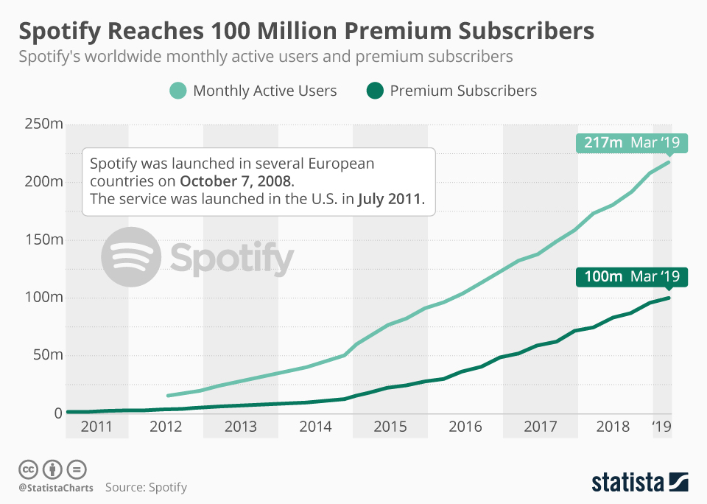
Evolution: 100 million subscribers
(4 of 4)
CASE STUDY
Industry
Source
Media: Music/Audio streaming
Statista, “Spotify Reaches 100 Million Premium
Subscribers,” 2019
Before Spotify’s launch, music streaming was still in its infancy, accounting for just 1 percent of global music revenues in 2007, but eventually, the company’s early bet on streaming would pay off.
As the following chart illustrates, it took a while for Spotify to really take off. By the time of its fifth birthday in 2013, Spotify had roughly 30 million active users and 8 million premium subscribers. In the five and a half years since, however, the service’s active user and premium subscriber numbers have skyrocketed, reaching 217 and 100 million, respectively, by the end of March 2019.
– Statista, “Spotify Reaches 100 Million Premium Subscribers”
Image source: Statista, “Spotify Reaches 100 Million Premium Subscribers”

Slide 16
Use this icon to help direct you as you navigate this research
Use this icon to help guide you through each step of the blueprint and direct you to content related to the recommended activities.
This icon denotes a slide with an associated activity. The activity can be performed either as part of your project or with the support of Info-Tech team members, who will come onsite to facilitate a workshop for your organization.

Slide 17
Info-Tech offers various levels of support to best suit your needs
Guided Implementation
DIY Toolkit
Workshop
Consulting
“Our team has already made this critical project a priority, and we have the time and capability, but some guidance along the way would be helpful.”
“Our team knows that we need to fix a process, but we need assistance to determine where to focus. Some check-ins along the way would help keep us on track.”
“We need to hit the ground running and get this project kicked off immediately. Our team has the ability to take this over once we get a framework and strategy in place.”
“Our team does not have the time or the knowledge to take this project on. We need assistance through the entirety of this project.”
Diagnostics and consistent frameworks used throughout all four options

Slide 18
Drive Digital Transformation With Platform Strategies – project overview
1. Set Goals for Your Platform Business Model
2. Configure Your Digital Platform
Best-Practice Toolkit | 1.1 Understand Four Dominant Business Models and the Assets They Leverage for Competitive Advantage 1.2 Understand Platform Model, Evaluate Various Platform Model Strategies, Select Platform Strategies 1.3 Discuss Two Enterprise Transformation Approaches and Agree on Approach for Your Enterprise 1.4 Document Platform Business Model Foundations and Evolution Key Questions and Develop a Roadmap | 2.1 Discuss, Agree on, and Document Digital Platform Design Goals 2.2 Define and Document DX Themes and Digital Platform Capabilities 2.3a. Define Architectural Components: UX, APIs, and Microservices 2.3b. Define Architectural Components: Stream Processing 2.4 Describe Team Structure, Culture, Principles, and Practices
Guided Implementations | Discuss the platform model and importance of platforms. Discuss various platform strategies. Discuss transformation approaches. Discuss key foundational and evolutionary questions for the platform business model. | Discuss design goals for enterprise digital platform. Discuss DX themes and platform capabilities and alignment between DX initiatives and platform enablement. Discuss digital platform components – understand the gaps. Discuss culture, structure, principles, and practices of successful platform engineering teams.
 | Phase 1 Outcomes: Understanding of current business model and key strengths: documented value proposition and core assets. Understanding of the platform model and strategies. Understanding of how enterprises are using two approaches for transformation: documented approach and next steps. Discussed and documented key strategic and evolutionary questions critical for the platform business model. Developed roadmap. | Phase 2 Outcomes: Documented design goals for digital platform. Documented link between DX themes and platform-enabling capabilities. Understanding of digital platform components: documented gap and transformation strategies. Understanding of digital platform teams: culture, structure, principles, and practices: documented gaps and strategies.

Slide 19
Workshop overview
Contact your account representative or email Workshops@InfoTech.com for more information.
 | Workshop Day 1 | Workshop Day 2 | Workshop Day 3 | Workshop Day 4
Activities | Understand Platform Business Model and Strategies 1.1 Understand predominant business models and identify existing business model, value proposition, and core assets. 1.2 Understand/discuss the platform business model: a. Platform thinking. b. Power of platforms. c. Anatomy of a platform: platform canvas interaction layer, business model layer, digital platform. d. Platform strategies: discuss in the context of your enterprise and select the ones that apply. | Planning for Platform Business Model 2.1 Discuss two transformational approaches. 2.2 Discuss fundamental questions on important aspects of the platform business model: a. Interaction layer. b. Business model layer: foundations c. Business model layer: evolution. 2.3 Develop strategic themes from fundamental questions and transformation tracks to plot roadmap. | Digital Platform Strategy 3.1 Discuss design goals for the Digital Platform 3.2 Discuss DX themes: a. Analyze DX Themes b. Analyze Platform capabilities c. Do gap analysis: capabilities vs platform capabilities required to enable DX. d. Align digital platform with DX roadmap. | Digital Platform Design: Key Components 4.1 UX/UI: discuss UX/UI strategy in the context of DX. 4.2 APIs: discuss API strategy in the context of DX. 4.3 Microservices: discuss architectural style, characteristics, constraints, and deployment models. 4.4 Real-time stream processing: discuss real-time stream processing. 4.5 Platform engineering teams: culture, structure, principles, and practices.
Deliverables | Documentation of current business model along with value proposition and key assets (that provide competitive advantage). Transformation narrative. Platform model canvas. Document the platform strategies in the context of the enterprise. | Documented decision on transformational approach and next steps. High-level strategic themes for platform business model and associated roadmap. | Documented design goals for digital platform. Documented DX themes and platform capabilities. DX themes and platform capabilities map. | Confirmation of UX/UI and API strategies. Microservices canvas. Real-time stream processing data pipeline and tool map. High-level architectural view.

