Slide 1
Build a Better Manager: Basic Management Skills
How to free up capacity to focus on your IT team.

Slide 2
ANALYST PERSPECTIVE
Managers are the connective fiber of your department. How are you supporting them?
Ninety-eight percent of managers say they need more training, but 93% of managers already receive some level of manager training. Unfortunately, the training typically provided, although copious, is not working. More of the same will never get you better outcomes.
How many times have you sat through training that was so long, you had no hope of implementing half of it?
How many times have you been taught best practices, with zero guidance on how to apply them?
To truly support our managers, we need to rethink manager training. Move from fulfilling an HR mandate to providing truly trainee-centric instruction. Teach only the right skills – no fluff – and encourage and enable their application in the day to day.
Jane Kouptsova,
Senior Consulting Analyst, CIO Practice Info-Tech Research Group

Slide 3
Our understanding of the problem
CIOs, department leads, and senior managers in charge of overseeing the training of first-time IT managers
Equip first-time IT managers with the fundamental skills necessary to tackle their new responsibilities
Easily apply a consistent training program throughout your department, increasing compliance
First-time IT managers
Acquire essential management skills and tactics for addressing the expectations of their new role
Develop a foundation of competencies on which to build more advanced leadership skills

Slide 4
Executive summary
IT departments often promote staff based on technical skill, resulting in new managers feeling unprepared for their new responsibilities in leading people. The success of your organization hinges on managers’ ability to lead their staff; by failing to equip new managers adequately, you are risking the productivity of your entire department.
When it comes to manager training, more is not more.
Attending training is not equal to being trained. Even good information is useless when it doesn’t get applied.
If your role hasn’t required you to use your training within 48 hours, you were not trained on the most relevant skills.
Good intentions don’t make a good manager. Will needs to be backed up by skill.
Despite the fact that $14 billion is spent annually on leadership training in the US alone (Freedman, 2016), only one in ten CIOs believe their department is very effective at leadership, culture and values (Info-Tech, 2019).
Training programs do not deliver results due to trainee overwhelm, ineffective skill development, and a lack of business alignment.
Use Info-Tech’s tactical, practical approach to management training to deliver training that:
Is specifically tailored to first-time IT managers.
Is designed around practical application of new skills.
Is aligned with your department’s business goals.
Equips your new managers with essential skills in the following key competencies:
Team management
People development
Self governance
This blueprint is part of a three-part series and specifically focuses on People Development.

Slide 5
Effective managers drive effective departments by engaging their teams
Engaged teams are:
Enterprise Effectiveness
52%
Department Effectiveness
more willing to innovate¹
Effective Managers
70%
People
more likely to be at the organization a year from now²
Self
57%
more likely to exceed their role’s expectations²
Team
Engaged teams are driven by managers:
70%
of team-level engagement is accounted for by managers³
¹McLean & Company; N=3,395; ²McLean & Company; N=5,902; ³Gallup, 2018

Slide 6
However, despite the criticality of their role, IT organizations are failing at supporting new managers
87%
Of middle managers wish they had more training when they were first promoted
98%
Of managers say they need more training
IT must take notice:
IT as an industry tends to promote staff on the basis of technical skill. As a result, new managers find themselves suddenly out of their comfort zone, tasked with leading teams using management skills they have not been trained in, and more often than not, having to learn on the job. This is further complicated because many new IT managers must go from a position of team member to leader, which can be a very complex transition.

Slide 7
The truth is, many organizations do try and provide some degree of manager training, it just is not effective
Fewer than one in ten CIOs believe their IT department is highly effective at leadership, culture and values.
99%
Of companies offer management training¹
93%
Of managers attend it¹
Yet…
$14 billion
Spent annually in the US on leadership training²
¹Good Manager, Bad Manager; ²Freedman, 2016
N=337 CIOs from Info-Tech’s Management & Governance Diagnostic

Slide 8
There are three key reasons why manager training fails
1. Information Overload
Seventy-five percent of managers report that their training was too long to remember or to apply in their day to day (Good Manager, Bad Manager). Trying to cover too much useful information results in overwhelm and does not deliver on key training objectives.
2. Limited Implementation
Thirty-three percent of managers find that their training had insufficient follow-up to help them apply it on the job (Good Manager, Bad Manager). Learning is only the beginning. The real results are obtained when learning is followed by practice, which turns new knowledge into reliable habits.
3. Lack of Departmental Alignment
Implementing training without a clear link to departmental and organizational objectives leaves you unable to clearly communicate its value, undermines your ability to secure buy-in from attendees and executives, and leaves you unable to verify that the training is actually improving departmental effectiveness.

Slide 9
Overcome those common training pitfalls with tactical solutions
MOVE FROM
TO
1. Information Overload
Timely, tailored topics
The more training managers attend, the less likely they are to apply any particular element of it. Combat trainee overwhelm by offering highly tactical, practical training that presents only the essential skills needed at the managers’ current stage of development.
2. Limited Implementation
Skills-focused framework
Many training programs end when the last manager walks out of the last training session. Ensure managers apply their new knowledge in the months and years after the training by relying on a research-based framework that supports long-term skill building.
3. Lack of Departmental Alignment
Outcome-based measurement
Setting organizational goals and accompanying metrics ahead of time enables you to communicate the value of the training to attendees and stakeholders, track whether the training is delivering a return on your investment, and course-correct if necessary.

Slide 10
This research combats common training challenges by focusing on building habits, not just learning ideas
Manager training is only useful if the skills it builds are implemented in the day-to-day.
Research supports three drivers of successful skill building from training:
Habits
Outcome
Measurement
Organizational
Support
The training modules include committing to implementing new skills on the job and scheduling opportunities for feedback.
Learning
Structure
Training activities are customizable, flexible, and accompanied by continuous learning self-evaluation.
Info-Tech’s methodology builds in activities that foster accountability and an attitude of continuous improvement
Personal
Commitment
Learning
When it comes to manager training, stop thinking about learning and start thinking about practice. In difficult situations, we fall back on habits, not theoretical knowledge. If a manager is only as good as their habits, we need to support them in translating knowledge into practice.

Slide 11
This research focuses on building good management habits in in order to drive enterprise success
Set up your first-time managers for success by leveraging Info-Tech’s training to focus on three key areas of management:
Managing people as a team
Managing people as individuals
Managing yourself as a developing leader
Each of these areas:
Is immediately important for a first-time manager
Includes practical, tactical skills that can be implemented quickly
Translates to departmental and organizational benefits
Enterprise Effectiveness
Department Effectiveness
People
Self
Effective Managers
Team
There is no such thing as “effective management training.” Various topics will be effective at different times for different roles. Delivering only the highest-impact learning at strategic points in your leadership development program will ensure the learning is retained and translates to results.

Slide 12
This blueprint is part two of a three-part series and will focus on the foundations of successful team management
This blueprint focuses on the essential skills necessary to develop people.
This blueprint can be used alone to kick-start your first-time managers’ team leadership skills or in conjunction with the team- and self-development modules for a well-rounded management primer.
This blueprint covers three key skills:
How to hold yourself and your direct reports accountable.
Tactical approaches to effective time management.
How to effectively delegate so tasks and goals are completed successfully.
Master Time
Delegate
Accountability
People
Conflict & Difficult Conversations
Your Role in the Organization
Your Role in Decisions
Self
Effective Managers
Communication
Feedback & Coaching
Performance Management
Team
This blueprint is not a replacement for formal leadership or management certification. It is designed as a practical, tactical, and foundational introduction to key management capabilities.

Slide 13
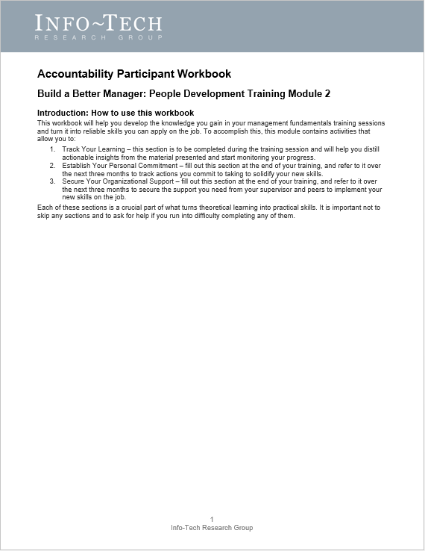
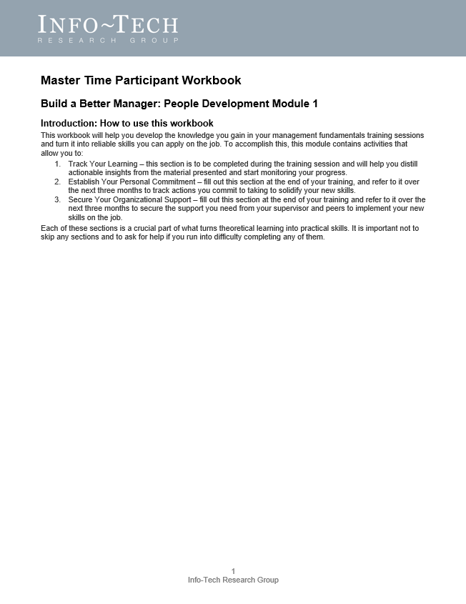
Info-Tech’s training tools guide participants through successful skill building
Practical facilitation guides equip you with the information, activities, and speaker’s notes necessary to deliver focused, tactical training to your management team.
The participant’s workbook guides trainees through applying the three drivers of skill building to solidify their training into habits.

Slide 14
Measure the effectiveness of your manager training with outcome-focused metrics
Linking manager training with measurable outcomes allows you to verify that the program is achieving the intended benefits, course-correct as needed, and secure buy-in from stakeholders and participants by articulating and documenting value.
Use the metrics suggested below to monitor your training program’s effectiveness at three key stages:
Program Metric | Calculation
Program enrolment and attendance | Attendance at each session / Total number enrolled in session
First-time manager (FTM) turnover rate | Turnover rate: Number of FTM departures / Total number of FTMs
FTM turnover cost | Number of departing FTMs this year * Cost of replacing an employee
Manager Effectiveness Metric | Calculation
Engagement scores of FTM’s direct reports | Use Info-Tech's Employee Engagement surveys to monitor scores
Departures as a result of poor management | Number of times “manager relationships” is selected as a reason for leaving on an exit survey / Total number of departures
Cost of departures due to poor management | Number of times “manager relationships” is selected as a reason for leaving on an exit survey * Cost associated with replacing an employee
Organizational Outcome Metric | Calculation
On-target delivery | % projects completed on-target = (Projects successfully completed on time and on budget / Total number of projects started) * 100
Business stakeholder satisfaction with IT | Use Info-Tech’s business satisfaction surveys to monitor scores
High performer turnover rate | Number of permanent, high-performing employee departures / Average number of permanent, high-performing employees

Slide 15
Use these icons to help direct you as you navigate this research
Use these icons to help guide you through each step of the blueprint and direct you to content related to the recommended activities.
This icon denotes a slide where a supporting Info-Tech tool or template will help you perform the activity or step associated with the slide. Refer to the supporting tool or template to get the best results and proceed to the next step of the project.
This icon denotes a slide with an associated activity. The activity can be performed either as part of your project or with the support of Info-Tech team members, who will come onsite to facilitate a workshop for your organization.

Slide 16
Info-Tech offers various levels of support to best suit your needs
Guided Implementation
DIY Toolkit
Workshop
Consulting
“Our team has already made this critical project a priority, and we have the time and capability, but some guidance along the way would be helpful.”
“Our team knows that we need to fix a process, but we need assistance to determine where to focus. Some check-ins along the way would help keep us on track.”
“We need to hit the ground running and get this project kicked off immediately. Our team has the ability to take this over once we get a framework and strategy in place.”
“Our team does not have the time or the knowledge to take this project on. We need assistance through the entirety of this project.”
Diagnostics and consistent frameworks used throughout all four options

Slide 17
Build a Better Manager: Basic Management Skills
1. Master Time
2. Accountability
Best-Practice Toolkit | 1.1 Prepare to deliver training 1.2 Deliver training 1.3 Review action plan | 2.1 Prepare to deliver training 2.2 Deliver training 2.3 Review action plan
Guided Implementations | Discuss need for training and training structure. Discuss facilitation plan and tackle challenges. Discuss long-term skill-building strategies. | Discuss need for training and training structure. Discuss facilitation plan and tackle challenges. Discuss long-term skill-building strategies.
Onsite Workshop | Module 1: Master Time | Module 2: Accountability
 | Phase 1 Outcome: Time management and delegation training delivered | Phase 2 Outcome: Accountability training delivered

Slide 18
Basic Management Skills workshop overview
Contact your account representative or email Workshops@InfoTech.com for more information.
 | Session 1 (half-day) | Session 2 (half-day)
Activities | Deliver Master Time Training 1.1 Master time manager training module: Know your ideal time mix Calendar diligence Effective delegation Limit interruptions | Deliver Accountability Training 2.1 Accountability manager training module Create clarity and transparency Articulate expectations and evaluations Help your team remove roadblocks Clearly introduce accountability to your team
Deliverables | Customized Master Time Facilitation Guide Completed Master Time Participant Workbook and action plan | Customized Accountability Facilitation Guide Completed Accountability Participant Workbook and action plan
This could be delivered over four days with each day having a different team complete the training.

Slide 19
Build a better manager workshop overview
Contact your account representative or email Workshops@InfoTech.com for more information.
 | Session 1 (full day) | Session 2 (full-day) | Session 3 (full-day) | Session 4 (full-day)
Activities | Deliver Self-Governance Training 1.1 Master Time manager training module 1.2 Accountability manager training module | Deliver People Development Training 2.1 Your Role in the Organization manager training module 2.2 Your Role in Decision Making manager training module | Deliver People Development & Team Essentials Training 2.3 Manage Conflict Constructively manager training module 3.1 Effective Communication manager training module | Deliver Team Essentials Training 3.2 Performance Management manager training module 3.3 Coaching & Feedback manager training module
Deliverables | Customized Master Time Facilitation Guide Completed Master Time Participant Workbook and action plan Customized Accountability Facilitation Guide Completed Accountability Participant Workbook and action plan | Customized Your Role in the Organization Facilitation Guide Completed Your Role in the Organization Participant Workbook and action plan Customized Your Role in Decision Making Facilitation Guide Completed Your Role in Decision Making Participant Workbook and action plan | Customized Manage Conflict Constructively Facilitation Guide Completed Manage Conflict Constructively Participant Workbook and action plan Customized Effective Communication Facilitation Guide Completed Effective Communication Participant Workbook and action plan | Customized Performance Management Facilitation Guide Completed Performance Management Participant Workbook and action plan Customized Coaching & Feedback Facilitation Guide Completed Coaching & Feedback Participant Workbook and action plan
These modules can be mixed and matched to create a customized experience for your team.

Slide 20
Works cited
Freedman, Erica. “How to Build an Internal Leadership Development Program.” Chief Executive, 2016. Web. Oct. 2016.
Gandhi, Vipula. “Want to Improve Productivity? Hire Better Managers.” Gallup, 3 Aug. 2018. Web.
Good Manager, Bad Manager. Grovo, 2016. Web.

