Slide 1
Own the Cloud: Strategy and Action Plan
Whether you move to the cloud or stay on premises, do it with confidence!
Info-Tech's products and services combine actionable insight and relevant advice with ready-to-use tools and templates that cover the full spectrum of IT concerns.© 1997-2018 Info-Tech Research Group

Slide 2
ANALYST PERSPECTIVE
You’ll find yourself in the cloud one way or another. Do it right.
The vast majority of organizations are experimenting with the cloud – and there’s certainly a case to be made for cloud adoption. But any effort to migrate to the cloud will be for nought without a well-defined, reasonable cloud strategy. A consistent framework for evaluating and implementing cloud services will demonstrate IT’s commitment to the shift to a service brokerage model.
The cloud has a defined set of characteristics, some of which it shares with non-cloud architectures. If your main justification for moving to the cloud is getting your infrastructure offsite, or reducing the amount of work you have to do on the back end, you might be better served by collocating your services or hiring a managed service provider.
Before moving to the cloud, clearly articulate the benefits of such a migration. You’ll be thankful you did.
Jeremy Roberts,
Senior Consulting Analyst, Infrastructure Practice Info-Tech Research Group

Slide 3
Our understanding of the problem
CIOs
Infrastructure managers
Enterprise architects
Cloud architects
Identify workloads that are good candidates for the cloud.
Outline and mitigate risks.
Develop a comprehensive cloud strategy.
Map initiatives on a roadmap.
Non-IT executives
IT administrators
Understand the reasons behind a cloud decision.
Differentiate between different cloud service and deployment models.

Slide 4
Executive summary
The cloud is more appealing than ever. According to RightScale, 95% of organizations are experimenting or running applications in Infrastructure-as-a-Service.
As pervasive as the cloud is today, its reach is only growing. By 2020, cloud is projected to be the default business deployment model (Gartner).
You shouldn’t move a workload to the cloud unless you expect to benefit from cloud-specific features. If your justification for the migration is “it won’t be here anymore,” think again.
Clouds have different benefits – align your workload to the right one. Host with IaaS; build with PaaS; consume with SaaS.
The cloud changes roles it doesn’t eliminate them. Even if you stick everything in SaaS, you’ll need someone to manage vendor relationships.
Cloud strategies (where they do exist) are incomplete. They lack focus on changes in responsibility for staff, governance, and financial controls.
According to Softchoice, 52% of organizations lacked a cloud strategy for 2017. Not all cloud options are created equal, and picking the wrong one can erode any benefit.
Creating and employing a comprehensive framework for evaluating workloads’ suitability for the cloud using Info-Tech’s methodology will allow you to select optimal cloud service models (or colocation, on-premises, or managed solutions) and provide high-quality service that end users expect from IT.
Codify risks tied to workloads’ cloud suitability, and tie them to mitigations that can be employed to improve the likelihood of a successful cloud project.
Design a cloud strategy to ensure that any cloud migration initiatives are successful in terms of governance, monitoring and reporting, financial controls, success factors, focus, people, and processes.
Develop a roadmap populated with detailed initiatives related to the outcome of the workload evaluation activity, the risk and mitigation exercise, and the components of the cloud strategy document.

Slide 5
What is the cloud, how is it deployed, and how is service provided? (Definitions from NIST)
Cloud characteristics
On-demand self-service: the ability to access resources instantly without vendor interaction.
Broad network access: all services delivered over the network.
Resource pooling: multi-tenant environment (shared).
Rapid elasticity: expand and retract capabilities as needed.
Measured service: transparent metering.
Service model
Software-as-a-Service: all but the most minor configuration is done by the vendor.
Platform-as-a-Service: customer builds the application using tools provided by the provider.
Infrastructure-as-a-Service: the customer manages OS, storage, and the application.
Delivery model
Public cloud: accessible to anyone over the internet; multi-tenant environment.
Private cloud: provisioned for a single organization with multiple units.
Hybrid cloud: two or more connected clouds; data is portable across them.
Community cloud: provisioned for a specific group of organizations.
For more information on these definitions see The NIST Definition of Cloud Computing at the National Institute of Standards in Technology.

Slide 6
Develop a strategy to align your needs with the appropriate cloud (or non-cloud) solution
Service Model
Example
Function
Software-as-a-Service
Salesforce.com
Office 365
Workday
Consume
Platform-as-a-Service
Azure Stack
Amazon Platforms
WordPress
Build
Infrastructure-as-a-Service
Microsoft Azure
Amazon EC2
Google Cloud Platform
Host
If an application you wish to put in the cloud is proprietary it cannot, by definition, be delivered as a SaaS, since that would require another organization to build and provision it.

Slide 7
Align your needs to a service delivery solution
A workload-first approach will allow you to take full advantage of the cloud’s strengths.
Under all but the most exceptional circumstances good cloud strategies will incorporate different service models. Very few organizations are “IaaS shops” or “SaaS shops,” even if they lean heavily in a one direction.
These different service models (including non-cloud options like colocation and on-premises infrastructure) each have different strengths. Part of your cloud strategy should involve determining which of the services makes the most sense for you.
Own the cloud by understanding which cloud (or non-cloud!) offering makes the most sense for you, given your unique context.
SaaS
Useful when the organization is consuming an off-the-shelf service that does not differentiate it.
PaaS
Ideal for developers who want to focus on building out an organization’s key product.
IaaS
Have to host some virtual machines in the cloud tomorrow? IaaS is your friend. It offers control.
Colocation
If your mandate is to transition IT from “here” to “not here,” a colocation site might be just the ticket.
On-premises
Ol’ reliable: if you’ve got everything you need, really sensitive data, or operate at a massive scale, that is.

Slide 8
What are your responsibilities based on different cloud/non-cloud service models?
Responsibility vs. “Cloudification”
On-premises
Meets the NIST cloud definition
Colo
Traditional architecture
The service models are not necessarily discrete; managed infrastructure services can include managed IaaS or even PaaS.
Responsibility
IaaS
PaaS
SaaS
“Cloudification”
Managed service providers (MSPs) can work with any of the other service models. The case for taking the MSP route is less about the nature of the technology underpinning a particular service model and more about your particular outsourcing needs. This is why MSP is not captured here.

Slide 9
Delivery models, too, have different strengths – pick the one that’s right for you
Public cloud
Potentially infinite scalability
Vendor management of facilities
Scale begets good value
Private cloud
Control over existing infrastructure while still being scalable
Resource pooling for efficiency
Ability to take advantage of on-premises infrastructure
Hybrid cloud
Dynamic bursting across clouds
Most fully capitalize on the cloud’s elasticity
Allows leveraging of existing infrastructure
Community cloud
Similar organizations can capitalize on their similar needs
Secure, certified environments
Still able to capture economies of scale
Though it’s been touted as the future, the hybrid cloud is only recently becoming “real.” With VMware on AWS, and Microsoft’s Azure Stack recently released, dynamic movement across workloads is possible. This has not historically been the case.

Slide 10
Moving to the cloud is a risky proposition (occasionally)
Is it legal to store my data in Redmond?
Can I meet my agreed-upon SLAs if I move to the cloud?
Can my cloud provider put important documents under legal hold?
How much availability can my vendor offer?
Data criticality
Security and compliance
Skills and roles
Availability and reliability
Do I have anyone on staff who knows how to handle vendors?
Do I have a big enough pipe to handle cloud traffic?
Integration
Enabling infrastructure
Can my staff handle the change in the required skills?
Will moving to SaaS break my calendar integration?

Slide 11
Developing a plan to optimize your cloud experience is an essential part of the cloud strategy document
An effective cloud strategy comprises the following seven categories, some of which are higher priority and different in maturity (Ruparelia, 2016).
Focus: the extent of cloud alignment with business needs.
Success factors: extent to which standards of interoperability are established.
People: skills and roles necessary to ensure cloud success.
Processes: extent to which cloud is integrated into business processes.
Monitoring/reporting: effectiveness of metric creation/tracking.
Governance: the degree of codification of ownership of cloud across business units.
Financial control: effectiveness of the rules surrounding budgeting for the cloud.
Maturity level
Less mature
More mature
Performed
Defined
Managed
Adapted
Optimized
Use Info-Tech’s tools and templates to evaluate your current state, define a future state, and create a list of initiatives to help you get there.

Slide 12
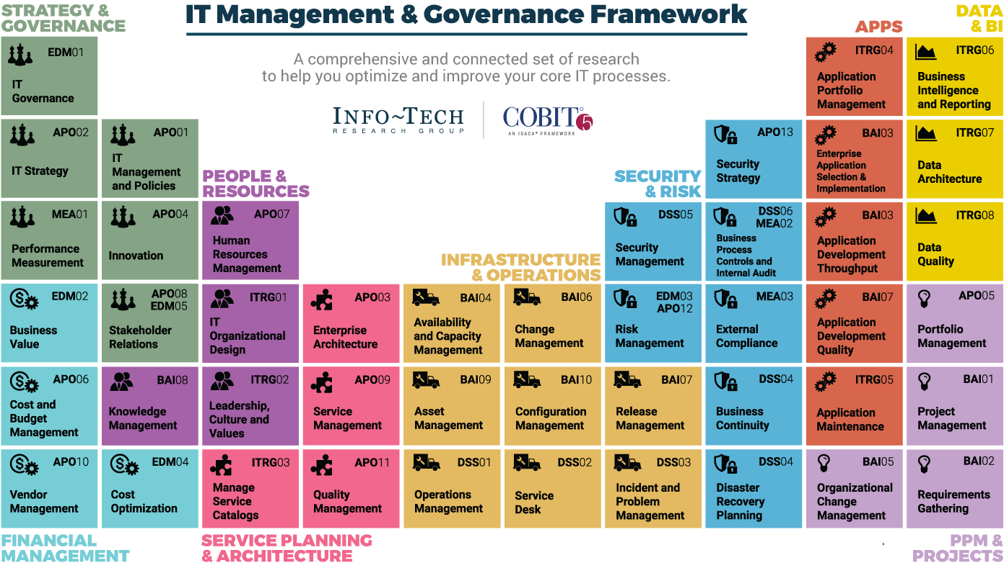
Dive Deeper Into Our Research
by Clicking One of the Elements Below
Find out how Info-Tech makes your job easier. Contact Us Today: Toll-Free (US & Canada): 1-888-670-8889

