Slide 1
Ensure Cloud Security in IaaS, PaaS, and SaaS Environments
Keep your information security risks manageable when leveraging the benefits of cloud computing.
Info-Tech's products and services combine actionable insight and relevant advice with ready-to-use tools and templates that cover the full spectrum of IT concerns.© 1997-2019 Info-Tech Research Group

Slide 2
Our understanding of the problem
CISOs
Security directors and managers
Project managers
Identify the cloud risk profile and security control gaps that must be covered.
Ensure the organization’s cloud environment is secured and protected from data leaks and breaches. Ensure privacy of data and other information is maintained.
Leverage the security capabilities from cloud vendors.
Vendor management
Security architects
Business managers
Factor security’s needs into the contract with a cloud service provider (CSP).
Address security’s needs in the project plan for configuration of the software and for supporting technology.
Put an ongoing program in place to manage the CSPs and monitor security controls.
Info-Tech Research Group
SAMPLE

Slide 3
Executive summary
Cloud environments, such as infrastructure as a service (IaaS), platform as a service (PaaS), or software as a service (SaaS) offer major IT and business benefits that organizations are looking to realize.
An organization has decided to migrate some part of the business into a cloud environment. This is being done for numerous cloud rationales.
Security perception. The cloud can be secure despite unique security threats.
Balancing act. Securing a cloud environment is a balancing act of who is responsible for meeting specific security requirements.
Structured CSP selection process. Most security challenges and concerns can be minimized through our structured process (CAGI) of selecting a trusted CSP partner.
Security remains a large impediment to realizing cloud benefits. Numerous concerns still exist around the ability for data privacy, confidentiality, and integrity to be maintained in a cloud environment.
Even if adoption is agreed upon, it becomes hard to evaluate vendors that have strong security offerings and even harder to utilize security controls that are internally deployed in the cloud environment.
The business is adopting a cloud environment and it must be secured, which includes:
Ensuring business data cannot be leaked or stolen.
Maintaining privacy of data and other information.
Securing the network connection points.
Determine the balancing act between yourself and your CSP; through contractual and configuration requirements, determine what security requirements your CSP can meet and cover the rest through internal deployment.
This blueprint and associated tools are scalable for all types of organizations within various industry sectors.
Info-Tech Research Group
SAMPLE

Slide 4
Cloud adoption today presents serious and unique security risks
Cloud Security Alliance Treacherous Twelve Cloud Security Risks
Data Breaches | Sensitive or valuable data falling into the control of either malicious attackers or competitors. | Cloud Abuse | Attackers can use cloud networks’ increased computational powers for various malicious activities.
2. Data Loss | The possibility of seeing valuable data disappear without a trace. | Insufficient Due Diligence | Lack of understanding of the cloud environment poses huge risk of various cloud vulnerabilities.
Credential Hijacking | Attacker gaining access to credentials for malicious intent. | Shared Technology | One vulnerability or misconfiguration can compromise all data hosted on shared infrastructure.
Insecure Interfaces and APIs | Attackers can discover vulnerabilities within the scripts of interfaces and APIs managing interfaces. | Advanced Persistent Threats | These malicious programs hide within systems for long periods of time, even in motion as they move laterally through the network.
Denial of Service | DOS attacks can make cloud programs unavailable, potentially bringing business to a standstill. | System and Application Vulnerabilities | Vulnerabilities can exist within software that allow unauthorized users to steal information or to disrupt operations.
Malicious Insiders | Angry or frustrated insiders of a CSP may have access to a network, system, or data. | Poor Identity and Access Management | A lack of identity and access management could allow insider threats or hijacked credentials unauthorized access to data.
General perceptions around cloud security are an aggregate of specific concerns. The ability to vet those out may disperse some perceived concerns in lieu of the truth: the cloud can be secure.
Info-Tech Research Group
SAMPLE

Slide 5
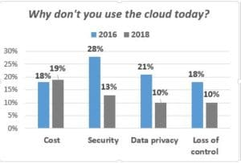
But security risks should not prevent you from adopting the cloud
In 2016, Unitrends conducted a survey of over 800 IT professionals about cloud usage habits, and then ran it again in 2018.
In 2016, only 48% of respondents stated that they were leveraging the cloud.
By 2018, this percentage had risen to 72%.
The popular perception that the cloud is inherently insecure is wrong. It seems to imply this relationship with the cloud is untrustworthy or higher risk.
– Wade Baker, Managing Principal of Research and Intelligence at Verizon
Source: Computerworld, 2014
Source: Unitrends, 2019
Security remains one of the biggest concerns, despite a significant decline seen between 2016 and 2018.
Most concerns with cloud are a composite of several individual concerns such as uncertainty or lack of control. Cloud computing can actually mitigate several of these concerns.
Providers put many resources into mitigating security concerns, as security is the major obstacle for many consumers of the cloud.
Many of the security and privacy concerns raised by cloud computing have existed since the first forms of IT outsourcing were introduced. These challenges should be seen as variants on previously existing issues rather than totally new ones. The security requirements that enterprises have today can be met. Through deployment and contractual options, the cloud can be secured.
Info-Tech Research Group
SAMPLE

Slide 6
A CSP can sometimes provide more mature security offerings than what is possible internally
The levels of security and privacy that are achieved in house are often no higher than those achieved by cloud services.
CSPs typically have more resources to assign to security design and monitoring than a single customer does.
CSPs have a strong business case for good security since a breach could undermine their entire business.
Since security is a “hot button” issue, many CSPs overcompensate for security risks, sometimes dedicating entire security teams to monitoring the system.
Improve Compliance
Mature Security Controls
Cloud has the potential to improve transparency and assurance through its more centralized and consolidated management platforms.
Providers can deliver first-day compliant solutions, so firms are able to enter markets and take actions that would have been cost-prohibitive in a pre-cloud era.
Compliance can be partly addressed through contractual delegation, allowing reluctant IT operations to be ready to adopt a cloud model.
Dedicated security team from the CSP.
Real-time detection of system tampering.
Greater investment in security infrastructure.
Data fragmentation and dispersal.
Fault tolerance and reliability.
Greater resiliency.
Hypervisor protection against network attacks.
There Are Four Layers of Security That Vendors Use to Secure Customer Data:
Site security – How the physical data center facility is secured, as well as backup and disaster recovery capabilities.
Communication security – How data is transmitted and secured, as well as how the network is monitored for signs of intrusion and/or vulnerability.
Application security – How the server is monitored for signs of intrusion and/or vulnerability, which roles can access which processes, which users can access which data, etc.
Database security – How data is stored and secured.
Balancing Act
When you see this icon, it means you need to balance!
Info-Tech Research Group
SAMPLE

Slide 7
This blueprint guides you through our approach to securing IaaS, PaaS, and SaaS environments
Cloud services include IaaS, PaaS, and SaaS. Cloud services can be accessed across any one of these models.
In-House
Co-Lo
MSP
IaaS
PaaS
SaaS
Application
Application
Application
Application
Application
Application
Database
Database
Database
Database
Database
Database
Runtime/ Middleware
Runtime/ Middleware
Runtime/ Middleware
Runtime/ Middleware
Runtime/ Middleware
Runtime/ Middleware
OS
OS
OS
OS
OS
OS
Hypervisor
Hypervisor
Hypervisor
Hypervisor
Hypervisor
Hypervisor
Server, Network, Storage
Server, Network, Storage
Server, Network, Storage
Server, Network, Storage
Server, Network, Storage
Server, Network, Storage
Facilities
Facilities
Facilities
Facilities
Facilities
Facilities
Organization has control
Organization or vendor may control
Vendor has control
Info-Tech Research Group
SAMPLE

Slide 8
IaaS and PaaS, although different, can be secured through a similar process
PaaS
IaaS
PaaS are used for applications and other development while providing cloud components to software.
What developers gain with PaaS is a framework they can build upon to develop or customize applications.
Applications using PaaS inherit cloud characteristics, such as scalability, high availability, multi-tenancy, and more.
The primary focus of this model is on protecting data.
An important element within PaaS is the ability to plan for an outage from a cloud provider. The security operation needs to consider providing for the ability to load balance across providers to ensure fail over of services in the event of an outage.
Consumers are responsible for managing the data protection, managing the application, and providing security controls for those areas.
IaaS are self-service models for accessing, monitoring, and managing remote data center infrastructures, such as compute (virtualized or bare metal), storage, networking, and networking services (e.g. firewalls).
Instead of having to purchase hardware outright, users can purchase IaaS based on consumption.
With this model, the focus is on managing virtual machines.
The CSO’s priority is to overlay a governance framework to enable the organization to put controls in place regarding how virtual machines are created and spun down.
Consumers are responsible for managing applications, data, runtime, middleware, and OSes. Providers still manage virtualization, servers, hard drives, storage, and networking.
Info-Tech Research Group
SAMPLE

Slide 9
SaaS must be secured very differently than IaaS and PaaS
SaaS is secured through:
General contract negotiation to ensure all required security controls are in place by the vendor, control and vendor auditing to provide visibility and transparency, and interoperability of the SaaS program.
IaaS and PaaS are secured through:
Delegating security control responsibility to either the vendor or consumer, auditing those controls to provide visibility and transparency, and ensuring interoperability of your hosted environment.
With a SaaS program, the vendor deploys and manages most of the security controls, resulting in a major emphasis on determining what you need, getting that from the vendor, verifying it, and maintaining it.
With IaaS and PaaS, you have significantly more control and responsibility to secure the cloud environment on your own, placing much of the fulfillment of the security requirements on your organization.
The primary focus of this model is on vendor relationships and vendor auditing.
Although technical capabilities to secure a SaaS program are still limited, consumers are gaining negotiating power when determining required security controls.
Consumers are only responsible for managing the vendor, and perhaps the application, depending on the scenario.
Cloud Consumer
Application Layer
SaaS
SaaS
PaaS
IaaS
PaaS
Middleware Layer
IaaS
With increased control comes increased responsibility. Organizations must readily adopt the auditor role of their providers to ensure security requirements are being met.
Operating System Layer
Cloud Provider
Info-Tech Research Group
SAMPLE

Slide 10
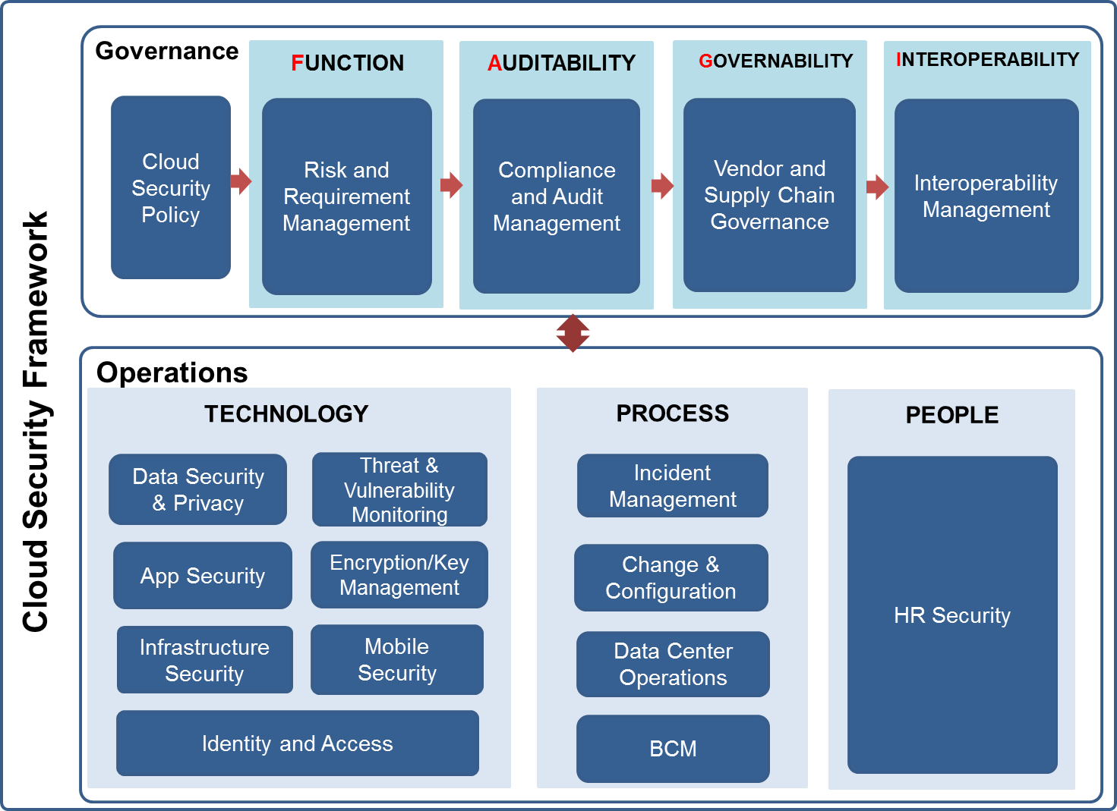
The Info-Tech Cloud Security Framework
Info-Tech Research Group
SAMPLE

Slide 11
Use Info-Tech resources to help your organization realize the full range of cloud benefits
The Main Value of a Secure Cloud Environment Is the Ability to Take Advantage of the Cloud Benefits:
Cost savings – The ability to shift capital expenditures to operational expenses as well as general reduced and/or re-allocated costs can be realized.
Economies of scale – The cloud levels the playing field and puts enterprise IT performance within reach for small to mid-sized enterprises.
Rapid flexibility – The ability to scale service depending on demand and the changing business requirements.
Service bottlenecks – High traffic periods usually result in cramped capacity in-house, but cloud services can be dialed up to meet needs on demand.
Improved security and compliance – Often many SaaS providers will increase the level of security placed on an organization’s data and meet regulatory requirements.
Measurement of IT – Adopting a public SaaS can often place measurable metrics on performance, uptime, and other IT-based areas that would otherwise not be measured internally.
What We Help You With:
Realizing full cloud value by ensuring that the contract with your provider and its associated service level agreement (SLA) has the appropriate provisions for security and privacy.
Determining if your CSPs have the required security certifications, as this is the responsibility of the consumer.
Communicating the division of security responsibilities between yourself and the provider and ensuring that your responsibilities are handled appropriately when using cloud computing services.
Making sure you don’t overreact. Our practical guidance in this area should be used to avoid overreaction and paralysis, which often result from overblown cloud security concerns.
For more information, see Info-Tech’s Define Your Cloud Vision blueprint.
Info-Tech Research Group
SAMPLE

Slide 12
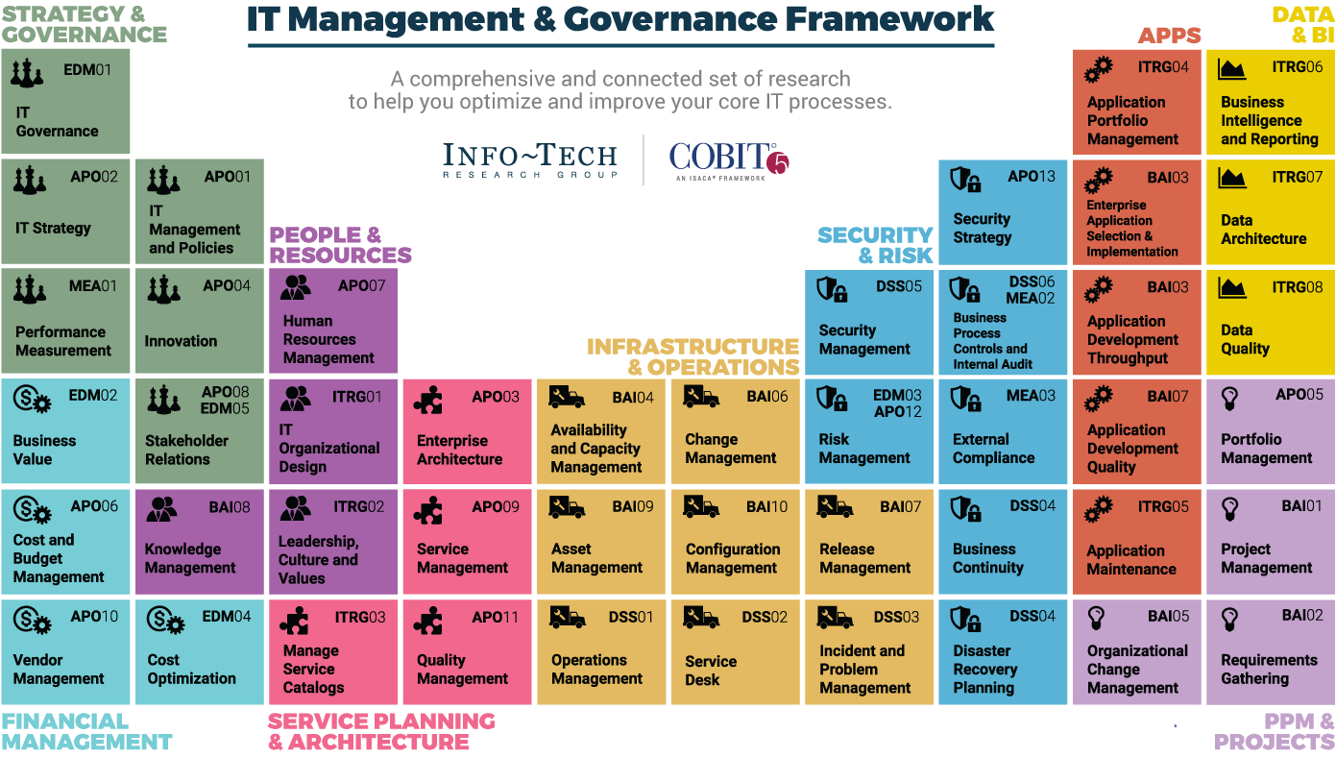
Dive Deeper Into Our Research
by Clicking One of the Elements Below
Find out how Info-Tech makes your job easier. Contact Us Today: Toll-Free (US & Canada): 1-888-670-8889
Info-Tech Research Group
SAMPLE

