Slide 1
Build a Service Support Strategy
Get service support and the business on the same page.
Info-Tech's products and services combine actionable insight and relevant advice with ready-to-use tools and templates that cover the full spectrum of IT concerns.© 1997-2019 Info-Tech Research Group

Slide 2
ANALYST PERSPECTIVE
The so-called demise of IT has caused much hand-wringing lately. Cloud, BYOD, consumerization: all trends point to a shift in the traditional role of internal IT departments. Many are becoming hybrids, focused as much on vendor management as on traditional service provision.
Where does that leave service support?
As long as technology continues to develop, there will be a need for people to sort out complex, time-consuming issues. These are not necessarily limited to recovering from incidents when things go wrong; they also include getting to the incidents’ root causes, fulfilling requests, and rolling out changes and releases.
The strategic direction of your service desk will depend in part on the complexity of your organization, and the convenience and quality of the service it provides.
Michel Hebert, PhD
Director, Infrastructure & Operations Practice Info-Tech Research Group
SAMPLE
Notes:
Optional to cover or not.

Slide 3
Executive summary
Situation
Service desks are evolving to reflect social and organizational changes. As organizations become ever more technologically complex, service desks have become highly skilled business technology service hubs. Increasingly, service desks are measuring the performance of technology services and acting as the dashboard for assessing the success of service operations.
Complication
There is a growing demand for service desks to demonstrate greater business value. Services desks that cannot deliver and communicate their contribution to the organization are closing or being outsourced.
Resolution
Articulating a clear service support strategy that aligns with business objectives is the most important activity an infrastructure leader can do for the IT department and the organization. The key is to identify the business capabilities required to execute the corporate strategy. Supporting these business capabilities will drive the service support strategy and focus the service desk’s efforts on achieving the strategic goals of the organization. Ultimately, the success of your service support strategy will hinge on whether you know your business goals and challenges, connect them to meaningful initiatives, and identify service support process owners accountable for specific roles and responsibilities.
SAMPLE

Slide 4
Use this research to formalize your service support strategy
Intended Audience
IT departments who are ready to move out of firefighting mode and plan a strategic direction for service support. IT leaders who need a strategic plan to implement a new service desk or improve an existing one. IT departments who need an efficient way to analyze different options, including changes to structures, processes, or outsourcing relationships. Mature IT departments looking to adapt service support to new environments.
This Research Includes
Service desk maturity assessment SWOT analysis Goals cascade Implementation and accountability roadmap
Expected Benefits
Long-term funding for multiyear initiatives Greater alignment between IT, the service support function, and the business
WALK AWAY FROM THIS BLUEPRINT WITH:
The critical steps and key players in the service support strategic planning process.
A clear understanding of the business expectations for service support.
Effective short-term and long-term service support strategies.
1
2
3
SAMPLE

Slide 5
Is this research right for you?
Research Navigation
A service support strategy will ensure the service support function creates value for the business. Use these questions to find the Info-Tech resources that best align with the outcomes you want to achieve..
Do you need to | If you answered yes | We also recommend
Build a strategy to meet service support requirements? | Follow the guidance in this blueprint. | Consider launching Info-Tech’s CIO Business Vision diagnostic.
Improve basic service desk processes? | Review Info-Tech’s blueprint Standardize the Service Desk and Build a Continual Improvement Plan for the Service Desk. | Consider launching Info-Tech’s End User Satisfaction Program.
Map requirements and design an RFP to outsource the service desk? | Review Outsource the Service Desk.
Map the dependencies between service management processes to plan an implementation? | Review Create a Service Management Roadmap | Consider launching Info-Tech’s IT Management & Governance Diagnostic.
Define the internal and external factors affecting the business to formalize your IT strategy? | Review Build an IT Strategy for the Small Enterprise or Rapidly Develop a Visual IT Strategy. | Consider launching Info-Tech’s CIO Business Vision diagnostic.
SAMPLE

Slide 6
Table of contents
STREAMLINE YOUR SEARCH
Use these navigation shortcuts to find the guidance that best aligns with your strategic needs.
Phase 1: Design Target State
Review service support trends
Document IT vision, mission, and principles
Define the scope of business requirements
Determine goals and capabilities
Phase 2: Assess Current State
Identify CSFs and KPIs
Define the structure of service support
Define the structure of the service desk
Perform service desk maturity assessment
Assess diagnostic results
Identify service support challenges
Perform a SWOT analysis
Identify key areas for improvement
Document in-flight service support initiatives
Document current service support capabilities
Phase 3: Develop Recommendations
Perform a gap analysis for service support capabilities
Identify key initiatives to bridge the gap
Connect initiatives to capabilities and goals
Create profiles for each initiative
Use a Service Support Strategy Roadmap to sequence initiatives
Create a communication plan
Looking for quick assessment of service desk maturity? Conduct an assessment in Activity 2.2.4.
Need to gain executive buy-in for service support improvement projects? Draft a Lean Canvas in Activity 3.2.1.
Need to review strategy trends in service support? Work through Step 1.1.
Want to create metrics to measure service support performance? Review critical success factors and key performance indicators in Step 2.1.
SAMPLE

Slide 7
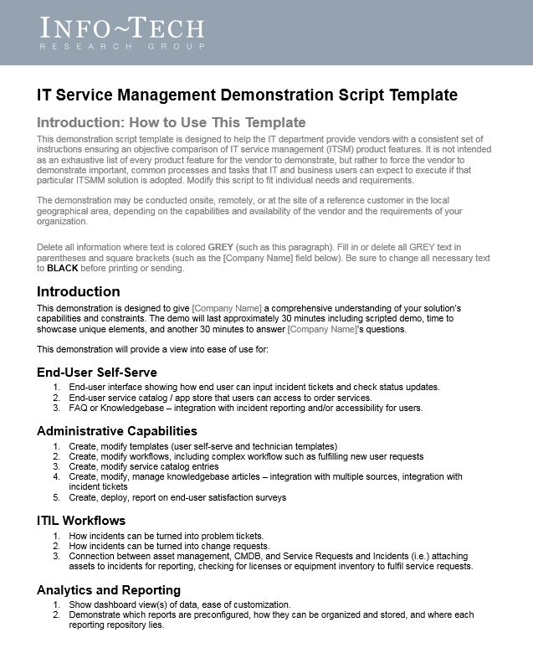
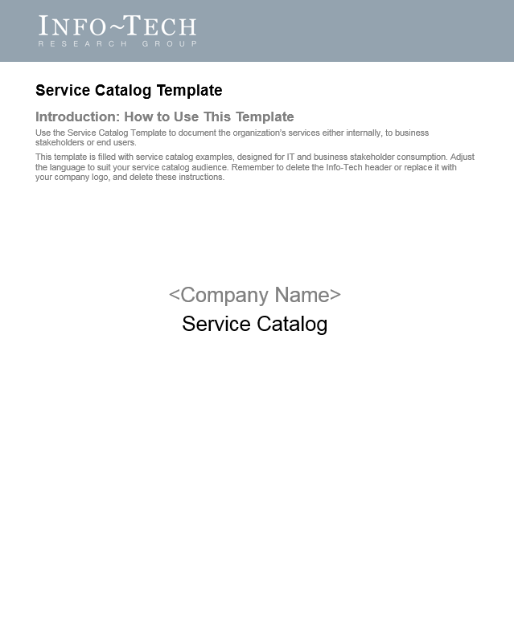
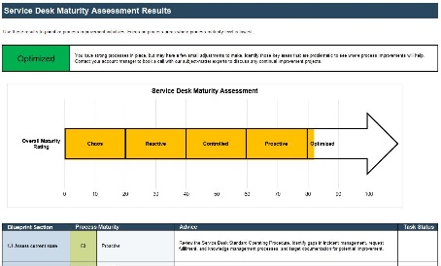
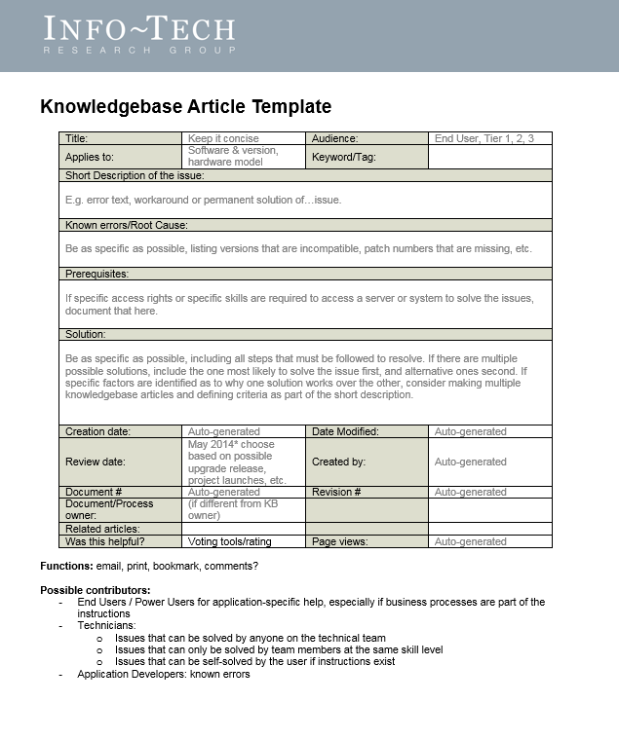
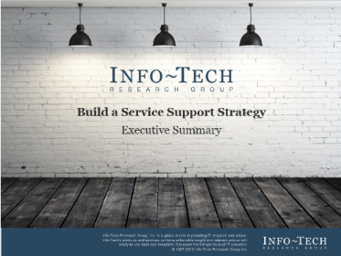
Use the project tools and templates to build key deliverables and accelerate your project
Service Desk
Maturity Assessment
SWOT Analysis
Service Support Strategy Worksheet
Service Support Strategy Examples
IT Vision, Mission, Guiding Principles, and Implications
Executive Presentation
SAMPLE

Slide 8
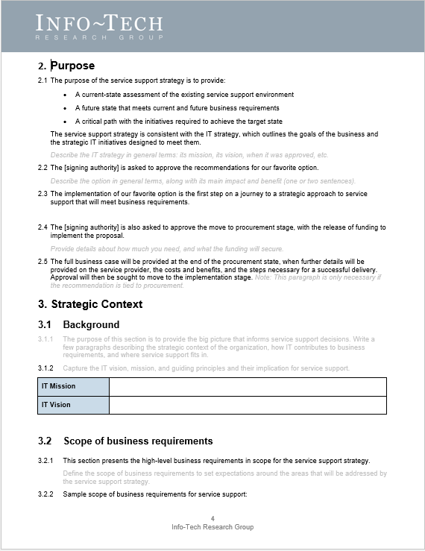
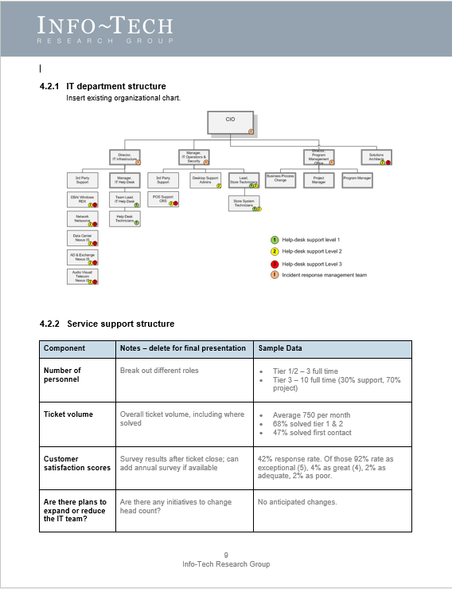
The project’s key deliverable is a service support strategy
Info-Tech’s Service Support Strategy Worksheet can be customized to reflect your processes and organization and will help you:
Document your organization’s support requirements.
Outline existing service support structure, process, and performance.
Define strategic goals and objectives.
Identify the nature, type, and size of the target service desk.
Identify implementation items, risks, dependencies, and accountabilities.
The project blueprint includes four sample service support strategies based on past engagements. Use them to inspire your own work.
SAMPLE

Slide 9
Project Map
PHASE 1:
Design Target State
PHASE 2:
Assess Current State
PHASE 3:
Develop Recommendations
2.1
3.1
1.1
Identify CSFs and KPIs
Identify target initiatives
Review strategy trends
1.2
2.2
3.2
Document the IT strategy
Identify strengths and challenges
Plan implementation
Strategy Trends
SWOT Analysis
Target Initiatives
IT Strategy Review
Service Desk Maturity Assessment
Action Plan
Service Support Goals
Governance Metrics
SAMPLE
Notes:
INTERNAL NOTE: We no longer cover tools. 1.4 is new. 3.2 is new.

Slide 10
Design Target State
Assess Current State
Develop Recommendations
What is a service support strategy?
A service support strategy defines a clear path for creating a service support organization with the skills and capabilities the business needs to produce growth, flexibility, and innovation.
A service support strategy will:
Organize IT's financial, technical, and human resources around generating business value through service support.
Provide risk management oversight of service support activities.
Identify improvement dependencies.
Prioritize service support initiatives.
Ensure initiatives help achieve the strategic goals of the organization and yield value over time.
Drive lower costs, increased output, and competitive advantage through the alignment of IT activities with drivers of business success.
SAMPLE

Slide 11
Make the case to garner support
There’s more than one way to build a business strategy
Consultants, practitioners, and scholars each have different ideas about what strategy is really about based on their emphasis, focus, and scope.
Competitive advantage
Process v. content
The 3 Cs approach
External v. internal
Economic v. organizational
Strategic leadership
Prescriptive v. descriptive
Customer
Driven
Market
Driven
Internally
Driven
SAMPLE

Slide 12
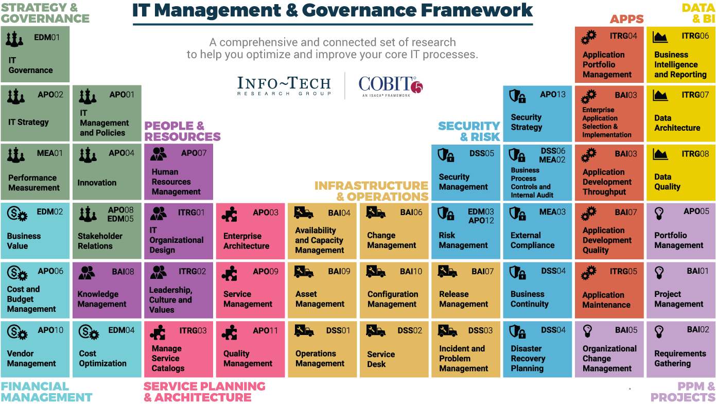
Dive Deeper Into Our Research
by Clicking One of the Elements Below
Find out how Info-Tech makes your job easier. Contact Us Today: Toll-Free (US & Canada): 1-888-670-8889
SAMPLE

