Slide 1


Select a Casino Anti-Money-Laundering Compliance Solution
Your casino is at risk from both regulatory fines and negative media. Protect your casino by selecting a system to support your anti-money-laundering compliance program.
Info-Tech's products and services combine actionable insight and relevant advice with ready-to-use tools
and templates that cover the full spectrum of IT concerns.© 1997-2019 Info-Tech Research Group

Slide 2


ANALYST PERSPECTIVE
Develop your AML program to meet the specific risks of your casino.
Anti-money-laundering (AML) compliance is no longer a simple matter of filing procedural reports. Today, regulators expect casinos to know as much about who is playing at their tables as an investment bank knows about who their business partners are.
AML compliance is a complicated system involving all parts of the casino and all sources of information, from monitoring transactions at the cage and gambling activities at the tables, to collecting player loyalty information and conducting rigorous online research.
There are many solutions available to assist casinos in meeting their compliance obligations, but there is no single solution that will suit every casino. Each casino has to create a program tailored to its specific risks.
Mark Maby,
Research Analyst
Info-Tech Research Group
SAMPLE

Slide 3
Our understanding of the problem
CIOs, VPs of IT, and IT directors
Understand the AML compliance market of today, specific to AML use-case scenarios.
Follow best practices to prepare for and execute on selection, including high-level requirements gathering and vendor evaluation.
Compliance officers
Casino executives
Decide whether or not to deploy an AML system.
Identify the correct AML use case.
Conduct AML requirements gathering.
Understand your regulatory, procedural, and technical requirements.
SAMPLE

Slide 4
Executive summary
Regulatory demands have increased in the last 20 years for both the gaming industry and the larger world of finance. Since 2012, the number of suspicious activity reports (SARs) filed by casinos has increased from a few thousand to almost a million (Financial Crimes Enforcement Network, 2019).
Casinos face both financial risks and risks to their reputation.
AML compliance requires use of all sources of information. This is an opportunity to gather business intelligence on valuable customers.
A casino is a financial institution in the eyes of the regulators. Casinos need to adapt the best practices of banking to the world of gaming.
Artificial intelligence and machine learning provide deeper searches on high-risk individuals, but the AI creates false positives that require analysts to resolve.
Compliance is risk-based, meaning there is no one solution for all casinos. Each casino has to tailor its compliance system to the risks associated with its size, location, regulatory environment, and customers.
Regulators expect casinos to use all available resources to identify threats, including all available information and the latest technology to capture it.
Depending on your organization’s size, compliance requirements, and budget, AML will be an investment. Ensuring your team understands its roles and responsibilities prior to implementation will help ease the transition into this new system.
A robust AML system requires both data to satisfy the know-your-customer (KYC) requirements and a method to monitor transactions for AML compliance and file the required documentation. These two functions need to be planned in tandem for an effective implementation.
Use the accompanying vendor landscape to evaluate the leading products in the market space for your particular risk-based scenario.
SAMPLE

Slide 5
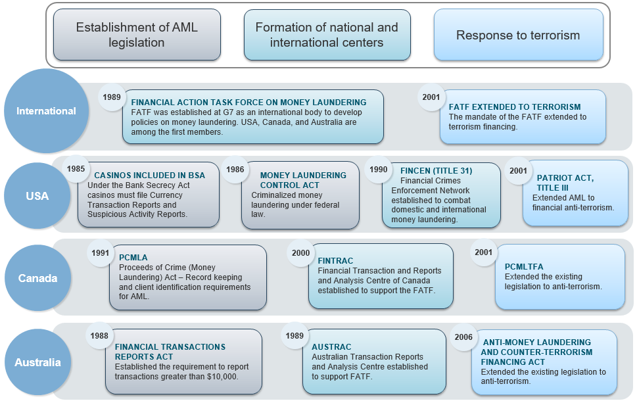
Timeline of AML legislation across selected jurisdictions
SAMPLE

Slide 6


Tinian Dynasty is a worst-case scenario for
AML noncompliance at a casino
CASE STUDY
Industry
Source
Gaming
Various public sources
Tinian Dynasty
The island of Tinian is located in the Northern Mariana Islands. As a US territory, it is subject to US law and regulations. Tinian Dynasty was a casino-resort located on the island with a 405-room hotel.
Fined by FinCEN for Compliance Violations
In 2015, the Financial Crimes Enforcement Network (FinCEN) fined Tinian Dynasty $75 million for “egregious anti money-laundering violations.” The casino had no AML compliance program and had failed to file reports, conduct audits, or train its staff. During its investigation, a FinCEN agent posing as a Russian businessman was assured by a VIP manager that the casino would file no reports on the agent’s activity.
Results
After being fined $75 million, the casino’s liabilities climbed to $250 million. Hong Kong Entertainment (HKE), the owner of the casino, was filed with 158 criminal charges. The final blow to Tinian Dynasty came as a result of its damaged reputation. The casino was unable to secure work visas for its staff because the US Citizen and Immigration Services determined that HKE was not an eligible employer engaged in legitimate business. Tinian Dynasty closed permanently in 2015.
Tinian Dynasty
Cantor Gaming
Trump Taj Mahal
Caesars
Hawaiian Gardens
Sparks Nugget
BCLC
Lower Sioux
SAMPLE

Slide 7


As casinos become more bank-like, it is important to be aware of the banks’ challenges with AML compliance
Top Three AML Challenges
42%
of risk executives say increased expectation is their main regulatory challenge.
26%
Having enough trained staff
24%
FinCEN’s new Customer Due Diligence Requirements for Financial Institutions came into effect in 2018. In general, it requires that banks create and maintain a risk profile of customer relationships. This new rule has increased the challenge of AML compliance for banks. At the moment, the rule does not apply to casinos, but it could be extended to casinos in the future.
Outdated technology
16%
False positives
Risk executives on regulatory technology:
55% of risk executives agree that RegTech has improved their ability to tackle AML/KYC requirements in the past two years.
77% of risk executives are likely to increase investment in RegTech over the next three to five years.
Regulators will be fully aware of the compliance standards set by the banking and investment industry. They will come to expect the same standards from casinos.
Source: Dow Jones Risk & Compliance Global Anti-Money Laundering Survey Results, 2017
SAMPLE

Slide 8
As casinos file more SARs, they need to be aware of the main suspicious activities to monitor
Top 10 Suspicious Activities
 | Individuals Working Together | 8.77%
 | Minimal Gaming | 7.32%
 | Avoidance of Currency Transaction Report (CTR) Requirement | 6.40%
 | Other Casinos | 6.33%
 | Transaction Below CTR Threshold | 6.30%
 | Structuring | 5.72%
 | Refused Request for Documentation | 5.06%
 | Suspicion About Source of Funds | 4.63%
 | Avoidance of Bank Secrecy Act (BSA) Requirement | 2.82%
 | Transaction with No Apparent Purpose | 2.51%
Instruments Used in Suspicious Activities
Source: Financial Crimes Enforcement Network, 2019
SAMPLE

Slide 9

IT needs to automate and enhance the existing AML compliance program
This is Info-Tech’s best-practice framework based on review and amalgamation of multiple jurisdictional agencies, specifically FinCEN, FINTRAC, and AUSTRAC. This framework is recommended to augment your local jurisdictional requirements.
Six Pillars of AML Gaming Compliance
Policies and Procedures
Independent Review and Test of the AML Program
An AML Compliance Officer
Documented Employee Training Program
Risk-Based Customer Due Diligence Program (Know Your Customer)
Automation and Use of All Available Information
In 2012, FinCEN expanded CFR Section 1021.210 to include six pillars for casinos. The added pillar requires that casinos use all available information to ascertain the customers’ identity and source of income.

Slide 10
Assign a project manager to take responsibility for your AML compliance initiative
To ensure the success of your project, choose a responsible party that understands the nature of selecting, implementing, or changing a system to support AML compliance.
1
Assign a project manager.
This person should be responsible for the overall project and project milestones. Other responsibilities include the day-to-day project management of the effort, coordinating the various stakeholders involved, tracking project activities and tasks, maintaining and distributing project documentation, scheduling meetings, managing project issues, defining project objectives and deliverables, defining project scope and estimating costs, and determining project timelines and tasks.
Identify an executive sponsor.
This person is usually a senior member of the project and casino, and should be responsible to the executive for the success of the AML compliance project. Other responsibilities include providing timely decisions; clarifying the decision-making framework, priorities, and strategy; and supporting the project manager role.
2
    Make sure key players from areas with major project deliverables participate early in the project lifecycle as they may have an impact on AML compliance.
SAMPLE

Slide 11


Use these icons to help direct you as you navigate this research
Use these icons to help guide you through each step of the blueprint and direct you to content related to the recommended activities.
This icon denotes a slide where a supporting Info-Tech tool or template will help you perform the activity or step associated with the slide. Refer to the supporting tool or template to get the best results and proceed to the next step of the project.
This icon denotes a slide with an associated activity. The activity can be performed either as part of your project or with the support of Info-Tech team members, who will come onsite to facilitate a workshop for your organization.
SAMPLE

Slide 12
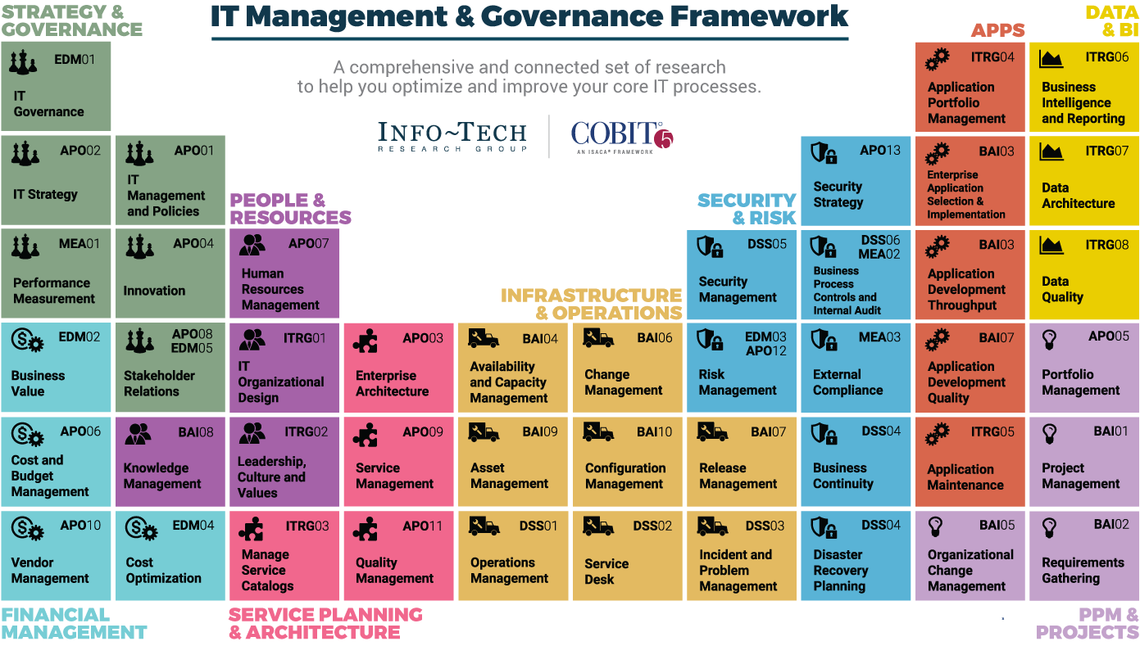
Dive Deeper Into Our Research
by Clicking One of the Elements Below
Find out how Info-Tech makes your job easier. Contact Us Today: Toll-Free (US & Canada): 1-888-670-8889
SAMPLE

