Slide 1
Embed Security Into the DevOps Pipeline
Shift security left to get to DevSecOps.
Info-Tech's products and services combine actionable insight and relevant advice with ready-to-use tools and templates that cover the full spectrum of IT concerns.© 1997-2019 Info-Tech Research Group

Slide 2
ANALYST PERSPECTIVE
The promise of DevOps is more agile application development to deliver better customer experiences faster. It is no wonder that many organizations are embracing the DevOps philosophy.
Unfortunately, the race towards DevOps often leaves Information Security behind. Cultural, resourcing, and skills gaps are all contributing factors.
The good news is that DevOps itself holds the secret to overcoming these challenges. Security leaders just need to let go of the old ways of doing application security and embrace new, collaborative approaches.
Kevin Peuhkurinen,
Research Director, Security, Risk & Compliance
Info-Tech Research Group
Info-Tech Research Group
SAMPLE

Slide 3
Our understanding of the problem
Chief Security Officers
Security Leaders
Security Architects
Understand the DevOps philosophy.
Explore opportunities to secure the DevOps pipeline.
Prioritize your opportunities and build an implementation strategy.
Development Leaders
Operations Leaders
Chief Information Officers
Compliance Officers
Understand the challenges with securing a DevOps environment.
Recognize the need to include the security function in DevOps planning.
Participate in finding collaborative solutions to security problems.
Info-Tech Research Group
SAMPLE

Slide 4
Executive summary
Your organization is starting its DevOps journey and is looking to you for guidance on how to ensure that the outcomes are secure.
Or, your organization may have already embraced DevOps but left the security team behind. Now you need to play catch-up.
Shift security left. Identify opportunities to embed security earlier in the delivery pipeline.
Start with minimum viable security. Use agile methodologies to further your goals of secure DevOps.
Treat “No” as a finite resource. The role of security must transition from that of naysayer to a partner in finding the way to “Yes.”
Many security teams don’t understand the new approaches to development and delivery.
Most developers don’t have adequate security training.
There are huge cultural gaps between development, operations, and security.
Selecting the right tools to help automate security testing and provide security-on-demand to developers is important, but there are other elements which should be considered for successful DevSecOps.
Leverage the CLAIM (Culture, Learning, Automation, Integration, Metrics) Framework to identify opportunities to close the gaps.
Collaborate to find new ways to shift security left so that it becomes part of development rather than an afterthought.
Start with creating minimum viable security by developing a DevSecOps implementation strategy that focuses initially on quick wins.
Info-Tech Research Group
SAMPLE

Slide 5
DevOps 101
What Is DevOps?
Development
Operations
DevOps is an operational philosophy that seeks to promote an improved relationship between Development and Operations in order to break down existing silos and better align the groups in providing customer value.
Hand Off
COLLABORATION
COMMUNICATION
INTEGRATION
Collaboration
Communication
Integration
Development and Operations working together through all stages of the development lifecycle, from design through the development process and into production support.
Prioritizing high-value modes of communication to break down existing silos and create common understanding and empathy across functions. This approach increases transparency and visibility across the entire development lifecycle.
Explore methods to integrate the workflows and toolsets between your Development and Operations groups to become more reactive to changes in business and customer expectations.
Info-Tech Research Group
SAMPLE

Slide 6
Legacy approach to security within development
The legacy approach to including security in application development was based on the waterfall methodology:
Security set up checkpoints within the development phases.
These checkpoints would halt development activities until security requirements were met.
This approach was often a point of contention, seen as slowing down the development process.
Info-Tech Research Group
SAMPLE

Slide 7
DevSecOps: shifting security left
As more organizations embrace the DevOps philosophy and associated methodologies, security teams are seeing the need to embed information security practices within DevOps, hence the term “DevSecOps.” A core principle of DevSecOps is the need to “shift security left,” referring to moving security testing and other security activities earlier in the delivery process.
Develop
Build
Test
Deploy
Shift Security Left
Continuous Integration
Continuous Delivery
Continuous Deployment
Info-Tech Research Group
SAMPLE

Slide 8
Obstacles to DevSecOps: resources
Companies report an average of a 100:1 ratio between developers and security professionals.
The scale of disparity means that organizations of all sizes cannot expect their security team to take on full responsibility for the security of their applications. Developers must be on the front lines of application security.
Source: Sonatype Inc.
Info-Tech Research Group
SAMPLE

Slide 9
Obstacles to DevSecOps: skills
Unfortunately, most organizations tell us that their developers are inadequately trained in application security and secure coding practices.
58% say that lack of skills is a significant hurdle in embedding security into development.*
76% of university educated developers were not required to complete any courses focused on security for their degrees.**
Almost 70% of developers say that their employers do not provide them with adequate training in software security.**
Sources: *Freeform Dynamics, **DevOps.com
Info-Tech Research Group
SAMPLE

Slide 10
Adopt the right DevSecOps practices with Info-Tech’s CLAIM Framework
Use Info-Tech’s CLAIM Framework to focus your secure DevOps program on the areas that will generate the most value.
Teams believe that value is best created by self-organizing, collaborative, cross-functional teams that are driven by customer satisfaction, common delivery mindsets, and grounded expectations from all perspectives.
DevOps is a radical change in how people work and think. Structured, facilitated learning is required throughout the transformation to help leaders and practitioners create mutual understanding and synergies across the organization.
Learning
Automation
Culture
Metrics and Governance
Integrated Teams
Successful DevOps implementations require the disciplined use of delivery and operations metrics that support and validate the satisfaction of the DevOps governance model.
DevOps organizations strive towards the automation of delivery and operational capabilities to achieve self-service and continuous delivery. Automation comes with a heavy investment so it must be applied in the right areas.
While temporary teams can get some benefits from DevOps, standing, self-organizing teams that cross business, delivery, and operations are essential to gain the full benefits of DevOps.
Info-Tech Research Group
SAMPLE

Slide 11
Use these icons to help direct you as you navigate this research
Use these icons to help guide you through each step of the blueprint and direct you to content related to the recommended activities.
This icon denotes a slide where a supporting Info-Tech tool or template will help you perform the activity or step associated with the slide. Refer to the supporting tool or template to get the best results and proceed to the next step of the project.
This icon denotes a slide with an associated activity. The activity can be performed either as part of your project or with the support of Info-Tech team members, who will come onsite to facilitate a workshop for your organization.
Info-Tech Research Group
SAMPLE

Slide 12
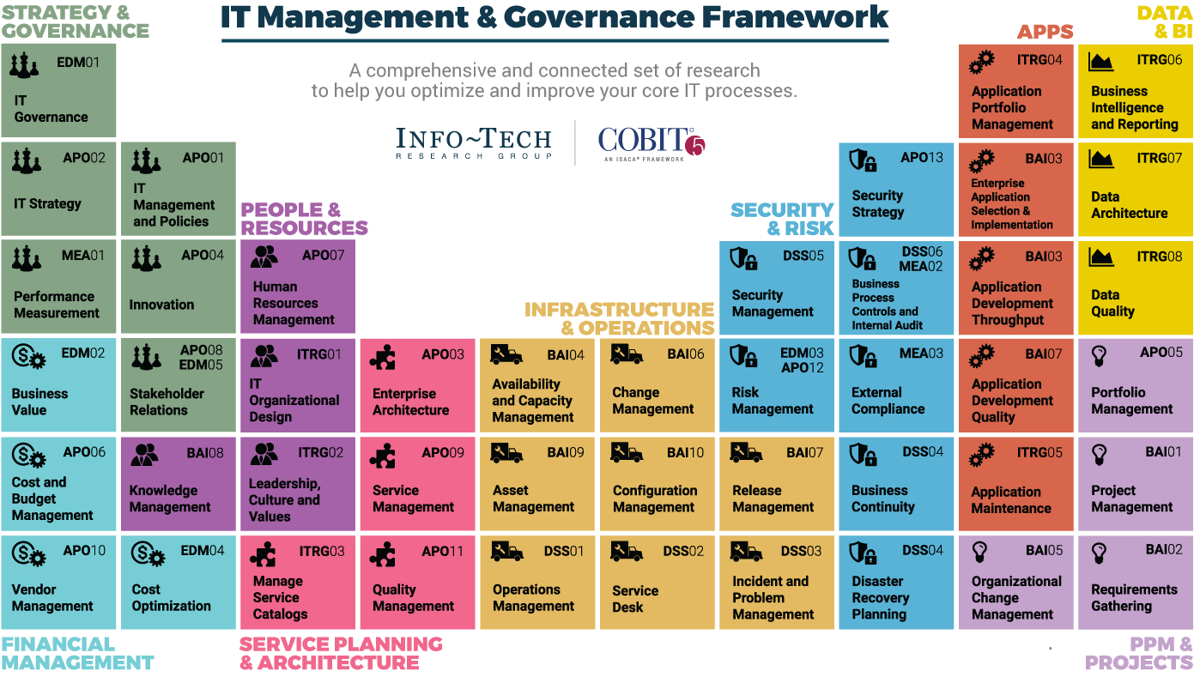
Dive Deeper Into Our Research
by Clicking One of the Elements Below
Find out how Info-Tech makes your job easier. Contact Us Today: Toll-Free (US & Canada): 1-888-670-8889
Info-Tech Research Group
SAMPLE

