Slide 1
Application Portfolio Management Foundations
Ensure your application portfolio delivers the best possible return on investment.
EXECUTIVE BRIEF

Slide 2


Analyst
Perspective
You can’t outsource accountability.
Many enterprises place little to no emphasis on managing their application portfolio, often due to a perceived need to focus on solely on operations and at the cost of strategic efforts.
Inevitably, application sprawl puts any organization in a position where they have more applications than they need, can afford, or can adequately support. Abandoning strategic competencies only adds to the high demands of keeping the lights on.
Others believe business managed or purchased applications do not warrant the same demand for governance or strategic oversight.
You can outsource development, you can even outsource maintenance, but you cannot outsource accountability for the portfolio. Someone needs to capture the holistic picture to determine if an application’s value is worth its cost and if the application does not have overt risk.
Ben Mackle
Senior Research Analyst, Small Enterprises
Info-Tech Research Group

Slide 3
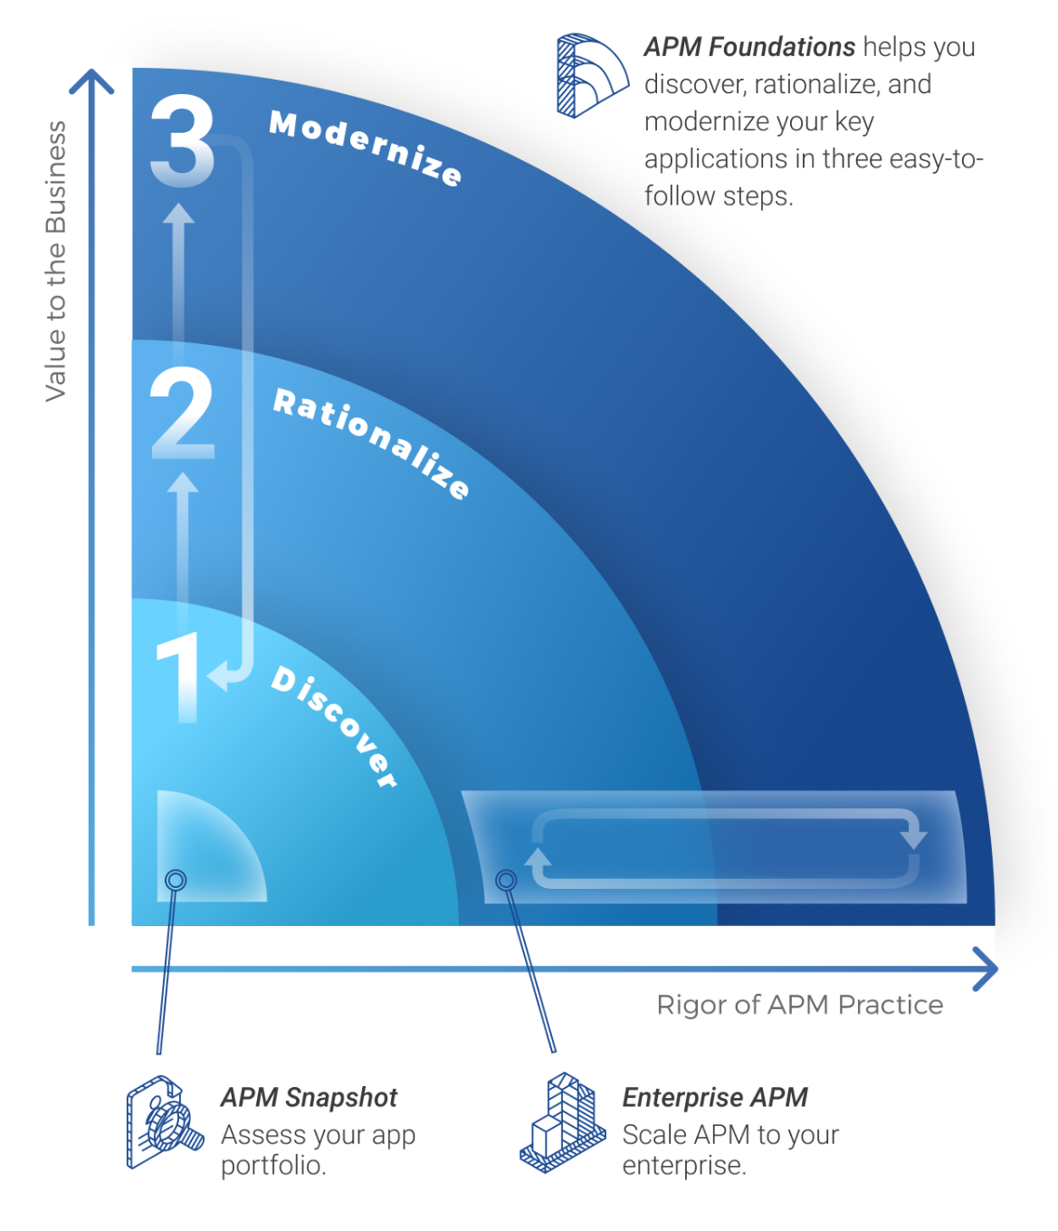
Build your APM journey map
APM Foundations
Step 0: APM Snapshot (optional)
  Application Portfolio Snapshot: Determine where APM is most needed (capabilities, business areas or functions, customer groups) and build a case for your APM program.
Steps 1-3: Application Portfolio Management Foundations
  APM Foundations: Ensure your application portfolio delivers the best possible return on investment.
Enterprise APM
Step 1: Complete APM Foundations Above
  Consider starting with APM Snapshot to build your case or determine where application rationalization can provide the most immediate value.
  Use APM Foundations to start rationalization and modernization for your most important applications or highest need areas before expanding to enterprise APM.
Step 2: Rationalize Your Applications
  Build a Rationalization Framework: Use your inventory to align your application architecture to your IT and business strategy.
Step 3: Modernize Your Applications
  Modernize Your Applications: Modernize your application portfolio using business and technical perspectives. Build your communication strategy and presentation.

Slide 4
Is this research right for you?
Research Navigation
Managing your application portfolio is essential regardless of its size or whether your software is purchased or developed in house. Each organization must have some degree of application portfolio management to ensure that applications deliver value efficiently and that their risk or gradual decline in technical health is appropriately limited.
Your APM Goals | If this describes your primary goal(s)
We are building a business case to determine where and if APM is needed now. We want to understand how well supported are our business capabilities, departments, or core functions by our current applications. | Start with Application Portfolio Snapshot Next step: APM Foundations [this blueprint]
We want to start our APM program with our core or critical applications. We want to build our APM inventory for less than 150 applications (division, department, operating unit, government, small enterprise, etc.). | Optionally start with Application Portfolio Snapshot for capability mapping and analysis Start with APM Foundations [this blueprint]
We want to start simple with a quick win for our 150 most important applications. We want to start with an APM pilot before committing to an enterprise APM program. We need to rationalize potentially redundant and underperforming applications to determine which to keep, replace, or retire. | Start with APM Foundations Continue with Build an Application Rationalization Framework
We want to start enterprise APM, with up to 150 critical applications. We want to collect and analyze detailed information about our applications. We need tools to help us calculate TCO and value. We want to customize our APM journey and rationalization. We want to build a formal communication strategy for our APM program. | Start with APM Foundations Continue with Build an Application Rationalization Framework Then continue with Modernize Your Applications

Slide 5



Executive Summary
Your Challenge
Common Obstacles
Info-Tech’s Approach
Organizations consider application oversight a low priority and app portfolio knowledge is poor.
No dedicated or centralized effort to manage the app portfolio means no single source of truth is available to support informed decision making.
Organizations acquire more applications over time, creating redundancy, waste, and the need for additional support.
Organizations are more vulnerable to changing markets. Flexibility and growth is compromised when applications are unadaptable or cannot scale.
APM implies a holistic approach and compiling multiple priorities and perspectives.
Organizations have limited time to act strategically or proactively and need to be succinct.
Uncertainties on business value prevent IT from successfully advising software decision making.
IT knows its technical debt but struggles to get the business to act on technical risks.
Attempts at exposing these problems rarely gain buy-in and discourage the push for improvement.
Think low priority over no priority.
Integrate these tasks into your mixed workload.
Create an inventory built for better decision making.
Rationalize your apps in accordance with business priorities and communicate risks on their terms.
Create a roadmap that improves communication between those who own, manage, and support an application.
Build your APM process fit for size.
Info-Tech Insight: You can’t outsource strategy.
Modern software options have decreased the need for organizations to have robust in-house application management capabilities. Your applications’ future and governance of the portfolio still requires a centralized IT oversight to ensure the best return on investment.

Slide 6
Every organization experiences some degree of application sprawl
Application Sprawl:
Inefficiencies within your application portfolio are created by the gradual and non-strategic accumulation of applications.
“You have more apps than you need.”
Only 34% of software is rated as both important and effective by users.
App
App
App
App
App
App
App
App
App
App
App
App
App
App
App
App
App
App
App
App
App
App
App
App
App
App
App
App
App
App
App
App
App
Causes of Sprawl
Poor Lifecycle Management
Turnover & a Lack of Knowledge Transfer
Siloed Business Units & Decentralized IT
Business Managed IT
(Shadow IT)
Mergers & Acquisitions
  34%
Problems With Sprawl
Redundancy and Inefficient Spending
Disparate Apps & Data
Obsolescence
Difficulties in Prioritizing Support
Barriers to Change & Growth
Source: Info-Tech’s CIO Business Vision

Slide 7
The top IT challenges for SE come from app management
The hidden and inefficient application portfolio is the root cause of so many pains experienced by both IT and the business.
Demand/Capacity Imbalance
Overspending
Security and Business Continuity Risk
Delays in Delivery
Barriers to Growth
#1 challenge small enterprise owners face in their use of technology:
Taking appropriate security precautions | 24%
The costs of needed upgrades to technology | 17%
Time it takes to fix problems | 17%
The cost of maintaining technology | 14%
Lack of expertise | 9%
Breaks in service | 7%
Having more applications than an organization needs means unnecessarily high costs and additional burden on the teams who support the applications. Especially in the case of small enterprises, this is added pressure the IT team cannot afford.
A poorly maintained portfolio will eventually hurt the business more than it hurts IT.
Legacy systems, complex environments, or anything that leads to a portfolio that can’t adapt to changing business needs will eventually become a barrier to business growth and accomplishing objectives. Often that blame is put on the IT department.
56% of small businesses cited inflexible technology as a barrier for growth
  56%
National Small Business Association, 2019
Salesforce as quoted by Tech Republic, 2019

Slide 8


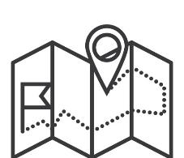

APM allows you to better understand and set the direction of your portfolio
Application Portfolio Management (APM):
The ongoing practice of:
Providing visibility into applications across the organization.
Recommending corrections or enhancements to decision makers.
Aligning delivery teams on priority.
Showcasing the direction of applications to stakeholders.
Application Alignment
Application Rationalization
The process of revealing application information through interviewing stakeholders and aligning to business capabilities.
The process of collecting information and assessing your applications to determine recommended dispositions.
Application Inventory
Application Roadmap
The artifact that documents and informs the business of your application portfolio.
The artifact that showcases the strategic directions for your applications over a given timeline.

Slide 9
Build your APM maturity by taking the right steps at the right time
Info-Tech’s Build an Application Rationalization Framework provides additional TCO and value tools to help build out your portfolio strategy.
Transform
Transform
Innovate Business Processes
Innovate Business Processes
Modernize Product
Modernize Product
Improve
Restructure Architecture
Improve
Restructure Architecture
Reduce Costs
Value to the Business
Eliminate Redundancy
Reduce Costs
Increase Business Value
Rationalization & Roadmapping
Reduce Complexity
Increase Business Value
Predict Retirement
Discover
Eliminate Redundancy
Recognize New Capabilities
Collect Inventory
Recognize New Capabilities
Reduce Risk
Discover Business Use
Reduce Risk
Increase Efficiency
Uncover Shadow IT
Increase Efficiency
Application Alignment
Enable Scalability & Agility
Enable Scalability & Agility
Uncover Redundancy
Increase Productivity
Increase Productivity
Identify Lifecycle Stage
APM Maturity

Slide 10
The core activity of APM is application rationalization
Directionless portfolio of applications
Assigned dispositions for individual apps
Info-Tech’s Five Lens Model
App
App
App
Maintain: Keep the application but adjust its support structure.
App
App
Application Alignment
Business Value
TCO
End-User Perspective
Technical Health
App
App
App
App
App
Modernize: Create a new initiative to address an inadequacy.
App
App
App
App
App
App
App
Consolidate: Create a new initiative to reduce duplicate functionality.
App
App
App
App
App
App
App
Retire: Phase out the application.
Application rationalization requires the collection of several data points that represent these perspectives and act as the criteria for determining a disposition for each of your applications.
Disposition: The intended strategic direction or implied course of action for an application.

Slide 11
APM comes at a justified cost
The benefits of APM
Return on investment (ROI) is experienced by the reduction in the number of applications and operational costs.
But other benefits can include:
Reduce redundancies
Reduce risk
Reduce complexity
Improve processes
Enable flexibility
Enable scalability
New Initiatives
Savings
Cost of APM
Cost of Existing Portfolio
New Initiatives
Increase in Innovation
Cost
Decrease in Overall Spend
Cost of Future Portfolio
Decrease in Operations
Before Rationalization
After Rationalization
Time
Adapted from LeanIX, 2017

Slide 12
Executive Brief Case Study
INDUSTRY
SOURCE
Retail
Deloitte
Supermarket Company
The grocer was a smaller organization for the supermarket industry with a relatively low IT budget. While its portfolio consisted of a dozen applications, the organization still found it difficult to react to an evolving industry due to inflexible and overly complex legacy systems.
The IT manager found himself in a scenario where he knew the applications well but had little awareness of the business processes they supported. Application maintenance was purely in keeping things operational, with little consideration for a future business strategy.
As the business demanded more responsiveness to changes, the IT team needed to be able to react more efficiently and effectively while still securing continuity of the business.
The IT manager found success by introducing APM and gaining a better understanding of the business use and future needs for the applications. The organization started small but then increased the scope over time to produce and develop techniques to aid the business in meeting strategic goals with applications.
The Application Portfolio Management Initiative included the following components:
Train teams and stakeholders on APM
Model the core business processes
Collect application inventory
Assign APM responsibilities
Start small, then grow
Results
The IT manager gained credibility and trust within the organization. The organization was able to build a plan to move away from the legacy systems and create a portfolio more responsive to the dynamic needs of an evolving marketplace.

Slide 13
Info-Tech’s methodology for Small Enterprise APM
 | 1. Lay Your Foundations | 2. Improve Your Inventory | 3. Rationalize Your Apps | 4. Populate Your Roadmap
Phase Activities | 1.1 Assess Your Portfolio 1.2 Define Goals and Metrics 1.3 Define Application Categories 1.4 Determine Steps and Roles 1.5 Weight Value Drivers | 2.1 Populate Inventory 2.2 Assign to Business Capabilities 2.3 Review Outstanding Data | 3.1 Assess Business Value 3.2 Assess End-User Perspective 3.3 Assess TCO 3.4 Assess Technical Health 3.5 Assess Redundancies 3.6 Determine Dispositions | 4.1 Prioritize Initiatives 4.2 Populate Roadmap 4.3 Determine Ongoing APM Cadence
Phase Outcomes | Work with the appropriate management stakeholders to: Extract key business priorities Set your goals Agree on key terms and set the scope for your APM effort | Gather information on your own understanding of your applications to build a detailed inventory and identify areas of redundancy. | Work with application subject matter experts to collect and compile data points and determine the appropriate disposition for your apps. | Work with application delivery specialists to determine the strategic plans for your apps and place these in your portfolio roadmap.

Slide 14



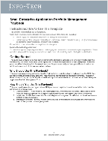
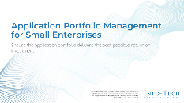
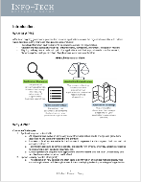
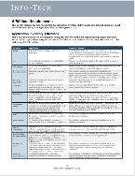
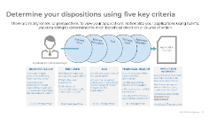
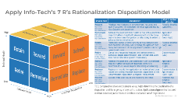
Blueprint deliverables
Key deliverable:
Each step of this blueprint is accompanied by supporting deliverables to help you accomplish your goals.
  Blueprint Storyboard
This is the PowerPoint document you are viewing now. Follow this guide to understand APM and how to use the tools, and build a repeatable APM process captured in your playbook.
  Application Portfolio Management Foundations Playbook
  Application Portfolio Management Foundations Tool
This template allows you to capture your APM roles and responsibilities and build a repeatable process.
This tool stores all relevant application information and allows you to execute rationalization and build a portfolio roadmap.

Slide 16

Guided Implementation
A Guided Implementation (GI) is a series
of calls with an Info-Tech analyst to help implement our right-sized best practices in your organization.
A typical GI, using our materials, is 4 to 6 calls over the course of 2 to 3 months.
What does a typical GI for on this topic look like?
Phase 1
Phase 4
Phase 2
Phase 3
Call #1: Establish goals and foundations for your APM practice.
Call #2:
Initiate inventory and determine data requirements.
Call #3:
Initiate rationalization with group of applications.
Call #5:
Initiate your roadmap and determine your ongoing APM practice.
Call #4:
Review result of first iteration and perform retrospective.
Info-Tech Research Group | 16

Slide 17
Workshop Overview
Contact your account representative for more information.
workshops@infotech.com 1-888-670-8889
 | Day 1 | Day 2 | Day 3 | Day 4 | Day 5
Activities | Lay Your Foundations | 2. Improve Your Inventory | 3. Rationalize Your Applications | 4. Populate Your Roadmap | Next Steps and Wrap-Up (offsite)
 | 1.2 Define Goals and Metrics 1.3 Define Application Categories 1.4 Determine Steps and Roles 1.5 Weight Value Drivers | 2.1 Populate Inventory 2.2 Assign to Business Capabilities 2.3 Review Outstanding Data | 3.1 Assess Business Value 3.2 Assess End-User Perspective 3.3 Assess TCO 3.4 Assess Technical Health 3.5 Assess Redundancies 3.6 Determine Dispositions | 4.1 Prioritize Initiatives 4.2 Populate Roadmap 4.3 Determine Ongoing APM Cadence 4.4 Build APM Action Plan | 5.1 Complete in-progress deliverables from previous four days. 5.2 Set up review time for workshop deliverables and to discuss next steps.
Outcomes | Work with the appropriate management stakeholders to: Extract key business priorities Set your goals Agree on key terms and set the scope for your APM effort | Work with your applications team to: Build a detailed inventory Identify areas of redundancy Understand outstanding data points needed for your inventory | Work with the SMEs for a subset of applications to: Collect and compile data points for different rationalization criteria Determine the appropriate disposition for your apps | Work with application delivery specialists to: Prioritize new potential initiatives Build an initial portfolio roadmap Build an action plan to complete APM activities Establish an ongoing cadence of APM activities | Info-Tech analysts complete: Workshop report APM Snapshot and Foundations Toolset Action plan

Slide 18




Blueprint Pre-Step: Get the right stakeholders to the right exercises
Recommended APM Lead
Applications Lead or the individual responsible for application portfolio management, along with any applications team members if available
Key Corporate Stakeholders
Depending on size and structure, participants could include:
Head of IT (CIO, CTO, IT Director, or IT Manager)
Head of shared services (CFO, COO, VP HR, etc.)
Compliance Officer, Steering Committee
Company owner or CEO
Application Subject Matter Experts
Individuals who have familiarity with a specific subset of applications.
Business owners (product owners, Head of Business Function, power users)
Support owners (Operations Manager, IT Technician)
Delivery Leads
Development Managers
Solution Architects
Project Managers
1. Lay Your
Foundations
2. Improve Your Inventory
3. Rationalize Your Apps
4. Populate Your Roadmap

