Slide 1
Build a Swarming Pilot Project
Optimize your service support and become more DevOps compatible.

Slide 2
EXPERT PERSPECTIVE
The approach to service support may not be one size fits all.
Support organizations with good self-service models are rethinking their support processes and moving from an escalation-based model to a collaboration-based model. They are collapsing their support tiers, creating a single team of people who collaborate on solving customer issues (playing catch). This is replacing the model of multiple teams that toss issues back and forth through incident routing, rerouting, escalation, and rejection (playing ping-pong).
Greg Oxton
Executive Director
Consortium for Service Innovation

Slide 3
Our understanding of the problem
The CIO and service manager who need to increase service support effectiveness and timeliness and improve end-user satisfaction.
The service manager who wants to lead the team from a silo-heavy organization to a collaborative and customer-focused environment.
The team that requires cross-functional collaboration and demands different skill sets.
An organization planning to adopt and scale DevOps or Agile.
Eliminate ping-pong support by creating ownership of tickets.
Create a consistent customer service experience for service desk patrons.
Increase customer satisfaction.
Create an environment that fosters collaboration and skill development.
Improve capabilities for solving complex tickets.
Decrease time and cost to resolve service desk tickets.
Ensure tickets are matched with the most-qualified agent every time.
Understand and address reporting needs to address root causes and measure success.
Reduce ticket backlog.
Create a stronger and more engaged team.
Build a solid foundation for future IT service improvements.
Service teams who want to increase their own effectiveness and move from a help desk to a service desk.
Infrastructure and application managers who want to decrease reactive support activities within the teams.

Slide 4
Executive summary
While the tiered model approach to the service desk may work in some organizations, for many others it results in a severe silo-effect, a breakdown in communication, and tickets being bounced back and forth like a game of ping-pong.
Despite best efforts, IT department managers are left with a dysfunctional system, ticket backlogs, resistance to share knowledge, elevated costs, and frustrated end users.
Don’t build the process alone. Set objectives and parameters. Then, involve your team and empower them to contribute to building and refining the processes.
Culture will trump strategy every time. Do not underestimate the importance of shifting your company culture to a collaboration-based approach. The best processes in the world won’t work if you don’t get everyone onboard.
Embrace the dynamic nature of swarming. Swarming is not one size fits all. Prepare for your processes to change, especially in the initial phases.
The further service desks shift-left, and as web-portal usage increases, it leads to the majority of tickets escalated to agents being complex tickets that require further escalations. This compounds the ping-pong effect, increasing ticket time to resolve and further alienating end users.
Furthermore, companies wanting to adopt DevOps, which is collaboration-heavy, will suffer process issues due to the silo effect.
To minimize risk and optimize stakeholder buy-in, create and launch a swarming pilot project with a small group in your IT department. By incorporating key benchmarks, metrics to monitor, and evaluation plans in place to test its efficacy with your company you can maximize your growth potential and ability to adapt to your maturing service support system.
This blueprint will help you:
Assess if your company should consider introducing swarming practices.
Create and implement a pilot project.
Increase adoption and evaluate the efficacy of the pilot project.

Slide 5
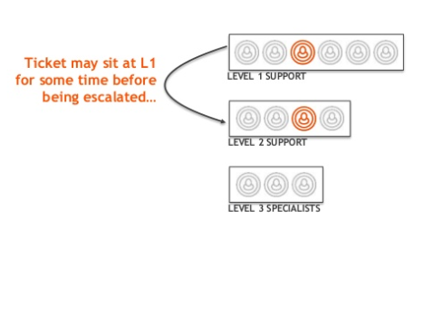
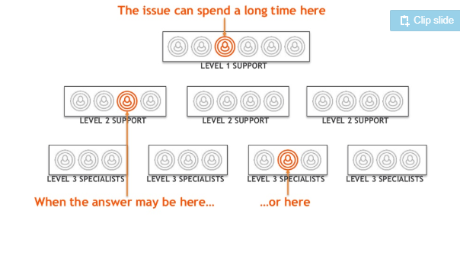
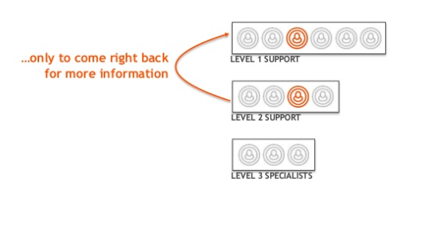
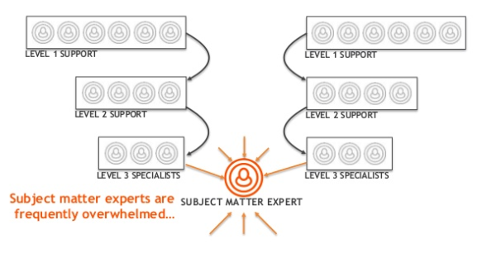
The tiered ticket lifecycle leaves gaps in customer service and exhausts your resources
The Ping-Pong Effect
Aging tickets and frustrated end users
(Source: Jon Hall, 2015)

Slide 6
Companies wanting to achieve a more DevOps state need to reconfigure their approach to service support
What is DevOps?
Development
Operations
DevOps is an operational philosophy that seeks to promote an improved relationship between Development and Operations in order to break down existing silos and better align the groups in providing customer value.
Hand Off
COLLABORATION
COMMUNICATION
INTEGRATION
Collaboration
Communication
Integration
Development and Operations working together through all stages of the development lifecycle, from design through the development process and into production support.
Prioritizing high-value modes of communication to break down existing silos and create common understanding and empathy across functions. This approach increases transparency and visibility across the entire development lifecycle.
Explore methods to integrate the workflows and toolsets between your development and operations groups to become more reactive to changes in business and customer expectations.

Slide 7
Introduce swarming to support the shift to a DevOps and Agile service support environment
How can DevOps help?
DevOps has helped organizations realize the following benefits*:
DevOps paves a targeted, yet flexible path for the future success of your organization.
Increased release velocity
Shorter lead times
Reduced time to recover upon failure
It enables IT organizations to:
Improved defect detection
Lower change failure rates
Reduced deployment failures and rollbacks
Align to the overarching business objectives.
Break down cross-functional silos and remove bottlenecks.
Increase cross-team collaboration and transparency.
Increased collaboration
Increased customer satisfaction
Improved ability to innovate
Improve the quality and performance of applications.
Enhance the customer experience.
(*Source: Puppet Labs)

Slide 8
Cisco, IBM, BMC Software, Microsoft, and Red Hat have seen massive improvements since adopting swarming practices
What are the benefits of swarming support?
Swarming helps organizations realize the following benefits:
Swarming support creates an atmosphere of collaboration, improving end-user satisfaction and reducing organizational costs.
Decrease onboarding times by 50%
Faster incident resolution
Streamline support processes
It enables IT organizations to:
Reduce the skills gaps
Facilitate faster root-cause analysis
Foster team spirit and skills development
Create a customer-centric approach.
Collapse silos and remove bottlenecks.
Streamline onboarding times and improve skills development.
Increased collaboration
Increased customer satisfaction
More time for innovation
Bring development teams to the frontline of support.
Reduce incident resolution time.

Slide 9
Swarming creates higher end-user satisfaction with all other IT services
Embrace collaboration.
Improves the end-user experience.
Alleviates the knowledge and skill dissemination between tiers.
Decreases time and money spent on onboarding by 50%.
Old model streaming
Tier 1
Increase business satisfaction.
Improve confidence that the Service Desk can meet service levels.
Create a single point of contact for incidents and requests, with technicians owning their tickets through to completion.
Tier 2
Tier 3
Escalation-based process
Align work with the right people.
Eliminate the game of service support ping-pong by identifying the right agent to solve the ticket.
Create visibility to all agents to allow them the opportunity to opt-in and help others solve tickets and foster opportunities for skill building.
New model
swarming
Increase efficiency and lower operating costs.
Empower end users and technicians with a targeted knowledgebase.
Faster ticket resolution times.
Improve skills transfer.
Swarming breaks down pesky silos and fosters cross-functional and cross-department learning and collaboration.
Collaboration-based process

Slide 10
By conducting a pilot project you can reduce the risk and maximize stakeholder buy-in to swarming practices
What is a pilot project?
A small-scale preliminary study used to assess the feasibility of an approach or project and test methods and procedures prior to being used on a large scale.
Why do a pilot project?
Pilot projects minimize risk, test and validate the benefit of swarming in your unique environment, and get stakeholders to buy into your project.
Strategize
Assess
Design
Deploy
Maintain
It enables IT organizations to:
Validate cost savings and initial productivity.
Minimize risk by being able to test a new approach in a controlled and live environment.
Pilot Project Life Cycle
Test and validate the efficacy of the program.
Increase stakeholder buy-in.
Verify the process is technically stable.
Identify and address obstacles prior to full-scale implementation.

Slide 11
Info-Tech’s approach to incorporating swarming into your service support model is by creating a pilot project
PHASE 3:
Build a Process
PHASE 1:
Assess Readiness
PHASE 2:
Build a Pilot
1.1
Assess current state
3.1
2.1
Design swarming processes
Build a project plan
1.2
Review swarming best practices
3.2
2.2
Create an evaluation plan
Build a communication strategy
1.3
Identify benchmarks and metrics
3.3
Review support best practices
Outcomes and Deliverables
Current-state assessment
Pilot Project Plan
Swarming processes
Collaboration assessment
Communication Strategy
Evaluation plan
Metrics and reports

Slide 12
BMC Software sets the bar high by changing the game of service support with Swarming
CASE STUDY
Industry
Source
Software
BMC Software
BMC Software
BMC Software is a multinational software company supporting approximately 96% of the Forbes Global 100 companies and 81% of the Fortune 500 companies. BMC produces software and services that assist businesses in moving towards optimized digital operations.
Swarming Initiative
BMC implemented swarming practices as an answer to the two key challenges it was facing: increasingly complex issues and the need to reduce interruptions to support analysts in the form of critical issues. BMC involved the entire team in developing the swarming process and started small with a pilot project as a proof of concept with only 14 people.
Benefits
Some of the key benefits BMC experienced after implementing swarming practices include freeing up managers’ time from being reactive to being able focus on development, fewer escalations to development, improved knowledge sharing, and significant improvement in teamwork and morale.
Key Findings
8%
2x
8% higher customer satisfaction scores.
Employees doubled their knowledge within a year.
25%
50%
25% faster mean time to resolve (MTTR).
Reduced onboarding time by 50%.
*(Source: Consortium, 2010)

Slide 13
Info-Tech offers various levels of support to best suit your needs
Guided Implementation
DIY Toolkit
Consulting
“Our team has already made this critical project a priority, and we have the time and capability, but some guidance along the way would be helpful.”
“Our team knows that we need to fix a process, but we need assistance to determine where to focus. Some check-ins along the way would help keep us on track.”
“Our team does not have the time or the knowledge to take this project on. We need assistance through the entirety of this project.”
Diagnostics and consistent frameworks used throughout all four options

Slide 14
Build a Swarming Pilot Project – project overview
1. Assess Readiness
2. Create a Pilot
3. Build a Process
Best-Practice Toolkit | 1.1 Assess current state 1.2 Review swarming best practices 1.3 Identify benchmarks and metrics | 2.1 Build the project plan 2.2 Build a communication strategy | 3.1 Design swarming processes 3.2 Create an evaluation plan 3.3 Review support best practices
Guided Implementations | Assess current state of service support and collaboration. Review swarming best practices. Identify benchmarks and metrics. | Build your swarming pilot project plan. Build a communication strategy for your pilot. | Design swarming processes. Create an evaluation plan to measure success. Review support best practices.
 | Phase 1 Results: Service desk maturity assessment Collaboration assessment Benchmarks, metrics, and reports | Phase 2 Results: Pilot project plan Communication strategy | Phase 3 Results: Swarming processes Evaluation plan to measure success Pilot project support plan

Slide 15
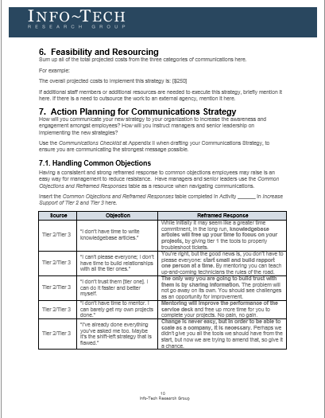
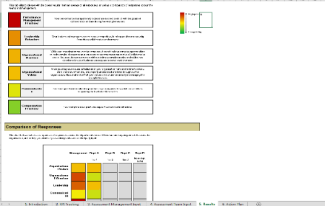
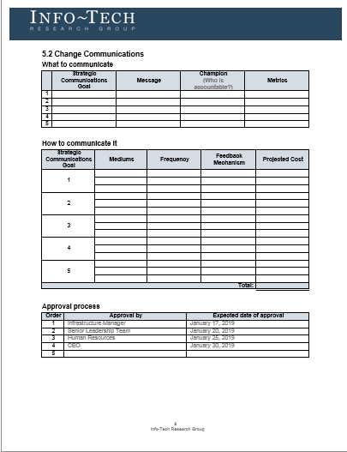
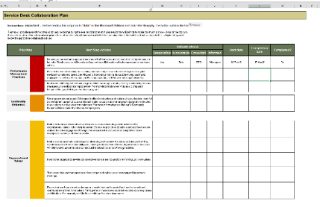
Info-Tech delivers: Use our tools and templates to accelerate your pilot project to completion
Service Desk
Maturity Assessment
Collaboration Assessment
Communication Strategy
Pilot Project Plan

