Slide 1
Build a Vendor Security Assessment Service
Use a risk-based approach to right-size your vendor security assessments
Info-Tech's products and services combine actionable insight and relevant advice with ready-to-use tools and templates that cover the full spectrum of IT concerns.© 1997-2018 Info-Tech Research Group

Slide 2
ANALYST PERSPECTIVE
There are security risks hiding in your supply chain, and left alone they will only get worse.
Unfortunately, traditional vendor security risk management is fraught with challenges. Trying to do too much due diligence discourages vendors from bidding for your business, exasperates internal clients, and strains the resources of security teams. Meanwhile, regulators are expecting organizations to do ever more in this area.
The answer to this dilemma is to re-think supply chain security, taking a risk-based approach that satisfies all stakeholders.
Kevin Peuhkurinen,
Director, Research – Security Info-Tech Research Group
Info-Tech Research Group
SAMPLE

Slide 3
Our understanding of the problem
Chief Information Security Officers
IT Risk Officers
CIOs or other IT leaders
Vendor Management
Understand the right level of information security due diligence for vendor management to achieve business goals and compliance obligations.
Design a process that meets business needs for supplier risk management in a cost-effective fashion.
Privacy Officers
Compliance Officers
Business leaders who procure products and services and need to understand third-party risks
Create a strategy for managing and mitigating risks to meet the organization’s risk appetite.
Develop plans for achieving compliance obligations related to third-party risk.
Info-Tech Research Group
SAMPLE

Slide 4
Executive summary
Vendor security risk management is a growing concern for many organizations. Whether suppliers or business partners, we often trust them with our most sensitive data and processes.
More and more regulations require vendor security risk management, and regulator expectations in this area are growing.
An efficient and effective assessment process can only be achieved when all stakeholders are participating.
Security assessments are time-consuming for both you and your vendors. Maximize the returns on your effort with a risk-based approach.
Effective vendor security risk management is an end-to-end process that includes assessment, risk mitigation, and periodic re-assessments.
Too many security leaders start with a one-size-fits-all approach to vendor security assessments and end their engagement as soon as a vendor is selected.
Security assessments that are too onerous will lead to vendors who refuse to bid for your business, driving the business to bypass your assessment process.
Develop an end-to-end security risk management process that includes assessments, risk treatment through contracts and monitoring, and periodic re-assessments.
Base your vendor assessments on the actual risks to your organization to ensure that your vendors are committed to the process and you have the internal resources to fully evaluate assessment results.
Understand your stakeholder needs and goals to foster support for vendor security risk management efforts.
Info-Tech Research Group
SAMPLE

Slide 5
Supply chain security breaches are on the rise
Many organizations know that they need to secure their supply chain, but struggle with finding the right level of due diligence.
56% of organizations experienced a data breach caused by their supply chain in 2017, an increase from 49% in 2016.
75% of organizations believe that security incidents involving third parties are increasing.
Disagree
Agree
Almost 60% of organizations admit that they do not always evaluate third parties before sharing sensitive or confidential data with them.
Unsure
Only 17% of organizations in 2017 felt that they were highly effective at mitigating third-party risk, a decrease from 22% in 2016.
No
Source: Ponemon Institute
Info-Tech Research Group
SAMPLE

Slide 6
Info-Tech’s risk-based approach to vendor security
Start
Periodic re-assessments are driven by contract risk
Level of due diligence required to assess vendor(s) is based on potential impact
Assess potential impact of vendor security incident (service risk)
Assess likelihood of security incident at the vendor (vendor risk)
Determine risk (contract risk)
Treat risk
Record details of assessment in vendor inventory
Service Risk x Vendor Risk = Contract Risk
Risk treatment is driven by organizational risk tolerance
Info-Tech Research Group
SAMPLE

Slide 7
This research aligns with Info-Tech’s overall vendor management framework
B
U
S
I
N
E
S
S
S
T
A
K
E
H
O
L
D
E
R
S
Vendor Management Program Creation
Vendor Risk Management
Vendor Relations & Performance Management
Vendor Management Continual Improvement
Mission, Vision, Values
Strategic Roadmap
Financial Risk
IT Security Risk
Vendor KPIs
C-Level Value Metrics
Strategic Partners
Innovation
Org. Structure
VM Operating Model
Operational Risk
Compliance Risk
Vendor Transitions
Select & Evaluate Vendors
Vendor Categories
Business Value
SOURCE TO CONTRACT CYCLE
Sourcing Strategy Alignment with Enterprise Strategy
Strategic Initiative Prioritization
Strategic Sourcing Roadmap
PROCURE TO PAY CYCLE
Tactical Sourcing
Spend Management
Contract Execution
STRATEGIC SOURCING (if separate function)
IT PROCUREMENT (if separate function)
VM Governance
Contract Management
Legal
Accounting
Finance
ITAM/SAM
ERM
IT – Security
IT – Enterprise Architecture
IT – Service Delivery
IT – Functional Leads
Info-Tech Research Group
SAMPLE

Slide 8
Use these icons to help direct you as you navigate this research
Use these icons to help guide you through each step of the blueprint and direct you to content related to the recommended activities.
This icon denotes a slide where a supporting Info-Tech tool or template will help you perform the activity or step associated with the slide. Refer to the supporting tool or template to get the best results and proceed to the next step of the project.
This icon denotes a slide with an associated activity. The activity can be performed either as part of your project or with the support of Info-Tech team members, who will come onsite to facilitate a workshop for your organization.
Info-Tech Research Group
SAMPLE

Slide 9
Info-Tech offers various levels of support to best suit your needs
Guided Implementation
DIY Toolkit
Workshop
Consulting
“Our team has already made this critical project a priority, and we have the time and capability, but some guidance along the way would be helpful.”
“Our team knows that we need to fix a process, but we need assistance to determine where to focus. Some check-ins along the way would help keep us on track.”
“We need to hit the ground running and get this project kicked off immediately. Our team has the ability to take this over once we get a framework and strategy in place.”
“Our team does not have the time or the knowledge to take this project on. We need assistance through the entirety of this project.”
Diagnostics and consistent frameworks used throughout all four options
Info-Tech Research Group
SAMPLE

Slide 10
Build a Vendor Security Assessment Service – project overview
1. Define Governance and Process
2. Develop Assessment Methodology
3. Implement Process
Best-Practice Toolkit | 1.1 Identify Requirements 1.2 Develop Policy 1.3 Identify Roles 1.4 Define Process 1.5 Define Treatment Matrix | 2.1 Assess Service Risk 2.2 Develop Questionnaire 2.3 Define Technical Assessments 2.4 Define Other Vendor Assessments 2.5 Assess Vendor Risk | 3.1 Treat Risks 3.2 Deploy the Process 3.3 Monitor the Process
Guided Implementations | Identify requirements and develop the policy. Define the RACI matrix, process, and treatment matrix. | Customize the Service Risk Questionnaire. Develop vendor risk assessment methodology. | Customize the Vendor Security Inventory and develop implementation strategy. Develop metrics.
Onsite Workshop | Module 1: Define Governance | Module 2: Develop Assessment Methodology | Module 3: Deploy Process
 | Phase 1 Outcome: Policy and process | Phase 2 Outcome: Assessment methodology | Phase 3 Outcome: Deployment and monitoring strategy
Info-Tech Research Group
SAMPLE

Slide 11
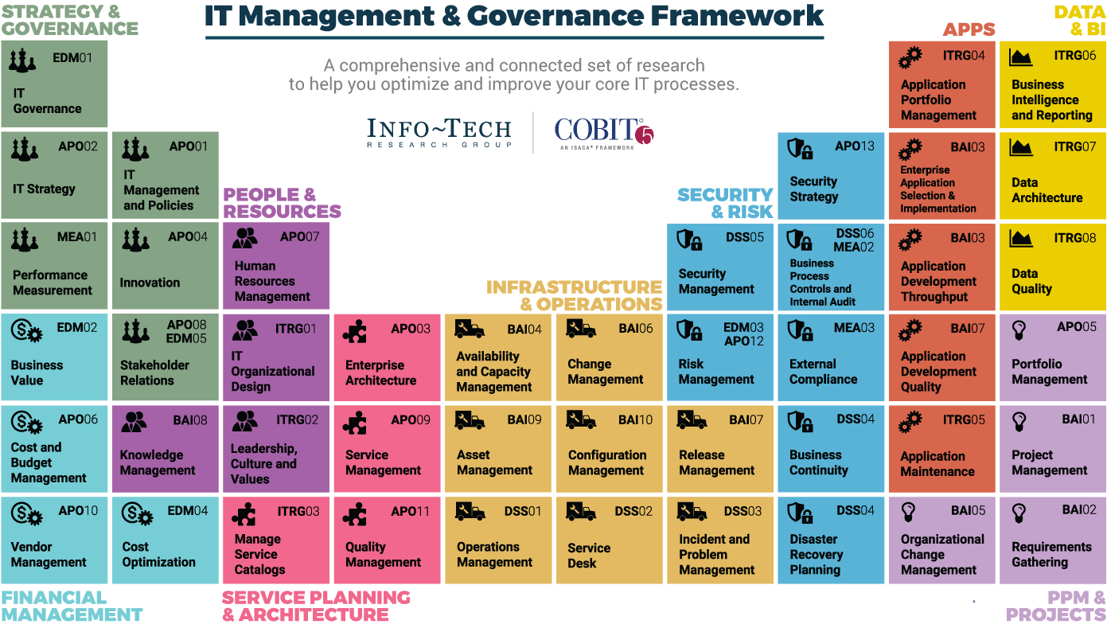
Dive Deeper Into Our Research
by Clicking One of the Elements Below
Find out how Info-Tech makes your job easier. Contact Us Today: Toll-Free (US & Canada): 1-888-670-8889
Info-Tech Research Group
SAMPLE

