Slide 1
Achieve Compliance for Large Projects With Independent Verification & Validation
A solid IV&V methodology will also strengthen oversight and project management.
Info-Tech's products and services combine actionable insight and relevant advice with ready-to-use tools and templates that cover the full spectrum of IT concerns.© 1997-2018 Info-Tech Research Group

Slide 2
ANALYST PERSPECTIVE
Independent verification and validation (IV&V) is more than just an academic exercise.
Large program delivery is hard. Multiple stakeholders and their priority requirements need attention and oversight.
External oversight provides repeatable and consistent perspective on program health and compliance, either at critical project milestones or at regularly scheduled checkpoints. This oversight enables delivery management to manage control and make appropriate adjustments.
IV&V functions best as advisory oversight. It provides program stakeholders and sponsors with the confidence that appropriate rigor and processes are in place.
An IV&V partner with an advisory support approach can ensure that oversight is invested in the success of the program’s delivery.
Paul Herzstein,
Consulting Director, Applications Info-Tech Research Group
SAMPLE

Slide 3
Our understanding of the problem
Leaders of organizations with mandated external oversight requirements
Leaders of organizations mandated to obtain independent review to ensure the continuation of project funding
Leaders of organizations with large projects that require quality and project and portfolio management oversight
Internal IT and business sponsors of large government projects seeking added objective quality control
Understand how independent verification and validation (IV&V) assessments are used to evaluate project health, at either regular intervals or a given point in time.
Identify the type of IV&V partners you may engage (an advisor vs. an auditor).
Learn about Info-Tech’s best practice IV&V process and framework.
Report on project health and compliance, thereby providing due diligence and accountability over public investments.
Project and portfolio managers who seek to improve their processes
PMO managers who seek to improve organizational processes
IT managers who support the execution and transition to IT of major projects
Learn about 19 key project parameters, with best practices and key questions, to monitor for project health and compliance.
SAMPLE

Slide 4
Executive summary
IV&V assessments are generally needed for large projects that must meet oversight requirements (internal or external). Often IV&V is mandated by a project’s total budget, scope, timeline, or complexity. IV&V assessments are performed at regular intervals or at a point in time.
Regular IV&V reviews enable continual feedback and improvement. IV&V prompts delivery management to fine tune and apply best practices. Maximize IV&V effectiveness through regularly scheduled assessments.
Choose an advisor, not an auditor. While both would verify the same project parameters, stakeholders will prefer to engage with an advisor who will seek to improve project health rather than an auditor who will seek to report project gaps.
Apply IV&V recommendations to improve ongoing project delivery. IV&V recommendations should be actionable, on top of demonstrating project health and compliance.
Large projects face more internal and external scrutiny, especially for public sector organizations. Many strategic projects today involve new technology, which can add complexity, time, and cost. Often projects experience compliance issues, delays, and budget overruns in implementation, which are not diagnosed for root causes until a post-implementation review is done. The results, though beneficial, are reactive rather than proactive.
Info-Tech’s four-step IV&V process assesses 19 parameters to help project sponsors and managers effectively facilitate large projects, demonstrate project health, and meet oversight and compliance requirements:
Prepare – Set your IV&V objectives, cadence, and interview schedule; gather documentation in advance.
Review – Conduct interviews; review documentation, milestones, and progress; confirm status and metrics.
Analyze – Review and compile results and metrics; analyze gaps and identify improvement opportunities.
Report – Develop the final report; summarize the results and recommendations for executive sponsors.
SAMPLE

Slide 5
Arizona Department of Child Safety’s
Separation Program
CASE STUDY
Industry
Source
Regional Government
Info-Tech IV&V Advisory Client
Context
The Arizona Department of Child Safety (DCS) launched its Separation Program to build an independent departmental infrastructure within the Government of Arizona. DCS was required by legislative oversight to procure IV&V services because its budget exceeded mandated thresholds.
Scope
Info-Tech conducted quarterly IV&V assessments over the span of the program, applying the best practice IV&V framework to review documents, interview stakeholders, and measure health.
Outcome
Info-Tech’s IV&V assessments helped the program team to demonstrate viability, meet State oversight requirements, and ensure continued program funding. In addition, Info-Tech provided the program team with supplementary project management oversight using its advisory approach to IV&V. Quarterly reports included proactive action items that supported program efforts in delivering a successful outcome.
Info-Tech’s Four-Step IV&V Process
1. Prepare
Verification
2. Review
3. Analyze
Validation
4. Report
SAMPLE

Slide 6
Info-Tech offers various levels of support to best suit your needs
Research
Advisory
Guided Implementation
DIY Toolkit
Workshop
Consulting
“Our team has already made this critical project a priority, and we have the time and capability, but some guidance along the way would be helpful.”
“Our team knows that we need to fix a process, but we need assistance to determine where to focus. Some check-ins along the way would help keep us on track.”
“We need to hit the ground running and get this project kicked off immediately. Our team has the ability to take this over once we get a framework and strategy in place.”
“Our team does not have the time or the knowledge to take this project on. We need assistance through the entirety of this project.”
Diagnostics and consistent frameworks used throughout all four options.
This particular research addresses a consulting service line.
SAMPLE

Slide 7
Info-Tech will set up an analyst call to answer any preliminary questions and scope further needs for IV&V services.
To accelerate a review of your project’s health and compliance, engage your project team in Info-Tech IV&V advisory services, supported by Info-Tech consultants.
Info-Tech consultants will join you and your team onsite at your location to participate in comprehensive IV&V assessments.
Contact your account manager for more information (www.infotech.com/account).
SAMPLE

Slide 8
1
IV&V Overview
Achieve Compliance for Large Projects With IV&V
SAMPLE

Slide 9
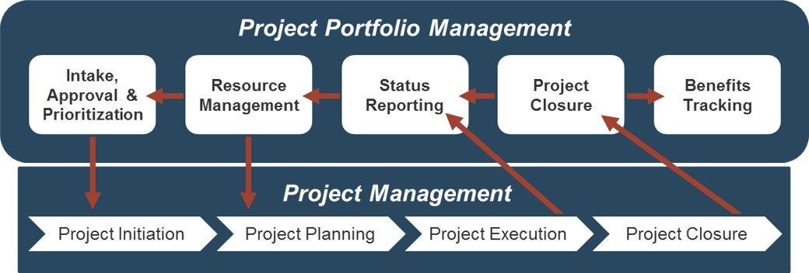
IV&V fits primarily in the context of your project planning and project execution processes
Project management doesn’t exist in a vacuum. Ultimately, your ecosystem of PM tools and processes needs to be able to inform effective decision making at the executive level.
An IV&V process reviews project health and compliance, adds quality control, and strengthens project management delivery. By implementing this approach:
Regular assessments can be planned for during project initiation, implemented throughout project planning and execution, and finalized at project closure (see below).
Organizations can proactively make tactical adjustments to have their large projects deliver on commitments.
Perform IV&V
IV&V can occur as a snapshot of project health at a point in time, but to be most effective it should instead follow a schedule of regular assessments.
SAMPLE

Slide 10
What is IV&V?
IV&V is a process that is used as a means of quality assurance, to ensure that a given product or process meets a certain set of requirements.
Independent
Objective, removed from the product or process and related outcomes.
Based on a regulation, requirement, specification or imposed condition for oversight or quality control:
Triggers often include overall project cost, size, scope or complexity.
Most often requires external partner services.
Where applicable, may be performed by an independent internal group.
Not a pure audit, though may contain components typical to audit processes.
Verification
&
Validation
The evaluation of whether or not the product or process complies with a regulation, requirement, specification or imposed condition.
Involves internal effort to demonstrate the verification of:
Plan Viability (“Will project delivery be successful?”)
Project Management Practices (“How effective is the project being run?”)
The assurance that the product or process meets the needs of identified stakeholders.
Involves acceptance and suitability with external partners and parameters.
Results focused on desired outcomes:
Requirement fulfillment
Funding continuation
Scope management
Improved compliance
Improved PM maturity
Enhanced reporting
SAMPLE

Slide 11
Who initiates IV&V and why?
This research is directed at organizational stakeholders responsible for effective program and project delivery and concerned about requirements that trigger the need for IV&V.
Oversight Bodies
Senior Executives
Business and IT Sponsors
IT Management
Operational Management
PMO Directors
Program and Project Managers
A requirement or mandate written in law (industry specific)
Budget or cost over a given threshold (e.g. over $10 million)
Projects in transition from one phase to another
Validation of realized benefits and a business case
Expected funding constraints; realized funding issues
Identification of major project risks (budget, timeline, scope)
Diagnoses of general project performance issues
Inconsistent or poor project management performance
Unsatisfactory vendor performance
Immature organizational project management practices
Other portfolio or program-level concerns
Internal Health Check
IV&V
Impact Assessment
Post-Implementation Review
SAMPLE

Slide 12
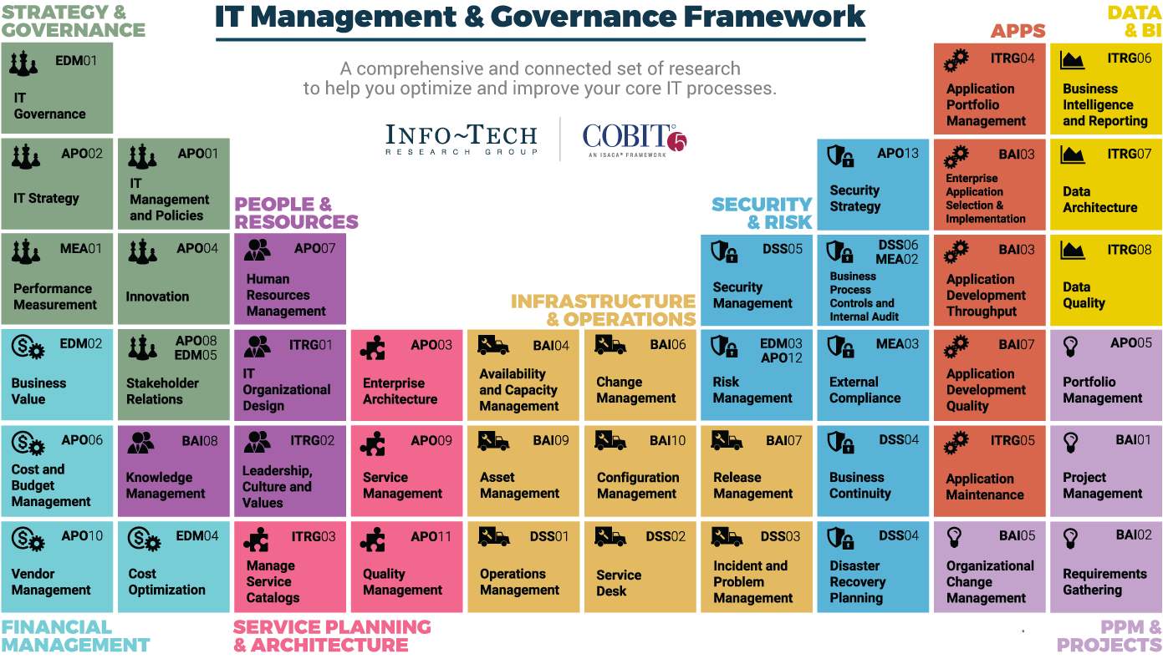
Dive Deeper Into Our Research
by Clicking One of the Elements Below
Find out how Info-Tech makes your job easier. Contact Us Today: Toll-Free (US & Canada): 1-888-670-8889
SAMPLE

