Slide 1


Automate Work Faster and More Easily With Robotic Process Automation
Embrace the symbiotic relationship between the human and digital workforce.
Info-Tech's products and services combine actionable insight and relevant advice with ready-to-use tools
and templates that cover the full spectrum of IT concerns.© 1997-2018 Info-Tech Research Group

Slide 2


ANALYST PERSPECTIVE
IT must play the role of a realist in the face of trending technologies.
History teaches us to be careful when adopting new trending technologies. It pays to wait until the second or third wave of interest, until the technology sufficiently matures for enterprise use.
If that wisdom holds true for robotic process automation, now is the time for adoption, as it has existed since the 1990s (albeit in simpler forms). However, artificial intelligence began in 1956, but it’s far from clear whether it is ready for adoption beyond “simple” applications such as chatbots and supervised machine learning.
Regardless, marketing hype for said technologies drives your stakeholders to your door with high hopes, aspirations, and possibly unrealistic expectations. It behooves us IT professionals to reconcile them with reality.
This is a difficult and delicate task, and we’re here to help.
W. David Lee, PhD, PMP,
Consulting Analyst, Applications Practice
Info-Tech Research Group
Info-Tech Research Group
SAMPLE

Slide 3
Our understanding of the problem
CIOs and CTOs
Chief Innovation Officers
Business Relationship Managers
Business Analysts
Discover robotic process automation (RPA), and how it differentiates from other automation technologies.
Understand the benefits and risks of complementing RPA with artificial intelligence (AI).
Identify and analyze your business processes to determine best fit for automation with RPA.
Communicate RPA’s potential quantitative and qualitative benefits to stakeholders.
CEOs, COOs, CFOs
Line of Business (LOB) Owners
Business Process Managers
Process Improvement Analysts
Discover RPA, and how it enables business units to automate routine, repetitive work faster.
Understand the benefits and risks of complementing RPA with AI.
Estimate the economic impact of RPA on business units.
Info-Tech Research Group
SAMPLE

Slide 4
Executive summary
Your organization has many rules-based business processes that rely on manual, routine, and repetitive data collection and processing work, and your stakeholders are interested in automating them.
You are investigating whether RPA is a suitable technological enabler for automating the processes.
RPA is “lightweight” IT.
RPA reduces the cost of entry, maintenance, and teardown associated with automation, as well as the technological requirement of resources that maintain it.
RPA is about more than just saving cost and time.
Free up human resources for creative, higher-value work, while making your process deliver outcomes more consistently and improving customer/employee experiences.
Being a trending technology, especially with its association with AI, there is much hype and misunderstanding about RPA.
Estimating the potential impact of RPA on business is difficult because relevant industry statistics often conflict with each other, and you aren’t sure how it applies to your business.
Discover RPA, and how it differentiates from other automation technologies.
Understand the benefits and risks of complementing RPA with AI.
Identify and analyze your business processes best suited for automation with RPA.
Communicate RPA’s potential quantitative and qualitative benefits to your business’ stakeholders.
Info-Tech Research Group
SAMPLE

Slide 5

Businesses rely heavily on routine, repetitive work manually done by their best human resources
Much of the routine work is done manually, causing mistakes, delays, variability in outcomes, and frustration.
According to ServiceNow and Lawless Research’s 2015 report:
2 days every week
are spent by 9 out of 10 managers performing routine administrative tasks.
=
US$575 billion
is spent on administrative tasks in the
United States, equivalent to 3.3% of GDP.
The successful and efficient delivery of these tasks is critical to business.
However, manually carrying out such tasks cannot deliver the desired outcome.
… of managers agreed that their productivity depends on how efficiently these services are delivered.
… of companies rely on manual tools to drive these processes: email, phone calls, and visits.
90%
80%
.. of managers say that these routine work processes cause significant delays.
… of managers were worried about making mistakes with manual tools.
80%
85%
Info-Tech Research Group
SAMPLE

Slide 6


Traditional solutions for delegating away routine, repetitive work delivered a mixed bag of results and challenges
Business Process Management (BPM) streamlines the underlying processes to maximize value and efficiency of the overall process.
Software solutions automate workflows to improve process outcomes and efficiency.
Development and maintenance of software solutions can be complex and resource intensive, often requiring large investments.
Business Process Outsourcing (BPO) reduces cost and effort by contracting out the process to another party.
Offshore vendors offer dramatic cost savings and expanded service availability by taking advantage of lower labor costs and different time zones.
BPO poses management challenges and security/privacy risks.
Loss of process control causes unforeseen costs to emerge.
Human factors that negatively affect process outcomes are not addressed: bored, frustrated people continue to make mistakes.
While either solution can deliver positive business outcomes if implemented and managed judiciously, technology that can automate routine, repetitive work in a lightweight, easy-to-maintain way can address the challenges posed by both BPM and BPO.
Info-Tech Research Group
SAMPLE

Slide 7

Automate routine, repetitive work with RPA
Will robots and AI take human jobs? Partially – the ones humans don’t want to do, and are not suitable for anyway.
Software “bots” work with applications as if they were human users to perform routine, repetitive work in your place.
Enlist the “digital workforce” for your organization.
Keep automation solutions lightweight and in-house.
Most RPA solutions offer low-code/ no-code ways of prescribing and maintaining robotic activity, so that your business stakeholders can develop and maintain automated solutions – with IT providing governance and guidance.
Reclaim human capacity for use in human activities.
70% of workers feel as though they have too much work on their plates and not enough time to do it.
– Reynolds, 2016
Reduce operating time and costs.
Effective use of RPA reduces average handling times by up to 40% and lowers processing costs by up to 80%.
– Thompson, 2017
RPA is a promising new development in business automation that offers a potential return on investment (ROI) of 30-200% – in the first year.
– Lhuer, 2016
Info-Tech Research Group
SAMPLE

Slide 8

Realize benefits of automation that extend beyond cost/time savings
Comprehensive insight into process
Bot activity can be more closely logged and monitored to enable a more comprehensive analysis of business processes.
Improve process compliance
Bots will precisely execute prescribed rules, so mistakes and errors are reduced.
Better predict process outcome
Reduce the contribution of human factors in the execution of rules-based processes.
Better employee experience
Use the human resource capacity freed up from repetitive work to get more interesting things done.
Reduce costs
Cost to automate processes and maintain them are usually lower than those of human resources.
Increase speed
Automation can reduce the cycle time and increase the availability of a business process.
Greater scalability
Solutions to expand or reduce the process capacity to meet variable or seasonal demand are technological rather than HR-based.
Increase process agility
Changes in business processes can go live more quickly by eliminating the time to train workers and the need to reinforce the training.
Info-Tech Research Group
SAMPLE

Slide 9

RPA is an important trend for CIOs in 2018
Info-Tech’s CIO Trend Report 2018 named robotics as an important technology that enables CIOs to become a driving force behind business growth. Robotics encompass both mechatronic robots that automate physical tasks and software bots that automate business processes, which RPA accomplishes.
53% of the Global 2000 [operations leaders] are planning
significant RPA investments to slash costs in 2018.
– Fersht, 2018
Identify and seize relevant technology at the height of its promise.
Download Info-Tech’s CIO Trend Report 2018.
Info-Tech Research Group
SAMPLE

Slide 10

RPA is the leading focus of significant investment amongst trending technologies, but reports of success are mixed
The promise of automating business processes in a lightweight way has boosted RPA’s place in the mindshare of businesses that look to drive down operating costs, and align middle- or back-office operations to improve customer experiences and business process efficiency.
Across all industries, significant investment is being made in RPA to realize the benefits of automation.
Source: Reed, 2018
However, there are mixed, and often conflicting, reports on their ability to realize expected benefits and get value for their investment. This indicates that implementing RPA may be tricky, and that businesses may have trouble setting realistic goals and expectations.
96% of customers
I’ve spoken to are getting real value from RPA.
– Karamouzis (qtd. in Fersht, 2018)
We have seen
as many as 30 to 50% of initial RPA projects fail.
– Lamberton, 2016
Info-Tech Research Group
SAMPLE

Slide 11
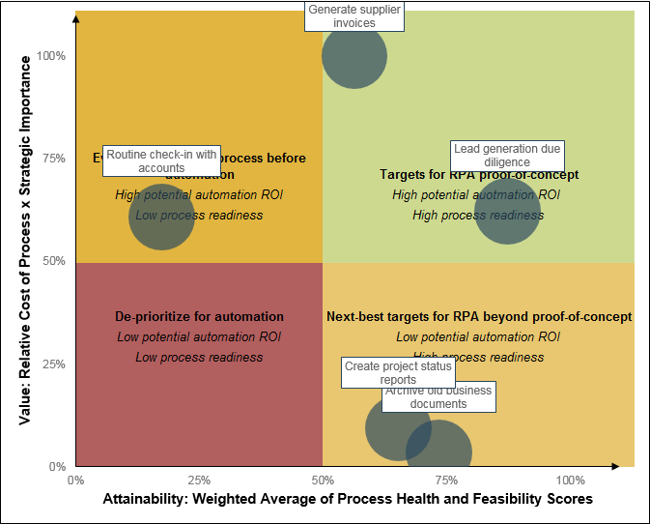
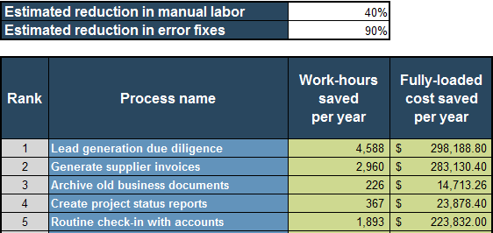
Practical, tactical focus on Info-Tech’s research helps you communicate with your stakeholders more effectively
Get started on your RPA journey the right way with Info-Tech’s methodology.
Discover RPA, and how it differentiates from other automation solutions. Amid marketing hype and preconceived notions about robotics and AI, making sense of RPA can be a challenge in and of itself.
Identify your business processes best suited for automation with RPA, and create a realistic estimate of impact. Follow our methodology to identify your existing business processes best suited for RPA, and calculate the savings in work effort and cost using our Process Evaluation Tool for Robotic Process Automation. This enables you to identify the right business stakeholder to engage, with a tailored, measurable, and more realistic statement of benefit for proposing to take on this initiative.
Sample outputs of Info-Tech’s Process Evaluation Tool for Robotic Process Automation
The economic outcomes [of RPA] often aren’t
as rosy as originally projected. While it may be possible to automate 30% of tasks for the majority of occupations, that doesn’t neatly translate into a 30% cost reduction.
– Sohoni and Edlich, 2017
Info-Tech Research Group
SAMPLE

Slide 12
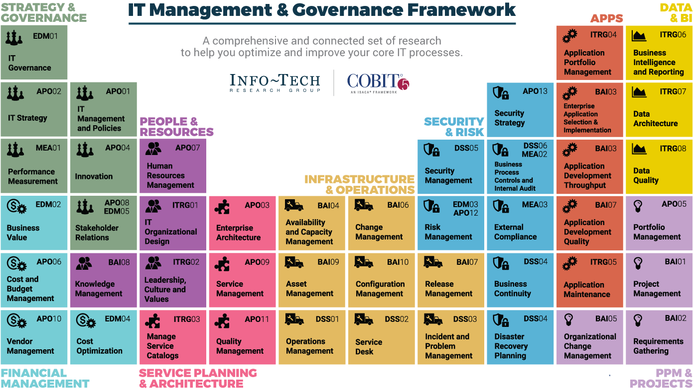
Dive Deeper Into Our Research
by Clicking One of the Elements Below
Find out how Info-Tech makes your job easier. Contact Us Today: Toll-Free (US & Canada): 1-888-670-8889
Info-Tech Research Group
SAMPLE

