Slide 1
Understanding Regulation With Blockchain Technology
Is compliance really easier with blockchain?
Info-Tech's products and services combine actionable insight and relevant advice with ready-to-use tools and templates that cover the full spectrum of IT concerns.© 1997-2018 Info-Tech Research Group

Slide 2
ANALYST PERSPECTIVE
Stop mistaking bitcoin for blockchain.
Blockchain isn’t going to solve all of the problems with provenance. You still need to be able to see the whole chain to know it is valid, defined, and protected. Does it make it easier? Yes. Does it remove the need for, or streamline, diligence? Emphatically NO.
– Sean Thurston, Senior Director, Security Info-Tech Research Group
SAMPLE

Slide 3
Our understanding of the problem
CIOs
IT leaders
Security leaders
Understand the implications of blockchain from a usage and forensic perspective and examine the potential unique issues of this transformative technology.
Understand the security limitations of this technology and validate its alignment with your organization.
Determine the practical next steps to ensure compliance and completeness of your solution.
CEOs
CDOs
Business stakeholders
Brainstorm where and how blockchain can solve current security and trust problems and create value.
Break down the blockchain ecosystem to identify your potential areas of reporting and risk.
SAMPLE

Slide 4
Executive summary
Blockchain, the underpinning technology behind bitcoin, is touted as a powerful technology capable of transforming the entire business world and enhancing security and reportability.
Many companies are racing towards blockchain adoption in hope of making reporting and compliance easier.
Do not panic if your blockchain use case is unique. The vast number of benefits and deployment options for a blockchain solution has led to countless use cases.
Understand how blockchain impacts your organization and ensure appropriateness to your current solutions. Determining how blockchain aligns with your organizational security and reporting will dictate its adoption.
However, most users and customers do not have a clear understanding of blockchain and its security implications, let alone how it impacts their ability to leverage it as a solution.
At the same time, with bitcoin drawing most of the media attention, organizations are finding it difficult to articulate blockchain in a consistent use and business case.
Distinguish blockchain from cryptocurrency by defining blockchain around its unique technological and security/reporting features. The definition should result in a clear understanding of the key characteristics and benefits that blockchain can offer your organization.
Discover successful blockchain use cases in different industries; business leaders can leverage tangible, real-life examples to interpret the impact of blockchain on their own industry.
By analyzing the value to their business, users can understand pain points and use cases that would be impacted. Begin the transformation by brainstorming use cases for the organization based on the current security, reporting, and forensic needs.
SAMPLE

Slide 5
Blockchain is already being deployed across all industries
Blockchain is to bitcoin what the internet is to email.
– Sally Davies, Technology & Innovation Reporter, Financial Times
Based on a survey sampling 308 senior executives in the United States at companies with $500M or more in annual revenue. At a minimum, each respondent had a broad understanding of blockchain and was able to comment on their organization’s blockchain investment plans.
– Deloitte Blockchain Survey 2017
Although financial services firms tended to be early adopters of blockchain technology due to the natural alignment of their products with cryptocurrencies, other industries are aggressively entering the space.
SAMPLE

Slide 6
Inherent flaws across all supply chains make blockchain a boon for financials and other organizations
The demand for standardization, consistency, and timely delivery of data has created inherent flaws across current supply chains and reporting technologies. Specifically, blockchain has the potential to improve supply chain management based on three factors: partnerships, simplified transactions, and real-time data.
Partnerships
Organizations are looking to gain efficiency in areas that generally require resources to maintain, manage, and report. They are being forced to find efficiency any way they can, regardless of industry.
One area of potential is maximizing due diligence by determining what suppliers/retailers you can trust when you have no information on them or pre-existing relationships.
Blockchain establishes trust with new players, as participants can view the entire transaction history of a blockchain, showing that players are acting as expected and fulfilling their obligations.
Simplified Transaction
Current transactions require significant communication and interaction between multiple parties.
This has made the managing (e.g. paper-based processes) of transactions and reporting difficult, especially for small- to medium-sized enterprises.
Blockchain can work to connect all of these parties digitally, leveraging smart contracts to trigger automatic payments and reducing paper-based processes to reduce overall transaction costs, all while enhancing reporting and compliance.
Real-Time Data
The lack of standard reporting, consistent data, and usage of untrusted or unknown sources makes it difficult to ensure a transaction is complete and to ensure viability through the process.
Poor visibility has made it difficult to provide and/or receive accurate reporting if something unexpected happens (e.g. product is held at customs, unexpected insertion).
Blockchain’s added transparency can enable events to be logged, tracked, and reported in real time, enhancing the flow of information and creating a single source of truth.
SAMPLE

Slide 7
Blockchain offers a spectrum of benefits that positions it to mitigate risks in the transportation and logistics industry
Blockchain technology extends far beyond bitcoin. Info-Tech defines blockchain as a decentralized record book based on four key benefits: transparency, integrity, efficiency, and security.
Transparency
Integrity
Efficiency
Security
The blockchain represents an unequivocal truth, where anyone can examine the entire transaction history. This provides never-before-seen auditability.
Blockchain technology can be permissionless, meaning anyone can post new transactions, but it ensures fairness by requiring users to rely on the network’s shared protocol.
By facilitating peer-to-peer transactions, the blockchain can cut third parties, minimizing settlement times and reducing high fees from payment processors.
Blockchain leverages cryptographic hashing, digital signatures, and script to become immutable, meaning that confirmed transactions cannot be modified.
There is a common misconception that blockchain = distributed ledger technology (DLT) = bitcoin. In fact, blockchain is only one type of DLT and bitcoin is only one application of this technology.
SAMPLE

Slide 8
Several players associated with the financials and logistics industry will be impacted by blockchain
WHO WILL BE IMPACTED?
WHY WILL THEY BE IMPACTED?
Suppliers
Suppliers want to prove their production methods to gain new customers.
$4T
in physical goods are shipped around the world each year (IBM).
15%
is the predicted increase in trade if international barriers were reduced (WEF).
&
Manufacturers
Manufacturers want to ensure their products have been received by customers.
yet
Transporters
Those responsible for shipping goods want to provide transparency for their customers.
20%
The cost to process and administer trade transactions can reach up to 20% of the physical transportation costs of the associated goods.
Financers
Financial institutions want to reduce paper-based processes and customer touchpoints.
The globalization of trade has poised supply chain management for disruption. Any organization with a supply chain can leverage blockchain to improve its current supply chain management practices. Consequently, this blueprint is applicable for all organizations.
Retailers/Buyers
End purchasers want to track their shipments in real time.
SAMPLE

Slide 9
Use this blueprint to drive your blockchain initiative forward
2
START LINE
Info-Tech’s blueprint Demystify Blockchain focused on providing a foundational understanding of blockchain technology and analyzing its alignment to your organization.
PHASE 2
Phase 2 helps you to brainstorm a set of blockchain use cases for your organization and determine the one that best fits with your ability to use it for compliance and reporting (i.e. consistency, constancy, reportability).
1
3
PHASE 1
The first part of this blueprint
helps to define the disruptive potential of blockchain in the
transportation and reporting of information by analyzing how it
could impact the value chain.
PHASE 3
The final section of this blueprint works to build the business case for your blockchain use case and provide you with Info-Tech’s guiding principles for approaching blockchain.
SAMPLE

Slide 10
Info-Tech is building a library to support your blockchain interest and initiatives
Info-Tech has been building a catalogue of blockchain-focused research, including a foundational research piece to explain the technology and determine your organization’s alignment to it. Other research includes guides to prototyping and adopting disruptive technology and industry notes available to premium members.
Foundation Blockchain Research
Demystify Blockchain: How Can It Bring Value to Your Organization?
Building Blocks for your Blockchain Initiatives
Prototype With an Innovation Design Sprint Exploit Disruptive Infrastructure Technology Kick-Start IT-Led Business Innovation
Blockchain Thought Pieces
Blockchain Basics Blockchain: Foundation Technology of the Future Fake Realities, Blockchain, and Star Trek Transform the Grocery Store Supply Chain with Blockchain Explore Blockchain in Oil and Gas
Foundation Blockchain Research
Demystify Blockchain: How Can It Bring Value to Your Organization?
Building Blocks for Your Blockchain Initiatives
Prototype With an Innovation Design Sprint Exploit Disruptive Infrastructure Technology Kick-Start IT-Led Business Innovation
Blockchain Thought Pieces
Blockchain Basics Blockchain: Foundational Technology of the Future Fake Realities, Blockchain, and Star Trek Transform the Grocery Store Supply Chain With Blockchain Explore Blockchain in Oil and Gas
SAMPLE

Slide 11
Use these icons to help direct you as you navigate this research
Use these icons to help guide you through each step of the blueprint and direct you to content related to the recommended activities.
This icon denotes a slide where a supporting Info-Tech tool or template will help you perform the activity or step associated with the slide. Refer to the supporting tool or template to get the best results and proceed to the next step of the project.
This icon denotes a slide with an associated activity. The activity can be performed either as part of your project or with the support of Info-Tech team members, who will come onsite to facilitate a workshop for your organization.
SAMPLE

Slide 12
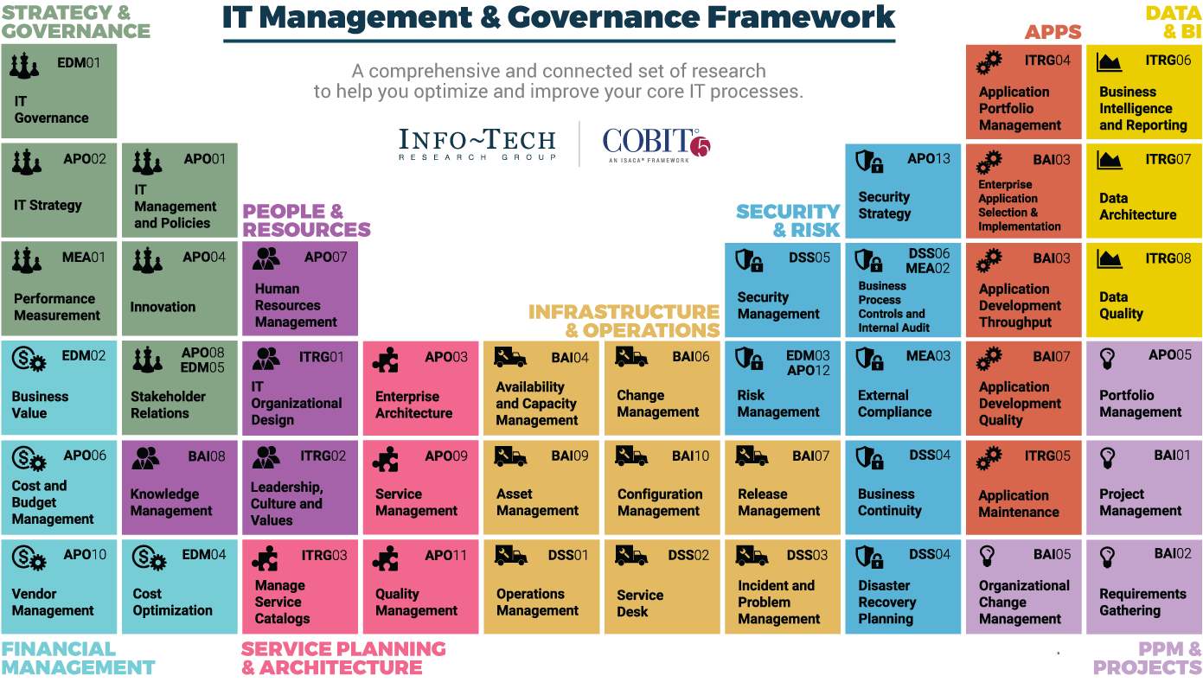
Dive Deeper Into Our Research
by Clicking One of the Elements Below
Find out how Info-Tech makes your job easier. Contact Us Today: Toll-Free (US & Canada): 1-888-670-8889
Info-Tech Research Group
SAMPLE

