Slide 1
Sustain and Grow the Maturity of Innovation in Your Enterprise
Going to the next level of maturity for innovation.
Info-Tech's products and services combine actionable insight and relevant advice with ready-to-use tools and templates that cover the full spectrum of IT concerns.© 1997-2018 Info-Tech Research Group

Slide 2
ANALYST PERSPECTIVE
Innovation maturity is about positive change, proactiveness, and being an ongoing opportunity catalyst. Take it to the next level!
Innovation is not about new shiny things or high risk initiatives with low expectations of implementation. Instead, it is about a shift – a shift in ideas, culture change, roles, delivery, customer expectations and making a difference. We innovate every day, from low-hanging fruit to major transformations. What we need in order to mature to the next level towards a continuous cycle of innovation for any type of entity is to have a blended approach to balance risk with opportunity, positive thinking with organizational support, and a focus on strengths and values – in essence, to think like an incubator.
Dave Wallace,
Senior Research Director and
Executive Advisor, CIO Practice Info-Tech Research Group
Info-Tech Research Group
SAMPLE

Slide 3
Our understanding of the problem
CIOs
IT Directors
Lead or Enterprise Architects
Senior IT Managers
Assess and gauge the success of the innovation initiatives in your innovation portfolio.
Evaluate the leadership skills needed to improve and grow your innovation program.
Understand the risks and the opportunities to evolve your innovation program to the next level and to ensure your IT strategy is positioning IT as a forward innovative leader.
IT Managers
IT Staff
Business Stakeholders
IT Partners
Gain a measured understanding of the innovations underway and planned.
Provide senior management with a report card on the innovation program.
Provide an opportunity for business stakeholders to play an active role in leveraging the results of innovation to advance their strategies.
Info-Tech Research Group
SAMPLE

Slide 4
Executive summary
Customers are not waiting – they are insisting on change now. The recent litany of business failures and the ongoing demand for improved services means that “not in my backyard” will mean no backyard.
Positive innovation is about achieving tomorrow’s success today, where everyone is a leader and ideas and people can flourish – in every sector.
Unlock your innovation potential by looking at your innovation projects on both a macro and micro level.
Innovation capacity is directly linked with creativity; allow your employees’ creativity to flourish using Info-Tech’s positive innovation techniques.
Innovations need to be re-harvested each year in order to maximize your return on investment.
Many innovation programs are not delivering value at a time when change is constant and is impacting both public and private sector organizations.
Organizations are not well positioned in terms of leadership skills to advance their innovation programs.
Create an effective innovation program that spawns more innovations, realizes benefits from existing assets not fully being leveraged, and lays the groundwork for enhanced products and services by taking an opportunity perspective.
Assess the aspirational level of innovations/the innovation program, determine the resources/capabilities that an entity has to date employed in its innovation program, and build the program for success to achieve the strategic objectives of the enterprise using a complementary toolkit and method (to existing blueprints/research).
Use the program mandate and terms of reference to formalize your program and to communicate it to your organization; additionally, use an innovation assessment tool to gauge the innovation level and resourcing of your program to position it for success and to assess the leadership and skills needed for your team to optimize program delivery.
Update your business context and IT strategy with the results of your innovations, as part of an ongoing formalization of your program.
Info-Tech Research Group
SAMPLE

Slide 5
Business stakeholders regularly undervalue IT services that drive satisfaction
In a recent survey of over 20,000 IT and business executives, it was found that four of the core IT services with the largest impact on satisfaction were considered the four least important IT services by the business.
It is often the case that business stakeholders overvalue services that drive “business as usual” activities, but undervalue services that IT uses to understand and innovate around what the business actually wants from IT.
Importance as reported by business stakeholders
Statistical impact on business satisfaction
Network Infrastructure
Service Desk
Business Applications
Data Quality
Devices
1
1
Projects
Work Orders
Innovation Leadership
Business Applications
Requirements Gathering
2
2
3
3
4
4
5
5
11
* As determined by strength of correlation between Core Service scores and Overall Satisfaction
Info-Tech’s Business Vision Survey N=21,367
Info-Tech Research Group
SAMPLE

Slide 6
There is a clear relationship between satisfaction with IT and the IT department’s innovation leadership
Organizations without high satisfaction with IT innovation leadership are only 20% likely to be highly satisfied with IT.
IT innovation leadership explains 75% of variation in satisfaction with IT.
You rarely see a real-world correlation of .86!
– Mike Battista, Staff Scientist, Cambridge Brain Sciences, PhD in Measurement¹
When organizations’ members were asked: “Overall, how satisfied are you with your IT department?” their response was strongly correlated with the IT department’s innovation leadership. Use our process to gain innovation leadership, and then clearly communicate it.
¹ As cited in Info-Tech’s blueprint Exploit Disruptive Infrastructure Technology.
Info-Tech Research Group
SAMPLE

Slide 7
A majority of CIOs believe that their IT departments will reach the transformational maturity level in 3-5 years
% of CIOs Currently Selecting the Expand or Transform Maturity Level
5%
% of CIOs Who Expect to Be at the Expand or Transform Maturity Level in 3-5 Years
71%
N=215 organizations
Info-Tech Research Group
SAMPLE

Slide 8
Is this research for you?
If you currently have an innovation program with projects underway and would like to improve its performance then this research may be for you. If you are new to IT-enabled innovation or do not have any current or potential innovation projects it is better to start with process mapping and continuous improvement to establish credibility.
Does your organization have a mindset to support IT-innovation?
Have you established a system for continued process improvement?
Does your innovation program currently have projects underway?
Yes
Yes
No
No
No
This research is for you!
Start here first
Start here first
Start off with Info-Tech’s blueprint: Kick-Start IT-Led Business Innovation.
Start off with Info-Tech’s blueprints: Apply Strategic Foresight to Enable IT-Led Growth and Exploit Disruptive Infrastructure Technology.
Info-Tech Research Group
SAMPLE

Slide 9
Knowledge strategy case study
CASE STUDY
Industry
Source
Government
Interview
Organization
Agency responsible for conservation of natural and cultural heritage.
Enterprise Knowledge Strategy Initiative
A senior scientist is leading an enterprise knowledge strategy that will change the way information is used and distributed within the agency. It is more than traditional knowledge management – its focus is on fostering a culture of evidence-based decisions.
Culture change requires a movement, not a mandate, and taking an innovation-based approach allows for:
Iterative, ongoing, employee-driven development of tools and techniques,
Experimenting with different approaches and adjusting as required,
Expanding upon existing best practices; and
Using the innovation process itself as a way to encourage the sharing of knowledge.
The goals of the knowledge strategy are to:
Improve our understanding of the knowledge we need, the knowledge we have, and the sources of that knowledge.
Encourage and facilitate knowledge sharing to increase the effective utilization of our knowledge resources in all aspects of our work.
Ensure that our decisions are based on the best available information and evidence that is balanced, understood, documented, and communicated.
Results
The strategy will build on the organization’s strong role to date in preserving the protected areas under its responsibility for future generations through enhanced decision making, with a stated outcome of ensuring that our stewardship of our places is trusted and respected.
Info-Tech Research Group
SAMPLE

Slide 10
Establish baseline metrics
Baseline metrics will improve through:
IT’s ability to deliver increased levels of innovation leadership.
An improved blend of innovation projects that allow IT to maximize returns from innovations.
Increased efficiencies in the innovation process.
These satisfaction metrics have the highest expected impact on your overall IT satisfaction. Track these metrics alongside your overall IT satisfaction to monitor your progress toward your maturity goals.
Metric Description | Current Metric | Future Goal
IT innovation leadership (from CIO business vision) | X% | Y%
Percentage of prototypes in the portfolio that get approved to be business cases per year | X% | Y%
Percentage of innovation solutions that are successfully deployed per year | X% | Y%
Organizational positive innovation score | X% | Y%
Innovation team positive innovation score | X% | Y%
Project owner positive innovation score | X% | Y%
Project team member positive innovation score | X% | Y%
Innovation potential (enabling innovations) score | X | Y
Info-Tech Research Group
SAMPLE

Slide 11
Improve the iterative process of innovation by analyzing innovation capabilities and positive innovation levels
Focus of this blueprint
Info-Tech’s four-step innovation management process:
Ideation
Portfolio View
External View
Strategic Foresight
Innovation Capabilities
Idea Promotion
Idea Realization
Idea Generation
Launch Innovation
Ideation
Prototype
Mature Innovation Capability
Ideation
Internal View
Psychological View
Process Mapping
Positive Innovation
Info-Tech Research Group
SAMPLE

Slide 12
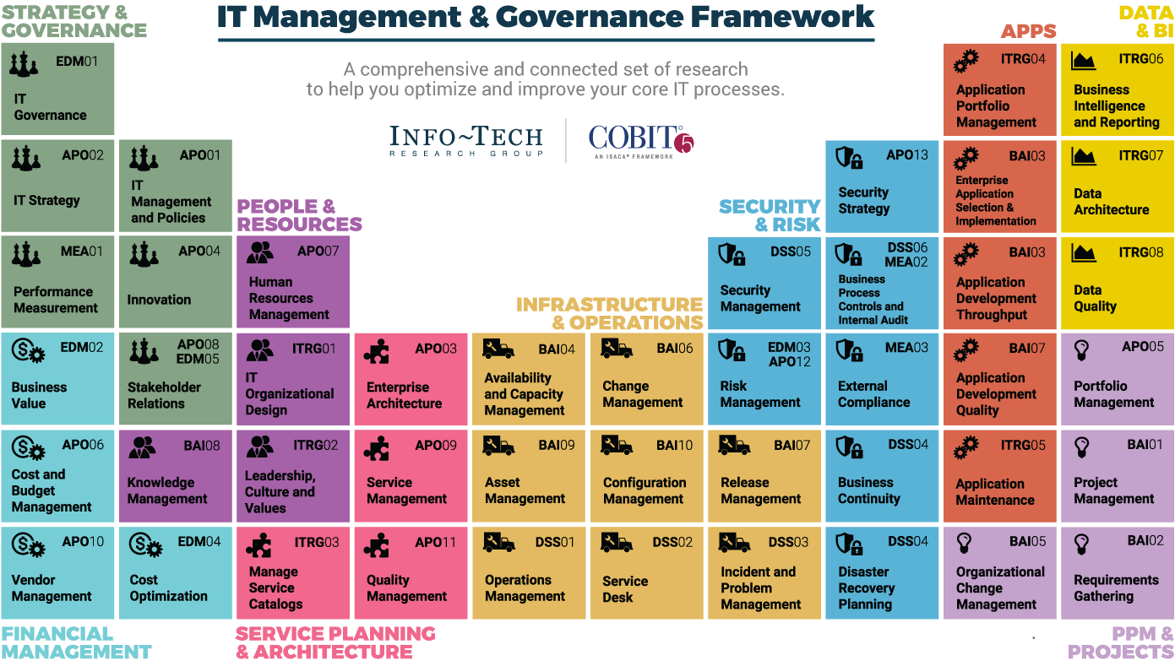
Dive Deeper Into Our Research
by Clicking One of the Elements Below
Find out how Info-Tech makes your job easier. Contact Us Today: Toll-Free (US & Canada): 1-888-670-8889
Info-Tech Research Group
SAMPLE

