Slide 1
Fast Track Your GDPR Compliance Efforts
Quickly address regulatory requirements, even after the deadline.
Info-Tech's products and services combine actionable insight and relevant advice with ready-to-use tools and templates that cover the full spectrum of IT concerns.© 1997-2018 Info-Tech Research Group

Slide 2
ANALYST PERSPECTIVE
GDPR is here to stay.
Many organizations struggle with the notion of a global data privacy regulation. Some question the enforceability of such a wide set of regulatory criteria, while many are concerned about their potential exposure and unsure of where to start.
It is important to understand the General Data Protection Regulation (GDPR) is first of many enhancements to worldwide data privacy standards. Other jurisdictions, such as the US (various states), Canada, and Australia are following GDPR with updates to their privacy regulations.
With this unstoppable freight train of inevitable and improved data privacy baselines, the GDPR should be seen as a framework for an organization’s data privacy efforts. Organizations should embrace GDPR’s risk-based and pragmatic approach to data privacy.
Aaron Shum,
Director – Security, Risk & Compliance Info-Tech Research Group
SAMPLE

Slide 3
Our understanding of the problem
A CIO or CISO who is dealing with the following:
Insufficient time or resources to fully understand the regulation and its applicability for their organization.
A lack of organization-wide acceptance of GDPR scope.
Organizational non-compliance.
Understand the regulation’s applicability and the risks imposed by GDPR.
Develop a defensible position for your internal and external stakeholders.
Lay the foundation for future data privacy regulations and directives.
Privacy officers and legal and business stakeholders who are responsible for the following:
Managing organization-wide compliance, privacy, and legal ramifications.
Generating revenue through the use of customer, employee, and/or other data subjects’ personal data.
Understand the regulatory requirements and determine their role in GDPR compliance.
Develop communication and expectations for their business units or teams.
Aid in the required documentation and privacy changes.
SAMPLE

Slide 4
Executive summary
The GDPR enforcement deadline is here. Organizations must understand the risk of non-compliance and what the ramifications may mean for their reputation and future revenue.
There is no one-size-fits-all methodology. The scope of GDPR projects depends on the nature of applicability for your organization.
Financial impact isn’t simply fines. A data controller fined for GDPR non-compliance may sue its data processor for damage.
Even day-to-day activities may be considered processing. Screen-sharing from a remote location is considered processing if the data shown on screen contains personal data!
This is not simply an IT problem. Organizations that address GDPR with a siloed approach will not be as successful as organizations that take a cross-functional approach.
Organizations often tackle compliance efforts in an ad hoc manner, resulting in ineffective use of resources.
The alignment of business objectives, information security, and data privacy is new for many organizations.
GDPR is an EU regulation that has global implications.
Follow a robust methodology that applies to any organization and aligns operational and situational GDPR scope. This framework allows organizations to tackle GDPR compliance in a right-sized, methodical approach.
Adhere to a core, complex GDPR requirement through the use of our documentation templates.
Understand how the risk of non-compliance is aligned to your organization’s functions and data scope.
This blueprint will guide you through projects and steps that will result in quick wins for near-term compliance.
SAMPLE

Slide 5
The facts about GDPR
The General Data Protection Regulation (GDPR) is a regulation passed by European government bodies to strengthen the security of citizens’ personal data.
1
The new regulation expands the definition of personal data to include the types of data modern organizations are collecting. In addition to the data types listed throughout this blueprint, anything that is an identifier is protected under the regulation. For example, IP addresses or pseudonymized data that is easy to interpret must be secured.
2
GDPR’s reach expands beyond companies within the European Union to include any organization around the world. The emphasis of the regulation is not company headquarters but rather where the data subject resides. Any organization, and its associated subprocessors, that handles data on EU citizens and residents is subject to GDPR.
3
Fines imposed under GDPR have increased – companies found to be negligent can be fined up to €20 million or 4% of annual turnover (whichever is higher) from their previous financial year. These fines will be imposed on organizations that regulators believe citizens trust and rely on, as well as hold sensitive data. For data breaches, the fine can be up to €10 million or 2% of annual turnover (whichever is higher).
SAMPLE

Slide 6
Follow Info-Tech’s methodology to move towards GDPR compliance
Value to the business
Outcome
Avoid consequences of non-compliance, e.g. €20M in fines, reputational impact.
Become Compliant
A comprehensive, defensible data environment across the entire organization.
Have documentation that paints a picture of the road to compliance. Integrates regulatory risk into enterprise risk.
A defined risk to data subjects that can be presented to supervisory authorities when necessary.
Data Subject Rights, DPIA, DPbD
Eliminates gaps in process governance, where process knowledge is held solely by specific individuals.
Process Assessment
Incident Response, Security of Processing, DPO
An improved level of certainty that specific requirements can be met, e.g. reporting a data breach in 72 hours.
Centralized directory acts as a shortcut to where data is processed at any given time.
Record of Processing
(Application/Business Processes)
Top-down view of organizational application and business processes.
Opportunity to leverage for insight generation.
Clear repository that shows where data flows and
where it’s stored.
Data Inventory and Mapping
Knowing your data allows informed risk tolerance.
Understand ratio of personal vs. org. data.
Data Discovery
SAMPLE

Slide 7
Key operational impacts of GDPR
GDPR extends beyond traditional data protection rules and boundaries, implementing a single set of rules across the European Union and beyond.
Record-Keeping Requirements
Organizations must keep track of processing activities involving personal data
Consent and Notice
Enhanced consent and privacy notice requirements
Right to Access, Rectify, Erasure
Organizations must support an individual’s right to review, correct, or request removal of their personal data
GDPR
Breach Notification
Organizations must report personal data breach under certain conditions
Right to Opt Out
Individuals can opt out of activities containing profiling or automated decision making
Data Transfer Considerations
Additional rules around processing of data outside the EU
This is not an exhaustive list!
Know your organization’s obligations under the regulation to determine your requirements.
SAMPLE

Slide 8
Ramifications of non-compliance go beyond financial consequences
Beyond costs resulting from a data breach, non-compliance through a security incident or complaint via a data subject can result in serious penalties.
Financial Impact
SUPERVISORY AUTHORITY
Conducts an audit or assessment of the incident.
The supervisory authority in the region of reporting will determine if a fine will be imposed.
Supervisory authorities will be motivated to fine organizations.
€20 million
4% of annual turnover
OR
whichever is greater
Non-Financial Impact
Reputational impact: Supervisory authority audits may become an extensive process once alleged non-compliance has occurred. If made public, ongoing audits will have ongoing reputational damage equivalent to a public breach.
Organizational strain: The operational reach of a supervisory authority for GDPR investigation is unclear for now, but it is likely to place a high degree of strain on organizational resources.
Financial impact isn’t simply fines. A data controller fined for GDPR non-compliance may sue its data processor for damage if they feel the fault lies with the data processor.
SAMPLE

Slide 9
Data breaches are resulting in major costs across industries
% of systems impacted by a data breach
1%
No impact
19%
1-10% impacted
41%
11-30% impacted
24%
31-50% impacted
15%
>50% impacted
% of customers lost from a data breach
61% Lost <20%
21% Lost
20-40%
8% Lost
40-60%
6% Lost
60-80%
4% Lost
80-100%
% of business opportunity lost from a data breach
58% Lost <20%
25% Lost
20-40%
9% Lost
40-60%
5% Lost
60-80%
4% Lost
80-100%
Average data breach costs per compromised record hit an all-time high of $141 (in 2017).
Source: 2017 Cost of Data Breach Study: United States, Ponemon Institute
Source: Cisco 2017 Security Capabilities Benchmark Study
SAMPLE

Slide 10
Integrate GDPR into your existing compliance processes
Each functional area of the organization influences GDPR compliance in a specific way. Integrate organizational influences to create corporate compliance.
GDPR
Example processes the security team must formalize:
Data discovery
Data classification
Vulnerability management
Business functions and corporate compliance have an intertwined relationship.
Business Impl.
Risk Mgmt. Function
Legal
Security Program
Corporate Compliance
Repeatedly communicate any process and procedure changes that impact employees through existing or updated security awareness & training methods.
All Employees
SAMPLE

Slide 11
Organizations are preparing for compliance with GDPR
31%
EU orgs confident
they can be ready by
May 25, 2018.
GDPR Enforcement Started
May 25, 2018
23%
US orgs confident
they can be ready by
May 25, 2018.
50%
EU orgs making changes
to their privacy and
IT security org. for GDPR.
61%
US orgs making changes
to their privacy and
IT security org. for GDPR.
Annual per capita budget for compliance with GDPR
$351.59
For organizations with headcount over 5,000
85% of US and EU respondents feel GDPR is equally difficult or more difficult to implement than existing data privacy and security requirements.
SAMPLE

Slide 12
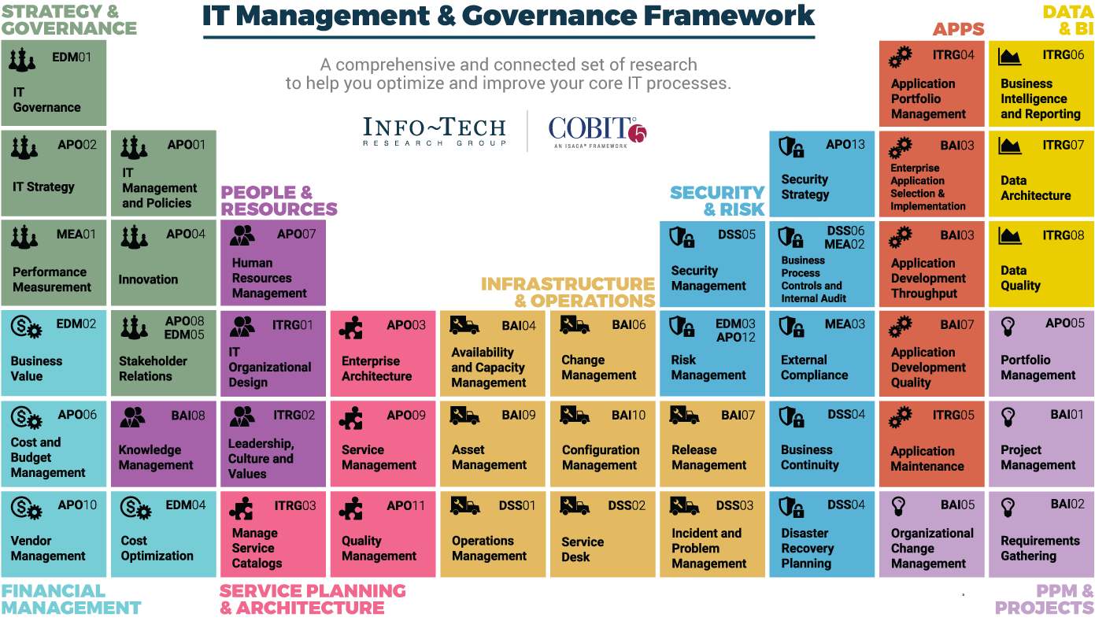
Dive Deeper Into Our Research
by Clicking One of the Elements Below
Find out how Info-Tech makes your job easier. Contact Us Today: Toll-Free (US & Canada): 1-888-670-8889
Info-Tech Research Group
SAMPLE

