Slide 1


Develop a Security Operations Strategy
Transition from a security operations center to a threat collaboration environment.
Info-Tech's products and services combine actionable insight and relevant advice with ready-to-use tools
and templates that cover the full spectrum of IT concerns.© 1997-2017 Info-Tech Research Group

Slide 2
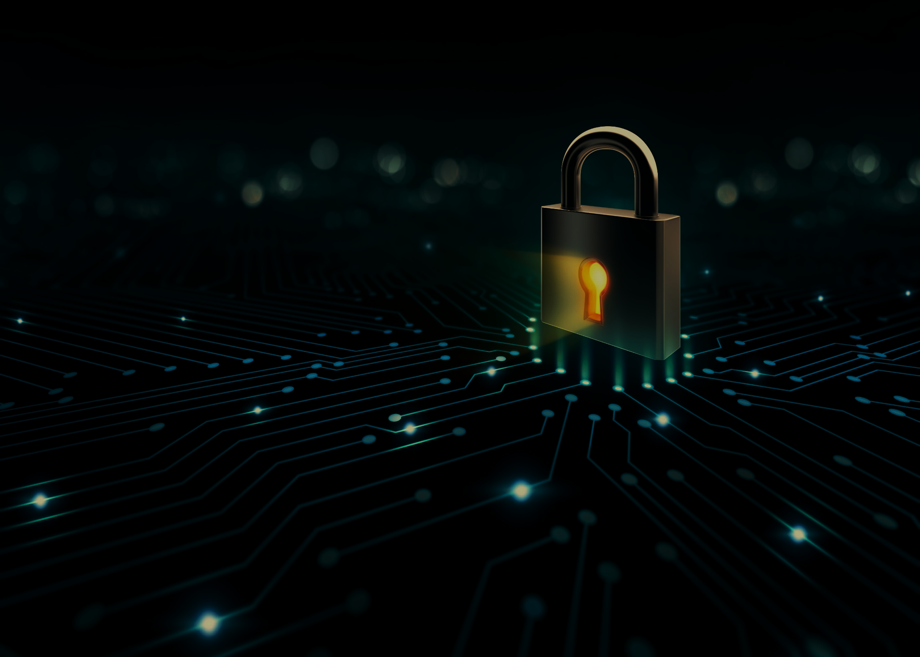




ANALYST PERSPECTIVE
A reactive security operations program is no longer an option. The increasing sophistication of threats demands a streamlined yet adaptable mitigation and remediation process. Protect your assets by preparing for the inevitable; unify your prevention, detection, analysis, and response efforts and provide assurance to your stakeholders that you are making information security a top priority.
Edward Gray,
Consulting Analyst, Security, Risk & Compliance
Info-Tech Research Group

Slide 3
Our understanding of the problem
Chief Information Officer (CIO)
Chief Information Security Officer (CISO)
Chief Operating Officer (COO)
Security / IT Management
Security Operations Director / Security Operations Center (SOC)
Network Operations Director / Network Operations Center (NOC)
Systems Administrator
Threat Intelligence Staff
Security Operations Staff
Security Incident Responders
Vulnerability Management Staff
Patch Management
Enhance your security program by implementing and streamlining next-generation security operations processes.
Increase organizational situational awareness through active collaboration between core threat teams, enriching internal security events with external threat intelligence and enhancing security controls.
Develop a comprehensive threat analysis and dissemination process: align people, process, and technology to scale security to threats.
Identify the appropriate technological and infrastructure-based sourcing decisions.
Design a step-by-step security operations implementation process.
Pursue continuous improvement: build a measurement program that actively evaluates program effectiveness.
Board / Chief Executive Officer
Information Owners (Business Directors/VP)
Security Governance and Risk Management
Fraud Operations
Human Resources
Legal and Public Relations
Aid decision making by staying abreast of cyberthreats that could impact the business.
Increase visibility into the organization’s threat landscape to identify likely targets or identify exposed vulnerabilities.
Ensure the business is compliant with regularity, legal, and/or compliance requirements.
Understand the value and return on investment of security operations offerings.

Slide 4
Executive summary
Current security practices are disjointed, operating independently with a wide variety of processes and tools to conduct incident response, network defense, and threat analysis. These disparate mitigations leave organizations vulnerable to the increasing number of malicious events.
Threat management has become resource intensive, requiring continuous monitoring, collection, and analysis of massive volumes of security event data, while juggling business, compliance, and consumer obligations.
Security operations is no longer a center, but a process. The need for a physical security hub has evolved into the virtual fusion of prevention, detection, analysis, and response efforts. When all four functions operate as a unified process, your organization will be able to proactively combat changes in the threat landscape.
Functional threat intelligence is a prerequisite for effective security operations – without it, security operations will be inefficient and redundant. Eliminate false positives by contextualizing threat data, aligning intelligence with business objectives, and building processes to satisfy those objectives.
If you are not communicating, you are not secure. Collaboration eliminates siloed decisions by connecting people, processes, and technologies. You leave less room for error, consume fewer resources, and improve operational efficiency with a transparent security operations process.
There is an onslaught of security data – generating information in different formats, storing it in different places, and forwarding it to different locations.
The organization lacks a dedicated enterprise security team. There is limited resourcing available to begin or mature a security operations center.
Many organizations are developing ad hoc security capabilities that result in operational inefficiencies, the misalignment of resources, and the misuse of their security technology investments.
It is difficult to communicate the value of a security operations program when trying to secure organizational buy-in to gain the appropriate resourcing.
There is limited communication between security functions due to a centralized security operations organizational structure.
A unified security operations process actively transforms security events and threat information into actionable intelligence, driving security prevention, detection, analysis, and response processes, addressing the increasing sophistication of cyberthreats, and guiding continuous improvement.
This blueprint will walk through the steps of developing a flexible and systematic security operations program relevant to your organization.

Slide 5



Data breaches are resulting in major costs across industries
% of systems impacted by a data breach
1%
No Impact
19%
1-10% impacted
41%
11-30% impacted
24%
31-50% impacted
15%
>50% impacted
% of customers lost from a data breach
61% Lost <20%
21% Lost
20-40%
8% Lost
40-60%
6% Lost
60-80%
4% Lost
80-100%
% of business opportunity lost from a data breach
Average data breach costs per compromised record hit an all-time high of $217 (in 2015); $74 is direct cost (e.g. legal fees, technology investment) and $143 is indirect cost (e.g. abnormal customer churn).
Source: Ponemon Institute, “2015 Cost of Data Breach Study: United States”
58% Lost <20%
25% Lost
20-40%
9% Lost
40-60%
5% Lost
60-80%
4% Lost
80-100%
Source: The Network, “ Cisco 2017 Security Capabilities Benchmark Study”

Slide 6


Persistent issues
Organizational barriers separating prevention, detection, analysis, and response efforts.
Siloed operations limit collaboration and internal knowledge sharing.
Of organizations say security operation teams have little understanding of each other’s requirements.
Lack of knowledgeable security staff.
Human capital is transferrable between roles and functions and must be cross-trained to wear multiple hats.
Failure to evaluate and improve security operations.
The effectiveness of operations must be frequently measured and (re)assessed through an iterative system of continuous improvement.
Of executives report that poor coordination leads to excessive labor and IT operational costs.
Lack of standardization.
Pre-established use cases and policies outlining tier-1 operational efforts will eliminate ad hoc remediation efforts and streamline operations.
38-100%
Increase in efficiency after closing operational gaps with collaboration.
Failure to acknowledge the auditor as a customer.
Many compliance and regulatory obligations require organizations to have comprehensive documentation of their security operations practices.
Source: Forbes, “The Game Plan for Closing the SecOps Gap”

Slide 7
The solution
“Empower a few administrators with the best information to enable fast, automated responses.”
– Ismael Valenzuela,
IR/Forensics Technical Practice Manager, Foundstone® Services, Intel Security
Insufficient security personnel resourcing has been identified as the most prevalent challenge in security operations…
When an emergency security incident strikes, weak collaboration and poor coordination among critical business functions will magnify inefficiencies in the incident response (IR) process, impacting the organization’s ability to minimize damage and downtime.
The solution: optimize your SOC. Info-Tech has seen SOCs with five analysts outperform SOCs with 25 analysts through tools and process optimization.
Sources:
Ponemon. "2016 State of Cybersecurity in Small & Medium-Sized Businesses (SMB).”
Syngress. Designing and Building a Security Operations Center

Slide 8
Maintain a holistic security operations program
Legacy security operations centers (SOCs) fail to address gaps between data sources, network controls, and human capital. There is limited visibility and collaboration between departments, resulting in siloed decisions that do not support the best interests of the organization.
Prevent: Defense in depth is the best approach to protect against unknown and unpredictable attacks. Diligent patching and vulnerability management, endpoint protection, and strong human-centric security (amongst other tactics) are essential.
Detect: There are two types of companies – those who have been breached and know it and those who have been breached and don’t know it. Ensure that monitoring, logging, and event detection tools are in place and appropriate to your organizational needs
Prevent
Detect
Next-Gen Security Operations
Analyze: Raw data without interpretation cannot improve security and is a waste of time, money, and effort. Establish a tiered operational process that not only enriches data but also provides visibility into your threat landscape.
Respond: Organizations can’t rely on an ad hoc response anymore – don’t wait until a state of panic. Formalize your response processes in a detailed incident runbook in order to reduce incident remediation time and effort.
Analyze
Respond
Security operations is part of what Info-Tech calls a threat collaboration environment, where members must actively collaborate to address cyberthreats affecting the organization’s brand, business operations, and technology infrastructure on a daily basis.

Slide 9




Info-Tech’s security operations blueprint ties together various initiatives
Deliverables
Vulnerability Management
Vulnerability management revolves around the identification, prioritization, and remediation of vulnerabilities. Vulnerability management teams hunt to identify which vulnerabilities need patching and remediating.
Vulnerability Tracking Tool
Vulnerability Scanning Tool RFP Template
Penetration Test RFP Template
Vulnerability Mitigation Process Template
Design and Implement a Vulnerability Management Program
Maturity Assessment Tool
Threat Intelligence RACI Tool
Management Plan Template
Threat Intelligence Policy Template
Alert Template
Alert and Briefing Cadence Schedule
Threat Intelligence
Threat intelligence addresses the collection, analysis, and dissemination of external threat data. Analysts act as liaisons to their peers, publishing actionable threat alerts, reports, and briefings. Threat intelligence proactively monitors and identifies whether threat indicators are impacting your organization.
Integrate Threat Intelligence Into Your Security Operations
Operations
Security operations include the real-time monitoring and analysis of events based on the correlation of internal and external data sources. This also includes incident escalation based on impact. Analysts are constantly tuning and tweaking rules and reporting thresholds to further help identify which indicators are most impactful during the analysis phase of operations.
Maturity Assessment Tool
Event Prioritization Tool
Efficiency Calculator
SecOps Policy Template
In-House vs. Outsourcing Decision-Making Tool
SecOps RACI Tool
TCO & ROI Comparison Calculator
Develop Foundational Security Operations Processes
Incident Response
Effective and efficient management of incidents involves a formal process of analysis, containment, eradication, recovery, and post-incident activities. IR teams coordinate root-cause analysis and incident gathering while facilitating post-incident lessons learned. Incident response can provide valuable threat data that ties specific indicators to threat actors or campaigns.
Incident Management Policy
Maturity Assessment Tool
Incident Management RACI Tool
Incident Management Plan
Incident Runbook Prioritization Tool
Various Incident Management Runbooks
Develop and Implement a Security Incident Management Program

Slide 10
This blueprint will…
…better protect your organization with an interdependent and collaborative security operations program.
Phase 01
Assess your operational requirements.
Briefly assess your current prevention, detection, analysis, and response capabilities.
Highlight operational weak spots that should be addressed before progressing.
Phase 02
Optimize and further mature your security operations processes
Develop a prioritized list of security-focused operational initiatives.
Conduct a holistic analysis of your operational capabilities.
Phase 3a
Develop the process flow and specific interaction points between functions
Define the operational interaction points between security-focused operational departments.
Document the results in comprehensive operational interaction agreement.
Phase 3b
Test your current capabilities with a table top exercise
Test your operational processes with Info-Tech’s security operations table-top exercise.

Slide 11
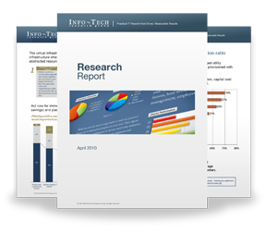

Info-Tech Research Group Helps IT Professionals To:
Quickly get up to speed
with new technologies
Make the right technology
purchasing decisions – fast
Deliver critical IT
projects, on time and
within budget
Manage business expectations
Justify IT spending and
prove the value of IT
Train IT staff and effectively
manage an IT department
Sign up for free trial membership to get practical
solutions for your IT challenges
“Info-Tech helps me to be proactive instead of reactive –
a cardinal rule in a stable and leading edge IT environment.
  - ARCS Commercial Mortgage Co., LP
Toll Free: 1-888-670-8889
www.infotech.com

