Slide 1
Welcome to our team.

Slide 2
Threat Landscape Briefing November 2017
Notes:
Good afternoon and welcome to the November 2017 Info-Tech Threat Landscape Briefing.
My name is TJ Minichillo and I am a Senior Director in our Security and Threat Intelligence practice. I will be facilitating today’s briefing.
During today’s discussion we will cover topics related to cybersecurity, threat actor campaigns, regulatory, compliance, and legal issues, and threat actor exploits and tactics.
Our cyber security section covers high-level topics, such as threat trends, data breaches, control strategies, and exposure to vulnerabilities, that act to broaden your understanding of the cybersecurity impact on your business.
Our threat actor campaign section covers topics related to nation states, cyber criminals, and hacktivists orchestrating campaigns designed to compromise networks and exfiltrate sensitive data.
Our regulatory, compliance, and legal section covers trends in the global regulatory and legal landscape with the potential to impact compliance adherences or disrupt business operations.
And lastly, our exploitation and tactics section provides information related to the tools, tactics, and exploits threat actors are leveraging in their attack campaigns.
<<<Advance to the next slide.>>>

Slide 3
Threat Briefing
Analysts
TJ Minichillo, MBA, CISSP Senior Director – Security, Risk & Compliance Info-Tech Research Group
Jessica Ireland
Associate. Director – Security, Risk & Compliance Info-Tech Research Group
Céline Gravelines, MSc, GSEC Research Manager – Security, Risk & Compliance Info-Tech Research Group
Ian Mulholland
Consulting Analyst – Security, Risk & Compliance Info-Tech Research Group
Azzam Jivraj Consulting Analyst – Security, Risk & Compliance Info-Tech Research Group
Notes:
Today’s briefing will also be supported by Associate Director Jessica Ireland, Research Manager Celine Gravelines, and Consulting Analyst(s) Ian Mulholland and Azzam Jivraj.
<<<Advance to the next slide.>>>

Slide 4
Agenda
Topics
Introduction
Cybersecurity
Round-up – Cybersecurity Awareness Month
Yahoo Data Breach
Threat Actor Campaigns
KnockKnock campaign targets Office 365 corporate email accounts
Regulatory, Legal, and Compliance
Best and worst security functions to outsource
Exploitation and Tactics
WPA2, Google, Microsoft, and other vulnerabilities
Notes:
During today’s briefing, we will cover topics related to:
October Cybersecurity Awareness Month
The Yahoo Data Breach
The KnockKnock campaign targeting Office 365 corporate email accounts
A review of the best and worst security functions to outsource
And an overview of the WPA2, Google, and Microsoft vulnerabilities
I would now like to pass the presentation over to Ian who will be covering our first topic.
<<<Advance to the next slide.>>>

Slide 5
High-level topics such as threat trends, data breaches, control strategies, and exposure to vulnerabilities that act to broaden your understanding of the cybersecurity impact to business.
Cybersecurity
Target Audience:
Chief Information Officer
Chief Information Security Officers
IT Risk Professionals
Business / Data Owners
Legal, Human Resources, and Public Relations
Vulnerability Management
Incident Responders, Security Operations
IT Professionals
Notes:
<<<Advance to the next slide.>>>

Slide 6
Round-up – Cyber Security Awareness Month
The internet has become an integral part of everyone’s daily life. The month of October is Cyber Security Awareness Month (CSAM). Every year, this time is used to raise awareness of cybersecurity best practices. Everybody should have the tools and knowledge that they need to stay safe when using the internet.
United States
Canada
Week 1 – Oct. 2-6
Simple Steps to Online Safety
Week 2 – Oct. 9-13
Cybersecurity in the Workplace is Everyone’s Business
Week 3 – Oct. 16-20
Today’s Predictions for Tomorrow’s Internet
Week 4 – Oct. 23-27
The Internet Wants YOU: Consider a Career in Cybersecurity
Week 5 – Oct. 30-31
Protecting Critical Infrastructure from Cyber Threats
Week 1 – Oct. 2-6
Get Cyber Safe and STOP.THINK.CONNECT.:
Simple Steps to Online Safety
Week 2 – Oct. 9-13
Cyber Security in the Workplace is Everyone’s Business
Week 3 – Oct. 16-20
Privacy Protection and the Internet of Things
Week 4 – Oct. 23-27
Digital Citizenship in an Increasingly Digital World
Sources: Public Safety Canada, Department of Homeland Security

Slide 7
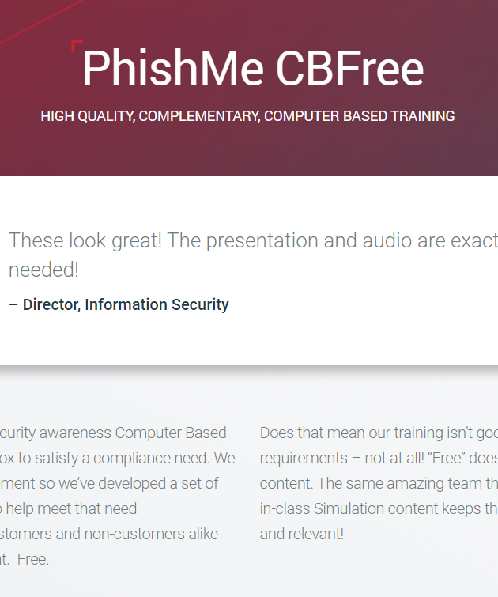
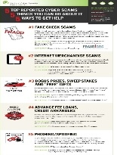
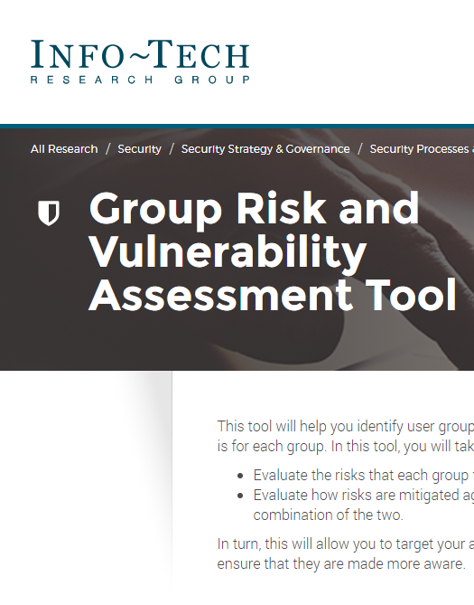
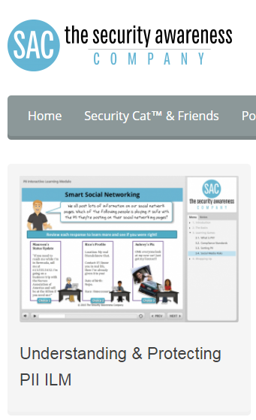
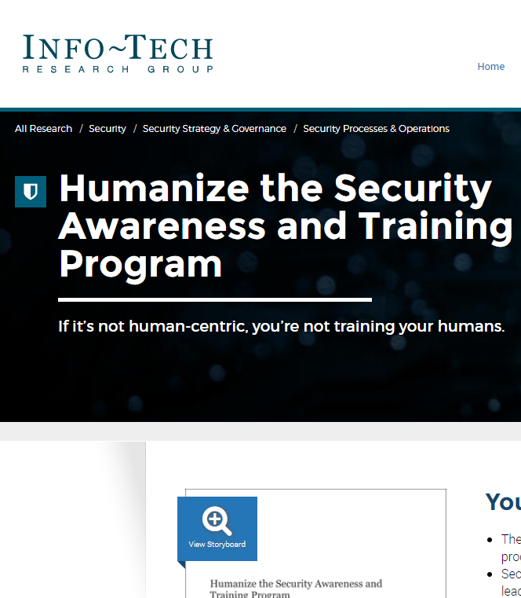
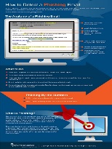
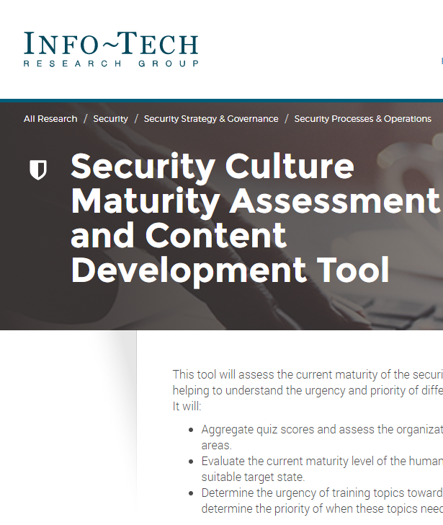
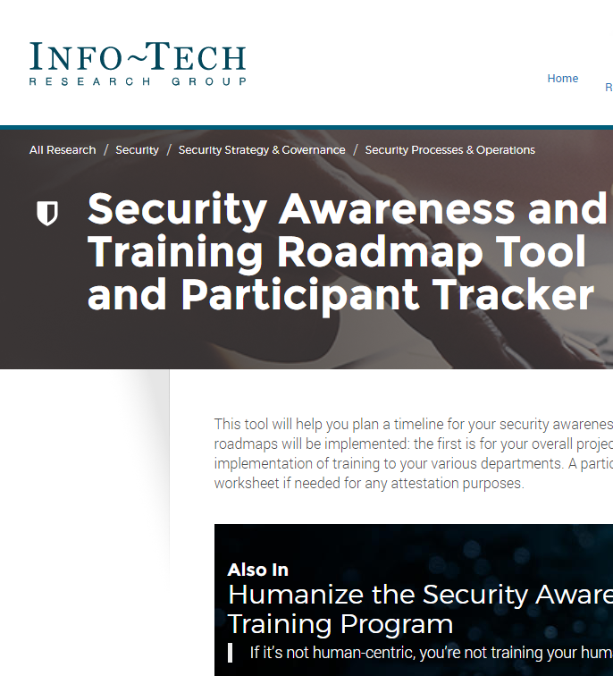
Round-up – Cyber Security Awareness Month
There is an abundance of online material that you can use to make both employees and your friends and family more aware of cybersecurity best practices. Some are even tailored to the Cyber Security Awareness Month’s weekly focuses:
MODULES
POSTERS
DEVELOPMENT
PhishMe CBFree
Be Safe Online
Group Risk Assessment
Security Awareness Co.
Info-Tech Modules
Inspired eLearning
Security Awareness Co.
Maturity Assessment
Roadmap and Participation Tracker

Slide 8
Yahoo Data Breach
Overview
1
Yahoo’s 2013 breach was worse than originally thought. At the time, it was reported that about 1 billion users were attacked. It was closer to 3 billion users (essentially all of Yahoo’s accounts).
2
What was taken: names, birth dates, phone numbers, and passwords that were encrypted, but encrypted with security that was fairly weak for what you’d expect from Yahoo. Also multi-factor authentication/verification was compromised as attackers also took users’ security questions and their backup email addresses used in the resetting of passwords.
3
The data itself has allegedly been for sale quietly throughout the dark web. InfoArmor – a cybersecurity company in Arizona that monitors the dark web – indicated at least 3 buyers have paid about $300,000 for each complete copy of Yahoo’s stolen database.
“Frankly, I don’t know how Yahoo got away with this.”
– Jay Kaplan, former Defense Department cybersecurity expert and senior analyst at National Security Agency (now chief executive of cybersecurity company Synack)
Notes:
It turns out Yahoo's 2013 breach was actually worse than originally stated:
At the time, it was reported that about one billion users were attacked. However, it's actually closer to 3 billion users, aka ALL Yahoo accounts (say Krebs on Security and the New York Times). This announcement was made in early October by Verizon Communications, which acquired Yahoo earlier this year.
As a reminder of what was taken: names, birth dates, phone numbers, and passwords that were actually encrypted, but encrypted with security that was fairly weak for an organization as big as Yahoo to be tied to.
To add insult to injury, attackers also got hold of security questions and individuals' backup email addresses used in the resetting of passwords – so multi-factor authentication and verification was also compromised.
Going back to the acquisition by Verizon, the disclosure of these breaches almost put a kibosh on the $4.48B deal in June 2017.
Quoted in the New York Times: “Frankly, I don’t know how Yahoo got away with this,” said Jay Kaplan, a former Defense Department cybersecurity expert and senior analyst at the National Security Agency who is now the chief executive of the cybersecurity company Synack.
From <https://www.nytimes.com/2017/10/03/technology/yahoo-hack-3-billion-users.html?_r=0>
Naturally, Yahoo has been subject to multiple stakeholder lawsuits and continued financial liabilities.
The data itself has allegedly been for sale quietly throughout the dark web.
InfoArmor, a cybersecurity company in Arizona that monitors the dark web, noted that at least three buyers paid about $300,000 for each complete copy of Yahoo's stolen database.

Slide 9
Yahoo Data Breach
So what has Yahoo done?
Recommendations
When the 1 billion affected accounts were announced in 2016, Yahoo directly notified individual impacted users, requiring password changes and invalidating unencrypted security questions and answers so those tools couldn’t be used to access an account.
With this new information, Yahoo posted a fact sheet for users (linked below), and Verizon communicated that it is working closely with law enforcement to remedy the situation.
What can users do?
Monitor your accounts.
Change the password of any accounts that have the same password as your Yahoo account.
Yahoo 2013 Account Security Update FAQs
Notes:
So what has Verizon/Yahoo done?
When the 1 billion affected accounts were announced in 2016, Yahoo directly notified individual impacted users, required password changes, and invalidated unencrypted security questions and answers so those tools couldn't be used to access an account.
With this new information, Yahoo posted a fact sheet for users (linked here), and Verizon communicated that it is working closely with law enforcement to remedy the situation.
What can users do?
Monitor your accounts.
Accounts with the same password could fall victim if they had the same password as your Yahoo account so change passwords.
Now onto Threat Actor Campaigns.

Slide 10
Current intelligence that addresses the increasing threat from prevalent nation states, cybercriminals, hacktivists, and/or cyberextremists orchestrating attack campaigns to compromise networks and exfiltrate sensitive data.
Threat Actor Campaign
Target Audience:
Chief Information Security Officers
Information Security Officers
IT Risk Professionals
Threat Intelligence Analysts
Vulnerability Management
Incident Responders
Security Operations
IT Professionals
Notes:
<<<Advance to the next slide.>>>

Slide 11
KnockKnock campaign
Overview:
KnockKnock: botnet campaign used to attack Office 365 Exchange Online email accounts targeting manufacturing, financial services, healthcare, US public sector, and more.
Keys to success:
1
Targeted admin automated accounts used to integrate corporate email systems with marketing and sales automation software – fewer password controls, more access/privileges, less suspicious.
3
KnockKnock used a slow and steady campaign – low volume, only five email addresses attacked per customer; botnet distributed by only 83 IP addresses across 63 networks.
2
4
3
The attackers used passwords that were exposed in previous breaches and brute-forced the account usernames to gain access to corporate systems.
5
Once access was gained, attackers exfiltrated valuable data, then created new rules in the inbox to hide/divert incoming messages before using phishing attacks to spread the infection further.
4
Sources: Skyhigh Networks; ZDNet; BleepingComputer
Notes:
The KnockKnock botnet campaign started in May 2017 and has spread rapidly over the course of the summer, targeting Office 356 Exchange Online email accounts across manufacturing, financial services, healthcare, US public sector, and other industries.
There were a few things done by the attackers that made this campaign particularly successful and unique.
One key was that it was able to fly under the radar by targeting AUTOMATED corporate email accounts – ones that weren’t tied to a human identity – since these ones often lack advanced security policies, such as not requiring multifactor authentication, or not requiring recurring password resets. This attack targeted these weakly protected admin accounts that were often used to integrate corporate email systems with marketing and sales automation – so these accounts had higher access and privileges compared to average accounts. In addition, other users don’t expect to receive malicious content from these addresses, so people are less suspicious and more likely to blindly click a link from an internal, generic email address.
Another key to the success of this campaign was the way in which it was deployed and propagated. The botnet itself was quite small – according to Skyhigh Networks, who detected it, it was distributed by just 83 IP addresses across 63 networks. And interestingly, rather than a typical botnet targeting a high volume and working quickly, KnockKnock focused on precision, attacking an average of only five email addresses for each customer targeted – again, allowing it to stay under the radar and avoid detection early on. It also used a slow approach, by guessing only a few credentials at a time and spreading the attack over several days, since a quick brute-force attempt would be easily recognized by decent security controls.
In order to get access, rather than brute-forcing the passwords, the attackers took advantage of previously leaked passwords. So for example, if Sally Jones had her LinkedIn account compromised before, the attackers would take that known password and try it with her corporate account. Since they didn’t know the corporate email exactly, they simply attempted different variations of common usernames, based on the name. So they’d try that known password with usernames like sjones, sally.jones, or jones.s.
So once access to a corporate system account was gained, KnockKnock would:
Exfiltrate any data in the inbox that was likely valuable – these admin accounts were often treasure troves of sensitive, valuable data.
They would create new rules in the inbox to hide and divert incoming messages, then use phishing attacks to further spread the infection around the enterprise. The emails would come from the compromised email address in an attempt to compromise more inboxes within the organization.
So overall, some key features that made KnockKnock so successful was the slow-moving, methodical, and stealthy nature of the attack, coupled with the type of admin accounts targeted and the use of previously compromised accounts, which allowed it to propagate so successfully before being detected
At the time of writing this, the treat actor hasn’t been identified yet – “the IP addresses of the hacked devices used to run it don’t appear on any lists of known botnets or bad actor IP address. They note that around 90% of login attempts come from China. However, attackers could easily change or re-route IP addresses in order to cover their tracks, so it's impossible to say for certain that the attacks originated from China.”
----------
Going after these accounts rather than the typical employee account was crucial to the success of the campaign.

Slide 12
KnockKnock campaign
Recommendations:
Use strong password policies for all accounts, even if not tied to a human individual. Use MFA and require password resets, complex characters, etc.
Don’t store sensitive/valuable information in your inbox. Practice email storage hygiene.
Implement awareness and training for phishing to recognize phishing even if it comes from an internal generic email address.
Don’t reuse passwords from other accounts – especially if it’s been breached!
Look for failed login attempts. Know how to identify suspicious attempts beyond simple brute force.
3
4
5
Notes:
As with most breaches, it at least lends itself to be a good learning opportunity. This botnet displayed how attackers are getting more intelligent to out-smart current security controls, so here we have a list of recommendations:
Lastly, be sure to investigate failed login attempts. The KnockKnock campaign didn’t employ a standard brte-force attempt, but rather, they spread it out over a number of days. Look for these patterns so that you can prevent similar incidents in the future.

Slide 13
Trends in the global regulatory and legal landscape with the potential to impact compliance adherences or disrupt business operations.
Regulatory, Legal, and Compliance
Target Audience:
Chief Information Officer
Chief Information Security Officers
IT Risk Professionals
Chief Privacy Officers
Privacy Professionals
Business / Data Owners
Legal, Human Resources, Public Relations
IT Professionals
Notes:
Thank you, Ed. Next we’ll move into the Regulatory, Legal, and Compliance section.
<<<Advance to the next slide.>>>

Slide 14
Best and worst security functions to outsource
It’s hard to find and retain security professionals. Therefore, most organizations won’t have a choice – they will have to outsource high-end security skills.
The main question is which functions should be outsourced and which ones should be kept in-house.
Remember that while you can outsource your responsibilities, the accountability remains with you. Therefore, you must understand the criticality of a function before you outsource it.
Should Outsource
Network Monitoring
Application Security
Shouldn’t Outsource
Incident Response and Breach Remediation
Security Strategy, Architecture, and Policy
Forensics
Litigation
Identity Governance
Vulnerability Management
Source: Dark Reading

Slide 15
Information related to the tools, tactics, and exploits threat actors are leveraging in their attack campaigns.
Exploitation and Tactics
Target Audience:
Chief Technology Officer
Chief Information Security Officers
Information Security Officers
Threat Intelligence Analysts
Vulnerability Management
Incident Responders
Security Operations
IT Professionals
Notes:
<<<Advance to the next slide.>>>

Slide 16
WPA2, Google, Microsoft, and other vulnerabilities
Overview
At least ten critical vulnerabilities have been identified in the Wi-Fi Protected Access II (WPA2) protocol that is commonly used to secure Wi-Fi networks.
The WPA2 protocol is susceptible to the vulnerabilities outlined in the below CVEs. Organizations should review the guidance provided to determine any impact and remediation.
CVE-2017-13077
CVE-2017-13078
CVE-2017-13079
CVE-2017-13080
CVE-2017-13081
CVE-2017-13082
CVE-2017-13084
CVE-2017-13086
CVE-2017-13087
CVE-2017-13088
1
The recently discovered vulnerabilities impact both client and access point infrastructure, providing the attacker with the ability to decrypt data.
2
Malware is injected into the data stream, hijacking the connection by leveraging the key reinstallation attacks or “KRACKs.” The KRACK attacks work on all modern wireless networks using the WPA2 protocol and any device that supports Wi-Fi.
3
Google, Microsoft, and others also reported a bug in several firmware versions, allowing attackers the ability to recover the private part of RSA keys.
4
Nearly all Chrome OS devices that include an Infineon TPM chip are affected, and although large-scale attacks are not possible, a practical exploit already exists for targeted attacks.
Sources: Dark Reading; Key Reinstallation Attacks
Notes:
Researchers at a University in Belgium discovered at least ten vulnerabilities in the Wi-Fi Protected Access II protocol which is commonly used to securely access to the internet through wireless devices. An attacker could take advantage of vulnerabilities in both client and access point implementations that could allow for the decryption of data, causing an opportunity to inject malware.
These vulnerabilities can be used by a threat actor to steal credit card numbers, user account information, passwords, and other very sensitive information. In addition, and depending on the network configuration, it is also possible for the threat actor to launch a ransomware or other malware campaign.
The WPA2 protocol is susceptible to the vulnerabilities outlined in the CVEs on this slide. Organizations are encouraged to review the guidance provided, determine their organizational impact, and update any affected infrastructure.
Infineon trusted platform modules are used in computers and other devices to generate RSA key pairs to establish secure virtual private network connections, used in full disk encryption, securing access to cloud services, and many other applications. Recently it was reported that it is possible to mathematically crack the encryption via a bug that would allow an attacker to calculate a private key just by having a public key. The bug has been around as early as 2012 and found on corporate-grade HP and Lenovo computers as well as Google Chromebooks, routers, and Internet-of-Things devices.

Slide 17
Welcome to our team.
Notes:
This concludes our monthly threat briefing. Included in today’s presentation were several hyperlinks to our research blueprints that you can use to address some of the threats presented during the briefing.
If you have any questions or need any support, please do not hesitate to contact us to set up an analyst call.
Thank you.

