Slide 1
Select and Implement a Next Generation Endpoint Protection Solution
Today’s security battles are fought at the endpoint.
Info-Tech's products and services combine actionable insight and relevant advice with ready-to-use tools and templates that cover the full spectrum of IT concerns.© 1997–2017 Info-Tech Research Group

Slide 2
ANALYST PERSPECTIVE
Server compute workloads continue to migrate from traditional on-premises delivery to cloud and hybrid models, and endpoint compute workloads continue to migrate from traditional, corporately owned form factors connected to a corporate network, to a wide mix of personal and corporate devices connecting to both corporate and foreign networks. Ready or not, ubiquitous computing is upon us.
As a result, protecting endpoints (and through them, our critical systems and data) against evolving threats requires new solutions – but as a consumer of such solutions, the IT security professional needs ongoing support to navigate through the rapidly changing endpoint solution space and (often) self-serving vendor claims.
James McCloskey,
Senior Director, Security, Risk & Compliance Info-Tech Research Group

Slide 3
Our understanding of the problem
Chief Information Officer (CIO)
Chief Information Security Officer (CISO)
Security / IT Management
Security Operations Director / SOC
Network Operations Director / NOC
Systems Administrator
Threat Intelligence Staff
Security Operations Staff
Security Incident Responders
Vulnerability Management Staff
Enhance your security program by selecting, implementing, and streamlining the most appropriate next generation endpoint protection suite.
Determine the most suitable sourcing decision(s) by identifying the use case and corresponding feature set that best aligns with your organizational landscape.
Increase situational awareness through continuous endpoint prevention, detection, analysis, and response techniques, enriching internal security events with external threat intelligence, and enhancing security controls.
Design a step-by-step NG-EPP implementation process.
Pursue continuous improvement; build a measurement program that actively evaluates program effectiveness.
Board / Chief Executive Officer
Information Owners (Business Directors/VP)
Security Governance & Risk Management
Human Resources
Legal & Public Relations
Execute educated endpoint protection purchasing decisions that cater to the organization’s needs and specific use case.
Understand the value and return on investment of endpoint protection offerings.
Increase visibility into the organization’s threat landscape to identify likely targets or identify exposed vulnerabilities.
Ensure the business is compliant with regularity, legal, and/or compliance requirements.

Slide 4
Executive summary
Endpoint protection is an ever-consolidating market of security controls. Traditional approaches are failing to address modern protection challenges while new market entrants are providing more focused coverage.
Identifying organizational needs while accounting for the diverse array of vendor solutions is both time consuming and a drain on resources.
Don’t let vendors and market reports define your endpoint protection needs. Identify the use cases and corresponding feature sets that best align with your risk profile before evaluating the vendor marketspace.
Your security controls are diminishing in value (if they haven’t already). Develop a strategy that accounts for the rapid evolution and imminent obsolescence of your endpoint controls. Plan for future needs when making purchasing decisions today.
Endpoint protection is a matter of defense in depth and risk modelling; there is no silver bullet protection and mitigation solution. As end-client-technology providers release regular product/software updates, security tools will become outdated. Multiyear endpoint protection commitments will leave you playing a constant game of catch up.
As the market evolves, capabilities that were once cutting edge become default and new functionality becomes differentiating.
The endpoint protection (EPP) market is overcrowded and fragmented, resulting in information overload and consequently, a difficult vendor assessment.
Disparate product solutions are being bundled into one-off solutions or suites, often resulting in inefficient solutions than the more niche players.
Imminent obsolescence: previous EPP solutions have not adapted with the rapidly evolving threat landscape and are no longer relevant, resulting in breaches or vulnerabilities.
Vendors use a lot of marketing jargon, buzzwords, and statistics to sell their solutions, making objective evaluation rather difficult.
The solution is a holistic internal security assessment that not only identifies, but satisfies, your desired endpoint protection feature set with the corresponding endpoint protection suite and a comprehensive implementation strategy.
This blueprint will walk through the steps of selecting and implementing an endpoint protection solution that best aligns with your organizational needs.

Slide 5
Data breaches are resulting in major costs across industries
% of systems impacted by a data breach
1%
No Impact
19%
1–10% impacted
41%
11–30% impacted
24%
31–50% impacted
15%
>50% impacted
% of customers lost from a data breach
61% Lost <20%
21% Lost
20–40%
8% Lost
40–60%
6% Lost
60–80%
4% Lost
80–100%
% of business opportunity lost from a data breach
Average data breach costs per compromised record hit an all-time high of $217 (in 2015); $74 is direct cost (e.g. legal fees, technology investment) and $143 is indirect cost (e.g. abnormal customer churn).
Source: 2015 Cost of Data Breach Study: United States, Ponemon Institute
58% Lost <20%
25% Lost
20–40%
9% Lost
40–60%
5% Lost
60–80%
4% Lost
80–100%
Source: Cisco 2017 Security Capabilities Benchmark Study

Slide 6
There’s a lot more to endpoint security than just anti-virus
Features
Traditional EPP/AV
NG-EPP
Signature-Based AV | . | .
Heuristic AV |  | .
Machine Learning |  | .
Host Firewall (Stateful Inspection) | . | .
Host IPS | . | .
Host IDS |  | .
Kernel Monitoring |  | .
Full-Disk Encryption | .
File-Folder Encryption | .
Removable Media Encryption | . | .
Port & Device Control | . | .
Endpoint DLP | . | .
Patch Management | . | .
System Hardening |  | .
Application Whitelisting/Blacklisting (Static) | . | .
URL Filtering | .
Cross-Platform Integration |  | .
Threat Intelligence Enrichment |  | .
MSSP Support | . | .
Digital Forensics |  | .
Long-Term Data Retention |  | .
Automated Remediation |  | .
Cloud-Based Application Detonation |  | .
Local Containerization |  | .
Secure Web Browsing/Micro-Segmentation |  | .
Central Portal Policy Management | . | .
Active Directory Integration | . | .
Mobile OS Support | . | .
Next-gen products will become current-gen and, eventually, last-gen.
Organizations must decide whether their next endpoint protection solution can transcend generations and adapt alongside the threat landscape.
admitted one or more endpoints had been compromised within the past 24 months
of incidents were detected via the endpoint
The average employee uses at least 3 devices for day-to-day work.
57%
Source: Sans 2016 Endpoint Security Survey

Slide 7
A vendor-driven EPP selection approach is unsustainable: DO NOT let vendors define your security needs
As threats and subsequent defenses evolve, the more appropriate question is:
“What is the right use case for my business?”
Private Asset on Foreign Network
Organizations consist of distributed endpoints that might be personally owned, unmanaged, and/or be connecting to unsecured networks on the regular, but still access corporate networks and assets.
…the perimeter is simply too fluid to successfully manage using a traditional network security architecture.
– Elliot Lewis, VP Security, Risk, and Compliance, Info-Tech Research Group
VPN
CASB
Digital Forensics
MDM/EM
SSO/IAM
DLP
System Hardening
Data Encryption
Private Asset on VPN
Private Asset on Corporate Network
Managed Asset on Foreign Network
Managed Asset on VPN
Managed Asset on Corporate Network
Corporate Network & Mgmt Systems
Corporate IaaS & PaaS
Corporate SaaS
Corporate-Approved Third-Party Services
On-premises Shadow IT
Off-premises Shadow IT
First, identify which operating models are relevant and from there assess the feature sets that best satisfy your organizational needs.

Slide 8
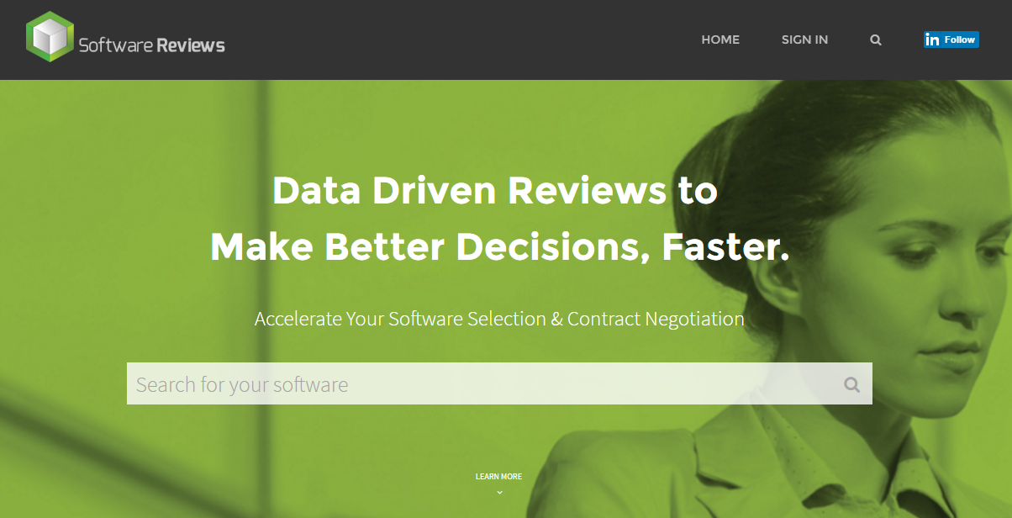
Use this blueprint to streamline your endpoint protection selection and implementation process
Launch the EPP Project & Collect Feature Requirements
Phase 1
Strategic Benefits
Not everyone’s endpoint protection needs are the same. Develop an endpoint protection strategy and identify the corresponding feature sets that best align with your organizational requirements.
Improved organizational situational awareness.
Improve internal and external communication with top executives about organizational risks, threat actor TTPs, and security ROI.
Leverage Software Reviews to begin making data-driven sourcing decisions based on industry expert reviews.
Select Your EPP Solution
Phase 2
Organizational cost savings. Limit unnecessary spending by streamlining the endpoint protection selection and management process.
Risk reduction.
NG-EPP reduces the margin for error through the consolidation of various network controls.
Plan Your EPP Implementation
Phase 3
Understand your business’ integration environment. Define the technical, functional, and strategic requirements for a smooth endpoint protection deployment strategy.

Slide 9
Benefits of a next generation endpoint protection solution
Tactical Benefits
Operational Benefits
Improved visibility into managed and unmanaged devices through active kernel monitoring and digital forensics.
Dynamic malware-based detection through the use of behavioral analysis and machine learning.
Application containment mechanisms for safe malware detonation and analysis.
Integration of network-based security controls within endpoint clients – host IDS, IPS, DLP, etc.
Automated remediation capabilities to restore infected endpoints to prior states.
Improved effectiveness of internal defense controls such as SIEM, NGFWs, IPS, IDS, SWGs, anti-malware, and anti-spam packages.
Increased resolution rate. Situational awareness provides data with context, allowing security operations teams to more effectively remediate incidents.
Increased device uptime as network-based security controls transition to the endpoint.
Intelligence-driven patch management. Threat intelligence provides actionable vulnerability and exploitation data to automatically patch critical vulnerabilities.
Contextualization of endpoint data. Digital forensics – accelerates the identification of root cause analysis.
Enhanced communication through the use of a central management portal.
Maximizing the value of your NG-EPP strategy depends on close integration with people, process, and technology.

Slide 10
Info-Tech offers various levels of support to best suit your needs
Guided Implementation
DIY Toolkit
Workshop
Consulting
“Our team has already made this critical project a priority, and we have the time and capability, but some guidance along the way would be helpful.”
“Our team knows that we need to fix a process, but we need assistance to determine where to focus. Some check-ins along the way would help keep us on track.”
“We need to hit the ground running and get this project kicked off immediately. Our team has the ability to take this over once we get a framework and strategy in place.”
“Our team does not have the time or the knowledge to take this project on. We need assistance through the entirety of this project.”
Diagnostics and consistent frameworks used throughout all four options

Slide 11
Measured value for Guided Implementations
Engaging in GIs offers valuable project advice and significant cost savings.
GI | Purpose | Measured Value
Phase 1: Create An EPP Strategy | Determine why you need a new endpoint protection solution Understand Info-Tech’s use-case approach Evaluate current endpoint protection feature sets and criteria | Time, value, and resources saved using our industry expertise, best practices, and templates: Project Manager: 2 days x $800/day = $1,600
Phase 2: Select Your EPP Solution | Optimize your endpoint protection procurement process Determine EPP vendor criteria Evaluate the EPP marketspace Design, submit, and evaluate vendor RFPs | Time, value, and resources saved using our industry expertise, best practices, and templates: Project Manager: 3 days x $800/day = $2,400 Variable savings: Cost avoidance associated with right-sizing product selection.
Phase 3: Implement and Manage Your EPP Solution | Identify the appropriate resourcing plan for your endpoint protection solution Plan the implementation Design, build, test, and roll out the solution Develop a comprehensive measurement program | Time, value, and resources saved using our industry expertise, best practices, and templates: Project Manager and SysAdmins: 2 days x $800/day = $1,600 Variable savings: Cost reduction associated with removing any existing EPP solutions.
Total Savings |  | $5,600 + any cost avoidance/cost reduction opportunities

Slide 12
Info-Tech Research Group Helps IT Professionals To:
Quickly get up to speed with new technologies
Make the right technology purchasing decisions – fast
Deliver critical IT projects, on time and within budget
Manage business expectations
Justify IT spending and prove the value of IT
Train IT staff and effectively manage an IT department
Sign up for free trial membership to get practical
solutions for your IT challenges
“Info-Tech helps me to be proactive instead of reactive – a cardinal rule in a stable and leading edge IT environment.
- ARCS Commercial Mortgage Co., LP
Toll Free: 1-888-670-8889
www.infotech.com

