Slide 1
Build, Optimize, and Present a Risk-Based Security Budget
Get the budget you deserve.

Slide 2
ANALYST PERSPECTIVE
Move away from the traditional approach to a risk-based budget.
We often hear about security budgets being built on what was allocated last year plus a little extra for contingency. In that vein, whenever there is a desire to increase the security budget, the amount that is requested is often just a guess of what would actually be needed.
That doesn’t work anymore.
Here at Info-Tech, we want you to build a risk-based security budget. With this approach, you will look at how different security controls change the overall risk level of the organization, while also examining the effectiveness of the controls themselves. This will allow your budget to evolve with the business growth model and still ensure that you are providing the correct level of security. The process will make it easier to discuss security with the business and ensure they understand what the true value of mitigation is.
Filipe De Souza,
Research Manager – Security, Risk & Compliance Info-Tech Research Group

Slide 3
Our understanding of the problem
CISOs or equivalent
Identify what requirements are needed for a defensible security budget.
Allocate funds based on the mitigation effectiveness and risk model of the organization.
Articulate and present security to the business as a necessary cost of doing business.
CIOs
Incorporate the security budget as part of the larger IT budget.
Understand how to explain the value of security to the rest of the organization.

Slide 4
Executive summary
Year after year, CISOs need to develop a comprehensive security budget that is able to mitigate against threats.
The budget will have to be defended to other stakeholders to ensure that there is proper funding.
CISOs can demonstrate the value of security when mitigations are correlated to business operations and any future budgetary needs are properly attributed to business evolution.
Develop a comprehensive corporate risk analysis and mitigation effectiveness model. This will illustrate the moving targets in your security posture, which helps identify critical issues to include in your budget.
Security budgets are unlike other departmental budgets. Increases or decreases in the budget can drastically affect the organization’s ability to address risk.
CISOs struggle with the ability to assess the effectiveness of their security controls and determine where to allocate money.
Info-Tech’s methodology moves you away from the traditional budgeting approach to build a budget that is designed to be as dynamic as the business growth model.
Collect the requirements of your organization and build different budget options to describe how increases/decreases can affect the risk level.
Discuss these different budgets with the business to determine what level of funding is needed for the desired level of security.
Gain easy approval of your budget by “preshopping” and presenting the budget early to individual stakeholders prior to the final budget approval process.

Slide 5
It’s time to start thinking and talking about security budgets differently
Security is often seen as a sunk cost to the business and has been difficult to budget for.
Go a step further and start describing security as a COGS to the business.
The security budget is no traditional budget. Companies need to evolve their security budgeting process to deal with the demands of today’s cybersecurity issues.
Previous budgetary methodologies were based on contained, static environments.
Organizations have become stagnant with their budget processes, as employees tend to follow what their predecessor did rather than challenge the status quo.
Start building your budget with a view into the risk your organization faces.
By focusing on how different budget allocations can change the organization’s ability to address risk (organizational risk level), it becomes easier to communicate with business stakeholders on the need for different controls.
COGS (cost of goods sold): the costs needed for the production of goods or services that are produced by an organization.
Security is often seen as solely a function of the IT or security department, instead of being integral to every business operation. This should be a shift in thought of security as a COGS to the business.
Security → COGS can be described at two levels:
At a high level, where it communicates how security enables business functions more generally.
At the individual project or initiative level, where security must be included as part of the initial budgets to ensure it is accounted for from the very beginning.
Security is no longer considered optional. Demonstrate how security is now the regular cost of doing business.

Slide 6
Build a high-quality security budget by measuring mitigation effectiveness and connecting this to business capabilities
64%
Problem: Security professionals struggle to articulate the value of security to the board and other executives. This makes it difficult for these same individuals to allocate money to security initiatives and controls, when they are looking toward more revenue-generating areas instead.
In a Ponemon Institute study on IT security spending and investments, 64% of survey respondents indicated that the security budget was not on the board’s agenda due to lack of “expertise and knowledge about security.”
36% indicated that IT security was not even considered a priority issue.
CISOs can demonstrate the value of security when mitigations are correlated to business operations and any future budgetary needs are properly attributed to business evolution. This is where you can transition thinking about security to a COGS for the business.
29%
Problem: Organizations struggle to know how to budget for security, as they are unsure which controls are working effectively. Budgeting is done through a great deal of guesswork and often leads to budget constraints, as there was not the proper planning and analysis at the beginning.
In a SolarWinds federal cybersecurity survey, budget constraints is at the top of a list, at 29%, of obstacles to maintaining or improving a federal agency’s IT security.
To identify the critical areas and issues that need to be reflected in your security budget, you need to develop a comprehensive corporate risk analysis and mitigation effectiveness model that will illustrate where the moving targets are in your security posture.

Slide 7
Info-Tech’s methodology to building the budget consists of three phases
Review requirements for the budget
Build the budget
Present the budget
This phase will involve:
Performing the correct level of analysis before building the budget itself.
This can include performing a mitigation effectiveness assessment, conducting a risk analysis, and refining your security strategy.
The level of requirements that need to be collected vary from organization to organization. There are three different efficacy options that can be used to determine what should be done.
See the next slide for an overview of the different requirements options that are available.
This phase will involve:
Inputting requirements identified in phase 1 into the budget.
This will include an identification of how security controls relate to IT systems and business capabilities.
Next, you will focus on the creation of an overall budget that is split for you into three different budgets based on three different risk profiles.
This will help demonstrate how changes to the budget can change the risk levels accordingly.
With the budget complete, this phase involves:
Starting with “preshopping,” where there are one-on-one sessions conducted with stakeholders prior to the final presentation. This will solicit feedback and make budget updates as needed.
Final presentation of the budget.
Finally, the budget can go to the final budget committee where there is additional support for how to succeed and gain approval.

Slide 8
In phase 1, you will review the different efficacy options in building your security budget
There are three options when it comes to building a security budget. These include:
High Efficacy Option
This method is valuable for organizations that need to build a highly defensible budget based on their threat model and their corresponding mitigations.
Medium Efficacy Option
This is valuable for organizations that need some level of validation for their security budget but may not require as much of a deep dive as the second option.
Low Efficacy Option
For organizations that do not struggle to defend a security budget, this method allows for the budget to be easily built and then presented.

Slide 9
High Efficacy Option
A high-efficacy budget is for you if you say yes to most of these questions:
Am I able to operate effectively with the budget that I am being allocated?
Am I regularly asked why certain security controls are needed?
Do I struggle to justify security expenses to our executives and/or board?
Am I aware of how effective my current security controls are in mitigating against risk?
What is my risk tolerance level? Is my budget allowing me to stay below an acceptable level of risk?
Are my security expenditures related to my security strategy, and by extension, the larger business strategy?
This option allows for a highly defensible security budget as it involves:
Defining a risk tolerance level to compare how different expenses exceed or stay below this level.
Conducting a risk analysis of the organization to understand where the largest risks are that need resources.
Performing an assessment to understand how effective security controls and mitigations are against your risk tolerance.
Refining the security strategy to incorporate all of the risk findings through prioritization.

Slide 10
Medium Efficacy Option
For the medium efficacy option, consider the trade-offs between time, quality, and money:
Quality: Am I looking to build a highly defensible budget that demonstrates the effectiveness of my controls?
Consider the high efficacy option.
OR
Money: Do I find that security can be difficult to justify at times but overall has the support of the business?
Time: Am I too time constrained to perform in-depth budget & risk analysis, but I still want some evaluation of mitigations?
Consider the medium efficacy option.
OR
Money & Time: Am I able to get security spend approved easily and need to complete a budget quickly?
Consider the low efficacy option.
This option allows for a budget to be built with some defensibility, but without the depth that the high efficacy option includes. This includes:
Performing a mitigation effectiveness assessment so that, at minimum, an understanding of the security controls and their ability to mitigate against the organizational threat model is well understood.
This allows for a budget that needs less of the prework involved with building a risk model and still provides a defensible model that demonstrates the effectiveness of security controls.

Slide 11
Low Efficacy Option
A low efficacy budget is for you if you say yes to most of these questions:
Are my business stakeholders supporters of security?
Does my culture not allow for in-depth analysis during budgeting?
Is it easy to secure funding for new projects and initiatives?
Have I found previous security budgets easy to justify and get approved?
Am I too time constrained to complete any of the other efficacy options and need to complete my budget as soon as possible?
This option allows you to go directly to building the budget itself. While it does not include an evaluation of the risk or an overview into the effectiveness of controls, you can still take advantage of the Security Budgeting Tool and accompanying presentation templates.
Here, we will focus solely on how to build the budget and how to present it. This is ideal for organizations that do not require their budgets to have a high degree of defensibility and where obtaining security funds is easier.

Slide 12
With Info-Tech’s approach, determine the efficacy option you need early in the process
Phase 1 will have you immediately understand what efficacy option is needed, based upon a simple assessment.
This is often the hardest problem for organizations to solve, as they are unsure of what level of analysis they need to provide.
In some company cultures, there will be a high degree of budget defensibility needed, while in other cultures, there may not be the time or need for budgets to have an intense review process.
Ensure that you are putting forth the correct level of effort into building your budget by identifying the correct efficacy option.
Based on the efficacy level that is identified, the next step is to then review the requirements for the budget.
Per the efficacy option, many of the requirements rely on certain established outputs, such as a defined risk tolerance or security strategy.
If these have not been developed, you may need to build some of them. Info-Tech has numerous blueprints that can assist you if starting from scratch, including:
Define the Information Security Risk Tolerance Level
Optimize Security Mitigation Effectiveness Using STRIDE
Develop and Implement a Security Risk Management Program
Build an Information Security Strategy

Slide 13
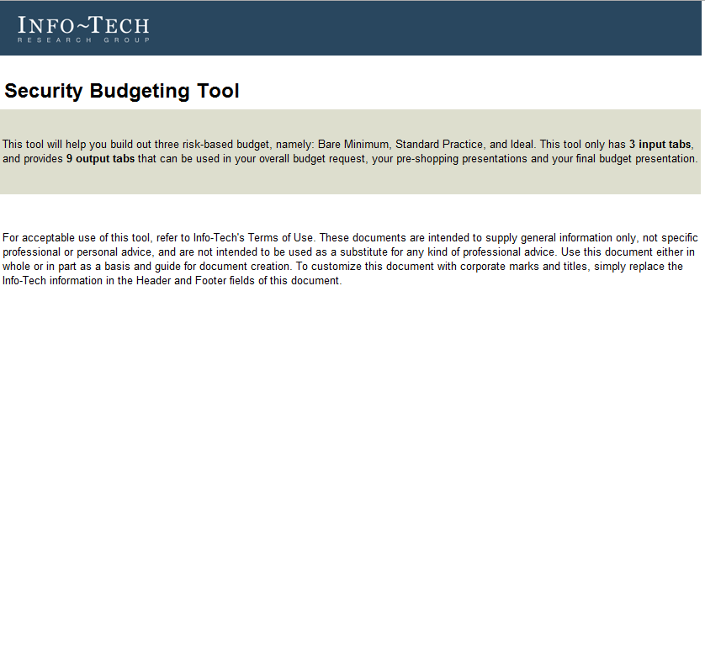
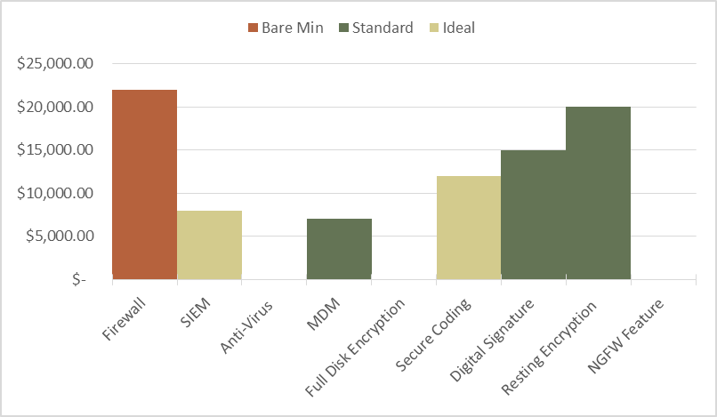
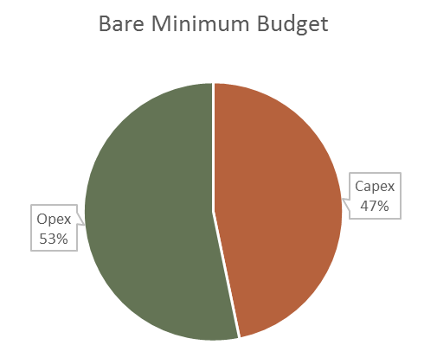
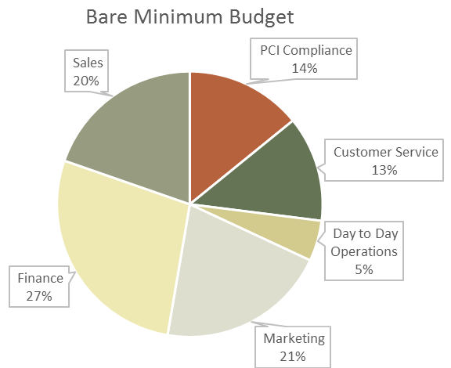
In phases 2 & 3, you will build and then present the security budget
In phase 2, start building the budget using the Security Budgeting Tool.
This tool will make creating your budget straightforward. Input your budget values only once and it will provide a series of outputs, including:
Three different budget options: a bare minimum budget, a standard practice budget, and an ideal budget.
Budgets based on different business capabilities.
An IT systems bubble chart.
Security controls bar chart.
Overall budget performance graph.
Capex vs. Opex comparison.
Phase 3 prepares you and your team for the budget presentations.
This will primarily take place using “preshopping” – this is where security professionals conduct one-on-one sessions with the business stakeholders involved in budgeting. This allows you to gain feedback prior to the final budget being submitted.
Further, when presenting the final budget, each of the stakeholders would have already been spoken to, ensuring that there are no surprises during this part of the process.
To assist you with the process, there are two key deliverables:
Preshopping Security Budget Presentation Template
Final Security Budget Presentation Template
In addition, phase 3 provides useful research and guidance on how to present security as a necessary function to the business.

Slide 14
Use these icons to help direct you as you navigate this research
Use these icons to help guide you through each step of the blueprint and direct you to content related to the recommended activities.
This icon denotes a slide where a supporting Info-Tech tool or template will help you perform the activity or step associated with the slide. Refer to the supporting tool or template to get the best results and proceed to the next step of the project.
This icon denotes a slide with an associated activity. The activity can be performed either as part of your project or with the support of Info-Tech team members, who will come onsite to facilitate a workshop for your organization.

Slide 15
Info-Tech offers various levels of support to best suit your needs
Guided Implementation
DIY Toolkit
Workshop
Consulting
“Our team has already made this critical project a priority, and we have the time and capability, but some guidance along the way would be helpful.”
“Our team knows that we need to fix a process, but we need assistance to determine where to focus. Some check-ins along the way would help keep us on track.”
“We need to hit the ground running and get this project kicked off immediately. Our team has the ability to take this over once we get a framework and strategy in place.”
“Our team does not have the time or the knowledge to take this project on. We need assistance through the entirety of this project.”
Diagnostics and consistent frameworks used throughout all four options

Slide 16
Optimize security budgeting – project overview
1. Review requirements for the budget
2. Build the budget
3. Present the budget
Best-Practice Toolkit | 1.1 Elect an executive champion 1.2 Review the risk tolerance level and the risk register 1.3 Review the mitigation effectiveness assessment 1.4 Review the security strategy | 2.1 Map business capabilities to security controls and specify need 2.2 Input the costs of the security controls, general expenses, and IT system-specific expenses 2.3 Analyze the three different budget outputs and explain surpluses and/or deficits 2.4 Optimize the budget by using defense-in-depth techniques | 3.1 Create and deliver preshopping presentations 3.2 Create and deliver the final budget presentation and collect feedback 3.4 Incorporate feedback and finalize the budget request
Guided Implementations | Determine which efficacy option is needed Review risk management work and the mitigation effectiveness assessment Review the security strategy and roadmap | Map business capabilities to security controls Input all costs including security controls, general expenses, and IT-system specific expenses Review three budget outputs based on bare minimum, standard practice, and ideal need, and discuss how to optimize | Develop budget stakeholder presentation Collect feedback and incorporate into the final budget request
Onsite Workshop | Module 1: Review requirements for the budget | Module 2: Build the budget | Module 3: Present the budget
 | Phase 1 Outcome: Understanding of what requirements are needed for the budget | Phase 2 Outcome: Completed budget with different risk-based outputs and visuals | Phase 3 Outcome: Budget presentation guidance and final approval on the budget

Slide 17
Workshop overview
Contact your account representative or email Workshops@InfoTech.com for more information.
 | Workshop Day 1 | Workshop Day 2 | Workshop Day 3 | Workshop Day 4
Activities | Collect budgeting requirements 1.1 Define the scope and boundaries of the security budget with business stakeholders. 1.2 Review the security strategy. 1.3 Identify the major business capabilities. 1.4 Map capabilities to the IT systems and security controls. | Build the budget 2.1 Categorize security controls by bare minimum, standard practice, and ideal. 2.2 Input all security control costs. 2.3 Input all other expenses related to security. 2.4 Review the different budget options. | Optimize and plan to present the budget 3.1 Optimize the budget through defense-in-depth options. 3.2 Finalize the budget. 3.3 Begin developing a communication strategy. 3.4 Build the preshopping report. | Present the budget 4.1 Practice the presentation. 4.2 Conduct preshopping discussions with stakeholders. 4.3 Collect initial feedback and incorporate into the budget. 4.4 Prepare for the final budget presentation.
Deliverables | Defined scope and boundaries of the security budget Identified major business capabilities, mapped to the IT systems and security controls | Completed security budget providing three different options based on risk associated | Optimized security budget Preshopping report | Final Budget Presentation

Slide 18
Info-Tech’s value for security budgeting
Phase | Guided Implementation
Phase 1: Review Requirements for the Budget | Collection and review of security budget requirements 40 FTE hours @ $80k/year = $1,600
Phase 2: Build the Budget | Cost to perform business capability to security control mapping 160 FTE hours @ $80k/year = $6,400 Cost to produce three different budgets 160 FTE hours @ $80k/year = $6,400
Phase 3: Present the Budget | Cost to prepare presentations regarding the budget 40 FTE hours @ $80k/year = $1,600
Potential financial savings from using Info-Tech resources: | Phase 1 ($1,600) + Phase 2 ($6,400) + Phase 3 ($1,600) = $9,600 By using our Guided Implementation rather than a self-directed implementation, you can expect to save ~75% of the overall cost, which represents ~$7,200. Also worth noting is that achieving optimal results without our targeted guidance may be difficult. You could spend more money/effort than we suggest without your desired returns. Engage with Info-Tech from the outset for the best opportunity to maximize your benefits.
The value of Info-Tech’s security budget approach
By following Info-Tech’s methodology for security budgets, you will be able to:
Collect and review requirements.
Build a budget that explains how changes to the budget can affect the overall risk.
Present security as a necessary cost to individual business units and to the larger organization.
Depending on the efficacy model chosen, you may need to develop other components, such as a risk tolerance level or a mitigation effectiveness assessment. These can be completed through Info-Tech as well, albeit through other projects.

