Slide 1
Build Your Data Quality Program
Quality Data Drives Quality Business Decisions
EXECUTIVE BRIEF

Slide 2

Analyst
Perspective
Get ahead of the data curve by conquering data quality challenges.
Regardless of the driving business strategy or focus, organizations are turning to data to leverage key insights and help improve the organization’s ability to realize its vision, key goals, and objectives.
Poor quality data, however, can negatively affect time-to-insight and can undermine an organization’s customer experience efforts, product or service innovation, operational efficiency, or risk and compliance management. If you are looking to draw insights from your data for decision making, the quality of those insights is only as good as the quality of the data feeding or fueling them.
Improving data quality means having a data quality management practice that is sustainably successful and appropriate to the use of the data, while evolving to keep pace with or get ahead of changing business and data landscapes. It is not a matter of fixing one data set at a time, which is resource and time intensive, but instead identifying where data quality consistently goes off the rails, and creating a program to improve the data processes at the source.
Crystal Singh
Research Director, Data and Analytics
Info-Tech Research Group

Slide 3



Executive Summary
Your Challenge
Common Obstacles
Info-Tech’s Approach
Your organization is experiencing the pitfalls of poor data quality, including:
Unreliable data and unfavorable output.
Inefficiencies and costly remedies.
Dissatisfied stakeholders.
Poor data quality hinders successful decision making.
Not understanding the purpose and execution of data quality causes some disorientation with your data.
Failure to realize the importance/value of data quality.
Unsure of where to start with data quality.
Lack of investment in data quality.
Organizations tend to adopt a project mentality when it comes to data quality instead of taking the strategic approach that would be all-around more beneficial in the long term.
Address the root causes of your data quality issues by forming a viable data quality program.
Be familiar with your organization’s data environment and business landscape.
Prioritize business use cases for data quality fixes.
Fixing data quality issues at the root cause to ensure a proper foundation for your data to flow.
It is important to sustain best practices and grow your data quality program.
Info-Tech Insight
Fix data quality issues as close as possible to the source of data while understanding that business use cases will each have different requirements and expectations from data quality.

Slide 4

Data is the foundation of your organization’s knowledge
Data enables your organization to make decisions.
  Raw Data
  Business Information
  Actionable Insights
Reliable data is needed to facilitate data consumers at all levels of the enterprise.
Insights, knowledge, and information are needed to inform operational, tactical, and strategic decision-making processes. Data and information are needed to manage the business and empower business processes such as billing, customer touchpoints, and fulfillment.
Data should be at the foundation of your organization’s evolution. The transformational insights that executives are constantly seeking can be uncovered with a data quality practice that makes high-quality, trustworthy information readily available to the business users who need it.
98% of companies use data to improve customer experience.
  98%
Source: Experian Data Quality, 2019

Slide 5







Determine data sources and ingestion SLAs
High-Level Data Architecture
Data Creation
Data Ingestion
Data Engineering
Data Delivery
Data Consumption
Data Accumulation
Determine MDM
Aggregated Business Use Case Requirements
Data Quality Controls
Master & Reference Data,
Classifications,
Hierarchies
Data Quality Controls
CRM
SLA
Reporting
Analytics Solution
Business Use Case
SLA
ERP
SLA
Use Case
Reporting
Analytics Solution
Business Use Case
Data Lake or
Data Warehouse
(Transactional/ Source Data)
SLA
Applications
SLA
Use Case
Augmenting and packaging data per use case requirements
Use Case
Use Case
Reporting
Analytics Solution
Business Use Case
SLA
Use Case
SLA
IoT devices
Use Case
Use Case
Use Case
Reporting
Analytics Solution
Business Use Case
External data feeds
SLA
SLA

Slide 6
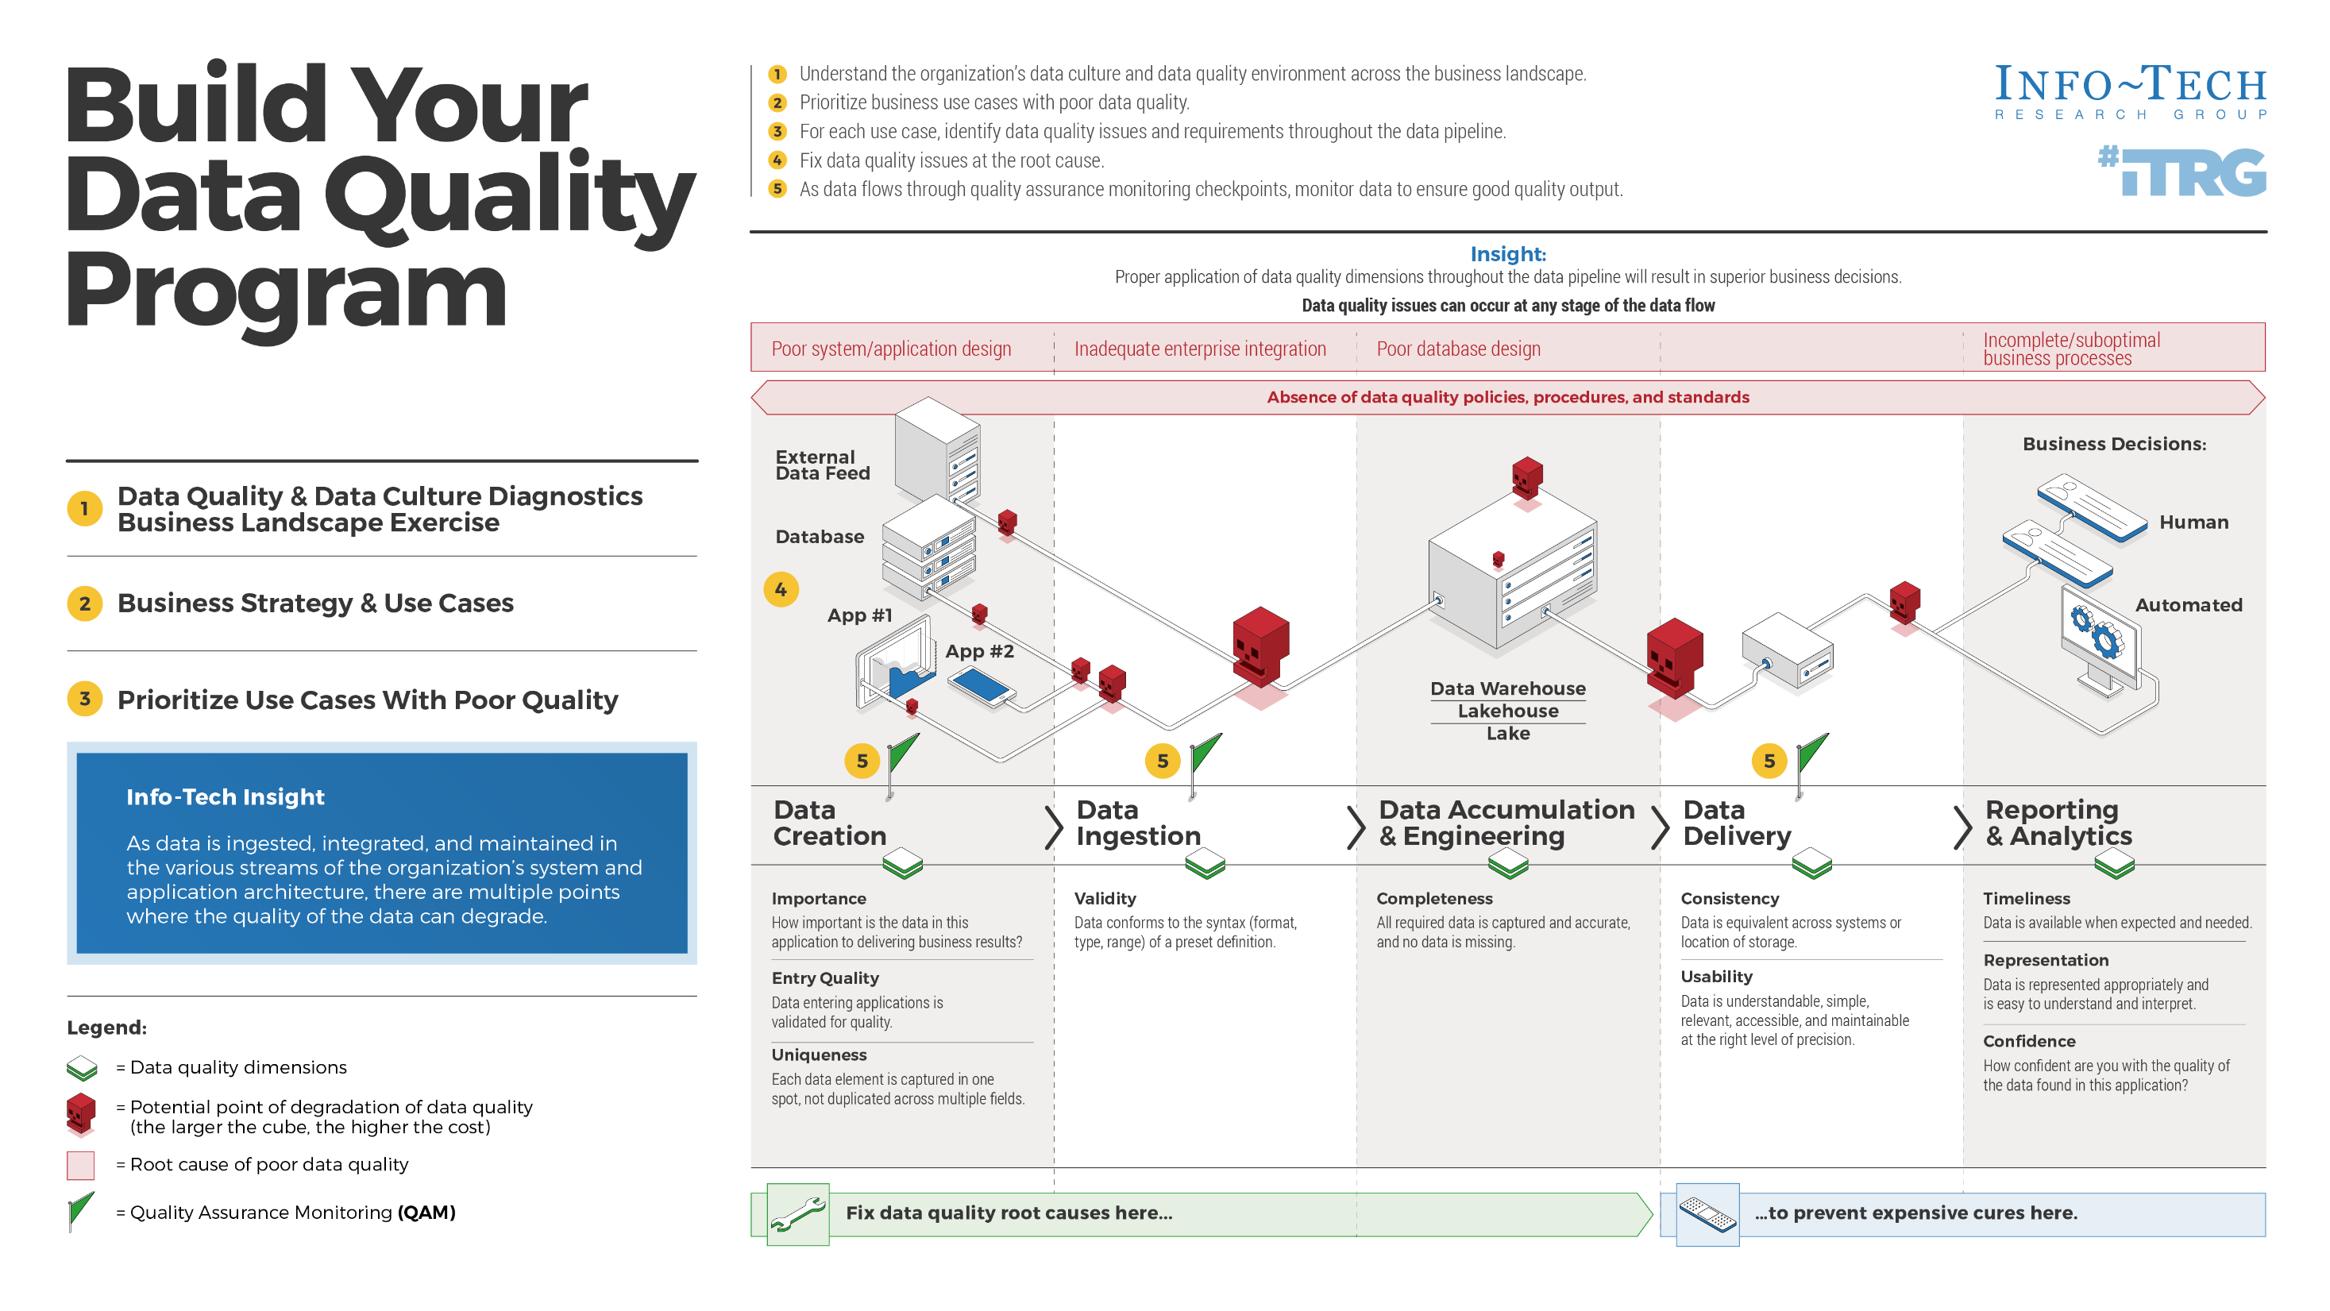

Slide 7
Prevent the domino effect of poor data quality
Three key challenges impacting the ability to deliver excellent customer experience
Data is the foundation of decisions made at data-driven organizations.
  30%
  30%
  30%
Therefore, if there are problems with the organization’s underlying data, this can have a domino effect on many downstream business functions.
Let’s use an example to illustrate the domino effect of poor data quality. Organization X is looking to migrate their data to a single platform, System Y. After the migration, it has become apparent that reports generated from this platform are inconsistent and often seem wrong. What is the effect of this?
Time must be spent on identifying the data quality issues, and often manual data quality fixes are employed. This will extend the time to deliver the project that depends on system Y by X months.
To repair these issues, the business needs to contract two additional resources to complete the unforeseen work. The new resources cost $X each, as well as additional infrastructure and hardware costs.
Now, the strategic objectives of the business are at risk and there is a feeling of mistrust in the new system Y.
Poor data quality
Method of interaction changing
Legacy systems or lack of new technology
Of organizations indicated that poor data quality undermines business performance.
  95%
Source: Experian Data Quality, 2019

Slide 8
Maintaining quality data will support more informed decisions and strategic insight
Improving your organization’s data quality will help the business realize the following benefits:
Data-Driven Decision Making
Customer Intimacy
Innovation Leadership
Operational Excellence
Business decisions should be made with a strong rationale. Data can provide insight into key business questions, such as, “How can I provide better customer satisfaction?”
Improve marketing and the customer experience by using the right data from the system of record to analyze complete customer views of transactions, sentiments, and interactions.
Gain insights on your products, services, usage trends, industry directions, and competitor results to support decisions on innovations, new products, services, and pricing.
Make sure the right solution is delivered rapidly and consistently to the right parties for the right price and cost structure. Automate processes by using the right data to drive process improvements.
  89%
  94%
  20%
  10 - 20%
Of CIOs surveyed say lack of quality data is an obstacle to good decision making.¹
Percentage of senior IT leaders who say that poor data quality impinges business outcomes.²
Businesses lose as much as 20% of revenue due to poor data quality.³
The implementation of data quality initiatives can lead to reductions in corporate budget of up to 20%.⁴
Sources: 1. Larry Dignan, CIOs juggling digital transformation pace, bad data, cloud lock0in and business alignment, 2020; 2. Clint Boulton, Disconnect between CIOs and LOB managers weakens data quality, 2016; 3. RingLead Data Management Solutions, 10 Stats About Data Quality I Bet You Didn’t Know; 4. HaloBI, 2015

Slide 9
However, maintaining data quality is difficult
1 | Data debt drags down ROI – a high degree of data debt will hinder you from attaining the ROI you’re expecting.
2 | Lack of trust means lack of usage – a lack of confidence in data results in a lack of data usage in your organization, which negatively effects strategic planning, KPIs, and business outcomes.
3 | Strategic assets become a liability – bad data puts your business at risk of failing compliance standards, which could result in you paying millions in fines.
4 | Increased costs and inefficiency – time spent fixing bad data means less workload capacity for your important initiatives and the inability to make data-based decisions.
5 | Barrier to adopting data-driven tech – emerging technologies, such as predictive analytics and artificial intelligence, rely on quality data. Inaccurate, incomplete, or irrelevant data will result in delays or a lack of ROI.
6 | Bad customer experience – Running your business on bad data can hinder your ability to deliver to your customers, growing their frustration, which negatively impacts your ability to maintain your customer base.
Avoid these pitfalls to get the true value out of your data.
Info-Tech Insight
Data quality suffers most at the point of entry. This is one of the causes of the domino effect of data quality – and can be one of the most costly forms of data quality errors due to the error propagation. In other words, fix data ingestion, whether through improving your application and database design or improving your data ingestion policy, and you will fix a large majority of data quality issues.
Source: Experian Data Quality, 2020

Slide 10
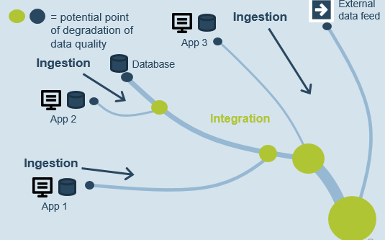

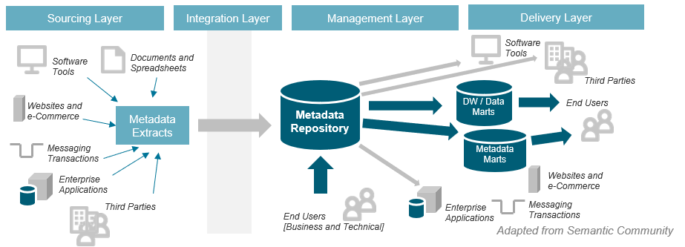
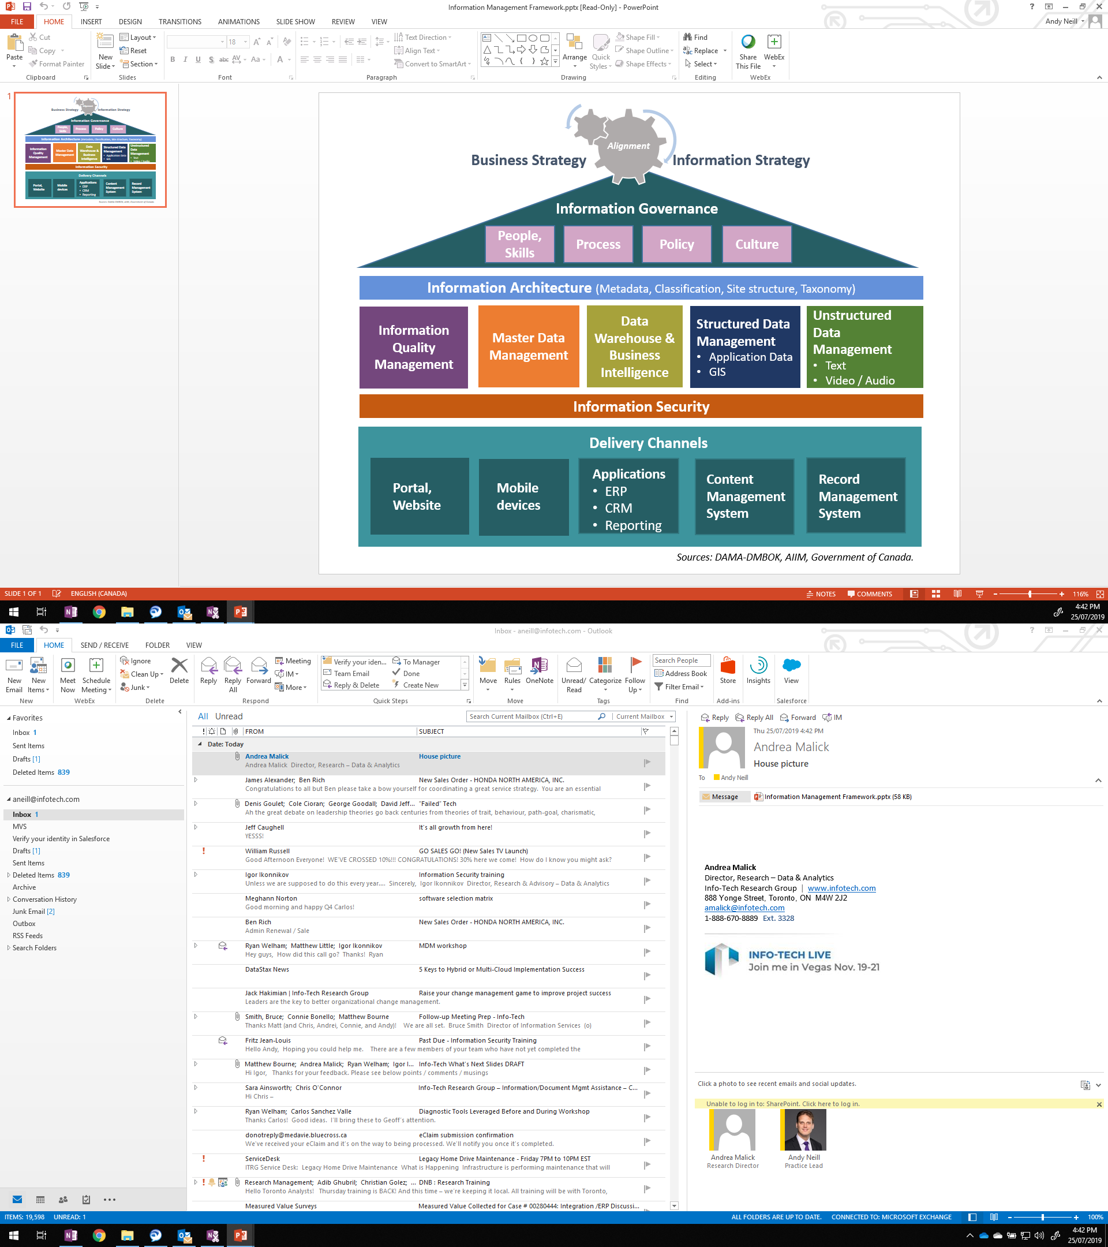
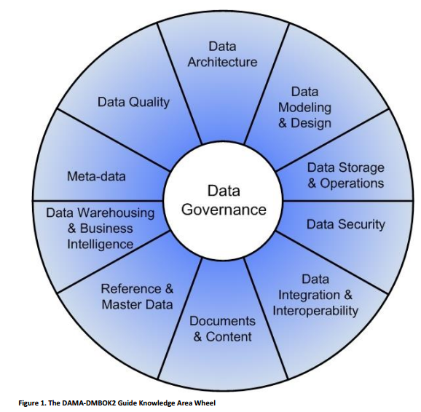
Follow Our Data & Analytics Journey
Data Quality is laced into Data Strategy, Data Management, and Data Governance.
Business vision / strategies
Data Quality
Management
Practice Evolution
Data Governance
MDM
Sources
Integration and Translation
Data Warehouse
BI & Analytics
Technology
Data Strategy
Planning
Data Operations
Management
Source Strategy (Content/Quality)
Informs
Data Integration Strategy
Drives
Data Warehouse/ Data Lake Strategy
Informs
BI & Analytics Strategy
Data Architecture
Analytical Data requirements
Data Risk Management
Current state determine: Data delivered
MDM
Reporting and Analytics
Data Quality
Data Source 1
Report
Data Source 2
Report
Data Integration
Data Source 3
Data Strategy
Data Leadership
Data Ownership & Stewardship
Data Source 4
Query
Policies & Procedures
Enterprise Projects & Services
DATA GOVERNANCE
Data Literacy & Culture
Data Warehouse/Lake/Lakehouse
Applied/ Narrow Artificial Intelligence (ANI)
Data Privacy & Security
Data Management
Oversight & Alignment
Data Architecture
Robotics
Machine Learning
Data Governance
Computer Vision
RPA
NLP
Enterprise Content Management
AI
Data Management
Regulatory
Employee Information
Customer Information
Financial Information
Competitive Information
Third-Party Information
Other Information Domains
1
General Regulations
Legislation (Laws and By-Laws)
Legal Precedents
Industry
2
Industry Regulations
Industry Group Best Practices
Research/Consulting Models
3
Organization
Organizational Objectives
Organizational Risk Tolerance
Competitive Strategy
Historic and Sentimental Values
Information Classification Scheme
Information Lifecycle Policies
Information Lifecycle Management

Slide 11
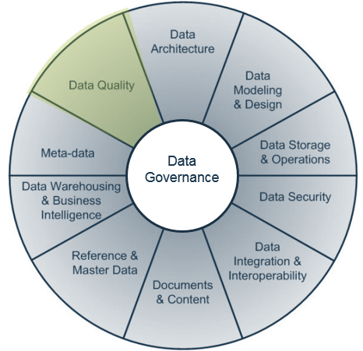
Data Quality is rooted in Data Management
Extract Maximum Benefit Out of Your Data Quality Management.
The DAMA DMBOK2 Data Management Framework
Data management is the planning, execution, and oversight of policies, practices, and projects that acquire, control, protect, deliver, and enhance the value of data and information assets (DAMA, 2009).
In other words, getting the right information, to the right people, at the right time.
Data quality management exists within each of the data practices, information dimensions, business resources, and subject areas that comprise the data management framework.
Within this framework, an effective data quality practice will replace ad hoc processes with standardized practices.
An effective data quality practice cannot succeed without proper alignment and collaboration across this framework.
Alignment ensures that the data quality practice is fit for purpose to the business.
Source: DAMA International

Slide 12

Related Info-Tech Research
Build a Robust and Comprehensive Data Strategy
People often think that the main problems they need to fix first are related to data quality when the issues transpire at a much larger level. This blueprint is the key to building and fostering a data-driven culture.
Create a Data Management Roadmap
Refer to this blueprint to understand data quality in the context of data disciplines and methods for improving your data management capabilities.
Data Ownership & Stewardship
Establish Data Governance
Data Leadership
Policies & Procedures
Enterprise Projects & Services
DATA GOVERNANCE
Data Literacy & Culture
Define an effective data governance strategy and ensure the strategy integrates well with data quality with this blueprint.
Data Privacy & Security
Oversight & Alignment
Data Management

Slide 13
Info-Tech’s methodology for Data Quality
Phase Steps | 1. Define Your Organization’s Data Environment and Business Landscape | 2. Analyze Your Priorities for Data Quality Fixes | 3. Establish Your Organization’s Data Quality Program | 4. Grow and Sustain Your Data Quality Practice
Phase Outcomes | This step identifies the foundational understanding of your data and business landscape, the essential concepts around data quality, as well as the core capabilities and competencies that IT needs to effectively improve data quality. | To begin addressing specific, business-driven data quality projects, you must identify and prioritize the data-driven business units. This will ensure that data improvement initiatives are aligned to business goals and priorities. | After determining whose data is going to be fixed based on priority, determine the specific problems that they are facing with data quality, and implement an improvement plan to fix it. | Now that you have put an improvement plan into action, make sure that the data quality issues don’t keep cropping up. Integrate data quality management with data governance practices into your organization and look to grow your organization’s overall data maturity.
Info-Tech Insight
“Data Quality is in the eyes of the beholder.”– Igor Ikonnikov, Research Director

Slide 14
Data Quality means tolerance, not perfection
Data from Info-Tech’s CIO Business Vision Diagnostic, which represents over 400 business stakeholders, shows that data quality is very important when satisfaction with data quality is low.
However, when data quality satisfaction hit a threshold, it became less important.
Info-Tech Insight
Data needs to be good, but truly spectacular data may go unnoticed.
Provide the right level of data quality, with the appropriate effort, for the correct usage. This blueprint will help you to determine what “the right level of data quality” means, as well as create a plan to achieve that goal for the business.
Respondents were asked “How satisfied are you with the quality, reliability, and effectiveness of the data you use to manage your group?” as well as to rank how important data quality was to their organization.
When the business satisfaction of data quality reached a threshold value of 71-80%, the rated importance reached its lowest value.
Source: Forbes, 2020

Slide 15


Data Roles and Responsibilities
Data Quality occurs through three main layers across the data lifecycle
Data Strategy
Data Strategy should contain Data Quality as a standard component.
← Data Quality issues can occur throughout at any stage of the data flow →
External data feed
DQ Dimensions
Timeliness – Representation – Usability – Consistency – Completeness – Uniqueness – Entry Quality – Validity – Confidence – Importance
Source System Layer
Data Resource Manager/Collector: Enters data into a database and ensures that data collection sources are accurate
Data Transformation Layer
ETL Developer: Designs data storage systems
Data Engineer: Oversees data integrations, data warehouses and data lakes, data pipelines
Database Administrator: Manages database systems, ensures they meet SLAs, performances, backups
Data Quality Engineer: Finds and cleanses bad data in data sources, creates processes to prevent data quality problems
Consumption Layer
Data Scientist: Gathers and analyses data from databases and other sources, runs models, and creates data visualizations for users
BI Analyst: Evaluates and mines complex data and transforms it into insights that drive business value. Uses BI software and tools to analyze industry trends and create visualizations for business users
Data Analyst: Extracts data from business systems, analyzes it, and creates reports and dashboards for users
BI Engineer: Documents business needs on data analysis and reporting and develops BI systems, reports, and dashboards to support them
Database
= potential point of degradation of data quality
Data Warehouse / Lake / Lakehouse
Inaccurate:
App 2
Business Decisions
Automated Decisions
App 1
SLA
QA
SLA
QA
Data Creation
Data Ingestion
Data Accumulation & Engineering
Data Delivery
Reporting & Analytics
Fix Data Quality root causes here…
to prevent expensive cures here.

Slide 16
Executive Brief Case Study
INDUSTRY
SOURCE
Healthcare
Primary Info-Tech Research
Align source systems to maximize business output.
“Data quality is subjective; you have to be selective in terms of targeting the data that matters the most.
When getting business tools right, most issues will be fixed and lead to achieving the most value.”
– Asif Mumtaz,
Data & Solution Architect
A healthcare insurance agency faced data quality issues in which a key business use case was impacted negatively. Business rules were not well defined, and default values instead of real value caused a concern. When dealing with multiple addresses, data was coming from different source systems.
The challenge was to identify the most accurate address, as some were incomplete, and some lacked currency and were not up to date. This especially challenged a key business unit, marketing, to derive business value in performing key activities by being unable to reach out to existing customers to advertise any additional products.
For this initiative, this insurance agency took an economic approach by addressing those data quality issues using internal resources.
Results
Without having any MDM tools or having a master record or any specific technology relating to data quality, this insurance agency used in-house development to tackle those particular issues at the source system. Data quality capabilities such as data profiling were used to uncover those issues and address them.

Slide 18

Guided Implementation
A Guided Implementation (GI) is a series
of calls with an Info-Tech analyst to help implement our best practices in your organization.
A typical GI is between eight to twelve calls over the course of four to six months.
What does a typical GI on this topic look like?
Phase 1
Phase 4
Phase 2
Phase 3
Call #1: Learn about the concepts of data quality and the common root causes of poor data quality.
Call #2: Identify the core capabilities of IT for improving data quality on an enterprise scale.
Call #4: Create a plan for addressing business unit data quality issues according to priority of the business units based on value and impact of data.
Call #6: Determine a strategy for fixing data quality issues for the highest priority business unit.
Call #8: Learn how to incorporate data quality practices in the organization’s larger data management and data governance frameworks.
Call #3: Determine which business units use data and require data quality remediation.
Call #7: Identify strategies for continuously monitoring and improving data quality at the organization.
Call #9: Summarize results and plan next steps on how to evolve your data landscape.
Call #5: Revisit the root causes of data quality issues and identify the relevant root causes to the highest priority business unit.
Info-Tech Research Group | 18

Slide 19
Workshop Overview
Contact your account representative for more information.
workshops@infotech.com 1-888-670-8889
 | Day 1 | Day 2 | Day 3 | Day 4 | Day 5
Activities | Define Your Organization’s Data Environment and Business Landscape | Create a Strategy for Data Quality Project 1 | Create a Strategy for Data Quality Project 2 | Create a Strategy for Data Quality Project 3 | Create a Plan for Sustaining Data Quality
 | Explain approach and value proposition. Detail business vision, objectives, and drivers. Discuss data quality barriers, needs, and principles. Assess current enterprise-wide data quality capabilities. Identify data quality practice future state. Analyze gaps in data quality practice. | Create business unit prioritization roadmap. Develop subject areas project scope. By subject area 1: Data lineage analysis Root cause analysis Impact assessment Business analysis | Understand how data quality management fits in with the organization’s data governance and data management programs. By subject area 2: Data lineage analysis Root cause analysis Impact assessment Business analysis | Formulate strategies and actions to achieve data quality practice future state. Formulate data quality resolution plan for defined subject area. By subject area 3: Data lineage analysis Root cause analysis Impact assessment Business analysis | Formulate metrics for continuous tracking of data quality and monitoring the success of the data quality improvement initiative. Workshop Debrief with Project Sponsor. Meet with project sponsor/manager to discuss results and action items. Wrap up outstanding items from the workshop, deliverables expectations, GIs.
Deliverables | Data Quality Management Primer Business Capability Map Template Data Culture Diagnostic Data Quality Diagnostic Data Quality Problem Statement Template | Business Unit Prioritization Roadmap Subject area scope Data Lineage Diagram | Data Lineage Diagram Root Cause Analysis Impact Analysis | Data Lineage Diagram Data Quality Improvement Plan | Data Quality Practice Improvement Roadmap Data Quality Improvement Plan (for defined subject areas)

