Slide 1

Map Technical Skills for a Changing Infrastructure & Operations Organization
Be practical and proactive – identify needed technical skills for your future state environment and the most efficient way to acquire them.

Slide 2
Table of contents
Analyst Perspective
Executive Summary
Project Overview
Phase 1: Identify Skills Needs for Your Future State Environment 1.1: Identify the future state of your environment 1.2: Identify skills gaps Phase 2: Acquire Needed Skills 2.1: Evaluate factors that impact skills decisions 2.2: Create your skills acquisition strategy Phase 3: Maximize the Value of Your Skills Map 3.1: Communicate the need for new skills 3.2: Leverage the skills map in other processes
Summary and Conclusion
Appendices

Slide 3


ANALYST PERSPECTIVE
The future of Infrastructure & Operations is technical.
In the waterfall model, roles were built around a step-wise process that took business requirements, translated them into coded business functionality, and directed various actors to deliver and support functionality.
As organizations move towards continuous service provisioning and away from waterfall planning, traditional roles will fade away.
The Infra & Ops roles of the future are built around configuring, operating, and interoperating technology. It is a strategic technical play, supporting the fundamental integration of technology in every business process.
It is your job to acquire the right skills to support new roles at the right time.
Darin Stahl,
Senior Director, Infrastructure & Operations Practice
Info-Tech Research Group

Slide 4
Our understanding of the problem
Infrastructure & Operations Leaders
Chief Technology Officers
Chief Information Officers
Plan to acquire technical skills needed to support your organization in a future state.
Develop roles that leverage these skills.
Infrastructure & Operations Line Managers
Chief Human Resources Officers
Infrastructure & Operations Staff
Understand how a changing technology environment will change Infrastructure & Operations roles.

Slide 5
Executive summary
Infrastructure & operations (I&O) is changing rapidly. It’s a constant challenge to find the right skills to support the next new technology, while at the same time maintaining the skills in house that allow you to support your existing platforms.
Hybrid and consolidated infrastructure are the new normal, with data flows and services across multiple environments.
Enabling and integrating services for the business – in other words, acting as a service broker – requires technical competence at all levels of the Infra & Ops organization.
Take the strategic view – looking only as far as the needs of the next project will lead to a constant skills shortage with no plan to for it to be addressed.
A lack of clarity around required skills makes finding the right skills difficult, and it’s not clear whether you should train, hire, contract, or outsource to address gaps.
You need to keep up with changes and new strategy while continuing to support your existing environment.
Actively plan to acquire needed skills in order to rapidly enable and integrate new business demands while still managing legacy workloads.
Begin by identifying your future state. Identify needed skills in the organization to support planned projects and initiatives, and to mitigate skills-related risks.
Leverage your infrastructure roadmap and cloud strategy to identify needed skills in your future state environment.
Decide how you’ll acquire needed skills based on the characteristics of need for each skill.
Communicate the change and create a plan of action for the skills transformation.

Slide 6

Mounting business and technological pressures are transforming the skills you need to manage your environment
A VUCA world
Increased rate of strategy shifts
Increased rate of technological change in the enterprise
Business strategy must adapt rapidly to keep pace with changes in the business environment.
Organizational skills must be sufficiently flexible to support rapid change, and there must be processes in place to acquire needed skills.
Proactively combat the projected gap to avoid business interruption or a lag in productivity by placing greater focus on key skills aligned with organizational goals to allow for targeted development efforts.
Infrastructure must react and redeploy faster to keep up with business needs.
Hybrid infrastructure is the new normal, with data and processes spanning multiple environments.
Technical coordination is required to ensure teams can work at “the speed of need” while maintaining appropriate controls and accountability.
The skills required for organizational success will constantly change to adapt to a world that is:
Volatile
Uncertain
Complex
Ambiguous

Slide 7


Operating processes in your new environment will change and will be served by new skills
A siloed approach to deploy, operate, and support technology just doesn’t work anymore.
Hybrid cloud and converged infrastructure requires I&O staff to maintain a level of technical skill across the stack that’s not currently commonplace.
Example:
Create a new server resource in a virtual environment vs. public cloud
Identify CPU requirements for a virtual machine
SDI code development and review, version control, build status, etc.
Calculate VM memory requirements
Identify software and specifications for the instance you want to use
Configure the floppy drive for a VM
In a virtualized environment, provisioning processes can still be relatively siloed.
Review configuration, storage, and security settings
Configure IDE devices for a VM
Secure the instance with an existing key pair or create a new key pair
Configure SCSI adapters for a VM
Configure network adapters for a VM
In an software-defined environment, many steps require knowledge across the infrastructure stack.
Update documentation – public IP address, physical and logical connections, data flows, etc.
Configure VM priority for host CPU resources
Launch and connect to instance
Server is live
Server is live

Slide 8

Skills sufficiency is the top concern of CIOs and CXOs
Respondents were asked to rate the severity of these IT-induced pain points
CIOs and CXOs agree that the top IT-induced pain point is staff sufficiency, skill, and engagement.
CIOs feel that pain more than the rest of the executive team.
Info-Tech Research Group, MeasureIT Benchmarking Data

Slide 9
Employee turnover is expensive and is accelerated by ineffective use of internal skills
Take a strategic view of the skills in your organization to effectively use the skills you have and minimize employee turnover.
Turnover is expensive, especially when needed skills are hard to find. A 2016 study commissioned by the Wall Street Journal found 558,000 IT job postings that remained open after 90 days of search.
A WorldatWork survey estimated turnover costs can range from 50-200% of an employee’s salary.

Slide 10

Take immediate action to address the technical skills drought
“Over the next five years… employers will need to hire… more than 600,000 employees with advanced STEM knowledge.”¹
of respondents stated they have a difficult time finding qualified applications for jobs requiring advanced computer and IT knowledge.²
of respondents said there is currently a skills gap in their organization.³
84%
62%
of IT leaders did not believe their organization had the skills in-house required to address business needs.⁴
A lack of expertise and resources overtook security concerns as the
#1 obstacle to cloud adoption.⁶
558,000
IT jobs in the United States remained open after 90 days of search.⁵
68%
Office of the White House Press Secretary, 2016.
Business Roundtable & Change the Equation, 2014.
ATD, 2015.
TEKsystems, 2015.
WSJ, 2016.
RightScale, 2016.

Slide 11
Take a strategic approach to assessing skills and addressing gaps
Don't be in a state of constant skills shortage with no plan for the shortage to be addressed. Look beyond the next project.
Relying on tactical, reactionary, short-term solutions to resourcing leads to inflexibility and sub-optimal outcomes.
Effectively acquiring skills for the organization in a rapidly changing world requires the organization to proactively and strategically assess future skills needs.
Understand what skills you need to support processes and services in your current and future state environment before you decide how to acquire those skills.
Organizations must plan for:
[a] continually changing set of required employee skills and job duties and a huge gap between the needed and the available skill sets.
– Dr. John Sullivan
In the long term, companies need people who can solve multiple problems within their skill sets, and apply skills in multiple tactical ways – but businesses have a tendency to think a quarter at a time.
– David Linthicum,
SVP, Cloud Technology Partners

Slide 12

Establish your future skills needs before you identify current capabilities for better planning outcomes
Base your skills map on the strategic requirements of your business and I&O department.
1
2
3
Define your
Future State
Identify Skills Gaps
Decide whether to build or buy skills
Review your infrastructure roadmap, upcoming I&O initiatives, and business strategy. How will planned initiatives change the way your I&O team provides services?
Identify skills-related risks to successfully execute on the identified initiatives.
Select new skills to acquire within recommended roles.
New skills should support the delivery of projects and initiatives, enable new or changing operating processes, and mitigate skills-related risks in your organization.
Take action to address gaps, mitigate risks, and deliver projects and initiatives.
Decide whether to build or buy needed skills. Identify whether to train, hire, contract or outsource each skill based on the level of impact across five key skills need factors.
Investments in service assets such as skill sets and knowledge… are driven by the critical success factors for a given market space.
– ITIL v3, Service Strategy

Slide 13

This blueprint integrates with other Info-Tech research
Go further and improve outcomes from the following projects with this blueprint.
Build a
Strategic Workforce Plan
Provide I&O’s perspective on internal and external I&O trends and the skills and roles required for the new environment.
Improve IT-Business Alignment with an Infrastructure Roadmap
Inform your skills map with the strategic initiatives identified in your roadmap.
Identify the skills and roles required to support roadmap initiatives.
Own the Cloud:
Strategy and Action Plan
Plan to acquire skills to support initiatives and mitigate risks identified in your Cloud Strategy and Action Plan.
Develop a Comprehensive Competency Framework
Inform your competency framework with I&O-specific, strategically- informed skills needs.
Map Technical Skills for a Changing Infrastructure & Operations Organization
Formalize a Learning & Development Strategy
Help L&D meet targets by identifying core I&O skills aligned to strategic objectives.
IT Organizational Design
Weigh skills acquisition against a build-or-buy decision.
Identify the needed I&O roles and skills before pursing an organizational redesign.

Slide 14
Project overview
Phase 1:
Phase 2:
Phase 3:
Identify skills needs for your future state environment
Acquire needed skills
Maximize the value of your skills map
Phases
1.1
Identify the future state of your environment
2.1
Evaluate factors that impact skills decisions
3.1
Communicate the need for new skills
Steps
1.2
Identify skills gaps
2.2
Create your skills acquisition strategy
3.2
Leverage the skills map in other processes
Technical Skills Map
Tools and Templates
Future State Playbook
Technical Skills Map
Technical Skills Map Communication Plan
Role Descriptions

Slide 15
Measured value for Guided Implementations
Engaging in GIs doesn’t just offer valuable project advice, it also results in significant cost savings.
GI | Measured Value
Phase 1: Identify skills needs for your future state environment | Begin the skills map by identifying the operating impacts of your desired future state. Get directly to value leveraging Info-Tech’s templates and guidance. Example Time Saved: 2 FTEs * 5 days * $80,000/year = $3,200
Phase 2: Acquire needed skills | Identify the preferred way to acquire needed skills given key factors. Example Time Saved: 2 FTEs * 5 days * $80,000/year = $3,200 Avoid 3 months of unproductive time by acquiring the right skills the right way @ $80,000/year = $38,400
Phase 3: Maximize the value of your skills map | Get more value from your skills map in other processes. Example Streamline operating processes to save 3% of employee time each year (10 staff @ $80,000/year) = $24,000
Total Savings | $68,800

Slide 16
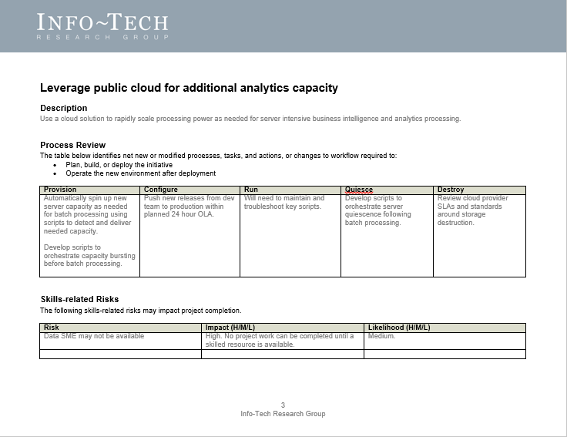
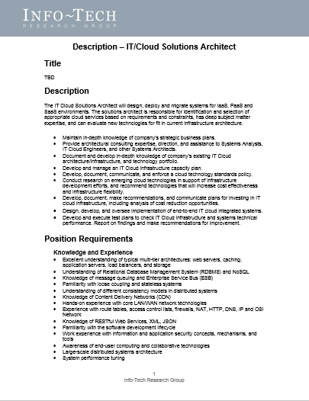
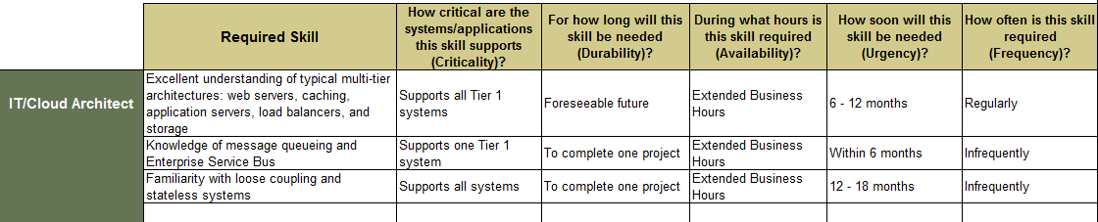
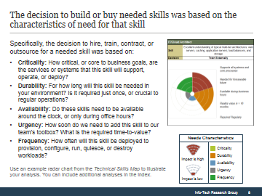
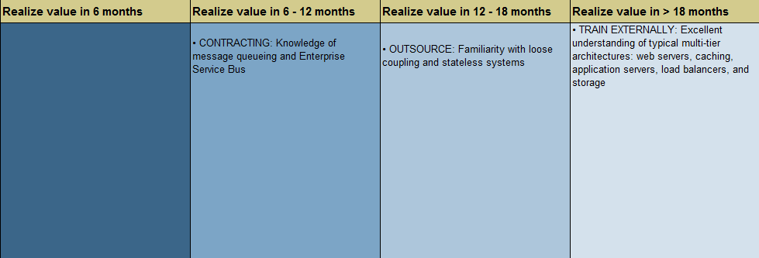
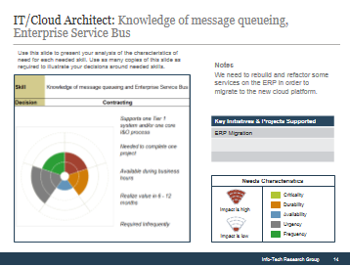
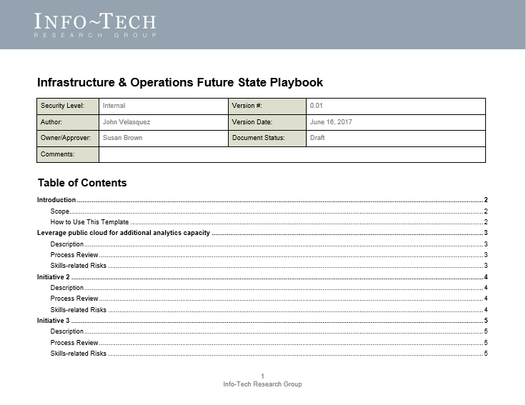
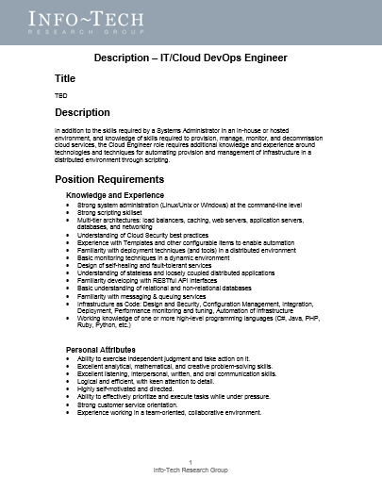
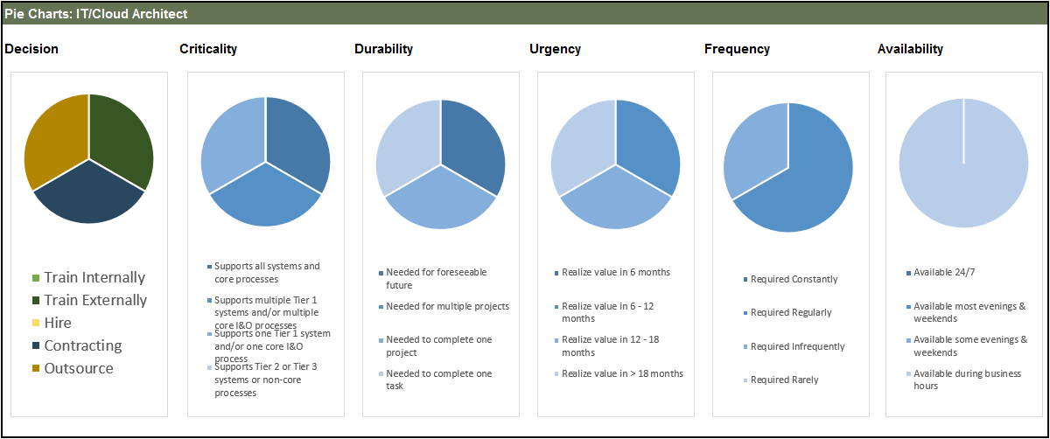
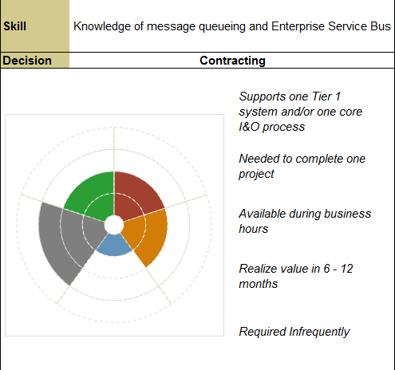
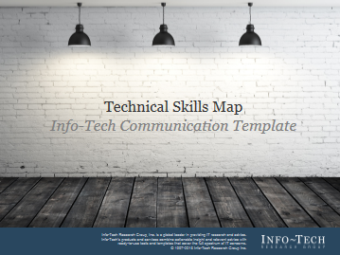
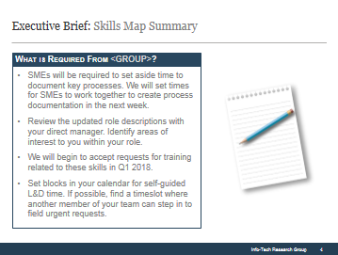
Info-Tech delivers: Use our tools and templates to accelerate your skills transformation to completion
1
2
3
4
Future State Playbook
Identify new and changing processes in your future state environment.
Role Descriptions
Descriptions and required skills for:
IT/Cloud Administrator
IT/Cloud Engineer
IT/Cloud Architect
Technical Skills Map Tool
Document and visualize your gap analysis and skills acquisition strategy.
Communication Template
Capture the analysis and next steps in a template that highlights key points for different stakeholders.

Slide 17


Use these icons to help direct you as you navigate this research
Use these icons to help guide you through each step of the blueprint and direct you to content related to the recommended activities.
This icon denotes a slide where a supporting Info-Tech tool or template will help you perform the activity or step associated with the slide. Refer to the supporting tool or template to get the best results and proceed to the next step of the project.
This icon denotes a slide with an associated activity. The activity can be performed either as part of your project or with the support of Info-Tech team members, who will come onsite to facilitate a workshop for your organization.

Slide 18




Info-Tech offers various levels of support to best suit your needs
Guided Implementation
DIY Toolkit
Workshop
Consulting
“Our team has already made this critical project a priority, and we have the time and capability, but some guidance along the way would be helpful.”
“Our team knows that we need to fix a process, but we need assistance to determine where to focus. Some check-ins along the way would help keep us on track.”
“We need to hit the ground running and get this project kicked off immediately. Our team has the ability to take this over once we get a framework and strategy in place.”
“Our team does not have the time or the knowledge to take this project on. We need assistance through the entirety of this project.”
Diagnostics and consistent frameworks used throughout all four options

Slide 19

Blueprint title – project overview (three phases)
1. Identify skills needs for your future state environment
2. Acquire needed skills
3. Maximize the value of your skills map
Best-Practice Toolkit | 1.1 Identify the future state of your environment 1.2 Identify skills gaps | 2.1 Evaluate factors that impact skills decisions 2.2 Create your skills acquisition strategy | 3.1 Communicate the need for new skills 3.2 Leverage the skills map in other processes
Guided Implementations | Discuss drivers for this project. Connect upcoming initiatives to environmental changes and skills-related risks. Review roles and skills required to support your future state environment. | Review the five key factors that influence your decision to hire, train, contract, or outsource needed skills. Review strategies for training, hiring, contracting, or outsourcing skills. | Review what the change is, why it’s happening, how it will be rolled out, how long it will take, and how stakeholders will be affected. Identify additional programs and projects that can add value to your skills map exercise.
Onsite Workshop | Module 1: Identify skills needs for your future state environment | Module 2: Acquire needed skills | Module 3: Maximize the value of your skills map
 | Phase 1 Results: Created updated role descriptions including new skills based on projects, initiatives, and risks. | Phase 2 Results: Identified the preferred method of skills acquisition based on the characteristics of skills need. | Phase 3 Result : Identified the what, why, when, and how of change and the roles of each key department and individual.

Slide 20
Workshop overview
Contact your account representative or email Workshops@InfoTech.com for more information.
 | Workshop Prep | Workshop Day 1 | Workshop Day 2 | Workshop Day 3 | Workshop Day 4
Activities | Set workshop scope Review initiatives, changes, and projects to be included in workshop. Review your infrastructure roadmap, cloud strategy, and existing skills inventory and role descriptions with facilitation team. | Review initiatives and skills-related risks 1.1 Review the list of initiatives and projects with the group. 1.2 Identify how key support, operational, and deployment processes will change through planned initiatives. 1.3 Identify skills-related risks and pain points. | Identify needed skills and roles 2.1 Identify skills required to support the new environment. 2.2 Map required skills to roles. 2.3 Identify skills gaps. | Create a plan to acquire needed skills 3.1 Modify impact scoring scale for key skills decision factors. 3.2 Apply impact scoring scales to needed skills. 3.3 Decide whether to train, hire, contract, or outsource to acquire needed skills. | Develop a communication plan 4.1 Review skills decisions and decide how you will acquire skills in each role. 4.2 Update roles descriptions. 4.3 Create a change message. 4.4 Identify opportunities to leverage the skills map in other processes.
Deliverables | Project scope and statement of work. | Future State Playbook | IT/Cloud Architect Role Description IT/Cloud Engineer Role Description IT/Cloud Administrator Role Description | Technical Skills Map | Technical Skills Map Communication Deck

